Slide 1
Project Report CS-542 Computer Network IMPLEMENTATION OF LINK STATE ROUTING ALGORITHM
Sumit Rana
A20350795
Vedant Godhamgaonkar A20353267
Mayuresh Jhakotia A20351962

Slide 2
Link State Routing Protocol
Used in packet switching networks by routers to forward packets in the network.
One of the two main classes of routing protocols used in packet switching networks for computer communications
Examples:
open shortest path first (OSPF)
intermediate system to intermediate system (IS-IS).
Every node constructs a map of the connectivity to the network showing which nodes are connected to which other nodes
Each node independently calculates the next best logical path from it to every possible destination in the network
Routing Table: The collection of best paths. Each node calculates a most logical and optimal path for forwarding a packet
Uses the Dijkstra’s algorithm to find the shortest path to a destination node

Slide 3
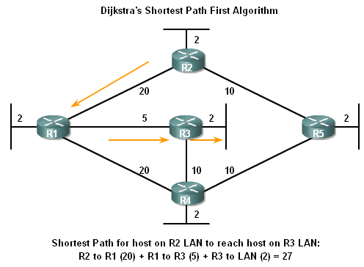
Link-State Routing
Dikjstra’s algorithm also known as the shortest path first (SPF) algorithm

Slide 4
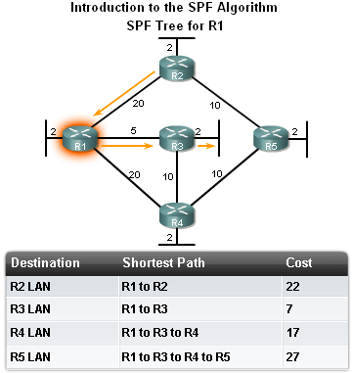
Link-State Routing
The shortest path to a destination is not necessarily the path with the least number of hops

Slide 5
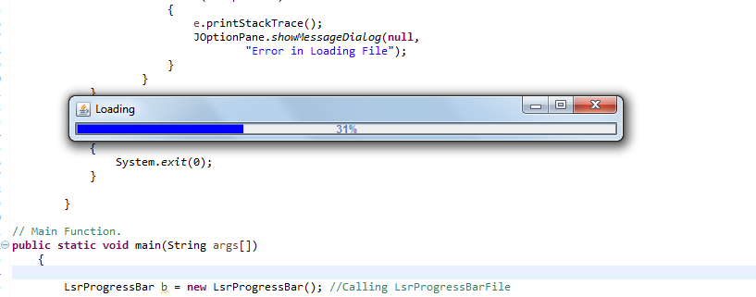
Progress Bar Display

Slide 6
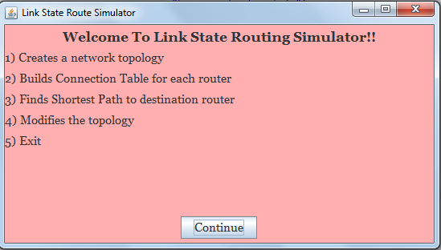
Main Screen Display

Slide 7
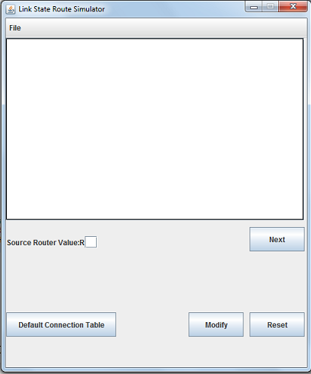
Topology Input Screen Display

Slide 8
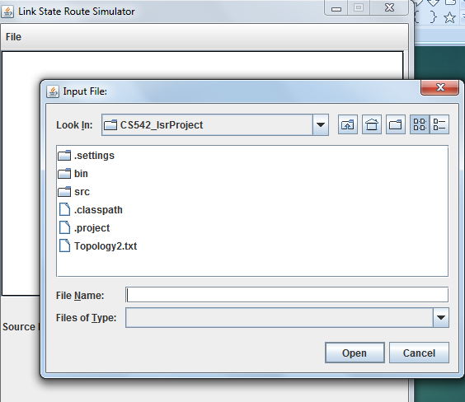
Upload Topology File to Simulator

Slide 9
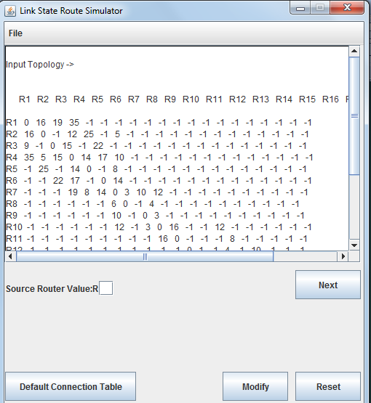

Slide 10
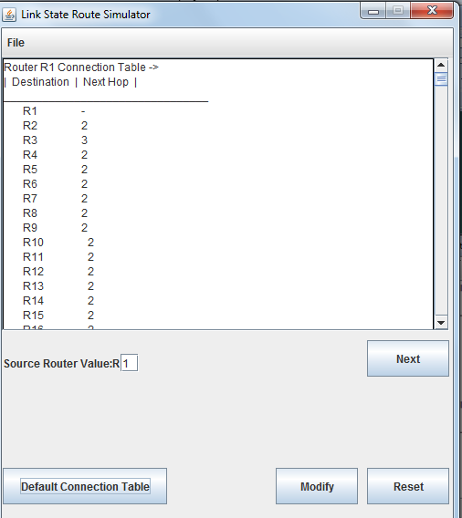
Case 1 Print Default Connection Tables

Slide 11
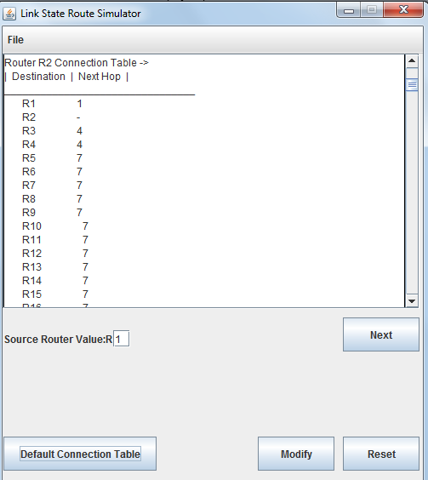

Slide 12
Case 1 Steps-
Click on Open button under File.
The Dialog Box will open, allows user to choose Topology File.
If the file exists, The file is passed into the Text Area.
To see the default connection table, click on Default Connection Table button.
The Text Area will depict the connection table of all the routers.

Slide 13
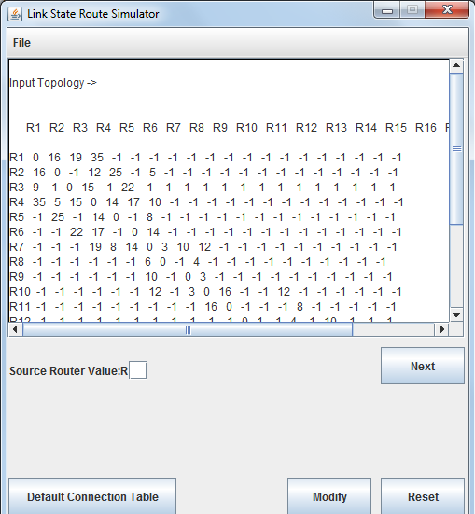
Case 2: Taking Input Source Router

Slide 14
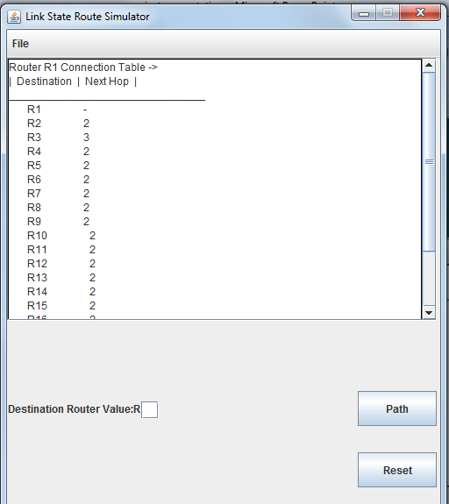

Slide 15
Case 2 Steps-
The program asks for the source node
When Source router is taken as input
This is the initial node.
Then a connection table is created
This table represents all of the destinations and interfaces

Slide 16
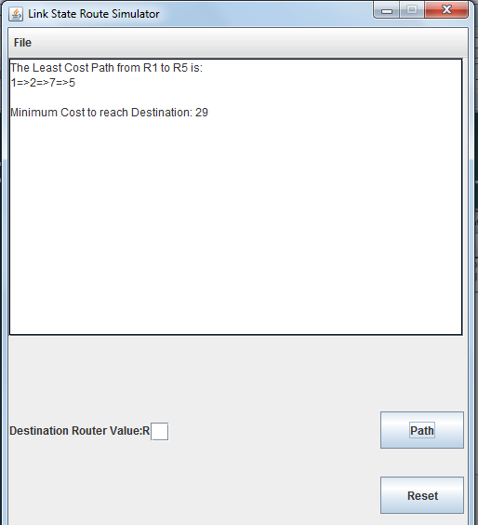
Case 3: Taking Output Source Router

Slide 17
Case 3
When Input Source Router is taken
The program displays the shortest pathway
This case uses the dijkstra’s principle to calculate the shortest path between the source node and the destination node
It then displays the path taken by the router from one point to all of the neighboring vertices and displays the shortest path

Slide 18
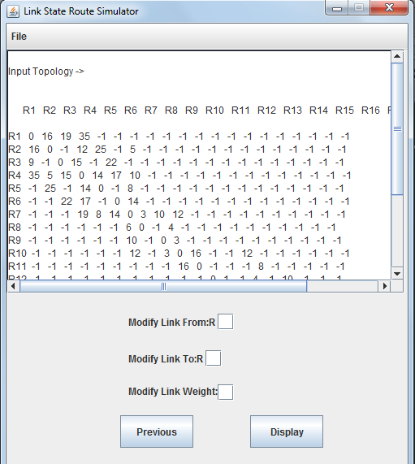
Case 4: Modifying The Topology

Slide 19
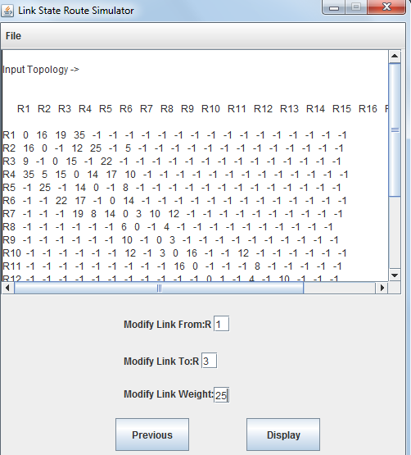

Slide 20
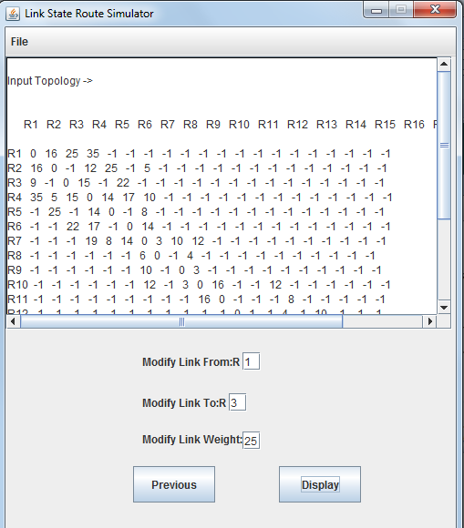

Slide 21
Case 4
When you want to modify the topology
The program asks for the router you want “to” modify the link
The program asks for the router you want “from” modify the link
It then displays the changes in the topology as per user’s wish.

Slide 22
Summary
Link State Routing protocols are also known as Shortest Path First protocols
Summarizing the link state process
-Routers 1ST learn of directly connected networks
-Routers then say “hello” to neighbors
-Routers then build link state packets
-Routers then flood LSPs to all neighbors
-Routers use LSP database to build a network topology map & calculate the best path to each destination

