Slide 1
Big Data Programming: Python HUSHHUSH RECRUITER Presentation - 3
Group 1
Aparanna Dash
Dharshan Dhanashekar
Navneeth Krishna Arravind
Terry Poonacha
Vedanth Balakrishna Reddy
Anil Keshav & Ajinkya Patil
SRH Hochschule Heidelberg

Slide 2
Index
User Story.
Data Acquisition.
Data Cleaning.
Data Storage.
Algorithm.
Code level Architecture.
Demo Video.
Challenges.
Future scope.
Roles
References

Slide 3

Hush Hush Recruiter
Mr. Ethan Hunt, the CEO of Doodle, was dissatisfied with the quality of candidates provided by external hiring companies, as they lacked the essential skills he expected. After careful deliberation, Mr. Hunt decided to take over the recruitment process himself. Inspired by his love for the Mission Impossible movie series, he conceived the idea of developing a sophisticated AI recruitment tool. This tool would thoroughly analyze the public digital profiles of top IT professionals, allowing the team to efficiently identify and hire the best talent while maintaining the highest standards of data privacy.
To initiate the selection process, Mr.Hunt plans to send interview invitations as pop-up messages to potential candidates. These messages will state, "You have been selected by us for [apt role selected by the algorithm]. After careful consideration, we invite you to take a comprehensive selection process. Should you choose to accept this test?" The candidate will then need to click 'yes' or 'no' to proceed.

Slide 4



User Story
Recruitment Manager : Implement an AI-powered skill assessment module, so that he can evaluate candidate’s technical abilities based on their digital profiles and past projects.
Potential Candidate : Receive personalized interview scheduling options, so that he can choose a convenient time for his interview. ​
Candidate : Receive feedback on interview, so that he can get to know whether he/she is selected or rejected.

Slide 5
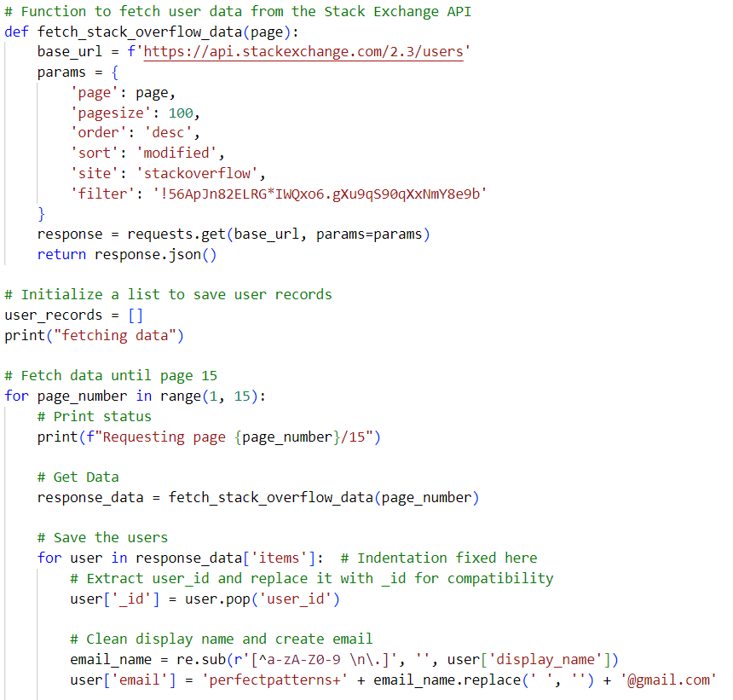
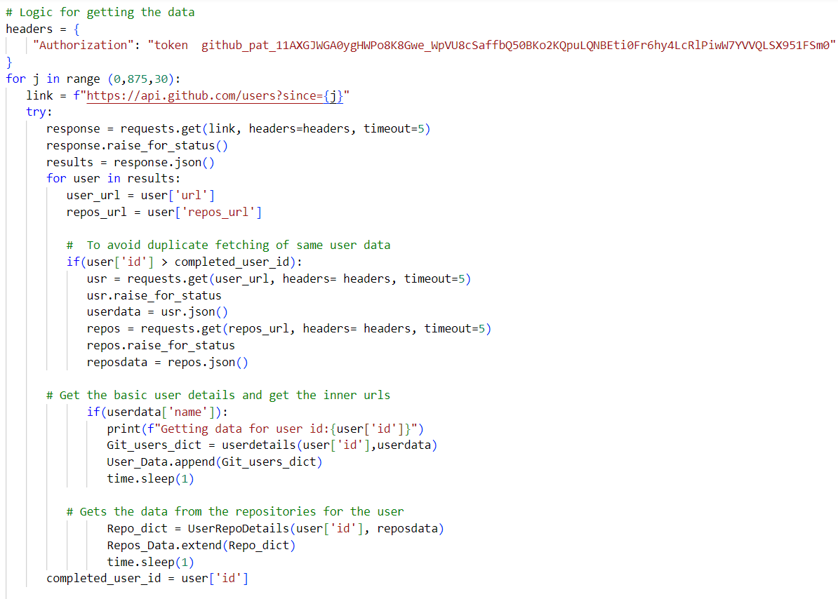
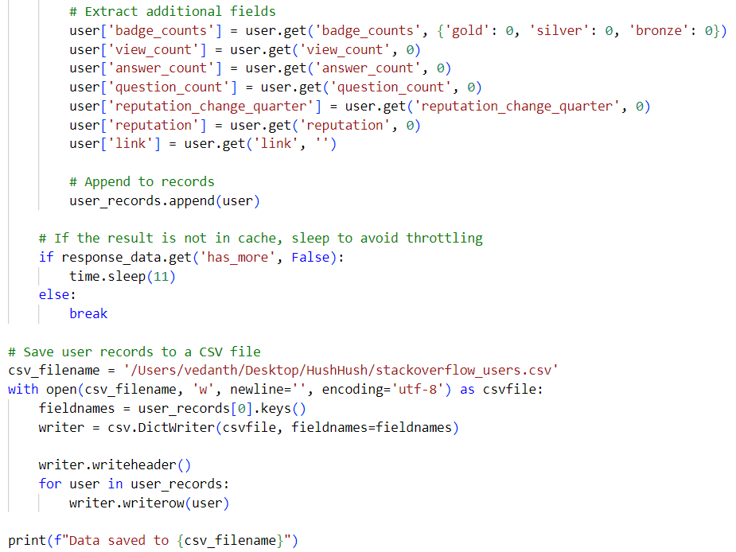
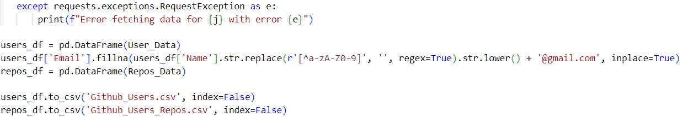
Data Acquisition
Stackoverflow
Github

Slide 6
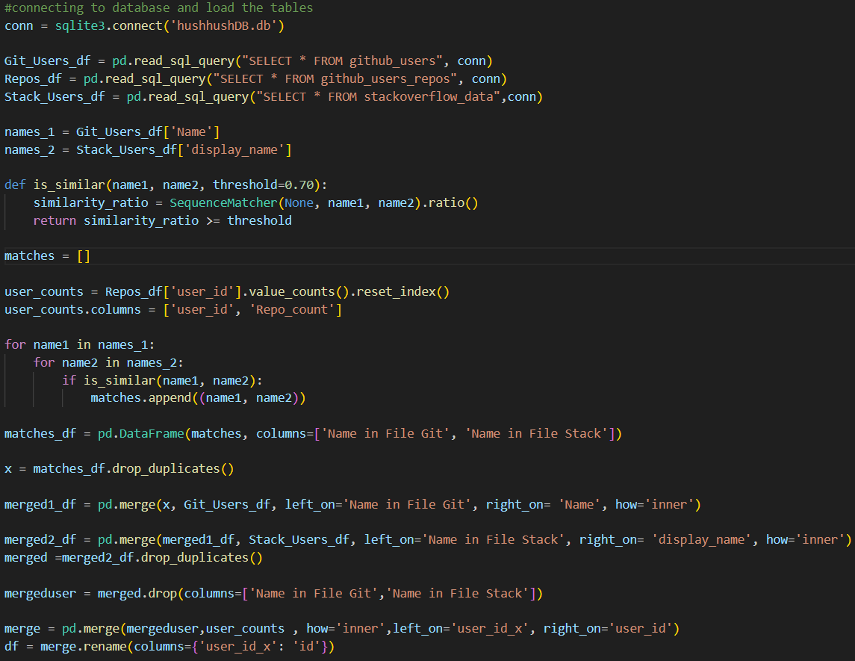
Data Cleaning

Slide 7
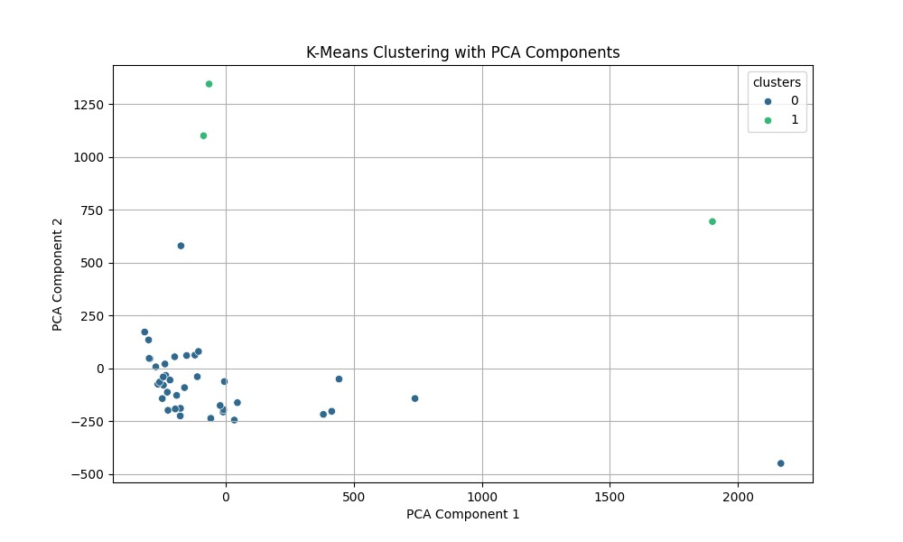
Algorithm
K Means Clustering
It is an unsupervised machine leaning algorithm used for partitioning a dataset into a pre-defined number of clusters. The goal is to group similar data points together and discover underlying patterns or structures within the data.

Slide 8
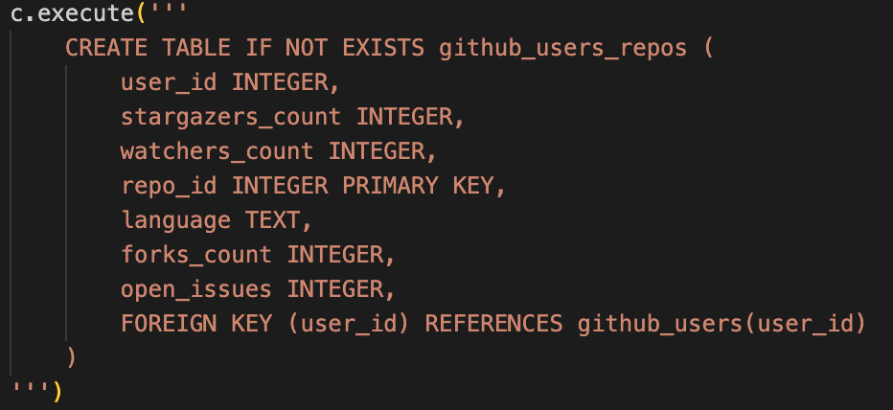
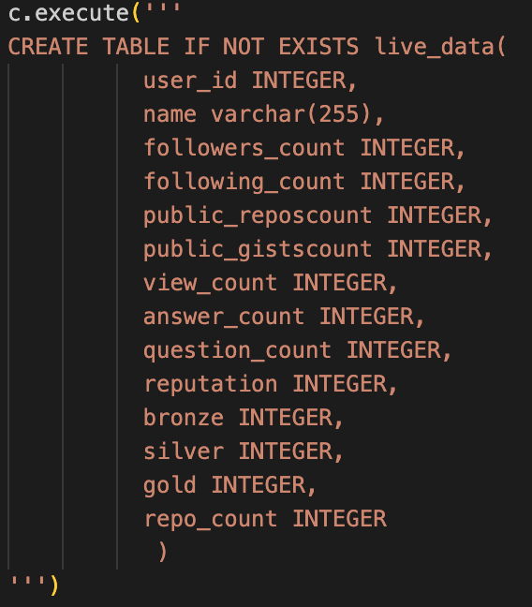
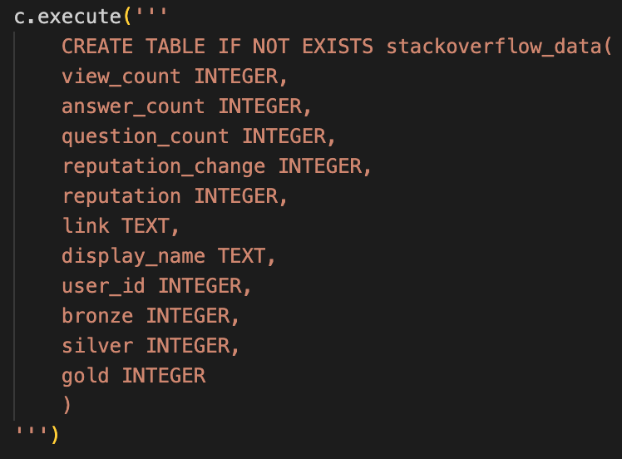
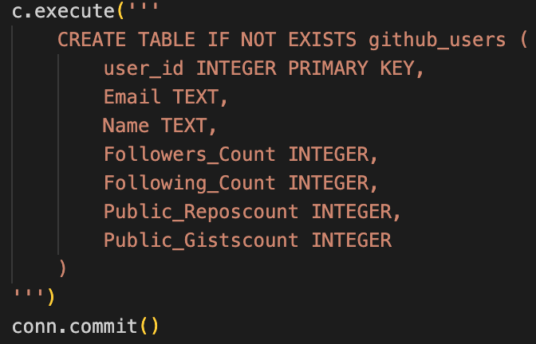
Data Storage

Slide 9
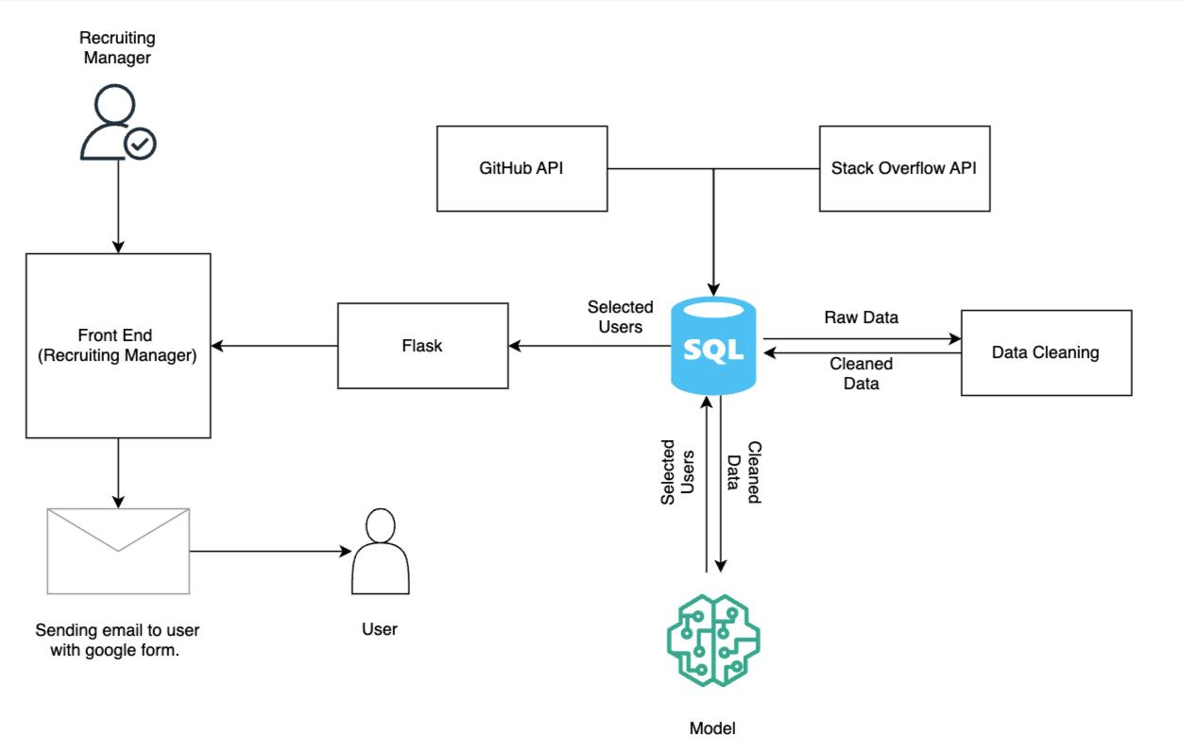
Code level Architecture

Slide 10
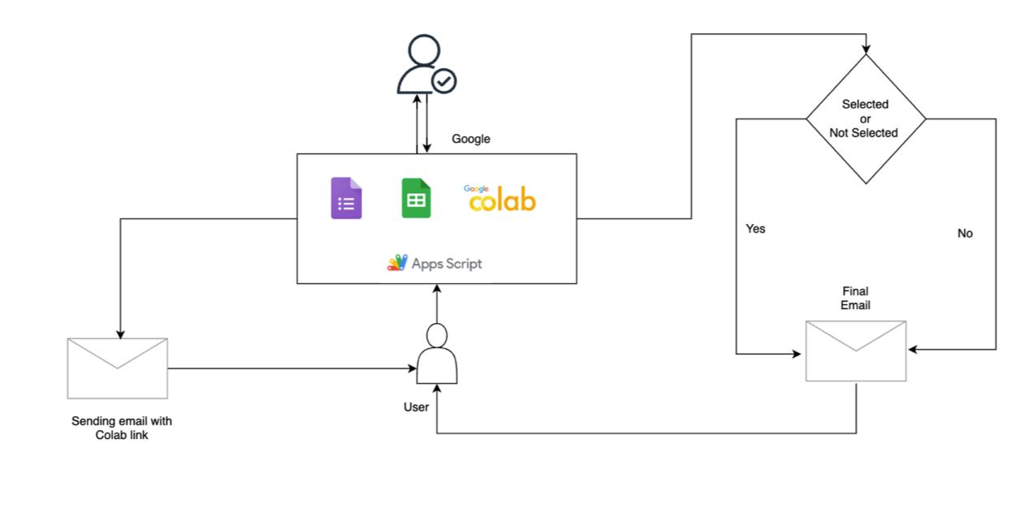

Slide 11
Demo video
Share point : https://srhk-my.sharepoint.com/:v:/g/personal/11038618_stud_hochschule-heidelberg_de/EUgwiiv0PRZJhu2RMSVQVVcB6UGmqSZ-z8_FlRnrhMWQrA?e=QMHeDf&nav=eyJyZWZlcnJhbEluZm8iOnsicmVmZXJyYWxBcHAiOiJTdHJlYW1XZWJBcHAiLCJyZWZlcnJhbFZpZXciOiJTaGFyZURpYWxvZy1MaW5rIiwicmVmZXJyYWxBcHBQbGF0Zm9ybSI6IldlYiIsInJlZmVycmFsTW9kZSI6InZpZXcifX0%3D

Slide 12
Challenges Faced
Kaggle API : Encountered difficulties in obtaining user information.
Not able to find common data with our approach of data fetching.
Flask application: Connecting it to a Python script for sending emails.
Automating Candidates results mail.
Automating Candidates Coding challenge mail.
Generating Unique collab links.

Slide 13
Future Scope
Improve UI for Recruiting process.
Develop a dedicated coding challenge environment.
Automate the entire pipeline, ensuring data updates at regular intervals and seamless integration with trained model.
Explore on more data source trends.
Security related improvements .
Dockerize the application.
Randomizing the coding question we provided.

Slide 14
Roles
Aparnna: Stack Overflow API.
Dharshan: Email automation, exam evaluation, flask and Presentation slides.
Navneeth: GitHub API, Model, Pickle file, Data Cleaning and Creating Environment files.
Terry: Stack Overflow API, Email automation, exam evaluation and Front End.
Vedanth: Data Base(SQLITE3), Front end, Model, Integration and Flask.

Slide 15
References
https://github.com/
https://mljar.com/blog/save-load-scikit-learn-model/
https://stackoverflow.com/
https://www.freecodecamp.org/news/how-to-build-an-automated-email-system-with-python/
https://www.geeksforgeeks.org/sequencematcher-in-python-for-longest-common-substring/
https://docs.python.org/3/library/sqlite3.html
https://www.w3schools.com/html/html_css.asp
https://www.google.com/intl/en-GB/forms/about/
https://www.geeksforgeeks.org/flask-creating-first-simple-application/

Slide 16
Thank You !! ☺

