Slide 1

Smart Expense Tracker Using NLP
Team Members:
Shashank Madipelly
Manichandra Domala
Vedanth Reddy Doddannagari
Notes:
"Hello, everyone. I'm Manichandra, We are going to present our project on 'Smart Expense Tracker Using NLP.' This project focuses on automating the classification of expense-related sentences into predefined categories, an innovative approach that can benefit individuals and organizations in financial management."

Slide 2
Objective
Main Goal: Automate the classification of expense-related sentences into predefined categories.
Why This Project?
- Helps individuals and organizations in financial tracking.
- Reduces manual effort in categorizing expenses.
- Generates actionable insights for budget planning.
Notes:
"The main goal of this project is to automate the classification of expense-related sentences into predefined categories
Why is this important?
It helps streamline financial tracking, reduces the manual effort required for categorization, and generates actionable insights for budget planning."

Slide 3
Dataset Overview
Source: Dataset of 50,000 labelled expense sentences.
Example Sentences:
- 'I bought a book for 20 dollars.' (Education)
- 'I went to a movie costing 15 dollars.’ (Entertainment)
Features:
- Sentence (input text).
- Category label (target variable).
Preprocessing:
- Mapped textual categories to numeric labels.
- Tokenized sentences using a pre-trained BERT tokenizer.
Notes:
"Our dataset consists of 50,000 labeled expense sentences. For example, 'I bought a book for 20 dollars' is categorized under education, while 'I went to a movie costing 15 dollars' falls under entertainment. We preprocessed the dataset by mapping textual categories to numeric labels and tokenized the sentences using a pre-trained BERT tokenizer, ensuring the data is ready for model training."

Slide 4
Technical Stack
Programming Language: Python
Libraries and Frameworks:
- Hugging Face Transformers
- ONNX Runtime
- Pandas
- Regex
Infrastructure:
- Google Colab with GPU acceleration.
Notes:
"For this project, we used Python as the primary programming language, leveraging libraries like Hugging Face Transformers, ONNX Runtime, Pandas, and Regex. The infrastructure used for training included Google Colab with GPU acceleration to ensure efficient processing."

Slide 5
Methodology
1. Data Preprocessing:
- Load dataset and map category labels.
- Tokenize sentences with the BERT tokenizer.
2. Model Fine-Tuning:
- Pre-trained BERT with a classification head.
3. Prediction:
- Classify unseen sentences into categories.
- Extract monetary amounts using regex.
4. Output:
- Store results in an Excel file.
Notes:
"Our approach involves four main steps:
Data Preprocessing: Loading the dataset, mapping category labels, and tokenizing sentences.
Model Fine-Tuning: Fine-tuning a pre-trained BERT model with a classification head for our task.
Prediction: Classifying unseen sentences and extracting monetary amounts using regex.
Output: Storing the results, including the sentence, category, and cost, in an Excel file for further analysis."

Slide 6
Model Fine-Tuning
Model Architecture: BERT-based model with sequence classification head.
Training Details:
- Learning rate: 2e-5
- Batch size: 16
- Epochs: 2
- Optimizer: AdamW with weight decay.
Why BERT?
- Handles complex sentence structures.
- State-of-the-art for text classification.
Notes:
"The model architecture is based on BERT with a sequence classification head. Training was conducted with a learning rate of 2e-5, a batch size of 16, and two epochs using the AdamW optimizer. BERT was chosen for its ability to handle complex sentence structures and deliver state-of-the-art text classification performance."

Slide 7
Results and Outputs
Classification Examples:
- 'I bought a book for 20 dollars.' → Education (Confidence: 1.00)
- 'I went to a movie costing 15 dollars.' → Entertainment (Confidence: 1.00)
Output Excel File:
- Columns: Sentence, Category, Cost
- Example: 'I bought jeans of 30 dollars.' → Clothing, 30
Inference Time:
- Optimized with ONNX Runtime.
Notes:
"The model demonstrated high accuracy, with examples like 'I bought a book for 20 dollars' classified as education and 'I went to a movie costing 15 dollars' as entertainment, both with full confidence. The output was saved in an Excel file, which included the sentence, category, and cost. Additionally, inference time was optimized using ONNX Runtime, ensuring fast predictions. Here is a preview of our performance metrics and a confusion matrix for further insights."

Slide 8
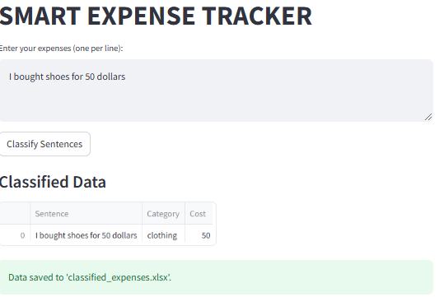
WEB APPLICATION

Slide 9
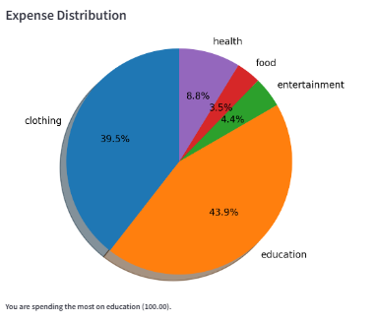
Visualizations

Slide 10
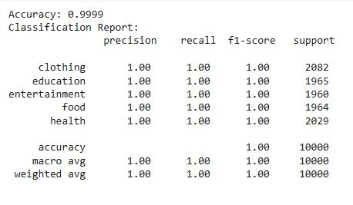
LOGISTIC REGRESSION

Slide 11
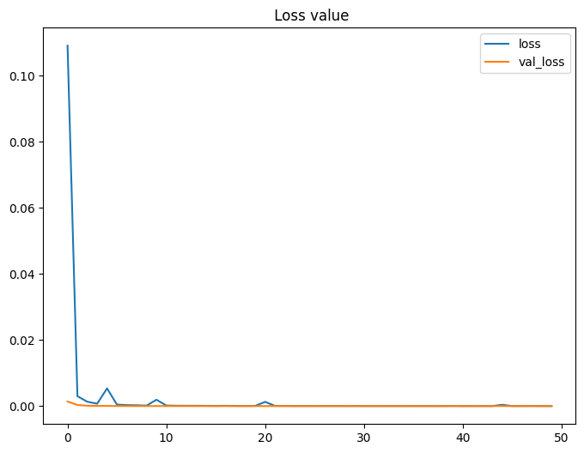
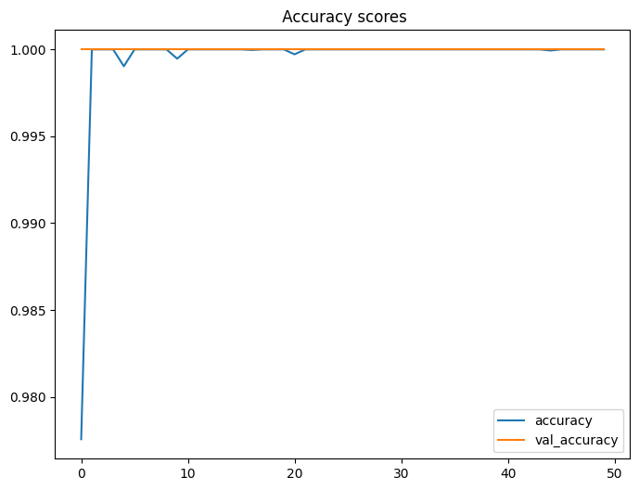
LSTM
OTHER APPROACHES

Slide 12
Challenges and Solutions
Challenges:
- Extracting monetary amounts accurately.
- Balancing data categories.
Solutions:
- Used regex for cost extraction.
- Verified balanced label distribution.
Notes:
"Like any project, this one had its challenges:
Extracting monetary amounts accurately was addressed using regex.
Balancing data categories was handled by verifying label distribution.
These solutions ensured a robust and scalable model."

Slide 13
Future Scope
Visualization:
- Integrate Power BI for interactive expense dashboards.
Support for More Categories:
- Expand to include additional expense types.
Multilingual Support:
- Fine-tune models for other languages.
Real-Time Application:
- Build a web app for real-time expense tracking.
Notes:
"Looking ahead, there are several exciting directions for this project:
Visualization: Integrating Power BI to create interactive dashboards for expense analysis.
Expanding Categories: Supporting additional expense types.
Multilingual Support: Adapting the system to handle multiple languages.
Web Application: Building a real-time expense tracking web app."

Slide 14

Thank You
Questions and Feedback Welcome!
Notes:
"Thank you for your attention. I am happy to answer any questions or hear your feedback."

