Slide 1

AI Healthcare Triage Assistant
Presented by NOSTALGIA
1

Slide 2


Problem Statement
The Crisis We’re Solving
India: 1 doctor per 1,000 people (WHO target: 1 per 445)
Rural patients wait 4–6 hrs; miss critical treatment windows
72% rely on unverified internet searches for health guidance
Misclassified emergencies: preventable deaths + overwhelmed ERs
2

Slide 3


Our Solution
MediGuide AI — What It Does
Conversational chatbot collects symptoms, age & BMI in plain English
NLP engine maps 100+ symptom terms to 80 medical feature flags
XGBoost classifier predicts LOW / MEDIUM / HIGH risk in real time
Outputs: triage level + care tips + warning signs + follow-up prompts
3

Slide 4

System Architecture
System Workflow:-
User Types Symptoms (text)
↓
NLP Keyword Extraction (100+ terms)
↓
Feature Vector (80 binary features)
↓
XGBoost Classifier → Risk Label
↓
Safety Override (chest pain, breathlessness)
↓
Triage: Home Care / Clinic / Emergency
Key Components:-
NLP extracts 80+ symptom features from free text
XGBoost ML model predicts LOW/MEDIUM/HIGH risk
Safety override layer catches emergency symptoms
4

Slide 5



AI Model
XGBoost ML Model — How It Works
Trained on Kaggle Disease-Symptom dataset (4920 samples, 42 diseases)
Input: 80-feature binary vector (symptom present/absent)
Output: risk label (LOW/MEDIUM/HIGH) + probability score 0–100
BMI adjustment: obesity/underweight raises risk score automatically
5

Slide 6

Safety Rules Layer
Safety Override Engine — Why It Matters
Chest pain → Emergency Alert
Breathing issues → High Risk
Recurring symptoms (2+ days same complaint) auto-escalate to Clinic Visit
Claude AI (Anthropic) fallback enriches advice when API key is configured
6

Slide 7
Live Demo — Triage Response
What the user sees in the dashboard:
Risk Score (0–100%) with color-coded meter: green/orange/red
Triage Level badge: HOME CARE / CLINIC VISIT / EMERGENCY
Matched symptoms list + emoji icons for visual clarity
Actionable home remedy tips + red-flag warning signs
Quick-reply buttons for natural follow-up (e.g. “Started today” / “2–3 days”)
Full session history saved per user — tracks recurring complaints
7

Slide 8
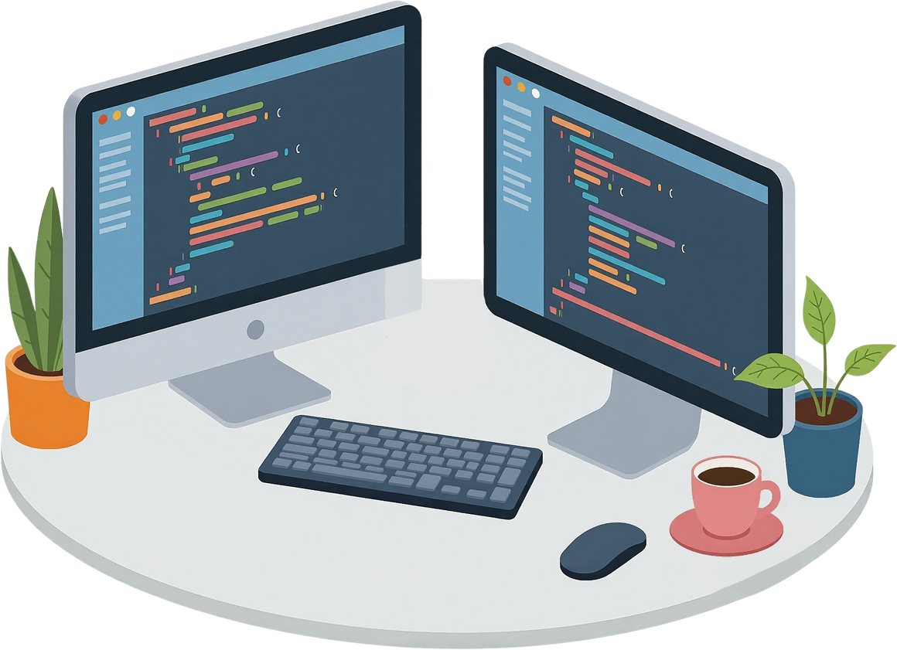
Tech Stack
Tech Stack — Full Breakdown
Frontend
HTML5 + CSS3 + Vanilla JS — single-file SPA, no frameworks
Sora + Lora Google Fonts, CSS variables for theming
Fetch API, multi-turn chat state, BMI calculator, history viewer
Backend & AI Layer
Flask + Flask-CORS — REST API with /predict, /login, /register, /history
XGBoost classifier + scikit-learn + numpy + SQLite3 database
Dataset & AI
Kaggle Disease-Symptom dataset + Anthropic Claude API (optional fallback)
8

Slide 9


Real-World Impact
Real-World Impact We Deliver
Cuts unnecessary ER visits by triaging 60–70% of cases as Home Care
Detects life-threatening symptoms (chest pain, breathlessness) within seconds
Works offline-first; accessible from any smartphone browser without an app
Gives personalized, Indian-context remedies (ORS, Paracetamol, Ajwain, Tulsi)
9

Slide 10

Future Improvements
Roadmap — What Comes Next
Fine-tuned medical NLP model (BioBERT) for intent + severity extraction
Flutter mobile app with offline-mode and push notification alerts
Wearable integration (heart rate, SpO2) for real-time vital-based triage
Multilingual support: Hindi, Tamil, Telugu, Kannada for rural reach
10

Slide 11

Thank You
Team Nostalgia | MediGuide AI | AI Fusion Challenge 2025
11

