Slide 1
MEASURED RESULTS FIRST
A leaf-disease model with a real-world gap
AgroScan
Pepper ? potato ? tomato | 8 supported classes
44.4%
58.3%
94.4%
Pipeline candidate ? top-1
Existing v5 ? top-1
Existing v5 ? top-3
PlantDoc test ? n=72
Same reported split ? n=72
Same reported split ? n=72
Decision support demo ? the field-image evaluation is weaker than the validation score.
Prepared-archive reports use separately cleaned test manifests; their scores are shown with their own sample counts later.
AGROSCAN ? MLOPS COURSE PROJECT
Source: reports/metrics.json; reports/v5_plantdoc_metrics.json; reports/model_comparison.json
Notes:
Lead with the directly compared 72-image PlantDoc reports: reports/metrics.json gives the pipeline candidate 44.4% test accuracy; reports/v5_plantdoc_metrics.json gives existing v5 58.3% top-1 and 94.4% top-3. reports/model_comparison.json records the candidate below the 0.50 gate and v5 above it. Do not imply these numbers establish performance outside this small sample.

Slide 2
PROBLEM AND INTENDED USE
A focused decision-support task
Supported crops
What this model is not
? Pepper
? Not an ?unknown disease? detector
? Potato
? Not a substitute for an agronomist
? Tomato
? Not a sole basis for treatment or pesticide decisions
Eight labels total: bacterial spot, early blight, late blight, Septoria leaf spot, and healthy classes represented in params.yaml.
AGROSCAN ? MLOPS COURSE PROJECT
Source: params.yaml; MODEL_CARD.md
Notes:
AgroScan predicts among eight fixed classes: one bell pepper bacterial spot class, two potato blight classes, and five tomato classes. It has no explicit unknown class. The intended use in MODEL_CARD.md is educational decision support, not autonomous agricultural advice.

Slide 3
DATA AND VALIDATION
Data scale and split counts
Split | Images | Use
Train | 10240 | PlantVillage + PlantDoc train
Validation | 1808 | Model selection / early stopping
PlantDoc test | 72 | Held-out evaluation
Dataset audit
46 exact duplicate groups across splits
42 groups had conflicting labels
Cleaned archive: 70 PlantDoc + 299 PlantWild test images
Different reports use different manifests. The 70-image cleaned archive result and 72-image DVC result are separate evaluations.
The current DVC validation report is marked valid and reports no duplicate-image issues across its three manifests.
AGROSCAN ? MLOPS COURSE PROJECT
Source: reports/data_validation.json; reports/prepared_dataset_audit.json
Notes:
Use the exact counts from reports/data_validation.json: train 10,240, validation 1,808, PlantDoc test 72. The separate prepared_dataset_audit.json records 46 crossing-split duplicate groups, 42 conflicting, and excludes 2 PlantDoc test images and 5 PlantWild test images in the cleaned archive. The reports refer to distinct datasets/manifests; present both carefully.

Slide 4
ARCHITECTURE
One pipeline, two evaluation paths, one export gate
DVC data
prepare
validate
train
evaluate
export
PlantVillage
PlantDoc
?
src.prepare_data
data/prepared/
?
src.validate_data
data_validation.json
?
src.train
model.keras
?
src.evaluate
metrics + matrix
?
src.export_model
model_meta.json
evaluate_v5_baseline
models/model_meta.v5.json
?
Export compares both reports
then writes serving metadata
Serving + operations
FastAPI (/predict) ? logs/predictions.jsonl ? src.monitor_logs ? weekly Airflow DAG ? GHCR release workflow
AGROSCAN ? MLOPS COURSE PROJECT
Source: dvc.yaml; docs/architecture.md
Notes:
This diagram follows dvc.yaml: the independent clean_prepared_archive branch is omitted for visual clarity; prepare feeds validate/train; train feeds candidate evaluation; v5 baseline evaluation runs in parallel from the prepared test manifest; candidate and baseline scores feed export; drift depends on export metadata and the prepared data. MLflow logs training information. Serving and log monitoring are outside the DVC graph.

Slide 5
PIPELINE AND QUALITY GATE
DVC stages make the handoff reproducible
Stage | Module / command | Main output
clean_prepared_archive | src.clean_prepared_archive | clean ZIP + cleaning audit
prepare | src.prepare_data | data/prepared manifests
validate | src.validate_data | reports/data_validation.json
train | src.train | models/model.keras + MLflow
evaluate | src.evaluate | metrics + per-class report + matrix
evaluate_v5_baseline | src.evaluate_v5 | v5 PlantDoc evaluation
export | src.export_model | models/model_meta.json
drift | src.drift_check | reports/drift.json
Quality gate: 0.50 PlantDoc top-1 | Candidate report: 0.444 | v5 report: 0.583 | export selects the passing v5 baseline
AGROSCAN ? MLOPS COURSE PROJECT
Source: dvc.yaml; params.yaml; reports/model_comparison.json
Notes:
The stage names are taken exactly from dvc.yaml. `dvc repro` runs the dependency graph; `dvc repro <stage>` targets one stage. Candidate accuracy is below params.yaml?s 0.50 gate, while the existing v5 model passes in reports/model_comparison.json. The pipeline code handles selection during export; this is not a separate quality-gate stage.

Slide 6
MEASURED RESULTS
The scores depend on which test manifest is used
Model / report | Dataset | Top-1 | Top-3 | n
Pipeline ? current DVC | PlantDoc | 44.4% | ? | 72
v5 ? current DVC report | PlantDoc | 58.3% | 94.4% | 72
v5 ? cleaned archive | PlantDoc | 61.4% | 94.3% | 70
v5 ? cleaned archive | PlantWild | 60.5% | 89.0% | 299
v5 ? all archive images | PlantWild | 60.9% | 88.8% | 304
Candidate ? cleaned archive | PlantDoc | 42.9% | 78.6% | 70
Candidate ? cleaned archive | PlantWild | 37.5% | 68.2% | 299
Top-1 is highest-ranked class. Top-3 counts a hit anywhere in the three returned classes. No committed report contains 62.5% PlantDoc top-1.
AGROSCAN ? MLOPS COURSE PROJECT
Source: reports/v5_plantdoc_metrics.json; reports/v5_plantdoc_prepared_metrics.json; reports/v5_plantwild_metrics.json; reports/v5_plantwild_metrics_including_duplicates.json; reports/pipeline_plantdoc_prepared_metrics.json; reports/pipeline_plantwild_prepared_metrics.json
Notes:
Read every row with its manifest. `reports/v5_plantdoc_metrics.json` is 72 images; `v5_plantdoc_prepared_metrics.json` is 70 cleaned images. The PlantWild reports differ by 5 excluded images. Candidate archive-cleaned evaluations are from their respective pipeline_*prepared_metrics.json files. The older 62.5% PlantDoc value does not appear in the current reports folder. These small samples should not be over-interpreted.

Slide 7
V5 CLASS METRICS
Class-level results reveal uneven performance
Class | Precision | Recall | F1 | n
Pepper__bell___Bacterial_spot | 0.800 | 0.889 | 0.842 | 9
Potato___Early_blight | 0.750 | 0.375 | 0.500 | 8
Potato___Late_blight | 0.500 | 0.625 | 0.556 | 8
Tomato_Bacterial_spot | 0.250 | 0.250 | 0.250 | 8
Tomato_Early_blight | 0.462 | 0.750 | 0.571 | 8
Tomato_Late_blight | 0.750 | 0.600 | 0.667 | 10
Tomato_Septoria_leaf_spot | 0.700 | 0.636 | 0.667 | 11
Tomato_healthy | 0.857 | 0.750 | 0.800 | 8
Cleaned PlantDoc v5 evaluation ? 70 images ? macro F1 = 0.607
AGROSCAN ? MLOPS COURSE PROJECT
Source: reports/v5_plantdoc_prepared_metrics.json
Notes:
This table is specifically from reports/v5_plantdoc_prepared_metrics.json, the cleaned 70-image archive test. Class supports are 8?11 images, so per-class precision/recall estimates are highly uncertain. The source reports macro F1 of 0.607. Keep this distinct from the candidate confusion matrix on the next slide.

Slide 8
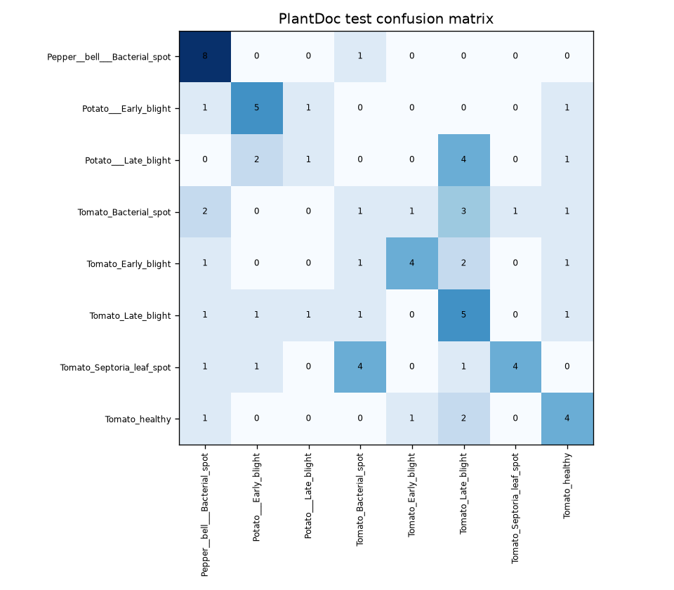
CANDIDATE ERROR PATTERN
The pipeline candidate still confuses field classes
44.4%
top-1 accuracy
PlantDoc test ? n=72
Lowest class F1s in this report
Tomato_Bacterial_spot 0.118
Potato___Late_blight 0.182
Tomato_Late_blight 0.370
Candidate report; do not read this as the v5 confusion matrix.
AGROSCAN ? MLOPS COURSE PROJECT
Source: reports/confusion_matrix.png; reports/classification_report.json
Notes:
The image is the committed reports/confusion_matrix.png produced by src.evaluate for the pipeline-trained candidate on the current 72-image PlantDoc test manifest. `reports/classification_report.json` shows F1 values for Tomato_Bacterial_spot 0.118, Potato___Late_blight 0.182, and Tomato_Late_blight 0.370. This is not a v5 confusion matrix and not the cleaned 70-image evaluation.

Slide 9
SERVING
A small API exposes predictions and uncertainty
Routes
? GET /health ? liveness
SCREENSHOT
? GET /ready ? model loaded
? POST /predict ? multipart image
Replace with the running AgroScan UI at /ui/
? GET /ui/ ? upload page
Metadata selects image size, range, center crop, threshold and top-k.
AGROSCAN ? MLOPS COURSE PROJECT
Source: api/main.py; ui/index.html; docs/deployment_runbook.md
Notes:
Add a screenshot of the actual UI in the bordered placeholder. The service listens on port 8000. `/health` can return OK even when the model is not loaded; `/ready` returns 503 unless the configured model and class names load. `/predict` reports top-k probabilities and flags low confidence using metadata. The browser page lives in ui/index.html.

Slide 10
AIRFLOW AUTOMATION
Weekly orchestration turns monitoring into a reviewable decision
prepare_sample_logs
validate_data
run_pipeline
summarize_live_logs
check_thresholds
?
?
?
?
real mode uses existing log
src.validate_data
dvc repro
src.monitor_logs
branch task
healthy_report
retrain_decision ? train ? evaluate ? export
SCREENSHOT
Replace with the Airflow Graph view for agroscan_pipeline
AGROSCAN ? MLOPS COURSE PROJECT
Source: airflow/dags/agroscan_pipeline.py; docs/airflow_setup.md
Notes:
Airflow schedule in the DAG is @weekly. It validates, runs `dvc repro`, summarizes prediction logs, then branches. In placeholder mode it generates sample logs; in real mode the first task only echoes that it uses the existing log. Replace the placeholder with a screenshot from Airflow UI. Setup and placeholder commands are in docs/airflow_setup.md. The retrain branch runs the configured train, evaluate, and export tasks; export still applies model selection.

Slide 11
MONITORING AND RESPONSIBLE USE
Monitoring watches inputs and outputs without saving leaf images
Two separate checks
Prediction log fields
Offline drift
src.drift_check compares brightness and RGB means for prepared train vs test samples.
Live summary
src.monitor_logs reads confidence, predicted class mix, latency and brightness from prediction JSONL.
ts ? model_version ? top1_class ? confidence ? top3 ? low_confidence ? latency_ms ? brightness
The API does not write original image bytes, filename, IP or user ID into this log. Multipart uploads may be spooled temporarily by the framework.
No saved reports/explainability figures are present yet; LIME / SHAP findings remain to be added.
AGROSCAN ? MLOPS COURSE PROJECT
Source: src/drift_check.py; src/monitor_logs.py; reports/drift.json; api/main.py
Notes:
The committed reports/drift.json says drift was detected for brightness and each RGB mean in the prepared-train vs PlantDoc test comparison. That is offline drift and not computed from the live log. The monitor can summarize live JSONL records and uses configs/monitoring.yaml. API logging fields listed are exact. App code does not save image bytes as a persistent prediction artifact; FastAPI multipart upload may use a spooled temporary file, so do not promise no temporary disk use. No explainability report figures exist under reports/explainability.

Slide 12
NEXT STEPS
What to do before calling this production-ready
1
Reconcile test reports
Keep 72-image DVC and 70-image cleaned archive results separately labelled.
2
Improve field performance
Candidate is 44.4% on current PlantDoc; v5 is 58.3% on same report split.
3
Verify container weights
Release workflow checks /health and does not pull DVC model artifacts.
4
Repair results renderer
Current nested classification_report causes KeyError in render_results_table.py.
5
Add evidence and review
Save explanation figures; record model-card owners and review date.
AgroScan is a useful MLOps teaching system; the current evidence supports continued evaluation, not broad agronomic claims.
AGROSCAN ? MLOPS COURSE PROJECT
Source: reports/; docs/deployment_runbook.md; README.md
Notes:
Close with work grounded in repo evidence: clarify the incompatible reports and dataset policies, improve real-world performance, verify the model artifact is in the published container and test `/ready`, repair the renderer in a future code task, and collect LIME/SHAP outputs plus owner/review metadata. The deck intentionally does not invent a cloud host or claim deployment readiness.

