Slide 1
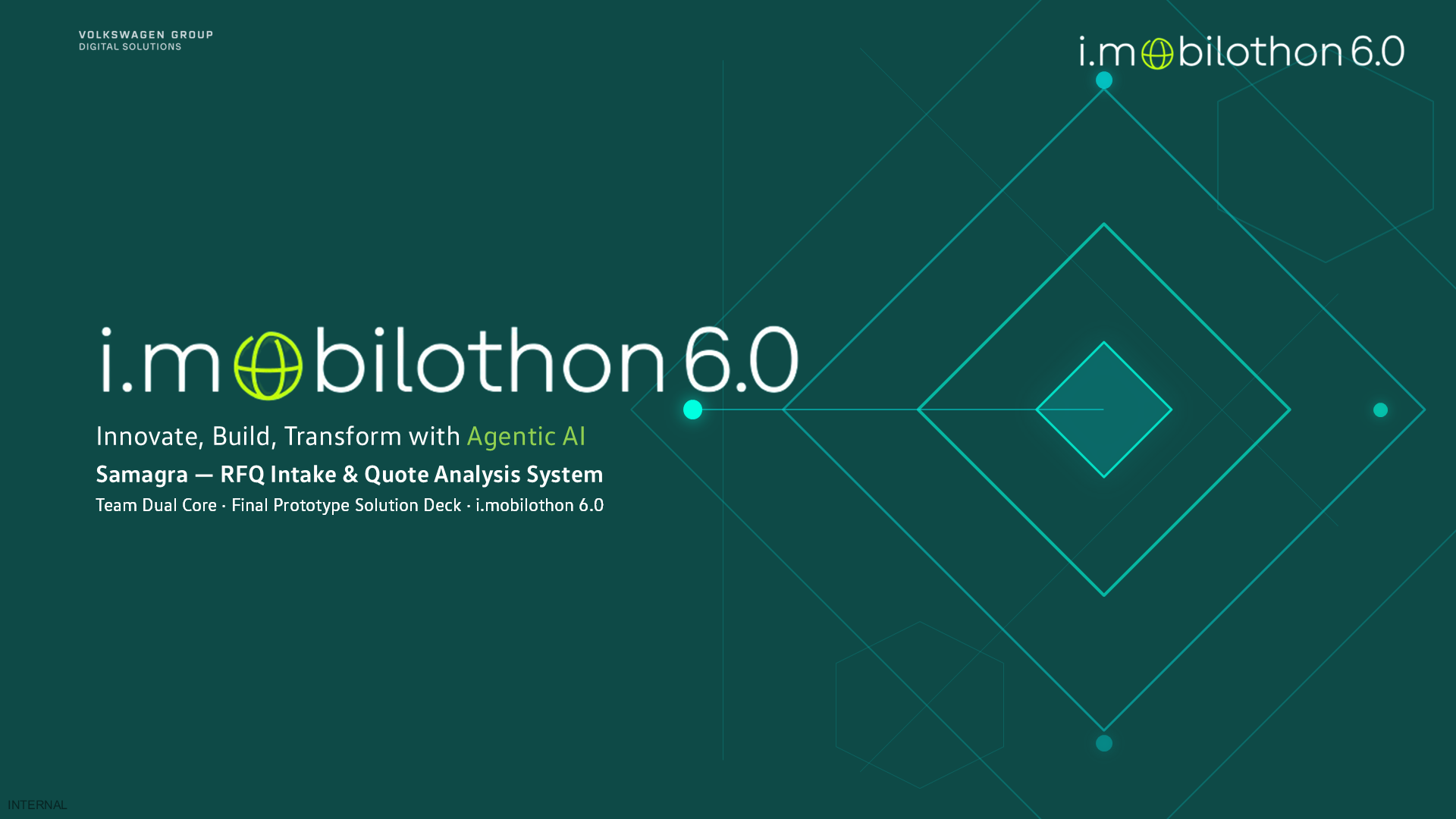
Notes:
0:00–0:30. Introduce the team in one breath: Vedanti Adsare and Monesh Deenadayalan. Samagra means complete: the whole sub-€50k sourcing cycle in one portal, request to PO.

Slide 2

1 · Small purchases, big effort
Sub-€50k buying runs on email and Excel. The figures are VW GDS General Procurement's own.
600
600–900
₹35–45
10–15%
cases a year under €50k
buyer hours a year, at 60–90 min per case
crore of spend a year
of requests sent back to the requester (estimate)
Incomplete requests
Quotes in every format
No shared view
Documents missing, so cases bounce back and forth by mail.
PDF, Word, Excel, mail — rebuilt by hand into one comparison.
Status means asking someone; no common record of why a supplier won.
TAT is already met in 97–98% of cases — so Samagra targets buyer effort, negotiation and visibility, not TAT.
Source: Himanshu Tiwari, VW GDS General Procurement, 13.10.2026
Notes:
0:30–2:00. These are GP's real numbers, not ours. 600 cases, 60–90 minutes each on the steps in the problem statement: 600–900 buyer hours a year. 35–45 crore of spend. Rework is an estimate; it isn't monitored today. Say the TAT point out loud: GP already meets TAT, so we don't claim to fix it.

Slide 3
2 · One portal, four people
Each role gets its own view of the same case, from request to PO.
Requester
GP buyer
Procurement head
Supplier
• Guided form with InfoSec screening
• Can't submit an incomplete request
• Runs the supplier enquiry
• Sees status live
• Assigned by commodity
• Quotes read and compared on one basis
• Market price to negotiate with
• Next action worked out
• TAT counted from complete documents
• Workload by buyer
• Single sourcing visible
• Excel export
• No account needed
• Private link, works on a phone
• Quote, revise or decline
• Every change of mind kept
Requester collects quotes
Complete request reaches GP
Buyer compares, negotiates
PO released
Under €50k the requester runs the supplier enquiry; GP takes over once the request arrives complete.
Notes:
2:00–3:30. Walk left to right. Requester: the form won't submit without cart, SFO, RFQ, at least one offer, and InfoSec clearance when any screening answer is yes. Buyer: the case lands with the right buyer, quotes are read and tax-stripped, the market check gives a reference price from Amazon.in and Flipkart. Head: live TAT and workload. Supplier: a private link, no login.

Slide 4
3 · Solution architecture
A layered monolith: one Python service, rules at the core, AI agents that read, three external APIs.
Samagra · FastAPI on Uvicorn · one Python process
Deployment
Today: one process, laptop
Next: VW cloud container
USERS & SOURCES
WEB LAYER
Requester
request, enquiry
Auth & roles
signed session
~60 routes
FastAPI routers
Pages
Jinja2, no SPA
GP buyer
check, compare, PO
DOMAIN SERVICES · RULES
EXTERNAL APIS
Intake parser
carts, quotes
Comparison
tax-stripped
Market check
trusted sellers
SerpAPI
Google Shopping, Amazon.in
GP head
dashboards
TAT & advisor
working days
Supplier RFQ
rounds, versions
Notifications
mail + in-app
Microsoft Graph
send mail, read inbox
Supplier
token link, tunnel
AI AGENTS · READ, NEVER DECIDE
LLM
VW LLMaaS gpt-4o
fallback: Ollama qwen7b
Offer agent
read, verify, rank
Enquiry agent
drafts only
Ask this case
case docs only
GP mailbox
mailed requests
DATA
SQLite
16 tables, audit trail
File store
per case and round
KSRM proposed
For SC
AI reads › rules decide › a person approves
Solid = built · dashed = proposed · lime = AI
Notes:
3:30–5:00. Users and sources: three internal roles in the browser behind a signed session; the supplier has no account, only a per-invitation token link reaching the laptop through a Cloudflare tunnel; and requests mailed to the GP mailbox, read through Microsoft Graph. Inside: a layered monolith — one FastAPI process, server-rendered Jinja2 pages. The domain layer is deterministic. The AI agents only read: the Offer agent reads quotes, code verifies every figure; the Enquiry agent drafts the supplier note from the RFQ; Ask this case answers from that case's documents only. Data: SQLite with 15 tables and an audit trail, plus a file store. Externals: SerpAPI, Microsoft Graph (SMTP is blocked on the VW network), LLMaaS GPT-4o with a local Ollama fallback. SAP is proposed. Scaling: same code in a VW container, Postgres, object storage, SSO.

Slide 5
4 · Business value
Time, money and control, on GP's own baseline.
Time
Money
Control
600–900 buyer hours a year go into checking and comparing. Samagra reads, ranks and chases, so buyers can negotiate.
The market price check gives buyers a reference price. If prices improve 1% on ₹35–45 crore, that is ₹35–45 lakh a year.
InfoSec clearance before GP, duplicate POs blocked, and every decision in the audit trail.
The 1% is a scenario, not a promise — a pilot would measure the real figure.
Baseline: Himanshu Tiwari, VW GDS General Procurement · Next: the live demo
Notes:
5:00–6:00, then into the demo. Lead with time and negotiation, not TAT. The 1% line: say 'if', and that a pilot would measure it. Control: InfoSec screening is enforced before a request can reach Procurement, a PO number can't be reused on two cases, and the activity trail records every step. Then: 'Let me show you.'

