Slide 1
Insurance Policy
Portfolio Analysis
Excel, SQL, Tableau and Power BI
Project findings and dashboard presentation
Notes:
Introduce the insurance policy portfolio project. This presentation reports findings from supplied practice data. Tool screenshots reflect earlier project stages. The SQL example was independently checked against the source records for this presentation.

Slide 2
Project objective and dataset
Understand the portfolio and identify where further investigation can improve policy monitoring.
Source table | What one row represents
Customer Information | A customer record
Policy Details | A policy
Claims | A claim
Payment History | A payment record
Additional Fields | Supplementary policy information
5,000 records per source table. Customer and policy counts use unique IDs.
02
Notes:
Source: Policy Data(3).xlsx, supplied project data. Recomputed from original records. Questions: KPI Questions(2).docx.
The purpose is to answer 21 KPI questions about policy scale, status, customer participation, policy types and annual trends. There are five original data tables of 5,000 rows each. Equal row counts do not mean one-to-one business relationships.

Slide 3
Role of each analysis tool
Tool | Role in the project | Example
Excel | Source review and KPI checks | COUNTIF, AVERAGE, PivotTables
SQL | Reproduce grouped results | COUNT(DISTINCT), GROUP BY
Tableau | Explore policy segments and trends | Status, age, gender and growth
Power BI | Build the interactive report | DAX measures and slicers
The SQL example in this deck uses normalized table and field names.
03
Notes:
Source: Policy Data(3).xlsx, supplied project data. Recomputed from original records. Questions: KPI Questions(2).docx.
The table explains how each tool supports the project. Excel formulas and PivotTables support transparent KPI checks. Tableau and Power BI provide visual analysis. SQL is represented by a reproduced validation query later in this deck, rather than an unprovided original SQL script.

Slide 4
Data relationships and calculation rules
Relationship | Matching field | Purpose
Customers to policies | Customer ID | Age and gender participation
Policies to claims | Policy ID | Claims by policy segment
Policies to payments | Policy ID | Payments by policy segment
Policies to additional fields | Policy ID | Renewal and risk context
Policy count = distinct Policy IDs
Customer count = distinct Customer IDs
04
Notes:
Source: Policy Data(3).xlsx, supplied project data. Recomputed from original records. Questions: KPI Questions(2).docx.
Customers relate to policies through Customer ID. Claims and payments relate to policies through Policy ID. Use one-to-many relationships where customer or policy keys repeat on the transactional side. Additional Fields matches Policy ID. Keep measures at their owning table grain to avoid double-counting after raw joins.

Slide 5
Portfolio KPI summary
5,000
5,000
251.38M
Customers in database
Policies issued
Total claim amount
254,562.95
1,052.20
3,148
Average coverage per policy
Average listed premium
Customers holding a policy
Amounts use source units. Claim amount includes all claim statuses.
05
Notes:
Source: Policy Data(3).xlsx, supplied project data. Recomputed from original records. Questions: KPI Questions(2).docx.
5,000 distinct customers are present in the database. 3,148 distinct customers appear in Policy Details, so the full customer population differs from policyholders. Premium and coverage averages use one row per policy. Claim amount sums all statuses. Currency is unspecified in the source.

Slide 6
Only 33.64% of policies are active
33.64%
Active share
1 : 1.97
Active to inactive
Inactive = Lapsed + Terminated. Recorded status does not measure retention over time.
06
Notes:
Source: Policy Data(3).xlsx, supplied project data. Recomputed from original records. Questions: KPI Questions(2).docx.
Active 1,682, Lapsed 1,640, Terminated 1,678. Inactive combines lapsed and terminated: 3,318 or 66.36%. Active:inactive is 1:1.97. The active category exceeds terminated by just four policies, so the largest individual status is only narrowly ahead. Status is the recorded source value and is not recalculated as of today. These are stock shares, not a measured retention or churn rate.

Slide 7
Health leads a broadly balanced policy mix
102
More Health policies
than Auto policies
26.32%
Health share
The smallest segment, Auto, still accounts for 24.28% of all policies.
07
Notes:
Source: Policy Data(3).xlsx, supplied project data. Recomputed from original records. Questions: KPI Questions(2).docx.
Health has 1,316 policies, Property 1,236, Life 1,234 and Auto 1,214. Health share is 26.32%. Auto share is 24.28%. Health exceeds Auto by 102 policies, a 2.04 percentage point difference in portfolio share. Policy count does not establish product profitability.

Slide 8
The 66+ age group holds 28.16% of policies
Policies by age group
Policies by gender
Gender | Policies
Other | 1,699
Male | 1,677
Female | 1,624
53 more male policies
Counts represent policies held by each demographic group, rather than customer counts.
08
Notes:
Source: Policy Data(3).xlsx, supplied project data. Recomputed from original records. Questions: KPI Questions(2).docx.
Policy counts use customer demographics joined to policies by Customer ID. Age bands are a project choice. Under 18 contains no policies and is omitted from the chart. Top age groups: 66+ 1,408, 26–35 805 and 56–65 772. Gender counts: Other 1,699, Male 1,677 and Female 1,624. The male–female difference is 53 policies. These describe this portfolio, not the wider insurance market.

Slide 9
Premium growth fluctuates after the 2015 spike
384.57%
Mean growth, 2015–2024
−1.02%
Mean excluding 2015
Chart: 2016–2024. The omitted 2015 growth point is 3,854.97%, from only 11 policies in 2014.
09
Notes:
Source: Policy Data(3).xlsx, supplied project data. Recomputed from original records. Questions: KPI Questions(2).docx.
Annual listed premium totals use Policy Start Date years 2014–2024. YoY growth = current annual premium / prior annual premium − 1. 2015 growth is 3,854.97%, driven by a 2014 base of only 11 policies. The arithmetic mean of all ten annual growth rates is 384.57%. Excluding 2015 gives −1.02%. Maximum minus minimum is 3,864.35 percentage points. Neither measure is premium collected or a renewal price increase. The plot excludes only the 2015 growth point for readability and retains 2015 as the prior year for 2016.

Slide 10
Scheduled endings peak at 526 policies in 2025
Scheduled end dates can guide renewal planning after a data refresh.
Policy End Date counts describe this extract. They do not establish actual renewals or cancellations.
10
Notes:
Source: Policy Data(3).xlsx, supplied project data. Recomputed from original records. Questions: KPI Questions(2).docx.
Counts group Policy End Date by year from 2016 to 2034. The peak is 526 in 2025, then the count falls to 33 in 2034. These are contractual end dates in a fixed historical extract, not observed churn or a forecast of future renewal performance. As of this presentation in October 2026, the 2025 peak is historical. A refreshed extract is needed for current operational planning.

Slide 11
SQL validation example
SELECT policy_type,
COUNT(DISTINCT policy_id) AS policies
FROM policy_details
GROUP BY policy_type
ORDER BY policies DESC;
Policy type | Policies
Health | 1316
Property | 1236
Life | 1234
Auto | 1214
Distinct IDs preserve the policy count.
Grouping reveals the largest and smallest types.
11
Notes:
Source: Policy Data(3).xlsx, supplied project data. Recomputed from original records. Questions: KPI Questions(2).docx.
Reproduced validation query for this presentation, not a supplied original project script. Table and column names use normalized identifiers. Executed in SQLite against the supplied Policy Details rows. All four counts match independently calculated source controls. Add the user’s actual SQL script if available.

Slide 12
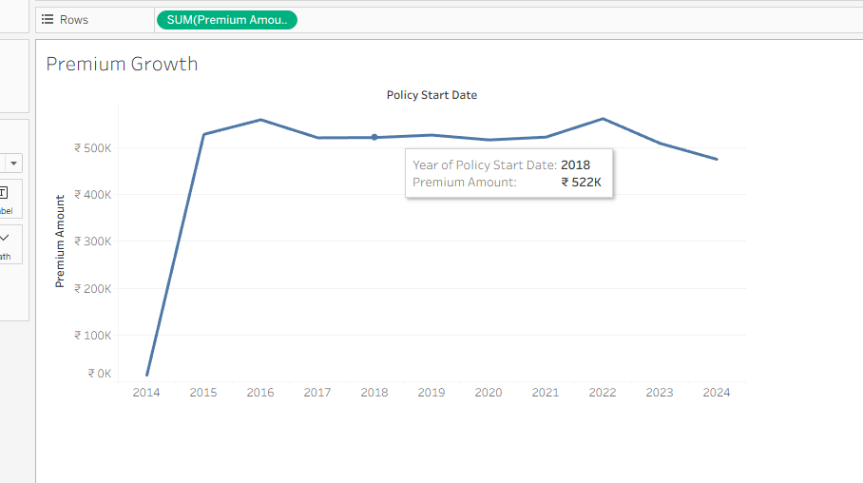
Tableau analysis
Premium totals
by start year
A separate percent-difference calculation measures yearly growth.
12
Notes:
Source: Policy Data(3).xlsx, supplied project data. Recomputed from original records. Questions: KPI Questions(2).docx.
Source image: user screenshot image(20261010-072312).png, shared 10 October 2026. The screenshot shows annual premium totals, despite the worksheet title Premium Growth. It is a work-in-progress view, not evidence of the final dashboard. Tableau percent difference was subsequently discussed, including percentage formatting and the low 2014 baseline. The rupee symbol reflects screenshot formatting; the source data does not confirm currency.

Slide 13
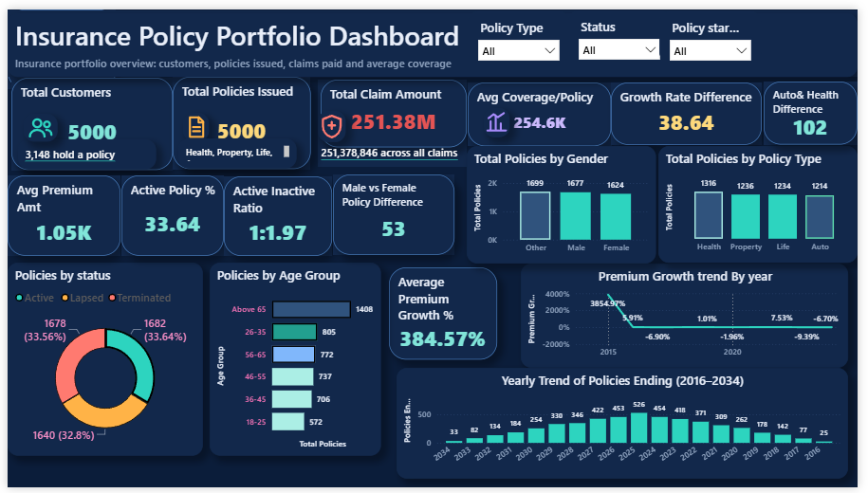
Power BI report
13
Notes:
Source: image(20261027-050035).png supplied by the user, 27 October 2026. The report contains the completed supplied arrangement of KPI cards, gender and policy type comparisons, age groups, status, premium growth and scheduled endings. Preserve the screenshot unchanged. Active Policy % displays 33.64 without a percent sign. Growth Rate Difference displays 38.64, which corresponds to a raw rate spread near 38.6435. Expressed in percentage points, the all-period spread is 3,864.35. The subtitle says claims paid while the total includes all claim statuses. These are presentation and reconciliation points, not evidence that the source data changed.

Slide 14
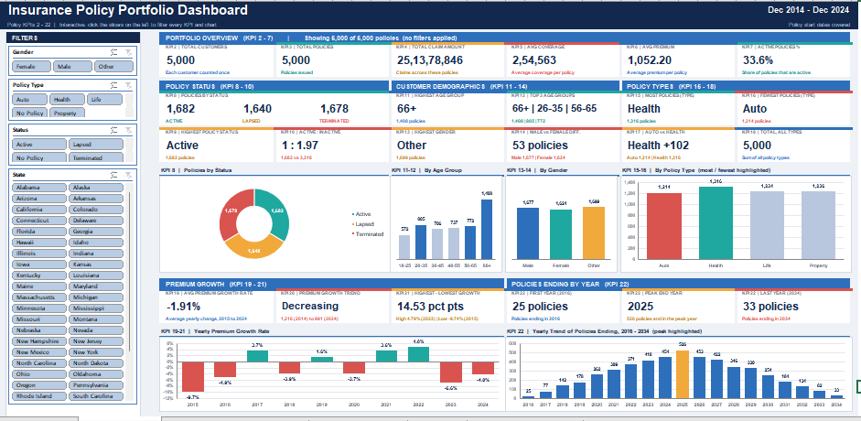
Excel dashboard
14
Notes:
Source: image(20261027-050347).png supplied by the user on 27 October 2026. The dashboard uses slicers for gender, policy type, status and state. It presents portfolio overview, policy status, demographics, policy types, growth and scheduled endings. Screenshot preserved unchanged. Core portfolio figures agree with Policy Data(3).xlsx. Excel average premium growth is shown as −1.91% for 2015–2024. That value differs from the source-based full-period average of 384.57% and the average excluding the 2015 spike of −1.02%. Excel growth spread is shown as 14.53 percentage points, also differing from source controls. The underlying Excel formulas were not provided, so the cause is not established. The displayed period and ending-year terminology need alignment because the dashboard also includes years through 2034.

Slide 15
Outcomes and recommended next steps
Finding | Recommended follow-up
66.36% of policies are inactive | Investigate lapse and termination reasons
66+ holds 28.16% of policies | Review service needs and segment coverage
2023 and 2024 premium totals declined | Check volume, mix and extract completeness
The 2015 spike distorts mean growth | Report the full mean with base-year context
Outcome: clear portfolio visibility and reproducible KPI definitions.
Recommendations need further evidence. This project does not demonstrate measured commercial improvement.
16
Notes:
Source: Policy Data(3).xlsx, supplied project data. Recomputed from original records. Questions: KPI Questions(2).docx.
The project outcomes are analytical: consistent baseline KPI definitions and visibility into policy mix, demographics and annual patterns. Suggested actions are hypotheses to investigate, not measured improvements. No revenue uplift, retention improvement or time saving was measured. The 66+ segment requires further analysis of coverage needs, claims and suitability. Lower listed premiums in 2023 and 2024 require checks for policy volume, policy mix and extract completeness before causal claims.

