Slide 1
E-Commerce Performance
Analytics Dashboard
Prepared for internship | Vedanti Kingri • Quillance Infotech.Pvt.Ltd

Slide 2
INTRODUCTION
Turning Raw E-Commerce Data Into a Single View
E-commerce businesses generate large volumes of transactional and behavioural data every day — from the moment a visitor lands on the site to the point of checkout. Without a structured way to consolidate this data, decision-makers struggle to see what is working and where revenue is being lost.
BUSINESS CONTEXT
A mid-sized online retail store selling across:
Categories
Furniture, Electronics, Home & Kitchen, Fashion, Sports & Fitness
This project brings revenue, acquisition channel, device usage, and product-level performance together into one interactive, filterable dashboard — covering the full workflow from data preparation to visualisation and interpretation.
Channels
Direct, Email, Search, Social, Referral
Devices
Desktop and Mobile
Window
6-month transactional analysis period
E-Commerce Performance Analytics Dashboard
2

Slide 3
PROBLEM & OBJECTIVES
THE PROBLEM
PROJECT OBJECTIVES
No single, consolidated view of core KPIs — revenue, conversion, AOV
Hard to compare performance across channels, devices, categories
No visibility into the purchase funnel: visit → cart → checkout → purchase
Difficult to identify top / bottom-performing products for planning
Design an interactive dashboard summarising key e-commerce metrics
Analyse revenue trends and period-over-period patterns
Evaluate category and product-level contribution to revenue
Assess conversion performance by traffic source and device
Enable drill-down by date, category, source, and device
Derive recommendations to improve conversion and stabilise revenue
E-Commerce Performance Analytics Dashboard
3

Slide 4
METHODOLOGY
Tools, Data Model & Analytics Workflow
TOOLS & TECHNOLOGIES
ANALYTICS WORKFLOW
Category | Tool / Technology
BI / Visualisation | Power BI
Data Preparation | Excel
Data Source | E-commerce transactional dataset
Documentation | Microsoft Word
1
Data Collection
Orders, revenue, traffic source, device, category, date
2
Cleaning & Prep
Handle missing values, standardise labels, structure dates
3
Metric Definition
Revenue, Conversion %, AOV, Add-to-Cart %, Checkout %
4
Dashboard Design
KPI strip, trend charts, category & funnel visuals
5
Interactivity
Slicers for Source, Device, Category, and Date
E-Commerce Performance Analytics Dashboard
4

Slide 5
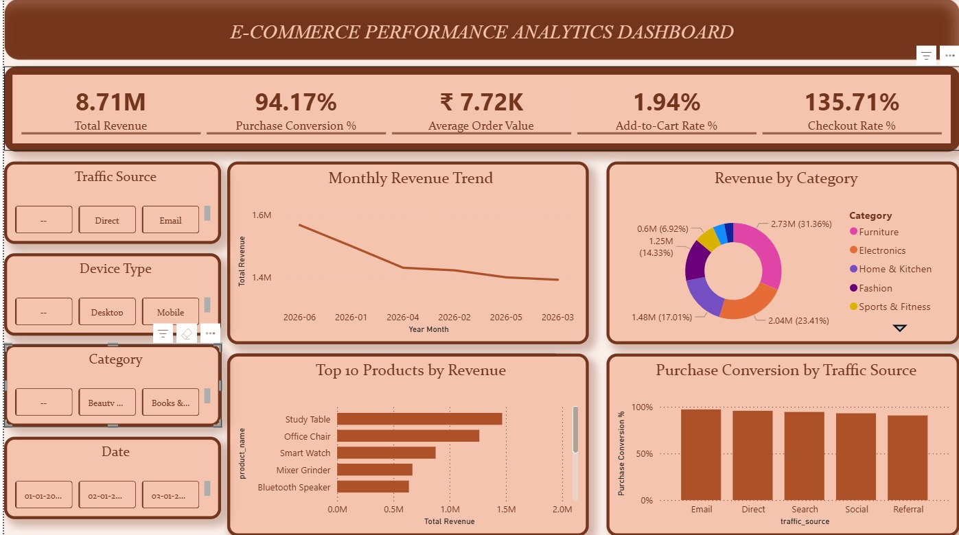
The Dashboard
Full interactive view — KPI strip, filters, and six analytical charts
E-Commerce Performance Analytics Dashboard
5

Slide 6
KPI SUMMARY
Five Headline Metrics at a Glance
₹8.71M
94.17%
₹7.72K
1.94%
135.71%
Total Revenue
Purchase Conversion
Average Order Value
Add-to-Cart Rate
Checkout Rate
Cumulative revenue across the analysis period
Very high conversion once checkout is initiated
Average revenue per completed order
Share of visitors who add a product to cart
Flagged as a data-quality anomaly
⚠ Checkout Rate exceeds the logical 100% ceiling — see Challenges & Limitations.
E-Commerce Performance Analytics Dashboard
6

Slide 7
REVENUE ANALYSIS
Revenue Trend Is Declining; Furniture Leads the Category Mix
MONTHLY REVENUE TREND (₹M)
REVENUE BY CATEGORY
E-Commerce Performance Analytics Dashboard
7

Slide 8
PRODUCT & CHANNEL
Furniture Products Lead Revenue; Email & Direct Convert Best
TOP PRODUCTS BY REVENUE (₹M)
PURCHASE CONVERSION BY TRAFFIC SOURCE
E-Commerce Performance Analytics Dashboard
8

Slide 9
FINDINGS & RISKS
What the Data Tells Us — and Where to Be Cautious
KEY FINDINGS
CHALLENGES & LIMITATIONS
Furniture & Electronics drive over 54% of total revenue
Revenue declined steadily across the 6-month window, ₹1.6M → ₹1.38M
94.17% conversion shows late-funnel customers reliably purchase
1.94% Add-to-Cart rate shows the biggest drop-off is early on
Direct & Email convert best; Referral trails the other channels
Study Table and Office Chair are the top two revenue products
Checkout Rate (135.71%) exceeds a logical 100% — likely a denominator or duplicate-count error
Monthly trend labels are not in chronological order, complicating interpretation
Only a 6-month window limits visibility into longer seasonal patterns
Some filter categories are truncated in the UI (e.g. “Beauty ...”)
Analysis reflects a static, point-in-time snapshot, not a live feed
E-Commerce Performance Analytics Dashboard
9

Slide 10
Future Scope & Conclusion
RECOMMENDED NEXT STEPS
CONCLUSION
Fix the Checkout Rate logic; add automated KPI-validation checks
Add revenue forecasting with time-series predictive models
Visualise the full funnel: Visit → Cart → Checkout → Purchase
Introduce customer segmentation (new vs. returning, RFM)
Connect to live data for real-time refresh
Extend analysis to margins, discounts, and returns
The dashboard successfully consolidates sales, marketing, and product performance into one interactive view. Furniture and Electronics are the primary revenue drivers, overall revenue has trended downward, and while late-funnel conversion is strong, the early add-to-cart stage is the biggest opportunity for improvement.
With the fixes and enhancements proposed, this dashboard can evolve into a robust, predictive decision-support tool for the business.
Thank You

