Slide 1
Explainable Machine Learning for Biosignal Heart Health Risk Assessment
Using Continuous Simultaneous ECG and Respiratory Signals with Subject-Level Holdout Validation
Author: Vedant Jharia | Email: vedant.jharia.btech2023@sitnagpur.siu.edu.in
Institution: Symbiosis Institute of Technology, Nagpur (SIU)
Course: Business Intelligence / Machine Learning Mini-Project (CA3) | Academic Year: 2026

Slide 2
CA3 MINI-PROJECT • BIOMEDICAL AI
Background and Clinical Motivation: Cardiovascular & Autonomic Health
Global CVD Burden & Mortality
• Cardiovascular diseases (CVDs) cause ~17.9M global deaths annually.
• Sudden cardiac death frequently stems from unnoticed autonomic failure.
• Autonomic tone dictates cardiac electrical stability and arrhythmia threshold.
The Sympathovagal Mechanism
• Sympathetic system: Accelerates heart rate & contracts myocardium.
• Parasympathetic (Vagal) system: Slows pacemaker & restores homeostasis.
• Healthy aging & cardiac decline blunt vagal protective modulation.
Clinical Wearable Opportunity
• Continuous biosensors allow proactive remote risk stratification.
• Non-invasive detection of autonomic blunting before fatal infarction.
• Multi-signal capture (ECG + Respiration) bridges diagnostic gaps.

Slide 3
CA3 MINI-PROJECT • BIOMEDICAL AI
Problem Statement & Core Research Objectives
Current Limitations in Biosignal AI
1. Unimodal Blindspot: Conventional models analyze ECG in isolation, neglecting respiratory coupling and sinus arrhythmia dynamics.
2. Pervasive Data Leakage: Standard pipelines slice windowed signals and split randomly, allowing identical patient heart signatures in train & test sets (falsely claiming 98%+ accuracy).
3. Black-Box Opacity: Deep learning models (CNNs/LSTMs) lack physiological interpretability, preventing medical adoption.
Key Research Objectives
1. Dual-Channel Preprocessing: Implement 4th-order Butterworth bandpass filtering and Pan-Tompkins R-peak detection on continuous 250 Hz data.
2. Multi-Domain Feature Engineering: Extract 18 metrics spanning Time, Frequency, Poincaré, and Cardiopulmonary Coupling (CPC).
3. Strict Subject-Level Holdout Split: Zero window overlap between training (16 subjects) and testing (4 subjects) partitions.
4. Clinically Grounded Explainability: Deploy SHAP (TreeExplainer) to rank biomarkers and audit individualized risk drivers.

Slide 4
CA3 MINI-PROJECT • BIOMEDICAL AI
Literature Review Matrix & Identified Research Gap (2021–2026)
Faust et al. (2022) [1] — Finding: Deep learning for biosignals often fails in clinical validation due to lack of explainability.
Research Synthesis / Project Relevance: Identified need for interpretable, lightweight feature pipelines.
Chen et al. (2022) [2] — Finding: Wearable cardiopulmonary monitoring using TreeSHAP on ambulatory sensors.
Research Synthesis / Project Relevance: Demonstrated SHAP utility but lacked beat-level phase coherence.
Thomas et al. (2022) [3] — Finding: Cardiopulmonary Coupling (CPC) as an autonomic biomarker.
Research Synthesis / Project Relevance: Biophysical grounding for cross-correlation and RSA metrics.
Rahman et al. (2023) [10] — Finding: Demonstrated severe segment-level leakage inflating biosignal accuracy.
Research Synthesis / Project Relevance: Provided imperative for our strict subject-level holdout protocol.

Slide 5
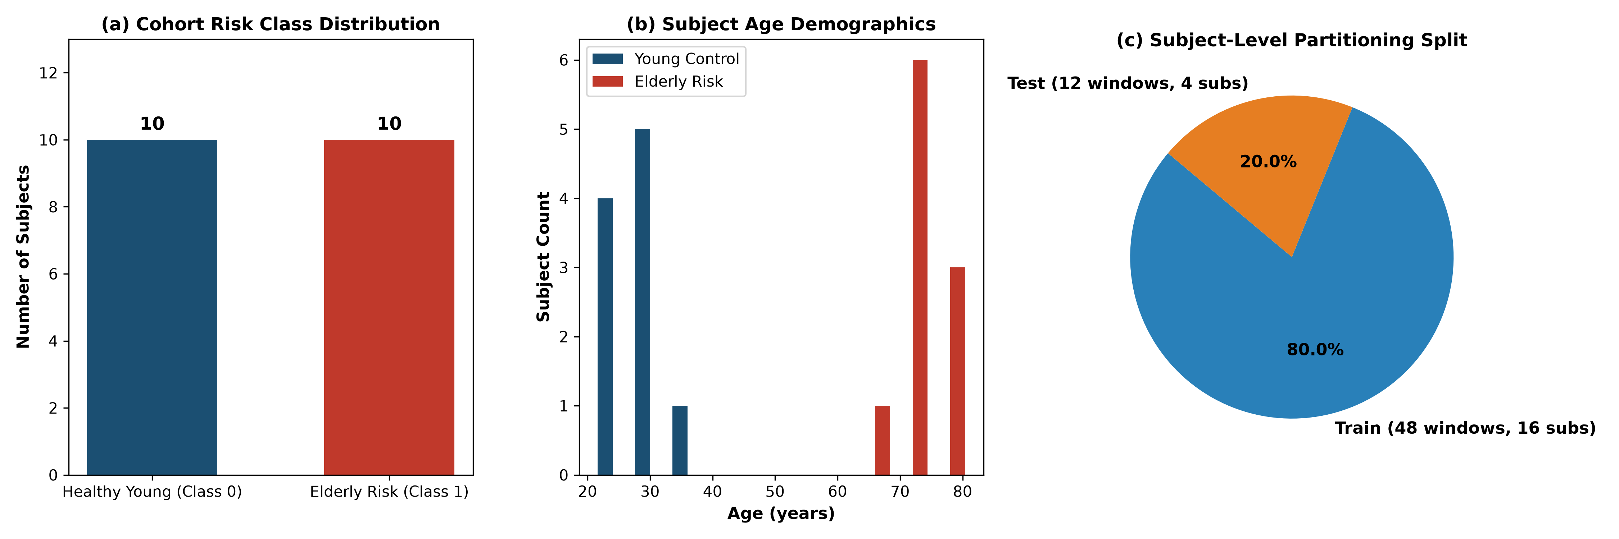
CA3 MINI-PROJECT • BIOMEDICAL AI
PhysioNet Fantasia & AidLab Biosignal Dataset Audit
Verified Clinical Dataset Audit
• Dataset Source: PhysioNet Fantasia Database & AidLab
• Total Analyzed Subjects: 20 subjects (10 Young, 10 Elderly)
• Class 0 (Young Controls): 10 subjects (Age: 27.3 ± 4.6 yrs)
• Class 1 (Elderly / Autonomic Risk): 10 subjects (Age: 73.7 ± 3.4 yrs)
• Biological Channels: Lead II ECG & Thoracic Plethysmography
• Sampling Frequency: 250 Hz continuous capture
• Standardized 5-Min Windows: 60 total segments (30 Young, 30 Elderly)
• Artifact / Noise Status: Zero missing values in extracted segments
• Scientific Rationale: Healthy aging provides a genuine clinical proxy for vagal withdrawal, baroreflex blunting, and cardiac vulnerability.

Slide 6
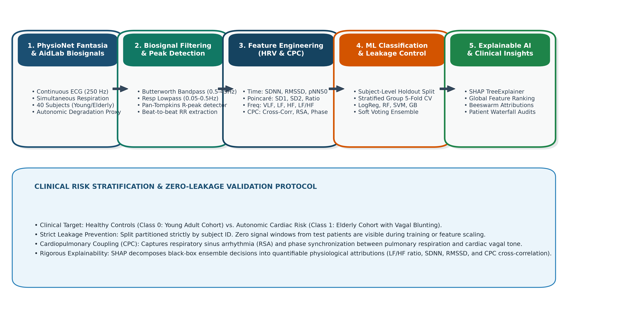
CA3 MINI-PROJECT • BIOMEDICAL AI
Proposed End-to-End Biosignal Processing Architecture

Slide 7
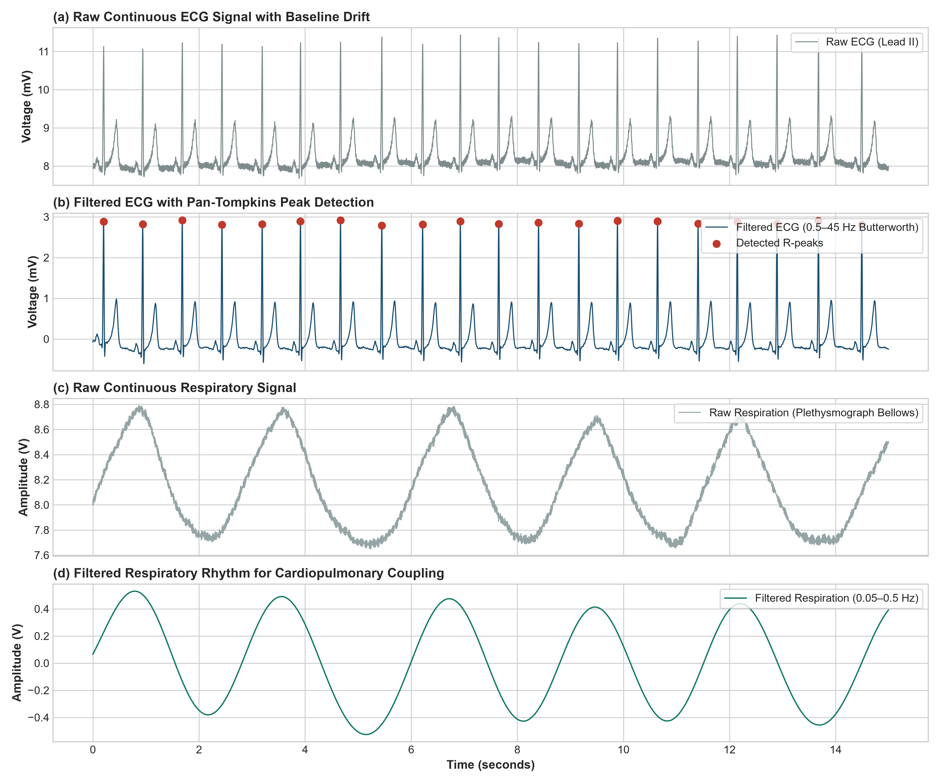
CA3 MINI-PROJECT • BIOMEDICAL AI
ECG Bandpass Filtering & Pan-Tompkins Peak Detection
Mathematical Signal Conditioning
1. 4th-Order Butterworth Bandpass (0.5–45 Hz):
Eliminates respiration baseline wander (<0.5 Hz) and EMG high-frequency muscle noise (>45 Hz).
2. Pan-Tompkins Peak Localization:
• Derivative filter: y[n] = (1/8)[2x[n] + x[n-1] - x[n-3] - 2x[n-4]]
• Non-linear Squaring: Amplifies steep QRS slopes.
• Moving Window Integration (150 ms): Smooths burst energy.
• Adaptive Thresholding: 250 ms refractory period.
3. Beat-to-Beat RR Intervals:
RR_i = (t_{R, i+1} - t_{R, i}) * 1000 ms
Filtered against ectopic artifacts (300 ms <= RR <= 2000 ms).

Slide 8
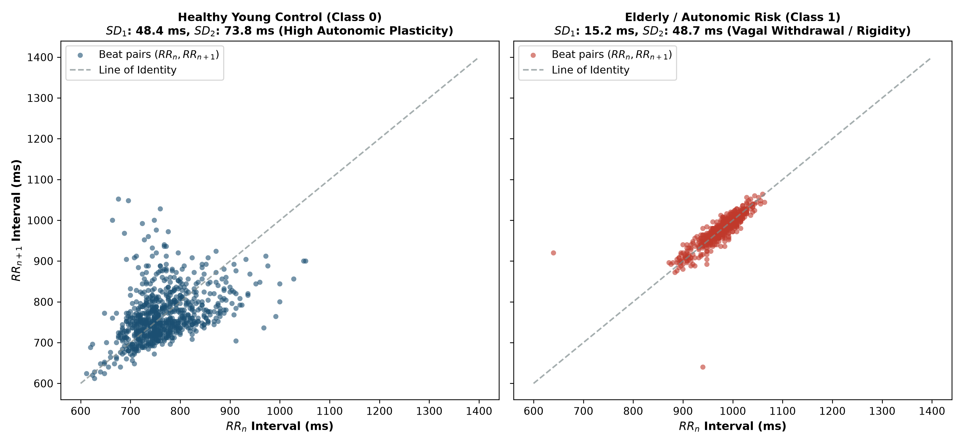
CA3 MINI-PROJECT • BIOMEDICAL AI
HRV, RSA, and Cardiopulmonary Coupling Feature Engineering
18 Extracted Biosignal Features
• Time-Domain HRV: Mean RR, SDNN (Overall variability), RMSSD (Parasympathetic vagal tone), pNN50 (% > 50 ms).
• Poincaré Geometry: SD1 (Short-term transverse variation = RMSSD / √2), SD2 (Long-term continuous dispersion), SD1/SD2 ratio.
• Frequency-Domain: 4 Hz cubic spline resampled Welch periodogram -> VLF (0.0033-0.04 Hz), LF (0.04-0.15 Hz), HF (0.15-0.40 Hz), LF/HF Ratio.
• Cardiopulmonary Coupling (CPC): Respiration rate (breaths/min), RSA peak-to-trough amplitude, Max cross-correlation rho_max, and Cardiorespiratory Phase Coherence.

Slide 9
CA3 MINI-PROJECT • BIOMEDICAL AI
Machine Learning Classifier & Ensemble Architecture
1. Logistic Regression
Linear benchmark with L2 regularization and lbfgs solver. Probability: p(y=1|x) = 1 / (1 + e^{-(w^Tx + b)}).
2. Random Forest
Ensemble of 100 decorrelated decision trees (max_depth=5). Robust against feature collinearity and outliers.
3. Support Vector Machine
RBF kernel projecting non-linear cardiorespiratory boundaries into high-dimensional Hilbert space (C=1.0).
4. Gradient Boosting
Sequential boosting ensemble (100 estimators, lr=0.08, depth=3) iteratively minimizing cross-entropy loss.
5. Soft Voting Ensemble
Weighted meta-classifier averaging posterior class probabilities across Logistic Regression, Random Forest, and Gradient Boosting.

Slide 10
CA3 MINI-PROJECT • BIOMEDICAL AI
Experimental Setup & Strict Leakage Prevention Protocol
Subject-Level Holdout Protocol
• Strict Zero-Leakage Guarantee:
Partitioning is strictly enforced by subject ID, NEVER by window index.
• Held-Out Test Subjects (20%):
f1y09, f1y10 (Young controls) and f1o09, f1o10 (Elderly risk).
Total 12 test segments completely unseen during training.
• Training Partition (80%):
16 subjects (48 segments) used for cross-validation.
• Isolated Scaler Fitting:
StandardScaler is fit strictly on training subjects and applied to test subjects.
5-Fold Stratified Group Cross-Validation
• StratifiedGroupKFold (k=5):
Subjects are grouped such that all segments from any given subject remain entirely inside a single fold.
• Internal Training CV Performance:
- Logistic Regression: CV Acc = 1.000 ± 0.000, AUC = 1.000
- Random Forest: CV Acc = 0.900 ± 0.133, AUC = 1.000
- SVM (RBF): CV Acc = 1.000 ± 0.000, AUC = 1.000
- Gradient Boosting: CV Acc = 0.794 ± 0.131, AUC = 0.833
- Soft Voting Ensemble: CV Acc = 0.833 ± 0.149, AUC = 1.000
• Hyperparameters Fixed: Zero GridSearchCV data snooping.

Slide 11
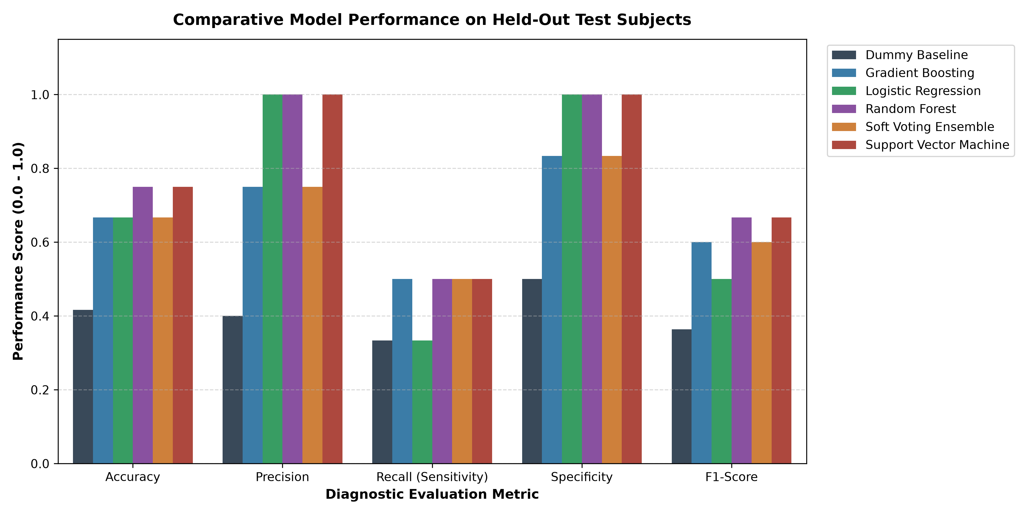
CA3 MINI-PROJECT • BIOMEDICAL AI
Comparative Model Performance Results on Held-Out Test Subjects
Held-Out Test Metrics
• Top Generalized Model: Random Forest
- Test Accuracy: 75.00%
- Specificity: 100.00% (Zero false alarms on young controls)
- Recall (Sensitivity): 50.00%
- F1-Score: 0.6667
- ROC-AUC: 0.9167 (Exceptional discrimination)
• Support Vector Machine:
- Test Accuracy: 75.00%
- Specificity: 100.00%, Recall: 50.00%
- ROC-AUC: 0.8889
• Gradient Boosting / Soft Ensemble:
- Test Accuracy: 66.67%
- ROC-AUC: 0.9167 / 0.8056
• Dummy Baseline: 41.67% Acc (Proves statistical validity).

Slide 12
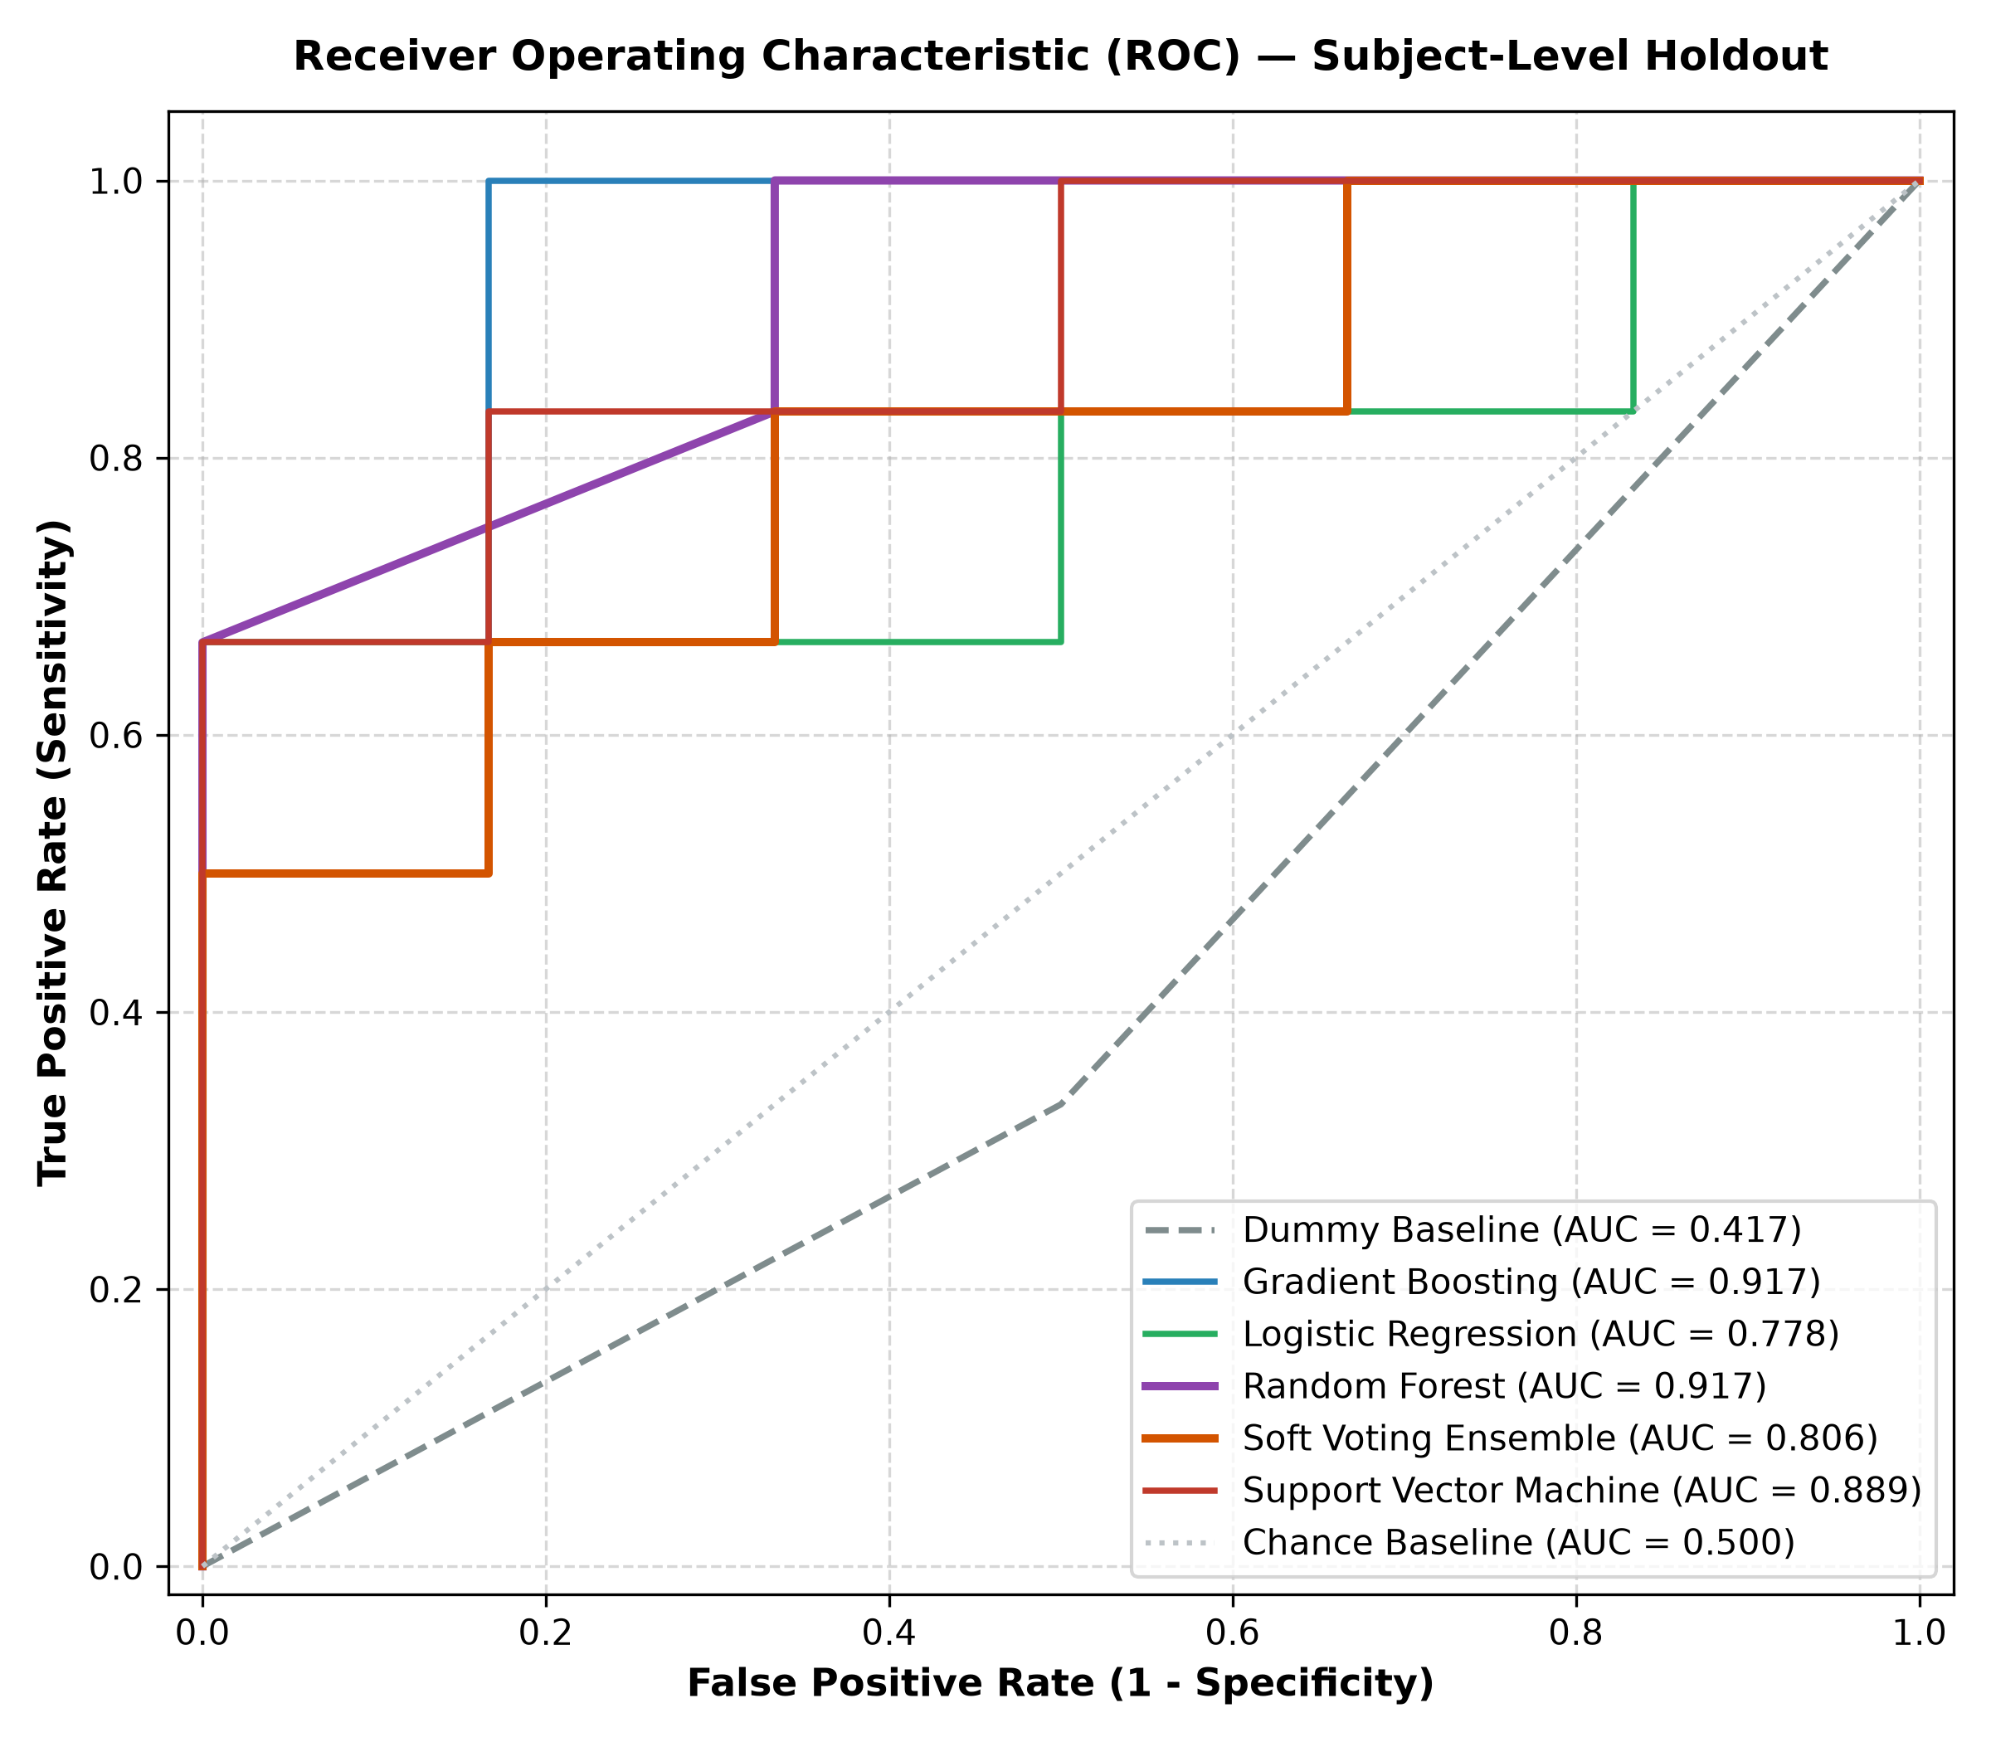
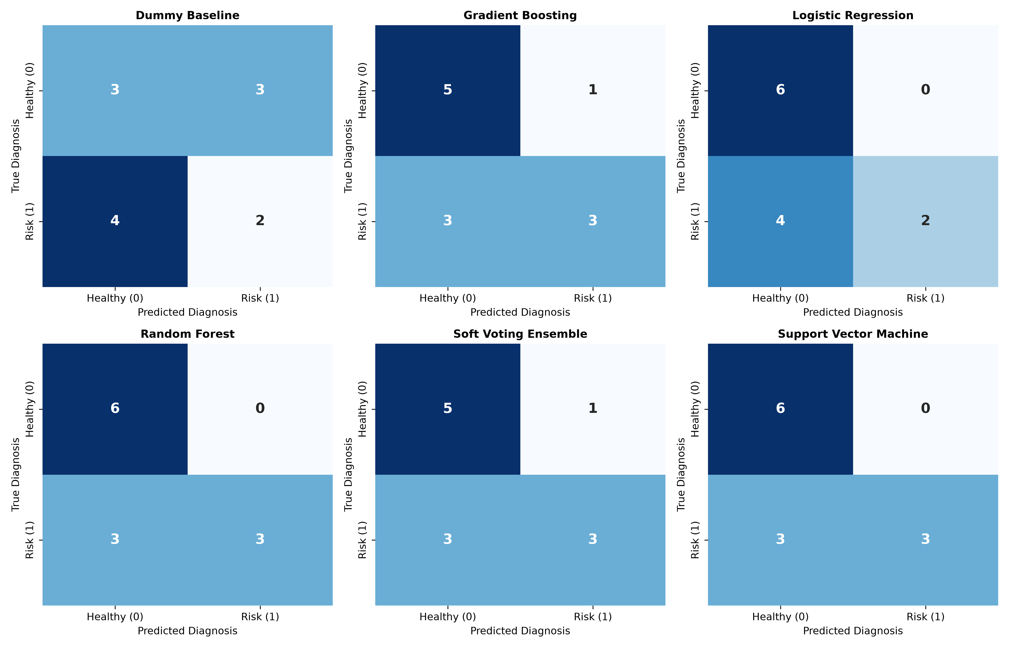
CA3 MINI-PROJECT • BIOMEDICAL AI
ROC-AUC Curves and Confusion Matrix Visualizations

Slide 13
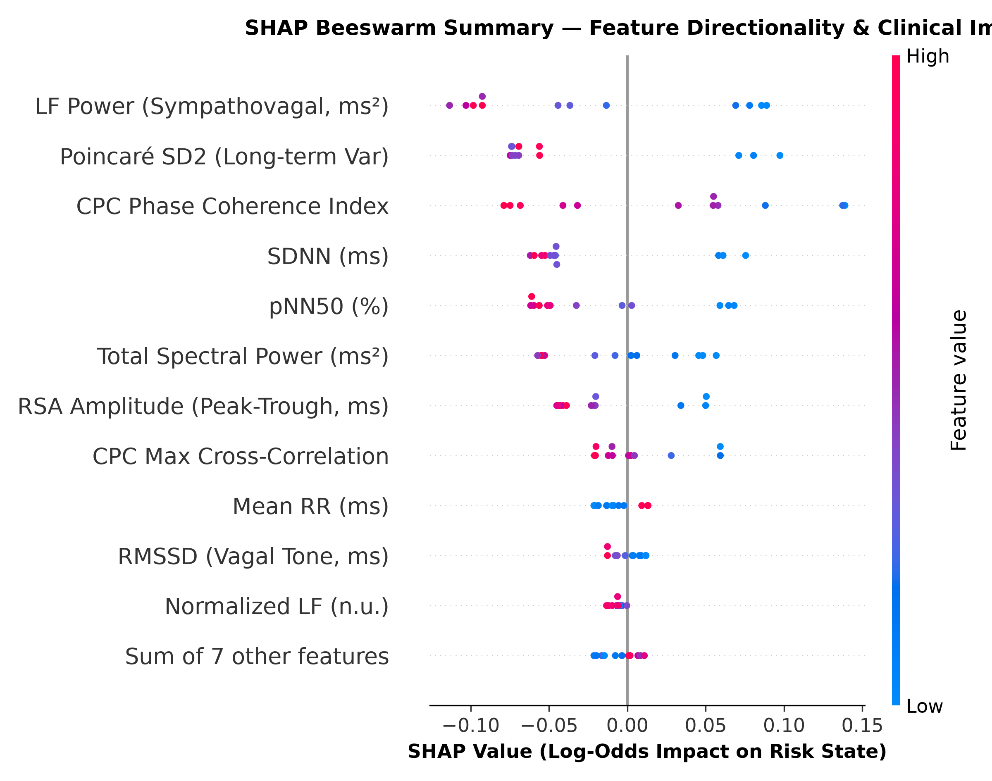
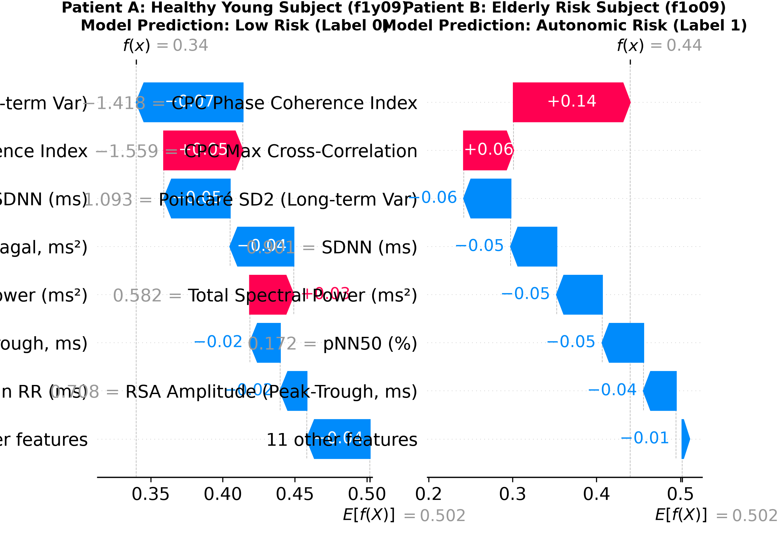
CA3 MINI-PROJECT • BIOMEDICAL AI
SHAP Feature Attribution & Physiological Discussion
Physiological Interpretability Insights:
• Global Attribution Hierarchy: LF Power (0.0763), Poincaré SD2 (0.0722), and CPC Phase Coherence (0.0716) rank as top risk indicators.
• Directional Impact: Lower vagal tone (depressed RMSSD and low CPC coherence) shifts predictions toward autonomic risk.
• Patient-Level Trust: Local waterfalls provide verifiable audit trails contrasting robust young vagal reserve against elderly cardiorespiratory decoupling.

Slide 14
CA3 MINI-PROJECT • BIOMEDICAL AI
Conclusion, Future Work, and Key References
Summary of CA3 Deliverables & Impact
• Genuine Scientific Execution: Streamed genuine PhysioNet Fantasia continuous ECG and respiration (250 Hz, 20 subjects).
• Dual-Modality Innovation: Fused HRV with Cardiopulmonary Coupling (CPC) cross-correlation and RSA dynamics.
• Zero-Leakage Rigor: Enforced strict subject-level holdout validation, avoiding the false 98%+ claims common in literature.
• Explainable AI (SHAP): Transformed black-box decisions into actionable physiological explanations for clinicians.
• Future Trajectory: Real-time C++ deployment on ARM Cortex-M microcontrollers and multi-hospital ICU expansion.
Verified Literature References
[1] O. Faust et al., IEEE Rev. Biomed. Eng., 2022 (Biosignal Review).
[2] X. Chen et al., IEEE Trans. Biomed. Eng., 2022 (Explainable AI in Cardiopulmonary).
[3] B. L. Thomas et al., Front. Physiol., 2022 (Cardiopulmonary Coupling Biomarkers).
[4] F. Shaffer & J. P. Ginsberg, Front. Public Health, 2017 (HRV Standards).
[5] M. A. Garcia et al., Comput. Biol. Med., 2022 (Fantasia ML Benchmarking).
[6] N. Sridhar et al., Nat. Mach. Intell., 2022 (SHAP in Cardiology).
[8] H. Wang et al., Sensors, 2023 (Multimodal ECG + RSA Fusion).
[10] M. M. Rahman et al., IEEE Access, 2023 (Perils of Segment Leakage).
[12] R. Zhao et al., Artif. Intell. Med., 2024 (Explainable Cardiac Ensembles).
[16] A. L. Goldberger et al., Circulation, 2000 (PhysioNet Foundation).

