Slide 1
Burglar alarm using plc
Vedant Kelkar
1912052
Etrx b-1
Vial mini-project

Slide 2
The importance of the Burglar Alarm Security System is that they facilitate a fast response by alerting the people in the vicinity as soon as it occurs.
They are used in different places like:
Industrial areas such as offices, factories and warehouses.
Residential houses.
Storage facilities, etc.

Slide 3
Here we have used two sensors, one is Window Sensor and other is Motion Detector.
Window sensor is nothing but a loop of wire that is a piece of thin metal foil which encircles the window. The motion detector is designed such that when a person is detected, the output of sensor goes true.
In the Window sensor, current is always flowing until there is a breakage in the glass of a window. Hence, the output is always true. When alarm system is active and someone tries to break the window, current does not flow through the metal coil causing output to go false.

Slide 4
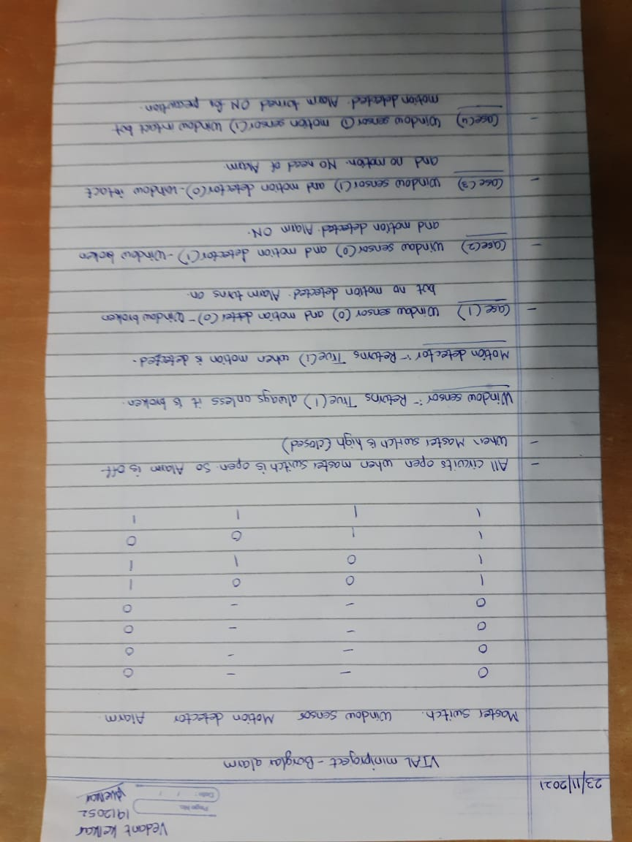
Truth Table
Simulation>>

Slide 6
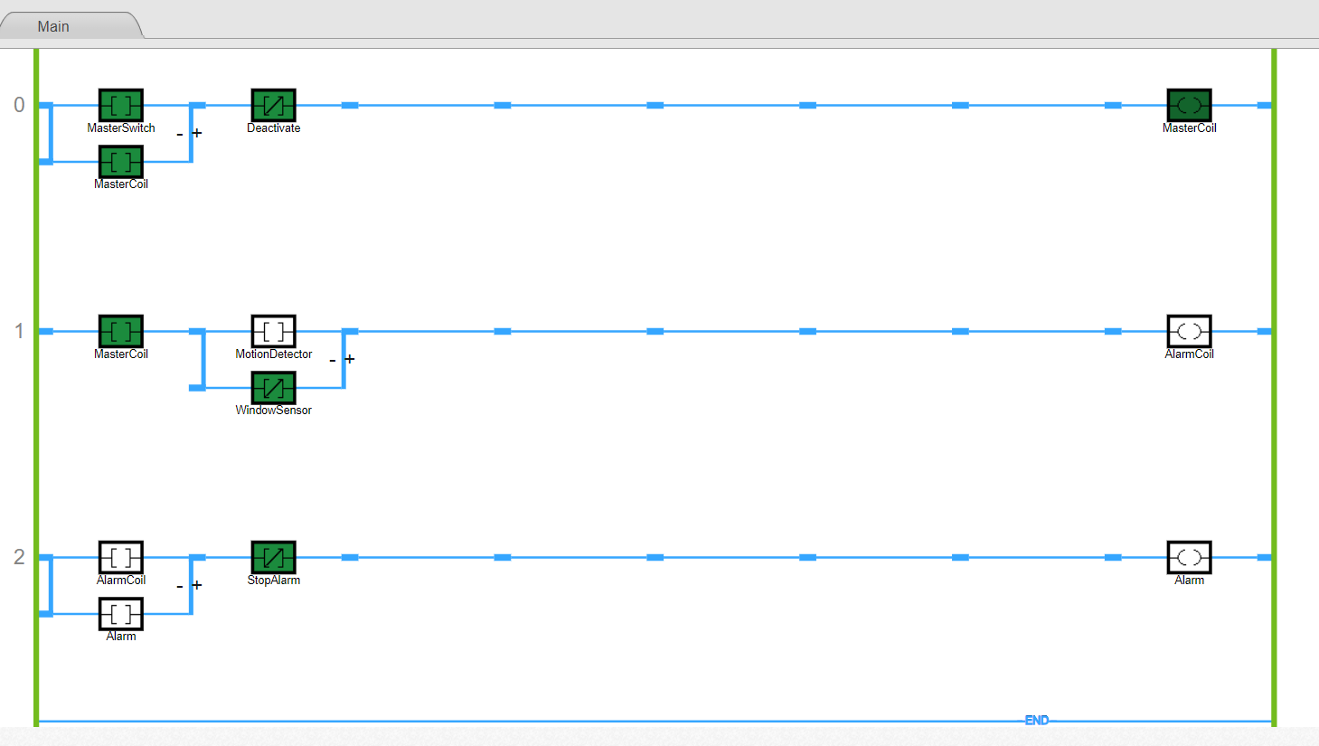
Motion Detector-> 0
Window Sensor-> 1

Slide 7
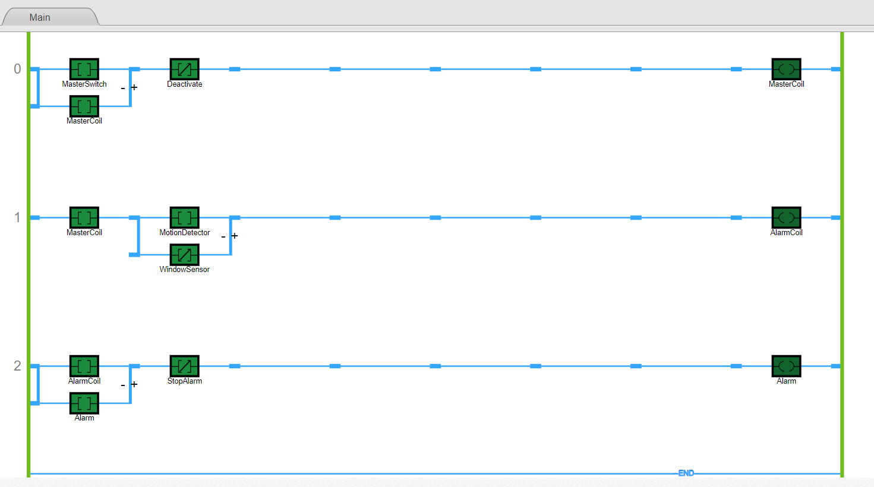
Motion Detector-> 1
Window Sensor-> 1

Slide 8
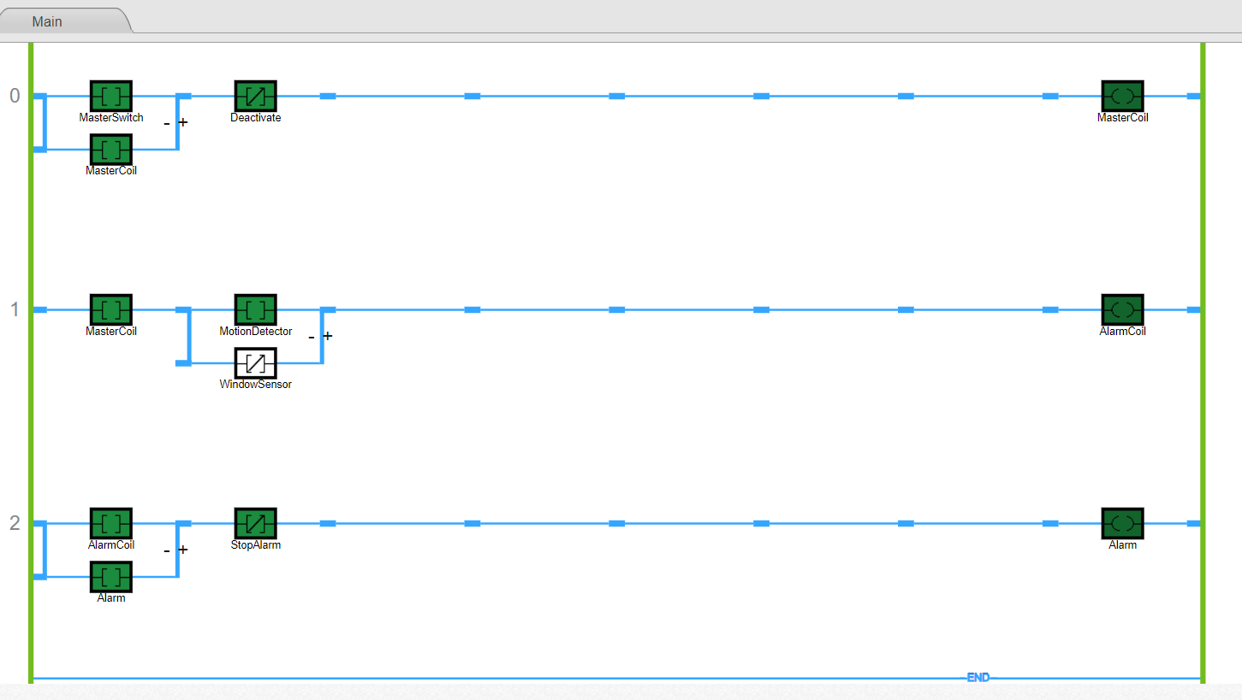
Motion Detector-> 1
Window Sensor-> 0

Slide 9
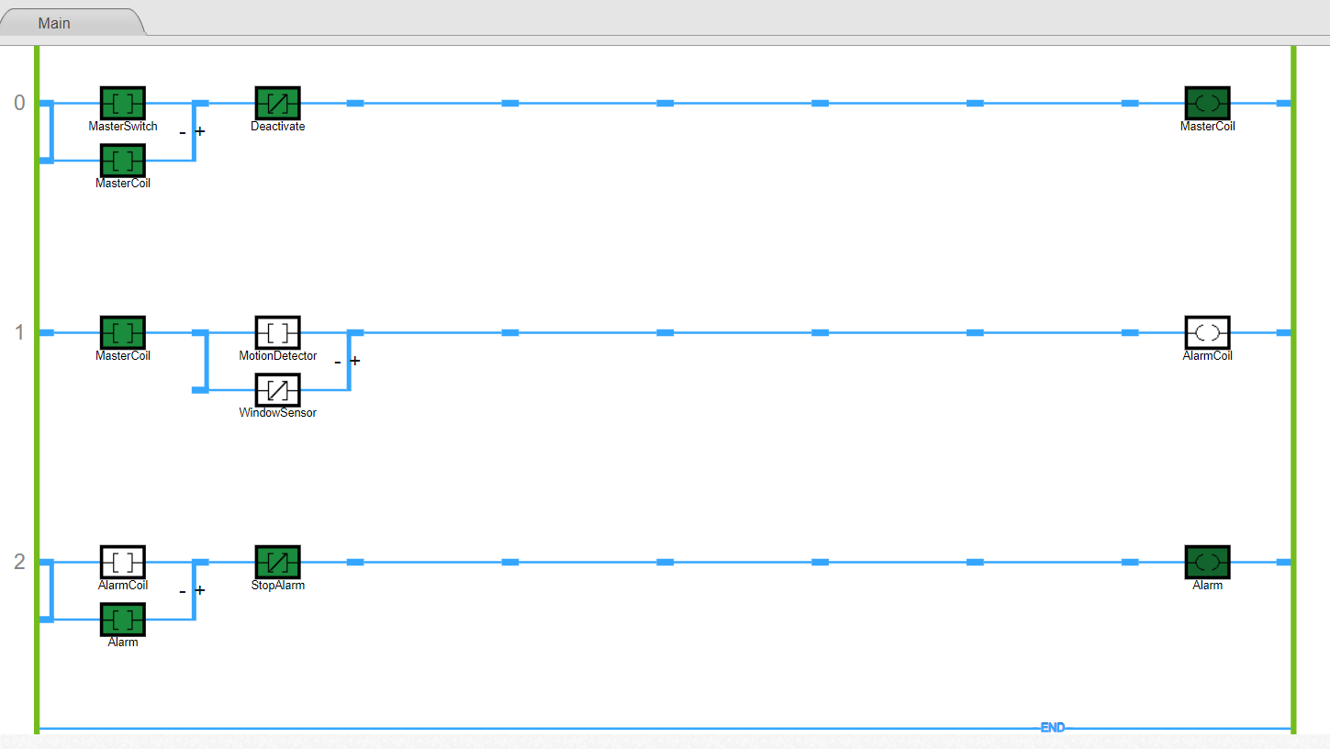
Motion Detector-> 0
Window Sensor-> 0

Slide 10
THANKYOU

