Slide 1
Section II
Storage and Querying

Slide 2
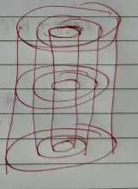
Disk
Disk , Track , Sector/Block
Track capacity=number of blocks * block size
Disk capacity= number of tracks * track capacity
Cylinder capacity= number of disks * Track capacity

Slide 3
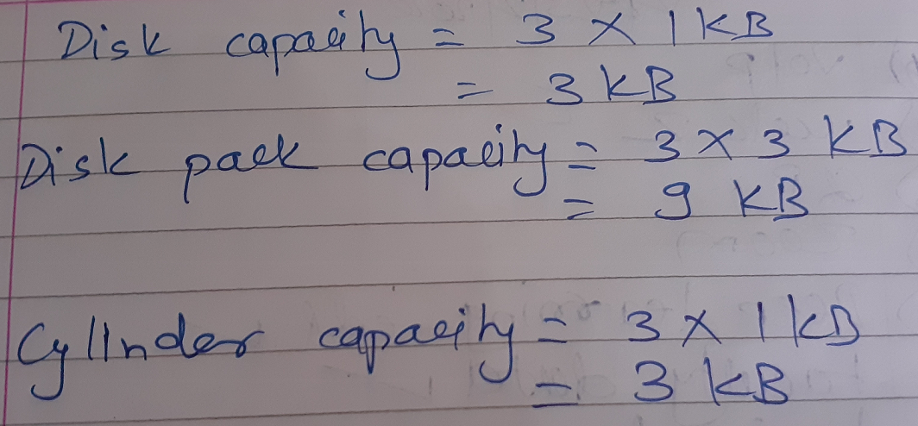
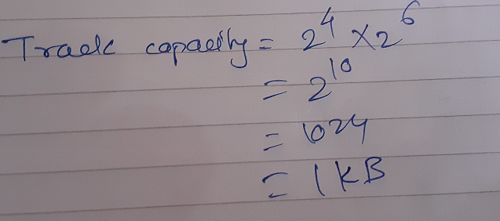
Disk Example
A disk pack with 3 single-sided disks
3 tracks with 16 sectors/blocks
Block size = 64 bytes
Track capacity=number of blocks * block size

Slide 4
Records
Data is stored in the form of records
Set of records organized into a set of files
File records stored on disk
Each record has a collection of data values
Record type or record format.
Example
1,x,Pune,9999999
2,y,Satara,888888
3,t,Akola,7777777

Slide 5
Records: Fixed and variable length
Fixed-length records: every record in the file has exactly the same size(in bytes)
Variable-length records: different records in the file have different sizes
  Field is of varying size e.g. name varchar2(20)
  Optional field (foreign key)
  Different record types(mixed file) e.g. Grade_Report may be placed following the Student’s record

Slide 6
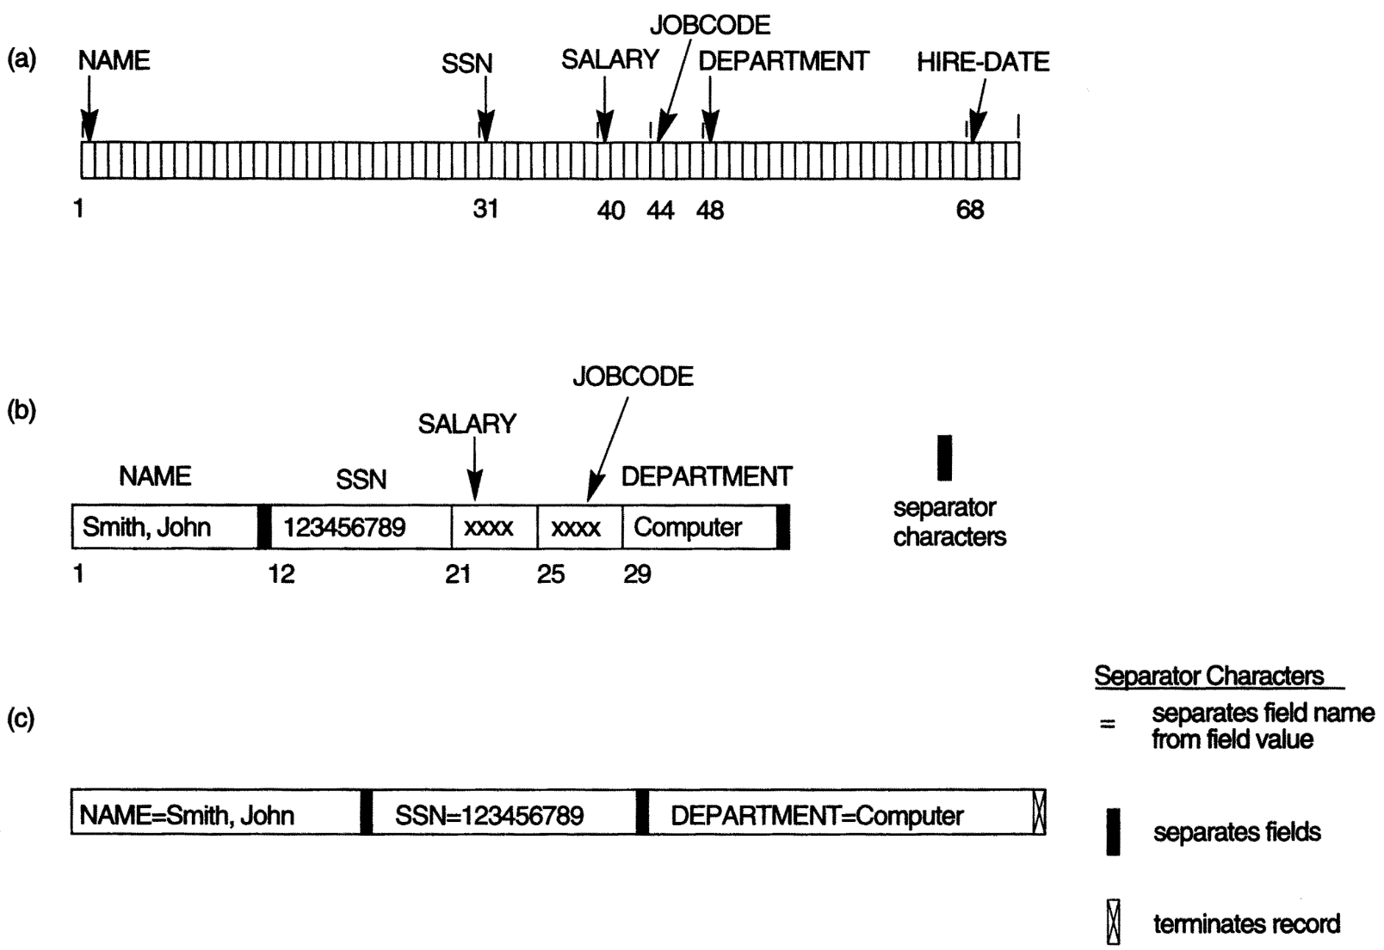
Three record storage formats.
System can identify the starting byte position of each field relative to the starting position of the record
A fixed-length record with six fields and size of 71 bytes.
To determine variable length field
A record with two variable-length fields and three fixed-length fields
A variable-field record with three types of separator characters
Optional fields : <field-name, field-value> pairs rather than just the field values

Slide 7
Blocking
Consider fixed-length record size R= 12 bytes
Block size B= 64 bytes
How many records in each block?
Number of records = 64 / 12 = 5.33 ~ 5
Unused Space in each block?
Unused Space = 64 - (12*5) = 4 bytes

Slide 8

Blocking
Blocking:
  Refers to storing a number of records in one block
Suppose block size is B bytes and fixed-length record size is R bytes then records per block are
  bfr =
bfr is Blocking factor
Unused space in each block
  B - (bfr * R) bytes

Slide 9
Blocking
How to utilize unused space ?
store part of record on one block and the rest on another
Keep pointer if not consecutive block on disk
Spanned organization of Records:
  Refers to records that exceed the size of one or more blocks and hence span a number of blocks
In Unspanned organization records are not allowed to cross block boundaries.
  Used with fixed-length records having B>R

Slide 10
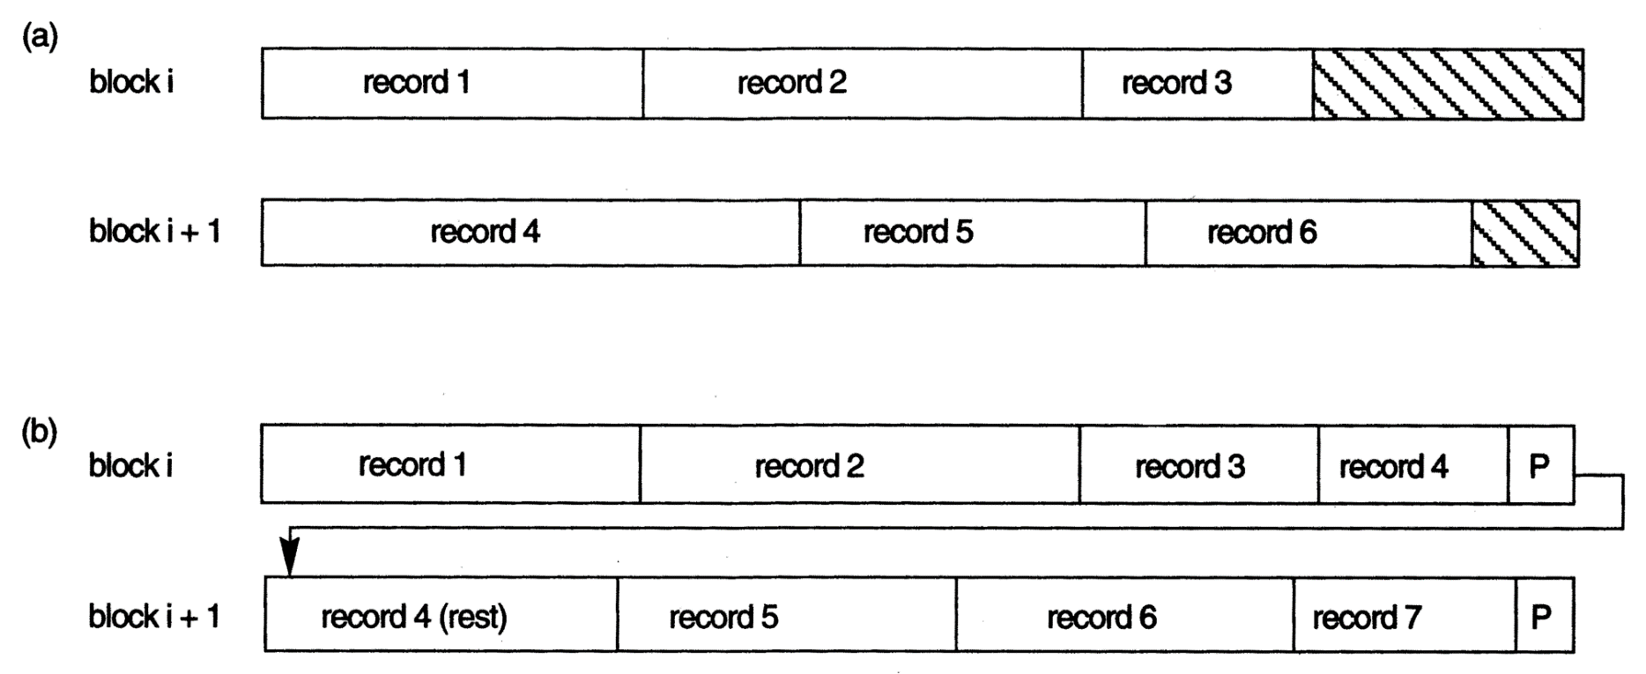
Types of record organization. (a) Unspanned. (b) Spanned.

Slide 11
Blocking
Consider fixed-length record size R= 12 bytes
Block size B= 64 bytes
How many records in each block? bfr = 5
How many blocks to store 100 records?
Number of blocks b = total number of records/ bfr
= 100/ 5 =20
Unspanned records
Number of blocks b = file size/ block size
= (100*12)/ 64 = 18.75 ~ 19
Spanned records

Slide 12

Blocking
For variable-length records using spanned organization, each block may store a different number of records
bfr represents average number of records per block
Number of blocks b for file of r records is
        b= blocks

Slide 13
Example
A file has r = 20,000 STUDENT records of fixed length. Each record has the following fields: Name (30 bytes), Ssn (9 bytes), Address (40 bytes), PHONE (10 bytes), Birth_date (8 bytes), Gender (1 byte), Major_dept_code (4 bytes), Minor_dept_code (4 bytes), Class_code (4 bytes, integer), and Degree_program (3 bytes). An additional byte is used as a deletion marker. The file is stored on the disk with block size =1024 bytes.
a. Calculate the record size R in bytes.
b. Calculate the blocking factor bfr and the number of file blocks b, assuming an unspanned organization.

Slide 14
Example
A file has r = 20,000 STUDENT records of fixed length. Each record has the following fields: Name (30 bytes), Ssn (9 bytes), Address (40 bytes), PHONE (10 bytes), Birth_date (8 bytes), gender (1 byte), Major_dept_code (4 bytes), Minor_dept_code (4 bytes), Class_code (4 bytes, integer), and Degree_program (3 bytes). An additional byte is used as a deletion marker. The file is stored on the disk with block size =1024 bytes.
a. Calculate the record size R in bytes.
R= 30+9+40+10+8+1+4+4+4+3+1 = 114 bytes
b. Calculate the blocking factor bfr and the number of file blocks b, assuming an unspanned organization.
bfr= block size/ record size = floor(B/R) =1024/114= 8
b= total records / bfr =ceil(r/bfr)= 20000/8=2500

Slide 15
Files of Records
A file is a sequence of records, where each record is a collection of data values (or data items).
A file descriptor (or file header) includes information that describes the file, such as the field names and their data types, and the addresses of the file blocks on disk.
Records are stored on disk blocks.
The blocking factor bfr for a file is the (average) number of file records stored in a disk block.
A file can have fixed-length records or variable-length records.

Slide 16
Files of Records (contd.)
File records can be unspanned or spanned
  Unspanned: no record can span two blocks
  Spanned: a record can be stored in more than one block
The physical disk blocks that are allocated to hold the records of a file can be contiguous, linked, or indexed.
In a file of fixed-length records, all records have the same format. Usually, unspanned blocking is used with such files.
Files of variable-length records require additional information to be stored in each record, such as separator characters and field types.
  Usually spanned blocking is used with such files.

