Slide 1
Section II
Storage and Querying

Slide 2
Files
A file organization
  the way records and blocks are placed on the storage medium and interlinked.
Primary file organization
  Files of Unordered Records (Heap Files)
  Files of Ordered Records (Sorted Files)
  Hash File

Slide 3
Files
An access method
  provides a group of operations can be applied to a file.
Operations on Files
  Retrieval operations
  Update operations

Slide 4
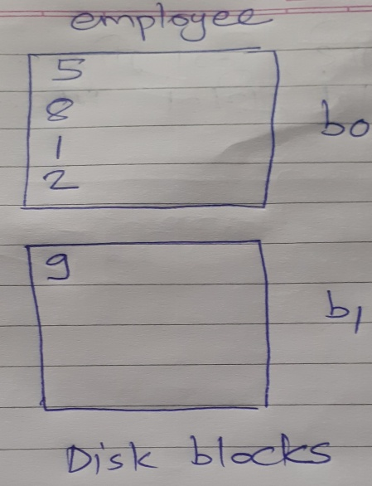
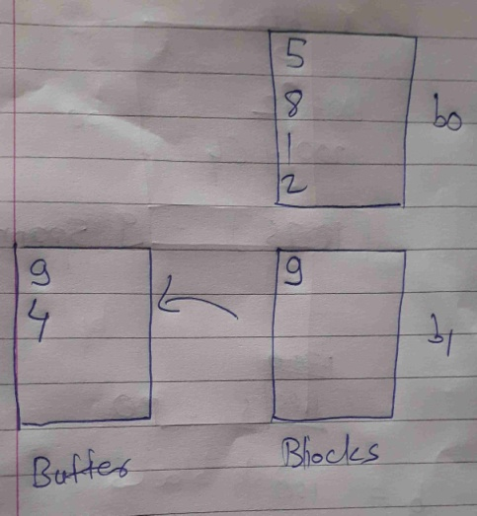
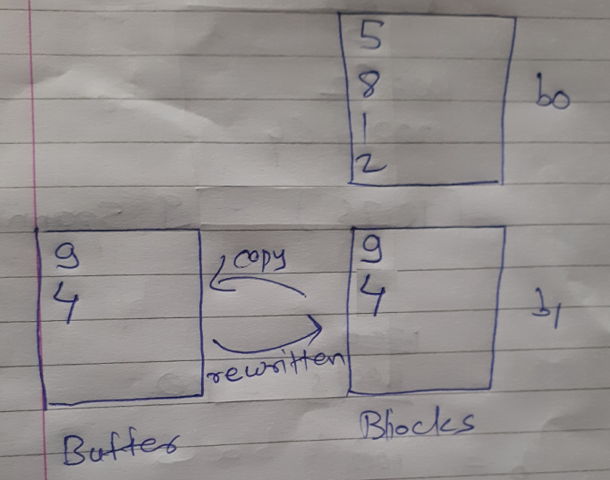
Unordered Files
Also called a heap or a pile file.
Insertion: New records at the end of the file.
  quite efficient.
  The address of the last file block is kept in file header+-
Insert new record with id 4

Slide 5
Unordered Files
Search : any search condition linear search
  If only one record satisfies the search condition
    for a file of b blocks, searching (b/2) blocks, on average
  If no records or several records satisfy the search condition
    search all b blocks in the file
  quite expensive.

Slide 6
Unordered Files
Delete:
  find its block, copy the block into a buffer
  delete the record from the buffer, and finally rewrite the block back to the disk
  leaves unused space in the disk block
  Another technique : deletion marker
  Both techniques: periodic reorganization of the file

Slide 7
Unordered Files
Spanned or unspanned organization with either fixed-length or variable-length records can be used.
Consider a file of unordered fixed-length records using unspanned blocks and contiguous allocation, access any record by its position in the file.
If the file records are numbered 0, 1, 2, ..., r − 1 and the records in each block are numbered 0, 1, ..., bfr − 1,
then the ith record of the file is located in block ⎣(i/bfr)⎦
and is the (i mod bfr)th record in that block
It is often called a relative or direct file

Slide 8
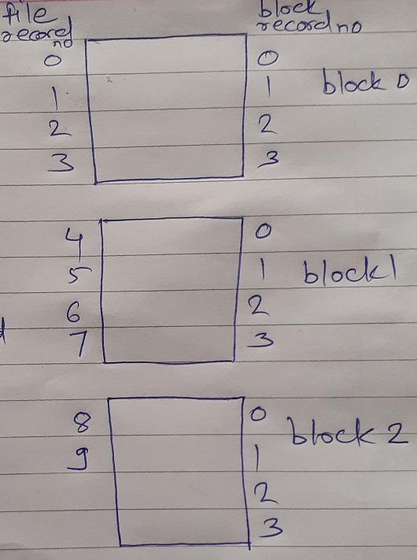
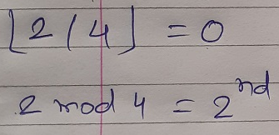
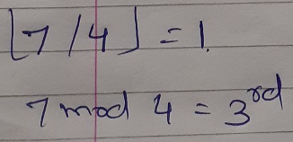
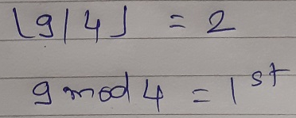
Unordered Files
block ⎣(i/bfr)⎦
(i mod bfr)th record
bfr =4

Slide 9
Ordered Files
Also called a sequential file.
File records are kept sorted by the values of an ordering field.
A binary search can be used to search for a record on its ordering field value.
  This requires reading and searching log₂ of the file blocks on the average, an improvement over linear search.
Reading the records in order of the ordering field is quite efficient.

Slide 10
Ordered Files
Insertion and deletion is expensive
To insert a record
  Find correct positon in the file, make space for new record by moving average half of the file records
  It is common to keep a separate unordered overflow (or transaction) file for new records to improve insertion efficiency; this is periodically merged with the main ordered file.
  The actual ordered file is called main or master file.
Deletion require deletion markers and periodic reorganization.

Slide 11
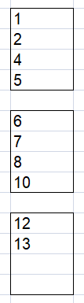
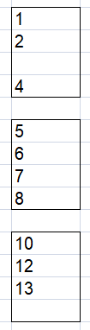
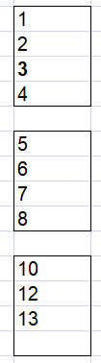
Ordered Files
To insert a record: Student file ordering field- Roll no
Insert roll no:3

Slide 12
Ordered Files
Ordered files are rarely used in database applications unless an additional access path, called a primary index, is used; this results in an indexed-sequential file.
If the ordering attribute is not a key, the file is called a
clustered file.

Slide 13
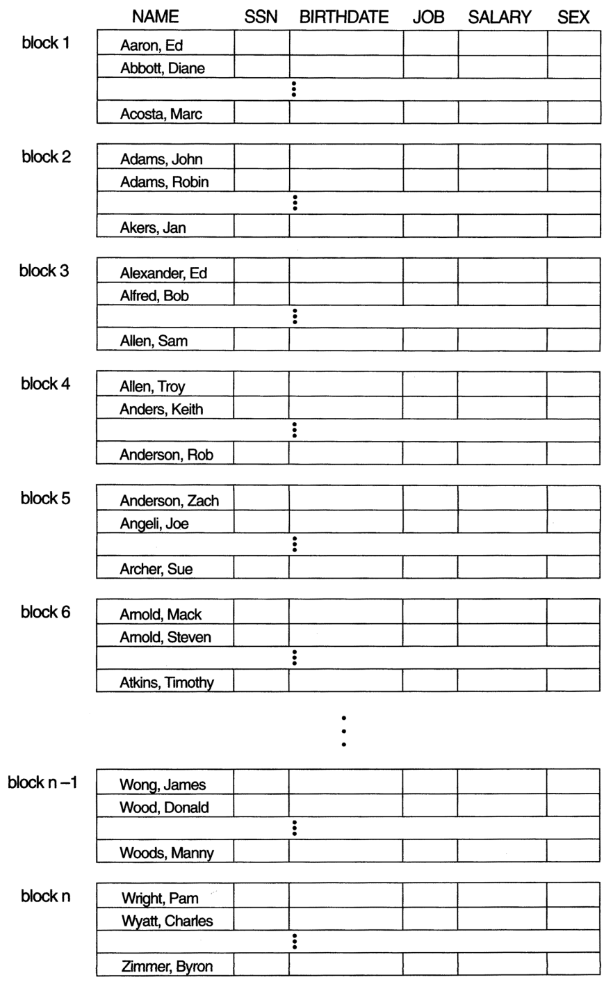
Some blocks of an ordered (sequential) file of EMPLOYEE records with NAME as the ordering key field.

Slide 14
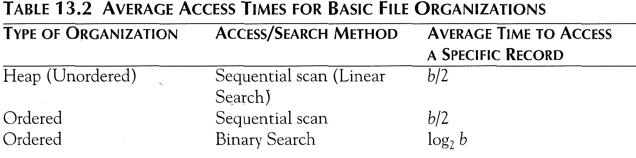
Average Access Times
The following table shows the average access time to access a specific record for a given type of file

Slide 15
Hashed Files
A hash file organization is based on hashing which provides very fast access to records
The search condition must be an equality condition on a single field, called the hash field
If the hash field is also a key field of the file, in which case it is called the hash key
A function h, called a hash function or randomizing function, is applied to the hash field value of a record and yields the address of the disk block in which the record is stored.
Search for the record within the block can be carried out in a main memory buffer, needs only a single-block access to retrieve that record.

Slide 16
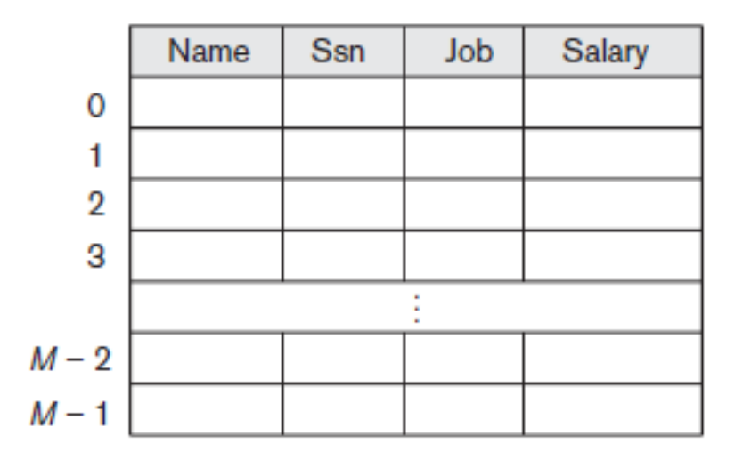
Internal Hashing
For internal files, hashing is typically implemented as a hash table through the use of an array of records
Array of M positions for use in internal hashing.
A hash function transforms the hash field value into an integer between 0 and M − 1. One common hash function is the h(K) = K mod M

Slide 17
Internal Hashing
A collision occurs when the hash field value of a record that is being inserted hashes to an address that already contains a different record.
To find another position is called collision resolution
  Open addressing: checks the subsequent empty position
  Chaining: various overflow locations, record pointer
  Multiple hashing: second hash function, open addressing or third hash function

Slide 18
Internal Hashing
There are numerous methods for collision resolution, including the following:
  Open addressing: Proceeding from the occupied position specified by the hash address, the program checks the subsequent positions in order until an unused (empty) position is found.
  Chaining: For this method, various overflow locations are kept, usually by extending the array with a number of overflow positions. In addition,
  location. A collision is resolved by placing the new record in an unused overflow location and setting the pointer of the occupied hash address location to the address of that overflow location.
  Multiple hashing: The program applies a second hash function if the first results in a collision. If another collision results, the program uses open addressing or applies a third hash function and then uses open addressing if necessary.

Slide 19
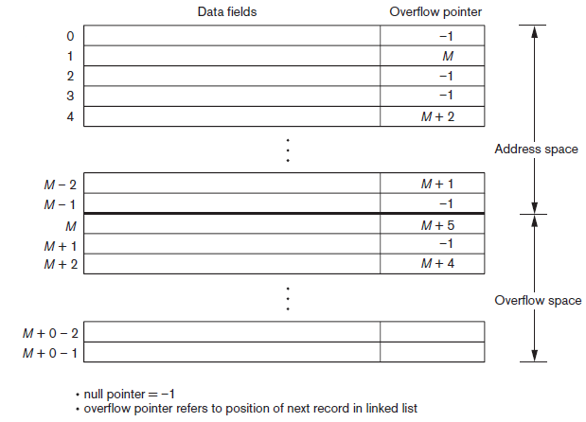
Internal Hashing
Collision resolution by chaining records

Slide 20
External Hashing for disk files
The file blocks are divided into M equal-sized buckets, numbered bucket₀, bucket₁, ..., bucket_{M-1}.
  Typically, a bucket corresponds to one (or a fixed number of) disk block.
One of the file fields is designated to be the hash key of the file.
The record with hash key value K is stored in bucket i, where i=h(K), and h is the hashing function.
A table maintained in the file header converts the bucket number into the corresponding disk block address.
Search is very efficient on the hash key.

Slide 21
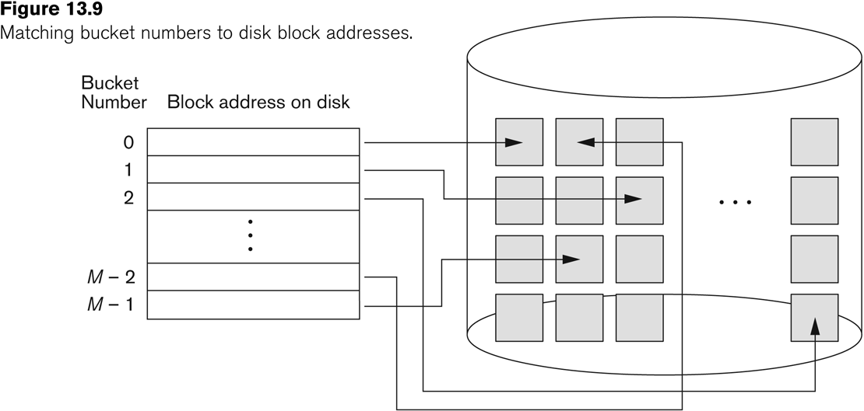
External Hashing for disk files

Slide 22
External Hashing for disk files
The collision problem is less severe with buckets, because as many records as will fit in a bucket can hash to the same bucket without causing problems.
Collisions occur when a new record hashes to a bucket that is already full.
  An overflow file is kept for storing such records.
  Overflow records that hash to each bucket can be linked together.

Slide 23
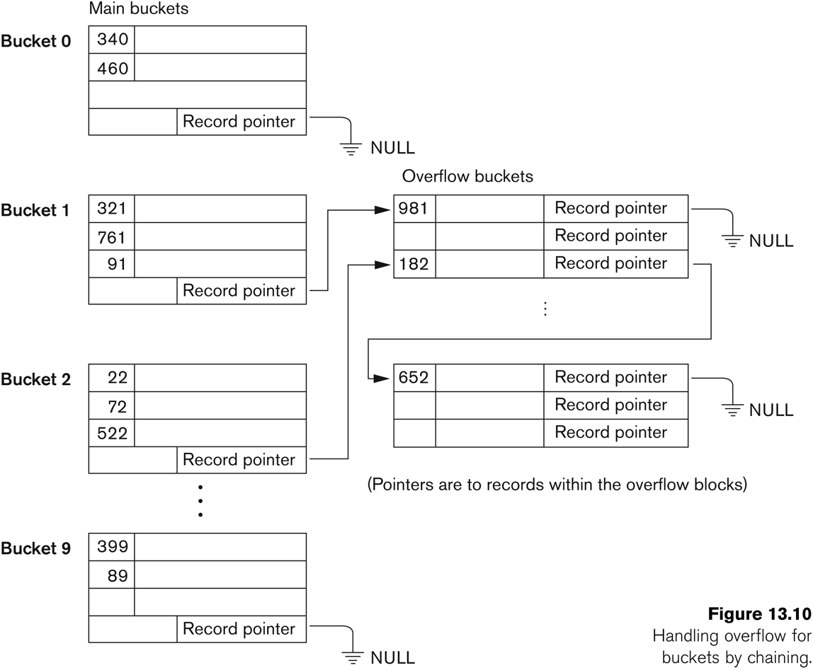
External Hashing for disk files

Slide 24
External Hashing for disk files
To reduce overflow records, a hash file is typically kept 70-80% full.
The hash function h should distribute the records uniformly among the buckets
  Otherwise, search time will be increased because many overflow records will exist.
Main disadvantages of static external hashing:
  Fixed number of buckets M is a problem if the number of records in the file grows or shrinks.
  Ordered access on the hash key is quite inefficient (requires sorting the records).

Slide 25
Hashing Techniques That Allow Dynamic File Expansion
Extendible Hashing Technique
  The directory is an array of size 2^{d} where d is called the global depth.
  The integer value corresponding to the first (high-order) d bits of a hash value is used as an index to the array to determine a directory entry, and the address in that entry determines the bucket in which the corresponding records are stored
  A local depth d’—stored with each bucket—specifies the number of bits on which the bucket contents are based.

Slide 26
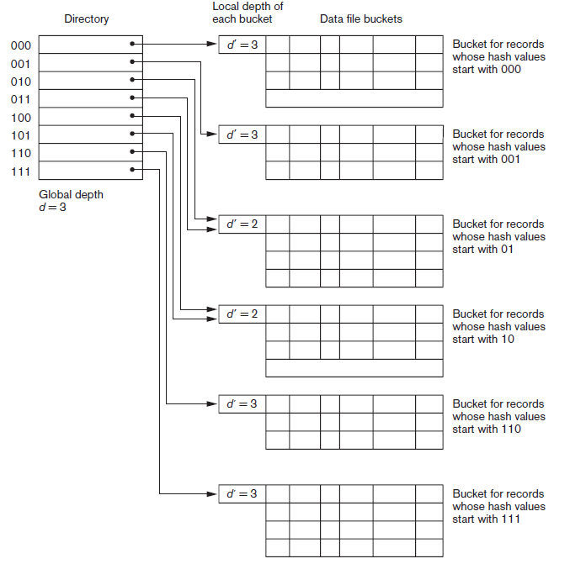
Structure of the extendible hashing scheme.

Slide 27
Hashing Techniques That Allow Dynamic File Expansion
Extendible Hashing Technique
  The value of d can be increased or decreased by one at a time, thus doubling or halving the number of entries in the directory array.
  Doubling is needed if a bucket, whose local depth d’ is equal to the global depth d, overflows.
  Halving occurs if d >d’ for all the buckets after some deletions occur.
  Most record retrievals require two block accesses—one to the directory and the other to the bucket.

Slide 28
Extendible Hashing (contd.)
The directories can be stored on disk, and they expand or shrink dynamically.
  Directory entries point to the disk blocks that contain the stored records.
An insertion in a disk block that is full causes the block to split into two blocks and the records are redistributed among the two blocks.
  The directory is updated appropriately.
  E.g 01 and 111
Extendible hashing do not require an overflow area.
Linear hashing does require an overflow area but does not use a directory.
  Blocks are split in linear order as the file expands.

Slide 29
Linear Hashing
Suppose that the file starts with M buckets numbered 0, 1, ..., M − 1 and uses the mod hash function h(K) = K mod M; this hash function is called the initial hash function h_{i}.
Overflow because of collisions is still needed and can be handled by maintaining individual overflow chains for each bucket.
However, when a collision leads to an overflow record in any file bucket, the first bucket in the file—bucket 0—is split into two buckets: the original bucket 0 and a new bucket M at the end of the file.
The records originally in bucket 0 are distributed between the two buckets based on a different hashing function h_{i+1}(K)== K mod 2M

Slide 30
Linear Hashing
As further collisions lead to overflow records, additional buckets are split in the linear order 1, 2, 3, ....
If enough overflows occur, all the original file buckets 0, 1, ...,M− 1 will have been split, so the file now has 2M instead of M buckets, and all buckets use the hash function h_{i+1}.
Hence, the records in overflow are eventually redistributed into regular buckets, using the function h_{i+1} via a delayed split of their buckets.

Slide 31
Linear Hashing
To retrieve a record with hash key value K, first apply the function h_{i} to K;
  if h_{i(}K) < n, then apply the function h_{i+1} on K because the bucket is already split.
  n—initially set to 0 and is Incremented by 1 whenever a split occurs—is needed to determine which buckets have been split
When n =M after being incremented, this signifies that all the original buckets have been split and the hash function hi+1 applies to all records in the file.
At this point, n is reset to 0 (zero), and any new collisions that cause overflow lead to the use of a new hashing function hi+2(K) = K mod 4M.

Slide 32
Linear Hashing
Splitting can be controlled by monitoring the file load factor instead of by splitting whenever an overflow occurs
In general, the file load factor l can be defined as
l =r/(bfr * N),
where r is the current number of file records,
bfr is the maximum number of records that can fit in a
bucket
N is the current number of file buckets.
Buckets that have been split can also be recombined if the load factor of the file falls below a certain threshold. Blocks are combined linearly, and N is decremented appropriately.

Slide 33
Linear Hashing
The file load can be used to trigger both splits and combinations; in this manner the file load can be kept within a desired range.
Splits can be triggered when the load exceeds a certain threshold—say, 0.9—and combinations can be triggered when the load falls below another threshold—say, 0.7.
The main advantages of linear hashing are that it maintains the load factor fairly constantly while the file grows and shrinks, and it does not require a directory

