Slide 1
Section II
Storage and Querying

Slide 2
Indexing Structures for Files

Slide 3
Indexes
additional auxiliary access structures
used to speed up the retrieval of records in response to certain search conditions.
The index structures are additional files on disk that provide secondary access paths
provide alternative ways to access the records without affecting the physical placement of records in the primary data file on disk

Slide 4
Types of Single-level Ordered Indexes
  Primary Indexes
  Clustering Indexes
  Secondary Indexes
Multilevel Indexes(ISAM)
Dynamic Multilevel Indexes Using B-Trees and B+-Trees

Slide 5
Indexes as Access Paths
The index is usually specified on one field of the file (although it could be specified on several fields)
One form of an index is a file of entries <field value, pointer to record>, which is ordered by field value
The index is called an access path on the field.
Field value | pointer to record

Slide 6
Indexes as Access Paths (contd.)
The index file usually occupies considerably less disk blocks than the data file because its entries are much smaller
A binary search on the index yields a pointer to the file record
Indexes can also be characterized as dense or sparse
  A dense index has an index entry for every search key value (and hence every record) in the data file.
  A sparse (or nondense) index, on the other hand, has index entries for only some of the search values

Slide 7
Types of Single-Level Indexes
Primary Index
  Defined on an ordered data file
  The data file is ordered on a key field
1
2
4
5
6
7
8
9
12
13
15
Block anchor
index entry | pointer to a disk block
1
6
12
Sparse index
Index file disk block
total number of entries in the index file =
the number of disk blocks in the ordered data file
Data file disk blocks

Slide 8
Types of Single-Level Indexes
Primary Index
  Defined on an ordered data file
  The data file is ordered on a key field
  Includes one index entry for each block in the data file; the index entry has the key field value for the first record in the block, which is called the block anchor
  A similar scheme can use the last record in a block.
  A primary index is a nondense (sparse) index, since it includes an entry for each disk block of the data file and the keys of its anchor record rather than for every search value.
  The problem of insertion and deletion is compounded.

Slide 9
1
2
4
5
6
7
8
9
12
13
15
index entry | pointer to a disk block
1
6
12
Insert record with id 3
Index file disk block
1
2
3
4
5
6
7
8
9
12
13
15
index entry | pointer to a disk block
1
5
9
Index file disk block
Data file disk blocks

Slide 10
Types of Single-Level Indexes
Primary Index
A record whose primary key value is K lies in the block whose address is P(i), where K(i) ≤ K < K(i + 1).
To retrieve a record, given the value K of its primary key field,
  find the appropriate index entry i
  retrieve the data file block whose address is P(i).
1
2
4
5
6
7
8
9
12
13
15
index entry K(i) | pointer to a disk block P(i)
1
6
12
Search K=8
6<8<12

Slide 11
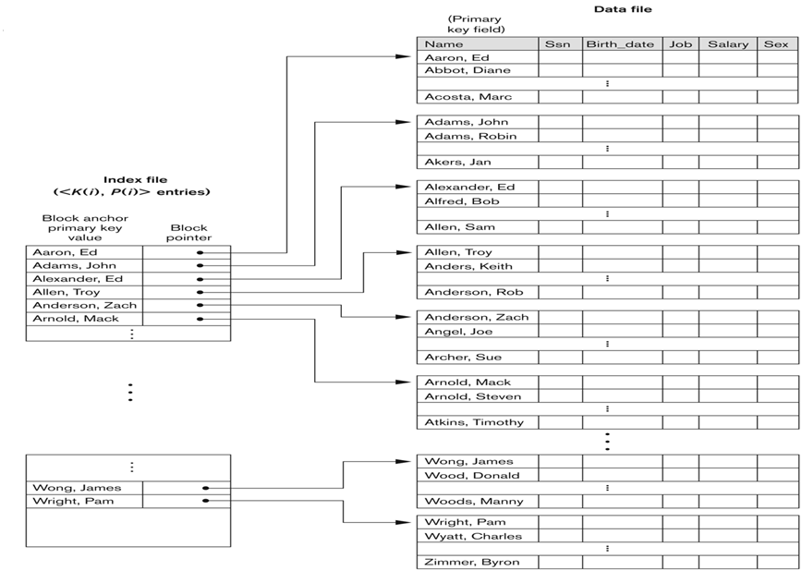
Primary index on the ordering key field

Slide 12
Suppose that we have an ordered file with r = 300,000 records stored on a disk with block size B = 4,096 bytes( 4k standard ). File records are of fixed size and are unspanned, with record length R = 100 bytes
blocking factor
The number of blocks b = ⎡(r/bfr)⎤ = ⎡(300,000/40)⎤ = 7,500 blocks
A binary search on the data file would need approximately ⎡log2 b⎤= ⎡(log2 7,500)⎤ = 13 block accesses
Suppose that the ordering key field of the file is V = 9 bytes long, a block pointer
is P = 6 bytes long, and a primary index is constructed for the file.
The size of each index entry Ri = (9 + 6) = 15 bytes
blocking factor for the index bfri = ⎣(B/Ri)⎦ = ⎣(4,096/15)⎦ = 273 entries per block.
The total number of index entries ri = the number of blocks in the data file=7,500
The number of index blocks bi = ⎡(ri/bfri)⎤ = ⎡(7,500/273)⎤ = 28 blocks
binary search on the index file would need ⎡(log2 bi)⎤ = ⎡(log2 28)⎤ = 5 block accesses.
To search for a record using the index, one additional block access to the data file for a total of 5 + 1 = 6 block accesses
—an improvement over binary search on the data file, which required 13 disk block accesses.
Index file size = 112.5 Kbytes(7500*15) would typically be kept in main memory

Slide 13
Types of Single-Level Indexes
Clustering Index
  Defined on an ordered data file
  The data file is ordered on a non-key field.
  Includes one index entry for each distinct value of the field; the index entry points to the first data block that contains records with that field value.
  It is another example of nondense index where Insertion and Deletion is relatively straightforward with a clustering index.

Slide 14
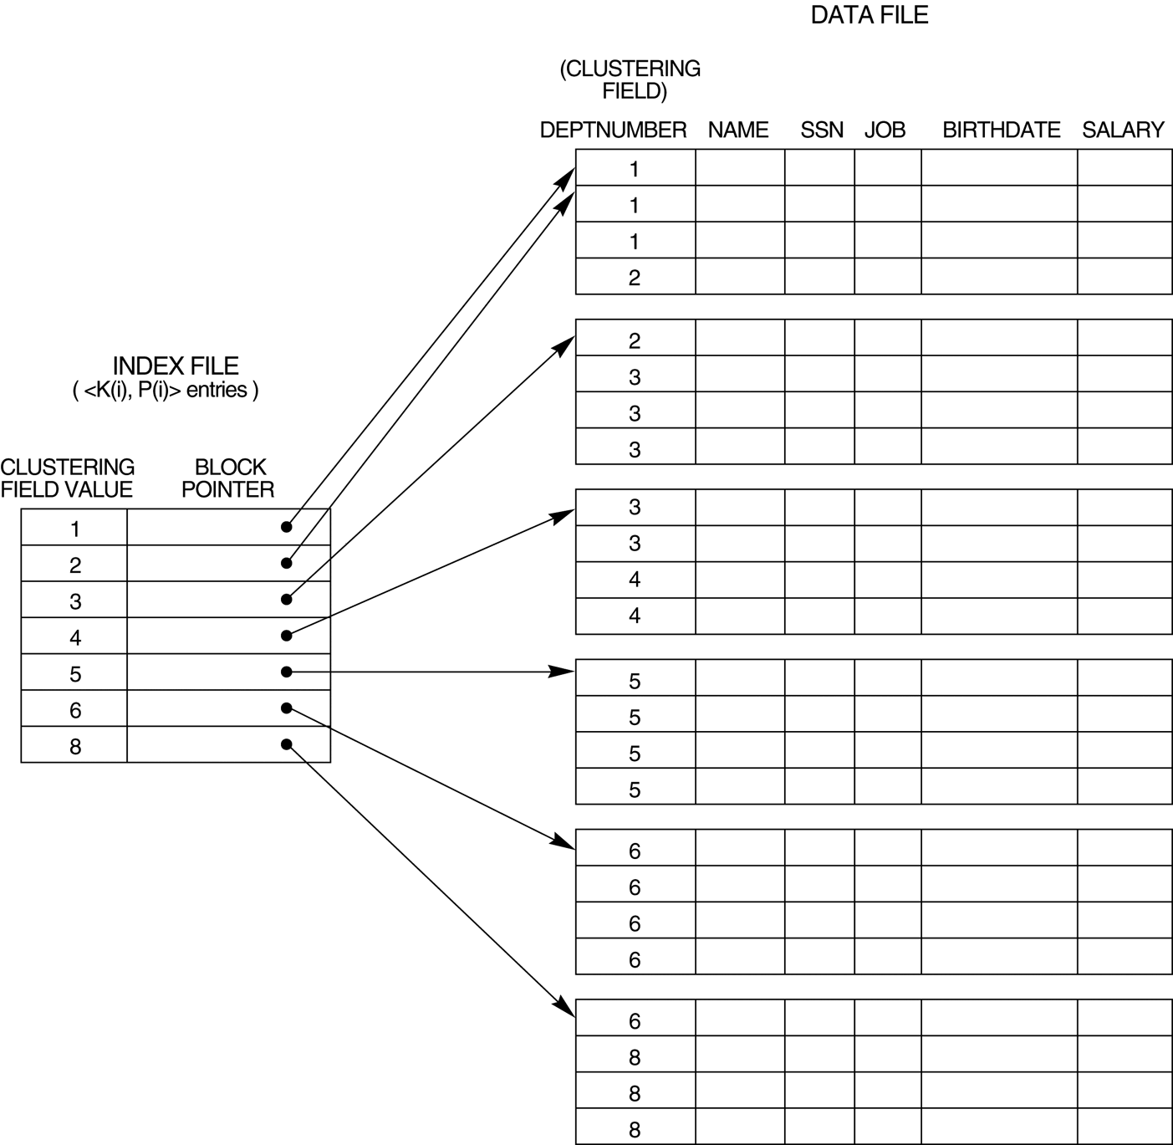
A Clustering Index Example
A clustering index on the Dept_number
ordering nonkey field of an EMPLOYEE file.

Slide 15
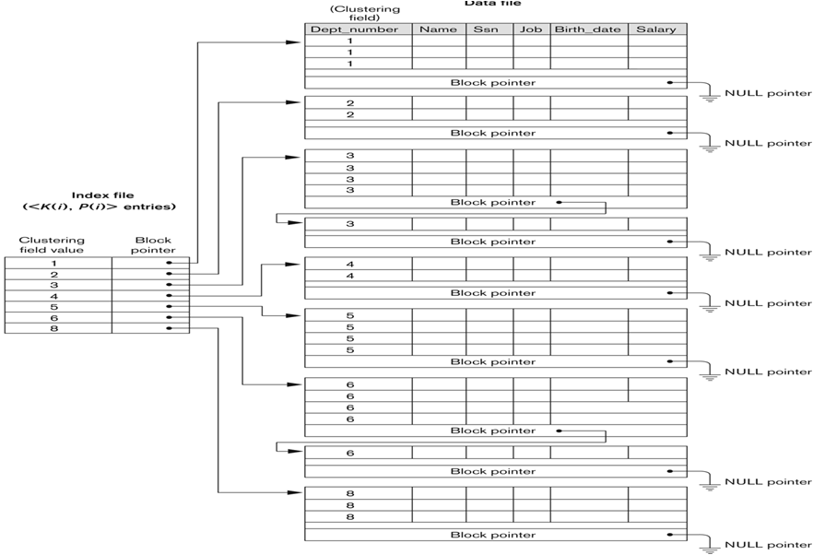
Another Clustering Index Example( reserve a whole block for each value of the clustering field to make insertion and deletion relatively straightfroward)

Slide 16
Example
Consider ordered file with r = 300,000 records stored on a disk with block size B = 4,096 bytes.
File is ordered by the attribute Zipcode and there are 1,000 zip codes in the file (with an average 300 records per zip code, assuming even distribution across zip codes.)
The index has 1,000 index entries of 11 bytes each (5-byte Zipcode and 6-byte block pointer)
blocking factor bfri = ⎣(B/Ri)⎦ = ⎣(4,096/11)⎦ = 372 index entries per block.
The number of index blocks bi = ⎡(ri/bfri)⎤ = ⎡(1,000/372)⎤ = 3 blocks.
binary search on the index file would need ⎡(log2 bi)⎤ = ⎡(log2 3)⎤ = 2 block accesses.
This index would typically be loaded in main memory (occupies 11,000 or 11 Kbytes)
One block access to the data file would lead to the first record with a given zip code.

Slide 17
Types of Single-Level Indexes
Secondary Index
  A secondary index provides a secondary means of accessing a file for which some primary access already exists.
  The secondary index may be on a field which is a candidate key and has a unique value in every record, or a non-key with duplicate values.
  The index is an ordered file with two fields.
    The first field is of the same data type as some non-ordering field of the data file that is an indexing field.
    The second field is either a block pointer or a record pointer.
    There can be many secondary indexes (and hence, indexing fields) for the same file.
  Includes one entry for each record in the data file; hence, it is a dense index

Slide 18
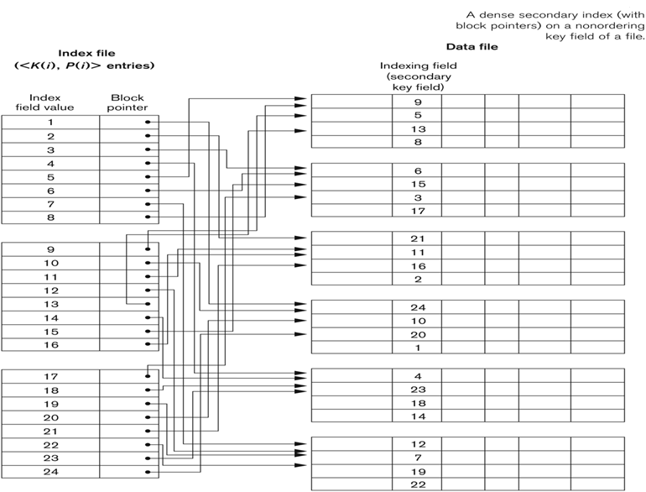
Example of a Dense Secondary Index

Slide 19
Secondary Index
the records of the data file are not physically ordered by values of the secondary key field, cannot use block anchors.
an index entry is created for each record in the data file, rather than for each block
A secondary index usually needs more storage space and longer search time than does a primary index, because of its larger number of entries
the improvement in search time for an arbitrary record is much greater for a secondary index (linear search on the data file if the secondary index did not exist)

Slide 20
Secondary Index
To create a secondary index on a nonkey, nonordering field of a file.
In this case, numerous records in the data file can have the same value for the indexing field.
There are several options for implementing such an index:
  To include duplicate index entries with the same K(i) value—one for each record-dense index
 |  | 20
 |  | 30
 |  | 20
 |  | 10
 |  | 10
 |  | 40
 |  | 20
 |  | 20
 |  | 50
 |  | 30
10
10
20
20
20
20
30
30
40
50

Slide 21
Secondary Index
  2. To have variable-length records for the index entries, with a repeating field for the pointer. We keep a list of pointers <P(i, 1), ..., P(i, k)> in the index entry for K(i)—one pointer to each block that contains a record whose indexing field value equals K(i).
10
20
30
40
50
 |  | 20
 |  | 30
 |  | 20
 |  | 10
 |  | 10
 |  | 40
 |  | 20
 |  | 20
 |  | 50
 |  | 30
Sparse index

Slide 22
Secondary Index
  To keep the index entries themselves at a fixed length and have a single entry for each index field value,
  but to create an extra level of indirection to handle the multiple pointers.
  In this nondense scheme, the pointer P(i) in index entry <K(i), P(i)> points to a disk block, which contains a set of record pointers;
  each record pointer in that disk block points to one of the data file records with value K(i) for the indexing field.

Slide 23
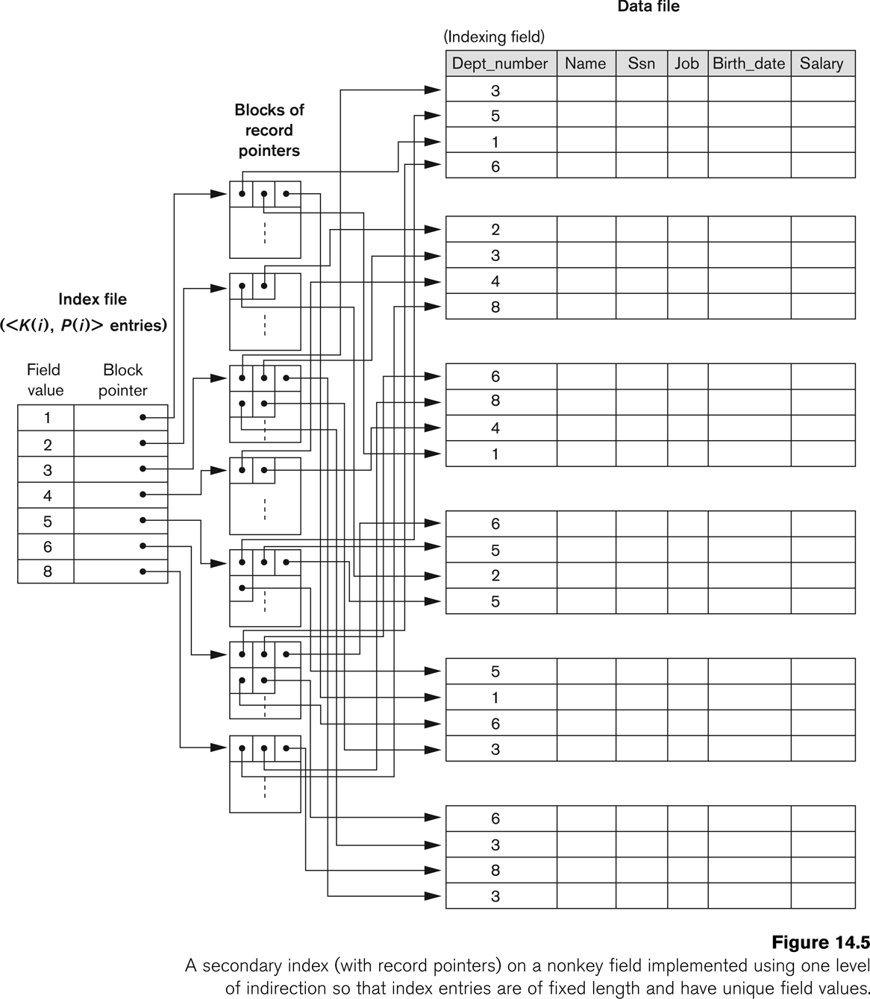
An Example of a Secondary Index

Slide 24
Consider the file of with r = 300,000, fixed-length records of size R =
100 bytes stored on a disk with block size B = 4,096 bytes. The file has b =
7,500 blocks.
Suppose we want to search for a record with a specific value for the secondary key—a nonordering key field of the file that is V = 9 bytes long.
Without the secondary index, to do a linear search on the file would require b/2 = 7,500/2 = 3,750 block accesses on the average.
Suppose that we construct a secondary index on that nonordering key field of the file.
A block pointer is P = 6 bytes long, so each index entry is Ri = (9 + 6) = 15 bytes
The blocking factor for the index is bfri = ⎣(B/Ri)⎦ = ⎣(4,096/15)⎦ = 273 index entries per block.
In a dense secondary index such as this, the total number of index entries ri is equal to the number of records in the data file, which is 300,000.
The number of blocks needed for the index is hence bi = ⎡(ri/bfri)⎤ = ⎡(300,000/273)⎤ = 1,099 blocks.
A binary search on this secondary index needs ⎡(log2 bi)⎤ = ⎡(log21,099)⎤ = 11 block accesses.
To search for a record using the index, we need an additional block access to the data file for a total of 11 + 1 = 12 block accesses
—a vast improvement over the 3,750 block accesses needed on the average for a linear search

Slide 25
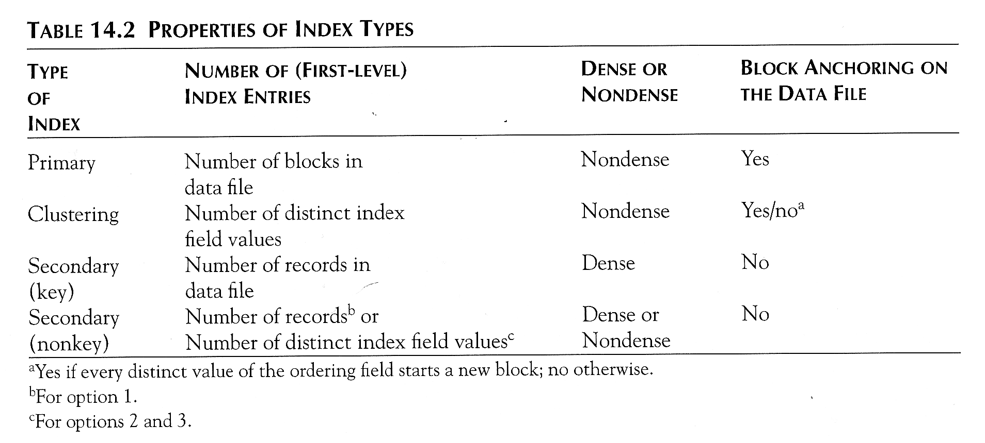
Properties of Index Types

Slide 26
Multi-Level Indexes
Because a single-level index is an ordered file, we can create a primary index to the index itself;
  In this case, the original index file is called the first-level index and the index to the index is called the second-level index.
We can repeat the process, creating a third, fourth, ..., top level until all entries of the top level fit in one disk block
A multi-level index can be created for any type of first-level index (primary, secondary, clustering) as long as the first-level index consists of more than one disk block

Slide 27
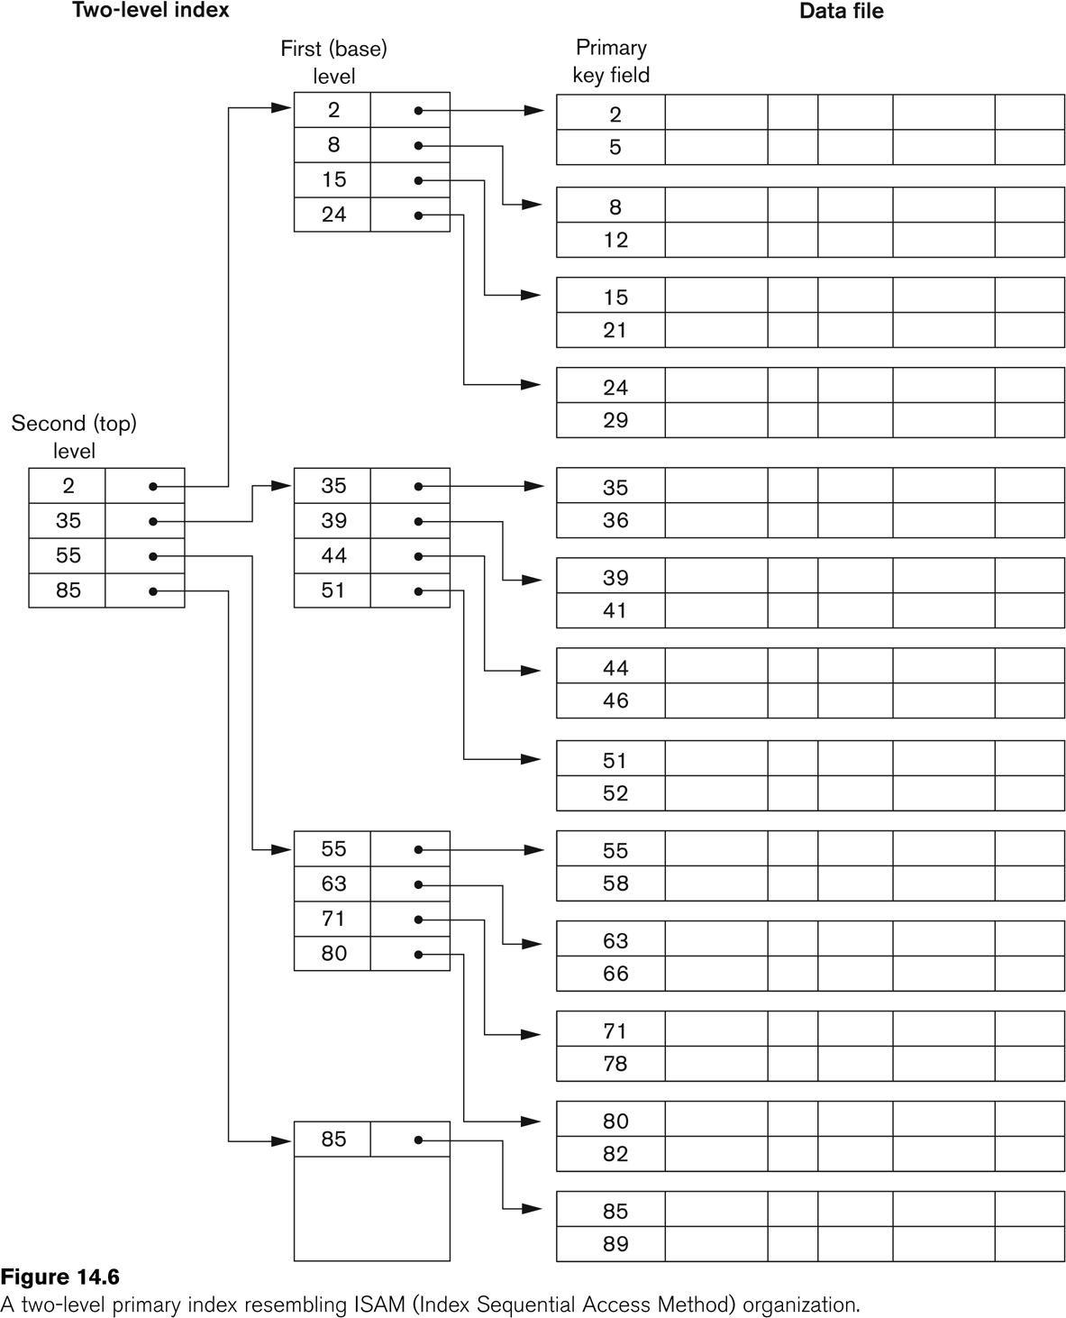
A Two-level Primary Index

Slide 28
Multi-Level Indexes
Such a multi-level index is a form of search tree
  However, insertion and deletion of new index entries is a severe problem because every level of the index is an ordered file.

Slide 29
Multi-Level Indexes
Slide 24 example secondary index
Consider the file of with r = 300,000, fixed-length records of size R = 100 bytes
stored on a disk with block size B = 4,096 bytes. The file has b = 7,500 blocks.
index blocking factor bfri = 273 index entries per block, which is also the fan-out f_{o} for the multilevel index
the number of first-level blocks b1 = 1,099 blocks (records for second level)
The number of second-level blocks will be b2 = ⎡(b1/fo)⎤ = ⎡(1,099/273)⎤ = 5 blocks,
the number of third level blocks will be b3 = ⎡(b2/fo)⎤ = ⎡(5/273)⎤ = 1 block
the third level is the top level of the index t = 3.
To access a record by searching the multilevel index, we must access one block at each level plus one block from the data file, so we need t + 1 = 3 + 1 = 4 block accesses.
Compare 12 block accesses

Slide 30
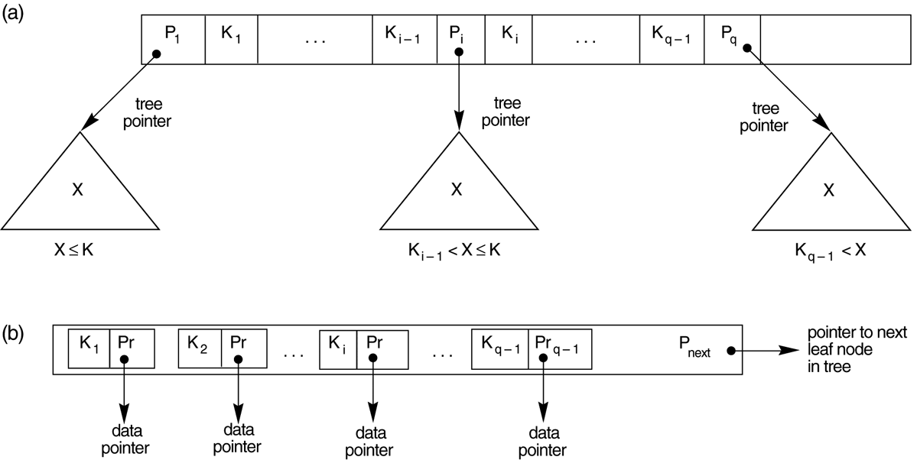
The Nodes of a B+-tree
The nodes of a B+-tree
  (a) Internal node of a B+-tree with q –1 search values.
  (b) Leaf node of a B+-tree with q – 1 search values and q – 1 data pointers.

Slide 31
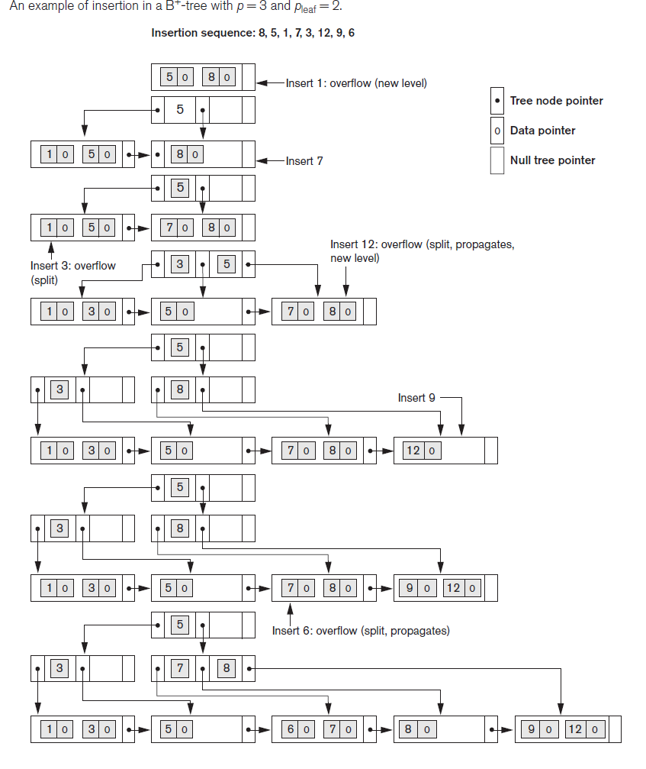

Slide 32
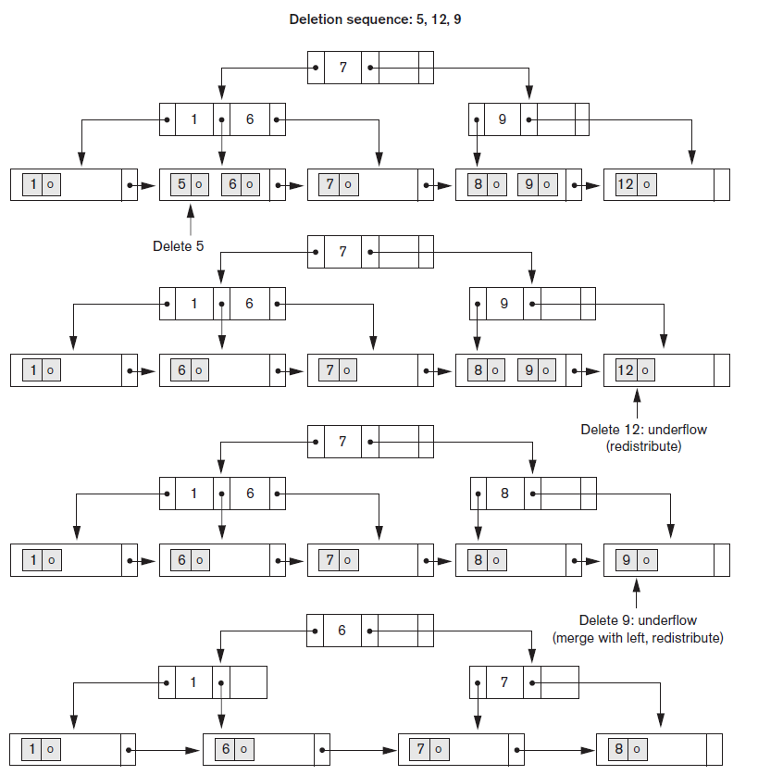

Slide 33
Insertion
The insert algorithm for B+ Tree
Data Page Full | Index Page Full | Action
NO | NO | Place the record in sorted position in the appropriate leaf page
YES | NO | Split the leaf page Place Middle Key in the index page in sorted order. Left leaf page contains records with keys below the middle key. Right leaf page contains records with keys equal to or greater than the middle key.
YES | YES | Split the leaf page. Records with keys < middle key go to the left leaf page. Records with keys >= middle key go to the right leaf page. Split the index page. Keys < middle key go to the left index page. Keys > middle key go to the right index page. The middle key goes to the next (higher level) index. IF the next level index page is full, continue splitting the index pages.

Slide 34
Deletion
Delete algorithm for B+ trees
Data Page Below Fill Factor | Index Page Below Fill Factor | Action
NO | NO | Delete the record from the leaf page. Arrange keys in ascending order to fill void. If the key of the deleted record appears in the index page, use the next key to replace it.
YES | NO | Combine the leaf page and its sibling. Change the index page to reflect the change.
YES | YES | Combine the leaf page and its sibling. Adjust the index page to reflect the change. Combine the index page with its sibling. Continue combining index pages until you reach a page with the correct fill factor or you reach the root page.

