Slide 1
NoSQL

Slide 2
What is NoSQL?
Stands for Not Only SQL
Class of non-relational data storage systems
Designed for distributed data stores where very large scale of data storing needs (for example Google or Facebook which collects terabits of data every day for their users)
Usually do not require a fixed table schema nor do they use the concept of joins and typically scale horizontally
NoSQL databases are finding significant and growing industry use in big data and real-time web applications

Slide 3
Why NoSQL?
The data has been increasing exponentially
Examples
Personal user information ,Social graphs , Geo location data , User-generated content, Machine logging data
It is required to process huge amount of data. Which SQL databases were never designed.
The evolution of NoSql databases is to handle these huge data properly

Slide 4
RDBMS vs NoSQL
RDBMS - Structured and organized data - Structured query language (SQL) - Data and its relationships are stored in separate tables. - Data Manipulation Language, Data Definition Language - Tight Consistency - ACID Transaction
NoSQL - Stands for Not Only SQL - No declarative query language - No predefined schema - BASE rather ACID property - Unstructured and unpredictable data - CAP Theorem - Prioritizes high performance, high availability and scalability

Slide 5
CAP Theorem
Consistency - This means that the data in the database remains consistent after the execution of an operation. For example after an update operation all clients see the same data.
Availability - This means that the system is always on (service guarantee availability), no downtime.
Partition Tolerance - This means that the system continues to function even the communication among the servers is unreliable, i.e. the servers may be partitioned into multiple groups that cannot communicate with one another.

Slide 6
CAP Theorem
In theoretically it is impossible to fulfill all 3 requirements. CAP provides the basic requirements for a distributed system to follow 2 of the 3 requirements.
All the current NoSQL database follow the different combinations of the C, A, P from the CAP theorem
CA - Single site cluster, therefore all nodes are always in contact. When a partition occurs, the system blocks.
CP - Some data may not be accessible, but the rest is still consistent/accurate.
AP - System is still available under partitioning, but some of the data returned may be inaccurate.

Slide 7
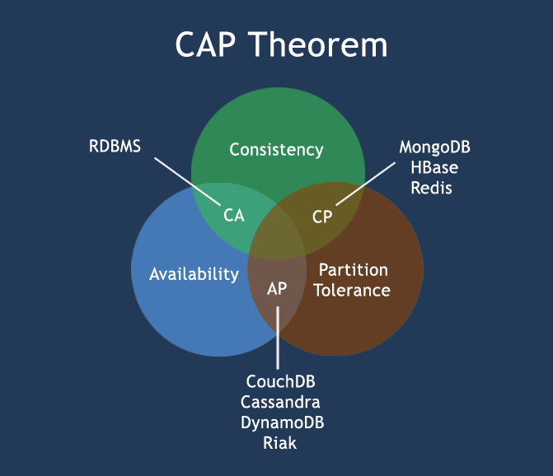

Slide 8
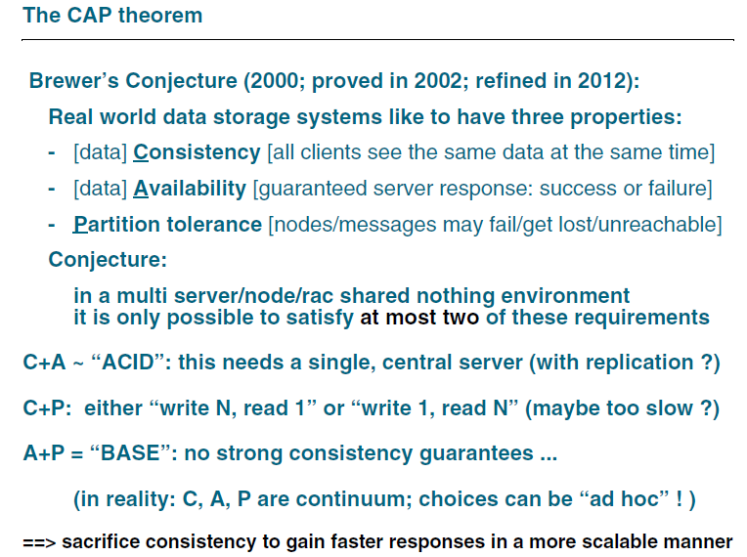

Slide 9
The BASE
A BASE system gives up on consistency.
Basically Available indicates that the system does guarantee availability, in terms of the CAP theorem.
Soft state indicates that the state of the system may change over time, even without input. (not consistent)
Eventual consistency indicates that the system will become consistent over time, given that the system doesn't receive input during that time.

Slide 10
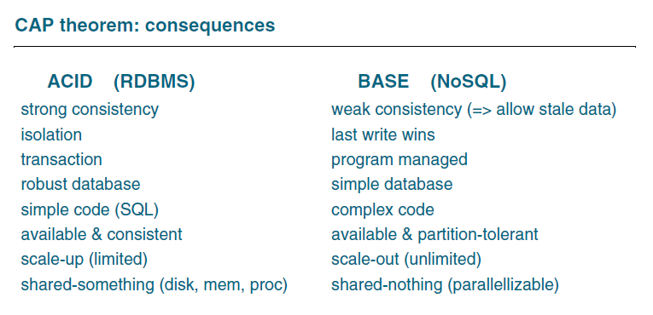

Slide 11
NoSQL Database Categories
Key-value stores
Column-oriented
Graph
Document oriented

Slide 12
Key-value stores
Key-value stores are most basic types of NoSQL databases.
Designed to handle huge amounts of data.
Key value stores allow developer to store schema-less data.
Database stores data as hash table where each key is unique and the value can be string

Slide 13
Key-value stores
For example a key-value pair might consist of a key like "Name" that is associated with a value like "Robin".
Key-Value stores follows the 'Availability' and 'Partition' aspects of CAP theorem.
Key-Values stores would work well for shopping cart contents, or individual values like color schemes, a landing page URI, or a default account number.

Slide 14
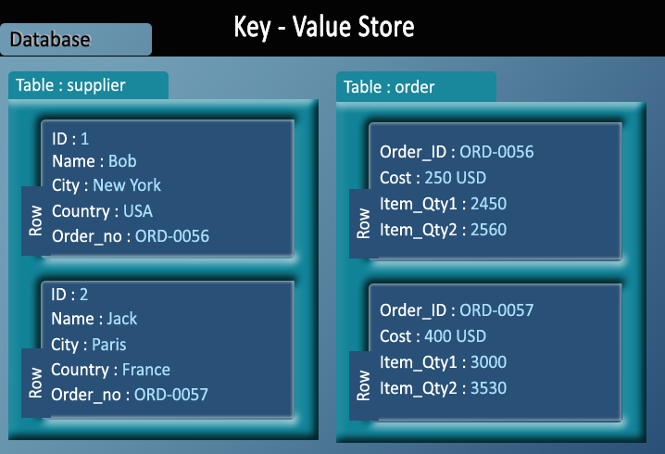
Example of Key-value store DataBase : Redis, Dynamo, Riak. etc

Slide 15
Column-oriented databases
Column-oriented databases primarily work on columns and every column is treated individually.
Values of a single column are stored contiguously.
Column stores data in column specific files.
ID Last First Bonus
1 Doe John 8000
2 Smith Jane 4000
3 Beck Sam 1000
A row-oriented database
1,Doe,John,8000;2,Smith,Jane,4000;3,Beck,Sam,1000;
A column-oriented database
1,2,3;Doe,Smith,Beck;John,Jane,Sam;8000,4000,1000;

Slide 16
Column-oriented databases
All data within each column data file have the same type which makes it ideal for compression.
High performance on aggregation queries (e.g. COUNT, SUM, AVG, MIN, MAX).
Works on data warehouses and business intelligence, customer relationship management (CRM), Library card catalogs etc

Slide 17
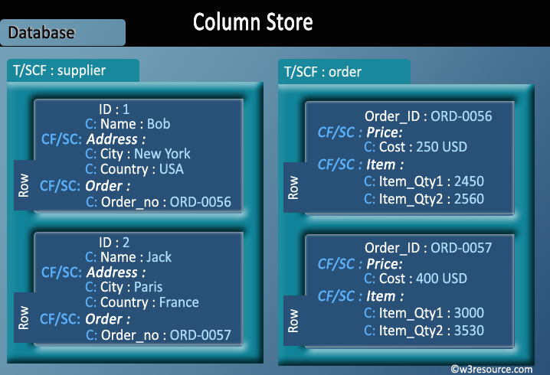
Example of Column-oriented databases : BigTable, Cassandra, SimpleDB etc

Slide 18
Graph databases
A graph database stores data in a graph.
It is capable of elegantly representing any kind of data in a highly accessible way.
A graph database is a collection of nodes and edges
Each node represents an entity (such as a student or business) and each edge represents a connection or relationship between two nodes.
Every node and edge is defined by a unique identifier.
Each node knows its adjacent nodes.
As the number of nodes increases, the cost of a local step (or hop) remains the same.
Index for lookups.

Slide 19
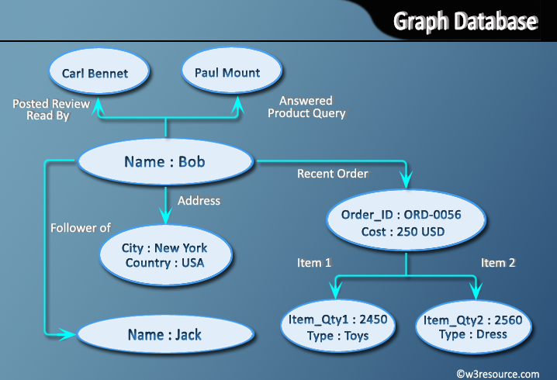
Example of Graph databases : OrientDB, Neo4J, Titan.etc

Slide 20
Document Oriented databases
A collection of documents
Data in this model is stored inside documents.
A document is a key value collection where the key allows access to its value.
Documents are not typically forced to have a schema and therefore are flexible and easy to change.
Documents are stored into collections in order to group different kinds of data.
Documents can contain many different key-value pairs, or key-array pairs, or even nested documents

Slide 21
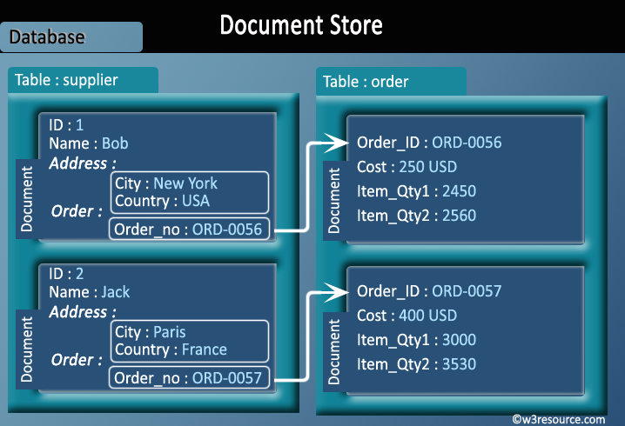
Example of Document Oriented databases : MongoDB, CouchDB

Slide 22
NoSQL pros/cons
Advantages :
High scalability
Distributed Computing
Lower cost
Schema flexibility, semi-structure data
No complicated Relationships
Disadvantages
No standardization
Limited query capabilities (so far)
Eventual consistent is not intuitive to program for

Slide 23
