Slide 1
Parallel Databases

Slide 2
Parallelism in Databases
Data can be partitioned across multiple disks for parallel I/O.
Individual relational operations (e.g., sort, join, aggregation) can be executed in parallel
  data can be partitioned and each processor can work independently on its own partition.
Queries are expressed in high level language (SQL, translated to relational algebra)
  makes parallelization easier.
Different queries can be run in parallel with each other. Concurrency control takes care of conflicts.
Thus, databases naturally lend themselves to parallelism.

Slide 3
I/O Parallelism
Reduce the time required to retrieve relations from disk by partitioning
the relations on multiple disks.
Horizontal partitioning – tuples of a relation are divided among many disks such that each tuple resides on one disk.
Partitioning techniques (number of disks = n):
  Round-robin:
    Send the i^{th} tuple inserted in the relation to disk i mod n.
    Ensures even distribution of tuples across disks
  Hash partitioning:
  Choose one or more attributes as the partitioning attributes.
  Choose hash function h with range 0…n - 1
  Let i denote result of hash function h applied to the partitioning attribute value of a tuple. Send tuple to disk i.

Slide 4
I/O Parallelism (Cont.)
Partitioning techniques (cont.):
Range partitioning:
  Choose an attribute A as the partitioning attribute.
  A partitioning vector [v_{o}, v₁, ..., v_{n-2}] is chosen such that v_{i} < v_{j}
  Consider a tuple t such that t[A]=x.
    If x < v_{o} then t goes on disk 0
    If x ≥ v_{n-2} then t goes on disk n-1
    If v_{i} ≤ x < v_{i+1} then t goes on disk i+1
  E.g. Consider three disks numbered 0, 1 and 2 with a partitioning vector [5,11]
  a tuple with partitioning attribute value of 2 will go to disk
  a tuple with value 8 will go to disk
  a tuple with value 20 will go to disk .

Slide 5
Example MySQL
CREATE TABLE employees (
id INT NOT NULL,
name VARCHAR(30),
hired DATE NOT NULL DEFAULT '1970-01-01',
store_id INT NOT NULL )
PARTITION BY RANGE (store_id) (
PARTITION p0 VALUES LESS THAN (6),
PARTITION p1 VALUES LESS THAN (11),
PARTITION p2 VALUES LESS THAN (16),
PARTITION p3 VALUES LESS THAN (21) );
All rows corresponding to employees working at stores 1 through 5 are stored in partition p0, to those employed at stores 6 through 10 are stored in partition p1, and so on.

Slide 6
Comparison of Partitioning Techniques
After partitioning, relation is retrieved in parallel using all the disks.
Evaluate how well partitioning techniques support the following types of data access:
1.Scanning the entire relation.
2.Locating a tuple associatively E.g., studentGRNO = 25.
point queries a specified value for a specific attribute
3.Locating all tuples such that the value of a given attribute lies within a specified range – range queries.
  E.g., 10000 ≤ salary < 25000
Different partitioning techniques support these types of accesses at different levels of efficiency

Slide 7
Comparison of Partitioning Techniques (Cont.)
Round robin:
Advantages
  Best suited for sequential scan of entire relation on each query.
  All disks have almost an equal number of tuples; retrieval work is thus well balanced between disks.
Range and point queries are difficult to process
  Each of n disks must be used for the search

Slide 8
Comparison of Partitioning Techniques(Cont.)
Hash partitioning:
Good for sequential access
  Assuming hash function is good, and partitioning attributes form a key, tuples will be equally distributed between disks
  Retrieval work is then well balanced between disks.
Good for point queries on partitioning attribute
  Can lookup single disk, leaving others available for answering other queries.
  Find the record of employees hired in the year 2004.
  Apply hash function to 2004 and search that disk, leaves other disks free to process other queries
All the disks need to be scanned , so difficult to answer range queries

Slide 9
Comparison of Partitioning Techniques (Cont.)
Range partitioning:
Provides data clustering by partitioning attribute value.
Good for sequential access
Good for point queries on partitioning attribute: only one disk needs to be accessed based on partitioning vector
For range queries on partitioning attribute, one to a few disks may need to be accessed
  Good if only few tuples are in result then query is send to one disk, as opposed to all the disks
  Remaining disks are available for other queries.
  If many tuples are to be fetched, they are retrieved from a few disks, resulting in an I/O bottleneck at those disks
  Example of execution skew- all processing occurs in one-- or only a few--- partitions

Slide 10
Comparison of Partitioning Techniques
 | Round Robin | Hashing | Range
Sequential Scan | Best/good parallelism | Good | Good
Point Query | Difficult | Good for hash key | Good for range vector
Range Query | Difficult | Difficult | Good for range vector

Slide 11
Forms of Parallelism
Forms of parallelism for database processing:
  Interquery parallelism
  Intraquery parallelism
    Intraoperation parallelism
    Interoperation parallelism
      Pipeline parallelism
      Independent parallelism

Slide 12
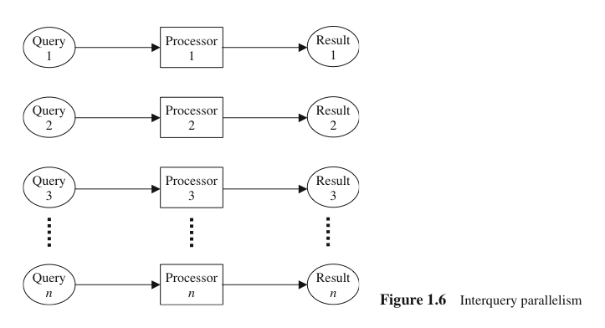
Forms of Parallelism (cont’d)
Interquery Parallelism
  “Parallelism among queries”
  Different queries or transactions are executed in parallel with one another
  Main aim: scaling up transaction processing systems

Slide 13
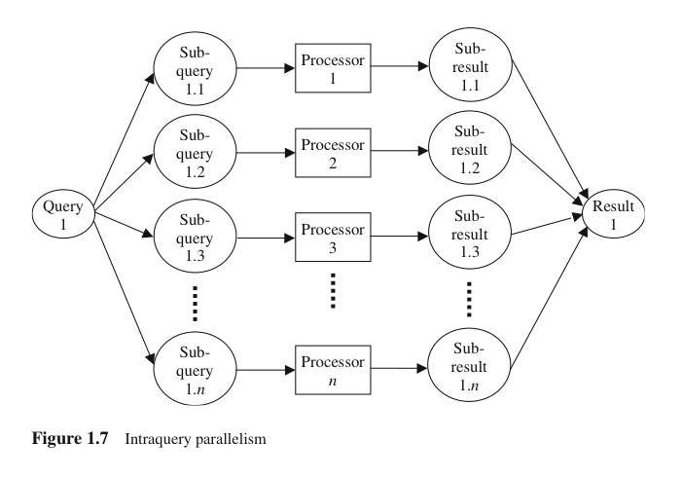
Forms of Parallelism (cont’d)
Intraquery Parallelism
  “Parallelism within a query”
  Execution of a single query in parallel on multiple processors and disks
  Main aim: speeding up long-running queries

Slide 14
Forms of Parallelism (cont’d)
Execution of a single query can be parallelized in two ways:
  Intraoperation parallelism: Speeding up the processing of a query by parallelizing the execution of each individual operation (e.g. parallel sort, parallel search, etc)
  Interoperation parallelism: Speeding up the processing of a query by executing in parallel different operations in a query expression (e.g. simultaneous sorting or searching)

Slide 15
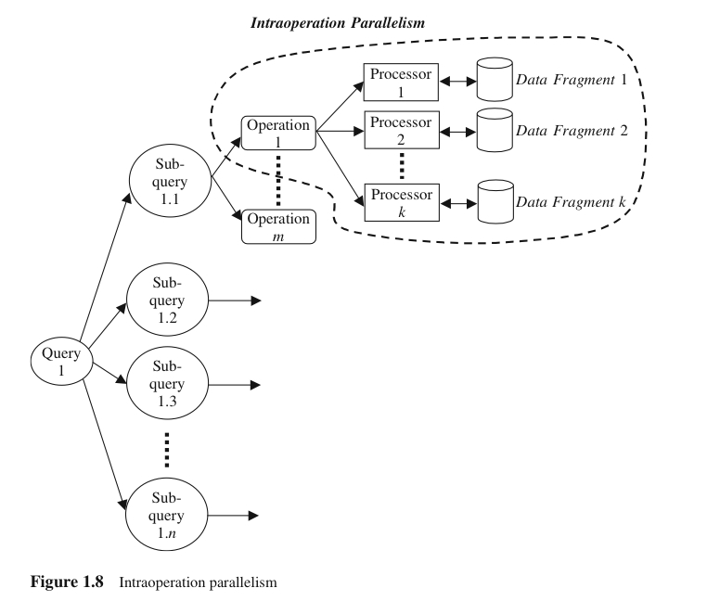
Forms of Parallelism (cont’d)
Intraoperation Parallelism
  “Partitioned parallelism”
  Parallelism due to the data being partitioned
  Since the number of records
  in a table can be large, the degree of parallelism is potentially enormous

Slide 16
Forms of Parallelism (cont’d)
Interoperation parallelism: Parallelism created by concurrently executing different operations within the same query or transaction
  Pipeline parallelism
  Independent parallelism

Slide 17
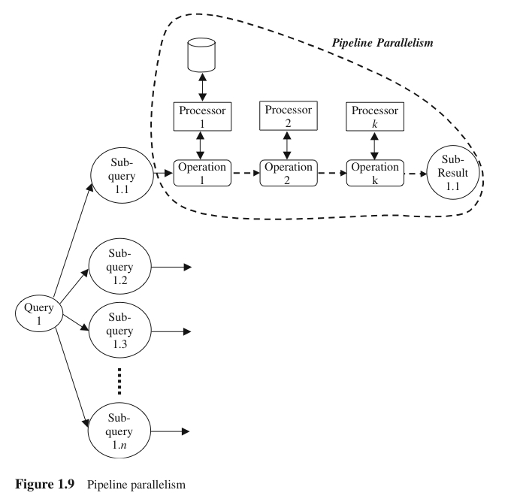
Forms of Parallelism (cont’d)
Pipeline Parallelism
  Output record of one operation A are consumed by a second operation B, even before the first operation has produced the entire set of records in its output
  Multiple operations form some sort of assembly line to manufacture the query results
  Useful with a small number of processors, but does not scale up well

Slide 18
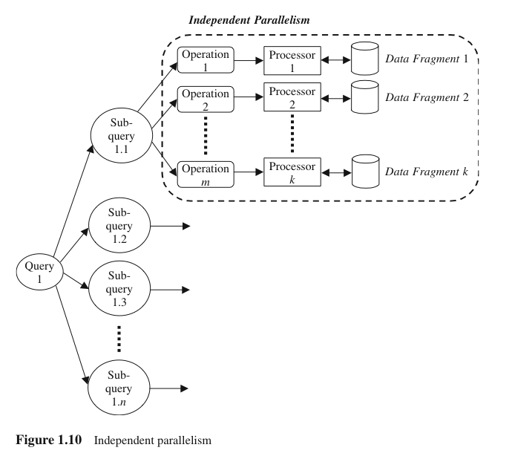
Forms of Parallelism (cont’d)
Independent Parallelism
  Operations in a query that do not depend on one another are executed in parallel
  Does not provide a high degree of parallelism

