Slide 1
Distributed Databases
Notes:
03/26/14
03/26/14

Slide 2
Outline
1 Distributed Database Concepts
2 Data Fragmentation, Replication and Allocation
3 Types of Distributed Database Systems
4 Query Processing
Notes:
03/26/14
03/26/14

Slide 3
Distributed Database Concepts
  It is a system to process Unit of execution (a transaction) in a distributed manner. That is, a transaction can be executed by multiple networked computers in a unified manner.
  It can be defined as
    A distributed database (DDB) is a collection of multiple logically interrelated databases distributed over a computer network, and a distributed database management system as a software system that manages a distributed database while making the distribution transparent to the user.
Notes:
03/26/14

Slide 4
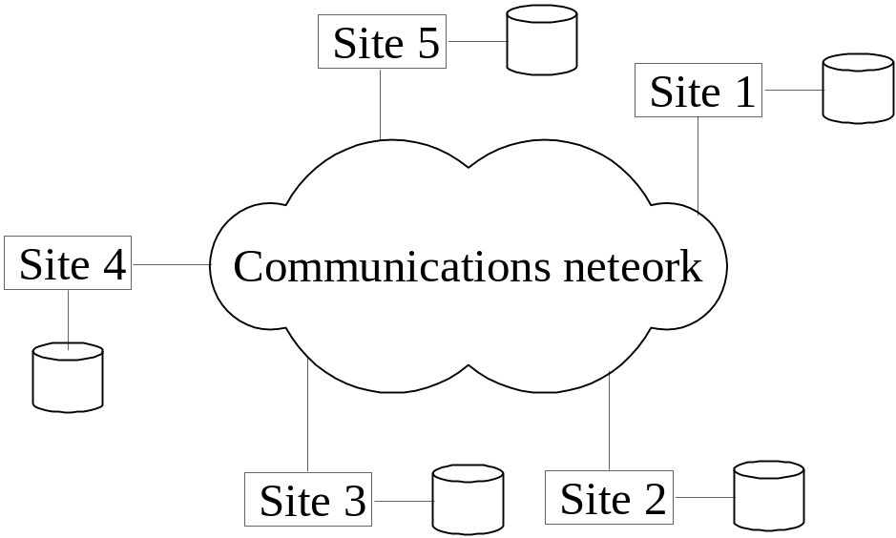
Distributed Database System
Advantages
  Management of distributed data with different levels of transparency: This refers to the physical placement of data (files, relations, etc.) which is not known to the user (distribution transparency).
Notes:
03/26/14

Slide 5
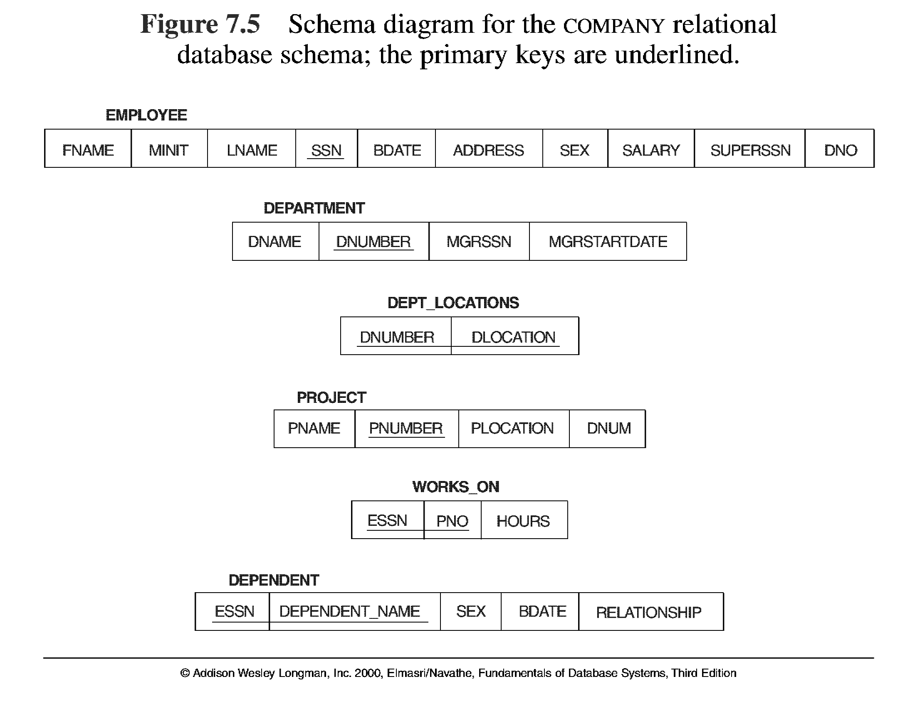
Notes:
03/26/14

Slide 6
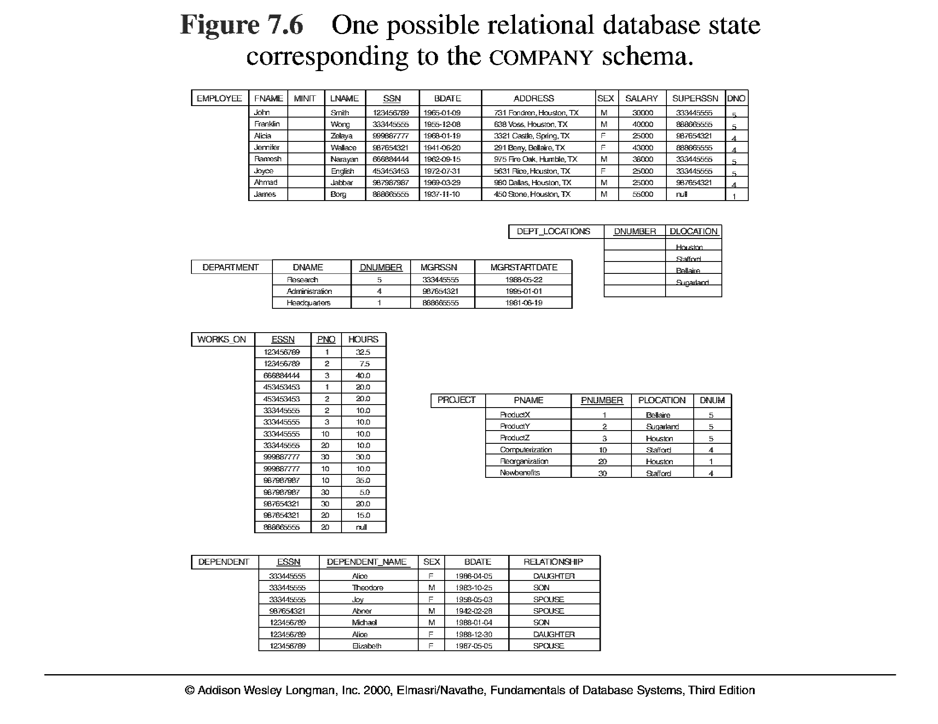
Notes:
03/26/14

Slide 7
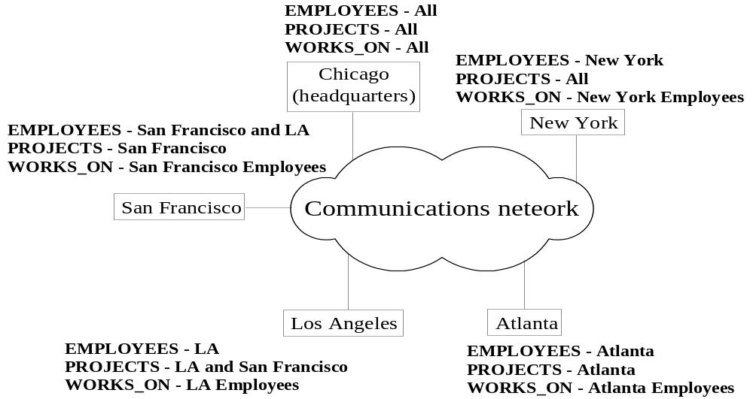
Distributed Database System
Advantages
  The EMPLOYEE, PROJECT, and WORKS_ON tables may be fragmented horizontally and stored with possible replication as shown below.
Notes:
03/26/14

Slide 8
Distributed Database System
Advantages: following types of transparencies are possible
  Distribution and Network transparency: Users do not have to worry about operational details of the network. There is Location transparency, which refers to freedom of issuing command from any location without affecting its working. Then there is Naming transparency, which allows access to any names object (files, relations, etc.) from any location.
  Replication transparency: It allows to store copies of a data at multiple sites as shown in the above diagram. This is done to minimize access time to the required data.
  Fragmentation transparency: Allows to fragment a relation horizontally (create a subset of tuples of a relation) or vertically (create a subset of columns of a relation).
Notes:
03/26/14

Slide 9
Distributed Database System
Advantages
  Increased reliability and availability: Reliability refers to system live time, that is, system is running efficiently most of the time. Availability is the probability that the system is continuously available (usable or accessible) during a time interval. A distributed database system has multiple nodes (computers) and if one fails then others are available to do the job.
  Improved performance: A distributed DBMS fragments the database to keep data closer to where it is needed most. This reduces data management (access and modification) time significantly. Interquery and Intraquery parallelism is achieved.
  Easier expansion (scalability): Allows new nodes (computers), more data to be added anytime without chaining the entire configuration.
Notes:
03/26/14

Slide 10
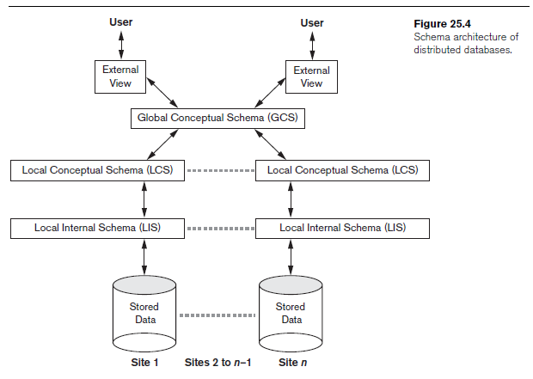
Distributed Database System

Slide 11
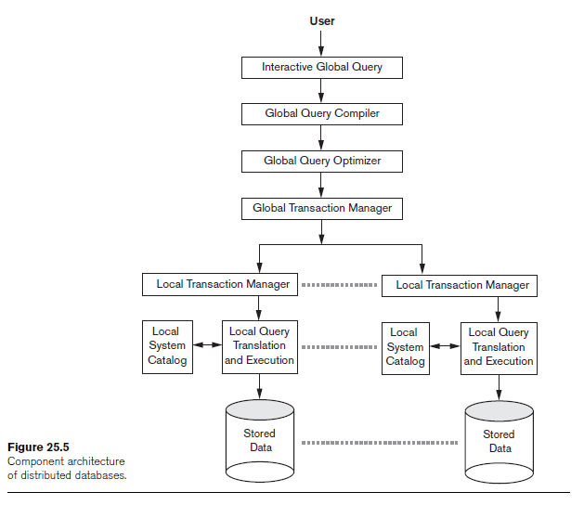
Distributed Database System

Slide 12
Data Fragmentation
Data Fragmentation
  Split a relation into logically related and correct parts. A relation can be fragmented in two ways.
Horizontal fragmentation
  It is a horizontal subset of a relation which contain those of tuples which satisfy selection conditions.
  Consider the Employee relation with selection condition (DNO = 5). All tuples satisfy this condition will create a subset which will be a horizontal fragment of Employee relation.
  A selection condition may be composed of several conditions connected by AND or OR.
Notes:
03/26/14

Slide 13
Data Fragmentation
Horizontal fragmentation
  Similarly for PROJECT relation three fragments can be made w.r.t department.
  Derived horizontal fragmentation: It is the partitioning of a primary relation to other secondary relations which are related with Foreign keys.
  Primary relation: DEPARTMENT
  Secondary relations: EMPLOYEE and PROJECT
Notes:
03/26/14

Slide 14
Data Fragmentation
Vertical fragmentation
  It is a subset of a relation which is created by a subset of columns.
  A vertical fragment of a relation will contain values of selected columns.
  No selection condition used in vertical fragmentation.
  Consider the Employee (SSN, Name, Bdate, Address, Salary, SuperSSN, Dno)
  Fragment1: Name, Bdate, and Address. Personal info
  Fragment2: SSN, Salary, SuperSSN, Dno Work-related info
  Each fragment must include the primary key attribute of the parent relation to ensure lossless join property.
  A special attribute, the tuple-id attribute may be added to each schema to serve as a candidate key.
Notes:
03/26/14

Slide 15
Horizontal Fragmentation of account Relation
account_number
branch_name
balance
A-305
A-226
A-155
Hillside
Hillside
Hillside
500
336
62
account₁ = σ_{branch_name=“Hillside”} (account )
account_number
branch_name
balance
A-177
A-402
A-408
A-639
Valleyview
Valleyview
Valleyview
Valleyview
205
10000
1123
750
account₂ = σ_{branch_name=“Valleyview”} (account )
Notes:
03/26/14

Slide 16
Vertical Fragmentation of customer_info Relation
branch_name
customer_name
tuple_id
Hillside
Hillside
Valleyview
Valleyview
Hillside
Valleyview
Valleyview
Lowman
Camp
Camp
Kahn
Kahn
Kahn
Green
1
2
3
4
5
6
7
deposit₁ = Πbranch_name, customer_name, tuple_id (customer )
account_number
balance
tuple_id
A-305
A-226
A-177
A-402
A-155
A-408
A-639
500
336
205
10000
62
1123
750
1
2
3
4
5
6
7
deposit₂ = Πaccount_number, balance, tuple_id (customer )
Notes:
03/26/14

Slide 17
Data Fragmentation
Representation
  Horizontal fragmentation
  Each horizontal fragment on a relation can be specified by a σ_{Ci} (R) operation in the relational algebra.
  Complete horizontal fragmentation
  A set of horizontal fragments whose conditions C1, C2, …, Cn include all the tuples in R- that is, every tuple in R satisfies (C1 OR C2 OR … OR Cn).
  Disjoint complete horizontal fragmentation: No tuple in R satisfies (Ci AND Cj) where i ≠ j.
  To reconstruct R from complete horizontal fragments a UNION is applied.
Notes:
03/26/14

Slide 18
Data Fragmentation
Representation
  Vertical fragmentation
  A vertical fragment on a relation can be specified by a Π_{Li}(R) operation in the relational algebra.
  Complete vertical fragmentation
  A set of vertical fragments whose projection lists L1, L2, …, Ln include all the attributes in R but share only the primary key of R. In this case the projection lists satisfy the following two conditions:
  L1 ∪ L2 ∪ ... ∪ Ln = ATTRS (R)
  Li ∩ Lj = PK(R) for any i j,
  To reconstruct R from complete vertical fragments a OUTER UNION is applied.
Notes:
03/26/14

Slide 19
Data Fragmentation, Replication and Allocation
Neither complete nor disjoint horizontal fragments
1. salary>50000
2. dno=4
May not include all employee tuples, also may include common tuples
Not complete vertical fragments
1. Name, Address
2. SSN, Name, Salary
Violate both conditions of vertical fragmentation.
Notes:
03/26/14

Slide 20
Data Fragmentation, Replication and Allocation
  Mixed (Hybrid) fragmentation
  A combination of Vertical fragmentation and Horizontal fragmentation.
  This is achieved by SELECT-PROJECT operations which is represented by Π_{L}(σ_{C} (R))
  If C = True (Select all tuples) and L ≠ ATTRS(R), we get a vertical fragment,
  If C = True ( for few tuples) and L = ATTRS(R), we get a horizontal fragment.
  If C = True ( for few tuples) and L ≠ ATTRS(R), we get a mixed fragment.
  When C = True (Select all tuples) and L = ATTRS(R), a relation itself is a fragment.
Notes:
03/26/14

Slide 21
Data Fragmentation, Replication and Allocation
Fragmentation schema
  A definition of a set of fragments (horizontal or vertical or horizontal and vertical) that includes all attributes and tuples in the database that satisfies the condition that the whole database can be reconstructed from the fragments by applying some sequence of OUTER UNION and UNION operations.
Allocation schema
  It describes the distribution of fragments to sites of distributed databases. It can be fully or partially replicated or can be partitioned.
Notes:
03/26/14

Slide 22
Data Replication and Allocation
Data Replication
  Full replication the entire database is replicated at every site
    improve availability
    improves performance of global queries.
    but slow down update operations
    also makes the concurrency control and recovery more expensive.
  No replication each fragment is stored at exactly one site.
  all fragments must be disjoint except for primary key.
  also called nonredundant allocation
Notes:
03/26/14

Slide 23
Data Replication and Allocation
Data Replication
  Partial replication some selected part is replicated to some of the sites whereas others may not.
  Data replication is achieved through a replication schema.
Data Distribution (Data Allocation)
  This is relevant only in the case of partial replication or partition. The selected portion of the database is distributed to the database sites.
  The choice of site and degree of replication depends on the performance and availability goals.
  Finding an optimal or even a good solution to distributed data allocation is a complex optimization problem.
Notes:
03/26/14

Slide 24
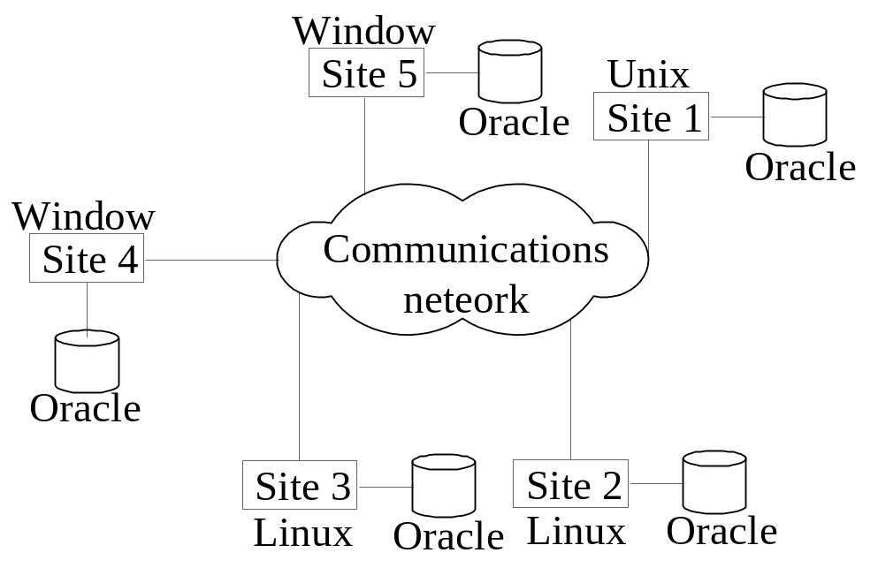
Types of Distributed Database Systems
Homogeneous
  All sites of the database system have identical setup, i.e., same database system software. The underlying operating system may be different. For example, all sites run Oracle or DB2, or Sybase or some other database system. The underlying operating systems can be a mixture of Linux, Window, Unix, etc. The clients thus have to use identical client software.
Notes:
03/26/14

Slide 25
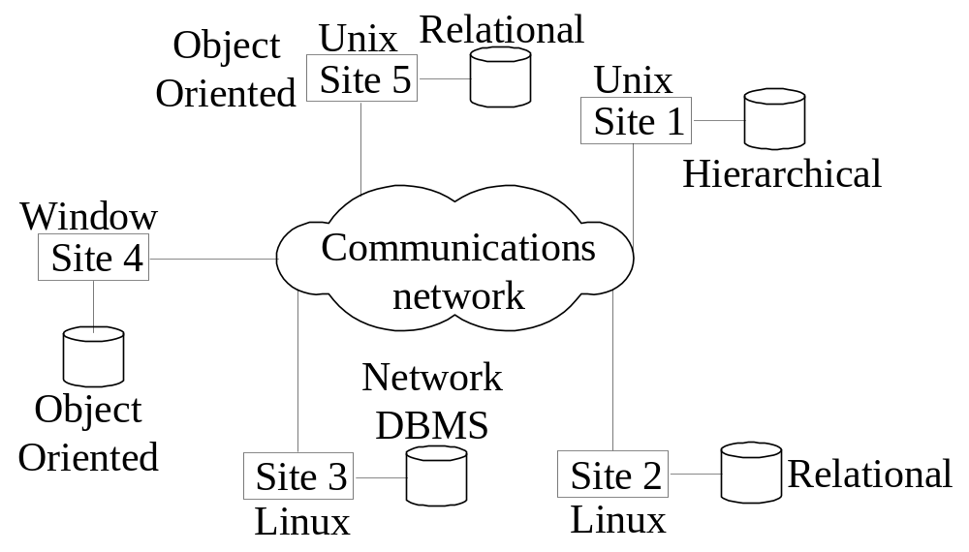
Types of Distributed Database Systems
Heterogeneous
  Federated: Each server is an independent and autonomous centralized DBMS. There may be a global schema shared by applications.
  Multidatabase: There is no one conceptual global schema. For data access a schema is constructed dynamically as needed by the application software.
Notes:
03/26/14

Slide 26
Types of Distributed Database Systems
Federated Database Management Systems Issues
Differences in data models: Relational, Objected oriented, hierarchical, network, etc.
Differences in constraints: Each site may have their own data accessing and processing constraints.
Differences in query language: Some site may use SQL-99, some may use SQL-89, some may use SQL-92, and so on.
Notes:
03/26/14

Slide 27

Query Processing in Distributed Databases
Issues
Cost of transferring data (files and results) over the network.
This cost is usually high so some optimization is necessary.
Example relations: Employee at site 1 and Department at Site 2
Employee at site 1. 10, 000 rows. Row size = 100 bytes. Table size = 10⁶ bytes
SSN=9bytes Dno=4bytes Fname, Lname=15bytes.
Fname | Minit | Lname | SSN | Bdate | Address | Sex | Salary | Superssn | Dno
Department at Site 2. 100 rows. Row size = 35 bytes. Table size = 3500 bytes
Dnumber=4bytes Mgrssn=9bytes Dname=10bytes.
Dname | Dnumber | Mgrssn | Mgrstartdate
Query is submitted to site 3
Q: For each employee, retrieve employee name and department name Where the employee works.
Q: Π_{Fname,Lname,Dname} (Employee _{Dno = Dnumber} Department)
Notes:
03/26/14

Slide 28
Query Processing in Distributed Databases
Result
The result of this query will have 10,000 tuples, assuming that every employee is related to a department.
Suppose each result tuple is 40 bytes long. The query is submitted at site 3 and the result is sent to this site.
Problem: Employee and Department relations are not present at site 3.
Strategies for executing distributed query:
Transfer Employee and Department to site 3. Total transfer bytes = 1,000,000 + 3500 = 1,003,500 bytes.
Transfer Employee to site 2, execute join at site 2 and send the result to site 3. Query result size = 40 * 10,000 = 400,000 bytes. Total transfer size = 400,000 + 1,000,000 = 1,400,000 bytes.
Transfer Department relation to site 1, execute the join at site 1, and send the result to site 3. Total bytes transferred = 400,000 + 3500 = 403,500 bytes.
Notes:
03/26/14

Slide 29
Query Processing in Distributed Databases
Optimization criteria: minimizing data transfer.
Preferred approach: strategy 3.
Consider the query
Q’: For each department, retrieve the department name and the name of the department manager
Relational Algebra expression:
Q’: Π_{Fname,Lname,Dname} (Employee _{Mgrssn = SSN} Department)
Notes:
03/26/14

Slide 30
Query Processing in Distributed Databases
The result of this query will have 100 tuples, assuming that every department has a manager, the execution strategies are:
Strategies:
Transfer Employee and Department to the result site and perform the join at site 3. Total bytes transferred = 1,000,000 + 3500 = 1,003,500 bytes.
Transfer Employee to site 2, execute join at site 2 and send the result to site 3. Query result size = 40 * 100 = 4000 bytes. Total transfer size = 4000 + 1,000,000 = 1,004,000 bytes.
Transfer Department relation to site 1, execute join at site 1 and send the result to site 3. Total transfer size = 4000 + 3500 = 7500 bytes.
Notes:
03/26/14

Slide 31
Query Processing in Distributed Databases
Preferred strategy: Chose strategy 3.
Now suppose the result site is 2. Possible strategies:
Possible strategies :
Transfer Employee relation to site 2, execute the query and present the result to the user at site 2. Total transfer size = 1,000,000 bytes for both queries Q and Q’.
Transfer Department relation to site 1, execute join at site 1 and send the result back to site 2. Total transfer size for Q = 400,000 + 3500 = 403,500 bytes and for Q’ = 4000 + 3500 = 7500 bytes.
Notes:
03/26/14

Slide 32
Query Processing in Distributed Databases
Semijoin: Objective is to reduce the number of tuples in a relation before transferring it to another site.
Q: Π_{Fname,Lname,Dname} (Employee _{Dno = Dnumber} Department) (15,15,4)
Example execution of Q :
Project the join attributes of Department at site 2 temp1=> Π _{Dno} (Department)
Transfer temp1 to site 1. 4 * 100 = 400 bytes are transferred
Join the transferred file with the Employee relation at site 1 temp2=> temp1 JOIN Employee
Transfer the required attributes from the resulting file to site 2. Fname, Lname, Dno 34 * 10,000 = 340,000 bytes are transferred
Execute the query by joining the transferred file with Department and present the result to the user at site 2.
result=> temp2 JOIN Department
Notes:
03/26/14

Slide 33
Query Processing in Distributed Databases
Semijoin: Objective is to reduce the number of tuples in a relation before transferring it to another site.
Q’: Π_{Fname,Lname,Dname} (Employee _{Mgrssn = SSN} Department) (15,15,9)
Example execution of Q or Q’:
Project the join attributes of Department at site 2
Transfer them to site 1. Q’, 9 * 100 = 900 bytes are transferred.
Join the transferred file with the Employee relation at site 1
Transfer the required attributes from the resulting file to site 2. For Q’, 39 * 100 = 3900 bytes are transferred.
Execute the query by joining the transferred file with Department and present the result to the user at site 2.
Notes:
03/26/14

Slide 34

Semijoin Strategy
Let r₁ be a relation with schema R₁ stores at site S₁
Let r₂ be a relation with schema R₂ stores at site S₂
Evaluate the expression r₁ r₂ and obtain the result at S₁.
1. Compute temp₁ ← ∏_{R1 ∩ R2} (r1) at S1.
2. Ship temp₁ from S₁ to S₂.
3. Compute temp₂ ← r₂ temp1 at S₂
4. Ship temp₂ from S₂ to S₁.
5. Compute r₁ temp₂ at S₁. This is the same as r₁ r₂.
Notes:
03/26/14

