Slide 1
Algorithms for Query Processing and Optimization

Slide 2
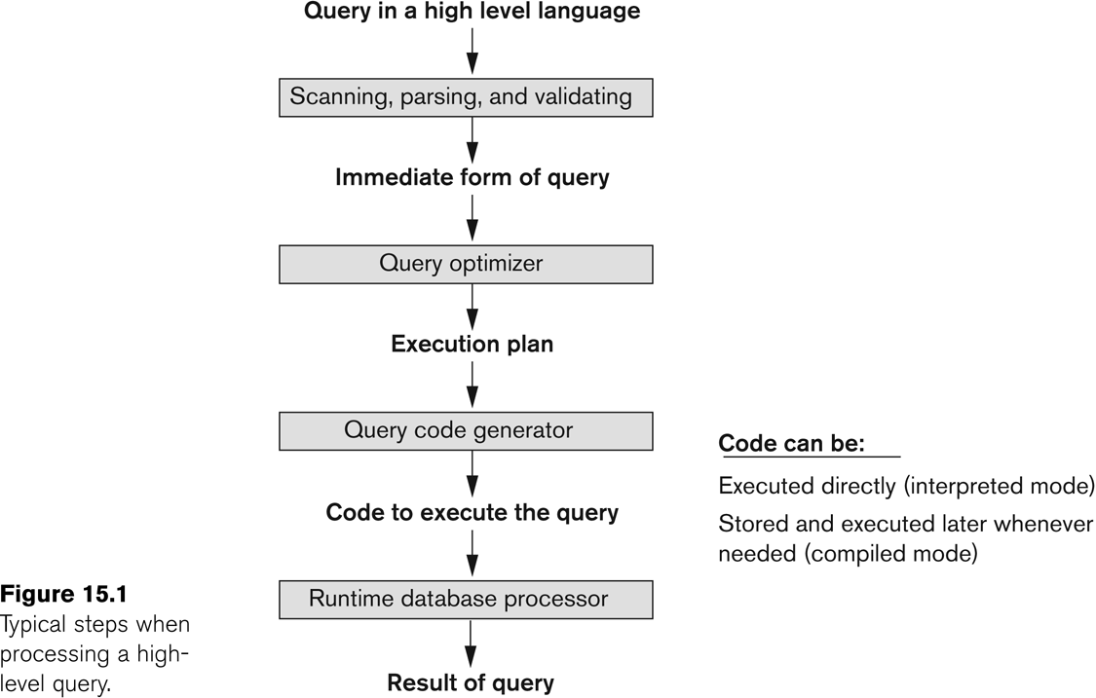
Introduction to Query Processing
1.Parsing and translation
2.Optimization
3.Evaluation
4.Execution
Produces a good execution plan
generates the code
to execute that plan
task of running (executing) the query code

Slide 3
Algorithms for SELECT and JOIN Operations
Implementing the SELECT Operation
Primary key, point
  (OP1): σ _{SSN='123456789'} (EMPLOYEE)
Point
  (OP2): σ _{DNO=5}(EMPLOYEE)
Range
  (OP3): σ _{10000<SALARY<30000} (EMPLOYEE)
Conjunction
  (OP4): σ _{DNO=5 AND SALARY>30000} (EMPLOYEE)

Slide 4
Algorithms for SELECT and JOIN Operations
Search Methods for Simple Selection:
  S1 Linear search (brute force): Expensive, but always applicable
  S2 Binary search: Point query on ordering key attribute
  σ _{SSN='123456789'} (EMPLOYEE)
  S3 Primary index or hash index: Single record retrieval; does not work for range queries.
  S4 Primary index to retrieve multiple records: use the index to find the record satisfying the corresponding equality condition, then retrieve all subsequent records in the (ordered) file.
  σ _{DNUMBER>5}(DEPARTMENT)

Slide 5
Algorithms for SELECT and JOIN Operations
Search Methods for Simple Selection:
  S5 Clustering index to retrieve multiple records:
    If the selection condition involves an equality comparison on a non-key attribute with a clustering index, use the clustering index to retrieve all the records satisfying the selection condition.
    σ _{DNO=5}(EMPLOYEE)
  S6 Using a secondary (B+-tree) index:
    On an equality comparison, retrieve a single record if the indexing field has unique values (is a key) or to retrieve multiple records if the indexing field is not a key.
    In addition, it can be used to retrieve records on conditions involving >,>=, <, or <=. (FOR RANGE QUERIES)
    σ _{10000<SALARY<30000} (EMPLOYEE)

Slide 6
Algorithms for SELECT and JOIN Operations
  S7 Conjunctive selection: use one of S2 to S6 to get records having dno=5 and then check whether each retrieved record satisfies the salary condition.
  σ _{DNO=5 AND SALARY>30000} (EMPLOYEE)
  S8 Conjunctive selection using a composite index: if composite index (or hash structure) exists on the combined field with equality conditions
  σ _{ESSN=123456789 AND PNO=10}(WORKS_ON)

Slide 7
Algorithms for SELECT and JOIN Operations
Search Methods for Complex Selection:
  S9 Conjunctive selection by intersection of record pointers:
    if secondary indexes are available on all (or some of) the fields involved in equality comparison conditions in the conjunctive condition and if the indexes include record pointers (rather than block pointers).
    Each index can be used to retrieve the record pointers that satisfy the individual condition.
    The intersection of these sets of record pointers gives the record pointers that satisfy the conjunctive condition, which are then used to retrieve those records directly.
    If only some of the conditions have secondary indexes, each retrieved record is further tested to determine whether it satisfies the remaining conditions.

Slide 8
Algorithms for SELECT and JOIN Operations
Implementing the JOIN Operation:
  Join (EQUIJOIN, NATURAL JOIN)
    two–way join: a join on two files
    e.g. R _{A=B} S
    multi-way joins: joins involving more than two files.
    e.g. R _{A=B} S _{C=D} T
Examples
  (OP6): EMPLOYEE _{DNO=DNUMBER} DEPARTMENT
  (OP7): DEPARTMENT _{MGRSSN=SSN} EMPLOYEE

Slide 9
Algorithms for SELECT and JOIN Operations
Methods for implementing joins:
  J1 Nested-loop join (brute force):
    For each record t in R (outer loop), retrieve every record s from S (inner loop) and test whether the two records satisfy the join condition t[A] = s[B].
  J2 Single-loop join (Using an access structure to retrieve the matching records):
    If an index (or hash key) exists for one of the two join attributes — say, A of R — retrieve each record t in S, one at a time, and then use the access structure to retrieve directly all matching records t from R that satisfy t[A]=s[B].

Slide 10
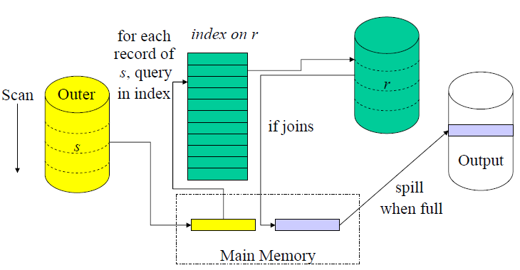
Algorithms for SELECT and JOIN Operations
  J2 Single-loop join (Using an access structure to retrieve the matching records):

Slide 11
Algorithms for SELECT and JOIN Operations
Methods for implementing joins:
  J3 Sort-merge join:
    If the records of R and S are physically sorted (ordered) by value of the join attributes A and B, respectively, we can implement the join in the most efficient way possible.
    Both files are scanned in order of the join attributes, matching the records that have the same values for A and B.
    In this method, the records of each file are scanned only once each for matching with the other file—unless both A and B are non-key attributes, in which case the method needs to be modified slightly.

Slide 12
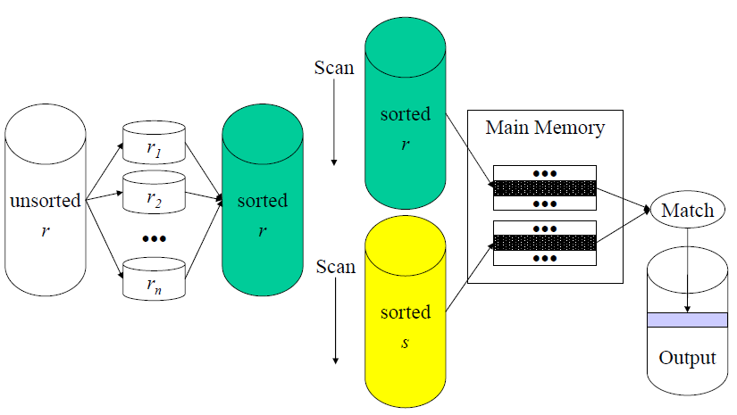
Algorithms for SELECT and JOIN Operations
J3 Sort-merge join

Slide 13
Algorithms for SELECT and JOIN Operations
Methods for implementing joins:
  J4 Hash-join:
    The records of files R and S are both hashed to the same hash file, using the same hashing function on the join attributes A of R and B of S as hash keys.
    A single pass through the file with fewer records (say, S) hashes its records to the hash file buckets.
    A single pass through the other file (R) then hashes each of its records to the appropriate bucket, where the record is combined with all matching records from R.

Slide 14
Hash Join Algorithm
S
B | C
2 | C3
3 | C4
R
A | D
1 | D2
3 | D4
5 | D6
Hash Table
Index | Entries
1
2 | 2, C3
3 | 3, C4
4
5
Result R.A=S.B
R.A | R.D | S.B | S.C
3 | D4 | 3 | C4

Slide 15
Hash Join Algorithm
Hash Ta
b
le
Tabl
e
S
Index
E
n
tr
i
es
Arts
8
1
Geology/10
Busi
n
ess
15
2
Comp
S
c/2
He
a
lt
h
/11
Comp
S
c
2
hashed
3
Danc
e
/12
Finan
c
e/21
Dance
12
into
4
Enginee
r
ing
7
→
5
Finan
c
e
21
6
Busi
n
es
s
/15
Geology
10
7
Enginee
r
ing/7
He
a
lth
11
8
Arts/8
IT
18
9
IT/18
10
11
12
F
igu
r
e
5.
6
.
Has
h
i
n
g
Ta
b
l
e
S

Slide 16
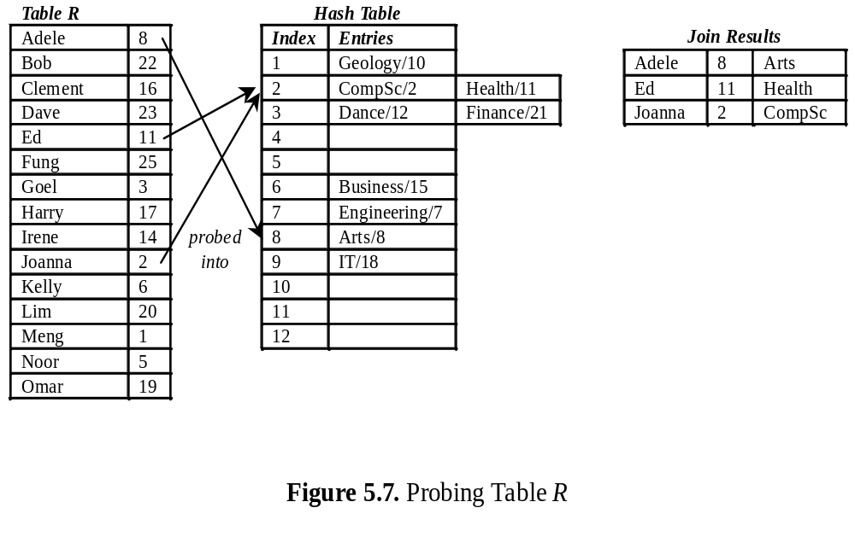
Hash Join Algorithm

Slide 17
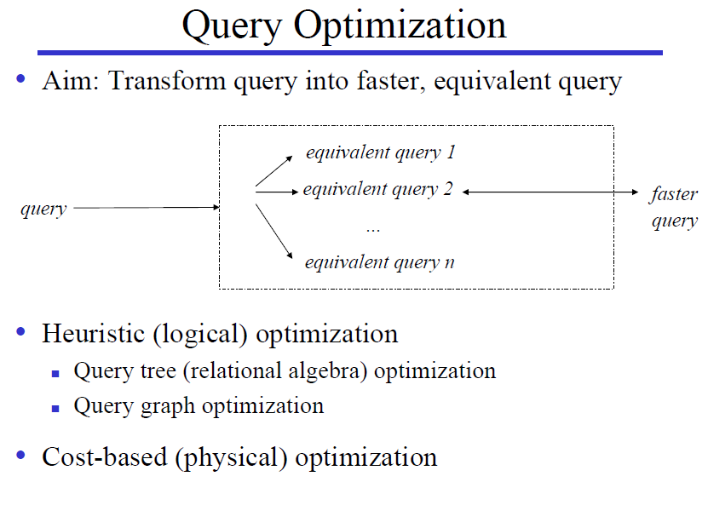

Slide 18
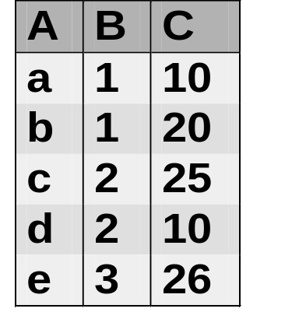
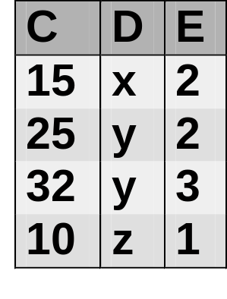
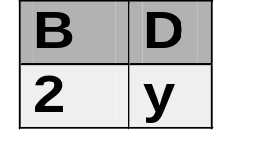
An Example
Query:
  Select B,D
  From R,S
  Where R.A = “c” and S.E = 2 and R.C=S.C
R
S
Answer

Slide 19
An Example (cont.)
Plan 1
  Cross product of R & S
  Select tuples using WHERE conditions
  Project on B & D
Algebra expression
π_{B,D}
σ_{R.A=‘c’∧ S.E=2 ∧R.C=S.C}
π_{B,D}(σ_{R.A=‘c’∧ S.E=2 ∧R.C=S.C} (R ×S))
×
R
S

Slide 20
An Example (cont.)
Plan 2
  Select R tuples with R.A=“c”
  Select S tuples with S.E=2
  Natural join
  Project B & D
Algebra expression
π_{B,D}
π_{B,D}(σ _{R.A=“c”} (R) σ_{S.E=2} (S))
σ_{R.A=‘c’}
σ_{S.E=2}
R
S

Slide 21
An Example (cont.)
π_{B,D}
σ_{R.A=‘c’∧ S.E=2 ∧R.C=S.C}
π_{B,D}(σ_{R.A=‘c’∧ S.E=2 ∧R.C=S.C} (R ×S))
×
R
S
π_{B,D}
π_{B,D}(σ _{R.A=“c”} (R) σ_{S.E=2} (S))
σ_{R.A=‘c’}
σ_{S.E=2}
R
S

Slide 22
Heuristics in Query Optimization
Process for heuristics optimization
  The parser of a high-level query generates an initial internal representation;
  Apply heuristics rules to optimize the internal representation.
  A query execution plan is generated to execute groups of operations based on the access paths available on the files involved in the query.
The main heuristic is to apply first the operations that reduce the size of intermediate results.
  E.g., Apply SELECT and PROJECT operations before applying the JOIN or other binary operations.

Slide 23
Heuristics in Query Optimization
Query tree:
  A tree data structure that corresponds to a relational algebra expression. It represents the input relations of the query as leaf nodes of the tree, and represents the relational algebra operations as internal nodes.
An execution of the query tree consists of executing an internal node operation whenever its operands are available and then replacing that internal node by the relation that results from executing the operation.
Query graph:
  A graph data structure that corresponds to a relational calculus expression. It does not indicate an order on which operations to perform first. There is only a single graph corresponding to each query.

Slide 24
Heuristics in Query Optimization
Example:
  For every project located in ‘Stafford’, retrieve the project number, the controlling department number and the department manager’s last name, address and birthdate.
Relation algebra:
  πPNUMBER, DNUM, LNAME, ADDRESS, BDATE (((σ_{PLOCATION=‘STAFFORD’}(PROJECT))
  _{DNUM=DNUMBER} (DEPARTMENT)) _{MGRSSN=SSN} (EMPLOYEE))
SQL query:
  Q2: SELECT P.NUMBER,P.DNUM,E.LNAME,
  E.ADDRESS, E.BDATE
  FROM PROJECT AS P,DEPARTMENT AS D, EMPLOYEE AS E
  WHERE P.DNUM=D.DNUMBER AND D.MGRSSN=E.SSN AND P.PLOCATION=‘STAFFORD’;

Slide 25
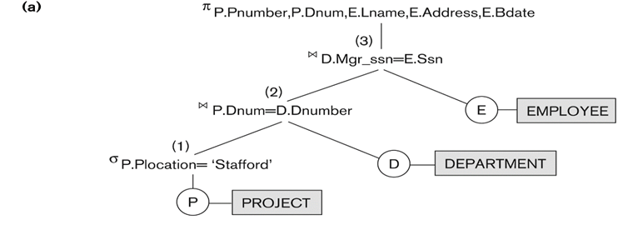
Heuristics in Query Optimization
πPNUMBER, DNUM, LNAME, ADDRESS, BDATE
(((σ_{PLOCATION=‘STAFFORD’}(PROJECT))
_{DNUM=DNUMBER} (DEPARTMENT)) _{MGRSSN=SSN} (EMPLOYEE))

Slide 26
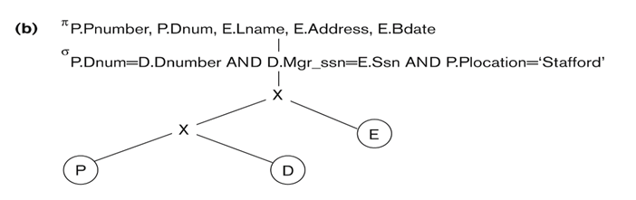
Heuristics in Query Optimization
  Q2: SELECT P.NUMBER,P.DNUM,E.LNAME, E.ADDRESS, E.BDATE
  FROM PROJECT AS P,DEPARTMENT AS D, EMPLOYEE AS E
  WHERE P.DNUM=D.DNUMBER AND D.MGRSSN=E.SSN AND
  P.PLOCATION=‘STAFFORD’;

Slide 27
Heuristics in Query Optimization
Heuristic Optimization of Query Trees:
  The same query could correspond to many different relational algebra expressions — and hence many different query trees.
  The query parser will typically generate a standard initial query tree to correspond to an SQL query, without doing any optimization
  The task of heuristic optimization of query trees is to find a final query tree that is efficient to execute.

Slide 28
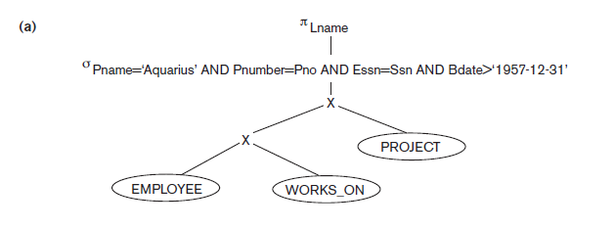
Using Heuristics in Query Optimization
Example:
Find the last names of employees born after 1957 who work on a project named ‘Aquarius’.
  Q: SELECT LNAME
  FROM EMPLOYEE, WORKS_ON, PROJECT
  WHERE PNAME = ‘AQUARIUS’ AND PNMUBER=PNO AND ESSN=SSN AND BDATE > ‘1957-12-31’;
Initial (canonical) query tree

Slide 29
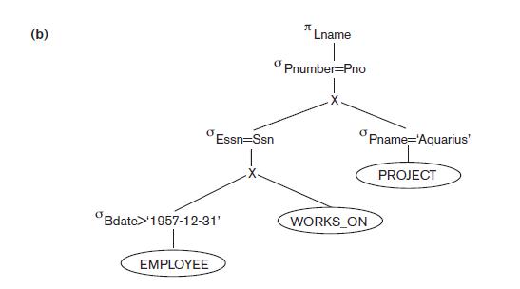
(b) Move SELECT down the query tree

Slide 30
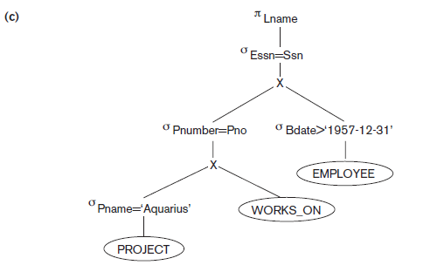
(c)Apply More restrictive SELECT first

Slide 31
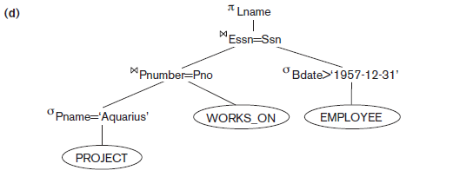
(d) Replace Cartesian product and Select with JOIN

Slide 32
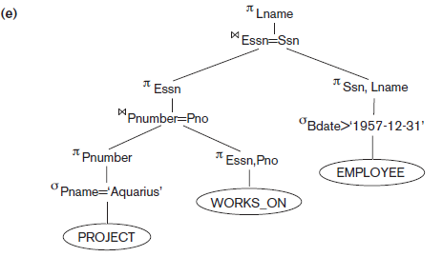
(e) Move Project down the query tree

Slide 33
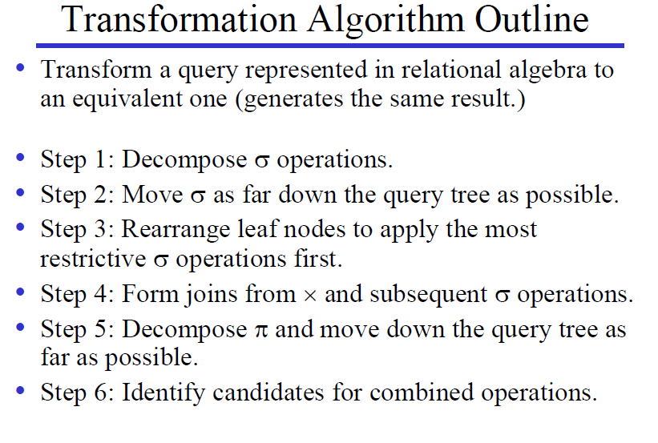

Slide 34
Using Heuristics in Query Optimization
Summary of Heuristics for Algebraic Optimization:
  The main heuristic is to apply first the operations that reduce the size of intermediate results.
  Perform select operations as early as possible to reduce the number of tuples and perform project operations as early as possible to reduce the number of attributes. (This is done by moving select and project operations as far down the tree as possible.)
  The select and join operations that are most restrictive should be executed before other similar operations. (This is done by reordering the leaf nodes of the tree among themselves and adjusting the rest of the tree appropriately.)

Slide 35
Using Heuristics in Query Optimization
Query Execution Plans
  An execution plan for a relational algebra query consists of a combination of the relational algebra query tree and information about the access methods to be used for each relation as well as the methods to be used in computing the relational operators stored in the tree.
  Materialized evaluation: the result of an operation is stored as a temporary relation.
  Pipelined evaluation: as the result of an operator is produced, it is forwarded to the next operator in sequence.

Slide 36
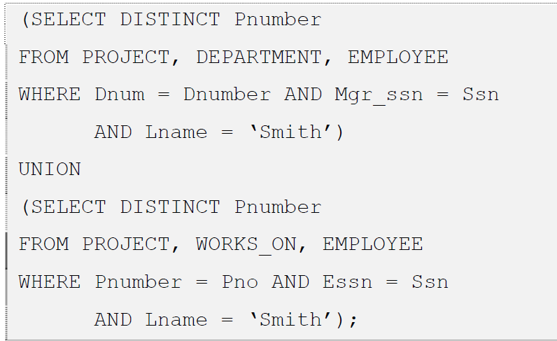
Draw at least two query trees that can represent the query

Slide 37

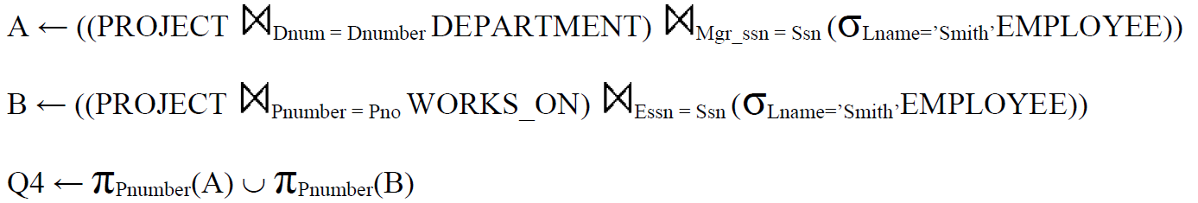
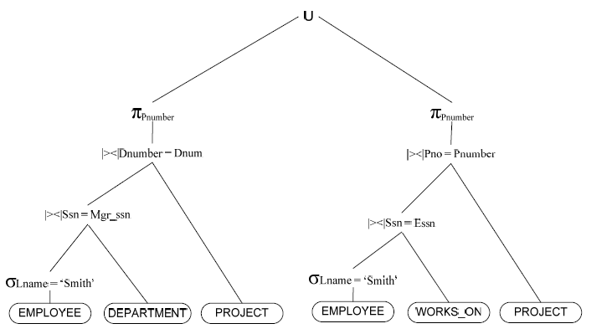

Slide 38
