Slide 1
Multithreading to achieve concurrency

Slide 2
Threads
A thread is a basic unit of CPU utilization, consisting of a program counter, a stack, and a set of registers, ( and a thread ID. )
Traditional processes have a single thread of control - There is one program counter, and one sequence of instructions that can be carried out at any given time.
Multi-threaded applications have multiple threads within a single process, each having their own program counter, stack and set of registers, but sharing common code, data, and certain structures such as opened files

Slide 3
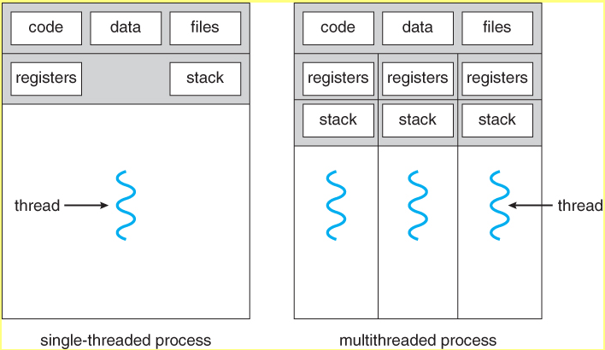

Slide 4
Threads are very useful in modern programming whenever a process has multiple tasks to be performed independently of the others
For example in a word processor, a background thread may check spelling and grammar while a foreground thread processes user input ( keystrokes ), while yet a third thread does periodic automatic backups of the file being edited.

Slide 5
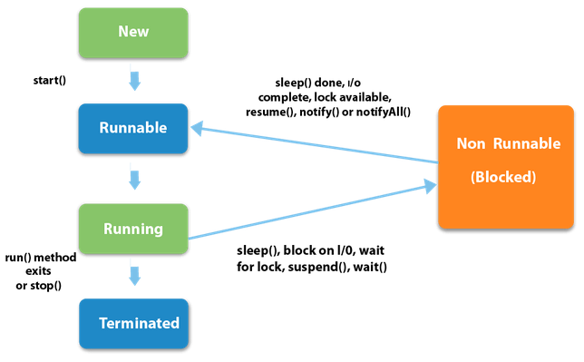
Thread LifeCycle

Slide 6
New: The thread is in new state if you create an instance of Thread class but before the invocation of start() method.
Runnable: The thread is in runnable state after invocation of start() method, but the thread scheduler has not selected it to be the running thread
Running: The thread is in running state if the thread scheduler has selected it

Slide 7
4) Non-Runnable (Blocked): This is the state when the thread is still alive, but is currently not eligible to run
5) Terminated (Dead): A thread is in terminated or dead state when its run() method exits.
In Java, Threads can be created by using two ways: 1. Extending the Thread class 2. Implementing the Runnable Interface:
We create a new class which implements java.lang.Runnable interface and then override run() method.

Slide 8
We create an object of our new class and call start() method to start the execution of a thread.
start() invokes the run() method on the thread object.

Slide 9
How Many Threads are present in the program ?

Slide 10
Thread Priority in Multithreading
In a Multi threading environment, thread scheduler assigns processor to a thread based on priority of thread.
Whenever we create a thread in Java, it always has some priority assigned to it.
Priority can either be given by JVM while creating the thread or it can be given by programmer explicitly.
Priority for a thread is in range of 1 to 10, 1 having least priority.
Whenever a new Java thread is created it has the same priority as the thread which created it.

Slide 11
There are 3 static variables defined in Thread class for priority.
public static int MIN_PRIORITY: This is minimum priority that a thread can have. Value for this is 1.
public static int NORM_PRIORITY: This is default priority of a thread if we do not explicitly define it. Value for this is 5.
public static int MAX_PRIORITY: This is maximum priority of a thread can have. Value for this is 10.

Slide 12
Get and Set Thread Priority:
public final int getPriority(): java.lang.Thread.getPriority() method returns priority of given thread.
public final void setPriority(int newPriority): java.lang.Thread.setPriority() method changes the priority of thread to the value “newPriority”.
This method throws IllegalArgumentException if value of parameter “newPriority” goes beyond minimum(1) and maximum(10) limit

Slide 13
Thread class Methods
public void run(): is used to perform action for a thread.
public void start(): starts the execution of the thread. JVM calls the run() method on the thread.
public void sleep(long milliseconds): Causes the currently executing thread to sleep for the specified number of milliseconds.

Slide 14
public int getPriority(): returns the priority of the thread.
public int setPriority(int priority): changes the priority of the thread.
public String getName(): returns the name of the thread.
public void setName(String name): changes the name of the thread.
Thread(String name)
Thread(Runnable r,String name)

Slide 15
public Thread currentThread(): returns the reference of currently executing thread.
public int getId(): returns the numeric ID of the thread.
public Thread.State getState(): returns the state of the thread.
public boolean isAlive(): tests if the thread is alive.
public void yield(): causes the currently executing thread object to temporarily pause and allow other threads to execute.

Slide 16
public void suspend(): is used to suspend the thread.
public void resume(): is used to resume the suspended thread.
public void stop(): is used to stop the thread.
void join(): It waits for a thread to die. It is used when you want a thread to wait for completion of another thread.
public boolean isDaemon(): tests if the thread is a daemon thread.
public void setDaemon(boolean b): marks the thread as daemon or user thread.

Slide 17
void notify() :used to wake up a single thread.
If we use notify() method and multiple threads are waiting for the notification then only one thread gets the notification and the remaining thread have to wait for further notification.
void notifyAll(): It is used to give the notification to all waiting threads of a particular object.

Slide 18
Issues with concurrency
With multithreading, there is a possibility of two or more threads trying to use the same limited resource at once.
Hence, Colliding over a resource must be prevented

Slide 19
1. Improperly accessing resources :
Consider a class which "guarantees" that it will always deliver an even number when you call getValue( ).
However, there's a second thread named "Watcher" that is constantly calling getValue( ) and checking whether i’s value is truly even or not.

Slide 20
public class AlwaysEven {
private int i;
public void next() { i++; i++; }
public int getValue() { return i; }
public static void main(String[ ] args) {
AlwaysEven ae = new AlwaysEven();
new Thread("Watcher") {
public void run() {
while(true) {
int val = ae.getValue();
if(val % 2 != 0) { System.out.println(val); System.exit(0);}
}
} // end run()
} .start();
while(true) ae.next(); } }

Slide 21
The fundamental problem with using threads is that “You never know when a thread might be run”
Imagine sitting at a table with a fork, about to spear the last piece of food on your plate, and as your fork reaches for it, the food suddenly vanishes (because your thread was suspended and another thread came in).
That's the problem that you're dealing with when writing concurrent programs.
For multithreading to work, you need some way to prevent two threads from accessing the same resource, at the same time, at least during critical periods.

Slide 22
Preventing this kind of collision is simply a matter of putting a lock on a resource when one thread is using it. The first thread that accesses a resource locks it, and then the other threads cannot access that resource until it is unlocked
If the front seat of the car is the limited resource, the child who shouts "Dibs!" asserts the lock.

Slide 23
2. Resolving shared resource contention:
Resource contention is a conflict over access to a shared resource such as random access memory, disk storage, cache memory, internal buses or external network devices
Access to resources is also sometimes regulated by locks, mutexes, queuing (i.e. scheduler)
If thread A has a lock and thread B wants to acquire that same lock, thread B will have to wait until thread A releases the lock or the O.S. pre-empts thread A.

Slide 24
3. Race Condition
A race condition occurs when two or more threads can access shared data and they try to change it at the same time.
Since the thread scheduling algorithm can swap between threads at any time, we don't know the order in which the threads will attempt to access the shared data.
Therefore, the result of the change in data completely dependents on the thread scheduling algorithm, i.e. both threads are "racing" to access/change the data.

