Slide 1
ASSEMBLER

Slide 2
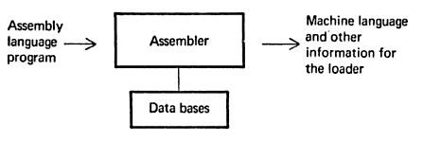
Assembler
Basic Assembler functions:
Translating mnemonic language to its equivalent object code.
Assigning machine addresses to symbolic labels.

Slide 3
ASSEMBLER
General Instruction Format :
Label:- Is optional.
Opcode:- Symbolic opcode
Operand:- Symbolic name (Register or Memory variable)
[Label *]
[opcode]
[operand1]*, [operand2]*
Notes:
LABEL FIELD
when processed by assembler it will store this label and its information.
Example:JHON,DATA
<number>

Slide 4
A simple assembly language
I am always a register..!!!
Statement
Operand1
Operand2
I am always a symbolic name..!!!

Slide 5
Mnemonic Operation Codes
Instruction Opcode | Assembly Mnemonic | Remarks
00 | STOP | Stop Execution
01 | ADD | Op1 ← Op1+ Op2
02 | SUB | Op1 ← Op1 – Op2
03 | MULT | Op1 ← Op1* Op2
04 | MOVER | CPU Reg ← Memory operand
05 | MOVEM | Memory ← CPU Reg
06 | COMP | Sets Condition Code
07 | BC | Branch on Condition
08 | DIV | Op1 ← Op1/ Op2
09 | READ | Operand 2 ← input Value
10 | PRINT | Output ← Operand2

Slide 6
MOVER and MOVEM
MOVEM
MOVEM
Source
, Dest
MOVER
MOVER
Dest
, Source

Slide 7
Assembler: Types of Staetments
Assembly language consist of three kinds of statements
1. Imperative statements
Imperative assembly language statements indicates actions to be performed during the execution of the assembled program. Hence each imperative statement translates into machine instruction.

Slide 8
Assembler: Types of Statements
1. Imperative statements
Example:
MOVEM AREG , B
MOVER AREG , C
ADD AREG , ONE
COMP AREG , =‘1’
SUB BREG , =‘2’

Slide 9
Assembler: Types of Statements
2. Declarative statements:
A declarative statement assembly language statement declares constants or storage areas in a program.
e.g.
i) A DS 1 ii) G DS 200
These statements simply declares a storage area of 1 word and block of 200 words respectively.
Constants are declared using Declare Constant (DC) statement.
e.g. ONE DC ‘1’

Slide 10
Assembler: Types of Statements
3. Assembler Directives:
Assembler Directives neither represent machine instructions instead of that they direct the assembler to take certain actions during the process of assembling a program.
e.g. START 100
This statement indicates that the first word of the object program generated by the assembler should be placed in the memory location with address ‘100’
END
Indicates end of assembly language program

Slide 11
The Process of Translation
The general model for the translation process can be represented as follows:
Analysis of Synthesis of Translation from Source Source Text + Source Text = to Target Text
Analysis Phase:
In the analysis phase , we are concerned with the determination of meaning of a source language text, for that we should know the grammar of source language . Further we should also know how to determine the meaning of a statement once its grammatical structure becomes known. The rules of grammar and rules of meanings are known as syntax and semantics of language respectively.
Notes:
<number>

Slide 12
General Design Procedure of Assembler
Synthesis Phase:
In the synthesis phase , the source language statements are replaced by target language statements.
Assembly Language Program
Equivalent Target Code
Analysis Phase
Synthesis Phase

Slide 13
General Design Procedure of Assembler
1. Analysis Phase.
In this phase following functions are performed.
Isolate the label, mnemonic operation code and operand fields of a statement
Enter the symbol found in label field (if any) and its address into Symbol Table.
Validate the mnemonic operation code by looking it up in the Mnemonic Table.
Determine the storage requirements of the statement by considering the mnemonic operation code and operand fields of the statement. Calculate the address of the first machine word following the target code generated for this statement (Location Counter processing).

Slide 14
General Design Procedure of Assembler
2. Synthesis Phase.
In this phase following functions are performed.
Obtain the machine operation code corresponding to the mnemonic operation code by searching the Mnemonic table.
Obtain address of the operand from Symbol table.
Synthesis the machine instruction or the machine form of the constant, as the case may be.

Slide 15
Some Assembler Directives
1. ORIGIN
This directive sets the location counter to the given address.
e.g. ORIGIN 200
sets the location counter(LC) value to 200.
2. EQU
The EQU statement simply defines a new symbol and gives it the value indicated by operand expressions.
e.g. FIRTST EQU LAST

Slide 16
Some Assembler Directives
3. LTORG
While assembling, a reference to literal, the following care should be taken:
i ) Allocation of machine location to contain the value of the literal during execution and
ii) Use of the address of this location as the operand address in the statement referencing the literal.
At every LTORG , statement assembler allocates all literals used in the program .

Slide 17
Some Assembler Directives
Sample program to find X+Y
Program to Find ……… numbers:
START 101
READ X
READ Y
MOVER AREG, X
ADD AREG, Y
MOVEM AREG, RESULT
PRINT RESULT
STOP
X DS 1
Y DS 1
RESULT DS 1
END

Slide 18
Sample program to find X+Y
Find X+Y
Register
Memory operand
Opcode
START 101
READ X
READ Y
MOVER AREG, X
ADD AREG, Y
MOVEM AREG, RESULT
PRINT RESULT
STOP
X DS 1
Y DS 1
RESULT DS 1
END
LC
101
102
103
104
105
106
107
108
109
110
+ 09 0 108
+ 09 0 109
+ 04 1 108
+ 01 1 109
+ 05 0 110
+ 10 0 110
+ 00 0 000

Slide 19
Required M/C Code
LC | Opcode | Register | Address
101 | 09 | 0 | 108
102 | 09 | 0 | 109
103 | 04 | 1 | 108
104 | 01 | 1 | 109
105 | 05 | 0 | 110
106 | 10 | 0 | 110
107 | 00 | 0 | 000
108
109
110
111
Variable | Address
X | 108
Y | 109
RESULT | 110
After LC Processing

Slide 20
Literals & Constants
int x=5;
x = x + 5; Constant
Literal cannot be changed during program execution
Literal is more safe and protected than a constant.

Slide 21
START 101
READ N
MOVER BREG, ONE
MOVEM BREG, TERM
AGAIN MULT BREG, TERM
MOVER CREG, TERM
ADD CREG, ONE
MOVEM CREG, TERM
COMP CREG, N
BC LE, AGAIN
MOVEM BREG, RESULT
PRINT RESULT
STOP
N DS 1
RESULT DS 1
ONE DC ‘1’
TERM DS 1
END
+ 09 0 113
+ 04 2 115
+ 05 2 116
+ 03 2 116
+ 04 3 116
+ 01 3 115
+ 05 3 116
+ 06 3 113
+ 07 2 104
+ 05 2 114
+ 10 0 114
+ 00 0 000

Slide 22
START 101
READ N
MOVER BREG, ONE
MOVEM BREG, TERM
AGAIN MULT BREG, TERM
MOVER CREG, TERM
ADD CREG, ONE
MOVEM CREG, TERM
COMP CREG, N
BC LE, AGAIN
DIV BREG, TWO
MOVEM BREG, RESULT
PRINT RESULT
STOP
N DS 1
RESULT DS 1
ONE DC ‘1’
TERM DS 1
TWO DC ‘2’
END
+ 09 0 114
+ 04 2 116
+ 05 2 117
+ 03 2 117
+ 04 3 117
+ 01 3 116
+ 05 3 117
+ 06 3 114
+ 07 2 104
+ 08 2 118
+ 05 0 115
+ 10 0 115
+ 00 0 000

Slide 23
Some Assembler Directives
Sample program
Program to Find …….numbers:
START 101
READ N
MOVER BREG, ONE
MOVEM BREG, TERM
AGAIN MULT BREG, TERM
MOVER CREG, TERM
ADD CREG, ONE
MOVEM CREG, TERM
COMP CREG, N
BC LE, AGAIN
MOVEM BREG,RESULT
PRINT RESULT
STOP
N DS 1
TERM DS 1
RESULT DS 1
ONE DC ‘1’
END

Slide 24
Types of Assembler
1. Multi-pass Assembler
2. Single-pass Assembler
An Assembler pass is one complete scan of the source program input an assembler.
Single-pass Assembler:
- Single-pass assembler have the advantage that every source statement processed only once.
- Single pass assembler would face a problem while translating forward references.
- This problem can be solved as below:

Slide 25
Single-pass Assembler
Instructions containing forward references can be left incomplete until address of the referenced symbol becomes known. These incomplete instructions are placed into a table called as Table of Incomplete Instructions (TII).
- The problem of forward reference can be handled using a technique called as back patching.(In encountering its definition, its address can be filled into that instruction.)
Notes:
aSSEMBLER
Two Pass Assemblers
Two Pass Assemblers
Eliminating forward reference to data items can be easily done.
Simply ask the programmer to define variables before using them.
However, eliminating forward reference to instruction cannot be easily done.
Sometimes your program needs a forward jump.
Asking your program to use only backward jumps is too restrictive.
DESIGN OF TWO PASS ASSEMBLERS
An assembler is a translator, that translates an assembler program into a conventional machine language program. Basically, the assembler goes through the program one line at a time and generates machine code for that instruction. Let us see two pass assemblers
Then the assembler processes to the next instruction. In this way, the entire machine code program is created
What is the difference between one pass and two pass assembler?
WHAT IS A SINGLE PASS ASSEMBLER?
It is an assembler that generally generates the object code directly in memory for immediate execution.
It parses through your source code only once and you are done.
Now let us see how a two pass assembler works.
Simple, while on its way, if the assembler encounters an undefined label, it puts it into a symbol table along with the address where the undefined symbol’s value has to be placed when the symbol is found in future
As explained, the one-pass assembler cannot resolve forward references of data symbols.
<number>

Slide 26
START 100
MOVER AREG, X
L1 ADD BREG, ONE
ADD CREG, TEN
STOP
X DC ‘5’
ONE DC ‘1’
TEN DC ‘10’
END

Slide 27
2. Multi-pass Assembler
- Multi pass assemble resolves the problem of forward reference by using more than one passes.
- In first pass analysis is takes place in which LC processing is performed and symbols defined in the program are entered into the symbol table.
- During the second pass, statements are processed or synthesized to generate machine instructions.
Assembly Language Program
Equivalent Target Code
Intermediate Code
Pass I
Pass II

Slide 28
Two Pass Assembler
Handles forward references easily.
Requires 2 scans of the source program.
LC processing is performed in the 1st pass and symbols are stored in the symbol table.
Second pass synthesis Target Program.
Notes:
The main reason why most assemblers use a 2-pass system is to address the problem of forward references — references to variables or subroutines that have not yet been encountered when parsing the source code. A strict 1-pass scanner cannot assemble source code which contains forward references. Pass 1 of the assembler scans the source, determining the size and address of all data and instructions; then pass 2 scans the source again, outputting the binary object code.Some assemblers have been written to use a 1.5 pass scheme, whereby the source is only scanned once, but any forward references are simply assumed to be of the largest size necessary to hold any native machine data type . The unknown quantity is temporarily filled in as zero during pass 1 of the assembler, and the forward reference is added to a ‘fix-up list’. After pass 1, the ‘.5’ the pass goes through the fix-up list and patches the output machine code with the values of all resolved forward references. This can result in sub-optimal opcode construction but allows for a very fast assembly phase.
<number>

Slide 29
Two Pass Assembler
ASSEMBLY
LANGUAGE
PROGRAM
EXECUTABLE
IMAGE
PASS1
PASS2
SYMBOL
TABLE
First Pass:
scan program file
find all labels and calculate the corresponding addresses; this is called the symbol table
Second Pass:
convert instructions to machine language, using information from symbol table

Slide 30
Pass structure of assembler
Data Structures
Pass I
Pass II
Target Program
Source Program
Intermediate Code
Figure: Overview of Two Pass Assembler
Notes:
DIFFERENCE BETWEEN ONE PASS AND TWO PASS ASSEMBLER
One Pass Assembler The one pass assembler passes over the file once, that is it collects all the information in one loop. It Collects labels and also resolves future references There is a major problem of future referencing Assembles assembly code in one pass It creates an intermediate file which acts as an input to two pass assembler
Two Pass Assembler As the name suggests two pass assembler does two passes over the source file. In first pass, all it does is looks for label definitions and introduces them in the symbol table (a dynamic table which includes the label name and address for each label in the source program). In the second pass, after the symbol table is complete, it does the actual assembly by translating the operations into machine codes and so on.
<number>

Slide 31
Data Structures Used in an Assembler
Following Data Structures are used in Pass-I of an Assembler:
1. OTAB (Opcode Table)
2. SYMTAB ( Symbol Table)
3. LITTAB (Literal Table)
4. POOLTAB(Literals Pools)

Slide 32
Some Assembler Directives
Sample program ILLUSTRATING ORIGIN & LTORG DIRECTIVE
1 START 200
2 MOVER AREG, =‘5’
3 MOVEM AREG, A
LOOP MOVER AREG, A
MOVER CREG, B
ADD CREG, =‘1’
…………………
12 BC ANY,NEXT
LTORG
=‘5’
=‘1’
………………..
NEXT SUB AREG, =‘1’
BC LT, BACK
LAST STOP
ORIGIN LOOP+2
MULT CREG, B
ORIGIN LAST +1
A DC 5
BACK EQU LOOP
B DC ‘1’
END
=‘1’

Slide 33
Some Assembler Directives
Sample program ILLUSTRATING ORIGIN & LTORG DIRECTIVE
1 START 200
2 MOVER AREG, =‘5’ 200) 04 1 211
3 MOVEM AREG, A 201) 05 1 217
LOOP MOVER AREG, A 202) 04 1 217
MOVER CREG, B 203) 05 3 218
ADD CREG, =‘1’ 204) 01 3 212
…………………
12 BC ANY, NEXT 210) 07 6 214
LTORG
=‘5’ 211) 00 0 005
=‘1’ 212) 00 0 001
………………..
NEXT SUB AREG, =‘1’ 214) 02 1 219
16 BC LT, BACK 215) 07 1 202
17 LAST STOP 216) 00 0 000
18 ORIGIN LOOP+2
19 MULT CREG, B 204) 03 3 218
20 ORIGIN LAST +1
21 A DS 1 217)
BACK EQU LOOP
B DC ‘1’ 218)
END
=‘1’ 219)
Notes:
The literals =’5’ and =’1’ are added to the literal pool in the statement 2 and 6 respectively. The first LTORG statement allocates the addresses 211 and 212 to the values ‘5’ and ‘1’. A new literal pool is now started. The value ‘1’ is put into this pool in statement 15
<number>

Slide 34
1. OPTAB (Opcode Table)
Mnemonic Opcode | Class | Machine Opcode/ Routine ID | Length
START | 3 ( Directive) AS | R#11 | -
MOVER | 1 (Imperative) IS | 04 | 1
DS | 2 (Declarative) DL | R#7 | -
START | 3 ( Directive) AS | R#11 | -
MOVEM | 1 (Imperative) IS | 05 | 1
Notes:
Data Structures Used in Pass-I of an Assembler
<number>

Slide 35
2. SYMTAB (Symbol Table)
Symbol | Address | Length
LOOP | 202 | 1
NEXT | 214 | 1
LAST | 216 | 1
A | 217 | 1
BACK | 202 | 1
B | 218 | 1

Slide 36
Data Structures Used in Pass-I of an Assembler
3. LITTAB (Literal Table)
Literal | Address
=‘5’ | 211
=‘1’ | 212
=‘1’ | 219
first | #literals
1 | 2
3 | 1
4 | 0
Next Free entry
Current Pool Pointer

Slide 37
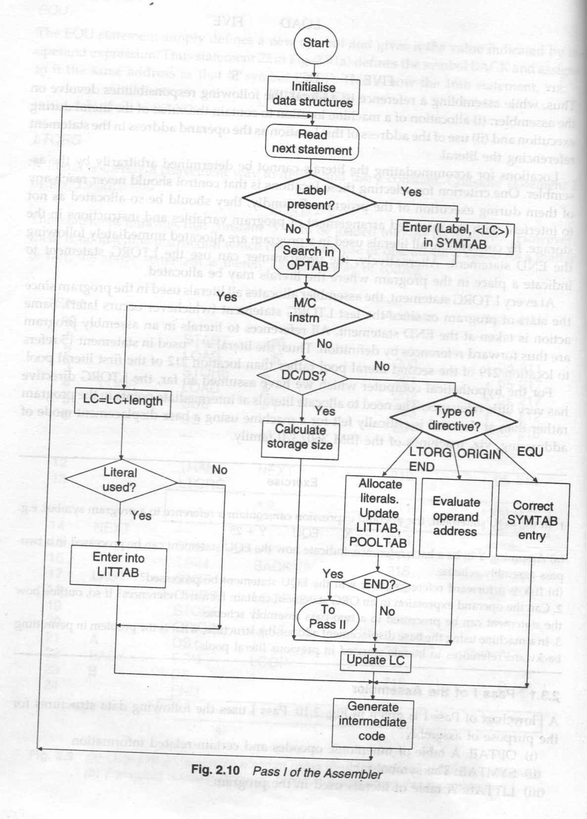
Pass-I of an Assembler

Slide 38


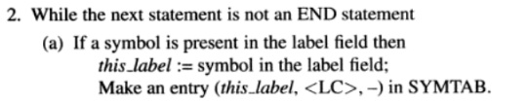
PASS-1 Algorithm

Slide 39
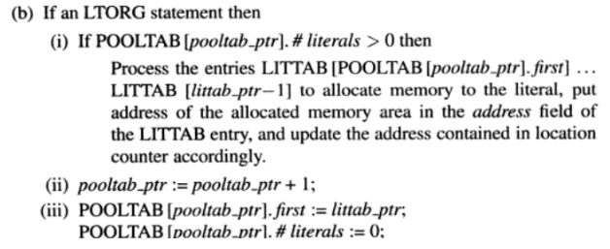
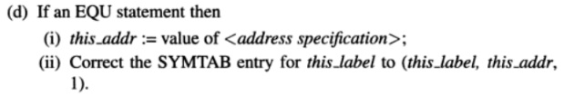
Notes:
<number>

Slide 40
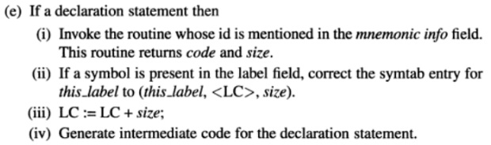
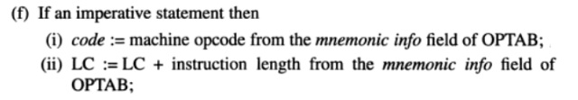

Slide 41
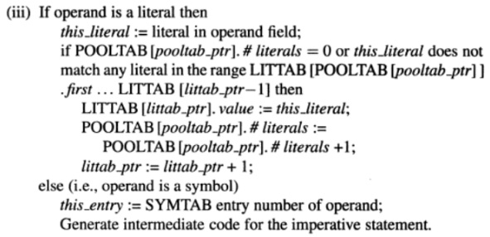


Slide 42
Pass 1 purpose: Define symbols and literals
Determine length of machine instructions
Keep track of location counter (LC)
Remember values of symbols until pass 2
Process some pseudo ops, e.g. EQU, DS
Remember literals

Slide 43
Pass Structure of Assembler
Single Pass Translation Example
START 100
MOVER AREG, X
ADD BREG, ONE
ADD CREG, TEN
STOP
X DC ‘5’
ONE DC ‘1’
TEN DC ‘10’
END
17/12/2020
<number>

Slide 44
Pass Structure of Assembler
Single Pass Translation Example
START 100
MOVER AREG, X
ADD BREG, ONE
ADD CREG, TEN
STOP
X DC ‘5’
ONE DC ‘1’
TEN DC ‘10’
END
04 1 _ _ _
01 2 _ _ _
06 3 _ _ _
00 0 000
Instruction Address | Symbol Making a forward reference
100 | X
101 | ONE
102 | TEN
Symbol | Address
X | 104
ONE | 105
TEN | 105
Figure : Symbol Table
Figure : TII (Table of Incomplete Instruction)
<number>

Slide 45
Pass Structure of Assembler
Single Pass Translation Example
START 100
MOVER AREG, X
ADD BREG, ONE
ADD CREG, TEN
STOP
X DC ‘5’
ONE DC ‘1’
TEN DC ‘10’
END
04 1 104
01 2 105
06 3 106
00 0 000
Notes:
<number>

Slide 46
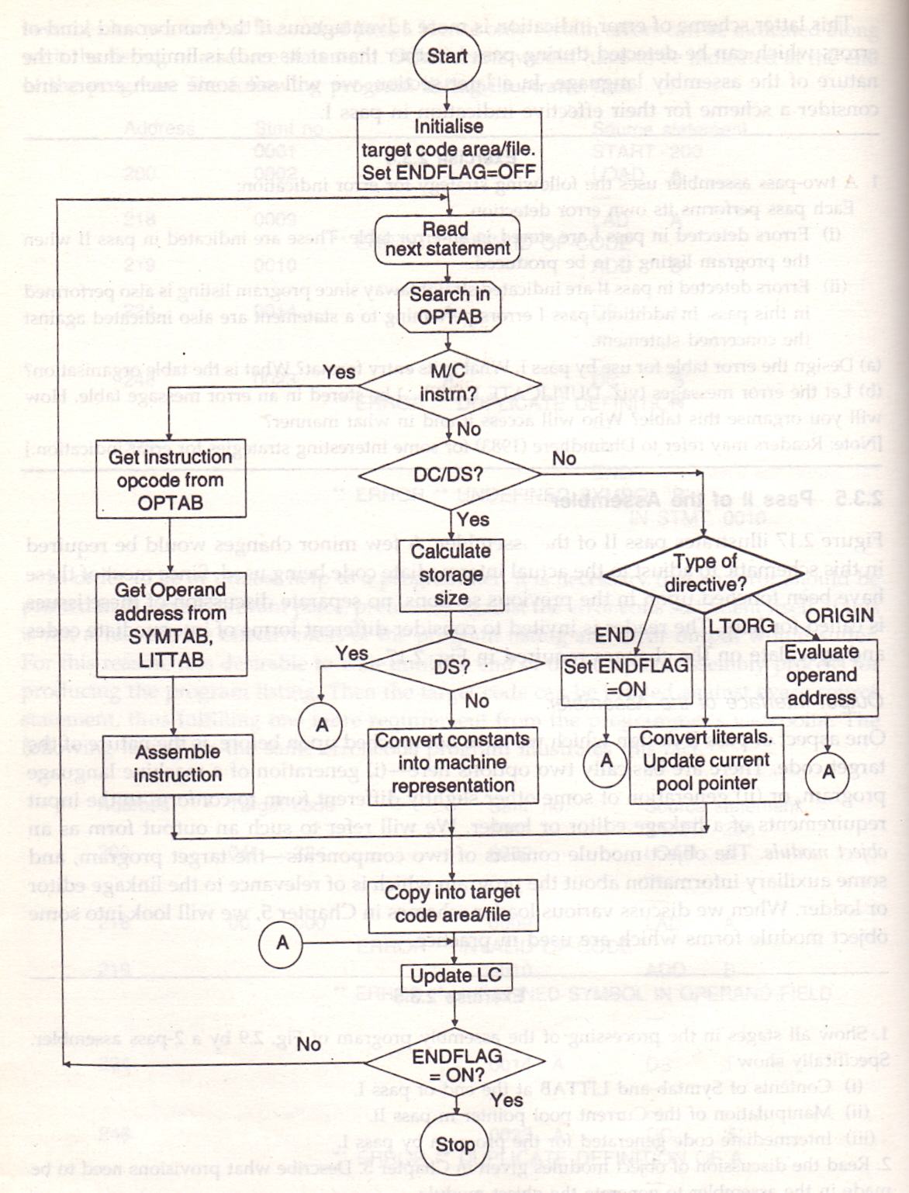
Pass-II of an Assembler

Slide 47
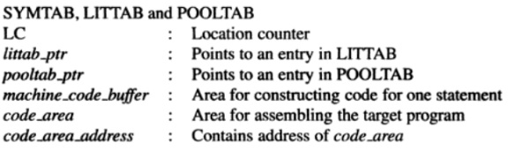
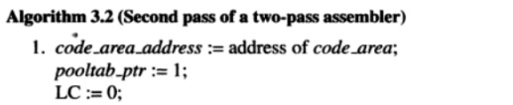
PASS – 2 of assembler

Slide 48
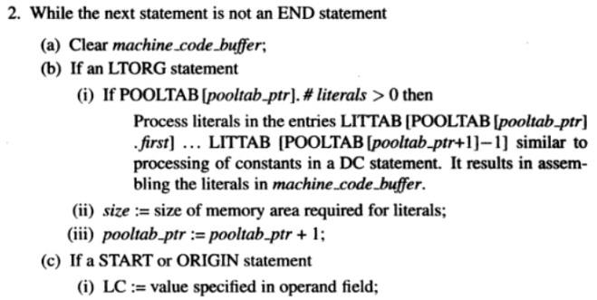
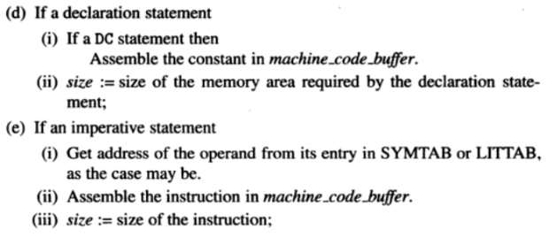
Notes:
<number>

Slide 49


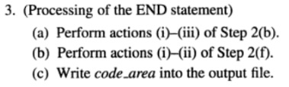

Slide 50
Pass 2 purpose: Generate object program
Look up value of symbols
Generate instructions
Generate data (for DS, DC and literals)
Process pseudo ops codes

Slide 51
Design of a two pass assembler
1. Separate label, opcode & operand
2. Build the symbol table
1st pass
3. Perform LC processing
4. Construct IC

Slide 52
2nd Pass
2nd Pass
Synthesize the machine instruction

Slide 53
Example
START 200
MOVER AREG, =‘5’
MOVEM AREG, X
L1 MOVER BREG, =‘2’
ORIGIN L1+3
LTORG
NEXT ADD AREG,=‘1’
SUB BREG,=‘2’
BC LT, BACK
LTORG
BACK EQU L1
ORIGIN NEXT+5
MULT CREG,=‘4’
STOP
X DS 1
END
LC
200
201
202
205
206
207
208
209
210
211
212
212
213
214

Slide 54
START 200
Symbol | Address
Literal | Address
First | #literal
1 | 0
MOVER AREG,=‘5’
200
Symbol | Address
Literal | Address
=‘5’ | ---
First | #literal
1 | 0

Slide 55
MOVEM AREG,X
201
Symbol | Address
X | ----
Literal | Address
=‘5’ | ---
First | #literal
1 | 0
L1 MOVER BREG,=‘2’ 202
Symbol | Address
X | ----
L1 | 202
Literal | Address
=‘5’ | ---
=‘2’ | ---
First | #literal
1 | 0

Slide 56
ORIGIN L1+3
203
Symbol | Address
X | ----
L1 | 202
Literal | Address
=‘5’ | ---
=‘2’ | ---
First | #literal
1 | 0
LTORG 205
206
Symbol | Address
X | ----
L1 | 202
Literal | Address
=‘5’ | 205
=‘2’ | 206
First | #literal
1 | 2

Slide 57
NEXT ADD AREG, =‘1’
207
Symbol | Address
X | ----
L1 | 202
NEXT | 207
Literal | Address
=‘5’ | 205
=‘2’ | 206
=‘1’ | ----
First | #literal
1 | 2
3 | 0
SUB BREG,=‘2’ 208
Symbol | Address
X | ----
L1 | 202
NEXT | 207
Literal | Address
=‘5’ | 205
=‘2’ | 206
=‘1’ | ----
=‘2’ | -----
First | #literal
1 | 2
3 | 0

Slide 58
BC LT, BACK
209
Symbol | Address
X | ----
L1 | 202
NEXT | 207
BACK | ----
Literal | Address
=‘5’ | 205
=‘2’ | 206
=‘1’ | ----
=‘2’ | ----
 | #literal
1 | 2
3 | 0
LTORG 210
211
Symbol | Address
X | ----
L1 | 202
NEXT | 207
Literal | Address
=‘5’ | 205
=‘2’ | 206
=‘1’ | 210
=‘2’ | 211
First | #literal
1 | 2
3 | 2
5 | 0

Slide 59
BACK EQU L1
212
Symbol | Address
X | ----
L1 | 202
NEXT | 207
BACK | 202
Literal | Address
=‘5’ | 205
=‘2’ | 206
=‘1’ | 210
=‘2’ | 211
First | #literal
1 | 2
3 | 2
5 | 0
ORIGIN NEXT+5 213
Symbol | Address
X | ----
L1 | 202
NEXT | 207
BACK | 202
Literal | Address
=‘5’ | 205
=‘2’ | 206
=‘1’ | 210
=‘2’ | 211
First | #literal
1 | 2
3 | 2
5 | 0

Slide 60
MULT CREG,=‘4’
212
Symbol | Address
X | ----
L1 | 202
NEXT | 207
BACK | 202
Literal | Address
=‘5’ | 205
=‘2’ | 206
=‘1’ | 210
=‘2’ | 211
=‘4’ | ----
First | #literal
1 | 2
3 | 2
5 | 0
STOP 213
Symbol | Address
X | ----
L1 | 202
NEXT | 207
BACK | 202
Literal | Address
=‘5’ | 205
=‘2’ | 206
=‘1’ | 210
=‘2’ | 211
=‘4’ | ----
First | #literal
1 | 2
3 | 2
5 | 0

Slide 61
X DS 1
214
Symbol | Address
X | 214
L1 | 202
NEXT | 207
BACK | 202
Literal | Address
=‘5’ | 205
=‘2’ | 206
=‘1’ | 210
=‘2’ | 211
=‘4’ | ----
First | #literal
1 | 2
3 | 2
5 | 0
END
Literal | Address
=‘5’ | 205
=‘2’ | 206
=‘1’ | 210
=‘2’ | 211
=‘4’ | 215
First | #literal
1 | 2
3 | 2
5 | 1
6 | 0
Symbol | Address
X | 214
L1 | 202
NEXT | 207
BACK | 202

Slide 62
General Design Procedure:
Specify the Problem
Specify Data Structure
Define Format of Data Structure
Specify Algorithm
Look for modularity
Repeat 1 through 5 on modules

Slide 63
Intermediate code Form
Intermediate code for Declarative Statements
DC 01
DS 02
Intermediate code for Assembler directives
START 01
END 02
ORIGIN 03
EQU 04
LTORG 05
THE MNEMONICS OPCODE FIELD CONTAIN A PAIR IN THE FORM
(Statement Class, Code)
Intermediate code for Imperative statements

Slide 64
Intermediate code Form
3. Intermediate code for Imperative statements
Consist of two variant of IC code (Differs in information contained in the operand fields)
Variant 1
Variant 2

Slide 65
Intermediate code Form
3. Intermediate code for Imperative statements (Variant 1):
The first operand(CPU Register) is represented by single digit number. E.g. 1 represents AREG, 2 represent BREG e.t.c.
The second operand is a memory operand is represented by pair of form as follows:
(OPERAND CLASS, CODE)
OPERAND CLASS:
Class | Meaning
C | Constant
S | Symbol
L | Literals

Slide 66
Syntax for BC
BC
Condition code
Memory Address
LT, LE, EQ, GT, GE, ANY
What if we want to have an unconditional jump?

Slide 67
Intermediate code Form
3. Intermediate code for Imperative statements (Variant 1):
First operand
Second operand
Represented by single digit number.
memory operand is represented by pair of
(OPERAND CLASS, CODE)
BC | No.
LT | 1
LE | 2
EQ | 3
GT | 4
GE | 5
ANY | 6
Register | No
AREG | 1
BREG | 2
CREG | 3
DREG | 4
Operand class
C | Constant
S | Symbol
L | Literal

Slide 68
Intermediate code Form
Intermediate code for Imperative statements (Variant 1):
START 200 (AD,01) (C,200)
READ A (IS,09) (S,01)
LOOP MOVER AREG,A (IS,04) (1)(S,01)
…………..
…………..
…………..
SUB AREG, =‘1’ (IS,02) (1) (L,01)
BC GT, LOOP (IS,07) (4) (S,02)
STOP (IS,00)
A DS 1 (DL,02) (C,1)
LTORG (AD,05)
……………

Slide 69
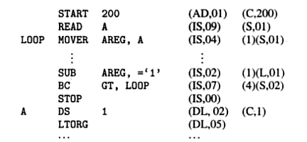
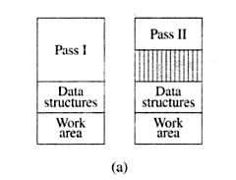
Variants 1 of IC

Slide 70
Intermediate code Form
Intermediate code for Imperative statements (Variant 2):
Operand field of intermediate code may be same as variant 1 or In source form itself.
Declarative statement & Assembler directives has to process to support LC processing.
Literals are referenced & their entries are made in LITTAB.(L,m)

Slide 71
Intermediate code Form
Intermediate code for Imperative statements (Variant 2):
START 200 (AD,01) (C,200)
READ A (IS,09) A
LOOP MOVER AREG,A (IS,04) AREG,A
…………..
…………..
…………..
SUB AREG, =‘1’ (IS,02) AREG (L,01)
BC GT, LOOP (IS,07) GT, LOOP
STOP (IS,00)
A DS 1 (DL,02) (C,1)
LTORG (DL,05)
……………

Slide 72
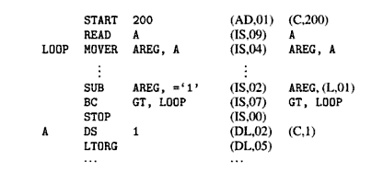
Variant - 2 of IC

Slide 73
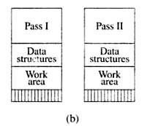
Variant-2 of IC

Slide 74
Variants of IC
Extra work in Pass I
Simplified Pass II
Pass I code occupies more
memory than code of Pass II
Does not simplify the task of Pass II or save much memory in some situation.
IC is less compact
Memory required for two passes
would be better balanced
So better memory utilization

Slide 75
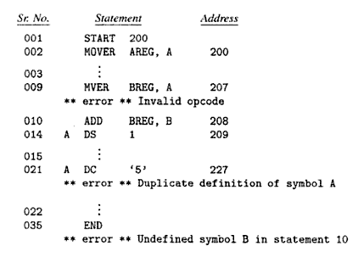
Error Reporting

Slide 76
Machine Dependent and Machine Independent features of Assembler
M/C Dependent Features
A] Instruction format & addr. mode:-
B] Program Relocation
Machine Independent Assembler Features
1) Literals
2) Symbol defining statements
3) Expressions

Slide 77
2. Literal
?????
Operand with syntax = ‘ value ’
What is the Difference between literal and constant..??
ADD AREG, =‘5’
The location of a literal cant be specified. So its value cant be changed like constant…

Slide 78
2. Literal
?????
What is the Difference between literal and immediate operand..??
( Literal )
ADD AREG, =‘5’
No Architectural provision is needed for literal like immediate operand..
( Imm. operand )
ADD AREG,5

Slide 79


Slide 80


