Slide 1
Linker
Presented By:
Sangeeta Ranjan
17/12/2020
1

Slide 2
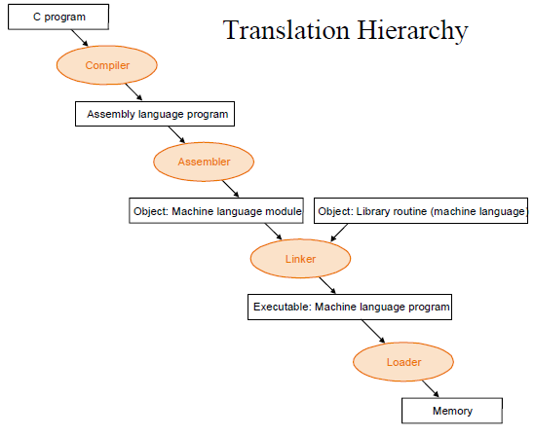
17/12/2020
1

Slide 3
Linker
The Linker is the software program which binds many object modules to make a single object program.(Done Automatically when program is executed).
Three tasks:-
Searches the program to find library routines used by program, e.g. Printf(), sqrt(), strcat() and various other.
Determines the memory locations that code from each module will occupy and relocates its instructions by adjusting absolute references.
Relocation, which modifies the object program so that it can be loaded at an address different from the location originally specified.
17/12/2020
1
Notes:
Linking
The Process of merging many object modules to form a single object program is called as linking.
Linker
A program is first written using any editor of programmer's choice in form of a text file, then it has to be compiled in order to translate the text file into object code that a machine can understand and execute.
The program we write might make use of other programs (which is usually the case), or libraries of programs. These other programs or libraries must be brought together with the program we write in order to execute it.
Linking is the process of bringing external programs together required by the one we write for its successful execution. Static and dynamic linking are two processes of collecting and combining multiple object files in order to create a single executable.
1

Slide 4
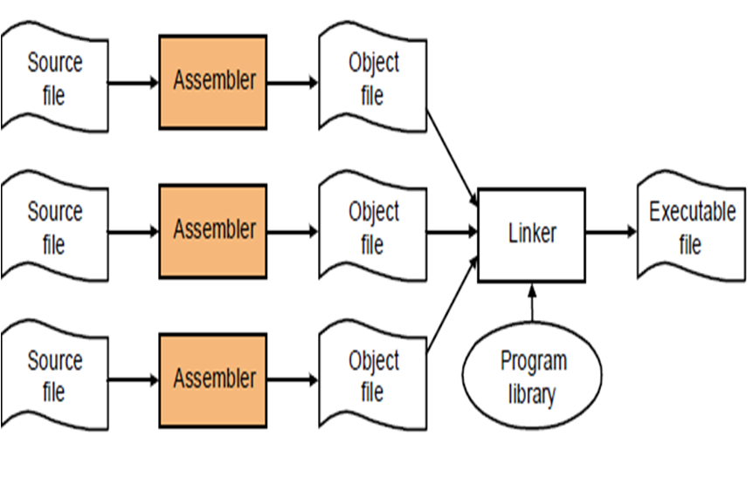
17/12/2020
1

Slide 5
Relocation and linking concepts
Execution of a program written in a language L involves following steps:
Translation of the program by translator of language L
Linking of the program with other program needed for its execution by a linker
Relocation of the program to execute from the specific memory area allocated to it by a linker
Loading of the program in the memory for the purpose of execution by a loader
17/12/2020
1
Notes:
1

Slide 6
Relocation and linking concepts
Schematic of program execution
Data
Translator
Linker
Loader
Binary Program
Result
Source Program
Object Module
Binary Program
Data flow
Control flow
Figure: Schematic of program execution
17/12/2020
1
Notes:
1

Slide 7
Linking Concepts
Computer programs typically comprise several parts or modules; all these parts/modules need not be contained within a single object file, and in such case refer to each other by means of symbols. Typically, an object file can contain three kinds of symbols:
Publicly defined symbols, which allow it to be called by other modules , also called as public definition .
Externally defined symbols(undefined symbols), which calls the other modules where these symbols are defined, also called as external reference.
Local symbols, used internally within the object file to facilitate relocation.

Slide 8
Relocation and linking concepts
Translated, linked and load time addresses
Translated origin: address of the origin assumed by translator which is specified by the programmer in an ORIGIN or START statement.
Linked origin: address of the origin assigned by the linker while Linking a binary program.
Load time (or load) address : address of the origin assigned by the loader while loading the program for execution.
17/12/2020
1
Notes:
1

Slide 9
Relocation and linking concepts
Translated, linked and load time addresses example
 | Statement |  | Address | Code
 | START | 500
 | EXTRN | MAX, ALPHA
 | READ | A | 500) | + 09 0 540
LOOP | . |  | 501)
 | .
 | MOVER | AREG, ALPHA | 518) | + 04 1 000
 | BC | ANY, MAX | 519) | + 06 6 000
 | .
 | .
 | BC | LT, LOOP | 538) | + 06 1 501
 | STOP |  | 539) | + 00 0 000
A | DS | 1 | 540)
TOTAL | DS |  | 541)
 | END
Translated origin of
the program = 500
Translation time
address of LOOP = 501
Suppose load time
origin = 900
Load time
address of LOOP = 901
17/12/2020
1
Notes:
1

Slide 10
Relocation and linking concepts
Program Relocation
Program relocation is the process of modifying the addresses used in the address sensitive instructions of a program such that the program can execute correctly from the designated area of memory.
If linked origin ≠ translated origin, relocation must be performed by the linker.
If load origin ≠ linked origin, relocation must be performed by the loader.
If load origin = linked origin, such loaders are called absolute loader.
17/12/2020
1
Notes:
1

Slide 11
Relocation and linking concepts
Program Relocation
 | Statement |  | Address | Code
 | START | 500
 | ENTRY | TOTAL
 | EXTRN | MAX, ALPHA
 | READ | A | 500) | + 09 0 540
LOOP | . |  | 501)
 | .
 | MOVER | AREG, ALPHA | 518) | + 04 1 000
 | BC | ANY, MAX | 519) | + 06 6 000
 | .
 | .
 | BC | LT, LOOP | 538) | + 06 1 501
 | STOP |  | 539) | + 00 0 000
A | DS | 1 | 540)
TOTAL | DS | 20 | 541)
 | END
Translated origin of
the program = 500
Suppose link origin = 900
Relocation factor = 900-500
= 400
17/12/2020
1
Notes:
1

Slide 12
Relocation and linking concepts
Linking
Linking is the process of binding an external reference to the correct link time address.
Program consist of
Public definition – a symbol may be referenced in other program unit. The ENTRY statement list the public definition of a program unit.
External reference – a reference to a symbol which is not defined in the program unit containing reference. The EXTRN statement lists the symbol to which external references are made in the program unit.
17/12/2020
1
Notes:
1

Slide 13
Relocation and linking concepts
Linking
 | Statement |  | Address | Code
 | START | 500
 | EXTRN | MAX, ALPHA
 | READ | A | 500) | + 09 0 540
LOOP | . |  | 501)
 | .
 | MOVER | AREG, ALPHA | 518) | + 04 1 000
 | BC | ANY, MAX | 519) | + 06 6 000
 | .
 | .
 | BC | LT, LOOP | 538) | + 06 1 501
 | STOP |  | 539) | + 00 0 000
A | DS | 1 | 540)
TOTAL | DS |  | 541)
 | END
Program P
17/12/2020
1
Notes:
1

Slide 14
Relocation and linking concepts
Linking
Let the link origin of P be 900 and its size be 42 words.
The link origin of Q is therefore 942 and link time address of ALPHA is 973.
Linking is performed by putting link time address of ALPHA in the instruction of P using ALPHA.
 | Statement |  | Address | Code
 | START | 200
 | ENTRY | ALPHA
 | -----
 | -----
ALPHA | DS | 25 | 231) | + 00 0 025
 | END
Program Q
17/12/2020
1
Notes:
1

Slide 15
Relocation and linking concepts
Object Module
Object module of a program contains all information necessary to relocate and link the program with other program.
It consist of 4 components:
Header : contains
Translated origin
Size
Execution start address of program P
Program : contains machine language program corresponding to program P.
17/12/2020
1
Notes:
1

Slide 16
Relocation and linking concepts
Object Module
3. Relocation Table (RELOCTAB) : describes IRRp (Set of instruction requiring relocation). It contains
Translated address of address sensitive instruction.
4. Linking Table (LINKTAB) : contains information concerning public definition and external references.
This table contains
Symbol : Symbolic name.
Type : PD/EXT
Translated Address
For public definition, this is the address of the first memory word allocated to the symbol.
For external reference, it is address of the memory word which is required to contain the address of the symbol.
17/12/2020
1
Notes:
1

Slide 17
Relocation and linking concepts
Object Module
 | Statement |  | Address | Code
 | START | 500
 | EXTRN | MAX, ALPHA
 | READ | A | 500) | + 09 0 540
LOOP | . |  | 501)
 | .
 | MOVER | AREG, ALPHA | 518) | + 04 1 000
 | BC | ANY, MAX | 519) | + 06 6 000
 | .
 | .
 | BC | LT, LOOP | 538) | + 06 1 501
 | STOP |  | 539) | + 00 0 000
A | DS | 1 | 540)
TOTAL | DS |  | 541)
 | END
Program P
17/12/2020
1
Notes:
1

Slide 18
Relocation and linking concepts
Object Module
for program P
Header : translated origin = 500, size = 42, execution start address = 500
Machine language instruction shown in figure.
Relocation table
Linking table
Translated address
500
538
Symbol | Type | Translated address
ALPHA | EXT | 518
MAX | EXT | 519
17/12/2020
1
Notes:
1

Slide 19
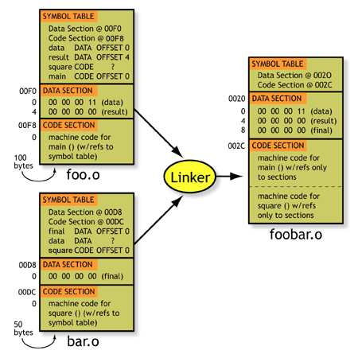
17/12/2020
1

Slide 20
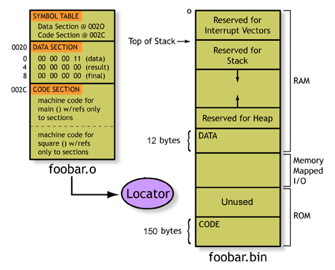
17/12/2020
1

Slide 21
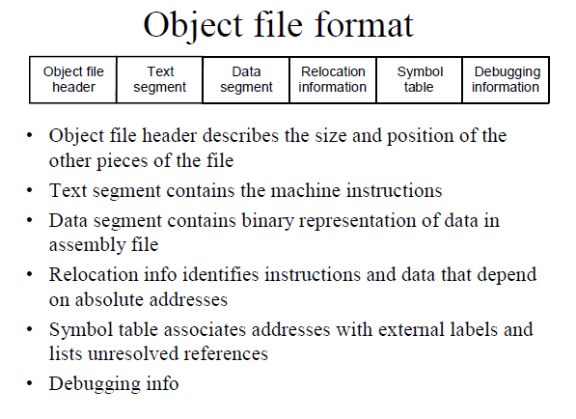
17/12/2020
1

Slide 22
Static Linking
Static linking is the process of copying all library modules used in the program into the final executable image.
Statically linked files are significantly larger in size because external programs are built into the executable files.
In static linking if any of the external programs has changed then they have to be recompiled and re-linked again else the changes won't reflect in existing executable file.
Statically linked program takes constant load time every time it is loaded into the memory for execution.
Programs that use statically-linked libraries are usually faster than those that use shared libraries.
Disadvantages:
Behavior of executable files cannot change without re-linking them
Size of Program increases.
Notes:
Static linking is the process of copying all library modules used in the program into the final executable image. This is performed by the linker and it is done as the last step of the compilation process. The linker combines library routines with the program code in order to resolve external references, and to generate an executable image suitable for loading into memory. When the program is loaded, the operating system places into memory a single file that contains the executable code and data. This statically linked file includes both the calling program and the called program.
<number>

Slide 23
Dynamic linking
In dynamic linking the names of the external libraries (shared libraries) are placed in the final executable file while the actual linking takes place at run time when both executable file and libraries are placed in the memory.
Dynamic linking is performed at run time by the operating system.
In dynamic linking only one copy of shared library is kept in memory. This significantly reduces the size of executable programs, thereby saving memory and disk space.
In dynamic linking load time might be reduced if the shared library code is already present in memory.
If a library is changed (for example, a new compiler release may change a library), applications might have to be reworked to be made compatible with the new version of the library.
If a library is removed from the system, programs using that library will no longer work.

Slide 24
Dynamic linking
Many operating system environments allow dynamic linking, that is the postponing of the resolving of some undefined symbols until a program is run.
That means that the executable code still contains undefined symbols, plus a list of objects or libraries that will provide definitions for these. Loading the program will load these objects/libraries as well, and perform a final linking.

Slide 25
Advantages and Disadvantages
Advantages:
Often-used libraries (for example the standard system libraries) need to be stored in only one location, not duplicated in every single binary.
If an error in a library function is corrected by replacing the library, all programs using it dynamically will benefit from the correction after restarting them. Programs that included this function by static linking would have to be re-linked first.
Disadvantages:
Known on the Windows platform as "DLL Hell", an incompatible updated DLL will break executables that depended on the behavior of the previous DLL.
A program, together with the libraries it uses, might be certified (e.g. as to correctness, documentation requirements, or performance) as a package, but not if components can be replaced.
Notes:
0
<number>

Slide 26
Thank You!
17/12/2020
1

