Slide 1
Process Management
Notes:
1
1
1
1

Slide 2
CONTENTS
Process Concept, Process States, Process Description
Processes and Threads
Symmetric Multiprocessing
Concurrency: Principles of Concurrency
Mutual Exclusion: S/W approaches, H/W Support
Programming Language construct: Semaphores, Monitors
Classical Problems of Synchronization: Readers-Writers problem, Producer Consumer problem, Dining Philosopher problem.
Notes:
2
2
2

Slide 3
Roadmap
Process Concept, Process States, Process Description
How are processes represented and controlled by the OS.
Process states which characterize the behaviour of processes.
Data structures used to manage processes.
Ways in which the OS uses these data structures to control process execution.
Notes:
3
3
3
3

Slide 4
Requirements of an Operating System
Fundamental Task: Process Management
The Operating System must
Interleave the execution of multiple processes
Allocate resources to processes, and protect the resources of each process from other processes,
Enable processes to share and exchange information,
Enable synchronization among processes.
The OS Manages Execution of Applications
Resources are made available to multiple applications
The processor is switched among multiple application
The processor and I/O devices can be used efficiently
Notes:
4
4
4
Explain that:
on a multiprogramming uniprocessor, the execution of multiple processes can be interleaved in time.
on a multiprocessor, not only may process execution be interleaved, but also multiple processes can execute simultaneously.
Explain that process management is compounded by the introduction of the concept of thread. In a multithreaded system,
the process retains the attributes of resource ownership,
The thread retains the attributes of multiple, concurrent execution streams running within a process.
4

Slide 5
What is a Process?
Recall from Unit 1 that a process is a program in
execution.
A process in execution needs resources like processing resource, memory and IO resource.
Imagine a program written in C – my_prog.c.
After compilation we get an executable.
If we now give a command like ./a.out it becomes a
process.
Notes:
5
5

Slide 6
Process
A program in execution
An instance of a program running on a computer
The entity that can be assigned to and executed on a processor
A unit of activity characterized by the execution of a sequence of instructions, a current state, and an associated set of system instructions
Notes:
6
6
6
6

Slide 7
Process Concept
An operating system executes a variety of programs:
Batch system – jobs
Time-shared systems – user programs or tasks
Textbook uses the terms job and process almost interchangeably
Process – a program in execution; process execution must progress in sequential fashion
process is comprised of:
Program code (possibly shared)
A set of data
A number of attributes describing the state of the process
of the process
Notes:
7
7
7
7

Slide 8
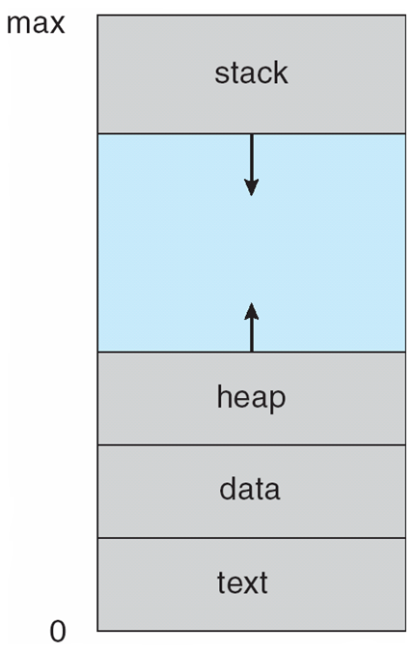
Process in Memory
Function Parameters, return address, local variables
Dynamically allocated memory for execution of program
Global variables
Program code
Notes:
8
8
8
8

Slide 9
Process Elements
While the process is running it has a number of elements including
Identifier
State
Priority
Program counter
Memory pointers
Context data
I/O status information
Accounting information
Notes:
9
9
9
9

Slide 10
Process Control Block
Contains the process elements
Created and manage by the operating system
The PCB is constructed at process creation.
PCB includes a pointer to be used in lists (queues) of PCBs.
Allows support for multiple processes
The PCB is used to save information about a process when switched out of CPU.
Notes:
10
10
10
10

Slide 11
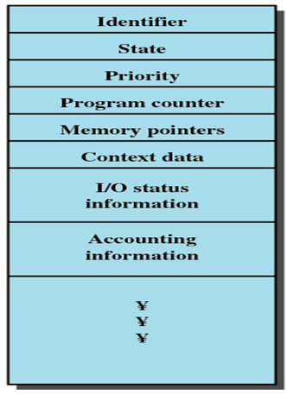
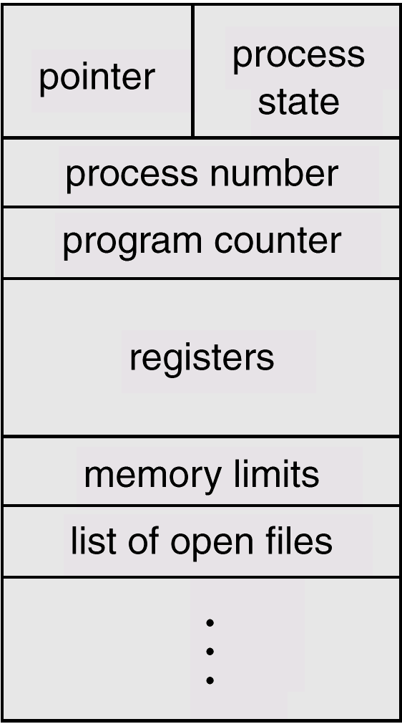
Process Control Block
Notes:
11
11
11
11

Slide 12
Process Control Block
Information associated with each process is stored in PCB.
Process state : new, running, etc.
Program counter : address of next instruction to be executed
CPU registers :E.g. accumulator, stack pointers, general purpose registers.
CPU scheduling information :Process priority, elapsed time, other scheduling parameters etc.
Memory-management information :E.g. base and limit registers, page table, segment table
Accounting information: E.g. amount of CPU & real time used, time limits, account number, etc.
I/O status information: I/O devices allocated, list of open files, etc.
Notes:
12
12
12

Slide 13
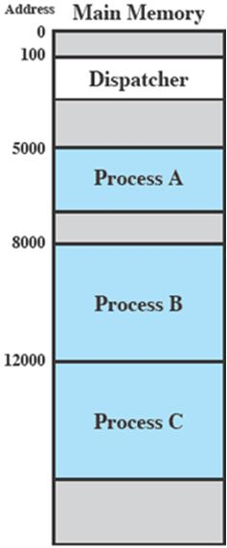
Trace of the Process
Process Execution
The behavior of an individual process is shown by listing the sequence of instructions that are executed
This list is called a Trace
Dispatcher is a small program which switches the processor from one process to another
Consider three processes being executed
All are in memory (plus the dispatcher)
Notes:
13
13
13
13

Slide 14
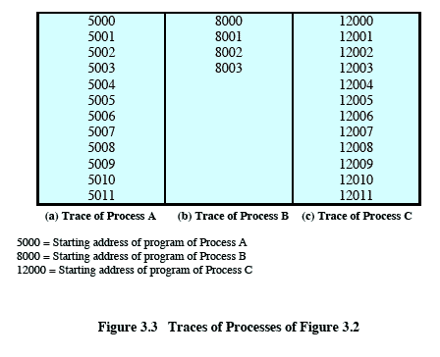
Trace from the processes point of view:
Each process runs to completion
Notes:
14
14
Animated slide
Wipes down to give impression of process progression
14

Slide 15
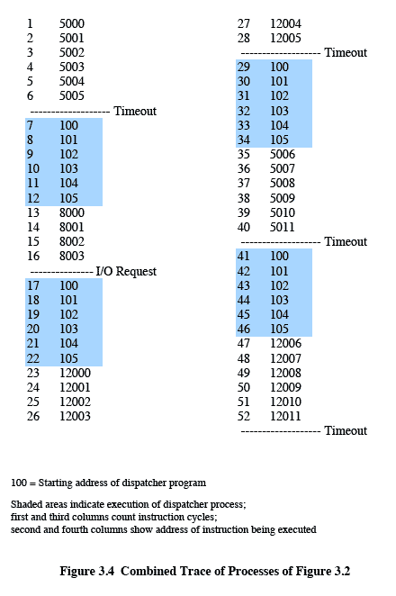
Trace from Processors point of view
Timeout
Timeout
Timeout
I/O
Notes:
15
15

Slide 16
Trace from Processors point of view
The shaded areas represent code executed by the dispatcher.
The same sequence of instructions is executed by the dispatcher in each instance because the same functionality of the dispatcher is being executed.
We assume that the OS only allows a process to continue execution for a maximum of six instruction cycles, after which it is interrupted; this prevents any single process from monopolizing processor time.
The first six instructions of process A are executed, followed by a time-out and the execution of some code in the dispatcher, which executes six instructions before turning control to process B2.
After four instructions are executed, process B requests an I/O action for which it must wait. Therefore, the processor stops executing process B and moves on, via the dispatcher, to process C.
After a time-out, the processor moves back to process A. When this process times out, process B is still waiting for the I/O operation to complete, so the dispatcher moves on to process C again
Notes:
16
16
16

Slide 17
Roadmap
Process Concept, Process States, Process Description
How are processes represented and controlled by the OS.
Process states which characterize the behaviour of processes.
Data structures used to manage processes.
Ways in which the OS uses these data structures to control process execution.
Notes:
17
17
17
Progress indicator
17

Slide 18
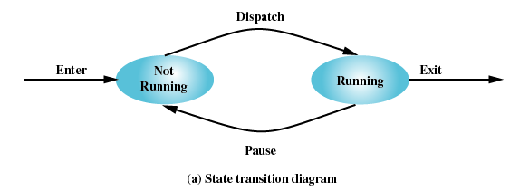
Two-State Process Model
Process may be in one of two states
Running
Not-running
Notes:
18
18
18
18

Slide 19
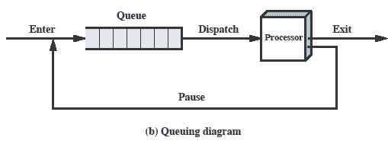
Queuing Diagram
Etc … processes moved by the dispatcher of the OS to the CPU then back to the queue until the task is competed
Notes:
19
19

Slide 20
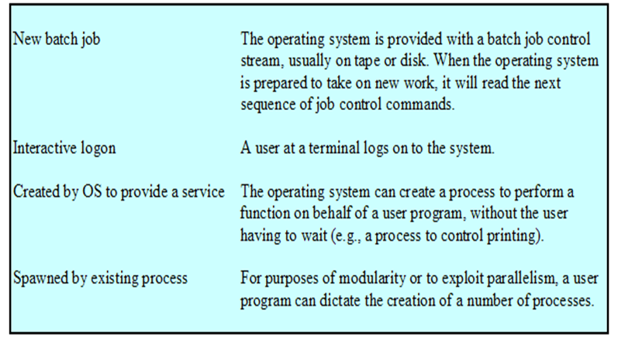
Process Creation
Notes:
20
20
20
20

Slide 21
Process Creation
The OS builds a data structure to manage the process
Traditionally, the OS created all processes
But it can be useful to let a running process create another
This action is called process spawning
Parent Process is the original, creating process
Child Process is the new process
Notes:
21
21
21
21

Slide 22
Process Termination
There must be some way that a process can indicate completion.
This indication may be:
A HALT instruction generating an interrupt alert to the OS.
A user action (e.g. log off, quitting an application)
A fault or error
Parent process terminating
Notes:
22
22
22

Slide 23
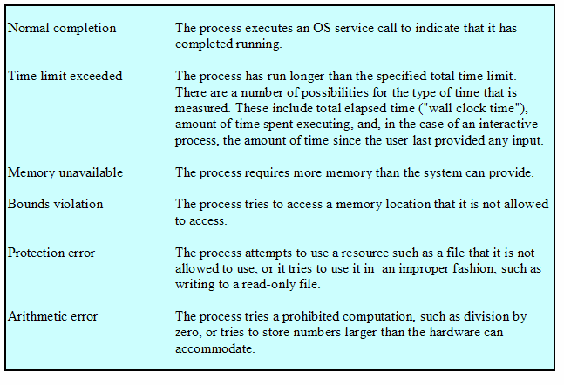
Process Termination
Notes:
23
23
23
23

Slide 24
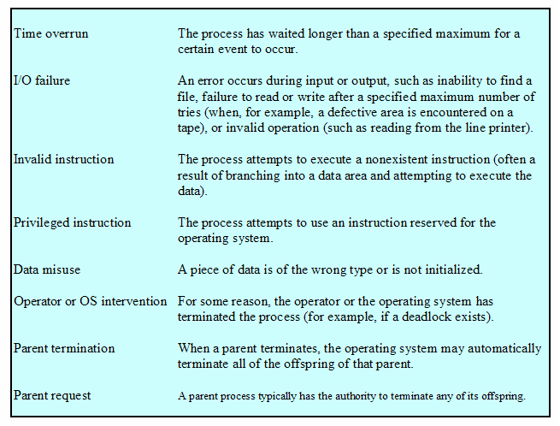
Process Termination
Notes:
24
24
24
24

Slide 25
Problems with two state model?
Are all processes that are “not running” always ready to run?
Split “Not Running” into two states!
Ready
Blocked
Vishal Kaushal
Notes:
25

Slide 26
Process states
Ready
ready to execute
Blocked
waiting for I/O
Dispatcher cannot just select the process that has been in the queue the longest because it may be blocked
Notes:
26
26
26
26

Slide 27
A Five-State Model
In all the previous examples, we said
A process is in “RUN” state if is engaging the
processor,
A process is in “WAIT” state if it is waiting for IO to be completed
In our simplistic model we may think of 5 states:
Running
Ready
Blocked
New
Exit
Notes:
27
27
27
27

Slide 28
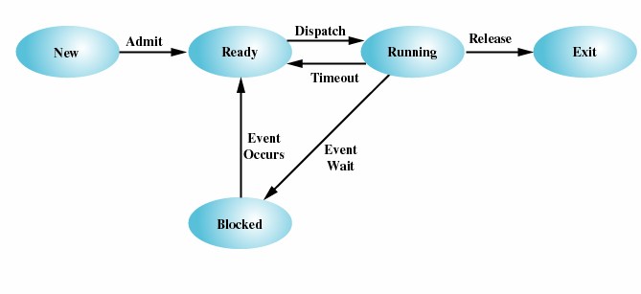
Five-State Process Model
Notes:
28
28
28
28

Slide 29
Possible transitions of Process State:
Null 🡪 New : New process is created to execute program
New 🡪 Ready : Submit the new process to ready queue
Ready 🡪 Running : Send the Ready Process to Execute
Running 🡪 Exit : After completion of Execution, exit the process
Running 🡪 Ready : In time sharing system, After time expired of process, put that process again into Ready queue
Running 🡪 Blocked : if process requesting for something (I/O), put that in
blocked queue until it get the resource
Blocked 🡪 Ready: After completing request put that process in ready queue
Ready 🡪 Exit : Parent process can terminate Child Process at any time
Blocked 🡪 Exit :If process requesting inaccessible resource.
Notes:
29
29
29
29

Slide 30
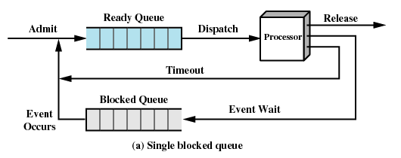
Using Two Queues
This model would require an additional queue for the blocked processes.
But when an event occurs the dispatcher would have to cycle through the entire queue to see which process is waiting for the event.
This can cause huge overhead when their may be 100’s or 1000’s of processes
Notes:
30
30
30
30

Slide 31
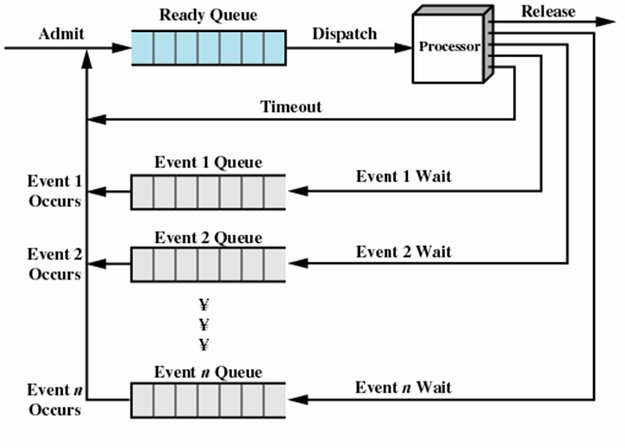
Multiple Blocked Queues
More efficient to have a separate ‘blocked’ queue for each type of event.
Notes:
31
31
31
31

Slide 32
A problem still exists!
Even with multi programming processor would be idle most of the time!
It is common for all processes in memory to be waiting for I/O soon
Solution?
Increase main memory to accommodate more processes
Two problems:
Cost
More memory need not necessarily mean more processes!
Vishal Kaushal
Notes:
32

Slide 33
Swapping
Moving part or all of a process from main memory to disk
“Part” in case of virtual memory
OS swaps one of the blocked processes out onto disk into a suspended queue
Queue of existing processes temporarily kicked out
Even with Virtual Memory this is required at times for performance reasons
OS then brings in another process from suspended queue or honors a new process request
But isn’t this also an I/O operation? Wont it make the problem worse?
Vishal Kaushal
Notes:
33

Slide 34
Suspended Processes
Processor is faster than I/O so all processes could be waiting for I/O
Swap these processes to disk to free up more memory
Blocked state becomes suspend state when swapped to disk
Two new states
Blocked/Suspend
Ready/Suspend
Notes:
34
34
34
34

Slide 35
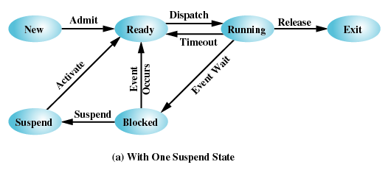
One Suspend State
Notes:
35
35
35
35

Slide 36
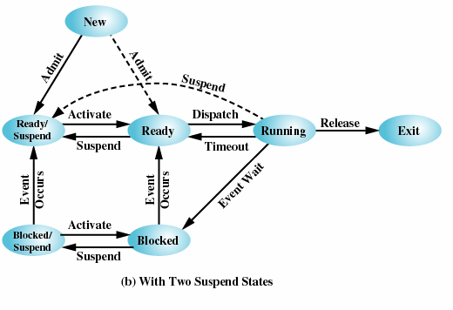
Two Suspend States
Notes:
36
36
36
36

Slide 37
Process State Transitions:
Ready: The process is in main memory and available for execution
Blocked: Process is in main memory and waiting for an event
Blocked / Suspended: The process is in secondary memory and waiting for an event
Ready / Suspended: Process is in secondary memory but is available for execution as soon as it loaded it into main memory
Notes:
37
37
37
37

Slide 38
Process State Transitions:
Blocked 🡪 Blocked/Suspend: If there are no ready processes, then at least one blocked process is swapped out to make room for another process that is not blocked. This transition can be made even if there are ready processes available, if the OS determines that the currently running process or a ready process that it would like to dispatch requires more main memory to maintain adequate performance.
Blocked/Suspend 🡪 Ready/Suspend: A process in the Blocked/Suspend state is moved to the Ready/Suspend state when the event for which it has been waiting occurs.
Ready/Suspend 🡪 Ready: When there are no ready processes in main memory, or if a suspended process has a higher priority, the OS will need to bring one in to continue execution.
Ready 🡪 Ready/Suspend: Normally, the OS would prefer to suspend a blocked process rather than a ready one, because the ready process can now be executed, whereas the blocked process is taking up main memory space and cannot be executed. However, it may be necessary to suspend a ready process if that is the only way to free up a sufficiently large block of main memory.
Notes:
38
38
38

Slide 39
Process State Transitions:
New 🡪 Ready/Suspend and New 🡪Ready: When a new process is created, it can either be added to the Ready queue or the Ready/Suspend queue.
In either case, the OS must create a process control block and allocate an address space to the process.There would often be insufficient room in main memory for a new process; hence the use of the (New 🡪 Ready/Suspend) transition.
Blocked/Suspend 🡪 Blocked: Inclusion of this transition may seem to be poor design. After all, if a process is not ready to execute and is not already in main memory, what is the point of bringing it in? But consider the following scenario:
A process terminates, freeing up some main memory.
There is a process in the (Blocked/Suspend) queue with a higher priority than any of the processes in the (Ready/Suspend) queue and
the OS has reason to believe that the blocking event for that process will occur soon.
Under these circumstances, it would seem reasonable to bring a blocked process into main memory in preference to a ready process.
Notes:
39
39
39

Slide 40
Process State Transitions:
Running 🡪 Ready/Suspend: Normally, a running process is moved to the Ready state when its time allocation expires. If, however, the OS is pre-empting the process because a higher-priority process on the Blocked/Suspend queue has just become unblocked, the OS could move the running process directly to the (Ready/Suspend) queue and free some main memory.
Any State 🡪 Exit: Typically, a process terminates while it is running, either because it has completed or because of some fatal fault condition. However, in some operating systems, a process may be terminated by the process that created it or when the parent process is itself terminated. If this is allowed, then a process in any state can be moved to the Exit state.
Notes:
40
40
40

Slide 41
Characteristics of Suspended process
The process in not immediately available for execution
The process may or may not be waiting on an event.
The process was placed in a suspended state by an agent: either itself, a parent process or OS ,for preventing its execution.
The process may not be removed from this state until the agent explicitly orders the removal.
Notes:
41
41
41

Slide 42
Reasons for Process Suspension
Reason | Comment
Swapping | The OS needs to release sufficient main memory to bring in a process that is ready to execute.
Other OS Reason | OS suspects process of causing a problem.
Interactive User Request | e.g. debugging or in connection with the use of a resource.
Timing | A process may be executed periodically (e.g. an accounting or system monitoring process) and may be suspended while waiting for the next time.
Parent Process Request | A parent process may wish to suspend execution of a descendent to examine or modify the suspended process, or to coordinate the activity of various descendants.
Notes:
42
42
42

Slide 43
Roadmap
Process Concept, Process States, Process Description
How are processes represented and controlled by the OS.
Process states which characterize the behaviour of processes.
Data structures used to manage processes.
Ways in which the OS uses these data structures to control process execution.
Notes:
43
43
43

Slide 44
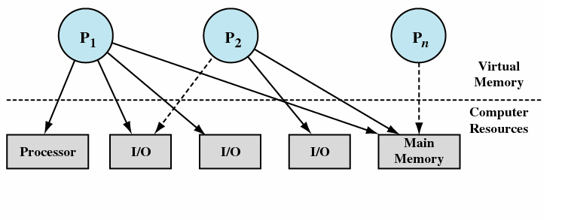
Process Description: Processes and Resources
Operating systems are considered as a manager of the underneath various hardware resources.
operating system is an entity that manages the use of system resources by processes
Waiting for resource
Notes:
44
44
44
44

Slide 45
Process Description: Processes and Resources
There are a number of processes (P1, . . ., Pn,) that have been created and exist in virtual memory.
Each process, during the course of its execution, needs access to certain system resources, including the processor, I/O devices, and main memory.
In the figure, process P1 is running; at least part of the process is in main memory, and it has control of two I/O devices.
Process P2 is also in main memory but is blocked waiting for an I/O device allocated to P1.
Process Pn has been swapped out and is therefore suspended.
Notes:
45
45
45

Slide 46
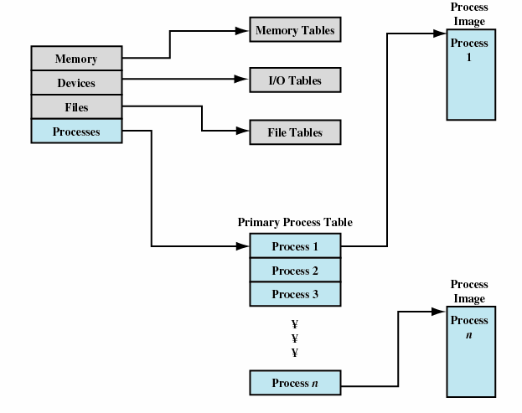
Operating system control tables
OS has to manage processes and resources, it must have information about the current status of each process and resource.
Tables are constructed for each entity, the operating system manages.
Notes:
46
46
46
46

Slide 47
Control structures
1. Memory tables: are used to keep track of both main memory and secondary memory.
- Part of main memory is reserved for use by the operating system;
The memory tables generally include the following information:
– the allocation of main memory to processes
– the allocation of secondary memory to processes
– protection attributes of blocks of main or virtual memory
2. I/O tables: are used by the operating system to manage I/O devices. They should record:
– the availability of each particular device
– the status of I/O operations relating to each device
- the location in main memory being used as the source or destination of the I/O transfer.
Notes:
47
47
47
47

Slide 48
Control structures
3. File tables: provides information about
– Existence of files
-Location on secondary memory
-Current Status
-Attributes
-Sometimes this information is maintained by a file management system
4. Process table :
- To manage processes the OS needs to know details of the processes
Current state
Process ID
Location in memory
etc
Process control block
Process image is the collection of program,Data, stack, and attributes
Notes:
48
48
48
48

Slide 49
Process Control Structure/Process Image
Elements of Process Image:
User Data: Modifiable part of user space;
- Includes program data, user stack area and programs that may be modified
User Program: the program to be executed
System Stack: each process have 1/more system stacks;
- Used to store parameters and calling address for system calls
Process Control Block: data needed by OS to control the process
We can group the process control block information into three general categories:
Process identification
Processor state information
Process control information
Notes:
49
49
49
49

Slide 50
Elements of a PCB
Process Identifier:
Identifier of this process
Identifier of the process that created this process (parent process)
User identifier
Processor state information:
User Visible register
Control and stack register
Stack pointer
Program status word (PSW) - contains status information
Process control information:
Scheduling and state Information
Data Structuring
Interprocess communication
Memory Management
Resource Ownership and Utilization
Notes:
50
50
50
50

Slide 51
Roadmap
Process Concept, Process States, Process Description
How are processes represented and controlled by the OS.
Process states which characterize the behaviour of processes.
Data structures used to manage processes.
Ways in which the OS uses these data structures to control process execution.
Notes:
51
51
51
Progress indicator
51

Slide 52
Modes of Execution
Most processors support at least two modes of execution
User mode
Less-privileged mode
User programs typically execute in this mode
System mode:also known as
Control Mode/ Kernel Mode / Protected Mode
More-privileged mode
Kernel of the operating system
Notes:
52
52
52

Slide 53
Process Control
Mode of Execution: Dual-mode operation allows OS to protect itself and other system components
How does the processor know in which mode it is to be executing? And how does it change
Mode bit provided by hardware (there is a bit in PSW that indicates the mode of execution)
Provides ability to distinguish when system is running user code or kernel code
Some instructions designated as privileged, only executable in kernel mode
System call changes mode to kernel, return from call resets it to user
Notes:
53
53
53
53

Slide 54
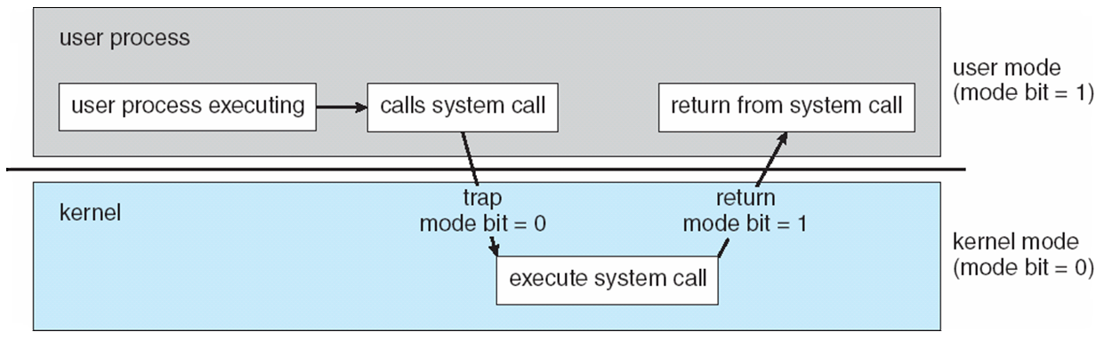
Transition from User to Kernel Mode
Timer to prevent infinite loop / process hogging resources
Set interrupt after specific period
Operating system decrements counter
When counter becomes zero generate an interrupt
Set up before scheduling process to regain control or terminate program that exceeds allotted time
Notes:
54
54
54
54

Slide 55
Process Creation
Once the OS decides to create a new process it:
Assign a unique process identifier
Allocate space for the process
Initialize process control block
Set up appropriate linkages
Ex: add new process to linked list used for scheduling queue
Create / expand other data structures
Ex: maintain an accounting file
Notes:
55
55
55
55

Slide 56
Switching Processes
Several design issues are raised regarding process switching
What events trigger a process switch?
We must distinguish between mode switching and process switching.
What must the OS do to the various data structures under its control to achieve a process switch?
Notes:
56
56
56

Slide 57
When to switch processes
A process switch may occur any time that the OS has gained control from the currently running process. Possible events giving OS control are:
Mechanism | Cause | Use
Interrupt | External to the execution of the current instruction | Reaction to an asynchronous external event
Trap | Associated with the execution of the current instruction | Handling of an error or an exception condition
Supervisor call | Explicit request | Call to an operating system function
Table : Mechanisms for Interrupting the Execution of a Process
Notes:
57
57
57
A process switch may occur any time that the OS has gained control from the currently running process.
Table 3.8 suggests the possible events that may give control to the OS.
Two kinds of system interrupts,
one is simply called an interrupt,
and the other called a trap.
“interrupts” are due to some sort of event that is external to and independent of the currently running process, such as the completion of an I/O operation.
With an ordinary interrupt, control is first transferred to an interrupt handler, which does some basic housekeeping and then branches to an OS routine that is concerned with
the particular type of interrupt that has occurred.
“Traps” relate to an error or exception condition generated within the currently running process, such as an illegal file access attempt.
With traps, the OS determines if the error or exception condition is fatal.
If so, then the currently running process is moved to the Exit state and a process switch occurs.
If not, then the action of the OS will depend on the nature of the error and the design of the OS.
It may attempt some recovery procedure or simply notify the user.
It may do a process switch or resume the currently running process.
Finally, the OS may be activated by a supervisor call from the program being executed.
For example, a user process is running and an instruction is executed that requests an I/O operation, such as a file open.
This call results in a transfer to a routine that is part of the operating system code. The use of a system call may place the user process in the Blocked state.
57

Slide 58
When to switch processes
Two kinds of system interrupts,
one is simply called an interrupt,
and the other called a trap.
“interrupts” are due to some sort of event that is external to and independent of the currently running process, such as the completion of an I/O operation.
With an ordinary interrupt, control is first transferred to an interrupt handler, which does some basic housekeeping and then branches to an OS routine that is concerned with the particular type of interrupt that has occurred.
With traps, the OS determines if the error or exception condition is fatal.
If so, then the currently running process is moved to the Exit state and a process switch occurs.
If not, then the action of the OS will depend on the nature of the error and the design of the OS.
It may attempt some recovery procedure or simply notify the user.
It may do a process switch or resume the currently running process.
Notes:
58
58
58
58

Slide 59
When to switch processes
the OS may be activated by a supervisor call from the program being executed.
For example, a user process is running and an instruction is executed that requests an I/O operation, such as a file open.
This call results in a transfer to a routine that is part of the operating system code.
The use of a system call may place the user process in the Blocked state
Notes:
59
59
59

Slide 60
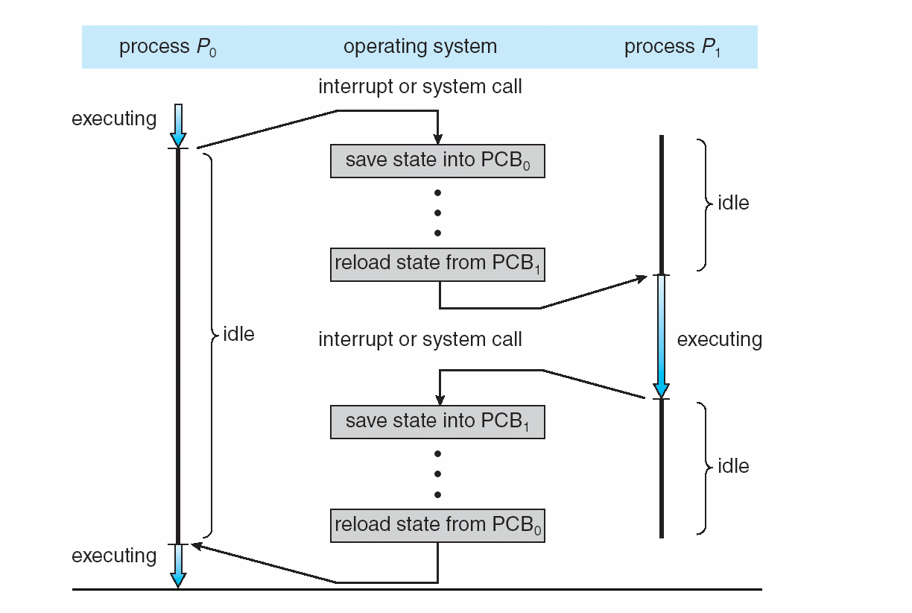
CPU Switch From Process to Process
Notes:
60
60
60
60

Slide 61
Process Switching (Cont)
Mode of switching:
Save the context of the current program being executed
Set the program counter to the starting address of an interrupt-handler program
Switch from user mode to kernel mode so that interrupt processing code may include privileged instructions
Notes:
61
61
61
61

Slide 62
Change process state:
If the currently running process is to be moved to another state (Ready, Blocked, etc.), then the OS must make substantial changes in its environment.
Steps involved in process switching:
Save the context of the processor including program counter and other register.
Update the PCB of the process that is currently in the Running state
Move PCB to appropriate queue – ready; blocked; ready/suspend
Select another process for execution
Update PCB of selected process
Update memory management data structure
Restore context of the processor
Notes:
62
62
62
62

Slide 63
Threads, SMP Operating Systems:Internals and Design Principles, William Stallings
Notes:
63
63
63
63

Slide 64
Roadmap
Threads: Resource ownership and execution
Symmetric multiprocessing (SMP).
Notes:
64
64
64
64

Slide 65
Processes and Threads
Processes have two characteristics:
Resource ownership - process includes a virtual address space to hold the process image
Scheduling/execution - follows an execution path that may be interleaved with other processes
These two characteristics are treated independently by the operating system
The unit of dispatching is referred to as a thread or lightweight process
The unit of resource ownership is referred to as a process or task
Notes:
65
65
65
65

Slide 66
Processes and Threads
Unit of dispatching is referred to as a thread (Light weight process)
Resource ownership is referred to as a process or task (Heavy weight process)
A process has
a virtual address space which holds the process image
global variables, files, child processes, signals and signal handlers
A traditional process has single thread of control.
If a process has multiple thread of control, it can do more than one task at a time.
Notes:
66
66
66
66

Slide 67
DOS
Threads and Process
JAVA
One process one thread
One process multiple thread
Multiple processes one thread per process
Multiple processes multiple thread per process
UNIX
UNIX
WINDOWS
Notes:
67
67
67
67

Slide 68
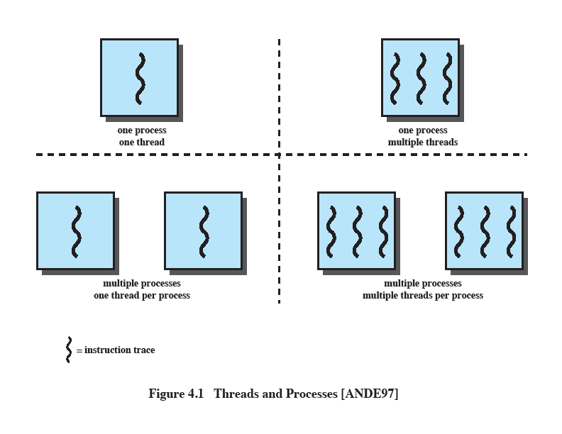
Multithreading
The ability of an OS to support multiple, concurrent paths of execution within a single process.
Notes:
68
68
68
68

Slide 69
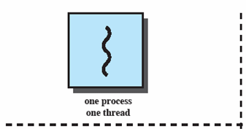
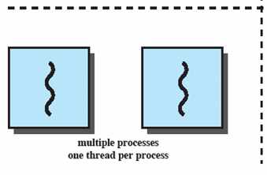
Single Thread Approaches
MS-DOS supports a single user process and a single thread.
Some UNIX, support multiple user processes but only support one thread per process
Notes:
69
69
69
69

Slide 70
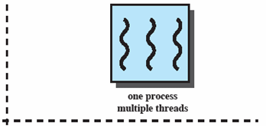
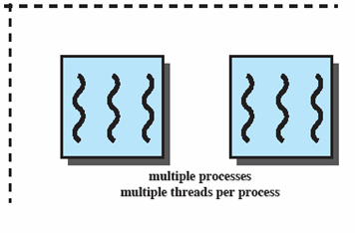
Multithreading
Java run-time environment is a single process with multiple threads
Multiple processes and threads are found in Windows, Solaris, and many modern versions of UNIX
Notes:
70
70
70
70

Slide 71
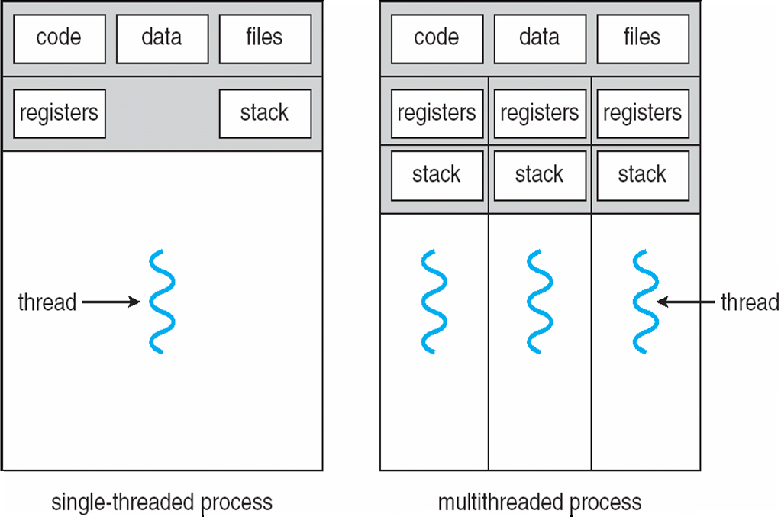
Single and Multithreaded Processes
Notes:
71
71
71
71
71

Slide 72
Thread attributes:
A thread has
Execution state
Save the thread context when not running
Execution stack
Per-thread static storage for local variable
Access to the memory and resources of its process, shared with all other threads in that process.
One way to view a thread is as an independent program counter operating within a process.
Notes:
72
72
72
72

Slide 73
Benefits of threads
Since threads within the same process share memory and files, they can communicate with each other without invoking the kernel.
It takes less time to create new thread in an existing process than to create brand new process.
It takes less time to terminate a thread than a process.
It takes less time to switch between two thread with in the same process.
Threads enhance efficiency in communication between different executing programs.
Utilization of multiple processor architecture, where each thread may be running in parallel on a different processor.
Notes:
73
73
73
73
73

Slide 74
Disadvantages of Threads
Suspending a process involves suspending all threads of the process since all threads share the same address space.
Termination of a process, terminates all threads within the process.
Notes:
74
74
74
74

Slide 75
Thread Execution States
Thread State/ States associated with a change in thread state:
Spawn (another thread)
Block
- Issue: will blocking a thread block other, or all, threads
Unblock
Finish (thread)
Deallocate register context and stacks
Notes:
75
75
75
75

Slide 76
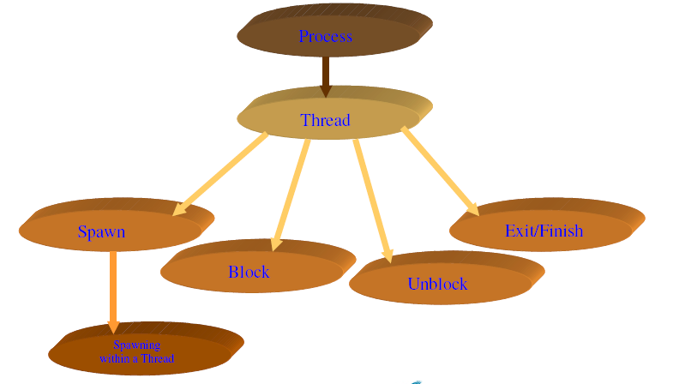
Thread state tree
Notes:
76
76
76
76

Slide 77
Example: Remote Procedure Call
Consider:
A program that performs two remote procedure calls (RPCs)
to two different hosts
to obtain a combined result.
Notes:
77
77
77

Slide 78
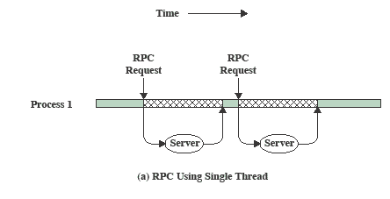
Remote Procedure Call Using Threads
The results are obtained in sequence, so that the program has to wait for a response from each server in turn.
Notes:
78
78
78
78

Slide 79
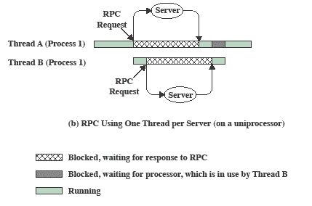
RPC Using One Thread per Server
Rewriting the program to use a separate thread for each RPC results in a substantial speedup.
Note that if this program operates on a uniprocessor, the requests must be generated sequentially and the results processed in sequence;
however, the program waits concurrently for the two replies.
Notes:
79
79
79
79

Slide 80
Benefits
Responsiveness: ex: Web browser
Resource Sharing: shares code /data section of program
Economy: due to memory & resource sharing
Scalability: Utilization of multiprocessor architecture
Notes:
80
80
80

Slide 81
Categories of Thread Implementation
User Level Thread (ULT)
Kernel level Thread (KLT) also called:
kernel-supported threads
lightweight processes.
Notes:
81
81
81

Slide 82
Thread Libraries
Thread library provides programmer with API for creating and managing threads
Two primary ways of implementing
Library entirely in user space
Kernel-level library supported by the OS
Three primary thread libraries:
1. Posix Pthreads: (IEEE) standard:
– Specifies interface
– Implementation (using user/kernel level threads) is up to the developer(s)
– More common in UNIX systems
2. Win32 thread library:
– Kernel-level library, windows systems
3. Java threads:
– Supported by the JVM
– Implementation is up to the developers –e.g. can use Pthreads API or Win32 API, etc
Notes:
82
82
82
82

Slide 83
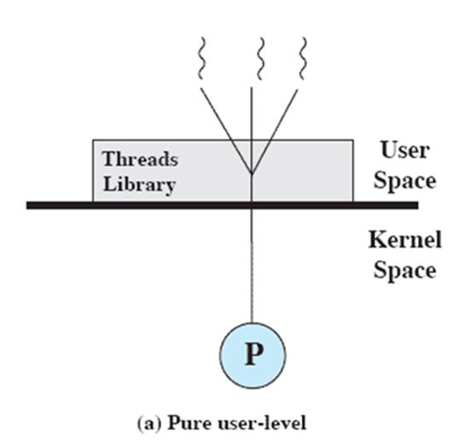
User Threads
Thread management done by user-level threads library
The kernel is not aware of the existence of threads
The library provides support for thread creation, scheduling and management without support from kernel.
Generally fast to create and manage as no kernel intervention.
Drawback: ULT performing blocking system call will cause entire process to block.(solution: Jacketing)
Notes:
83
83
83
83
83

Slide 84
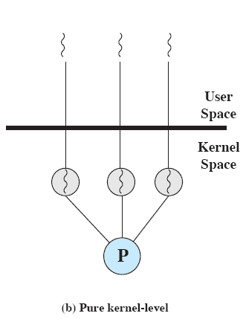
Kernel Threads
Supported by the Kernel (Operating system)
Kernel performs thread creation, scheduling and management.
Advantages:
The kernel can simultaneously schedule multiple threads from the same process on multiple processors.
If one thread in a process is blocked, the kernel can schedule another thread of the same process.
Kernel routines themselves can be multithreaded
Disadvantages:
Generally slower to create and manage than ULT
Needs mode switch
Examples
Windows XP/2000
Solaris
Linux
Tru64 UNIX
Mac OS X
Notes:
84
84
84
84
84

Slide 85
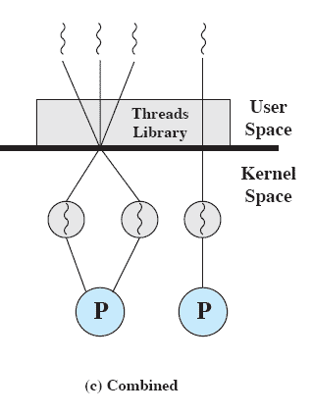
Combined Approaches
Example is Solaris
Thread creation done in the user space
Bulk of scheduling and synchronization of threads done in the user space.
If properly designed, this approach should combine the advantages of the pure ULT and KLT approaches while minimizing the disadvantages
Notes:
85
85
85
85

Slide 86
Multithreading Models
Many-to-One
One-to-One
Many-to-Many
Notes:
86
86
86
86
86

Slide 87
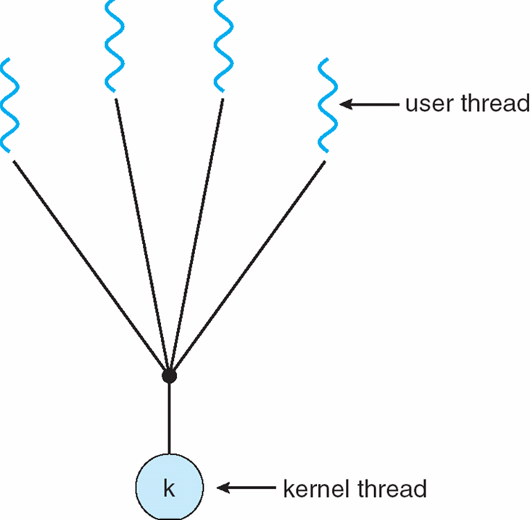
Many-to-One
Many user-level threads mapped to single kernel thread
Thread management is done by thread library in user space.
Entire process will block if a thread makes a blocking system call.
Examples:
Solaris Green Threads
Windows NT
Notes:
87
87
87
87
87

Slide 88
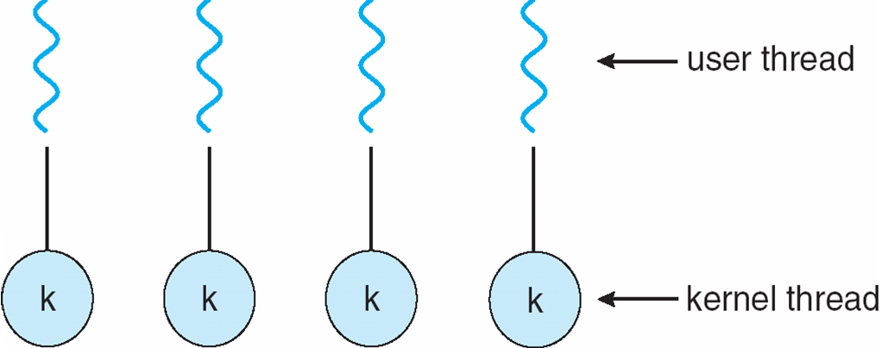
One-to-One
Each user-level thread maps to kernel thread
Provides more concurrency than many-to-one
Drawback: Creating user level thread requires creation of corresponding kernel level thread
Examples
Windows 98/XP/2000
Traditional Unix
Solaris 9 and later
Notes:
88
88
88
88
88

Slide 89
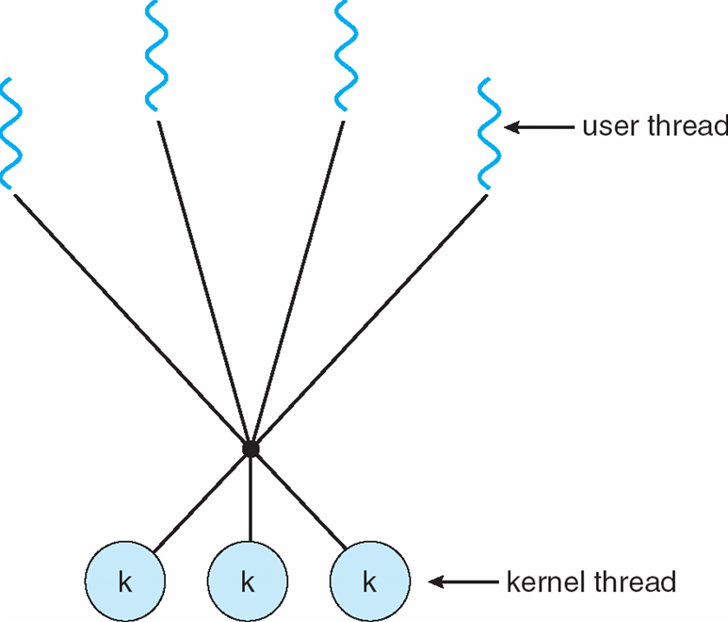
Many-to-Many Model
Allows many user level threads to be mapped to many kernel threads
The number of kernel threads may be application /system dependent.
Solaris prior to version 9
Windows NT/2000 with the ThreadFiber package
Ex: TRIX
Notes:
89
89
89
89
89

Slide 90
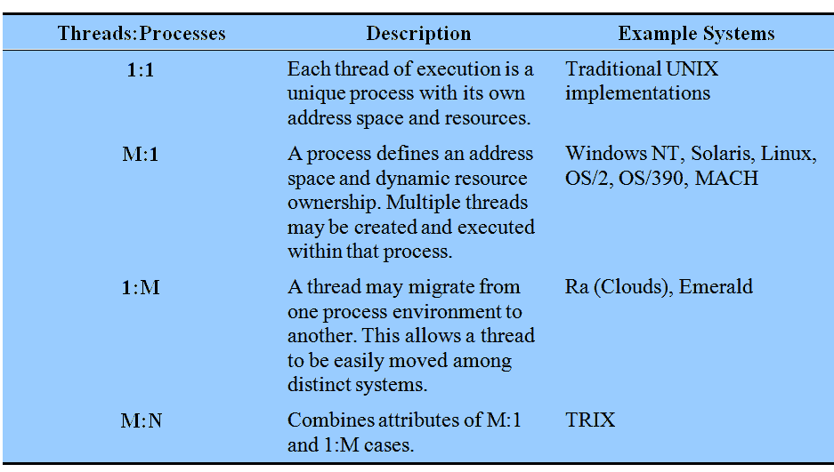
Relationship Between Thread and Processes
Notes:
90
90
90
The concepts of resource allocation and dispatching unit have traditionally been embodied in the single concept of the process; that is, as a 1 : 1 relationship between threads and processes.
There has been much interest in providing for multiple threads within a single process, which is a many-to-one relationship
.
However, as the table shows, the other two combinations have also been investigated, namely,
a many-to-many relationship and
a one-to-many relationship.
90

Slide 91
Advantages of ULT over KLT:
Thread switching does not require kernel mode privileges.
Scheduling can be application specific.
ULT can run over any OS.
Disadvantages of ULT over KLT:
When a ULT executes a blocking system calls, not only is that thread blocked but all of the thread within the process are blocked
In pure ULT strategy, multithreaded application can not take advantage of multiprocessing.
Notes:
91
91
91
91

Slide 92
Process Vs Thread
PROCESS
Do not share their address space
Can execute independent of each other and the synchronization between processes is taken care by kernel only
Context switching is slow.
The interaction between two processes is achieved only through the standard inter process communication
Processes should be used for programs that need coarser
parallelism.
THREAD
Threads executing under same process share the address space.
Thread synchronization has to be taken care by the process under which the threads are executing
Context switching is fast
Threads executing under the same process can communicate easily as they share most of the resources like memory, text segment etc
Threads should be used for programs that need fine-grained parallelism
Notes:
92
92

Slide 93
Process Vs Thread
PID
A process ID is unique across the system
A process ID is an integer value
A process ID can be printed very easily.
TID
A thread ID is unique only in context of a single process.
Thread ID is not necessarily an integer value. It could well be a structure
A thread ID is not easy to print.
Notes:
93
93

Slide 94
ULT Vs KLT
ULT
Created, controlled and destroyed using user space thread libraries
Not known to kernel and hence kernel is nowhere involved in their processing
These threads follow co-operative multitasking, the scheduler cannot preempt the thread.
KTL
Created, controlled and destroyed by the kernel
For every thread that exists in user space there is a corresponding kernel thread so are managed by kernel
Since these threads are managed by kernel so they follow preemptive multitasking
Notes:
94
94

Slide 95
ULT Vs KLT
UTL
. The switching between two threads does not involve much overhead and is generally very fast
These threads follow co-operative multitasking so if one thread gets block the whole process gets blocked.
KTL
The context switch is not very fast as compared to user space threads.
The major advantage of kernel threads is that even if one of the thread gets blocked the whole process is not blocked
Notes:
95
95

Slide 96
Roadmap
Threads: Resource ownership and execution
Symmetric multiprocessing (SMP).
Notes:
96
96
96
96

Slide 97
Traditional View
Traditionally, the computer has been viewed as a sequential machine.
A processor executes instructions one at a time in sequence
Each instruction is a sequence of operations
Each instruction is executed in a sequence of operations
(fetch instruction, fetch operands, perform operation, store results).
Two popular approaches to providing parallelism
Symmetric MultiProcessors (SMPs)
Clusters
Notes:
97
97
97
Traditionally, the computer has been viewed as a sequential machine.
Most computer programming languages require the programmer to specify algorithms as sequences of instructions.
A processor executes programs by executing machine instructions in sequence and one at a time. Each instruction is executed in a sequence of operations
(fetch instruction, fetch operands, perform operation, store results).
This view of the computer has never been entirely true.
As computer technology has evolved and as the cost of computer hardware has dropped, computer designers have sought more and more opportunities for parallelism, usually to improve performance and, in some cases, to improve reliability.
the two most popular approaches to providing parallelism by replicating processors:
symmetric multiprocessors (SMPs) and
clusters.
97

Slide 98
Symmetric Multiprocessing (SMP)
Multiple processors share similar access to a common memory space
Incremental path from the old serial programming model
Each processor sees the same memory space it saw before.
Existing applications run unmodified (unaccelerated as well of course)
Old applications with millions of lines of code can run without modification.
SMP programming model has task-level and thread-level parallelism.
Task-level is like multi-tasking operating system behavior on serial platforms.
Notes:
98
98
98
98

Slide 99
SMP (Cont.)
To use more parallelism the tasks must become parallel: Multithreading
Programmer writes source code which forks off separate threads of execution
Programmer explicitly manages data sharing, synchronization
Commercial SMP Platforms:
Multicore GP processors: Intel, AMD (not for embedded systems)
Multicore DSPs: TI, Freescale, ...
Multicore Systems-on-Chip: using cores from ARM, MIPS, ...
Notes:
99
99
99
99

Slide 100
Categories of Computer Systems
Single Instruction Single Data (SISD)
single processor executes a single instruction stream to operate on data stored in a single memory
Single Instruction Multiple Data (SIMD)
each instruction is executed on a different set of data by the different processors
Multiple Instruction Single Data (MISD)
a sequence of data is transmitted to a set of processors, each of which executes a different instruction sequence. Never implemented
Multiple Instruction Multiple Data (MIMD)
a set of processors simultaneously execute different instruction sequences on different data sets
Notes:
100
100
100
100

Slide 101
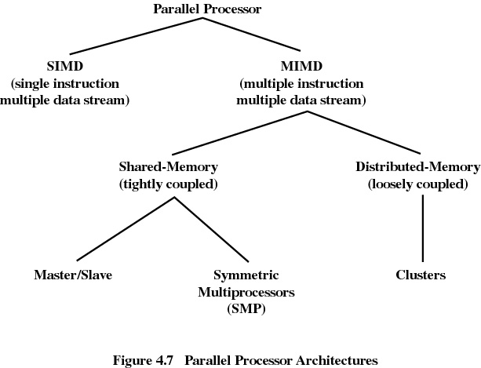
Parallel Processor Architectures
Based upon memory is shared or not
Based upon how processes are assigned to processors
Notes:
101
101
101
101

Slide 102
Symmetric Multiprocessing
Kernel can execute on any processor
- Allowing portions of the kernel to execute in parallel
Typically each processor does self-scheduling from the pool of available process or threads
Notes:
102
102
102
102

Slide 103
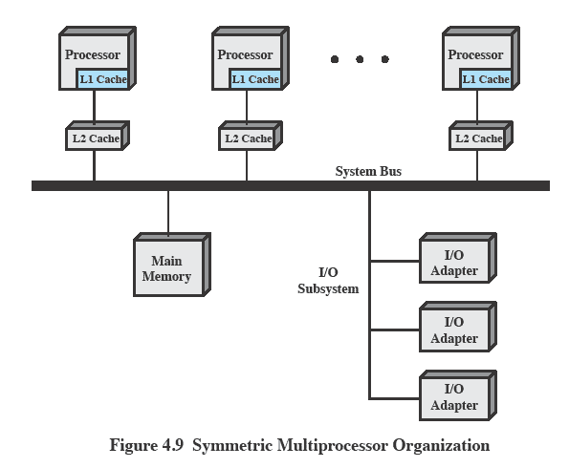
Typical SMP Organization
There are multiple processors, each of which contains its own
1. control unit,
2. arithmetic-logic unit, and 3. registers.
Each processor has access to a shared main memory and the I/O devices through some form of interconnection mechanism; a shared bus is a common facility.
Notes:
103
103
103
There are multiple processors, each of which contains its own
control unit,
arithmetic-logic unit, and
registers.
Each processor has access to a shared main memory and the I/O devices through some form of interconnection mechanism; a shared bus is a common facility.
The processors can communicate with each other through memory (messages and status information left in shared address spaces).
It may also be possible for processors to exchange signals directly. The memory is often organized so that multiple simultaneous accesses to separate blocks of memory are possible.
103

Slide 104
Multiprocessor OS Design Considerations:
The key design issues include:
Simultaneous concurrent processes/threads: Kernel routines are to be reentrant, so multiple processors can execute the same kernel code simultaneously.
Scheduling: Scheduling can be done by any processor, so conflict handling mechanism must be in place.
Synchronization: Synchronization must provide mutual exclusion and event ordering, as sharing is used.
Memory Management: Similar issues relating to uni-processor model must be handled and paging mechanism must be coordinated when more than one processor is sharing a page or segment.
Reliability & Fault tolerance: The scheduler in case of a processor failure must restructure for graceful degradation response.
Notes:
104
104
104
104

Slide 105
CONTENTS
Process Concept, Process States, Process Description
Processes and Threads
Symmetric Multiprocessing, Microkernel
Concurrency: Principles of Concurrency
Mutual Exclusion: S/W approaches, H/W Support
Programming Language construct: Semaphores, Monitors
Classical Problems of Synchronization: Readers-Writers problem, Producer Consumer problem, Dining Philosopher problem.
Notes:
105
105
105
105

Slide 106
Principles of concurrency,
Mutual exclusion
Operating Systems :
Internals and Design Principles William Stallings
Notes:
106
106
106

Slide 107
Concurrency
Multi-programming:
- Management of multiple processes within a uniprocessor system, every system has this support, whether big, small or complex.
Multi-processing:
- Management of multiple processes within a multi-processor system, servers and works stations. (Shared Memory)
Distributed Processing:
Management of multiple processes executing on number of distributed computer systems, for example clusters. (Do not Share Memory)
Concurrency: Execution of multiple processes no matter on single or more processing elements.
One thing is common among all these categories?
Notes:
107
107
107

Slide 108
Principles of Concurrency
Interleaving:
In a single processor case, multiple processes are interleaved in time to provide the illusion of simultaneous execution of these processes.
Although, it is not really parallel processing but there are benefits using such technique, apart from having overheads involved in switching of these processes.
Notes:
108
108
108

Slide 109
Concurrency
Concurrency arises in:
Multiple applications
Sharing time
Structured applications
Extension of modular design
Operating system structure
OS themselves implemented as a set of processes or threads
Notes:
109
109
109
• Multiple applications:
Multiprogramming was invented to allow processing time to be dynamically shared among a number of active applications.
• Structured applications:
As an extension of the principles of modular design and structured programming, some applications can be effectively programmed as a set of concurrent processes.
• Operating system structure:
The same structuring advantages apply to systems programs, and we have seen that operating systems are themselves often implemented as a set of processes or threads.
109

Slide 110
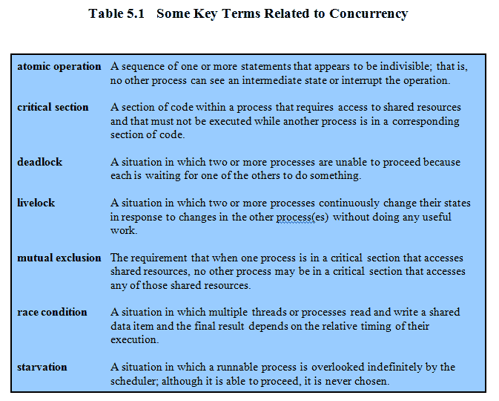
Key Terms
Notes:
110
110
110
These terms will be explained throughout this chapter – do not labor this table.
It may be best skipped over and given as a reference point for students.
110

Slide 111
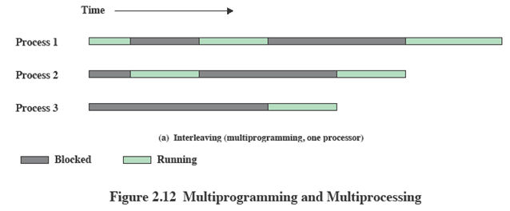
Interleaving and Overlapping Processes
Earlier we saw that processes may be interleaved on uniprocessors
Notes:
111
111
111

Slide 112
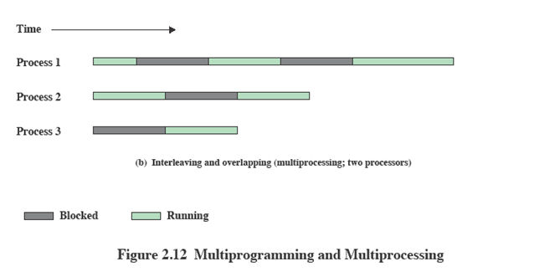
Interleaving and Overlapping Processes
And not only interleaved but overlapped on multi-processors
Notes:
112
112
112

Slide 113
Difficulties of Concurrency
Sharing of global resources:
If two processes both make use of the same global variable and both perform reads and writes on that variable, then the order in which the various reads and writes are executed is critical.
Optimally managing the allocation of resources:
It is difficult for the OS to manage the allocation of resources optimally.
e.g. A process may request use of, and be granted control of, a particular I/O channel and then be suspended before using that channel.
It may be undesirable for the OS simply to lock the channel and prevent its use by other processes;
indeed this may lead to a deadlock condition,
Difficult to locate programming errors as results are not deterministic and reproducible.
Notes:
113
113
113
113

Slide 114
Principles of Concurrency
Suppose we have two or more applications reading input from the keyboard and put the result on the screen.
function_test ( )
{
Chin=getchar();
Chout=chin;
Putchar(chout)
}
A program that will provide a character
input is obtained from a keyboard one keystroke at a time.
Each input character is stored in variable chin.
It is then transferred to variable chout
and finally sent to the display.
Now consider that we have a single-processor multiprogramming system supporting a single user.
The user can jump from one application to another, and each application uses the same keyboard for input and the same screen for output.
Notes:
114
114
114

Slide 115
A Simple Example: On a uniprocessor,multiprogramming
P2
Process P2 has called function_test and
allowed to run till end with input “Y”,
P1
Process P1 has called function_test and
have just read (X) the input and being
interrupted,
so chin = X;
P1
P1 resumed, it will display what ?
the character input to P1 is lost
Notes:
115
115
115

Slide 116
Principles of Concurrency
So the first ”chout” is lost, what can we do to prevent such problem (which is called mutual exclusion),
The above example is for uniprocessor system, but similar problem can occur on a Multi-processor platform while sharing of resources.
e.g. accessing the same location (variable) by two or more processes running on different machines.
Process p1
…
Chin=getchar();
…
Chout=chin;
Putchar(chout)
..
..
Process P2
…
..
Chin=getchar();
Chout=chin;
….
…..
Putchar( chout)
Notes:
116
116
116

Slide 117
Enforce Single Access
If we enforce a rule that only one process may enter the function at a time then:
P1 & P2 run on separate processors
P1 enters function_test() first,
P2 tries to enter but is blocked – P2 suspends
P1 completes execution
P2 resumes and executes function_test()
Notes:
117
117
117
Processes P1 and P2 are both executing, each on a separate processor.
P1 invokes the test procedure.
2. While P1 is inside the test procedure, P2 invokes test.
Because P1 is still inside the test procedure (whether P1 is suspended or executing), P2 is blocked from entering the procedure.
Therefore, P2 is suspended awaiting the availability of the test procedure.
3. At a later time, process P1 completes execution of test, exits that procedure, and continues executing.
Immediately upon the exit of P1 from test, P2 is resumed and begins executing test.
117

Slide 118
Race Condition
When two/more processes are reading/writing some shared data and the final result depends on who runs precisely when.
Consider P1 & P2 processes sharing same variable ‘a’ .
P3 & P4 have b & c with values b=1 & c=2
P3 executes the statement b=b+c
P4 executes the statement c=b+c
Two processes update different variables & final value depend on the order execution of two processes P3 & P4.
If P3 executes before P4 then b=3,c=5
If P4 executes before P3 then b=4,c=3
Notes:
118
118
118

Slide 119

Race Condition
Occurs when multiple processes or threads read and write data items
The final result depends on the order of execution
the “loser” of the race is the process that updates last and will determine the final value of the variable
Notes:
A race condition occurs when multiple processes or threads read and write data items so that the final result depends on the order of execution of instructions in the multiple processes. Let us consider two simple examples.
As a first example, suppose that two processes, P1 and P2, share the global variable a . At some point in its execution, P1 updates a to the value 1, and at some point in its execution, P2 updates a to the value 2. Thus, the two tasks are in a race to write variable a . In this example, the “loser” of the race (the process that updates last) determines the final value of a .
For our second example, consider two process, P3 and P4, that share global variables b and c , with initial values b = 1 and c = 2 . At some point in its execution, P3 executes the assignment b = b + c , and at some point in its execution, P4 executes the assignment c = b + c . Note that the two processes update different variables. However, the final values of the two variables depend on the order in which the two processes execute these two assignments. If P3 executes its assignment statement first, then the final values are b = 3 and c = 5 . If P4 executes its assignment statement first, then the final values are b = 4 and c = 3 .
Appendix A includes a discussion of race conditions using semaphores as an example.
119

Slide 120
Operating system concerns
Design and management issues raised by the existence of concurrency:
O/S must keep track of all the processes (normally it is done through PCB’s)
O/S must allocate and deallocate the resources for the processes. Which includes processor time, memory, files and i/o devices.
Protection of resources again unintended interference from other processes.
The results of a process must be independent of the speed at which the execution is taking place relative to the speed of other concurrent processes.
Notes:
120
120
120

Slide 121
Process Interaction
Competition among processes: Mutual exclusion, deadlock, starvation
Cooperation among processes by sharing: shared variables ,files ,databases
- Access to data item-read/write
Writing must be mutually exclusive
Need to maintain data integrity
3. Cooperation among processes by communication: send ,receive message primitives-synchronization
- No sharing of data/resources b/n processes
Notes:
121

Slide 122

Resource Competition
Concurrent processes come into conflict when they are competing for use of the same resource
for example: I/O devices, memory, processor time, clock
In the case of competing processes three control problems must be faced:
the need for mutual exclusion
deadlock
starvation
Notes:
Concurrent processes come into conflict with each other when they are competing for the use of the same resource. In its pure form, we can describe the situation as follows. Two or more processes need to access a resource during the course of their execution. Each process is unaware of the existence of other processes, and each is to be unaffected by the execution of the other processes. It follows from this that each process should leave the state of any resource that it uses unaffected. Examples of resources include I/O devices, memory, processor time, and the clock.
There is no exchange of information between the competing processes. However, the execution of one process may affect the behavior of competing processes. In particular, if two processes both wish access to a single resource, then one process will be allocated that resource by the OS, and the other will have to wait. Therefore, the process that is denied access will be slowed down. In an extreme case, the blocked process may never get access to the resource and hence will never terminate successfully.
In the case of competing processes three control problems must be faced. First is the need for mutual exclusion . Suppose two or more processes require access to a single non-sharable resource, such as a printer. During the course of execution, each process will be sending commands to the I/O device, receiving status information, sending data, and/or receiving data. We will refer to such a resource as a critical resource , and the portion of the program that uses it as a critical section of the program. It is important that only one program at a time be allowed in its critical section. We cannot simply rely on the OS to understand and enforce this restriction because the detailed requirements may not be obvious. In the case of the printer, for example, we want any individual process to have control of the printer while it prints an entire file. Otherwise, lines from competing processes will be interleaved.
The enforcement of mutual exclusion creates two additional control problems. One is that of deadlock . For example, consider two processes, P1 and P2, and two resources, R1 and R2. Suppose that each process needs access to both resources to perform part of its function. Then it is possible to have the following situation: the OS assigns R1 to P2, and R2 to P1. Each process is waiting for one of the two resources. Neither will release the resource that it already owns until it has acquired the other resource and performed the function requiring both resources. The two processes are deadlocked.
A final control problem is starvation . Suppose that three processes (P1, P2, P3) each require periodic access to resource R. Consider the situation in which P1 is in possession of the resource, and both P2 and P3 are delayed, waiting for that resource. When P1 exits its critical section, either P2 or P3 should be allowed access to R. Assume that the OS grants access to P3 and that P1 again requires access before P3 completes its critical section. If the OS grants access to P1 after P3 has finished, and subsequently alternately grants access to P1 and P3, then P2 may indefinitely be denied access to the resource, even though there is no deadlock situation.
122

Slide 123
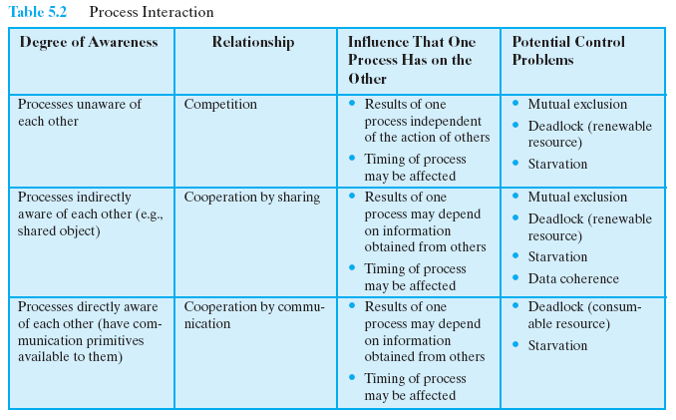
Process Interaction
multiprogramming of multiple independent processes.
Notes:
123
123
123

Slide 124

Conditions for Mutual Exclusion
Necessary conditions to provide mutual exclusion
No two processes simultaneously in critical region
No assumptions made about speeds or numbers of CPUs
No process running outside its critical region may block another process
No process must wait forever to enter its critical region
A process remains inside its critical section for a finite time only
No deadlock or starvation
Notes:
124
124
124

Slide 125
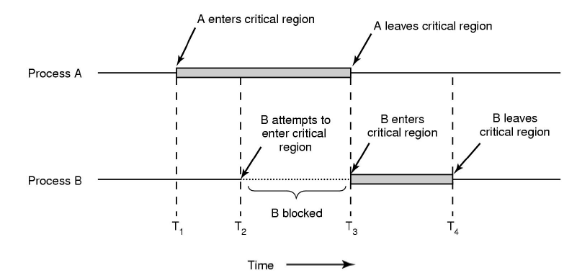
How to achieve mutual exclusion
Notes:
125
125
125

Slide 126
CONTENTS
Process Concept, Process States, Process Description
Processes and Threads
Symmetric Multiprocessing, Microkernel
Concurrency: Principles of Concurrency
Mutual Exclusion: S/W approaches, H/W Support
Programming Language construct: Semaphores, Monitors
Classical Problems of Synchronization: Readers-Writers problem, Producer Consumer problem, Dining Philosopher problem.
Notes:
126
126
126
126

Slide 127
Disabling Interrupts
S/w approach(Dekkers’s and Peterson’s lgorithm) : high processing overhead & risk of logical errors
Uniprocessors allow interleaving not overlapped execution
To guarantee mutual exclusion, it is sufficient to prevent a process from being interrupted.
Interrupt Disabling
A process runs until it invokes an operating system service or until it is interrupted
Disabling interrupts guarantees mutual exclusion
Critical section can not be interrupted
Notes:
127
127
127
In a uniprocessor system, concurrent processes cannot have overlapped execution;
they can only be interleaved.
To guarantee mutual exclusion, it is sufficient to prevent a process from being interrupted.
127

Slide 128
Pseudo-Code
while (true) {
/* disable interrupts */;
/* critical section */;
/* enable interrupts */;
/* remainder */;
}
The price of this approach, however, is high.
The efficiency of execution could be degraded because the processor is limited in its ability to interleave processes.
Notes:
128
128
128
Because the critical section cannot be interrupted, mutual exclusion is guaranteed.
The price of this approach, however, is high.
The efficiency of execution could be noticeably degraded because the processor is limited in its ability to interleave processes.
128

Slide 129
Disabling Interrupts
Disadvantages:
the efficiency of execution could be noticeably degraded
this approach will not work in a multiprocessor
architecture
Notes:
In a uniprocessor system, concurrent processes cannot have overlapped execution;
they can only be interleaved. Furthermore, a process will continue to run until it
invokes an OS service or until it is interrupted. Therefore, to guarantee mutual exclusion,
it is sufficient to prevent a process from being interrupted. This capability
can be provided in the form of primitives defined by the OS kernel for disabling and
enabling interrupts.
Because the critical section cannot be interrupted, mutual exclusion is guaranteed.
The price of this approach, however, is high. The efficiency of execution could
be noticeably degraded because the processor is limited in its ability to interleave
processes. Another problem is that this approach will not work in a multiprocessor
architecture. When the computer includes more than one processor, it is possible (and
typical) for more than one process to be executing at a time. In this case, disabled
interrupts do not guarantee mutual exclusion.
129

Slide 130
Special Machine Instructions
In multiprocessor, several processors share access to a common main memory.
Processes behave independently in a peer relationship
No interrupt mechanism b/n processors
M/c instructions are atomic
Notes:
130
130
130
130

Slide 131
Special Machine Instructions
At h/w level ,access to memory location excludes any other access to the same location.
With this foundation we have different m/c instructions .
Two types
Compare & Swap Instruction
Exchange Instruction
Notes:
131

Slide 132

Special Machine Instructions
Compare & Swap Instruction
also called a “compare and exchange instruction”
a compare is made between a memory value and a test value
if the values are the same a swap occurs
carried out atomically
Notes:
This version of the instruction checks a memory location ( *word ) against a test value ( testval ). If the memory location’s current value is testval, it is replaced with newval ; otherwise it is left unchanged. The old memory value is always returned; thus, the memory location has been updated if the returned value is the same as the test value. This atomic instruction therefore has two parts: A compare is made between a memory value and a test value; if the values are the same, a swap occurs. The entire compare&swap function is carried out atomically—that is, it is not subject to interruption.
Another version of this instruction returns a Boolean value: true if the swap occurred; false otherwise. Some version of this instruction is available on nearly all processor families (x86, IA64, sparc, IBM z series, etc.), and most operating systems use this instruction for support of concurrency.
132

Slide 133
Compare & Swap Instruction
int compare_and_swap (int *word,
int testval, int newval)
{
int oldval;
oldval = *word;
if (oldval == testval) *word = newval;
return oldval;
}
Notes:
133
133
133
This version of the instruction checks a memory location (*word) against a test value (testval).
If the memory location’s current value is testval, it is replaced with newval;
otherwise it is left unchanged.
The old memory value is always returned;
thus, the memory location has been updated if the returned value is the same as the test value.
A compare is made between a memory value and a test value;
if the values differ a swap occurs.
The entire compare&swap function is carried out atomically;
Ie it is not subject
to interruption.
133

Slide 134
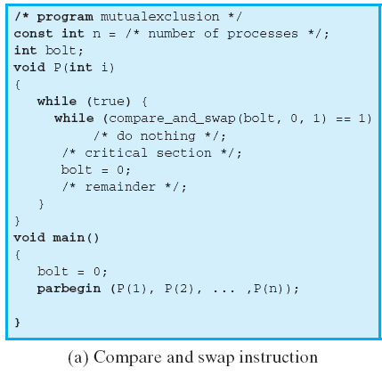
Compare & Swap Instruction
Notes:
134
134
134
This shows a mutual exclusion protocol based on the use of this instruction.
A shared variable bolt is initialized to 0.
The only process that may enter its critical section is one that finds bolt equal to 0.
All other processes that enter their critical section go into a busy waiting mode.
134

Slide 135
Exchange Instruction
void exchange(int register, int memory)
{
int temp;
temp=memory;
memory=register;
register=temp;
}
Notes:
135

Slide 136

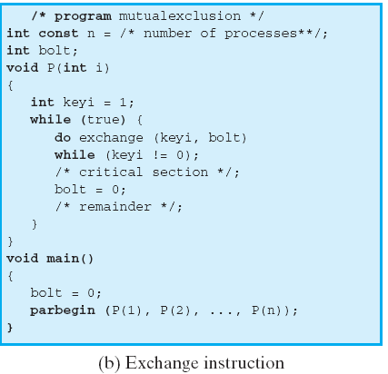
Exchange Instruction
Notes:
136
136
136
This shows a mutual exclusion protocol based on the use of an exchange instruction.
A shared variable bolt is initialized to 0.
Each process uses a local variable key that is initialized to 1.
The only process that may enter its critical section is one that finds bolt equal to 0.
It excludes all other processes from the critical section by setting bolt to 1.
When a process leaves its critical section, it resets bolt to 0, allowing another process to gain access to its critical section.
136

Slide 137

Special Machine Instruction:
Advantages
Applicable to any number of processes on either a single processor or multiple processors sharing main memory
Simple and easy to verify
It can be used to support multiple critical sections; each critical section can be defined by its own variable
Notes:
The use of a special machine instruction to enforce mutual exclusion has a number of advantages:
• It is applicable to any number of processes on either a single processor or multiple processors sharing main memory.
• It is simple and therefore easy to verify.
• It can be used to support multiple critical sections; each critical section can be defined by its own variable.
137

Slide 138

Special Machine Instruction:
Disadvantages
Busy-waiting is employed, thus while a process is waiting for access to a critical section it continues to consume processor time
Starvation is possible when a process leaves a critical section and more than one process is waiting , selection of a waiting process is arbitrary
Deadlock is possible
Notes:
There are some serious disadvantages:
• Busy waiting is employed: Thus, while a process is waiting for access to a critical section, it continues to consume processor time.
Starvation is possible: When a process leaves a critical section and more than one process is waiting, the selection of a waiting process is arbitrary. Thus, some process could indefinitely be denied access.
•
Deadlock is possible: Consider the following scenario on a single-processor system. Process P1 executes the special instruction (e.g., compare & swap, exchange ) and enters its critical section. P1 is then interrupted to give the processor to P2, which has higher priority. If P2 now attempts to use the same resource as P1, it will be denied access because of the mutual exclusion mechanism. Thus, it will go into a busy waiting loop. However, P1 will never be dispatched because it is of lower priority than another ready process, P2.
Because of the drawbacks of both the software and hardware solutions just outlined, we need to look for other mechanisms.
138

Slide 139
CONTENTS
Process Concept, Process States, Process Description
Processes and Threads
Symmetric Multiprocessing, Microkernel
Concurrency: Principles of Concurrency
Mutual Exclusion: S/W approaches, H/W Support
Programming Language construct: Semaphores, Monitors
Classical Problems of Synchronization: Readers-Writers problem, Producer Consumer problem, Dining Philosopher problem.
Notes:
139
139
139
139

Slide 140
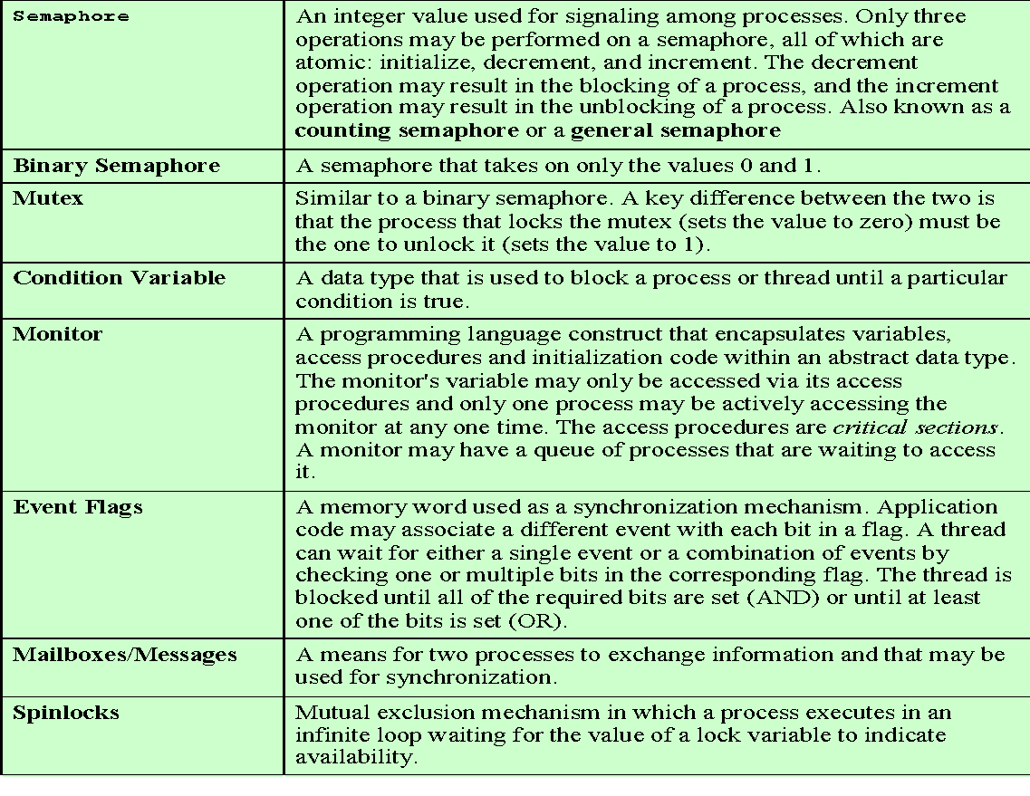

Common Concurrency Mechanisms
Notes:
We now turn to OS and programming language mechanisms that are used to provide concurrency. Table 5.3 summarizes mechanisms in common use. We begin, in this section, with semaphores. The next two sections discuss monitors and message passing.
140

Slide 141
Motivation for Semaphores
Locks only provide mutual exclusion
Ensure only one thread is in critical section at a time
May want more: Place ordering on scheduling of threads
Example: Producer/Consumer
Producer: Creates a resource (data)
Consumer: Uses a resource (data)
Example
- ps | grep “gcc” | wc
Don’t want producers and consumers to operate in lock step
Place a fixed-size buffer between producers and consumers
Synchronize accesses to buffer
Producer waits if buffer full; consumer waits if buffer empty
Notes:
141
141
141

Slide 142
Semaphore
Semaphores: Introduced by Dijkstra in 1960s
Principle: Two or more processes can cooperate by means of simple signal.
Semaphores have two purposes
Mutex: Ensure threads don’t access critical section at same time
Scheduling constraints: Ensure threads execute in specific order
Notes:
142
142
142

Slide 143
Semaphore Operations
Initialization: Initialize a value atomically
P (or Down or Wait) definition :
Atomic operation
Wait for semaphore to become positive and then decrement
P(s){
while (s <= 0)
;
s--;
}
V (or Up or Signal) definition :
Atomic operation
Increment semaphore by 1
V(s){
s++;
}
Notes:
143
143
143

Slide 144
Semaphore as General Synchronization Tool
Counting/general semaphore – integer value can range over an unrestricted domain
Binary semaphore – integer value can be either 0 or 1; can be simpler to implement
Also known as mutex locks
Can implement a counting semaphore S as a binary semaphore
Provides mutual exclusion
Semaphore S; // initialized to 1
wait (S);
Critical Section
signal (S);
Notes:
144
144
144

Slide 145
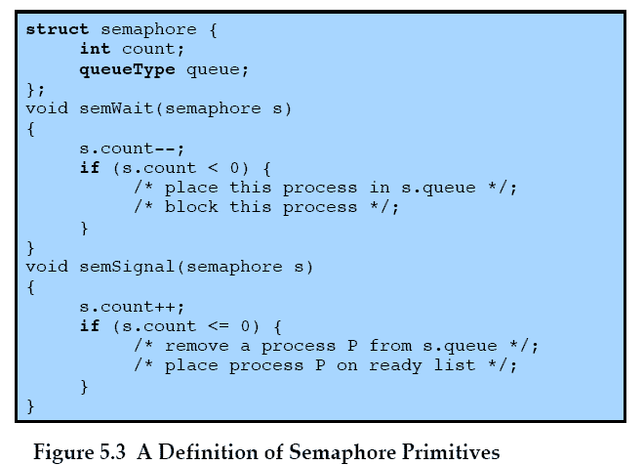
Semaphore Primitives
Notes:
145
145
145

Slide 146
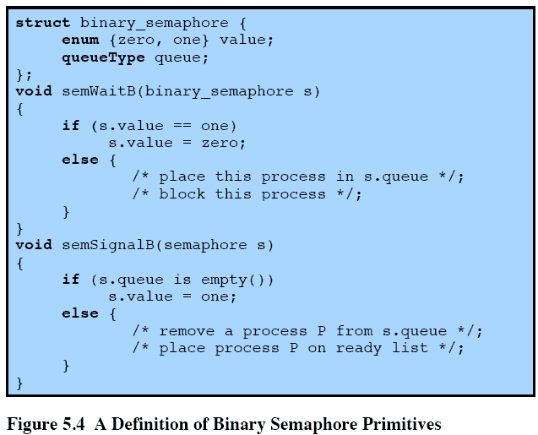
Binary Semaphore Primitives
Notes:
146
146
146

Slide 147
Binary Semaphore
A more restrictive semaphore which may only have the value of 0 or 1
A similar concept related to the binary semaphore is the mutex.
A key difference between the two is that the process that locks the mutex (sets the value to zero) must be the one to unlock it (sets the value to 1).
In contrast, it is possible for one process to lock a binary semaphore and for another to unlock it.
Notes:
147
147
147

Slide 148
Strong/Weak Semaphore
A queue is used to hold processes waiting on the semaphore
In what order are processes removed from the queue?
Strong Semaphores uses FIFO-No starvation
Strong semaphore guarantee freedom from starvation
Weak Semaphores don’t specify the order of removal from the queue
Weak semaphore do not guarantee freedom from starvation
Notes:
148
148
148

Slide 149
Mutual Exclusion using Semaphore
As the semaphore is initialized to 1, the first process executing wait will enter into its critical section and will set the value of s to 0. Any other process may attempt to enter, resulting in decrementing s to a negative value and suspension of that process. Ultimately, the process initially
entered into its critical section will depart with incrementing the value of s, resulting one of the suspended process to be released. Next a possible sequence of events for 3 processes are shown to
achieve mutual exclusion.
The following pseudo ops can be used for the mutual exclusion problem
There could be n processes
Each process executes wait before entering to its critical section
Positive value means it can enter into critical section
If the value becomes negative, process is suspended
Semaphore s = 1; n = “number of processes”;
Process ()
{
{
wait (s)
critical section
signal (s)
}
remaining execution
}
Notes:
149
149
149

Slide 150
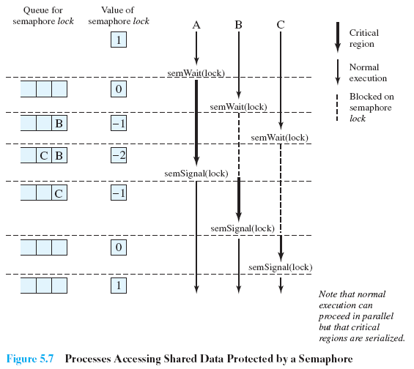
Mutual Exclusion using Semaphore
Notes:
150
150
150

Slide 151
consequences of the semaphore definition
There is no way to know before a process decrements a semaphore whether it will block or not
There is no way to know which process will continue immediately on a uniprocessor system when two processes are running concurrently
You don’t know whether another process is waiting so the number of unblocked processes may be zero or one
Notes:
[DOWN08] points out three interesting consequences of the semaphore definition:
• In general, there is no way to know before a process decrements a semaphore whether it will block or not.
After a process increments a semaphore and another process gets woken up, both processes continue running concurrently. There is no way to know which process, if either, will continue immediately on a uniprocessor system.
• When you signal a semaphore, you don’t necessarily know whether another process is waiting, so the number of unblocked processes may be zero or one.
151

Slide 152
Mutex(MUTual EXclusion locks)
These are useful to manage mutual exclusion to some shared resource
Easy & efficient to implement
It can be in one of two states: locked /unlocked
0 means unlocked & other values means locked.
Two operation: mutex_locked & mutex_unlocked
When thread needs access to CR it calls mutex_lock ()
After working with CR it calls mutex_unlock()
Example of lavatory
Process ()
{
{
mutex_lock()
critical section
mutex_unlock ()
}
remaining execution
}
Notes:
152
152
152

Slide 153
Producer/Consumer Problem
General Statement:
one or more producers are generating data and placing these in a buffer
a single consumer is taking items out of the buffer one at a time
only one producer or consumer may access the buffer at any one time
The Problem:
ensure that the producer can’t add data into full buffer and consumer can’t remove data from an empty buffer
Notes:
We now examine one of the most common problems faced in concurrent processing: the producer/consumer problem. The general statement is this: There are one or more producers generating some type of data (records, characters) and placing these in a buffer. There is a single consumer that is taking items out of the buffer one at a time. The system is to be constrained to prevent the overlap of buffer operations. That is, only one agent (producer or consumer) may access the buffer at any one time. The problem is to make sure that the producer won’t try to add data into the buffer if it’s full and that the consumer won’t try to remove data from an empty buffer. We will look at a number of solutions to this problem to illustrate both the power and the pitfalls of semaphores.
153

Slide 154
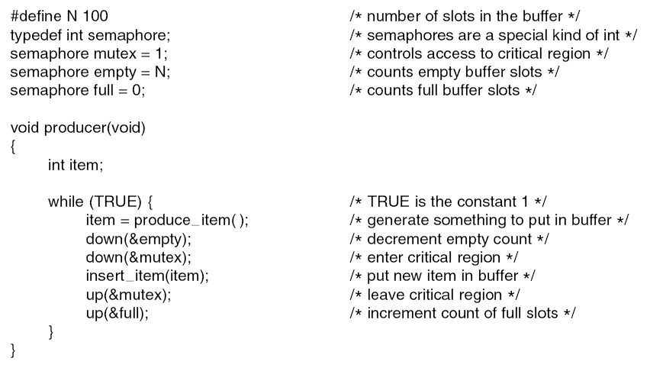
Semaphores: Producer-Consumer problem (Bounded buffer )
Notes:
154
154
154

Slide 155

Semaphores: Producer-Consumer problem
Notes:
155
155
155

Slide 156
Readers/Writers Problem
A data area is shared among many processes
some processes only read the data area, (readers) and some only write to the data area (writers)
Conditions to satisfy:
Multiple readers may read the file at once.
Only one writer at a time may write
If a writer is writing to the file, no reader may read it.
Notes:
156
156
156

Slide 157

Semaphore: Reader- writer problem
Notes:
157
157
157
The readers/writers problem is defined as follows: There is a data area shared among a number of processes. The data area could be a file, a block of main memory, or even a bank of processor registers. There are a number of processes that only read the data area (readers) and a number that only write to the data area (writers). The conditions that must be satisfied are as follows:
1. Any number of readers may simultaneously read the file.
2. Only one writer at a time may write to the file.
3. If a writer is writing to the file, no reader may read it.
Thus, readers are processes that are not required to exclude one another and writers are processes that are required to exclude all other processes, readers and writers alike.

Slide 158

Semaphore: Reader- writer problem
Notes:
158
158
158

Slide 159

Dining philosopher problem
Situation:
Five philosophers at table
Want to eat spaghetti
Must have 2 forks to eat
Only 5 forks at the table
Each philosopher:
Must grab fork one at a
time
Can act at any time
(concurrently with other
philosophers)
Is either thinking, hungry, or eating
Notes:
159
159
159

Slide 160
Dining philosopher problem
Everyone follows:
Grab left fork
Grab right fork
Eat spaghetti
If fork not available, wait until available
Release fork when done eating
What if all grab left fork at same time?
DEADLOCK
Notes:
160
160
160

Slide 161
Dining philosopher problem
One person follows:
Grab right fork
Grab left fork
Eat spaghetti
Everyone else follows:
Grab left fork
Grab right fork
Eat spaghetti
Avoids deadlock!
Notes:
161
161
161

Slide 162

Semaphore: Dining philosopher problem
Notes:
162
162
162

Slide 163

Semaphore: Dining philosopher problem
Notes:
163
163
163

Slide 164

Semaphore: Dining philosopher problem
Notes:
164
164
164

Slide 165
Monitors
Semaphores exhibit flexible and powerful mechanism for enforcing mutual exclusion.
Can produce incorrect program because of the scattering of the operation.
Monitors are another option which is basically a programming language construct providing equivalent functionality to the semaphores.
Easier to implement and control.
Programming languages can be concurrent pascal, pascal-plus, java, modula-2,molula-3
Has also been implemented as a program library
Notes:
165
165
165

Slide 166
Monitors
A monitor is a software module consist of one or more functions , initializing sequence and the local data.
Characteristics of a Monitor with Signal
Local data is only accessible to monitor’s functions.
A process can enter into monitor by calling one of its function.
Only one process is allowed to execute in monitor at any given time, any other process that may have invoked the monitor remains suspended till it becomes available. This characteristics makes mutual exclusion possible.
Data variables in the monitor will be accessible by only one process at a time, therefore, shared variables can be protected by placing them in the monitor.
Notes:
166
166
166

Slide 167
Monitors synchronization
Monitor supports synchronization by use of condition variables.
These conditional variables are contained within the monitor
Are accessible only within monitor.
Conditional Variables are special data type in monitor & are operated on by two operations:
cwait( c) : suspends execution of calling process on condition c. Monitor is available for use by another process.
csignal( c): Resume execution of some blocked process after a cwait on the same condition.
If there are several such processes, choose one of them; if there is no such process, do nothing.
Notes:
167
167
167

Slide 168

Structure of a Monitor
Notes:
168
168
168

Slide 169

Monitor Example
Notes:
169
169
169

Slide 170

Monitors: Producer-Consumer problem
Notes:
170
170
170

Slide 171

Monitors: Producer-Consumer problem
Notes:
171
171
171

Slide 172
CONTENTS
Process Concept, Process States, Process Description
Processes and Threads
Symmetric Multiprocessing, Microkernel
Concurrency: Principles of Concurrency
Mutual Exclusion: S/W approaches, H/W Support
Programming Language construct: Semaphores, Monitors
Classical Problems of Synchronization: Readers-Writers problem, Producer Consumer problem, Dining Philosopher problem.
Different useful functions
Notes:
172
172
172
172

Slide 173
Commonly used pThread API’s
pthread_create( )
pthread_detach( )
pthread_equal( )
pthread_exit( )
pthread_join( )
pthread_self( )
sched_yield( )
pthread_cancel()
pthread_mutex_init()
pthread_mutex_destroy()
pthread_mutex_lock()
pthread_mutex_trylock()
pthread_mutex_unlock()
Notes:
173
173
173

Slide 174

Thread State Transitions
Ready
Wait satisfied
Blocked
Preempted
Start
Scheduled
Wait for resource
Running
Done or cancelled
Terminated
Notes:
174
174
174

Slide 175
int pthread_create ( pthread_t *tid, // Thread ID returned by the system const pthread_attr_t *attr, // optional creation attributes void *(*start)(void *), // start function of the new thread void *arg // Arguments to start function ); Description: Create a thread running the start function.
pthread_t pthread_self(void);
It return the thread ID of the calling thread.
This is the same value that is returned in *thread in the pthread_create() call that created this thread.
Notes:
175
175
175

Slide 176
int pthread_exit( void *valud_ptr, // Return value. ); Description: Terminate the calling thread, returning the value value_ptr to any joining thread. int pthread_join( pthread_t thread, // ID of thread void **value_ptr // return value of thread ); Description: Wait for thread to terminate, and return thread’s exit value if value_ptr is not NULL. This also detaches thread on successful completion.
Notes:
176
176
176

Slide 177
Pthread Mutex
When several threads compete
One wins
The rest block
Queue of blocked threads
States
Locked
Some thread holds the mutex
Unlocked
No thread holds the mutex
Notes:
177
177
177

Slide 178
Synchronization(Mutexes)
A typical sequence in the use of a mutex
Create and initialize mutex
Several threads attempt to lock mutex
Only one succeeds and now owns mutex
The owner performs some set of actions
The owner unlocks mutex
Another thread acquires mutex and repeats the process
Finally mutex is destroyed
Notes:
178
178
178

Slide 179
Synchronization(Mutexes)
pthread_mutex_init()
pthread_mutex_destroy()
pthread_mutex_lock()
pthread_mutex_trylock()
pthread_mutex_unlock()
Notes:
179
179
179

Slide 180
Synchronization(Mutexes)
#include <pthread.h>
int pthread_mutex_init(pthread_mutex_t *mutex, const pthread_mutexattr_t *attr);
Initialize a pthread mutex: the mutex is initially unlocked
Returns
0 on success
Error number on failure
EAGAIN: The system lacked the necessary resources; ENOMEM: Insufficient memory ; EPERM: Caller does not have privileges; EBUSY: An attempt to re-initialise a mutex; EINVAL: The value specified by attr is invalid
Parameters
mutex: Target mutex
attr:
NULL: the default mutex attributes are used
Non-NULL: initializes with specified attributes
Notes:
180
180
180

Slide 181
#include <pthread.h>
int pthread_mutex_destroy (pthread_mutex_t *mutex);
Destroy a pthread mutex
Returns
0 on success
Error number on failure
EBUSY: An attempt to re-initialise a mutex; EINVAL: The value specified by attr is invalid
Parameters
mutex: Target mutex
Notes:
181
181
181

Slide 182
int pthread_mutex_lock ( pthread_mutex_t *mutex ); Description: Lock a mutex. If the mutex is currently locked, the calling thread is blocked until mutex is unlocked. On return, the thread owns the mutex until it calls pthread_mutex_unlock. Parameters mutex: Target mutex int pthread_mutex_unlock ( pthread_mutex_t *mutex ); Description: UnLock a mutex. The mutex becomes unwoned. If any threads are waiting for the mutex, one is awakened(scheduling policy SCHED_FIFO and SCHED_RR policy waiters are chosen in priority order, then any others are chosen in unspecified order. Parameters mutex: Target mutex
Notes:
182
182
182

Slide 183
POSIX Semaphores
Data type
Semaphore is a variable of type sem_t
Include <semaphore.h>
Atomic Operations
int sem_init(sem_t *sem, int pshared, unsigned value);
int sem_destroy(sem_t *sem);
int sem_post(sem_t *sem);
int sem_trywait(sem_t *sem);
int sem_wait(sem_t *sem);
Notes:
183
183
183

Slide 184
#include <semaphore.h>
int sem_init(sem_t *sem, int pshared, unsigned value);
Initialize an unnamed semaphore
Returns
0 on success
-1 on failure, sets errno
Parameters
sem:
Target semaphore
pshared:
0: only threads of the creating process can use the semaphore
Non-0: other processes can use the semaphore
value:
Initial value of the semaphore
Notes:
184
184
184

Slide 185
#include <semaphore.h>
int sem_destroy(sem_t *sem);
Destroy an semaphore
Returns
0 on success
-1 on failure, sets errno
Parameters
sem:
Target semaphore
Notes
Can destroy a sem_t only once
Destroying a destroyed semaphore gives undefined results
Destroying a semaphore on which a thread is blocked gives undefined results
Notes:
185
185
185

Slide 186
#include <semaphore.h>
int sem_post(sem_t *sem);
Unlock a semaphore - same as signal
Returns
0 on success
-1 on failure, sets errno (== EINVAL if semaphore doesn’t exist)
Parameters
sem:
Target semaphore
sem > 0: no threads were blocked on this semaphore, the semaphore value is incremented
sem == 0: one blocked thread will be allowed to run
Notes:
186
186
186

Slide 187
#include <semaphore.h>
int sem_wait(sem_t *sem);
Lock a semaphore
Blocks if semaphore value is zero
Returns
0 on success
-1 on failure, sets errno (== EINTR if interrupted by a signal)
Parameters
sem:
Target semaphore
sem > 0: thread acquires lock
sem == 0: thread blocks
Notes:
187
187
187

Slide 188
#include <semaphore.h>
int sem_getvalue(sem_t *sem, int *sval);
places the current value of the semaphore pointed to sem into the integer pointed to by sval.
Notes:
188
188
188

Slide 189
Summery
Process Concept, Process States, Process Description
Processes and Threads
Symmetric Multiprocessing
Concurrency: Principles of Concurrency
Mutual Exclusion: S/W approaches, H/W Support
Programming Language construct: Semaphores, Monitors
Classical Problems of Synchronization: Readers-Writers problem, Producer Consumer problem, Dining Philosopher problem.

Slide 190
Self Study
IPC: Shared memory,
Message passing.
Sleeping Barber problem.
Notes:
190

