Slide 1
Memory Management
Notes:
1
1
1
1
1

Slide 2
Unit 5: Memory Management (7 Hours)
Memory Management concepts: Memory Management requirements, Memory Partitioning: Fixed, Dynamic Partitioning, Buddy Systems, Fragmentation, Paging, Segmentation, Address translation.
Placement Strategies: First Fit, Best Fit, Next Fit and Worst Fit.
Virtual Memory: Concepts, Swapping, VM with Paging, Page Table Structure, Inverted Page Table, Translation Lookaside Buffer, Page Size, VM with Segmentation,VM with combined paging and segmentation.
Page Replacement Policies: FIFO, LRU, Optimal, Clock.
Swapping issues: Thrashing
2
Notes:
2
2
2
2
2
2
2

Slide 3
Memory Management
In a uniprogramming system, main memory is divided into two parts:
one part for the operating system (resident monitor, kernel) and
one part for the program currently being executed.
In a multiprogramming system, the “user” part of memory must be further subdivided to accommodate multiple processes.
The task of subdivision is carried out dynamically by OS is known as Memory Management.
Memory needs to be allocated to ensure a reasonable supply of ready processes to consume available processor time.
Memory Management, involves swapping blocks of data from secondary storage
Notes:
3
3
3
3
3

Slide 4
Execution of a Program
Operating system brings into main memory a few pieces of the program.
Resident set - portion of process that is in main memory.
An interrupt is generated when an address is needed that is not in main memory.
Operating system places the process in a blocking state.
Notes:
4
4
4
4
4

Slide 5
Memory Management Requirements
Relocation
Protection
Sharing
Logical organisation
Physical organisation
Notes:
5
5
5
5
5
The following slides expandon these topics.
5

Slide 6
Memory Management Terms
Term | Description
Frame | Fixed-length block of main memory.
Page | Fixed-length block of data in secondary memory (e.g. on disk).
Segment | Variable-length block of data that resides in secondary memory.
Notes:
6
6
6
6
6
6

Slide 7
Memory Management Requirements
1. Relocation:
Programmer does not know where the program will be placed in memory when it is executed.
While the program is executing, it may be swapped to disk and returned to main memory at a different location (relocated).
Memory references must be translated in the code to actual physical memory address.
Notes:
7
7
7
7
7

Slide 8
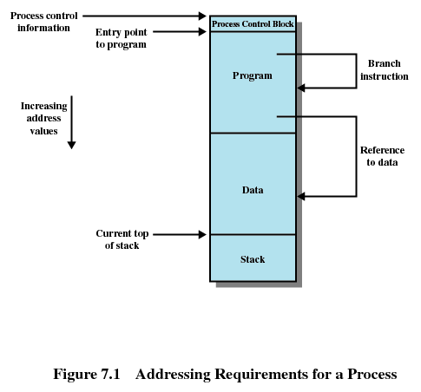
Addressing
The OS needs to know the location of:
process control information
the execution stack,
the entry point to begin execution of the program for this process.
There will be memory references within the program
Eg. BT, GD, PD
Processor HW and OS should be able to translate these into actual physical memory addresses
Changes every time
Notes:
8
8
8
8
8

Slide 9
Memory Management Requirements
2. Protection
Processes should not be able to reference memory locations in another process without permission.
Impossible to check absolute addresses at compile time.
Must be checked at run time.
Memory protection requirement must be satisfied by the processor (hardware) rather than the operating system (software)
Operating system cannot anticipate all of the memory references a program will make
Notes:
9
9
9
9
9

Slide 10
Memory Management Requirements
3. Sharing
Allow several processes to access the same portion of memory
Ex. Number of processes executing same program
Better to allow each process access to the same copy of the program rather than have their own separate copy
Protection mechanism must have flexibility to allow several processes to access the same portion of memory
Processes that are cooperating on some task may need to share access to the same data structure.
Notes:
10
10
10
10
10

Slide 11
Memory Management Requirements
4. Logical Organization
Memory is organized linearly (usually)
- Main memory is usually organized as a linear, or 1-D address space, consisting of a sequence of bytes or words.
- Secondary memory, at its physical level, is similarly organized.
If memory can also be dealt with in form of modules, there are several advantages( Programs are written in modules)
Modules can be written and compiled independently
Different degrees of protection given to modules (read-only, execute-only)
Share modules among processes.
Ex: use of segmentation uses module concept
Notes:
11
11
11
11
11

Slide 12
Memory Management Requirements
5. Physical Organization
Memory is organized into Two –levels
Main memory :fast , expensive, volatile
Secondary memory : Slow , less expensive, non-volatile
Flow of information b/n main & secondary memory is major concern
Can it be programmer’s responsibility?
No
Memory available for a program plus its data may be insufficient
Overlaying allows various modules to be assigned the same region of memory
Programmer dependent
Wastage of time of programmer
Programmer does not know how much space will be available and where that space will be.
Notes:
12
12
12
12
12

Slide 13
Overlays
Program & its related data is loaded in physical memory for execution.
What happens if process is larger that the amount of memory allocated to it?
Use overlays.
Overlays can be implemented by users without OS support
The entire program /application is divided into instructions & data sets such that when one instruction set is needed it is loaded in memory and after its execution is over, the space is released.
As & when requirement for other instruction arises, it is loaded into space that was released previously by the instructions that are no longer needed.
The program based on overlays scheme mainly consist of following:
A root piece which is always memory resident
Set of overlays

Slide 14
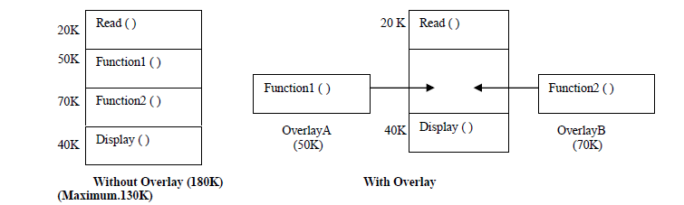
Overlays example

Slide 15
Overlays limitations
Requires careful and time consuming planning
Programmer is responsible for designing overlays structure of program
OS provides the facility to load files into overlays region.

Slide 16
Swapping
A process can be swapped temporarily out of memory to a backing store, and then brought back into memory for continued execution.
Backing store – fast disk large enough to accommodate copies of all memory images for all users; must provide direct access to these memory images
Roll out, roll in – swapping variant used for priority-based scheduling algorithms; lower-priority process is swapped out so higher-priority process can be loaded and executed
Major part of swap time is transfer time; total transfer time is directly proportional to the amount of memory swapped
Modified versions of swapping are found on many systems (i.e., UNIX, Linux, and Windows)
System maintains a ready queue of ready-to-run processes which have memory images on disk
Notes:
16
16
16
16
16
16
16

Slide 17
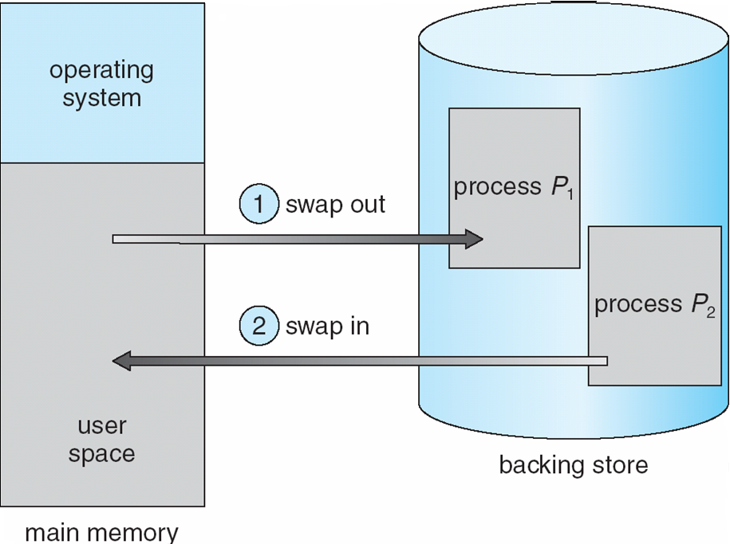
Swapping

Slide 18
Vishal Kaushal
Swapping
Benefits:
Allows higher degree of multiprogramming
Allow dynamic relocation
Better memory utilization
Less wastage of CPU time on compaction
Can easily be applied on priority based scheduling algorithms to improve performance
Limitations:
Entire program must be resident in store when it is executing
Processes with changing memory requirements will need to issue system calls for requesting & releasing memory.
Notes:
18
18

Slide 19
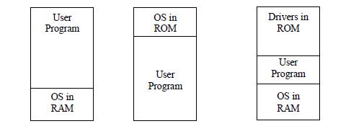
Single process monitor(Monoprogramming)
Only one process in main memory
No address translation during execution of program
Protection of OS
Ex: MS-DOS
Limited capacity & performance

Slide 20
Contents
Memory Management requirements
Memory Partitioning: Fixed and Variable Partitioning,
Allocation Strategies (First Fit, Best Fit, and Worst Fit), Fragmentation, Swapping.
Virtual Memory: Concepts, Segmentation, Paging, Address Translation,
Page Replacement Policies (FIFO, LRU, Optimal, Other Strategies),
Thrashing.
Notes:
20
20
20
20
20

Slide 21
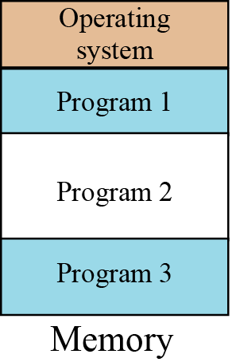
Multiprogramming
In multiprogramming, more than one program is in memory at the same time, and they are executed concurrently, with the CPU switching rapidly between the programs.
7.21
Notes:
21

Slide 22
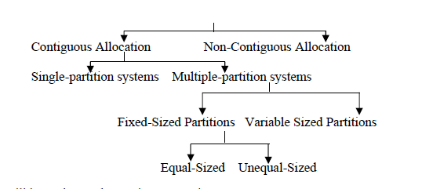

Memory Allocation Methods
7.22
Notes:
22

Slide 23
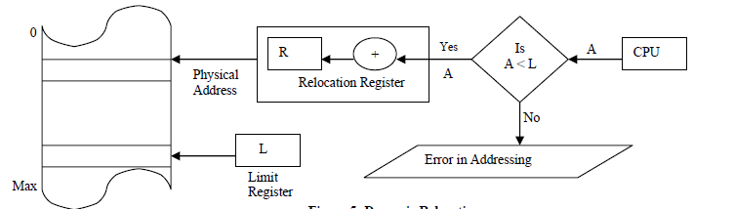
Single partition System
OS can be protected by keeping it in lower part and user processes in upper part of memory
Dynamic relocation is used using relocation register & base register
Relocation register contains smallest physical address
Limit register contains logical address range
If logical address space is 0 to MAX then physical address space is R+0 to R+MAX

Slide 24
Memory Management
Principal operation of MM is to bring process from secondary memory to main memory
This typically involves Virtual Memory which in turn involves segmentation and/or paging
Prior to Virtual Memory, other simpler techniques were used
Partitioning
Fixed
Variable / Dynamic
Concept of paging
Concept of segmentation
Notes:
24

Slide 25
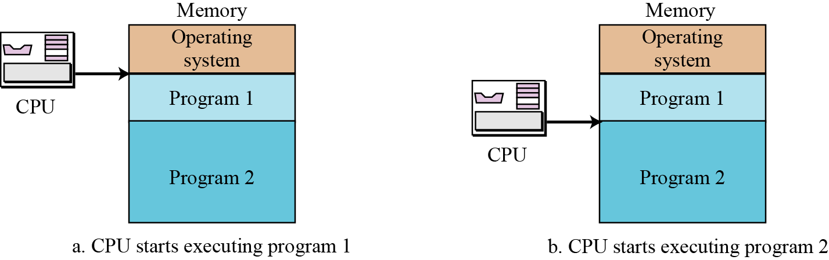
7.25
Notes:
25

Slide 26
Contiguous Memory Partitioning
Partition the available memory into regions with fixed boundaries.
1. Fixed Partitioning:
Equal-size Partitions
Unequal-size Partitions
2. Variable Partitioning
Notes:
26
26
26
26
26

Slide 27
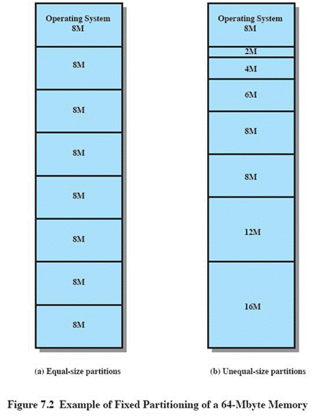
Fixed Partitioning
Equal-size partitions
Any process whose size is less than or equal to the partition size can be loaded into an available partition
If all partitions are full, the operating system can swap a process out of a partition
Notes:
27
27
27
27
27

Slide 28
Fixed Partitioning
Problems:
A program may be too big to fit in any partition.
Use of overlays is compulsory.
Main memory use is inefficient.
Any program, no matter how small, occupies an entire partition.
Wasted space internal to the partition called internal fragmentation
Notes:
28
28
28
28
28

Slide 29
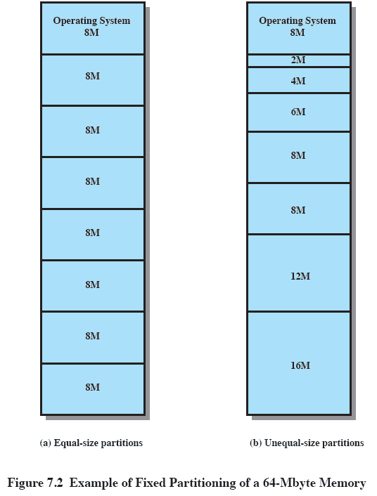
Solution: Unequal Size Partitions
Lessens both problems
but doesn’t solve completely
In Figure
Programs up to 16M can be accommodated without overlay
Smaller programs can be placed in smaller partitions, reducing internal fragmentation
Notes:
29
29
29
29
29

Slide 30
Placement Algorithm with Partitions
Equal-size partitions
Because all partitions are of equal size, it does not matter which partition is used.
If all partitions occupied with processes not ready to run, swap one out and load this guy in -Which one to swap out is a scheduling decision
Unequal-size partitions
Can assign each process to the smallest partition within which it will fit.
Queue for each partition.
Processes are assigned in such a way as to minimize wasted memory within a partition.
Two possible strategies
Notes:
30
30
30
30
30

Slide 31
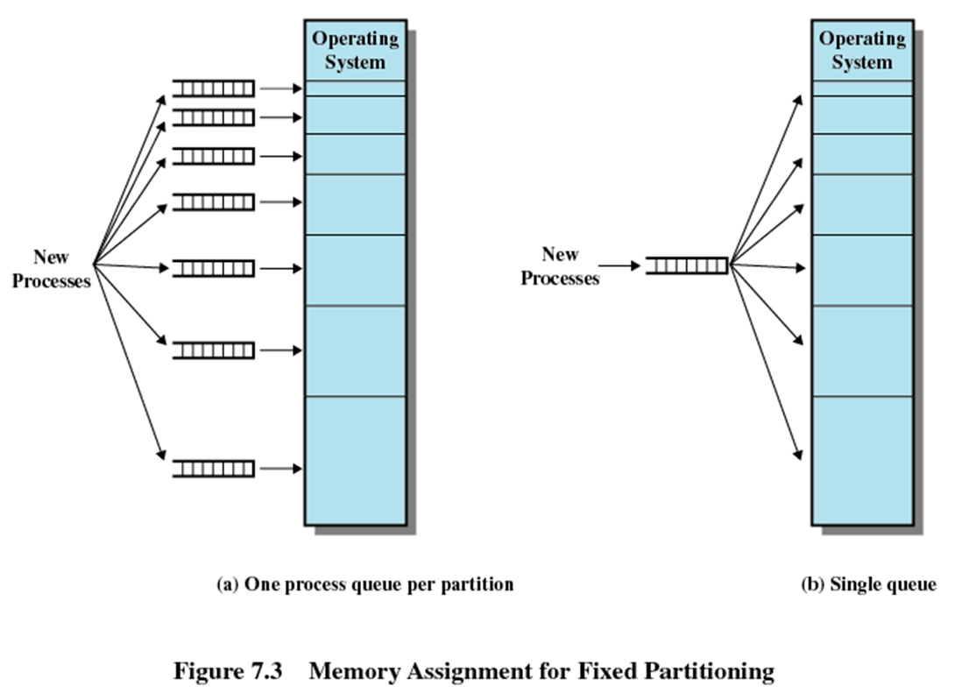
Strategy 1
Assign to smallest partition possible
May have to wait because somebody else is already there
Needs a scheduling queue for each partition to hold swapped out processes destined for that partition
If memory requirement is not clear, overlaying or virtual memory are the only solutions
Advantage: minimum internal fragmentation
Disadvantage?
Small process cannot go to bigger partition even if available
Notes:
31
Small process cannot go to bigger partition even if available
31

Slide 32
Strategy 2
Single queue
Smallest available partition is selected when needed
If all are occupied, then swap out somebody
Smallest partition process that is enough to hold this guy
Priority
Process state
Notes:
32

Slide 33
Fixed Partitioning
Advantages
Simple, require minimal OS and processing overhead
Disadvantages
Number of partitions specified at system generation time limits the number of active processes system can support
Internal fragmentation cannot be completely eliminated
It is always possible to get small jobs which do not utilize partitions fully
Fixed partitioning is no where to be seen today
Example: IBM Mainframe's OS/MFT(Multiprogramming with fixed number of tasks)
Notes:
33

Slide 34
Dynamic Partitioning
Purpose:to overcome the difficulties of fixed partitioning
Partitions are of variable length and number.
Process is allocated exactly as much memory as required.
Eventually get holes in the memory. This is called external fragmentation
Example:I BM Mainframe's OS/MVT OS/MFT(Multiprogramming with variable number of tasks)
Notes:
34
34
34
34
34

Slide 35
Dynamic Partitioning Example
External Fragmentation
Memory external to all processes is fragmented
Can resolve using coalescing holes & compaction
OS (8M)
P1
(20M)
P2
(14M)
Empty (6M)
P2
(14M)
P4(8M)
Empty (56M)
Empty (6M)
P3
(18M)
Empty (4M)
Refer to Figure 7.4
Notes:
35
35
Animated slide
Imagine a system with 64M RAM
Initially, main memory is empty, except for the operating system
Three processes are loaded in – leaving a ‘hole’ too small for any further process
At some point, none of the processes in memory is ready. The operating system swaps out process 2,
Which leaves sufficient room to load a new process, process 4 – but that creates another hole
Later, a point is reached at which none of the processes in main memory is ready, but process 2, in the Ready-Suspend state, is available. Because there is insufficient room in memory for process 2, the operating system swaps process 1 out and swaps process 2 back in leaving yet another hole
Explain External Fragmentation and compaction – mention that compaction implies the capability of dynamic relocation
35

Slide 36
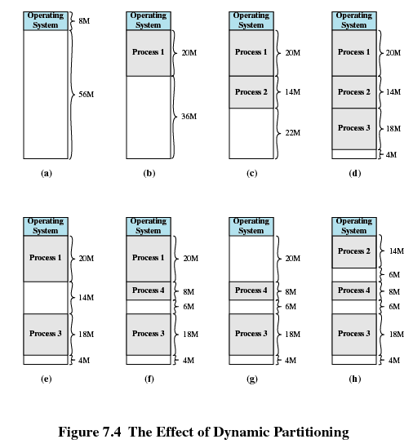
Dynamic Partitioning Example
Notes:
36
36
36
36
36

Slide 37
Dynamic Partitioning
Coalescing holes is the process of merging existing hole adjacent to a process that will terminate and free its allocation space. So that new adjacent hole & existing holes can be viewed as a single large hole and can be efficiently used.
In Compaction, shuffle all occupied areas of memory to one end and leave all free memory space as a large block
Problem with compaction?
Extra overhead in terms of resource utilization & large response time
Expensive
Needs dynamic relocation of processes in memory

Slide 38
Contents
Memory Management requirements
Memory Partitioning: Fixed and Variable Partitioning,
Allocation Strategies (First Fit, Best Fit, and Worst Fit), Fragmentation, Swapping.
Virtual Memory: Concepts, Segmentation, Paging, Address Translation,
Page Replacement Policies (FIFO, LRU, Optimal, Other Strategies),
Thrashing.
OS Services layer in the Mobile OS: Multimedia and Graphics Services, Connectivity Services.
Notes:
38
38
38
38
38

Slide 39
Dynamic Partitioning Placement Algorithm
Purpose: To overcome on problem of compaction
Operating system must decide which free block to allocate to a process
When more than one choice available, OS must decide cleverly which hole to fill
Hole must be big enough to accommodate the to-be-loaded process
Placement algorithms:
First fit
Best fit
3. Next fit
4. Worst fit
Notes:
39
39
39
39
39

Slide 40
Dynamic Partitioning Placement Algorithm
First-fit algorithm
Scans memory from the beginning and chooses the first available block that is large enough
Simplest, Fastest
May have many process loaded in the front end of memory that must be searched over when trying to find a free block
Notes:
40
40
40
40
40

Slide 41
Dynamic Partitioning Placement Algorithm
Best-fit algorithm
scan all holes to see which is best
Chooses the block that is closest in size to the request
Worst performer overall
Since smallest block is found for process, the smallest amount of fragmentation is left
Memory compaction must be done more often
Notes:
41
41
41
41
41

Slide 42
Dynamic Partitioning Placement Algorithm
Next-fit
Scans memory from the location of the last placement
More often allocate a block of memory at the end of memory where the largest block is found
The largest block of memory is broken up into smaller blocks
Compaction is required to obtain a large block at the end of memory
Notes:
42
42
42
42
42

Slide 43
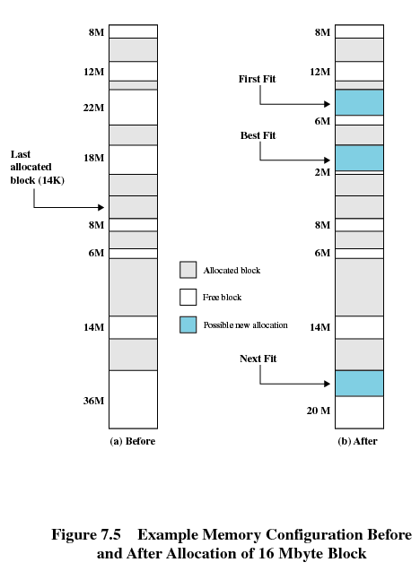
The last block that was used was a 22-Mbyte block from which a 14-Mbyte partition was created.
Notes:
43
43
43
43
43

Slide 44
Comparison
Depends on exact sequence of process swapping and size of processes
First fit
Simplest and usually the best and fastest
Splits regions towards beginning requiring more searches
Next fit produces slightly worse results than first fit
Tends to allocate more frequently towards the end of the memory, thus largest block of free memory which usually appears at the end is quickly fragmented requiring more frequent compaction
Best fit is usually the worst performer
Every allocation leaves behind smallest fragment of no good use
Requires compaction even more frequently
How about worst-fit strategy?
Worst-fit: Allocate the largest hole; must also search entire list
Produces the largest leftover hole
First-fit and best-fit better than worst-fit in terms of speed and storage utilization
Notes:
44

Slide 45
Given memory partitions of 100 KB, 500 KB, 200 KB, 300 KB, and 600 KB. How would each of the First fit, Best-Fit and Worst-Fit algorithms place processes of 212 KB, 417 KB, 112 KB, and 426 KB ? 2. Given memory partition of 100 KB, 500 KB, 200 KB and 600 KB (in order). Show with neat sketch how would each of the first-fit, best-fit and worst fit algorithms place processes of 412 KB, 317 KB, 112 KB and 326 KB (in order). Which algorithm is most efficient in memory allocation?

Slide 46
Fragmentation
External Fragmentation – Total memory space exists to satisfy a request, but it is not contiguous.
Internal Fragmentation – allocated memory may be slightly larger than requested memory; this size difference in memory is internal to a partition, but not being used.
Reduce external fragmentation by compaction
Shuffle memory contents to place all free memory together in one large block
Compaction is possible only if relocation is dynamic, and is done at execution time
I/O problem
Latch job in memory while it is involved in I/O
Do I/O only into OS buffers
Notes:
46
46
46
46
46
46
46

Slide 47
Buddy System
To overcome on the drawbacks of Fixed & Variable partitioning scheme.
Memory blocks are available of size 2^{K} words, where L<=K<=U
2^{L} Smallest size block that is allocated
2^{U} largest block that is allocated
Generally 2U is the size of entire memory available for allocation
Entire space available is treated as a single block of size 2^{U}
If a request of size s where 2^{U-1} < s <= 2^{U}
entire block is allocated
Otherwise block is split into two equal buddies of size 2^{U-1.}
Process continues until smallest block greater than or equal to s is generated
Notes:
In a fixed partitioning scheme limits the number of active processes and may use space inefficiently if there is a poor match between available partition sizes and process sizes.
A dynamic partitioning scheme is more complex to maintain and includes the overhead of compaction.
An interesting compromise is the buddy system.
47

Slide 48
Buddy System
The buddy system of partitioning relies on the fact that space
allocations can be conveniently handled in sizes of power of 2.
There are two ways in which the buddy system allocates space.
Suppose we have a hole which is the closest power of two. In that case, that hole is used for allocation.
In case we do not have that situation then we look for the next power of 2 hole size, split it in two equal halves and allocate one of these.
Because we always split the holes in two equal sizes, the two are “buddies”. Hence, the name buddy system.
The buddy system has the advantage that it minimizes the internal fragmentation.
In practice, some Linux flavors use it.

Slide 49
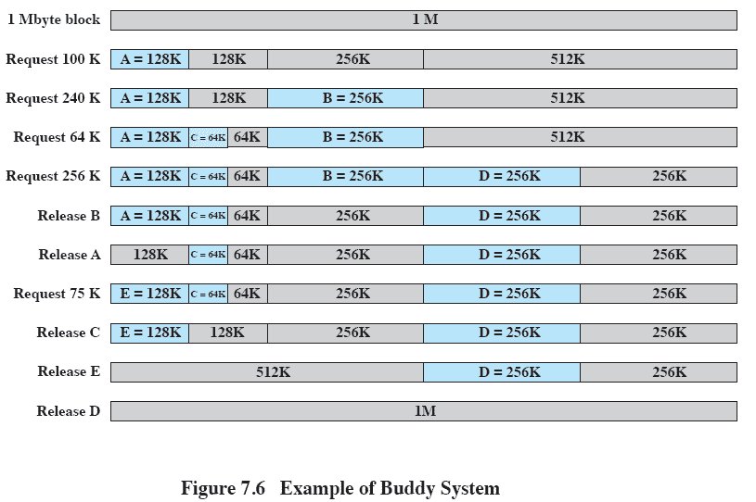
Example of Buddy System
Notes:
Figure 7.6 gives an example using a 1-Mbyte initial block.
The first request,A, is for 100 Kbytes, for which a 128K block is needed.
The initial block is divided into two 512K buddies.
The first of these is divided into two 256K buddies,
and the first of these is divided into two 128K buddies,
one of which is allocated to A.
The next request,B, requires a 256K block. Such a block is already available and is allocated.
The process continues with splitting and coalescing occurring as needed.
Note that when E is released,two 128K buddies are coalesced into a 256K block, which is immediately coalesced with its buddy
49

Slide 50
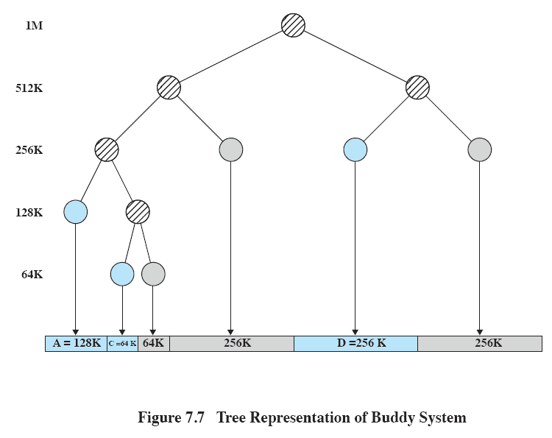
Tree Representation of Buddy System
Notes:
Figure 7.7 shows a binary tree representation of the buddy allocation immediately after the Release B request.
The leaf nodes represent the current partitioning the memory.
If two buddies are leaf nodes, then at least one must be allocated;
otherwise they would be coalesced into a larger block.
The buddy system is a reasonable compromise to overcome the disadvantages of both the fixed and variable partitioning schemes,
But in contemporary operating systems, virtual memory based on paging and segmentation is superior.
However, the buddy system has found application in parallel systems as an efficient means of allocation and release for parallel programs. A modified form of the buddy system is used for UNIX kernel memory allocation (described in Chapter 8).
50

Slide 51
Tree Representation of Buddy System
Figure 7.7 shows a binary tree representation of the buddy allocation immediately after the Release B request.
The leaf nodes represent the current partitioning the memory.
If two buddies are leaf nodes, then at least one must be allocated;
otherwise they would be coalesced into a larger block.
The buddy system is a reasonable compromise to overcome the disadvantages of both the fixed and variable partitioning schemes,
But in contemporary operating systems, virtual memory based on paging and segmentation is superior.
However, the buddy system has found application in parallel systems as an efficient means of allocation and release for parallel programs. A modified form of the buddy system is used for UNIX kernel memory allocation

Slide 52
Example on Buddy system
A minicomputer uses the buddy system for memory management. Initially it has one
block of 256K at address 0. After successive requests of 7K, 26K, 34K and 19K come in,
how many blocks are left and what are their sizes and addresses?

Slide 53
Example on Buddy system
Solution:
7K: We recursively break the address space into 2 halves until we have:
8K - 8K - 16K - 32K - 64K -128 K
The first segment is used to satisfy the 7K request.
26K: We use the 32K block to allocate the request.
8K - 8K - 16K - 32K - 64K -128 K
34K: We use the 64K block to satisfy the request:
8K - 8K - 16K - 32K - 64K -128 K
19K: Since 8K and 16K cannot satisfy the request on their own, we need to break the big
128K block recursively until we get the size we need. The blocks will look like:
8K - 8K - 16K - 32K - 64K - 32K - 32K - 64K

Slide 54
Example on Buddy system
A 1MB block of memory is allocated using the buddy system.Show the result of the following sequence:Request A 70,request B 35,request C 80, return A,request D 60,return B,return D,return C.
Show the binary tree representation following Return B

Slide 55
Contents
Memory Management requirements
Memory Partitioning: Fixed and Variable Partitioning,
Allocation Strategies (First Fit, Best Fit, and Worst Fit), Fragmentation, Swapping.
Paging, Segmentation, Address Translation,
Page Replacement Policies (FIFO, LRU, Optimal, Other Strategies),
Thrashing.
Notes:
55
55
55
55
55

Slide 56
Addresses
Logical
Reference to a memory location independent of the current assignment of data/instruction to memory. Generated by CPU
Relative
Type of logical address wherein address is specified as a location relative to some known point, say a value in a register
Physical or Absolute
The absolute address or actual location in main memory.
Typically, all of the memory references in a loaded process are relative to the base address
Hardware mechanism is used to translate logical/relative to physical at the time of execution of instruction that contains the reference
Notes:
56
56
56
56
56

Slide 57
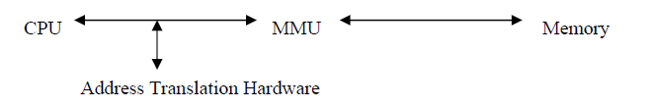
Memory Management Unit
MMU is the hardware device that maps logical address to physical address

Slide 58
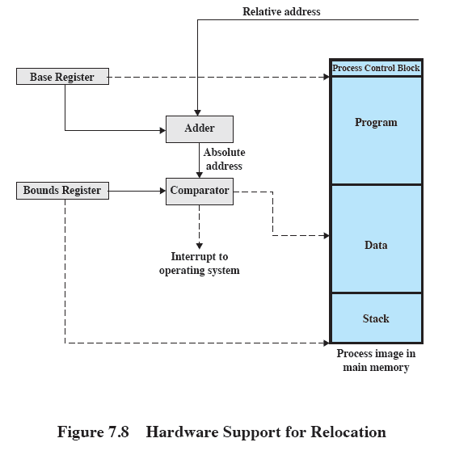
Relocation
Limit register
Notes:
58
58
58
58
58

Slide 59
Registers Used during Execution
Base register: Starting address for the process.
Bounds register: Ending location of the process.
These values are set when the process is loaded or when the process is swapped in.
The value of the base register is added to a relative address to produce an absolute address.
The resulting address is compared with the value in the bounds register.
If the address is not within bounds, an interrupt is generated to the operating system otherwise instruction gets executed.
Notes:
59
59
59
59
59

Slide 60
Paging
Fixed & variable size partitions are insufficient as involves internal / external fragmentation.🡪 contiguous
What were the two problems with equal sized fixed partitions?
Program too large for a partition
Program too small for a partition
Partition memory into small equal fixed-size chunks and divide each process into the same size chunks.
The chunks of a process are called pages and chunks of memory are called frames.
Operating system maintains a page table for each process
Contains the frame location for each page in the process
Memory address consist of a page number and offset within the page
Page number is used as an index to page table.
Notes:
60
60
60
60
60

Slide 61
Paging
Each process has its own page table.
Each page table entry contains the frame number of the corresponding page in main memory
A bit is needed to indicate whether the page is in main memory or not.
No external fragmentation
all frames (physical memory) can be used by processes
Possibility of Internal fragmentation
The physical memory used by a process is no longer contiguous
The logical memory of a process is still contiguous
The logical and physical addresses are separated
the process does not see the translation or the difference to having physical memory
Notes:
61
61
61
61
61

Slide 62
Advantages of Breaking up a Process
More processes may be maintained in main memory
Only load in some of the pieces of each process
With so many processes in main memory, it is very likely a process will be in the Ready state at any particular time
A process may be larger than all of main memory
Notes:
62
62
62
62
62

Slide 63
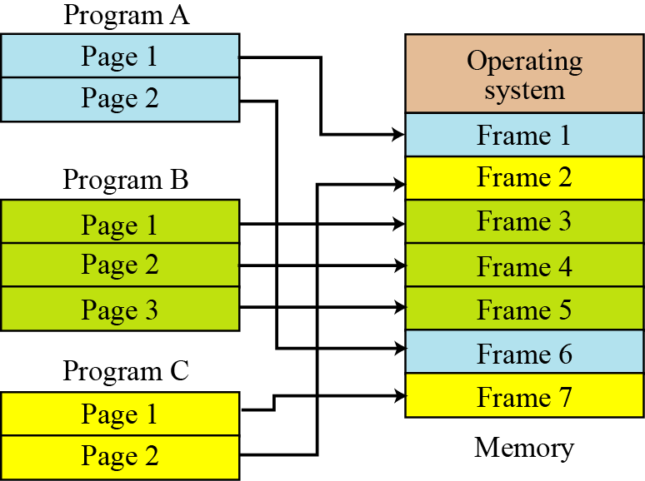
7.63
Notes:
63

Slide 64
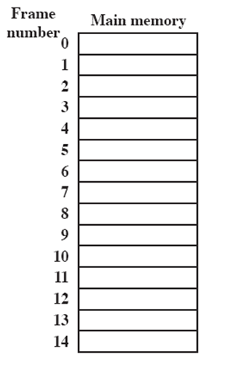
Processes and Frames
A.0
A.1
A.2
A.3
B.0
D.0
B.1
D.1
B.2
D.2
C.0
C.1
C.2
C.3
D.3
D.4
Notes:
64
64
64
64
Animated slide
System with a number of frames allocated
Process A, stored on disk, consists of four pages. When it comes time to load this process, the operating system finds four free frames and loads the four pages of process A into the four frames.
Process B, consisting of three pages, and process C, consisting of four pages, are subsequently loaded.
Then process B is suspended and is swapped out of main memory.
Later, all of the processes in main memory are blocked, and the operating system needs to bring in a new process, process D, which consists of five pages. The Operating System loads the pages into the available frames and updates the page table
64

Slide 65
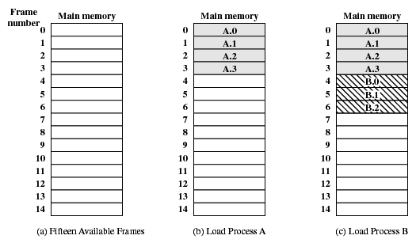
Assignment of Process Pages to Free Frames
Notes:
65
65
65
65
65

Slide 66
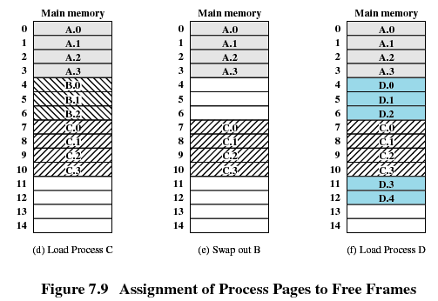
Assignment of Process Pages to Free Frames
Notes:
66
66
66
66
66

Slide 67
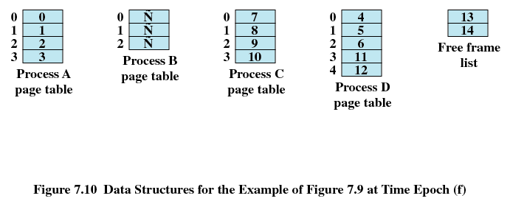
Page Tables for Example
Notes:
67
67
67
67
67

Slide 68

Paging
The page size is defined by the hardware.
The page size is typically a power of 2.The size can be 512 bytes to 16 MB.
The selection of power of 2 as a page size makes translation of logical address into a page number and page offset easy.
Address generated by CPU is divided into:
Page number (p) – used as an index into a page table which contains base address of each page in physical memory
Page offset (d) – combined with base address to define the physical memory address that is sent to the memory unit.
For given logical address space 2^{m} and page size 2^{n}
Notes:
68
68
68
68
68

Slide 69
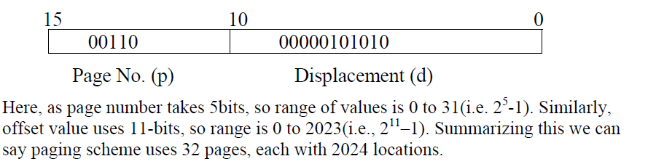
Paging
Assume 16 bit address

Slide 70
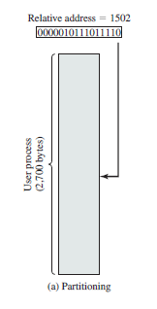
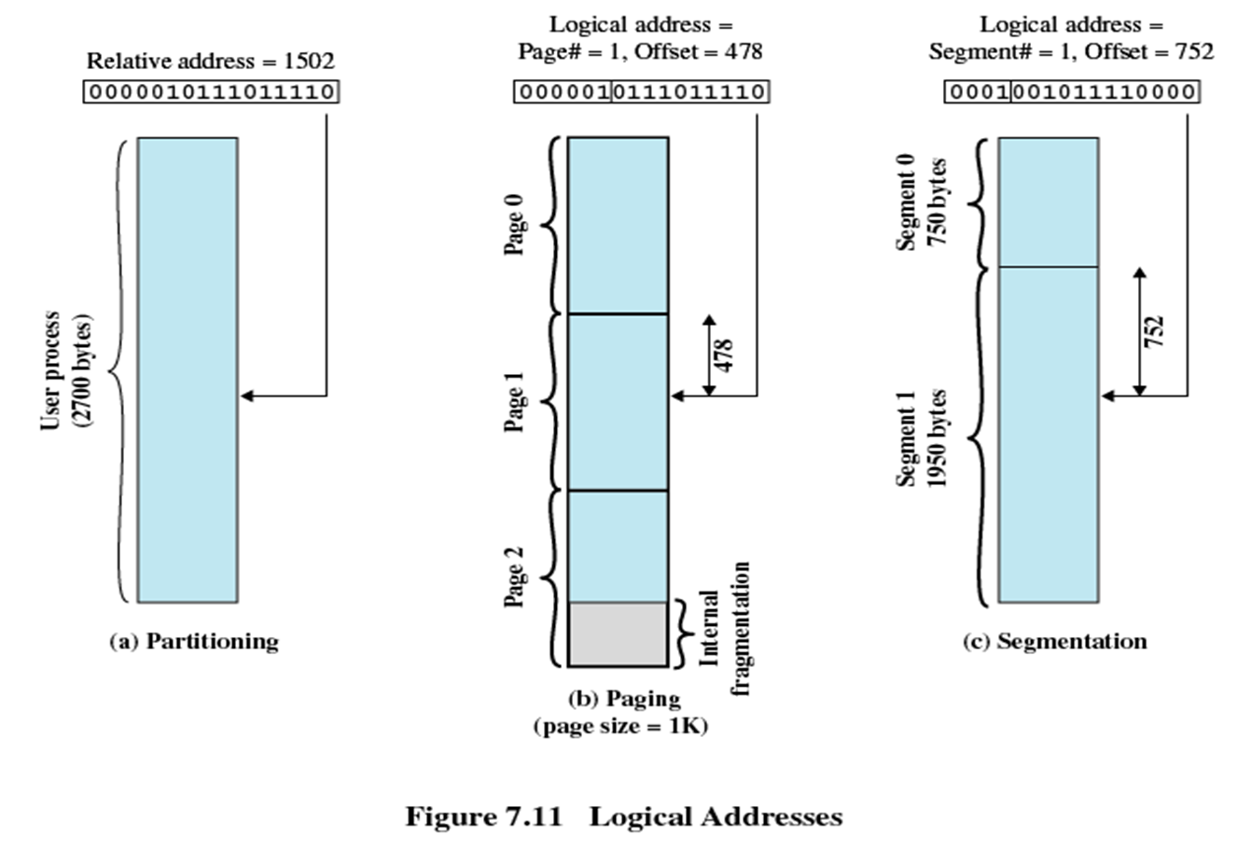
Logical Address vs Relative Address
What does relative address 1502 mean?
Start from base relative address of the process
What logical address would this correspond to?
Let page size be 1000 bytes
Logical address = page 1, offset 502
That is, relative address 1502 corresponds to logical address (1,502)
Expressed as 16 bit values, relative address is 0000010111011110 and
logical address is (000001, 0111100110)
They are different
Vishal Kaushal
Notes:
70

Slide 71
In this example, 16-bit addresses are used, and the page size is 1K =1024 bytes=2¹⁰
The relative address 1502, in binary form, is 0000010111011110.
From page size, we understand how many bits the offset would need
Remaining bits are then available for page number
Logical address simply corresponds to the two portions of relative address
With a page size of 1K, an offset field of 10 bits is needed,
leaving 6 bits for the page number.
Can you compute maximum number of pages a program can contain?
- 2⁶ =64 pages of 1K bytes each.
As Figure 7.11b shows, relative address 1502 corresponds to
an offset of 478 (0111011110) on page 1 (000001),
which yields the same 16-bit number, 0000010111011110.
Notes:
71
71
71
71

Slide 72
Illustration
Notes:
72
72
72
72
72

Slide 73
Logical to physical address translation
Consider a logical address of n+m bits
First n bits = page number
Last m bits = offset
Use the page number as an index into process page table to find frame number, k
Starting physical address of that frame then would be k X 2^m
Desired physical address = this + offset, m
Again, doesn’t need to be calculated
Just append offset to the frame number k
Notes:
73

Slide 74
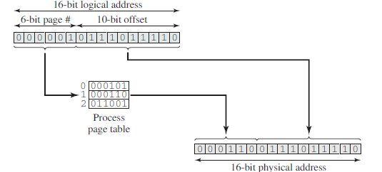
Logical to Physical Address Translation in Paging
The logical address is 0000010111011110, which is page number 1, offset 478.
Suppose that this page is residing in main memory frame 6 = binary 000110. Then the physical address is frame number 6, offset 478 = 0001100111011110
( 6*2^10=6144+478=6622 (0001100111011110 )
Notes:
74
74
74
74
74

Slide 75
Example
Consider a logical address space of 64 pages of 1024 words each, mapped onto a physical memory of 32 frames.
How many bits are there in the logical address?
Sol:64 pages=64*1024=2^6*2^10=2^16=16 bits
How many bits are there in the physical address?
Sol: 32 frames= 32 *1024=2^5*2^10=2^15=15 bits
Notes:
75

Slide 76
Example
Consider a logical address space of 32 pages of 1024 words per page, mapped onto a physical memory of 16 frames.
How many bits are there in the logical address?
Sol:32 pages=32*1024=2^5*2^10=2^15=15 bits
b) How many bits are there in the physical address?
Sol:16 pages=16*1024=2^4*2^10=2^14=14 bits
Notes:
76

Slide 77
Example
Consider a computer system with a 32 bit logical address and 4KB page size. The system supports up to 512 MB of physical memory. How many entries are there in a conventional page table?
Logical address =32 bit
Page size=4KB=4*1024=2^2*10^2=10^12
page number =32-12=20 bits, offset=12 bits
Physical address=512 MB=512*1024*1024=2^9*2^20=2^29
Page table entry=total frames=2^20
Notes:
77

Slide 78
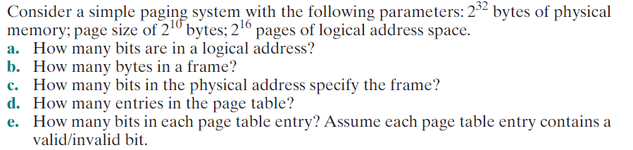
Example
26 BITS
2^10 bytes:1Kb
22 BITS
2^16
22+1 BITS
Solve same by replacing 2^ 32 bytes with 2^32 frames of physical memory
Notes:
78

Slide 79
Consider a simple paging system with the following parameters: 2³² bytes of physical memory; page size of 2¹⁰ bytes; 2¹⁶ pages of logical address space.
How many bits are in a logical address?
b. How many bytes in a frame?
c. How many bits in the physical address specify the frame?
d. How many entries in the page table?
e. How many bits in each page table entry? Assume each page table entry contains a valid/invalid bit.

Slide 80
Segmentation
User program and associated data now divided not into pages, but segments which could be of unequal size
All segments of all programs do not have to be of the same length, May be unequal, dynamic size
There is a maximum segment length, Simplifies handling of growing data structures
Logical Address consist of two parts - a segment number and an offset
Similar to dynamic partitioning
A program however can now occupy more than one partitions
Partitions need not be contiguous
No internal fragmentation?
No external fragmentation?
Notes:
80
80
80
80
80

Slide 81
Segmentation
Paging is invisible to the programmer, segmentation is usually visible and is provided as a convenience for organizing programs and data
Compiler or programmer assigns programs and data to different segments
One program may be further broken down into multiple segments for purposes of modular programming
Allows programs to be altered and recompiled independently
Lends itself well to sharing data among processes
Lends itself well to protection
Simplifies handling of growing data structures
Logical address to physical address translation is now little complicated but similar
Segment table
Length of segment and starting physical address
Notes:
81

Slide 82
Segment Organization
Starting address corresponding segment in main memory
Each entry contains the length of the segment
A bit is needed to determine if segment is already in main memory
Another bit is needed to determine if the segment has been modified since it was loaded in main memory
Notes:
82
82
82
82
82

Slide 83
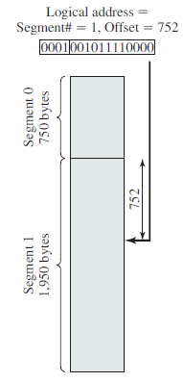
Logical to Physical Address Translation in Segmentation
In this example, 16-bit addresses are used,
The relative address 1502, in binary form, is 0000010111011110.
Consider an address of n + m bits, where the leftmost n bits are the segment number and the rightmost m bits are the offset.
In the example on the slide n = 4
And m =12.
Notes:
83
83
83
83

Slide 84
Address translation
Extract segment number from logical address (left most n bits)
Find base address of this segment from segment table
Compare offset (rightmost m bits) with segment length
If ok, desired physical address = base address + offset
Notes:
84

Slide 85
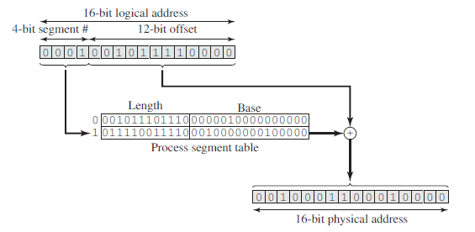
Logical to Physical Address Translation in Segmentation
The logical address is 0001001011110000, which is segment number 1, offset 752.
Suppose that this segment is residing in main memory starting at physical address 0010000000100000.
Then the physical address(base addess+offset): 0010000000100000 +
001011110000 =0010001100010000
Notes:
85
85
85
85
85

Slide 86
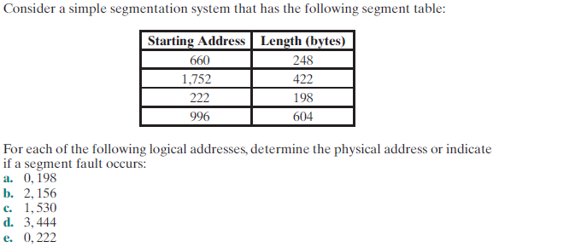
Examples
Notes:
86

Slide 87
Segment no | Start | Length | End (start+length)
S2 | 222 | 198 | 420
S0 | 660 | 248 | 908
S3 | 996 | 604 | 1600
S1 | 1752 | 422 | 2174
(0,198): 660+198=858
(2,156)=222+156=377
(1,530)=invalid,as offset > length
(3,444)=996+444=1440
(0,222)=Invalid as offset > length

Slide 88
Example
8-bit virtual address, 10-bit physical address, and each page is 64 bytes.
How many virtual pages?
How many physical pages?
How many entries in page table?
Given page table = [2, 5, 1, 8], what’s the physical address for virtual address 241?
4 pages
16 frames
4 PTE
561

Slide 89
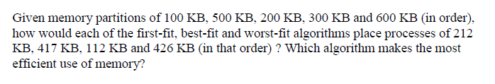
Example
Notes:
89

Slide 90
Virtual Memory : Paging & Segmentation
Notes:
90
90
90

Slide 91
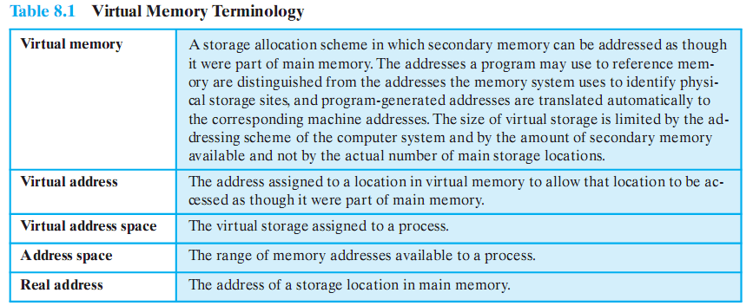
Addresses
Notes:
91
91
91
91
91

Slide 92
Key points in Memory Management
1) Memory references are logical addresses dynamically translated into physical addresses at run time
A process may be swapped in and out of main memory occupying different regions at different times during execution
2) A process may be broken up into pieces that do not need to located contiguously in main memory
Portion of a process that is in memory at any given time is called resident set of the process
Notes:
92
92
92
92
92

Slide 93
Breakthrough in Memory Management
If both of those two characteristics are present,
then it is not necessary that all of the pages or all of the segments of a process be in main memory during execution.
If the next instruction, and the next data location are in memory then execution can proceed
at least for a time
Notes:
93
93
93
93
93

Slide 94
Background
Virtual memory – separation of user logical memory from physical memory.
Only part of the program needs to be in memory for execution
Logical address space can therefore be much larger than physical address space
Allows address spaces to be shared by several processes
Allows for more efficient process creation
Virtual memory can be implemented via:
Demand paging
Demand segmentation
Notes:
94
94
94
94

Slide 95
Virtual Memory
Demand paging and demand segmentation mean that, when a program is being executed, part of the program is in memory and part is on disk.
This means that, for example, a memory size of 10 MB can execute 10 programs, each of size 3 MB, for a total of 30 MB.
At any moment, 10 MB of the 10 programs are in memory and 20 MB are on disk. There is therefore an actual memory size of 10 MB, but a virtual memory size of 30 MB. Figure 7.11 shows the concept. Virtual memory, which implies demand paging, demand segmentation or both, is used in almost all operating systems today.
7.95
Notes:
95

Slide 96
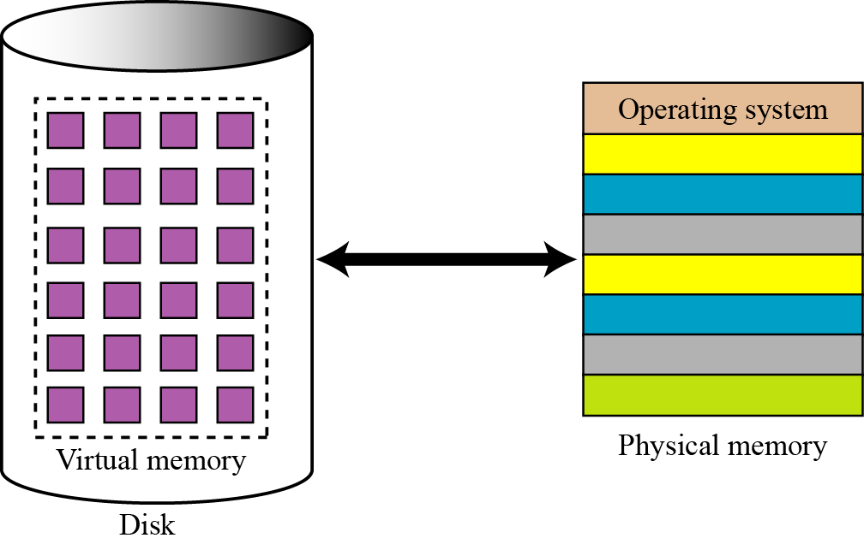
Virtual Memory
7.96
Notes:
96

Slide 97
Virtual Memory
If a ‘piece’ is not in memory and is required, processor generates interrupt indicating memory access fault
OS takes charge, puts process in blocked state
OS issues disk I/O to bring in the desired piece
Schedules another process in the mean time
Once brought in, I/O interrupt is raised, OS takes control again and puts the process in Ready queue
VM 🡪 Virtual Memory, Virtual Machine
Notes:
97

Slide 98
Advantages of having only a portion
More processes in memory at a given time with increase in CPU utilization, throughput but no increase in response time & turnaround time
Processes can now be larger than main memory without any tension on part of the programmer (overlaying)
Why to waste memory with portions of program/data which are being used only rarely
Time is saved as unused pieces are not being swapped in/out
Less I/O needed to load or swap user programs into memory, so each user program would run faster.
Notes:
98

Slide 99
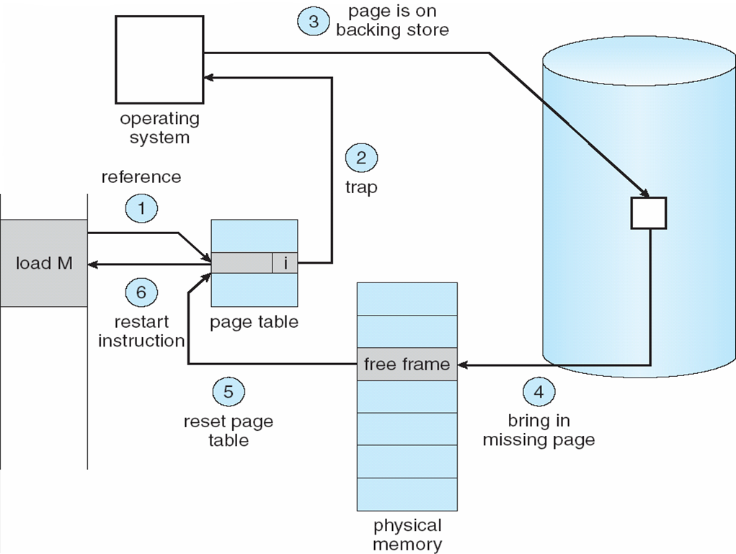
Steps in handling a page fault
Notes:
99

Slide 100
Issues
To bring in a piece, some other piece needs to be thrown out
Piece is thrown out just before it is used
Go get that piece again almost immediately
Leads to thrashing
System spends to much time swapping the pieces rather than executing instructions
Problem is worsened if OS mistakes it to be an indicator to increase the level of multi programming
Solution: OS tries to guess which pieces are least likely to be used in the near future
Notes:
100

Slide 101
Virtual Memory Requirements
Hardware must support paging and/or segmentation
OS must support swapping of pages and/or segments
Notes:
101

Slide 102
Virtual Memory + Paging
Earlier paging: when all pages of a process are loaded into memory, its page table is created and loaded
Page Table Entry (PTE) now needs to have
An extra bit to indicate whether page is in memory or not (P)
Another bit to indicate whether it is modified since it was last loaded (M)
When somebody else comes to replace me, I will not need to be written back to disk
Some control bits
For example protection or sharing at page level
Notes:
102

Slide 103
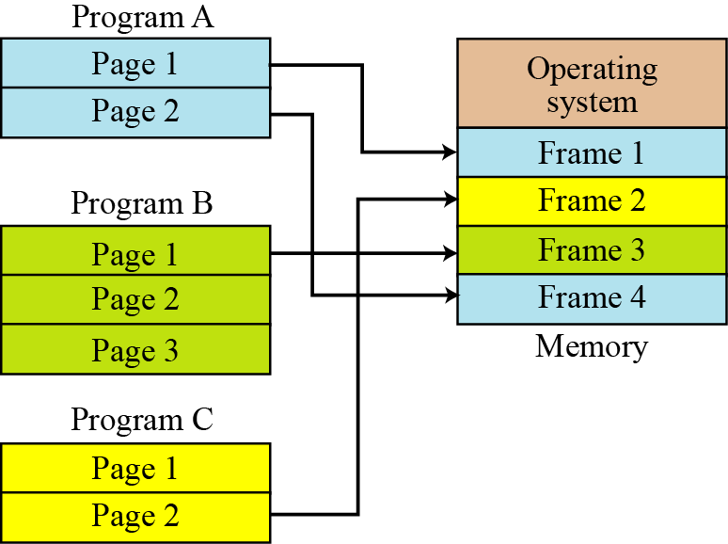
Virtual Memory + Paging /Demand Paging
7.103
Notes:
103

Slide 104
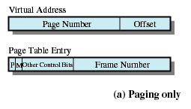
Page Table Entry
Present bit
Modify bit
Notes:
104
104
104
104
104

Slide 105
Page protection
Implemented by associating protection bits with each virtual page in page table
Protection bits
present bit: map to a valid physical page?
read/write/execute bits: can read/write/execute?
user bit: can access in user mode?
x86: PTE_P, PTE_W, PTE_U
Checked by MMU on each memory access
Notes:
105
105
105
105

Slide 106
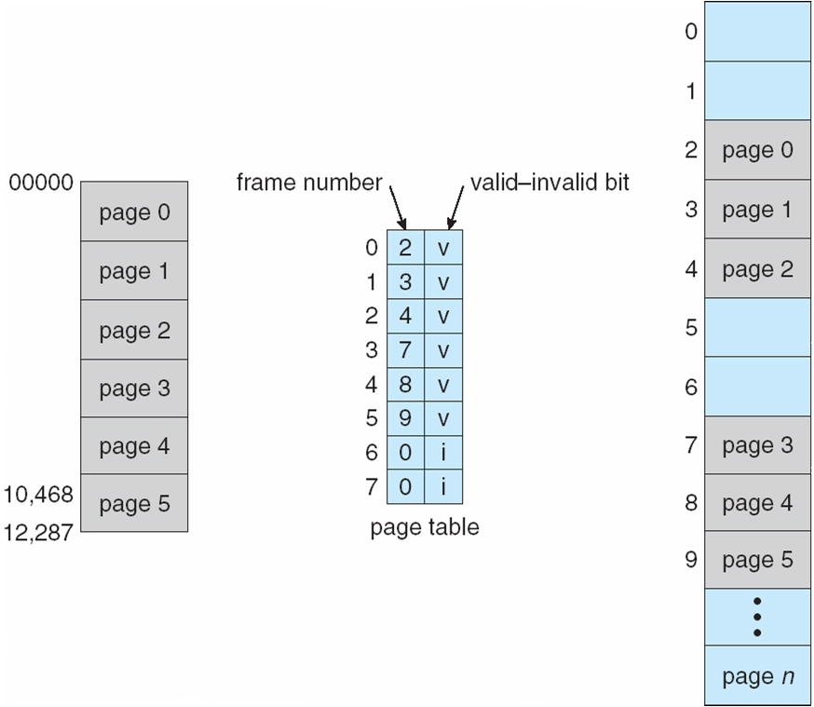
Example:Valid (v) or Invalid (i) Bit In A Page Table
Process
Main Memory
Notes:
106
106
106
106
106
106
106

Slide 107
Demand paging
Page is needed 🡪 reference to it
invalid reference 🡪 abort
not-in-memory 🡪 bring to memory
Lazy swapper – never swaps a page into memory unless page will be needed
Swapper that deals with pages is a pager
Notes:
107

Slide 108
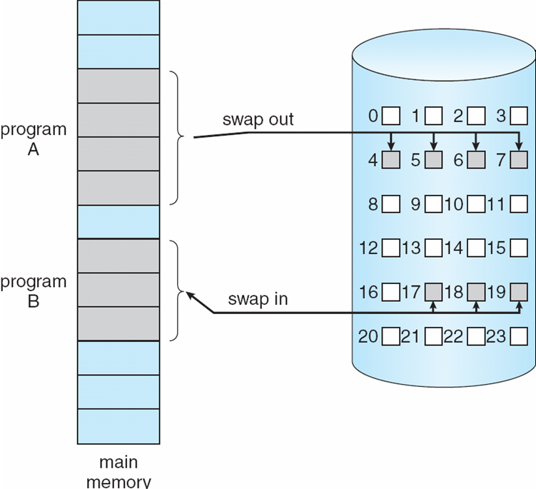
Transfer of a Paged Memory to Contiguous Disk Space
Notes:
108
108
108
108

Slide 109
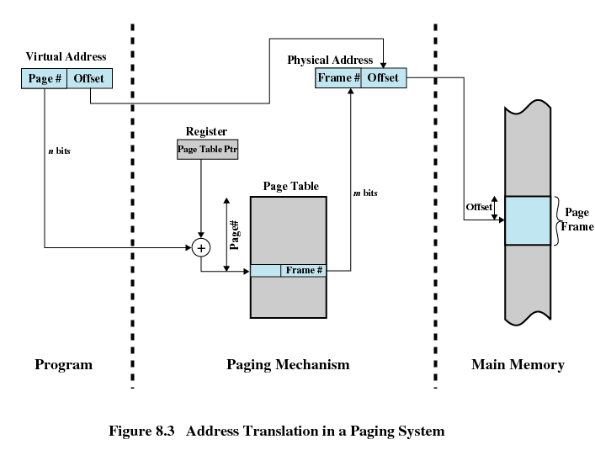
Address Translation in Paging
Page number field > frame number field n>m
Notes:
109
109
109
109
109

Slide 110
Page Tables
Generally one page table per process
Let us say a process requires 2GB virtual memory
How many 512 bytes pages will it contain?
As the size of page table increases, amount of memory required by it could be unacceptably high
Page tables are also stored in virtual memory
Page tables are subject to paging as other pages
When a process is running, part of its page table must be in main memory.
Page-table base register (PTBR) points to the page table
Page-table length register (PRLR) indicates size of the page table
In this scheme every data/instruction access requires two memory accesses. One for the page table and one for the data/instruction.
2^31 pages /process
2^31/2^9=2^22 pages /process
Notes:
110
110
110
110
110

Slide 111
Translation Lookaside Buffer
Each virtual memory reference can cause two physical memory accesses
One to fetch appropriate page table
One to fetch appropriate data
Effect of doubling the memory access time!
To overcome this problem a high-speed cache is set up for page table entries
Called a Translation Lookaside Buffer (TLB)
Contains page table entries that have been most recently used
Notes:
111
111
111
111
111

Slide 112
TLB Operation
Given a virtual address, processor examines the TLB
If page table entry is present (TLB hit), the frame number is retrieved and the real address is formed
If page table entry is not found in the TLB (TLB miss), the page number is used to index the process page table
First checks if page is already in main memory
If yes, go ahead, update TLB to include this new entry
If no, a page fault is issued to get the page (OS takes over), page table is updated, instruction is re-executed
It have entries between 64 to 1024
Notes:
112
112
112
112
112

Slide 113
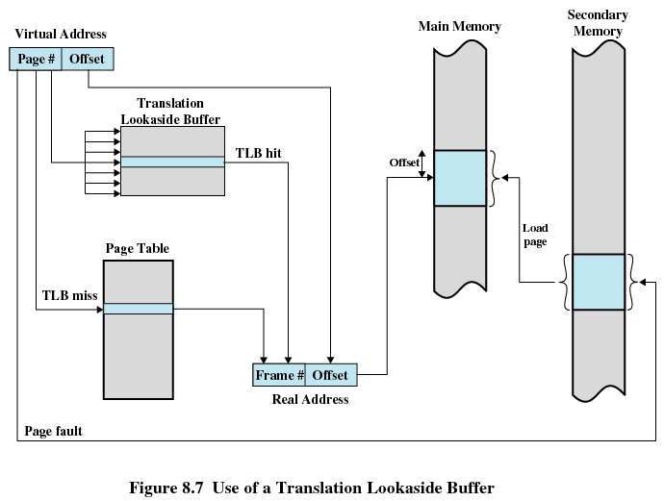
Translation Lookaside Buffer
Notes:
113
113
113
113
113

Slide 114
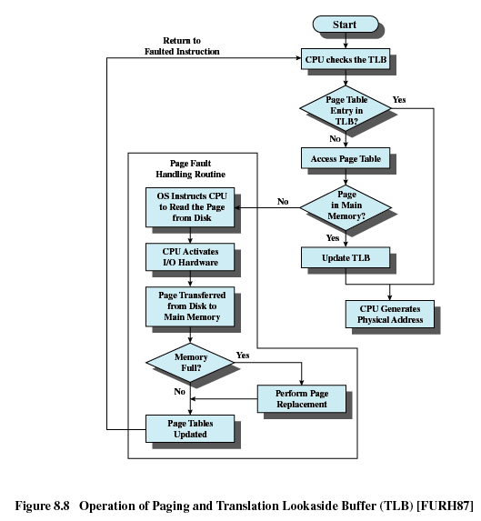
TLB Operation
Notes:
114
114
114
114
114

Slide 115
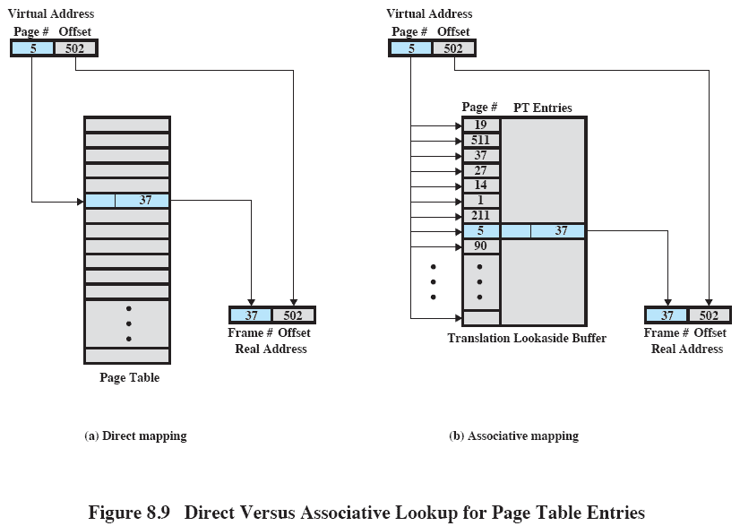
Translation Lookaside Buffer
Notes:
115

Slide 116
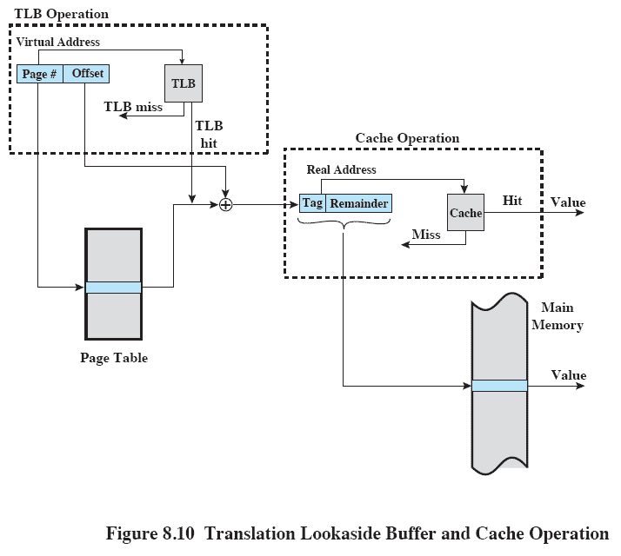
Translation Lookaside Buffer
Notes:
116

Slide 117
Page table size issues
Given:
A 32 bit address space (4 GB)
4 KB pages
A page table entry of 4 bytes
Implication: page table is 4 MB per process!
Observation: address space are often sparse
Few programs use all of 2^32 bytes
Change page table structures to save memory
Trade translation time for page table space
Solution: Hierarchical page table

Slide 118
Two Level Hierarchical Page Table
Some processor makes use of two-level scheme to organize large page tables
There is a page directory
Each entry points to a page table
If length of page directory is X & maximum length of a page table is Y,
A process can consist of up to X*Y pages.
Maximum length of a page table is restricted to be equal to one page

Slide 119
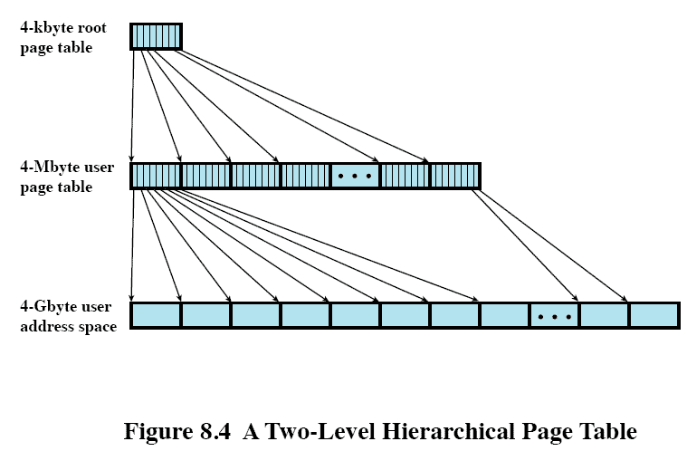
Two Level Hierarchical Page Table
4kbyte=2^12=page size
PTE=2^2
2^32
Pages=2^20

Slide 120
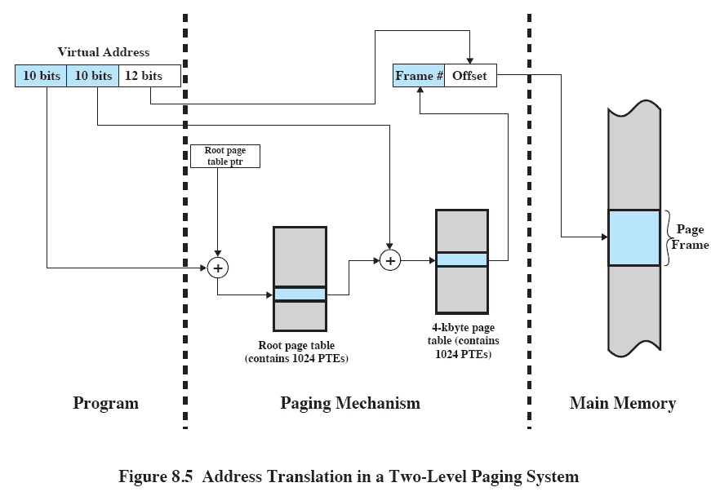
Address Translation in Two-Level Paging System

Slide 121
Inverted Page Table
Used on PowerPC, UltraSPARC, and IA-64 architecture
Page number portion of a virtual address is mapped into a hash value
Hash value points to inverted page table
Fixed proportion of real memory is required for the tables regardless of the number of processes
Notes:
121

Slide 122
Inverted Page Table
Page number
Process identifier
Control bits
Chain pointer
Notes:
122

Slide 123
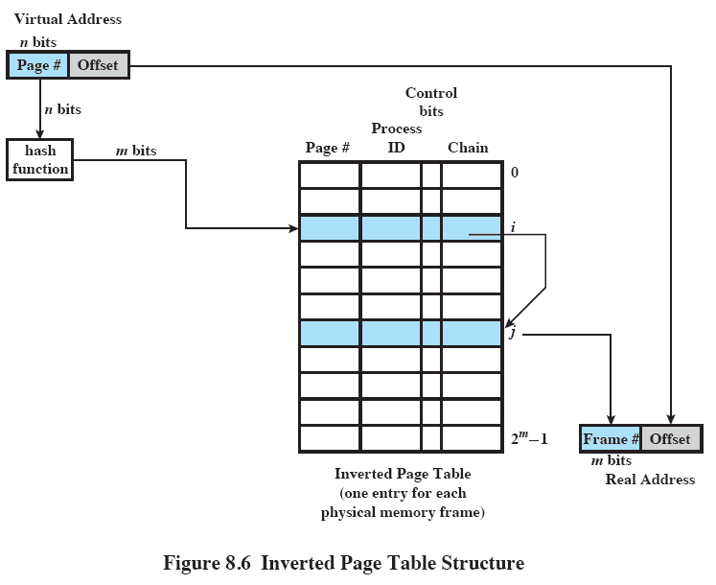
Inverted Page Table
Notes:
123

Slide 124
Page Size
Effect on internal fragmentation?
Smaller 🡺 less internal fragmentation
optimal memory utilization-We want less internal fragmentation
Keep page size small
But small page size 🡺 more number of pages per process 🡺 larger page tables 🡺 using virtual memory for page table 🡺 potential double page fault!
Further, larger page size 🡺 more efficient block transfer of data
Due to physical characteristics of rotational devices
Vishal Kaushal
Notes:
124

Slide 125
Page Size
Secondary memory is designed to efficiently transfer large blocks of data so a large page size is better
Small page size, large number of pages will be found in main memory
As time goes on during execution, the pages in memory will all contain portions of the process near recent references => Page faults low.
Increased page size causes pages to contain locations further from any recent reference => Page faults rise.
Notes:
125
125
125
125
125

Slide 126
Effect of page size on number of page faults
With very small page size
More pages in memory, thus lesser page faults
Greater effect of principle of locality
One page refers to nearby locations
As page size increases
Lesser pages in memory, thus more page faults
Effect of locality reduced
Each page will contain locations further and further away from recent references
Page fault rate is also determined by the number of frames allocated to a process.
3. Size of physical memory & program size:
Vishal Kaushal
Notes:
126

Slide 127
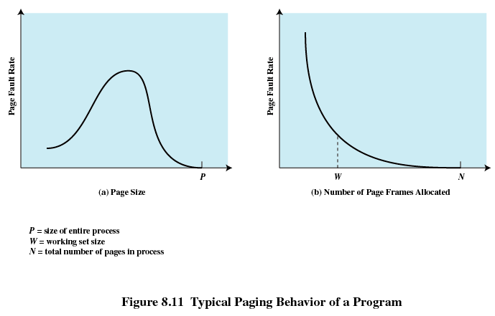
Page Size
Notes:
127
127
127
127
127

Slide 128
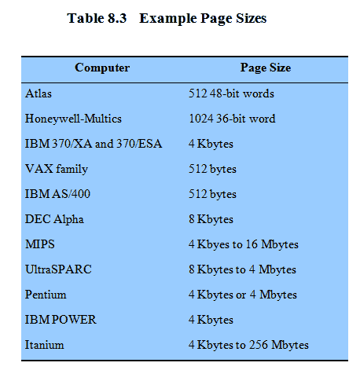
Example Page Size
Notes:
128
128
128
128
128

Slide 129
Ordinary Paging vs VM Paging
Paging | Virtual memory paging
Main memory partitioned small into fixed -size chunks called frames | Main memory partitioned into small fixed -size chunks called frames
Program broken into pages by the compiler or memory management system | Program broken into pages by the compiler or memory management system
Internal fragmentation within frames | Internal fragmentation within frames
No external fragmentation | No external fragmentation
OS must maintain page table for each process showing which frame each page occupies | OS must maintain page table for each process showing which frame each page occupies
OS must maintain a free frame list | OS must maintain a free frame list
Processor uses page number, offset to calculate absolute address | Processor uses page number, offset to calculate absolute address
All the pages of a process must be in main memory for process to run, unless overlays are used | Not All the pages of a process must be in main memory for process. Page may be read in as needed
 | Reading a page into main memory may require writing a page out to disk
Notes:
129
Demand paging
129

Slide 130
Segmentation
Memory consist of multiple address space/segments
Segments may be of unequal/dynamic in size
Memory reference consist of segment number, offset to form address.
Have advantages to programmer over non segmented memory
Easier to relocate segment than entire program
Simplifies handling of growing data structures
Allows programs to be altered and recompiled independently
Sharing among processes
Provides protection
Avoids allocating unused memory (no internal fragmentation)
Efficient translation -> Segment table small ( fit in MMU )
Disadvantages
Segments have variable lengths -> how to fit?
Segments can be large -> external fragmentation
Notes:
130
130

Slide 131
VM + Segmentation
Earlier segmentation: each process has its own segment table
When all of its segments are loaded into main memory, segment table is created and loaded
With VM, STEs become more complex
P bit (present/absent)
M bit (modify)
Other control bits
For example to support sharing or protection at segment level
Notes:
131

Slide 132
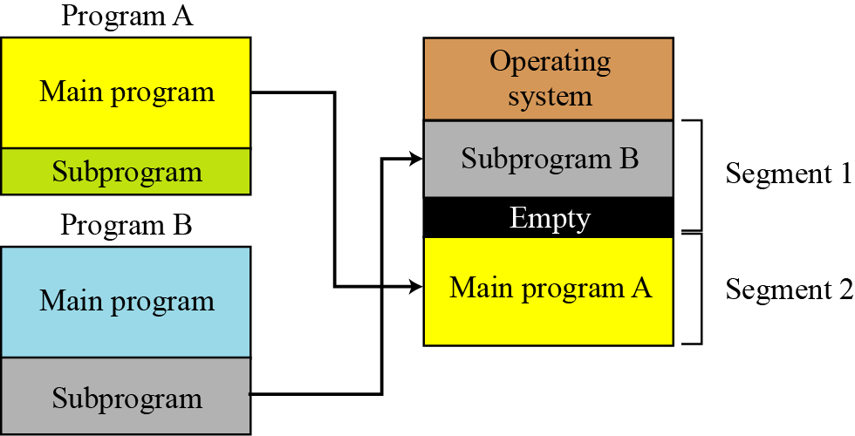
VM + Segmentation
7.132
Notes:
132

Slide 133
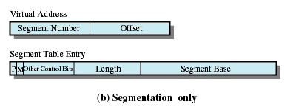
Segment Table Entries
Present bit
Modify bit
Notes:
133
133
133
133
133

Slide 134

Address Translation in Segmentation
Notes:
134
134
134
134
134

Slide 135
Ordinary Segmentation vs VM Segmentation
Simple Segmentation | Virtual memory segmentation
Main memory not partitioned | Main memory not partitioned
Program segments specified by the programmer to the compiler | Program segments specified by the programmer to the compiler
No Internal fragmentation | No Internal fragmentation
External fragmentation | External fragmentation
OS must maintain segment table for each process showing the load address and length of each segment | OS must maintain segment table for each process showing the load address and length of each segment
OS must maintain a list of holes | OS must maintain a list of holes
Processor uses segment number, offset to calculate absolute address | Processor uses segment number, offset to calculate absolute address
All the segments of a process must be in main memory for process to run, unless overlays are used | Not all the segments of a process must be in main memory for process to run. Segment s may be read in as needed
 | Reading a segment into main memory may require writing one/more segments out to disk
Notes:
135
135

Slide 136
Contents
Memory Management requirements
Memory Partitioning: Fixed and Variable Partitioning,
Allocation Strategies (First Fit, Best Fit, and Worst Fit), Fragmentation, Swapping.
Virtual Memory: Concepts, Segmentation, Paging, Address Translation,
Page Replacement Policies (FIFO, LRU, Optimal, Other Strategies),
Thrashing.
OS Services layer in the Mobile OS: Multimedia and Graphics Services, Connectivity Services.
Notes:
136
136

Slide 137
What happens when there is no free frame?
Notes:
137

Slide 138

Page Table When Some Pages Are Not in Main Memory
Notes:
138
138
138
138

Slide 139
Page Fault
If there is a reference to a page, first reference to that page will trap to operating system:
page fault
Operating system looks at another table to decide:
Invalid reference ⇒ abort
Just not in memory
Get empty frame
Swap page into frame
Reset tables
Set validation bit = v
Restart the instruction that caused the page fault
Notes:
139
139
139
139

Slide 140
Steps in handling a page fault
Notes:
140

Slide 141
What happens if there is no free frame?
Page replacement – find some page in memory, but not really in use, swap it out
Different algorithms, different performance
Want an algorithm which will result in minimum number of page faults
Same page may be brought into memory several times
Notes:
141
141
141
141

Slide 142
Page Replacement
Prevent over-allocation of memory by modifying page-fault service routine to include page replacement
Use modify (dirty) bit to reduce overhead of page transfers – only modified pages are written to disk
Page replacement completes separation between logical memory and physical memory – large virtual memory can be provided on a smaller physical memory
Notes:
142
142
142
142

Slide 143
Basic Page Replacement
Find the location of the desired page on disk
Find a free frame: - If there is a free frame, use it - If there is no free frame, use a page replacement algorithm to select a victim frame
Bring the desired page into the (newly) free frame; update the page and frame tables
Restart the process
Notes:
143
143
143
143

Slide 144

Page Replacement
Notes:
144
144
144
144

Slide 145
Page-Replacement Algorithms
Want lowest page-fault rate.
Evaluate algorithm by running it on a particular string of memory references (reference string) and computing the number of page faults on that string.
In all our examples, the reference string is
A B C A B D A D B C B
Notes:
145

Slide 146
Basic Replacement Algorithms
First-in, first-out (FIFO)
Treats page frames allocated to a process as a circular buffer
Pages are removed in round-robin style
Simplest replacement policy to implement
Page that has been in memory the longest is replaced
These pages may be needed again very soon
How would you implement FIFO strategy?
Keep a queue and do round robin
Notes:
146
146

Slide 147
Example: FIFO
Suppose we have 3 page frames, 4 virtual pages, and following reference stream:
A B C A B D A D B C B
Consider FIFO Page replacement:
FIFO: 7 faults.
When referencing D, replacing A is bad choice, since need A again right away
Ref:
Page:
A
B
C
A
B
D
A
D
B
C
B
1
A
D
C
2
B
A
3
C
B
Notes:
147

Slide 148
Basic Replacement Algorithms
Optimal policy
Selects for replacement that page for which the time to the next reference is the longest
Impossible to have perfect knowledge of future events
Notes:
148
148

Slide 149
Example: Optimal(MIN)
Suppose we have the same reference stream:
A B C A B D A D B C B
Consider Optimal Page replacement:
MIN: 5 faults
Where will D be brought in? Look for page not referenced farthest in future.
Ref:
Page:
A
B
C
A
B
D
A
D
B
C
B
1
A
C
2
B
3
C
D
Notes:
149

Slide 150
Basic Replacement Algorithms
Least Recently Used (LRU)
Replaces the page that has not been referenced for the longest time
By the principle of locality, this should be the page least likely to be referenced in the near future
Each page could be tagged with the time of last reference. This would require a great deal of overhead.
Notes:
150
150

Slide 151
Example: LRU
Suppose we have the same reference stream:
A B C A B D A D B C B
Consider LRU Page replacement:
LRU: 5 faults
What will LRU do?
Same decisions as MIN here, but won’t always be true!
Ref:
Page:
A
B
C
A
B
D
A
D
B
C
B
1
A
C
2
B
3
C
D
Notes:
151

Slide 152
LRU Algorithm (Cont.)
How would you implement LRU strategy?
Stack implementation – keep a stack of page numbers in a double link form:
Any time Page is referenced move it to the top
Replace page from the bottom of the stack
No search for replacement
Notes:
152
152
152
152

Slide 153
RANDOM:
Pick random page for every replacement
Typical solution for TLB’s. Simple hardware
Pretty unpredictable – makes it hard to make real-time guarantees

Slide 154
Global vs. Local Allocation
Global replacement – process selects a replacement frame from the set of all frames; one process can take a frame from another.
Local replacement – each process selects from only its own set of allocated frames.
Notes:
154

Slide 155

Graph of Page Faults Versus The Number of Frames
One desirable property: When you add memory the miss rate goes down
Does this always happen?
Seems like it should, right?
No: BeLady’s anomaly
Certain replacement algorithms (FIFO) don’t have this obvious property!
Notes:
155

Slide 156
Adding Memory Doesn’t Always Help Fault Rate
Does adding memory reduce number of page faults?
Yes for LRU and MIN
Not necessarily for FIFO! (Called Belady’s anomaly)
Ref:
Page:
A
B
C
D
A
B
E
A
B
C
D
E
1
A
D
E
2
B
A
C
3
C
B
D
Ref:
Page:
A
B
C
D
A
B
E
A
B
C
D
E
1
A
E
D
2
B
A
E
3
C
B
4
D
C
Notes:
156

Slide 157
Comparison of Algorithms
 | FIFO | OPT/MIN | LRU
Data structure for implementation | Queue | NA | DLL using counter or stack method
Traversal of reference string | Forward | Forward | Backward
Implementation | Easy to understand n imple. | Diff. to impl. | Approximation of OPT ,impl is possible
Performance | Not good | Mainly used for comparison study | Good
Time to be considered | Uses the time when page was brought into memory | Uses the time when a page is to be used | Approximation of OPT , Uses the time when a page is used
Notes:
157

Slide 158
Decisions involved in VM implementation
Whether or not to use virtual memory techniques?
Depend on hardware support
The use of paging or segmentation or both
Depend on hardware support
The algorithms employed for various aspects of memory management
Depends on OS
Notes:
158

Slide 159


Slide 160
Fetch policy
Determines when page should be brought into main memory.
1. Demand paging-page is brought into memory only when a reference is made to a location on that page.
2. Prepaging-pages other than the one demanded by a page fault are brought in.
Notes:
160

Slide 161
Fetch policy
Prepaging exploits the characteristics of most secondary memory devices,such as disks.
If the pages of a process are stored contiguously in secondary memory, then it is more efficient to bring in a number of contiguous pages at one time rather than bringing them in one at a time over an extended period.
this policy is ineffective if most of the extra pages that are brought in are not referenced.

Slide 162
Placement Policy
determines where in real memory a process piece is to reside.
In a pure segmentation system, the placement policy is an important design issue;policies such as best-fit, first-fit, and so on
Notes:
162

Slide 163
Replacement policy
How many page frames are to be allocated to each active process
Global/local replacement
Victim page selection(Page Replacement).
First two are resident set management
Notes:
163

Slide 164
Frame locking
Some of the frames in main memory may be locked.
If frame is locked ,page stored in that may not be replaced.
Kernel code ,control structures,i/o buffers are stored in locked frames.
Associate lock bit with each frame.
Notes:
164

Slide 165
Page Buffering
LRU is better than FIFO, but is more complex
Cost of replacing a page that has been modified is greater than for one that has not
Interesting strategy: Page Buffering
Page replacement algorithm is simple FIFO
A replaced page is not lost but rather is assigned to one of two lists
Free page list if the page has not been modified, or the modified page list if it has
Page is not physically moved about in main memory
Entry in the page table for this page is removed and placed in either the free or modified page list
Notes:
165

Slide 166
Page Buffering
When an unmodified page is to be replaced, it remains in memory and its page frame is added to the tail of the free page list
Free page list is a list of page frames available for reading in pages
When a page is to be read in, the page frame at the head of the list is used, destroying the page that was there
When a modified page is to be written out and replaced, its page frame is added to the tail of the modified page list
Notes:
166

Slide 167
Advantage?
Page to be replaced remains in memory
If the process references that page, it is returned to the resident set of that process at little cost
In effect, the free and modified page lists act as a cache of pages
Modified pages are written out in clusters rather than one at a time
Notes:
167

Slide 168
Decisions taken by OS
Resident Set Management
How many frames to be allocated to each active process
Victim should be from the same process or could be page from any process?(Local /Global)
Notes:
168

Slide 169
Resident Set Management
OS must decide how many pages to bring in
how much main memory to allocate to a particular process
Factors
Less memory 🡺 more multi programming
Less pages 🡺 more page faults
Beyond a certain size, further allocations of pages will not affect the page fault rate due to principle of locality
Two policies
Fixed Allocation
Variable Allocation
Notes:
169

Slide 170
Fixed Allocation Policy
Gives a process a fixed number of frames in main memory within which to execute.
Number is decided at initial load time (process creation time)
Based upon
Type of process (interactive, batch, type of application)
Guidance from the programmer or system manager
Page fault 🡺 one of the pages of that process must be replaced by the needed page.
Notes:
170

Slide 171
Variable Allocation Policy
Number of page frames allocated to a process to be varied over the lifetime of the process.
A process suffering from high page fault rate will be given more frames and vice versa.
Related with the concept of replacement scope.
Obviously better, but requires OS to assess the behavior of active processes.
Notes:
171

Slide 172
Replacement Scope
Could be global or local
Activated when there is a page fault and no free frame is available
Local replacement policy
Chooses only among the resident pages of the process that generated the page fault as victim
Easier to analyze
Global replacement policy
Considers all unlocked page frames in main memory as candidates for replacement, regardless of which process owns a particular page
Simple implementation, minimal overhead
Notes:
172

Slide 173
Valid Combinations
Fixed allocation 🡺 local replacement
Variable 🡺 global or local
Notes:
173

Slide 174
Fixed Allocation, Local Scope
Decide ahead of time the amount of allocation to give a process
Allocation could depend upon type of application or amount requested by programmer.
Drawbacks:
If allocations tend to be too small, then there will be a high page fault rate, causing the entire multiprogramming system to run slowly.
If allocations tend to be unnecessarily large, then there will be too few programs in main memory and there will be either considerable processor idle time or considerable time spent in swapping.
Notes:
174
A process that is running in main memory with a fixed number of frames.
When a page fault occurs, the operating system must choose which page from among the currently resident pages for this process is to be replaced.
With a fixed-allocation policy, it is necessary to decide ahead of time the amount of allocation to give to a process.
This could be based on the type of application and the amount requested by the program.
Two drawbacks:
If allocations tend to be too small, then there will be a high page fault rate, causing the entire multiprogramming system to run slowly.
If allocations tend to be unnecessarily large, then there will be too few programs in main memory and there will either be considerable processor idle time or considerable time spent in swapping.
174

Slide 175
Variable Allocation, Global Scope
Easiest to implement
Adopted by many operating systems
Operating system keeps list of free frames
When a page fault occurs, a free frame is added to the resident set of a process and the page is brought in
A process experiencing page faults will gradually grow in size, which should help reduce overall page faults in the system
If no free frame, replaces one from another process
Therein lies the difficulty … which to replace.
Use different page replacement algorithms
Notes:
175
This combination is perhaps the easiest to implement and has been adopted in a number of operating systems.
At any given time, there are a number of processes in main memory, each with a certain number of frames allocated to it.
Typically, the operating system also maintains a list of free frames.
When a page fault occurs, a free frame is added to the resident set of a process and the page is brought in.
Thus, a process experiencing page faults will gradually grow in size, which should help reduce overall page faults in the system.
The difficulty with this approach is in the replacement choice.
When there are no free frames available, the operating system must choose a page currently in memory to replace.
The selection is made from among all of the frames in memory, except for locked frames such as those of the kernel.
The process that suffers the reduction in resident set size may not be optimum.
175

Slide 176
Variable Allocation,Local Scope
When a new process is loaded into main memory, allocate to it a certain number of page frames as its resident set
Based on some factors
Use either prepaging or demand paging to fill up the allocation
When a page fault occurs, select the page to replace from among the resident set of the process that suffers the fault
From time to time, reevaluate the allocation provided to the process, and increase or decrease it to improve overall performance
Based on an assessment of the likely future demands of active processes
Notes:
176
When a new process is loaded into main memory, allocate to it a certain number of page frames as its resident set, based on application type, program request, or other criteria.
Use either prepaging or demand paging to fill up the allocation.
2. When a page fault occurs, select the page to replace from among the resident set of the process that suffers the fault.
3. From time to time, re-evaluate the allocation provided to the process, and increase or decrease it to improve overall performance.
With this strategy, the decision to increase or decrease a resident set size is a deliberate one and is based on an assessment of the likely future demands of active processes.
Because of this evaluation, such a strategy is more complex than a simple global replacement policy.
However, it may yield better performance.
176

Slide 177
Variable Allocation,Local Scope
More complex than variable, global
May yield better performance
Key parameters
Criteria used to determine resident set size and the timing of changes
One such strategy is working set strategy
Notes:
177

Slide 178

Resident Set Management Summary
Notes:
178
178

Slide 179
Decisions taken by OS
Cleaning Policy
When a modified page should be written out to secondary memory?
Demand cleaning: page is written out to secondary memory only when it has been selected for replacement
Process blocked for more time
Pre-cleaning: writes modified pages before their page frames are needed so that pages can be written out in batches
Problem: writing could be waste if modified again while in memory
Best approach is page buffering
Load Control
Determining the number of processes that will be resident in main memory – called multi programming level
Notes:
179

Slide 180
Contents
Memory Management requirements
Memory Partitioning: Fixed and Variable Partitioning,
Allocation Strategies (First Fit, Best Fit, and Worst Fit), Fragmentation, Swapping.
Virtual Memory: Concepts, Segmentation, Paging, Address Translation,
Page Replacement Policies (FIFO, LRU, Optimal, Other Strategies),
Thrashing.
Notes:
180
180

Slide 181
Thrashing
If a process does not have “enough” pages, the page-fault rate is very high. This leads to:
low CPU utilization
operating system thinks that it needs to increase the degree of multiprogramming
another process added to the system
Thrashing ≡ a process is busy swapping pages in and out
Swapping out a piece of a process just before that piece is needed
The processor spends most of its time swapping pieces rather than executing user instructions
Notes:
181
181
181
181

Slide 182

Thrashing (Cont.)
If global page replacement algorithm is used then thrashing occurs
To avoid this use local page replacement algorithm
Notes:
182
182
182
182

Slide 183
Thrashing and Global Replacement Policy
Global scope increases thrashing
The process scheduler see that CPU utilization is low.
Increases the degree of multiprogramming by introducing a new process into the system
One process now needs more frames
It starts faulting and takes away frames from other processes. (i.e., global-page replacement).
These processes need those pages and thus they start to fault, taking frames from other processes.
These faulting processes must use the paging device to swap pages in and out.
As they queue up on the paging device, the ready-queue empties.
However, as processes wait on the paging device, CPU utilization decreases
The process scheduler sees the decreasing CPU utilization and increases the degree of multiprogramming !!!
Notes:
183

Slide 184
Thrashing and Local Replacement Policy
Only partially solves the problem
If one process starts thrashing, it cannot steal frames of another process and cause the later to thrash
However, the thrashing processes will be in the paging device queue which will increase the time for a page fault to be serviced
Effective access time will increase even for those processes not thrashing
Notes:
184

Slide 185
How to avoid thrashing?
Provide processes with as many frames as they need
How to determine this?
Look at how many frames a process actually "uses“
Locality model
Working set model
Page Fault Frequency Model
Notes:
185

Slide 186
Self Study
Combined Paging and segmentation
Working Set Model
Notes:
186

Slide 187
Principle of Locality
Program and data references within a process tend to cluster
Only a few pieces of a process will be needed over a short period of time
Possible to make intelligent guesses about which pieces will be needed in the future
This suggests that virtual memory may work efficiently
Notes:
187
187

Slide 188
Working-Set Model
Δ ≡ working-set window ≡ a fixed number of page references Example: 10,000 instruction
WSS_{i} (working set of Process P_{i}) = total number of pages referenced in the most recent Δ (varies in time)
if Δ too small will not encompass entire locality
if Δ too large will encompass several localities
if Δ = ∞ ⇒ will encompass entire program
D = Σ WSS_{i} ≡ total demand frames
if D > m ⇒ Thrashing
Policy if D > m, then suspend one of the processes
Notes:
188
188
188
188

Slide 189

Working-set model
Notes:
189
189
189
189

Slide 190
Keeping Track of the Working Set
Approximate with interval timer + a reference bit
Example: Δ = 10,000
Timer interrupts after every 5000 time units
Keep in memory 2 bits for each page
Whenever a timer interrupts copy and sets the values of all reference bits to 0
If one of the bits in memory = 1 ⇒ page in working set
Why is this not completely accurate?
Improvement = 10 bits and interrupt every 1000 time units
Notes:
190
190
190
190

Slide 191

Page-Fault Frequency Scheme
Establish “acceptable” page-fault rate
If actual rate too low, process loses frame
If actual rate too high, process gains frame
Notes:
191
191
191
191

Slide 192
Combined Segmentation and Paging
Single segment table
pointer to page table(base address -> page table)
Present & modify bits are needed as they are handled at page level.
Other control bits are used for sharing & protection
Multiple page tables
Frame number for respective page number
Present ,modify ,sharing & protection bits are present.
Notes:
192

Slide 193
Combined Segmentation and Paging
User’s address space is broken up into a number of segments, at the discretion of the programmer
Each segment is then broken up into a number of fixed size pages
If segment is lesser, it just occupies one page
Programmer’s view logical address
Segment number and offset
System’s view
Segment offset = page number and page offset for a page within the specified segment.
Notes:
193

Slide 194

Combined Paging and Segmentation
Notes:
194

Slide 195

Address Translation
Notes:
195

Slide 196

Protection Relationships
Notes:
196

