Slide 1
Deadlocks

Slide 2
Principles of deadlock,
Deadlock Prevention,
Deadlock Avoidance,
Deadlock Detection,
Deadlock Recovery.

Slide 3

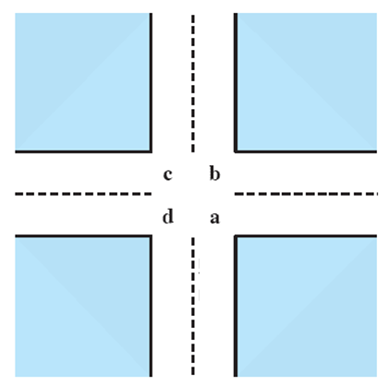
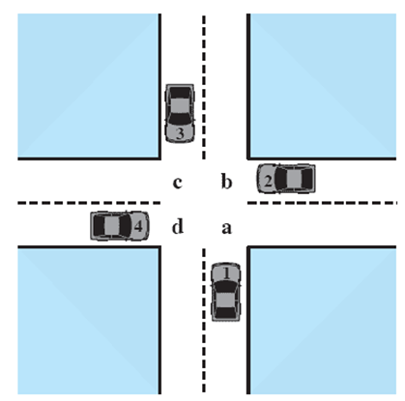



Potential Deadlock
I need quad C and B
I need quad B and C
I need quad A and B
I need quad D and A
Notes:
Animated Slide
Click 1 Cars approach intersection
Then Cars announce their resource needs
All deadlocks involve conflicting needs for resources by two or more processes. A common example is the traffic deadlock.
The typical rule of the road in the United States is that a car at a four-way stop should defer to a car immediately to its right.
This rule works if there are only two or three cars at the intersection.
If all four cars arrive at about the same time, each will refrain from entering the intersection, this causes a potential deadlock.
The deadlock is only potential, not actual, because the necessary resources are available for any of the cars to proceed.
If one car eventually does proceed, it can do so.

Slide 4
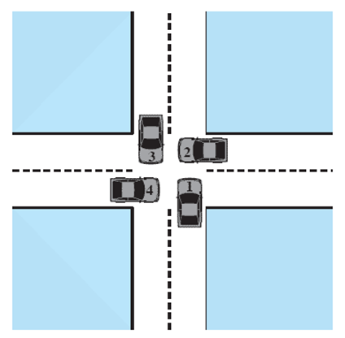
Actual Deadlock
HALT until D is free
HALT until C is free
HALT until B is free
HALT until A is free
Notes:
Animated Slide
Click 1 Cars move to deadlock
Then Cars announce their resource need
But if all four cars ignore the rules and proceed (cautiously) into the intersection at the same time, then each car seizes one resource (one quadrant) but cannot proceed because the required second resource has already been seized by another car.
This is an actual deadlock.

Slide 5
Example of deadlock
Dining Philosophers Problem

Slide 6
Example of deadlock
Boss said to secretary: For a week we will go abroad, so make arrangement. Secretary make call to Husband: For a week my boss and I will be going abroad, you look after yourself. Husband make call to secret lover: My wife is going abroad for a week, so lets spend the week together. Secret lover make call to small boy whom she is giving private tution: I have work for a week, so you need not come for class. Small boy make call to his grandfather: Grandpa, for a week I don't have class 'coz my teacher is busy. Lets spend the week together. Grandpa make call to his secretary: This week I am spending my time with my grandson. We cannot attend that meeting. Secretary make call to her husband: This week my boss has some work, we cancelled our trip. Husband make call to secret lover: We cannot spend this week together, my wife has cancelled her trip. Secret lover make call to small boy whom she is giving private tution: This week we will have class as usual. Small boy make call to his grandfather: Grandpa, my teacher said this week I have to attend class.
Sorry I can't give you company. Grandpa make call to his secretary: Don't worry this week we will attend that meeting, so make arrangement .

Slide 7
DEADLOCKS
Permanent blocking of a single or set of processes, competing for system resources or may want to cooperate for communication.
Formal definition : A set of processes is deadlocked if each process in the set is waiting for an event that only another process in the set can cause.
Usually the event is release of a currently held resource.
Generally it is because of the conflicting needs of different processes.
There is no general solution to solve it completely.

Slide 8
Resource Categories
Reusable resources vs. Consumable resources
Physical vs. logical resources
Preemptable resources vs. Non preemptable resources

Slide 9
Reusable Resources
Can be safely used by only one process at a time and is not depleted by that use
Processors, I/O channels, memory, devices and data structure such as database, files,semaphores etc.
Examples of deadlock with reusable resources
If each process holds on resource and requests for the other
Dining Philosophers
General access pattern:
Request
Lock
Use
Release

Slide 10
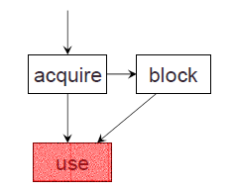
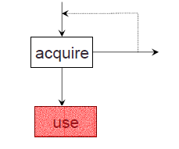
Resources
Process must wait if request is denied
Requesting process may be blocked
May fail with error code
Deadlocks
Occur only when processes are granted
exclusive access to resources

Slide 11
Example of accessing Disk file and Tape drive

Slide 12
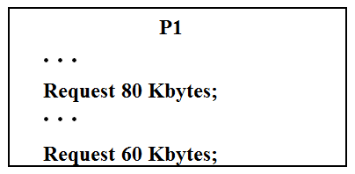
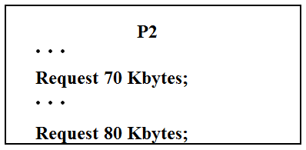
Another Example
Space is available for allocation of 200Kbytes, and the following sequence of events occur
Deadlock occurs if both processes progress to their second request

Slide 13
Consumable Resources
One that can be created/produced and destroyed/consumed
Typically no limit on the number of consumable resources of a particular type
Resource ceases to exist after consumption
Examples
Interrupts, signals, messages, contents of I/O buffers
Can there be deadlock involving consumable resources?

Slide 14
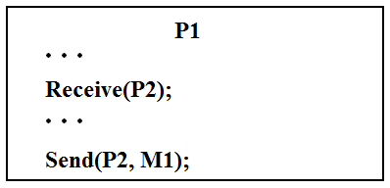
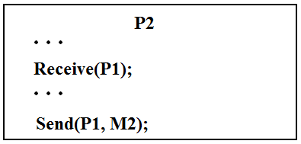
Example
Each process attempts to receive a message from the other and then sends a message to it
Deadlock occurs if the “receive” is blocking
Takes a rare combination of events!
Ever heard that a s/w is never bug free?

Slide 15
Other Kinds
Physical
Printer, tape drive
Logical
File, semaphore, data structure
Preemptable
Can be taken away from process for some time with no ill effects
CPU,memory
Non Preemptable
Will cause process to fail if taken away
Printer
Resource type (e.g. Printer) vs resource instances (e.g. 2)

Slide 16
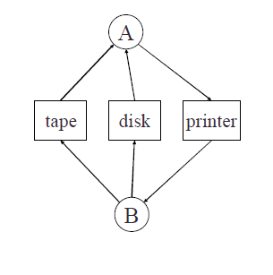
Deadlock Example
utility program
Copies a file from a tape to disk
Prints the file to a printer
Resources
Tape
Disk
Printer
A deadlock

Slide 17
System Model
Resource types R₁, R₂, . . ., R_{m}
CPU cycles, memory space, I/O devices
Each resource type R_{i} has W_{i} instances.
Each process utilizes a resource as follows:
request
use
release

Slide 18
Deadlock Characterization
Deadlock can arise if four conditions hold simultaneously.
Mutual exclusion :Only single process is allowed to use the resource.
Hold and wait :Process holding at least one resource and waiting to acquire additional resources currently held by other processes.
No preemption :No resource can be removed forcibly from a process.
4. Circular wait: A closed chain of processes exists, such that each process holds at least one resource needed by the next process in the chain
First three are necessary but not sufficient conditions for a deadlock to exist

Slide 19
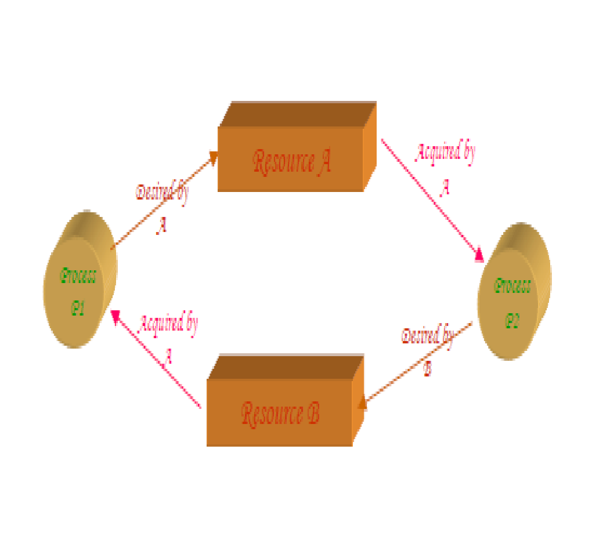
Resource-Allocation Graph

Slide 20
Resource-Allocation Graph
Characterizes allocation of resources to processes.
Directed graph to describe deadlocks
A set of vertices V and a set of edges E.
V is partitioned into two types:
P = {P₁, P₂, …, P_{n}}, the set consisting of all the processes in the system.
R = {R₁, R₂, …, R_{m}}, the set consisting of all resource types in the system.
request edge – directed edge P_{i --🡪} R_{j}
assignment edge – directed edge R_{j} ---🡪 P_{i}

Slide 21
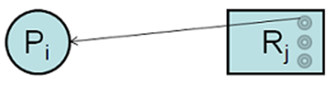
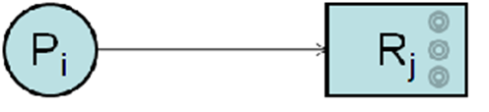
Resource-Allocation Graph (Symbols)
Process node
Resource node
Assignment edge
Request edge
P_{i}
R_{j}

Slide 22
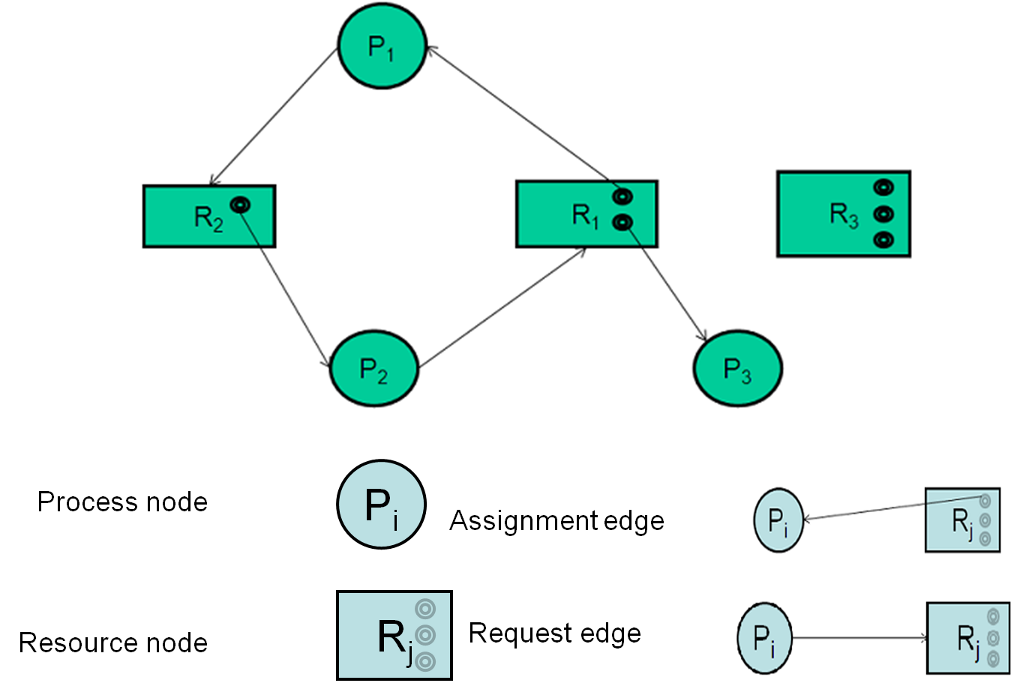
Example of a Resource allocation graph

Slide 23
Case Study

Slide 24
Case Study
Notes:
Cycle, but no deadlock

Slide 25
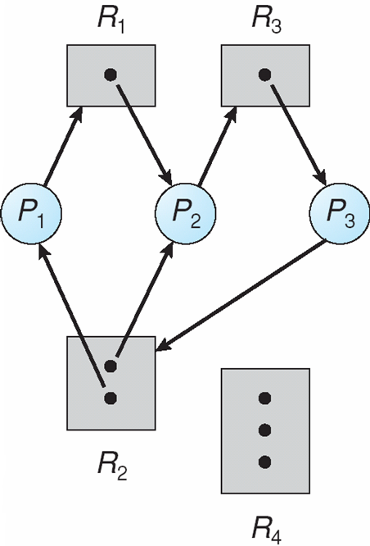
And this?
Yes deadlock
Notes:
Deadlock

Slide 26
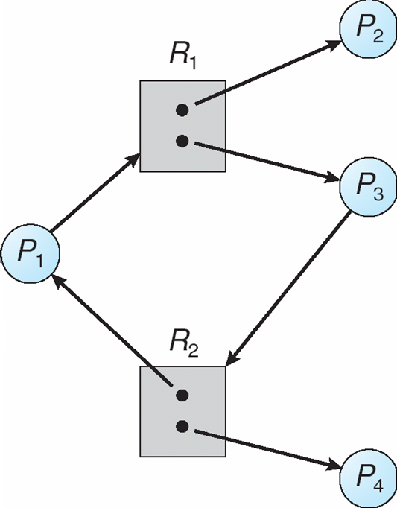
… and this?
Cycle but no deadlock
Notes:
Cycle but no deadlock

Slide 27
Basic Facts
Deadlock 🡺 cycle
No cycle 🡺 no deadlock
Cycle 🡺 deadlock
if only one instance per resource type
if several instances per resource type then there is a possibility of a deadlock
If there is single instance of each resource type then cycle in the RAG is necessary and sufficient condition for the existence of a deadlock
If each resource type has multiple instances ,then a cycle is a necessary but not sufficient condition for the existence of a deadlock

Slide 28
Dealing with deadlocks
Four general approaches
Deadlock prevention – by adopting a policy that eliminates one of the four conditions
Deadlock avoidance – by making the appropriate dynamic choices based on the current state of resource allocation
Deadlock detection and recovery – attempt to detect presence of deadlock and take actions to recover
Ignore the problem and pretend that deadlocks never occur in the system
Used by most operating systems, including UNIX & windows
Remains a programmer’s responsibility to write deadlock free code

Slide 29
Deadlock prevention
Design a system in such a way that the possibility of deadlock is excluded by ensuring that at least one of the necessary conditions cannot hold
Two main methods
1. Indirect – prevent all three of the necessary conditions occurring at once (Mutual exclusion, Hold-wait,No-preemption)
2. Direct – prevent Circular wait

Slide 30
Deadlock Prevention: Deny Mutual Exclusion
Mutual Exclusion – not required for sharable resources;
must hold for non-sharable resources.
A process never needs to wait for a sharable resource
But in reality, some resources are intrinsically non-sharable and hence we cannot prevent deadlock by denying mutual exclusion
If access to a resource requires mutual exclusion, then mutual exclusion must be supported by the OS.
Some resources, such as files, may allow multiple accesses for reads but only exclusive access for writes.
Even in this case, deadlock can occur if more than one process requires write permission.
Notes:
Example of copying file from tape drive to disk & then printing it.

Slide 31
Deadlock Prevention:Disable hold & wait
Must guarantee that whenever a process requests a resource, it does not hold any other resources
Requires each process to request and be allocated all its resources before it begins execution
Allow process to request resources only when the process has none
Disadvantages:
Low resource utilization
Starvation is possible
Process may not know in advance all of the resources that it will require.

Slide 32
Example
Process that copies data from DVD drive to a file on disk, sorts the file and prints the results to a printer
First protocol
First request DVD drive, disk file and printer
Do the job
Obvious demerit?
Second protocol
Request DVD drive and disk file
Copy, release
Request disk file and printer
Print, release
Problem: data may have changed by now
Starvation common to both
A process that needs several popular resources may have to wait indefinitely because at least one of the resources it needs is always allocated to some other process
Notes:
Low resource utilization
Process may not know what all resources it may need right upfront

Slide 33
Deadlock Prevention: Enable Pre-emption
If a process that is holding some resources and requests another resource that cannot be immediately allocated to it, then all resources currently being held are released.
Preempted resources are added to the list of resources for which the process is waiting.
Process will be restarted only when it can regain its old resources, as well as the new ones that it is requesting

Slide 34
Enable preemption
Alternatively, if a process request some resources
Check if they are available.
If yes, grant
If not, check if they are allocated to some other process that is waiting for additional resources
If yes, preempt desired resources from waiting process and allocate to the requesting process
If no, requesting process must wait
Some of its resources may be preempted, but only if another process requests them
Process resumes only when it is allocated the new resources it is requesting and recovers any resources that were preempted while it was waiting
Often applied to resources whose state can be easily saved and restored – CPU registers, memory space

Slide 35
Deadlock Prevention: Disable Circular Wait
Impose a total ordering of all resource types,.
Each process requests resources in an increasing order of enumeration.
Lets say tape drive is 1, disk drive is 5 and printer is 12
A process can initially request any number of instances of a resource type Ri
After that process can request instances of resource type Rj only if f(j)>f (i)
Alternatively, before requesting Rj, release all Ri such that f(i) >= f(j)
When several instances of same type are needed, a single request for all of them must be issued
Re-ordering of resources requires re-programming
Ordering should be as per usage pattern of resources.

Slide 36
Deadlock Avoidance
Deadlock prevention leads to inefficient use of resources & execution of processes.
Requires that OS be given in advance additional information concerning which resources a process will request and use during its lifetime
Based on this info, OS decides whether to grant the request or delay it
System must consider resources currently available, resources currently allocated, future requests and releases

Slide 37
Deadlock Avoidance
With this knowledge of complete sequence of requests and releases for each process, system can decide for each request whether or not the process should wait in order to avoid a future deadlock
Variations in algorithms differ in amount and type of information required
Simplest: each process declares the max number of resources of each type that it may need
Dynamically examines the resource allocation state to ensure that a circular wait condition can never exist
State: number of available and allocated resources, maximum demands of processes

Slide 38
Safe State
When a process requests an available resource, system must decide if immediate allocation leaves the system in a safe state.
System is in safe state if there exists a safe sequence of all processes.
Sequence <P₁, P₂, …, P_{n}> is safe if for each P_{i}, the resources that P_{i} can still request can be satisfied by currently available resources + resources held by all the P_{j}, with j<i.
If P_{i} resource needs are not immediately available, then P_{i} can wait until all P_{j} have finished.
When P_{j} is finished, P_{i} can obtain needed resources, execute, return allocated resources, and terminate.
When P_{i} terminates, P_{i+1} can obtain its needed resources, and so on.

Slide 39
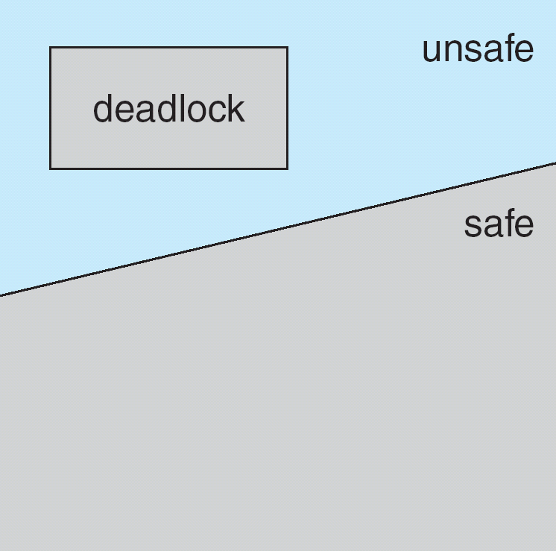
Safe, Unsafe , Deadlock State
Safe state is not a deadlocked state
Deadlocked state is an unsafe state
Not all unsafe states are deadlocks
Unsafe state may lead to a deadlock
Better to always be in safe state

Slide 40
Example
12 magnetic tape drives, 3 processes
Snapshot at t0
3 more tape drives available
System is in safe state with sequence P1, P0, P2
Process | Maximum needs | Currently holding
P0 | 10 | 5
P1 | 4 | 2
P2 | 9 | 2

Slide 41
From safe to unsafe state
Suppose at t1, P2 requests and is allocated 1 more tape drive
System is no longer in safe state
Only P1 can be allocated now. When done, both P0 and P2 will have to wait forever!
If only we had made P2 wait until either of the other processes had finished, we could have avoided the deadlock
Process | Maximum needs | Currently holding
P0 | 10 | 5
P1 | 4 | 2
P2 | 9 | 3

Slide 42
bottom line of avoidance algorithms
Grant request only if the system remains in the safe state
Even if the resources it is asking for is currently available

Slide 43
Avoidance algorithms
When single instance of all resource types use RAG algorithm
Uses a variant of the RAG we saw earlier
When multiple instances of resource types,
- Use Banker’s algorithm

Slide 44
Resource-Allocation Graph Scheme
Claim edge P_{i} → R_{j} indicated that process P_{i} may request resource R_{j} at some time in future
Similar to request edge in direction but is represented by a dashed line
when a process requests a resource, Claim edge converts to request edge
Request edge converted to an assignment edge when the resource is allocated to the process.
When a resource is released by a process, assignment edge reconverted to a claim edge
Resources must be claimed a prior in the system

Slide 45
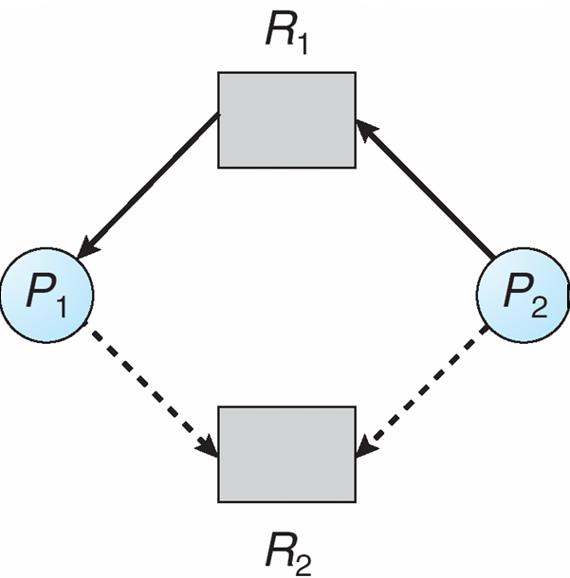
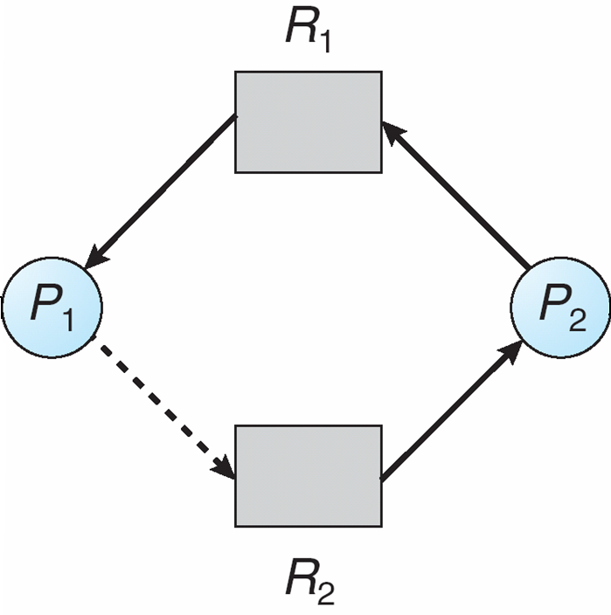
Resource-Allocation Graph
Snapshot at time t
Suppose P2 requests R2
Although R2 is currently free it cannot be allocated to P2
Cycle!

Slide 46
Resource-Allocation Graph Algorithm
Suppose that process P_{i} requests a resource R_{j}
The request can be granted only if converting the request edge to an assignment edge does not result in the formation of a cycle in the resource allocation graph.
Time complexity: For detecting a cycle in a graph it requires an order of n² operations, Where n in number of processes in the system.

Slide 47
Banker’s Algorithm
Multiple instances of each resource type.
Each process must a prior claim maximum use.
Every process declares it maximum need/requirement.
Maximum requirement should not exceed the total number of resources in the system.
When a process requests a resource, system determines whether allocation will keep the system in safe state or not.
If it is, resources get allocated. Otherwise need to wait until resources get available.
When a process gets all its resources it must return them in a finite amount of time.

Slide 48
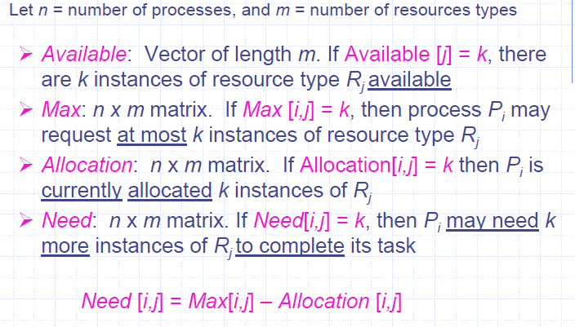
Data Structures for the Banker’s Algorithm

Slide 49
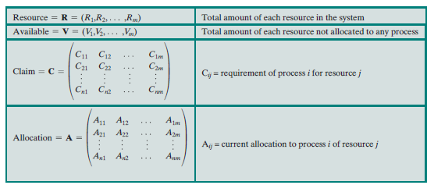

Slide 50
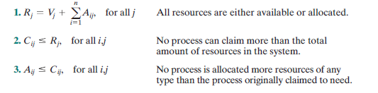
Following relationship holds

Slide 51
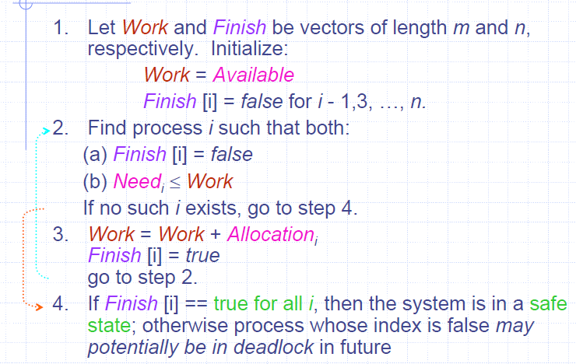
Safety Algorithm
Requires m * n² operation to decide whether a state is safe.

Slide 52
Example
5 processes P0 through P4
3 resource types: A (10 instances), B (5 instances), and C (7 instances)
Snapshot of system at t₀
Process | Allocation |  |  | Max |  |  | Need
 | A | B | C | A | B | C | A | B | C
P₀ | 0 | 1 | 0 | 7 | 5 | 3
P₁ | 2 | 0 | 0 | 3 | 2 | 2
P₂ | 3 | 0 | 2 | 9 | 0 | 2
P₃ | 2 | 1 | 1 | 2 | 2 | 2
P₄ | 0 | 0 | 2 | 4 | 3 | 3

Slide 53
Example
5 processes P0 through P4
3 resource types: A (10 instances), B (5 instances), and C (7 instances)
Snapshot of system at t₀ : is it safe?
Process | Allocation |  |  | Max |  |  | Need
 | A | B | C | A | B | C | A | B | C
P₀ | 0 | 1 | 0 | 7 | 5 | 3 | 7 | 4 | 3
P₁ | 2 | 0 | 0 | 3 | 2 | 2 | 1 | 2 | 2
P₂ | 3 | 0 | 2 | 9 | 0 | 2 | 6 | 0 | 0
P₃ | 2 | 1 | 1 | 2 | 2 | 2 | 0 | 1 | 1
P₄ | 0 | 0 | 2 | 4 | 3 | 3 | 4 | 3 | 1

Slide 54
Safe State?
Process | Allocation |  |  | Need |  |  | Finish | Finish | Finish | Finish | Finish
 | A | B | C | A | B | C
P₀ | 0 | 1 | 0 | 7 | 4 | 3 | F
P₁ | 2 | 0 | 0 | 1 | 2 | 2 | F
P₂ | 3 | 0 | 2 | 6 | 0 | 0 | F
P₃ | 2 | 1 | 1 | 0 | 1 | 1 | F
P₄ | 0 | 0 | 2 | 4 | 3 | 1 | F
Work
3 | 3 | 2

Slide 55
Safe State?
Process | Allocation |  |  | Need |  |  | Finish | Finish | Finish | Finish | Finish
 | A | B | C | A | B | C
P₀ | 0 | 1 | 0 | 7 | 4 | 3 | F | F
P₁ | 2 | 0 | 0 | 1 | 2 | 2 | F | T
P₂ | 3 | 0 | 2 | 6 | 0 | 0 | F | F
P₃ | 2 | 1 | 1 | 0 | 1 | 1 | F | F
P₄ | 0 | 0 | 2 | 4 | 3 | 1 | F | F
Work
3 | 3 | 2
5 | 3 | 2

Slide 56
Safe State?
Process | Allocation |  |  | Need |  |  | Finish | Finish | Finish | Finish | Finish
 | A | B | C | A | B | C
P₀ | 0 | 1 | 0 | 7 | 4 | 3 | F | F | F
P₁ | 2 | 0 | 0 | 1 | 2 | 2 | F | T | T
P₂ | 3 | 0 | 2 | 6 | 0 | 0 | F | F | F
P₃ | 2 | 1 | 1 | 0 | 1 | 1 | F | F | T
P₄ | 0 | 0 | 2 | 4 | 3 | 1 | F | F | F
Work
3 | 3 | 2
5 | 3 | 2
7 | 4 | 3

Slide 57
Safe State?
Process | Allocation |  |  | Need |  |  | Finish | Finish | Finish | Finish | Finish
 | A | B | C | A | B | C
P₀ | 0 | 1 | 0 | 7 | 4 | 3 | F | F | F | T
P₁ | 2 | 0 | 0 | 1 | 2 | 2 | F | T | T | T
P₂ | 3 | 0 | 2 | 6 | 0 | 0 | F | F | F | F
P₃ | 2 | 1 | 1 | 0 | 1 | 1 | F | F | T | T
P₄ | 0 | 0 | 2 | 4 | 3 | 1 | F | F | F | F
Work
3 | 3 | 2
5 | 3 | 2
7 | 4 | 3
7 | 5 | 3

Slide 58
Safe State?
Process | Allocation |  |  | Need |  |  | Finish | Finish | Finish | Finish | Finish
 | A | B | C | A | B | C
P₀ | 0 | 1 | 0 | 7 | 4 | 3 | F | F | F | T | T
P₁ | 2 | 0 | 0 | 1 | 2 | 2 | F | T | T | T | T
P₂ | 3 | 0 | 2 | 6 | 0 | 0 | F | F | F | F | T
P₃ | 2 | 1 | 1 | 0 | 1 | 1 | F | F | T | T | T
P₄ | 0 | 0 | 2 | 4 | 3 | 1 | F | F | F | F | F
Work
3 | 3 | 2
5 | 3 | 2
7 | 4 | 3
7 | 5 | 3
10 | 5 | 5

Slide 59
Safe State?
Process | Allocation |  |  | Need |  |  | Finish | Finish | Finish | Finish | Finish | Finish
 | A | B | C | A | B | C
P₀ | 0 | 1 | 0 | 7 | 4 | 3 | F | F | F | T | T | T
P₁ | 2 | 0 | 0 | 1 | 2 | 2 | F | T | T | T | T | T
P₂ | 3 | 0 | 2 | 6 | 0 | 0 | F | F | F | F | T | T
P₃ | 2 | 1 | 1 | 0 | 1 | 1 | F | F | T | T | T | T
P₄ | 0 | 0 | 2 | 4 | 3 | 1 | F | F | F | F | F | T
Work
3 | 3 | 2
5 | 3 | 2
7 | 4 | 3
7 | 5 | 3
10 | 5 | 5
10 | 5 | 7
Safe Sequence: <P1, P3, P0, P2, P4>

Slide 60
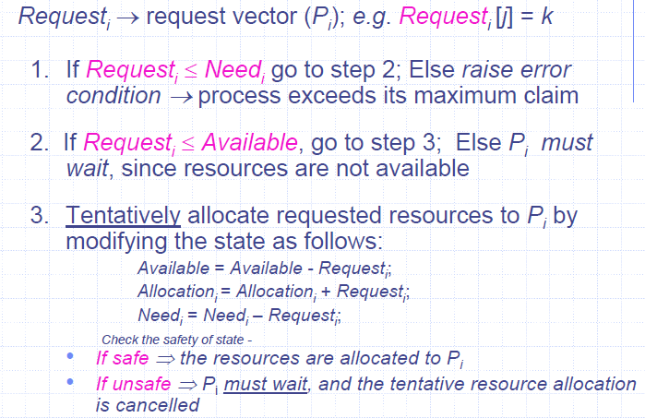
Resource-Request Algorithm

Slide 61
Example: P₁ Request (1,0,2)
Check that Request ≤ need that is, (1,0,2) ≤ (1,2,2) ⇒ true
Check that Request ≤ Available that is, (1,0,2) ≤ (3,3,2) ⇒ true
Allocation Need Available
A B C A B C A B C
P₀ 0 1 0 7 4 3 2 3 0
P₁ 3 0 2 0 2 0
P₂ 3 0 2 6 0 0
P₃ 2 1 1 0 1 1
P₄ 0 0 2 4 3 1
Can request for (3,3,0) by P₄ be granted?
Can request for (0,2,0) by P₀ be granted?

Slide 62
Request₁ = (1, 0, 2)
Request <need that is, (1,0,2) < (1,2,2) ->true
Request₁ <= Available
(1, 0, 2) <= (3, 3, 2)
Pretend to grant
Allocation₁ , Need₁ , Available will change (2, 3, 0)
Process | Allocation |  |  | Max |  |  | Need
 | A | B | C | A | B | C | A | B | C
P₀ | 0 | 1 | 0 | 7 | 5 | 3 | 7 | 4 | 3
P₁ | 3 | 0 | 2 | 3 | 2 | 2 | 0 | 2 | 0
P₂ | 3 | 0 | 2 | 9 | 0 | 2 | 6 | 0 | 0
P₃ | 2 | 1 | 1 | 2 | 2 | 2 | 0 | 1 | 1
P₄ | 0 | 0 | 2 | 4 | 3 | 3 | 4 | 3 | 1

Slide 63
Is the state safe?
Process | Allocation |  |  | Need |  |  | Finish | Finish | Finish | Finish | Finish
 | A | B | C | A | B | C
P₀ | 0 | 1 | 0 | 7 | 4 | 3 | F
P₁ | 3 | 0 | 2 | 0 | 2 | 0 | F
P₂ | 3 | 0 | 2 | 6 | 0 | 0 | F
P₃ | 2 | 1 | 1 | 0 | 1 | 1 | F
P₄ | 0 | 0 | 2 | 4 | 3 | 1 | F
Work
2 | 3 | 0

Slide 64
Is the state safe?
Process | Allocation |  |  | Need |  |  | Finish | Finish | Finish | Finish | Finish
 | A | B | C | A | B | C
P₀ | 0 | 1 | 0 | 7 | 4 | 3 | F | F
P₁ | 3 | 0 | 2 | 0 | 2 | 0 | F | T
P₂ | 3 | 0 | 2 | 6 | 0 | 0 | F | F
P₃ | 2 | 1 | 1 | 0 | 1 | 1 | F | F
P₄ | 0 | 0 | 2 | 4 | 3 | 1 | F | F
Work
2 | 3 | 0
5 | 3 | 2

Slide 65
Is the state safe?
Process | Allocation |  |  | Need |  |  | Finish | Finish | Finish | Finish | Finish
 | A | B | C | A | B | C
P₀ | 0 | 1 | 0 | 7 | 4 | 3 | F | F | F
P₁ | 3 | 0 | 2 | 0 | 2 | 0 | F | T | T
P₂ | 3 | 0 | 2 | 6 | 0 | 0 | F | F | F
P₃ | 2 | 1 | 1 | 0 | 1 | 1 | F | F | T
P₄ | 0 | 0 | 2 | 4 | 3 | 1 | F | F | F
Work
2 | 3 | 0
5 | 3 | 2
7 | 4 | 3

Slide 66
Is the state safe?
Process | Allocation |  |  | Need |  |  | Finish | Finish | Finish | Finish | Finish
 | A | B | C | A | B | C
P₀ | 0 | 1 | 0 | 7 | 4 | 3 | F | F | F | T
P₁ | 3 | 0 | 2 | 0 | 2 | 0 | F | T | T | T
P₂ | 3 | 0 | 2 | 6 | 0 | 0 | F | F | F | F
P₃ | 2 | 1 | 1 | 0 | 1 | 1 | F | F | T | T
P₄ | 0 | 0 | 2 | 4 | 3 | 1 | F | F | F | F
Work
2 | 3 | 0
5 | 3 | 2
7 | 4 | 3
7 | 5 | 3

Slide 67
Is the state safe?
Process | Allocation |  |  | Need |  |  | Finish | Finish | Finish | Finish | Finish
 | A | B | C | A | B | C
P₀ | 0 | 1 | 0 | 7 | 4 | 3 | F | F | F | T | T
P₁ | 3 | 0 | 2 | 0 | 2 | 0 | F | T | T | T | T
P₂ | 3 | 0 | 2 | 6 | 0 | 0 | F | F | F | F | T
P₃ | 2 | 1 | 1 | 0 | 1 | 1 | F | F | T | T | T
P₄ | 0 | 0 | 2 | 4 | 3 | 1 | F | F | F | F | F
Work
2 | 3 | 0
5 | 3 | 2
7 | 4 | 3
7 | 5 | 3
10 | 5 | 5

Slide 68
Is the state safe?
Process | Allocation |  |  | Need |  |  | Finish | Finish | Finish | Finish | Finish | Finish
 | A | B | C | A | B | C
P₀ | 0 | 1 | 0 | 7 | 4 | 3 | F | F | F | T | T | T
P₁ | 3 | 0 | 2 | 0 | 2 | 0 | F | T | T | T | T | T
P₂ | 3 | 0 | 2 | 6 | 0 | 0 | F | F | F | F | T | T
P₃ | 2 | 1 | 1 | 0 | 1 | 1 | F | F | T | T | T | T
P₄ | 0 | 0 | 2 | 4 | 3 | 1 | F | F | F | F | F | T
Work
2 | 3 | 0
5 | 3 | 2
7 | 4 | 3
7 | 5 | 3
10 | 5 | 5
10 | 5 | 7
Safe Sequence: <P1, P3, P0, P2, P4>

Slide 69
Request₄ = (3, 3, 0)
Request₄ <= Available?
(3, 3, 0) <= (2, 3, 0)?
No. Thus request from P4 cannot be granted

Slide 70
Request₀ = (0, 2, 0)
Request₀ <= Available
(0, 2, 0) <= (2, 3, 0)
Pretend to grant
Allocation₀ , Need₀ , Available will change (2, 1, 0)
Process | Allocation |  |  | Max |  |  | Need
 | A | B | C | A | B | C | A | B | C
P₀ | 0 | 3 | 0 | 7 | 5 | 3 | 7 | 2 | 3
P₁ | 3 | 0 | 2 | 3 | 2 | 2 | 0 | 2 | 0
P₂ | 3 | 0 | 2 | 9 | 0 | 2 | 6 | 0 | 0
P₃ | 2 | 1 | 1 | 2 | 2 | 2 | 0 | 1 | 1
P₄ | 0 | 0 | 2 | 4 | 3 | 3 | 4 | 3 | 1

Slide 71
Is the state safe?
Process | Allocation |  |  | Need |  |  | Finish | Finish | Finish | Finish | Finish
 | A | B | C | A | B | C
P₀ | 0 | 3 | 0 | 7 | 2 | 3 | F
P₁ | 3 | 0 | 2 | 0 | 2 | 0 | F
P₂ | 3 | 0 | 2 | 6 | 0 | 0 | F
P₃ | 2 | 1 | 1 | 0 | 1 | 1 | F
P₄ | 0 | 0 | 2 | 4 | 3 | 1 | F
Work
2 | 1 | 0

Slide 72
Is the state safe?
Process | Allocation |  |  | Need |  |  | Finish | Finish | Finish | Finish | Finish
 | A | B | C | A | B | C
P₀ | 0 | 3 | 0 | 7 | 2 | 3 | F
P₁ | 3 | 0 | 2 | 0 | 2 | 0 | F
P₂ | 3 | 0 | 2 | 6 | 0 | 0 | F
P₃ | 2 | 1 | 1 | 0 | 1 | 1 | F
P₄ | 0 | 0 | 2 | 4 | 3 | 1 | F
Work
2 | 1 | 0

Slide 73
Example : Is the below system in safe state?
Process | Allocation |  |  |  | Max
 | A | B | C | D | A | B | C | D
P₀ | 0 | 0 | 1 | 2 | 0 | 0 | 1 | 2
P₁ | 1 | 0 | 0 | 0 | 1 | 7 | 5 | 0
P₂ | 1 | 3 | 5 | 4 | 2 | 3 | 5 | 6
P₃ | 0 | 6 | 3 | 2 | 0 | 6 | 5 | 2
P₄ | 0 | 0 | 1 | 4 | 0 | 6 | 5 | 6
Available
1 | 5 | 2 | 0

Slide 74
Deadlock Detection
When neither prevention nor avoidance is employed, a deadlock situation may arise
System can provide an algorithm to detect an algorithm and an algorithm to recover from it if it has occurred
Requires overhead that includes not only the run-time costs of maintaining the necessary information and executing the detection algorithm but also the potential losses inherent in recovering from a deadlock

Slide 75
Case 1: Single instance of each resource type
Use a variant of RAG called WFG
by removing the resource nodes and collapsing the appropriate edges
An edge from P_{i} to P_{j} in a wait-for graph implies that
process P_{i} is waiting for process P_{j} to release a resource that P_{i} needs
if the corresponding RAG contains two edges
P_{i} 🡪 R_{q} and R_{q} 🡪 P_{j} for some R_{q}
Periodically invoke an algorithm that searches for a cycle in the WFG
If there is a cycle, there exists a deadlock.
O(n^2) operations

Slide 76
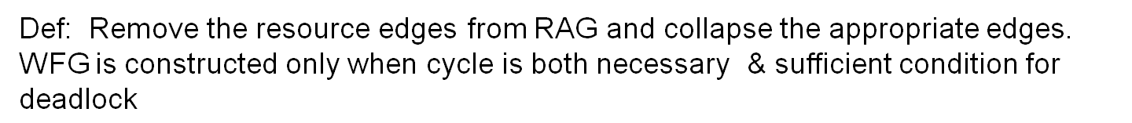
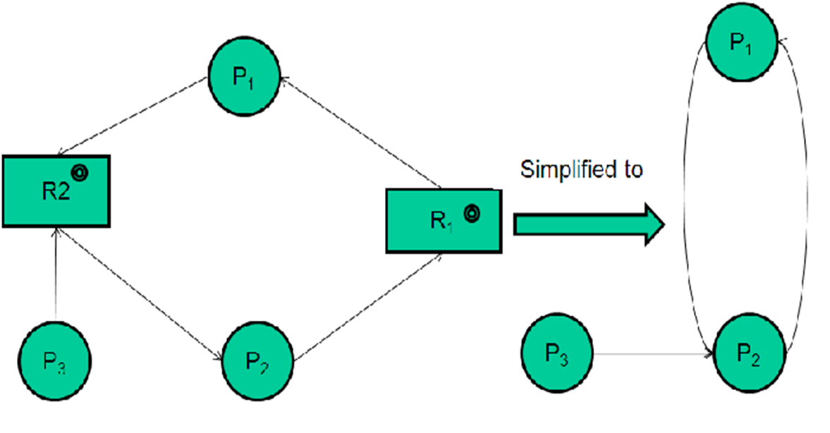
Resource-Allocation Graph and Wait-for Graph

Slide 77
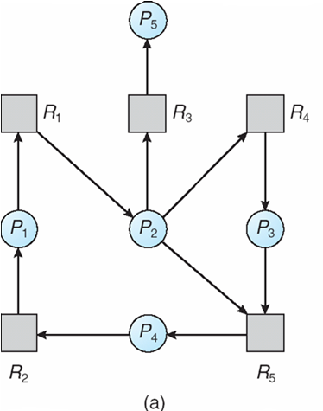
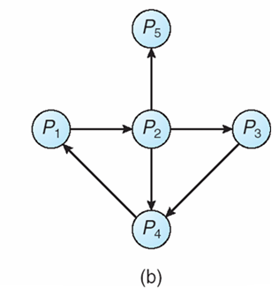
Resource-Allocation Graph and Wait-for Graph
Resource-Allocation Graph
Corresponding wait-for graph

Slide 78
Case 2: Several instances of each resource type
WFG is no longer applicable for this case
Why?
Detection algorithm
Uses several time varying data structures similar to those of Banker’s
Available (m), Allocation (nXm), Request(nXm)
Same definition of <= notation
Same definition of Allocation_{i} and Request_{i}
Crux of the algorithm
Simply investigates every possible allocation sequence for the processes that remain to be completed

Slide 79
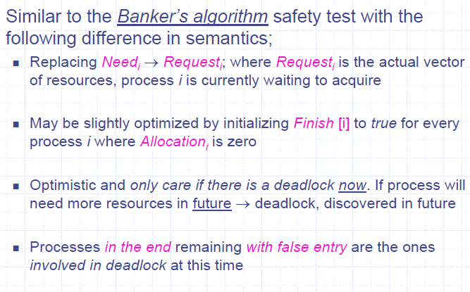
Case 2: Several instances of each resource type

Slide 80
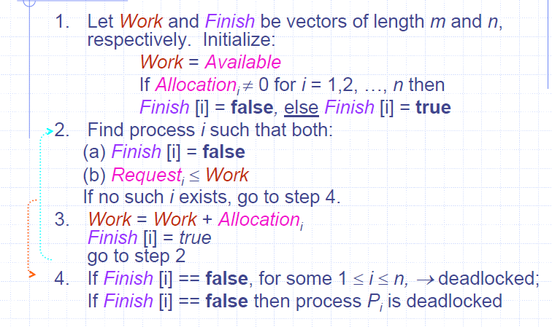
Deadlock Detection Algorithm
Requires m * n² operation to detect a deadlock

Slide 81
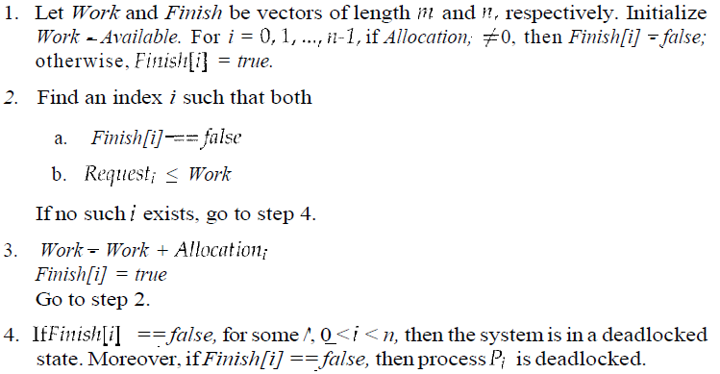
Contrast with Banker’s Algorithm

Slide 82
Example
5 processes P0 through P4
3 resource types: A (7 instances), B (2 instances), and C (6 instances)
Snapshot of system at t₀ : is there a deadlock?
Process | Allocation |  |  | Request
 | A | B | C | A | B | C
P₀ | 0 | 1 | 0 | 0 | 0 | 0
P₁ | 2 | 0 | 0 | 2 | 0 | 2
P₂ | 3 | 0 | 3 | 0 | 0 | 0
P₃ | 2 | 1 | 1 | 1 | 0 | 0
P₄ | 0 | 0 | 2 | 0 | 0 | 2
Available
0 | 0 | 0

Slide 83
Is there a deadlock?
Process | Allocation |  |  | Request |  |  | Finish | Finish | Finish | Finish | Finish
 | A | B | C | A | B | C
P₀ | 0 | 1 | 0 | 0 | 0 | 0 | F
P₁ | 2 | 0 | 0 | 2 | 0 | 2 | F
P₂ | 3 | 0 | 3 | 0 | 0 | 0 | F
P₃ | 2 | 1 | 1 | 1 | 0 | 0 | F
P₄ | 0 | 0 | 2 | 0 | 0 | 2 | F
Work
0 | 0 | 0
Please note that all are initially ‘F’ here by coincidence

Slide 84
Is there a deadlock?
Process | Allocation |  |  | Request |  |  | Finish | Finish | Finish | Finish | Finish
 | A | B | C | A | B | C
P₀ | 0 | 1 | 0 | 0 | 0 | 0 | F | T
P₁ | 2 | 0 | 0 | 2 | 0 | 2 | F | F
P₂ | 3 | 0 | 3 | 0 | 0 | 0 | F | F
P₃ | 2 | 1 | 1 | 1 | 0 | 0 | F | F
P₄ | 0 | 0 | 2 | 0 | 0 | 2 | F | F
Work
0 | 0 | 0
0 | 1 | 0

Slide 85
Is there a deadlock?
Process | Allocation |  |  | Request |  |  | Finish | Finish | Finish | Finish | Finish
 | A | B | C | A | B | C
P₀ | 0 | 1 | 0 | 0 | 0 | 0 | F | T | T
P₁ | 2 | 0 | 0 | 2 | 0 | 2 | F | F | F
P₂ | 3 | 0 | 3 | 0 | 0 | 0 | F | F | T
P₃ | 2 | 1 | 1 | 1 | 0 | 0 | F | F | F
P₄ | 0 | 0 | 2 | 0 | 0 | 2 | F | F | F
Work
0 | 0 | 0
0 | 1 | 0
3 | 1 | 3

Slide 86
Is there a deadlock?
Process | Allocation |  |  | Request |  |  | Finish | Finish | Finish | Finish | Finish
 | A | B | C | A | B | C
P₀ | 0 | 1 | 0 | 0 | 0 | 0 | F | T | T | T
P₁ | 2 | 0 | 0 | 2 | 0 | 2 | F | F | F | T
P₂ | 3 | 0 | 3 | 0 | 0 | 0 | F | F | T | T
P₃ | 2 | 1 | 1 | 1 | 0 | 0 | F | F | F | F
P₄ | 0 | 0 | 2 | 0 | 0 | 2 | F | F | F | F
Work
0 | 0 | 0
0 | 1 | 0
3 | 1 | 3
5 | 1 | 3

Slide 87
Is there a deadlock?
Process | Allocation |  |  | Request |  |  | Finish | Finish | Finish | Finish | Finish
 | A | B | C | A | B | C
P₀ | 0 | 1 | 0 | 0 | 0 | 0 | F | T | T | T | T
P₁ | 2 | 0 | 0 | 2 | 0 | 2 | F | F | F | T | T
P₂ | 3 | 0 | 3 | 0 | 0 | 0 | F | F | T | T | T
P₃ | 2 | 1 | 1 | 1 | 0 | 0 | F | F | F | F | T
P₄ | 0 | 0 | 2 | 0 | 0 | 2 | F | F | F | F | F
Work
0 | 0 | 0
0 | 1 | 0
3 | 1 | 3
5 | 1 | 3
7 | 2 | 4

Slide 88
Is there a deadlock?
Process | Allocation |  |  | Request |  |  | Finish | Finish | Finish | Finish | Finish
 | A | B | C | A | B | C
P₀ | 0 | 1 | 0 | 0 | 0 | 0 | F | T | T | T | T | T
P₁ | 2 | 0 | 0 | 2 | 0 | 2 | F | F | F | T | T | T
P₂ | 3 | 0 | 3 | 0 | 0 | 0 | F | F | T | T | T | T
P₃ | 2 | 1 | 1 | 1 | 0 | 0 | F | F | F | F | T | T
P₄ | 0 | 0 | 2 | 0 | 0 | 2 | F | F | F | F | F | T
Work
0 | 0 | 0
0 | 1 | 0
3 | 1 | 3
5 | 1 | 3
7 | 2 | 4
7 | 2 | 6
Thus, no deadlock: Sequence <P₀, P₂, P₃, P₁, P₄>

Slide 89
P2 now makes an additional request for 1 C
Request matrix is modified. Is there deadlock now?
Process | Allocation |  |  | Request |  |  | Finish | Finish | Finish | Finish | Finish
 | A | B | C | A | B | C
P₀ | 0 | 1 | 0 | 0 | 0 | 0 | F
P₁ | 2 | 0 | 0 | 2 | 0 | 2 | F
P₂ | 3 | 0 | 3 | 0 | 0 | 1 | F
P₃ | 2 | 1 | 1 | 1 | 0 | 0 | F
P₄ | 0 | 0 | 2 | 0 | 0 | 2 | F
Work
0 | 0 | 0

Slide 90
Is there a deadlock?
Process | Allocation |  |  | Request |  |  | Finish | Finish | Finish | Finish | Finish
 | A | B | C | A | B | C
P₀ | 0 | 1 | 0 | 0 | 0 | 0 | F | T
P₁ | 2 | 0 | 0 | 2 | 0 | 2 | F | F
P₂ | 3 | 0 | 3 | 0 | 0 | 1 | F | F
P₃ | 2 | 1 | 1 | 1 | 0 | 0 | F | F
P₄ | 0 | 0 | 2 | 0 | 0 | 2 | F | F
Work
0 | 0 | 0
0 | 1 | 0

Slide 91
Is there a deadlock?
Process | Allocation |  |  | Request |  |  | Finish | Finish | Finish | Finish | Finish
 | A | B | C | A | B | C
P₀ | 0 | 1 | 0 | 0 | 0 | 0 | F | T
P₁ | 2 | 0 | 0 | 2 | 0 | 2 | F | F
P₂ | 3 | 0 | 3 | 0 | 0 | 1 | F | F
P₃ | 2 | 1 | 1 | 1 | 0 | 0 | F | F
P₄ | 0 | 0 | 2 | 0 | 0 | 2 | F | F
Work
0 | 0 | 0
0 | 1 | 0
P1, P2, P3 and P4 are in a deadlock now!

Slide 92
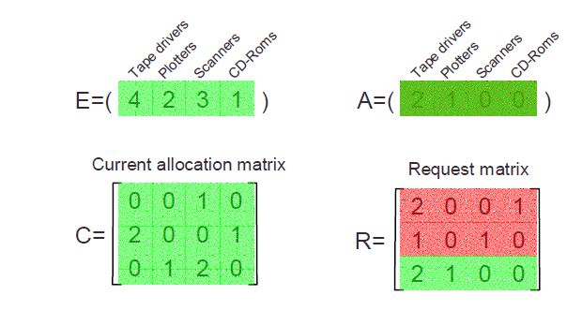
Example: Multiple resources of each type

Slide 93
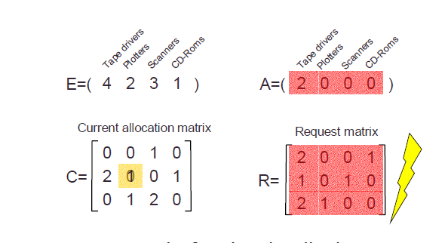
Example: Multiple resources of each type

Slide 94
Detection-Algorithm Usage
When, and how often, to invoke algorithm depends on:
How often a deadlock is likely to occur?
How many processes will be affected by deadlock when it happens?
If deadlock occurs frequently, then the detection algorithm should be invoked frequently.
We could invoke the deadlock detection algorithm every time a request for allocation cannot be granted immediately.
By this we can identify deadlock causing process & processes involved in deadlock also.
But this incurs overhead in computation time.
So can call algorithms after 1 hour / CPU utilization drops below 40%.
If detection algorithm is invoked arbitrarily, there may be many cycles in the resource graph and so we would not be able to tell which of the many deadlocked processes “caused” the deadlock.

Slide 95
Contents
Uniprocessor Scheduling: Types of Scheduling: Preemptive, Non-preemptive, Long-term, Medium-term, Short-term scheduling
Scheduling Algorithms: FCFS, SJF, RR, Priority
Multiprocessor Scheduling: Granularity
Design Issues, Process Scheduling
Deadlock: Principles of deadlock, Deadlock Avoidance
Deadlock Detection, Deadlock Prevention
Deadlock Recovery

Slide 96
Deadlock Recovery
Once detected, several alternatives are available for recovery inform the operator that a deadlock has occurred and to let the operator deal with the deadlock manually
Abort one or more processes to break the circular wait
Preempt some resources from one or more of the deadlocked processes

Slide 97
Process Termination / Abort
Two alternatives
In both, system reclaims all resources held by the terminated process
Abort all deadlocked processes
Everything the processes had done so far has gone down the drain!
Abort one process at a time until the deadlock cycle is eliminated
Whose turn is next?
Policy decision similar to scheduling decisions
Considerable overhead of detecting deadlock after each termination!
Aborting comes with several issues
What if in the middle of updating a file or printing to a printer

Slide 98
Whom to abort next?
Abort those processes whose termination will incur the minimum cost
Cost depends upon
What is the priority of the process?
How long the process has computed and how much longer the process will compute before completing its designated task?
How many and what type of resources the process has used (e.g., preemptable, non-preemptable)?
How many more resources the process needs in order to complete?
How many processes will need to be terminated?
Whether the process is interactive or batch?

Slide 99
Resource Preemption
We successively preempt some resources from processes and give these resources to other processes until the deadlock cycle is broken
Three issues need to be addressed:
Selecting a victim
Rollback
Starvation

Slide 100
Selecting a victim
Which resources and of which processes next in order to minimize cost

Slide 101
Rollback
What to do with the process from whom resource has been preempted? It cannot continue normal execution
Rollback to some safe state and restart it from that state
What is safe state, also system will require to keep states of all processes
Thus some systems prefer total rollback

Slide 102
Starvation
How can we guarantee that resources will not always be preempted from the same process
If decision to pick is primarily based on cost factors, same unfortunate fellow may get picked up every time!
We thus need an upper bound (small and finite) on how many times you can be chosen as a victim
Include the number of rollbacks in the cost factor

Slide 103
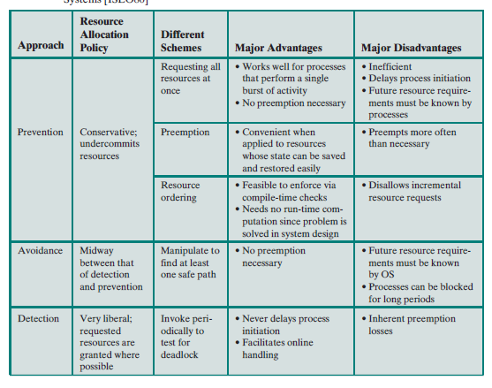
Summary of Deadlock prevention, Avoidance,Detection

