Slide 1
Device Driver

Slide 2
User mode and kernel mode
A processor in a computer has two different modes: user mode and kernel mode.
The processor switches between the two modes depending on what type of code is running on the processor.
Applications run in user mode, and core operating system components run in kernel mode. Many drivers run in kernel mode, but some drivers run in user mode.
When you start a user-mode application, Windows creates a process for the application.
The process provides the application with a private virtual address space and a private handle table. Because an application's virtual address space is private, one application cannot alter data that belongs to another application.
Each application runs in isolation, and if an application crashes, the crash is limited to that one application. Other applications and the operating system are not affected by the crash.
Notes:
User programs (like your editor, terminal, ssh daemon, etc) need to interact with the Linux kernel so that the kernel can perform a set of operations on behalf of your user programs that they can’t perform themselves.
For example, if a user program needs to do some sort of IO (open, read, write, etc) or modify its address space (mmap, sbrk, etc) it must trigger the kernel to run to complete those actions on its behalf.
What prevents user programs from performing these actions themselves?
It turns out that the x86-64 CPUs have a concept called privilege levels. Privilege levels are a complex topic suitable for their own blog post. For the purposes of this post, we can (greatly) simplify the concept of privilege levels by saying:
Privilege levels are a means of access control. The current privilege level determines which CPU instructions and IO may be performed.
The kernel runs at the most privileged level, called “Ring 0”. User programs run at a lesser level, typically “Ring 3”.
In order for a user program to perform some privileged operation, it must cause a privilege level change (from “Ring 3” to “Ring 0”) so that the kernel can execute.
There are several ways to cause a privilege level change and trigger the kernel to perform some action.
<number>

Slide 3
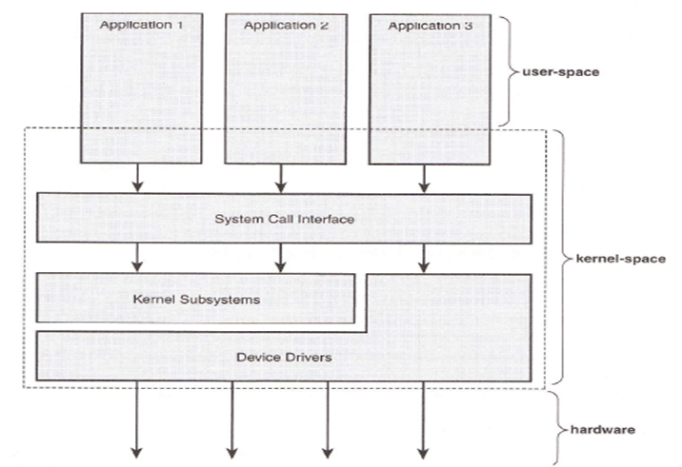
Kernel Basics
Notes:
The system call is the fundamental interface between an application and the Linux kernel.
Because the service is provided in the kernel, a direct call cannot be performed; instead, you must use a process of crossing the user-space/kernel boundary.
<number>

Slide 4
Types of Drivers, Driver History, Driver Issues, Kernel Level Device drivers, Virtual device drivers(VxD),Writing a Driver, Device Driver Stack Buses and Physical Devices,
Static Device drivers, Dynamic Device drivers, PnP,
Device Namespace, and Named Devices.

Slide 5
Device Driver
Device driver or software driver is a computer program allowing higher-level computer programs to interact with a hardware device.
Device driver simplifies programming by acting as translator between a hardware device and the applications or operating systems that use it
Drivers are hardware-dependent and operating-system-specific
Hide implementation and hardware-specific details
from a user program
Notes:
Writing a device driver requires an in-depth understanding of how the hardware and the software of a given platform function. Drivers operate in a highly privileged environment and can cause disaster if they get things wrong
<number>

Slide 6
DEVICE DRIVER
A device driver is a program that controls a particular type of device that is attached to your computer.
Black boxes to hide details of hardware devices.
Use standardized calls
Main role is to Map standard calls to device-specific operations
Can be developed separately from the rest of the kernel
Plugged in at runtime when needed

Slide 7
Device Driver
User Space
Device File
Device Driver
Physical
Open read , write , Close,
File Operation
Kernel Space

Slide 8
Concurrency in the Kernel
Reentrant code
Data structure – to keep multiple thread execution separate
Code access to shared data prevent corruption
Concurrency but avoid race condition
Nonpreemtive behaviour prevent unwanted concurrency

Slide 9
Device Driver Types
A character device driver ( c )
Reading/Writing character by character
Most devices are this type (e.g.Modem, lp, USB
No buffer.
A block device driver (b)
Reading/Writing block by block
Through a system buffer that acts as a data cache.
Hard drive controller and HDs
Random access devices (buffering) For example a file system can only be mounted on a block device, because it requires random access.
For example, disks are commonly implemented as block devices.

Slide 10
Kernel basics
No libc functions!!!
No printf, use printk instead
Some common functions implemented inside the kernel
Small, fixed size stack
Synchronization and Concurrency issues

Slide 11
Major and Minor Numbers
Linux identifies each device by a major device number and a minor device number. The major device number identifies the driver associated with the device.
Major number
Each device driver is identified by a unique major number.
This number is assigned by the Linux Device Registrar.
This number is the index into an array that contains the information about the driver (the device_struct)
The major device number identifies the driver associated with the device.
Minor number
This uniquely identifies a particular instance of a device. For example, a system may have multiple IDE hard disks each would have a major number of 3, but a different minor number.
the minor device number is used by the kernel to determine exactly which device is being referred to.
Notes:
mknod /dev/name type major minor
in UNIX, the interface to devices is via the file system. To create a file representing a device, you use mknod and supply the filename and the device’s type (c for character or b for block) and the device’s major and minor number.
<number>

Slide 12
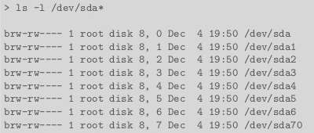
Major and Minor Numbers
Notes:
he following prefixes are used for the names of some devices in the /dev hierarchy, to identify the type of device:
lp: line printers (compare lp)
pt: pseudo-terminals (virtual terminals)
tty: terminals
Some additional prefixes have come into common use in Linux-based systems:
fb: frame buffer
fd: (platform) floppy disks, though this same abbreviation is also commonly used to refer to file descriptor
hd: (“classic”) IDE driver (previously used for ATA hard disk drive, ATAPI optical disc drives, etc.)
hda: the master device on the first ATA channel (usually identified by major number 3 and minor number 0)
hdb: the slave device on the first ATA channel
hdc: the master device on the second ATA channel
hdc1: first primary partition on this disk (example)
hdc5: first logical drive in the extended partition (example)
hdd: the slave device on the second ATA channel
parport, pp: parallel ports
SCSI driver, also used by libATA (modern PATA/SATA driver), USB, IEEE 1394, etc.
sd: mass-storage driver
sda: first registered device
sda4: last partition on this disk (example)
sda6: second logical drive in the extended partition (example)
sdb, sdc, etc.: second, third, etc. registered devices
ses: Enclosure driver
sg: generic SCSI layer
sr: “ROM” driver (data-oriented optical disc drives; scd is just a secondary alias)
st: magnetic tape driver
tty: terminals
ttyS: (platform) serial port driver
ttyUSB: USB serial converters, modems, etc.
<number>

Slide 13
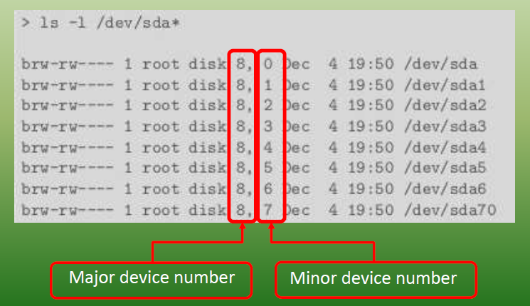
Major and Minor Numbers
Notes:
<number>

Slide 14
Implementation
Assuming that your device name is Xxx
Xxx_init() initialize the device when OS is booted
Xxx_open() open a device
Xxx_read() read from kernel memory
Xxx_write() write
Xxx_release() clean-up (close)
init_module()
cleanup_module()

Slide 15
Driver program
#include <linux/module.h> /* Needed by all modules */
#include <linux/kernel.h> /* Needed for KERN_INFO */
int init_module(void)
{
printk(KERN_INFO "Hello world 1.\n");
/* A non 0 return means init_module failed; module can't be loaded. */
return 0;
}
void cleanup_module(void)
{
printk(KERN_INFO "Goodbye world 1.\n");
}

Slide 16
printk()
- not meant to communicate information to the user.
- logging mechanism for the kernel, and is used to log information or give warnings.
- printk() statement comes with a priority
-If the priority is less than (int)console_loglevel, the message is printed on your current terminal. If both syslogd and klogd are running, then the message will also get appended to /var/log/messages

Slide 17
Makefile
Makefile is a script for appropriate compilation of different type of sources to the appropriate object code.
To use a makefile just type make or gmake in a console window opened in the same dir as the makefile
Notes:
<number>

Slide 18
Makefile
obj-m += hello-1.o
all:
make -C /lib/modules/$(shell uname -r)/build M=$(PWD) modules
clean:
make -C /lib/modules/$(shell uname -r)/build M=$(PWD) clean
Notes:
kernel headers are more than sufficient to compile kernel modules / drivers
<number>

Slide 19
Commands to run module
$ dmesg (display message or driver message) is a command on most Unix-like operating systems that prints the message buffer of the kernel.)
$ make
$ dmesg
$ sudo insmod hello.ko (insmod command is used to insert modules to Linux kernel. )
$ lsmod | hello (to verify that the module has been inserted successfully)
$ rmmod hello
$ dmesg
Notes:
The output of dmesg is maintained in the log file /var/log/dmesg, and it can thus also be easily viewed by reading that file with a text editor, such as vi or gedit, or with a command such as cat, e.g.,
cat /var/log/dmesg | less
Preparing and Running Make
To prepare to use make, you must write a file called the makefile that describes the relationships among files in your program and provides commands for updating each file. In a program, typically, the executable file is updated from object files, which are in turn made by compiling source files.
Once a suitable makefile exists, each time you change some source files, this simple shell command:
make
suffices to perform all necessary recompilations. The make program uses the makefile data base and the last-modification times of the files to decide which of the files need to be updated. For each of those files, it issues the recipes recorded in the data base.
You can provide command line arguments to make to control which files should be recompiled, or how. See How to Run make.
insmod installs a loadable module in the running kernel.
insmod tries to link a module into the running kernel by resolving all symbols from the kernel's exported symbol table.
If the module file name is given without directories or extension, insmod will search for the module in some common default directories.
<number>

Slide 20
kernel functions
add_timer()
Causes a function to be executed when a given amount of time has passed
cli()
Prevents interrupts from being acknowledged
end_request()
Called when a request has been satisfied or aborted
free_irq()
Frees an IRQ previously acquired with request_irq() or irqaction()
get_user*()
Allows a driver to access data in user space, a memory area distinct from the kernel
inb(), inb_p()
Reads a byte from a port. Here, inb() goes as fast as it can, while inb_p() pauses before returning.
irqaction()
Registers an interrupt like a signal.
IS_*(inode)
Tests if inode is on a file system mounted with the corresponding flag.
kfree*()
Frees memory previously allocated with kmalloc()
kmalloc()
Allocates a chu nk of memory no larger than 4096 bytes.
MAJOR()
Reports the major device number for a device.
MINOR()
Reports the minor device number for a device.

Slide 21
kernel functions
memcpy_*fs()
Copies chunks of memory between user space and kernel space
outb(), outb_p()
Writes a byte to a port. Here, outb() goes as fast as it can, while outb_p() pauses before returning.
printk()
A version of printf() for the kernel.
put_user*()
Allows a driver to write data in user space.
register_*dev()
Registers a device with the kernel.
request_irq()
Requests an IRQ from the kernel, and, if successful, installs an IRQ interrupt handler.
select_wait()
Adds a process to the proper select_wait queue.
*sleep_on()
Sleeps on an event, puts a wait_queue entry in the list so that the process can be awakened on that event.
sti()
Allows interrupts to be acknowledged.
sys_get*()
System calls used to get information regarding the process, user, or group.
wake_up*()
Wakes up a process that has been put to sleep by the matching *sleep_on() function.

Slide 22
Virtual device drivers
used to emulate a hardware device, particularly in virtualization environments
Instead of enabling the guest operating system to dialog with hardware, virtual device drivers take the opposite role and emulate a piece of hardware, so that the guest operating system and its drivers running inside a virtual machine can have the illusion of accessing real hardware

Slide 23
VxD(virtual xxx driver)
A virtual device driver (VxD) is a software device driver that emulates hardware and other devices so that multiple applications running in protected mode can access hardware interrupt channels, hardware resources and memory without causing conflicts.
To share arbitrary physical resources amongst these virtual machines, Microsoft introduced dynamically-loadable virtual device drivers.

Slide 24
In Windows, a device driver is controlled by the operating system's virtual device driver manager (VDDM) and is shared by the applications running within that kernel
There was no hardware device sharing allowed in most standard DOS applications, so the virtual device driver (VxD) was introduced to prevent device access conflicts. The VxD passed interrupt and memory requests through to the kernel, which in turn allocated the resources as required, always ensuring only a single request thread could access a single interrupt channel of any device at any one time

Slide 25
User mode and kernel mode
A processor in a computer running Windows has two different modes: user mode and kernel mode.
The processor switches between the two modes depending on what type of code is running on the processor.
Applications run in user mode, and core operating system components run in kernel mode. Many drivers run in kernel mode, but some drivers run in user mode.
When you start a user-mode application, Windows creates a process for the application.
The process provides the application with a private virtual address space and a private handle table. Because an application's virtual address space is private, one application cannot alter data that belongs to another application.
Each application runs in isolation, and if an application crashes, the crash is limited to that one application. Other applications and the operating system are not affected by the crash.

Slide 26
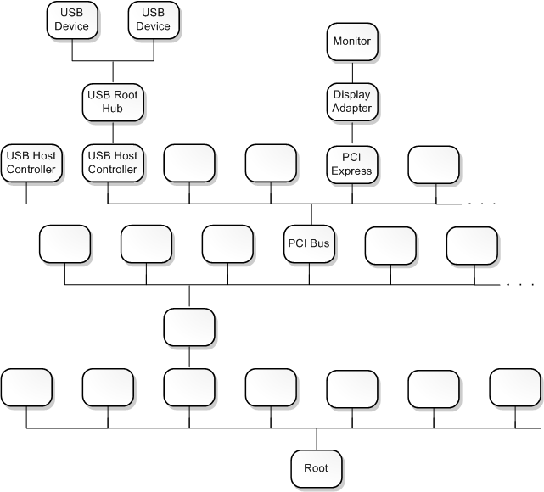
Device nodes and device stacks
Windows organizes devices in a tree structure called the device tree
node in the device tree is called a device node

Slide 27
Device objects and device stacks
A device object is an instance of a DEVICE_OBJECT structure.
Each device node has an ordered list of device objects, and each of these device objects is associated with a driver.
The ordered list of device objects, along with their associated drivers, is called the device stack for the device node.
first device object to be created in the device stack is at the bottom, and the last device object to be created and attached to the device stack is at the top

Slide 28
Driver stacks
In the Windows operating system, WDM drivers are layered in a vertical calling sequence that is called a driver stack.
The topmost driver in the stack typically receives I/O requests from user applications, after the requests have passed through the operating system's I/O manager. The lower driver layers typically communicate with computer hardware.

Slide 29
Device stacks
Each driver stack supports one or more device stacks. A device stack is a set of device objects that are created from WDM-defined DEVICE_OBJECT structures. Each device stack represents one device. Each driver creates a device object for each of its devices and attaches each device object to a device stack. Device stacks are created and removed as devices are plugged in and unplugged, and each time the system is rebooted.
When a bus driver detects that child devices have been plugged in or unplugged, it informs the Plug and Play (PnP) manager. In response, the PnP manager asks the bus driver to create a physical device object (PDO) for each child device that is connected to the parent device (that is, the bus). The PDO becomes the bottom of a device stack.
Notes:
Next, the PnP manager loads function and filter drivers to support each device (if they are not already loaded), and then the PnP manager calls these drivers so that each can create a device object and add it to the top of the device stack. Function drivers create functional device objects (FDOs), and filter drivers create filter device objects (filter DOs).
When the I/O manager sends an I/O request to a device's drivers, it passes the request to the driver that created the topmost device object in the device stack. If that driver asks the I/O manager to pass the request to the next-lower driver, the I/O manager uses the device stack to determine the next-lower driver. (The next-lower driver is the driver that created the next-lower device object.)
<number>

Slide 30
Device stacks
Next, the PnP manager loads function and filter drivers to support each device (if they are not already loaded), and then the PnP manager calls these drivers so that each can create a device object and add it to the top of the device stack. Function drivers create functional device objects (FDOs), and filter drivers create filter device objects (filter DOs).
When the I/O manager sends an I/O request to a device's drivers, it passes the request to the driver that created the topmost device object in the device stack. If that driver asks the I/O manager to pass the request to the next-lower driver, the I/O manager uses the device stack to determine the next-lower driver. (The next-lower driver is the driver that created the next-lower device object.)
Notes:
<number>

Slide 31
Function drivers, filter drivers, and bus drivers
Each driver in a device stack plays the role of either function driver, filter driver, or bus driver.
main driver for the device stack is called the function driver for the device stack or the function driver for the device node
function driver is responsible for handling read requests, write requests, and device control requests
device object that is associated with a function driver is called a functional device object (FDO).

Slide 32
driver at the bottom of the device stack is called the bus driver for the device stack or the bus driver for the device node.
A device object that is associated with the bus driver for a device stack is called a physical device object (PDO).
A driver that is above the function driver or in between the bus and function drivers is called a filter driver.
A device object that is associated with a filter driver is called a filter device object (Filter DO).

Slide 33
.inf, PnP
When the drivers for a device are installed, the installer uses information in an information (INF) file to determine which driver is the function driver and which drivers are filters.
Typically the INF file is provided either by Microsoft or by the hardware vendor.
After the drivers for a device are installed, the Plug and Play (PnP) manager can determine the function and filter drivers for the device by looking in the registry.

Slide 34
Buses and bus drivers
A bus is any parent node in the device tree. In other words, any device node that has one or more child nodes is a bus.
The bus driver for a device node is the driver associated with the PDO at the bottom of the node's device stack.

Slide 35
2. A bus is a physical device that can have other physical devices connected to it. For example, the PCI bus is a set of conductors and circuitry on the motherboard, and devices are connected to the PCI bus by being built into the motherboard or by being plugged into expansion slots. Physical USB devices can be connected to a USB host controller.
A bus driver is the function driver associated with a physical bus

Slide 36
Implementation
Assuming that your device name is Xxx
Xxx_init() initialize the device when OS is booted
Xxx_open() open a device
Xxx_read() read from kernel memory
Xxx_write() write
Xxx_release() clean-up (close)
init_module()
cleanup_module()

Slide 37
Driver program
#include <linux/module.h> /* Needed by all modules */
#include <linux/kernel.h> /* Needed for KERN_INFO */
int init_module(void)
{
printk(KERN_INFO "Hello world \n");
/* A non 0 return means init_module failed; module can't be loaded. */
return 0;
}
void cleanup_module(void)
{
printk(KERN_INFO "Goodbye world \n");
}

Slide 38
$ gcc –c hello.c
$ insmod ./hello.o
Hello world
$ rmmod hello
Goodbye world

Slide 39
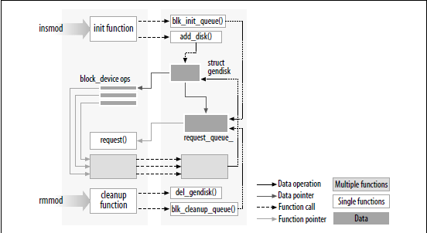

Slide 40
printk()
- not meant to communicate information to the user.
- logging mechanism for the kernel, and is used to log information or give warnings.
- printk() statement comes with a priority
-If the priority is less than (int)console_loglevel, the message is printed on your current terminal. If both syslogd and klogd are running, then the message will also get appended to /var/log/messages

Slide 41
Kernel Module
Modules are pieces of code that can be loaded and unloaded into the kernel upon demand.
They extend the functionality of the kernel without the need to reboot the system.
(For Ex- device driver, which allows the kernel to access hardware connected to the system.)
Without modules, we would have to build monolithic kernels and add new functionality directly into the kernel image. Besides having larger kernels, this has the disadvantage of requiring us to rebuild and reboot the kernel every time we want new functionality
kernel headers are more than sufficient to compile kernel modules / drivers

Slide 42
Lsmod- Command to see which modules are already loaded into the kernel
It reads information by reading the file /proc/modules.
When the kernel needs a feature that is not resident in the kernel, the kernel module daemon kmod execs modprobe to load the module in.

Slide 43
insmod-modprobe uses insmod to first load any prerequisite modules into the kernel, and then the requested module.
modprobe directs insmod to/lib/modules/version/, the standard directory for modules
modprobe is aware of the default location of modules, knows how to figure out the dependancies and load the modules in the right order.

Slide 44
kernel functions
add_timer()
Causes a function to be executed when a given amount of time has passed
cli()
Prevents interrupts from being acknowledged
end_request()
Called when a request has been satisfied or aborted
free_irq()
Frees an IRQ previously acquired with request_irq() or irqaction()
get_user*()
Allows a driver to access data in user space, a memory area distinct from the kernel
inb(), inb_p()
Reads a byte from a port. Here, inb() goes as fast as it can, while inb_p() pauses before returning.
irqaction()
Registers an interrupt like a signal.
IS_*(inode)
Tests if inode is on a file system mounted with the corresponding flag.
kfree*()
Frees memory previously allocated with kmalloc()
kmalloc()
Allocates a chu nk of memory no larger than 4096 bytes.
MAJOR()
Reports the major device number for a device.
MINOR()
Reports the minor device number for a device.

Slide 45
kernel functions
memcpy_*fs()
Copies chunks of memory between user space and kernel space
outb(), outb_p()
Writes a byte to a port. Here, outb() goes as fast as it can, while outb_p() pauses before returning.
printk()
A version of printf() for the kernel.
put_user*()
Allows a driver to write data in user space.
register_*dev()
Registers a device with the kernel.
request_irq()
Requests an IRQ from the kernel, and, if successful, installs an IRQ interrupt handler.
select_wait()
Adds a process to the proper select_wait queue.
*sleep_on()
Sleeps on an event, puts a wait_queue entry in the list so that the process can be awakened on that event.
sti()
Allows interrupts to be acknowledged.
sys_get*()
System calls used to get information regarding the process, user, or group.
wake_up*()
Wakes up a process that has been put to sleep by the matching *sleep_on() function.

Slide 46
Kernel Functions
copy_to_user()
copy_from_user()
vmalloc()
alloc_pages(), alloc_page()
free_pages(), free_page()
kmalloc(), kfree()
vmalloc(), vfree()

Slide 47
Makefile
Makefiles are a simple way to organize code compilation
Makefile is a script for appropriate compilation of different type of sources to the appropriate object code.
To use a makefile just type make or gmake in a console window opened in the same dir as the makefile

Slide 48
hellomake.c | hellofunc.c | hellomake.h
#include <hellomake.h> int main() { // call a function in another file myPrintHelloMake(); return(0); } | #include <stdio.h> #include <hellomake.h> void myPrintHelloMake(void) { printf("Hello makefiles!\n"); return; } | /* example include file */ void myPrintHelloMake(void);
gcc -o hellomake hellomake.c hellofunc.c -I

Slide 49
Makefile1
hellomake: hellomake.c hellofunc.c
gcc -o hellomake hellomake.c hellofunc.c -I.
Makefile2
CC=gcc
CFLAGS=-I.
hellomake: hellomake.o hellofunc.o
$(CC) -o hellomake hellomake.o hellofunc.o -I.

Slide 50
create a C test file "test.c" and then create makefile as shown below
Makefile
all:
cc -o test test.c
clean:
rm -f test
Save this file as "Makefile"
Run this makefile by make command. It then creates test executable file at present directory
Run the file using ./test
You can use make clean to delete the executable file(test).

Slide 51
Makefile
obj-m += hello-1.o
all:
make -C /lib/modules/$(shell uname -r)/build M=$(PWD) modules
clean:
make -C /lib/modules/$(shell uname -r)/build M=$(PWD) clean
From a technical point of view just the first line is really necessary, the "all" and "clean" targets were added for pure convenience.

Slide 52
(obj-m) specifies object files which are built as loadable kernel modules.
CUR = $(shell uname -r)
DIR = /lib/modules/$(CUR)/build
PWD = $(shell pwd)
obj-m := m1.o m2.o
default: $(MAKE) -C $(DIR) SUBDIRS=$(PWD) modules
if we delete the obj-m variable initialization then this make doesn't compile m1 and m2 kernel modules

Slide 53
$(obj-m) specifies object files which are built as loadable kernel modules.
A module may be built from one source file or several source files.
In the case of one source file, the kbuild or makefile simply adds the file to $(obj-m).

Slide 54
Commands to run module
$ make
$ insmod hello.ko
$ lsmod | less
$ tail –f /var/log/messages
$modinfo hello.ko
$ rmmod hello
$ tail –f /var/log/messages

Slide 55
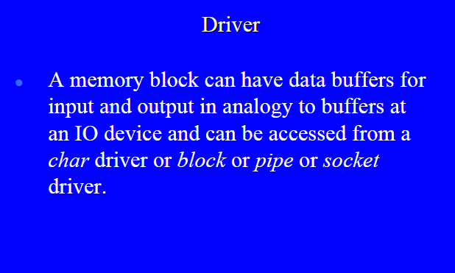

Slide 56
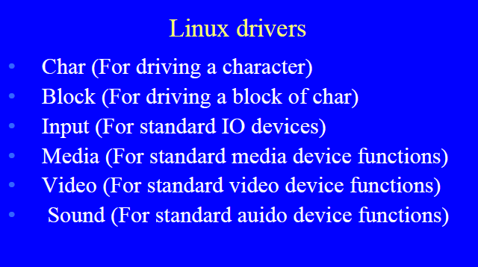

Slide 57
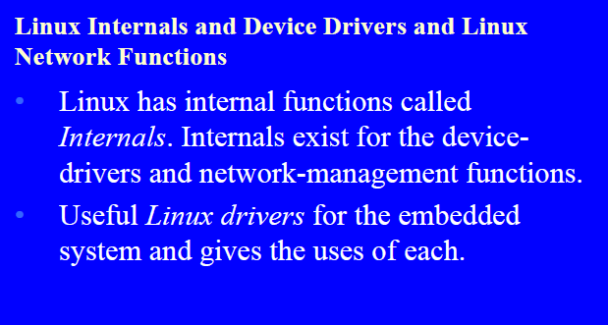

Slide 58
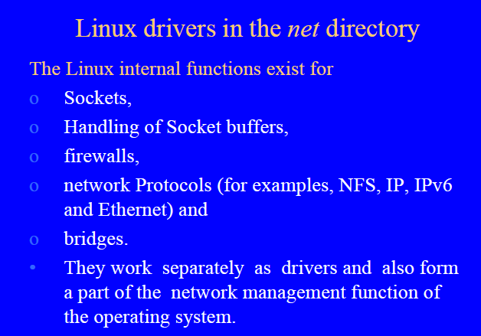

Slide 59
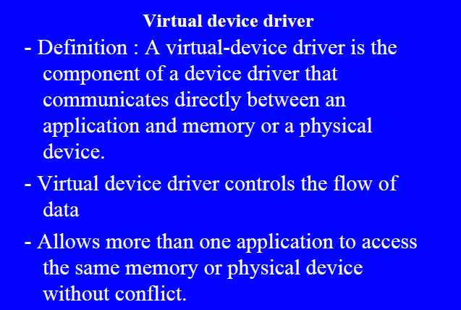

Slide 60
Virtual device drivers
used to emulate a hardware device, particularly in virtualization environments
Instead of enabling the guest operating system to dialog with hardware, virtual device drivers take the opposite role and emulate a piece of hardware, so that the guest operating system and its drivers running inside a virtual machine can have the illusion of accessing real hardware

Slide 61
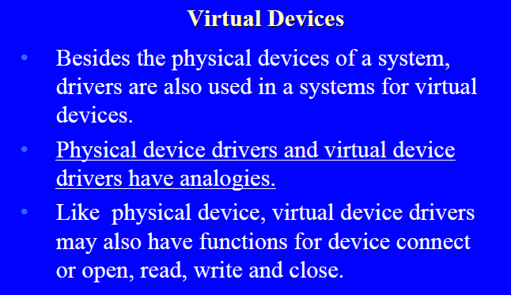

Slide 62
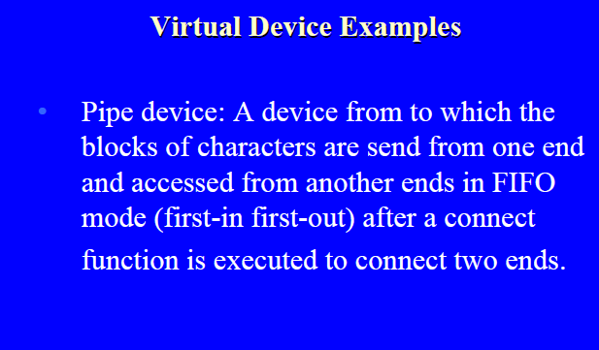

Slide 63
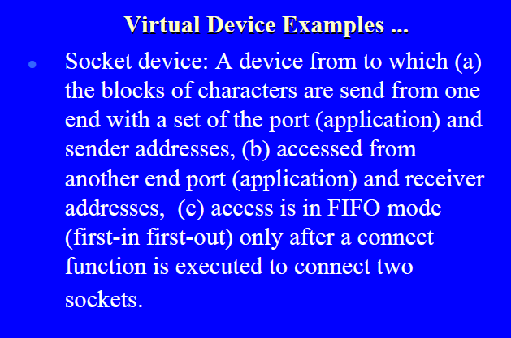

Slide 64
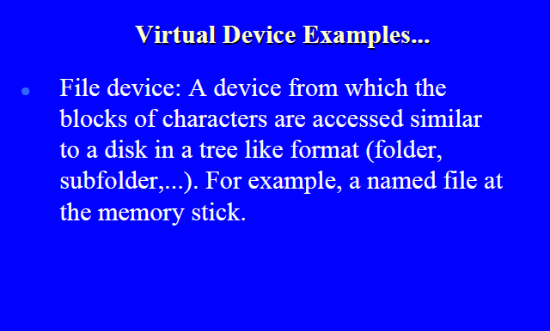

Slide 65
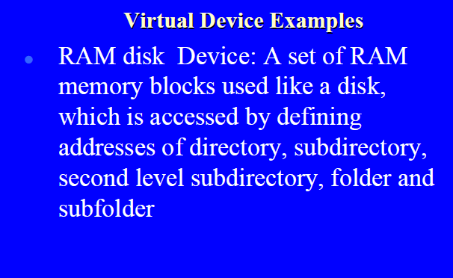

Slide 66
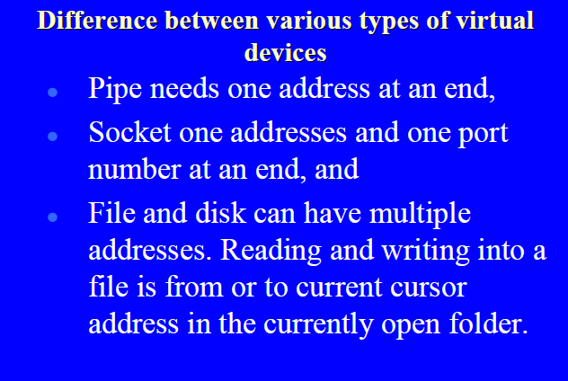
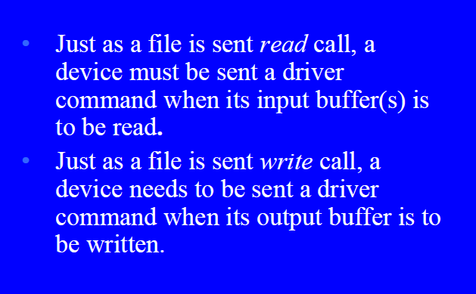

Slide 67
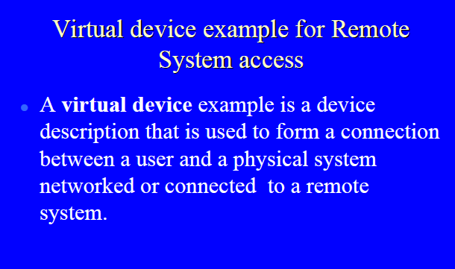

Slide 68
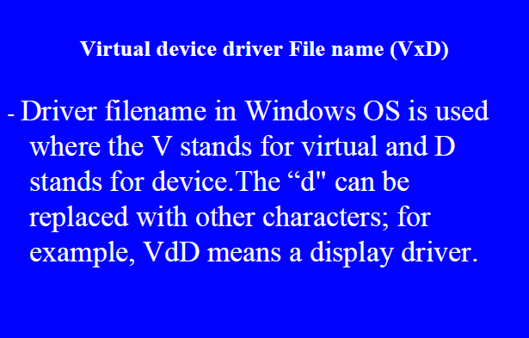

Slide 69
VxD(virtual xxx driver)
A virtual device driver (VxD) is a software device driver that emulates hardware and other devices so that multiple applications running in protected mode can access hardware interrupt channels, hardware resources and memory without causing conflicts.
To share arbitrary physical resources amongst these virtual machines, Microsoft introduced dynamically-loadable virtual device drivers.

Slide 70
In Windows, a device driver is controlled by the operating system's virtual device driver manager (VDDM) and is shared by the applications running within that kernel
There was no hardware device sharing allowed in most standard DOS applications, so the virtual device driver (VxD) was introduced to prevent device access conflicts. The VxD passed interrupt and memory requests through to the kernel, which in turn allocated the resources as required, always ensuring only a single request thread could access a single interrupt channel of any device at any one time

Slide 71
Device nodes and device stacks
Windows organizes devices in a tree structure called the device tree
node in the device tree is called a device node

Slide 72
Device objects and device stacks
A device object is an instance of a DEVICE_OBJECT structure.
Each device node has an ordered list of device objects, and each of these device objects is associated with a driver.
The ordered list of device objects, along with their associated drivers, is called the device stack for the device node.
first device object to be created in the device stack is at the bottom, and the last device object to be created and attached to the device stack is at the top

Slide 73
Driver stacks
In the Windows operating system, WDM drivers are layered in a vertical calling sequence that is called a driver stack.
The topmost driver in the stack typically receives I/O requests from user applications, after the requests have passed through the operating system's I/O manager. The lower driver layers typically communicate with computer hardware.

Slide 74
Device stacks
Each driver stack supports one or more device stacks. A device stack is a set of device objects that are created from WDM-defined DEVICE_OBJECT structures. Each device stack represents one device. Each driver creates a device object for each of its devices and attaches each device object to a device stack. Device stacks are created and removed as devices are plugged in and unplugged, and each time the system is rebooted.
When a bus driver detects that child devices have been plugged in or unplugged, it informs the Plug and Play (PnP) manager. In response, the PnP manager asks the bus driver to create a physical device object (PDO) for each child device that is connected to the parent device (that is, the bus). The PDO becomes the bottom of a device stack.
Next, the PnP manager loads function and filter drivers to support each device (if they are not already loaded), and then the PnP manager calls these drivers so that each can create a device object and add it to the top of the device stack. Function drivers create functional device objects (FDOs), and filter drivers create filter device objects (filter DOs).
When the I/O manager sends an I/O request to a device's drivers, it passes the request to the driver that created the topmost device object in the device stack. If that driver asks the I/O manager to pass the request to the next-lower driver, the I/O manager uses the device stack to determine the next-lower driver. (The next-lower driver is the driver that created the next-lower device object.)

Slide 75
Function drivers, filter drivers, and bus drivers
Each driver in a device stack plays the role of either function driver, filter driver, or bus driver.
main driver for the device stack is called the function driver for the device stack or the function driver for the device node
function driver is responsible for handling read requests, write requests, and device control requests
device object that is associated with a function driver is called a functional device object (FDO).

Slide 76
driver at the bottom of the device stack is called the bus driver for the device stack or the bus driver for the device node.
A device object that is associated with the bus driver for a device stack is called a physical device object (PDO).
A driver that is above the function driver or in between the bus and function drivers is called a filter driver.
A device object that is associated with a filter driver is called a filter device object (Filter DO).

Slide 77
.inf, PnP
When the drivers for a device are installed, the installer uses information in an information (INF) file to determine which driver is the function driver and which drivers are filters.
Typically the INF file is provided either by Microsoft or by the hardware vendor.
After the drivers for a device are installed, the Plug and Play (PnP) manager can determine the function and filter drivers for the device by looking in the registry.

Slide 78
Buses and bus drivers
A bus is any parent node in the device tree. In other words, any device node that has one or more child nodes is a bus.
The bus driver for a device node is the driver associated with the PDO at the bottom of the node's device stack.

Slide 79
2. A bus is a physical device that can have other physical devices connected to it. For example, the PCI bus is a set of conductors and circuitry on the motherboard, and devices are connected to the PCI bus by being built into the motherboard or by being plugged into expansion slots. Physical USB devices can be connected to a USB host controller.
A bus driver is the function driver associated with a physical bus

