Slide 1
CS3203 : System Software

Slide 2
Books
Text Books
Stalling William; “Operating Systems”, 6thEdition, Pearson Education.
Silberschatz A., Galvin P., GagneG.; “Operating System Concepts”, 9th Edition, JohnWiley and Sons.
D M Dhamdhere; "Systems Programming & Operating Systems"; Tata McGraw HillPublications, ISBN – 0074635794
John J Donovan; " Systems Programming " ; Tata Mc-Graw Hill edition , ISBN-13978-0-07-460482-3
2
Notes:
2
2
2
2
2
2
2

Slide 3
Books
Text Books
Silberschatz A., Galvin P., Gagne G ;“Operating System Principles” 7th Edition John Wiley and Sons.
YashavantKanetkar; “Unix Shell Programming”, 2 nd Edition, BPB Publications.
Forouzan B. A., Gilberg R. F.; “Unix And Shell Programming”, 1 st Edition, Australia Thomson Brooks Cole.
Achyut S. Godbole ,AtulKahate; “Operating Systems”, 3 rd Edition, McGraw Hill.
Robert Love, " Linux System Programming " ;O’Reilly, ISBN 978-0-596-00958-8
Mahesh Jadhav; " Easy Linux Device Driver "; HighTechEasy publishing, Second edition.
Ray Duncan; “Advanced MSDOS programming”; Microsoft press
3
Notes:
3
3
3
3
3
3
3

Slide 4
Course Project: OPERATING SYSTEMS
Implementation of a multiprogramming operating system:
1. Stage I:
i. CPU/ Machine Simulation
ii. Supervisor Call through interrupt
2. Stage II:
i. Paging
ii. Error Handling
iii. Interrupt Generation and Servicing
iv. Process Data Structure
3. Stage III:
i. Multiprogramming
ii. Virtual Memory
iii. Process Scheduling and Synchronization
iv. Inter-Process Communication
v. I/O Handling, Spooling and Buffering
Notes:
4

Slide 5
Unit I Introduction to Operating System
5
Notes:
5
5
5
5
5
5
5
5

Slide 6
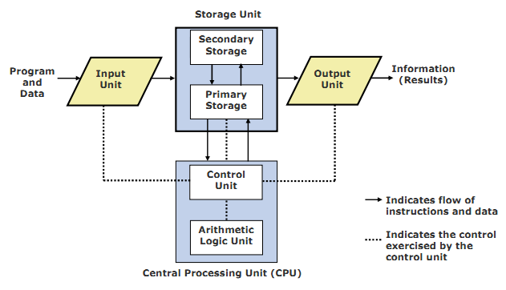
Block Diagram of a Computer (Logical)
6
Notes:
6
6
6

Slide 7
Operating System (OS)
What do you do with just computer hardware?
If someone gives you a computer with no software whatsoever, how do you get it to do anything?
You write a program that runs on the hardware
In the early days, that was the way it worked ...
You started with just the bare hardware
You wrote a program that did everything:
Including managing all aspects of the hardware
Including solving your particular problem
Your program was all the computer did!
7
Notes:
7
7
7

Slide 8
Without an OS
Each program runs directly on the hardware
Each program must do everything
Each program needs to know the details of the hardware and how to use it
If the hardware changes, the program must change as well
The hardware supports only one program at a time - each user must wait until the previous program is done to “share” the hardware with other users.
Writing programs is incredibly complex and expensive
OS is like an extended machine to provide a better interface for convenience.
8
Notes:
8
8
8

Slide 9
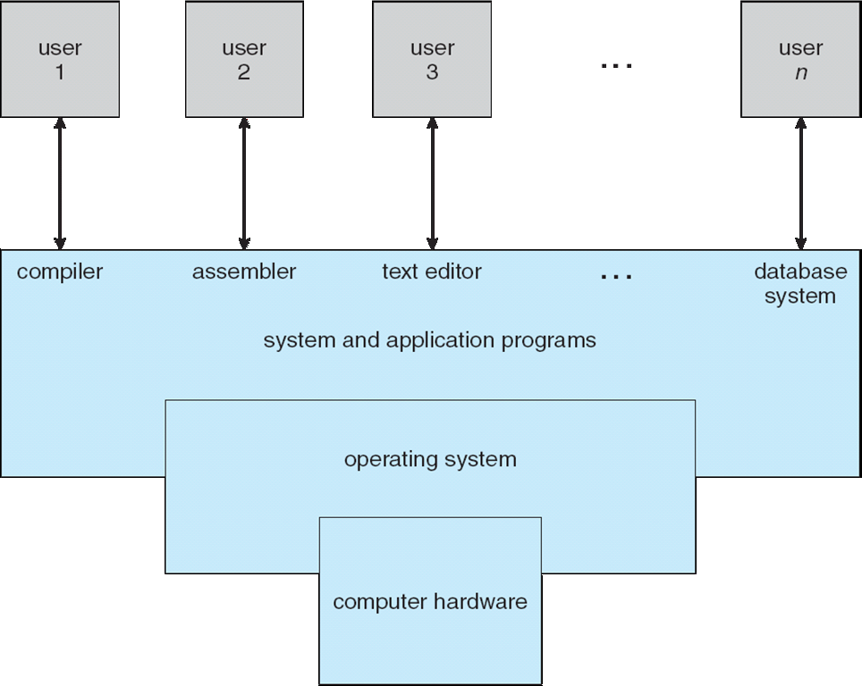
Four Components of a Computer System:
9
Notes:
9
9
9
9
9
9
9

Slide 10
Computer System Structure
Computer system can be divided into four components:
Hardware – provides basic computing resources
CPU, memory, I/O devices
Operating system
Controls and coordinates use of hardware among various applications and users
Application programs – define the ways in which the system resources are used to solve the computing problems of the users
Word processors, compilers, web browsers, database systems, video games
Users
People, machines, other computers
10
Notes:
10
10
10
10
10
10
10

Slide 11
Operating System (OS)
Integrated set of programs that controls the resources of a computer system
Provides its users with an interface which is more convenient to use than bare machine
Directly sits on top of the hardware and controls it
Manages computer hardware
Provides a basis for application programs
Acts as an intermediary between computer user and computer hardware
11
Notes:
11
11
11

Slide 12
Introduction
“An operating system is similar to a government. Like a government, it performs no useful function by itself. It simply provides an environment within which other programs can do useful work”
“The fundamental goal of computer systems is to execute user programs and to make solving user problems easier”
12
Notes:
12
12
Suppose we had two programs, running on the bare hardware which by themselves accomplished different user goals. There would likely be much shared code across the two– e.g., managing memory, accessing disk, accessing graphical displays. An OS collects this software into one place.

Slide 13
Views of an Operating System
Resource Allocator
Operating system manages or allocates resources
What resources?
CPU time, RAM Memory, disk & other I/O devices, interrupt numbers (IRQ’s), files, network ports & sockets, and other software resources
Who uses the resources?
Resource users: One or more user processes & threads
Control Program
Operation and control of hardware devices
Implements security and protection
Execution of user program to prevent errors and prevent improper use of the computer
13
Notes:
13
13

Slide 14
Goals of an OS
Execute user programs and make solving user problems easier
Make the computer system convenient to use
Use the computer resources in an efficient manner
Ability to evolve
Can you think of reasons which make evolution necessary?
H/W changes, new services, fixes
Different design goals for different OS
Mainframes, PC, Handheld
14
Notes:
14
14
14
Hardware changes
New services
Fixes
14

Slide 15
The Role of an OS
A computer is a set of resources for the movement, storage, and processing of data.
The OS is responsible for managing these resources.
15
Notes:
15
15
15
15
15
15

Slide 16
Operating System as Software
The OS functions in the same way as an ordinary computer software
It is a program that is executed by the CPU
The OS frequently relinquishes control and must depend on the processor to allow it to regain control.
16
Notes:
16
16
16
16
16
16
The OS functions in the same way as ordinary computer software;
It is a program or suite of programs executed by the processor.
The OS frequently relinquishes control and must depend on the processor to allow it to regain control.
16

Slide 17
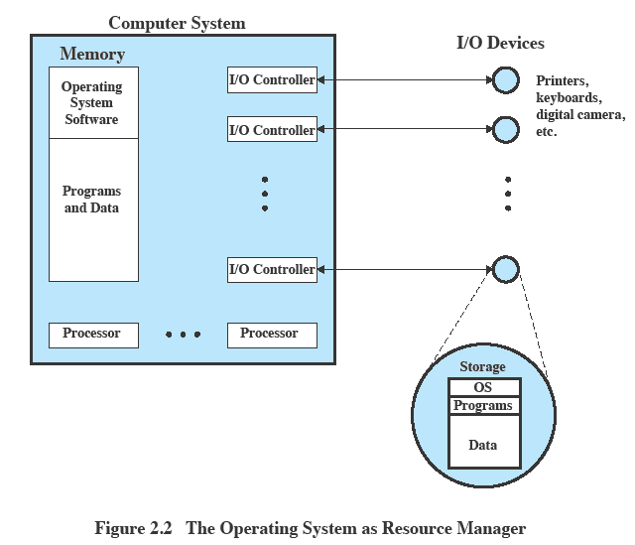
OS as Resource Manager
17
Notes:
17
17
17
17
17
17
17

Slide 18
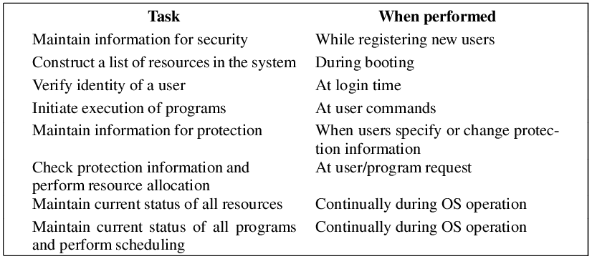
Common Tasks by OS
18
Notes:
18
18
18

Slide 19
Basic function of OS:
Process Management
Main memory management
Secondary storage management
I/O Subsystem Management
File Management
19
Notes:
19
19
19
19
19
19
19

Slide 20
1. Process Management
A process is a program in execution. It is a unit of work within the system. Program is a passive entity, process is an active entity.
Process needs resources to accomplish its task
CPU, memory, I/O, files
Initialization data
Process termination requires reclaim of any reusable resources
Single-threaded process has one program counter specifying location of next instruction to execute
Process executes instructions sequentially, one at a time, until completion
Multi-threaded process has one program counter per thread
Typically system has many processes, some user, some operating system running concurrently on one or more CPUs
Concurrency by multiplexing the CPUs among the processes / threads
20
Notes:
20
20
20
20
20
20
20

Slide 21
Process Management Activities
The operating system is responsible for the following activities in connection with process management:
Creating and deleting both user and system processes
Suspending and resuming processes
Providing mechanisms for process synchronization
Providing mechanisms for process communication
Providing mechanisms for deadlock handling
21
Notes:
21
21
21
21
21
21
21

Slide 22
2. Main Memory Management
Main memory -array of words/bytes
All data in memory before and after processing
All instructions in memory in order to execute
Memory management determines what is in memory when
Optimizing CPU utilization and computer response to users
Memory management activities
Keeping track of which parts of memory are currently being used and by whom
Deciding which processes (or parts thereof) and data to move into and out of memory
Allocating and deallocating memory space as needed
22
Notes:
22
22
22
22
22
22
22

Slide 23
3. Secondary Storage Management
Main memory is small and volatile
Secondary storage is large and nonvolatile
OS activities related to disk management include
Free space management
Storage allocation
Disk scheduling
23
Notes:
23
23
23
23
23
23
23

Slide 24
4. I/O Subsystem management
One purpose of OS is to hide peculiarities of hardware devices from the user
I/O subsystem responsible for
Memory management of I/O including
buffering (storing data temporarily while it is being transferred),
caching (storing parts of data in faster storage for performance),
spooling (the overlapping of output of one job with input of other jobs)
General device-driver interface
Drivers for specific hardware devices
24
Notes:
24
24
24
24
24
24
24

Slide 25
5. File Management
OS provides uniform, logical view of information storage
Abstracts physical properties to logical storage unit - file
Each medium is controlled by device (i.e., disk drive, tape drive)
Varying properties include access speed, capacity, data-transfer rate, access method (sequential or random)
File-System management
Files usually organized into directories
25
Notes:
25
25
25
25
25
25
25

Slide 26
FS Management Activities
Creating and deleting files
Creating and deleting directories
Supporting primitives for manipulating files and directories
Mapping files onto secondary storage
Backing up files on stable (non-volatile) storage media
i
Notes:
26
26
26

Slide 27
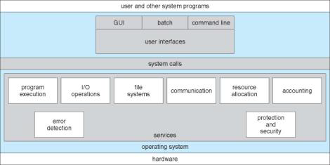
OS Services
A view of OS services
27
Notes:
27
27
27

Slide 28
Operating System Services
Operating-system provides certain services to programs and users of that program.(For convenience of programmers)
User interface - Almost all operating systems have a user interface (UI)
Varies between Command-Line (CLI), Graphics User Interface (GUI), Batch
Program execution - The system must be able to load a program into memory and to run that program & end execution, either normally or abnormally (indicating error)
I/O operations - A running program may require I/O, which may involve a file or an I/O device
For protection & security IO done by OS not by user
28
Notes:
28
28
28
28
28
28
28
28

Slide 29
Operating System Services (Cont)
File-system manipulation - The file system is of particular interest. Obviously, programs need to read and write files and directories, create and delete them, search them, list file Information, permission management.
Communications – Processes may exchange information, on the same computer or between computers over a network
Communications may be via shared memory(Tightly coupled system) or through message passing(Loosely coupled system) packets moved by the OS
29
Notes:
29
29
29
29
29
29
29
29

Slide 30
Operating System Services (Cont)
Error detection – OS needs to be constantly aware of possible errors
May occur in the CPU and memory hardware(memory error,power failure)
In I/O devices(connection failure in n/w)
In user program(access to illegal memory, arithmetic overflow)
For each type of error, OS should take the appropriate action to ensure correct and consistent computing.
Debugging facilities can greatly enhance the user’s and programmer’s abilities to efficiently use the system
30
Notes:
30
30
30
30
30
30
30
30

Slide 31
Operating System Services (Cont)
Another set of OS functions exists for ensuring the efficient operation of the system itself via resource sharing
Resource allocation - When multiple users or multiple jobs running concurrently, resources must be allocated to each of them
Many types of resources - Some (such as CPU cycles, main memory, and file storage) may have special allocation code, others (such as I/O devices) may have general request and release code
Accounting - To keep track of which users use how much and what kinds of computer resources
31
Notes:
31
31
31
31
31
31
31
31

Slide 32
Operating System Services (Cont)
Protection and security - The owners of information stored in a multiuser or networked computer system may want to control use of that information, concurrent processes should not interfere with each other
Protection involves ensuring that all access to system resources is controlled
Security of the system from outsiders requires user authentication(password) , defending external I/O devices modem,NIC from invalid access attempts
32
Notes:
32
32
32
32
32
32
32
32

Slide 33
User – OS Interface
GUI
Graphical User Interface
Desktop, icons, mouse
CLI
Command Line Interface
Allows direct command entry
Sometimes implemented in kernel, sometimes by systems program
Command interpreter
Windows: Command shell
UNIX/LINUX: Terminal – bash, ksh, csh: shells
Built-in commands vs external commands
Notes:
33
33
33

Slide 34
Protection and Control
Ensuring proper operation of the operating system, and programs
Examples
(a) only certain users can access certain files;
(b) restricted access to operating system parts of RAM;
(c) restrictions about which instructions can be executed by applications;
(d) restricted access to RAM of other processes
34
Notes:
34

Slide 35
Protection
A main way that modern operating systems provide protection is through use of dual-mode hardware features
User-mode & kernel mode
Hardware boots in kernel mode; switches to user-mode when running user processes
System call or interrupt enables switch back to kernel mode
35
Notes:
35
35

Slide 36

Protection modes
User mode
limited access to RAM memory; just the memory of a single program running
limited access to machine instructions; illegal to execute I/O instructions, interrupt management instructions and some others
kernel mode
access to all RAM memory
access to all machine instructions
User vs. kernel mode implemented as a bit in CPU
36
Notes:
36
36

Slide 37
So, if we have these protection modes, how does a process gain access to the OS?
How can a user process request an operation or function be carried out by the operating system?
37
Notes:
37

Slide 38
System Calls
User programs are not allowed to access system resources directly. They must ask the OS to do that for them.
OS provides a set of functions that can be called by user programs to request for OS services. These functions are called “system calls”
System calls run in kernel mode.
They can be called by executing a special instruction (trap or software interrupt) which causes processor to switch to the kernel mode and jump to a previously defined location in the kernel.
When the system call finishes, processor returns to the user program and runs in user mode.
38
Notes:
38
38
38
38
38

Slide 39
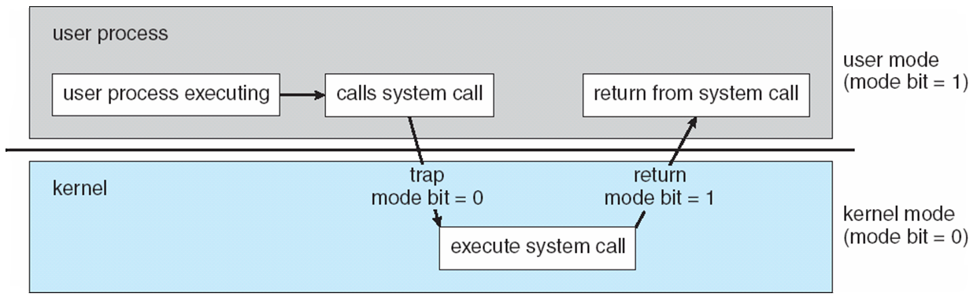
Dual Mode Operation
Figure : Transition from User to Kernel Mode
Kernel mode is also called Supervisor mode
Notes:
39

Slide 40
System Calls
System calls provide the interface between a running program and the operating system.
Generally available as assembly-language instructions.
Languages defined to replace assembly language for systems programming allow system calls to be made directly (e.g., C, C++)
Mostly accessed by programs via a high-level Application Program Interface (API) rather than direct system call use.
Three most common APIs are Win32 API for Windows, POSIX API for POSIX-based systems (including virtually all versions of UNIX, Linux, and Mac OS X), and Java API for the Java virtual machine (JVM)
Why use APIs rather than system calls?
40
Notes:
40
40
40
40
40
40
40
40

Slide 41
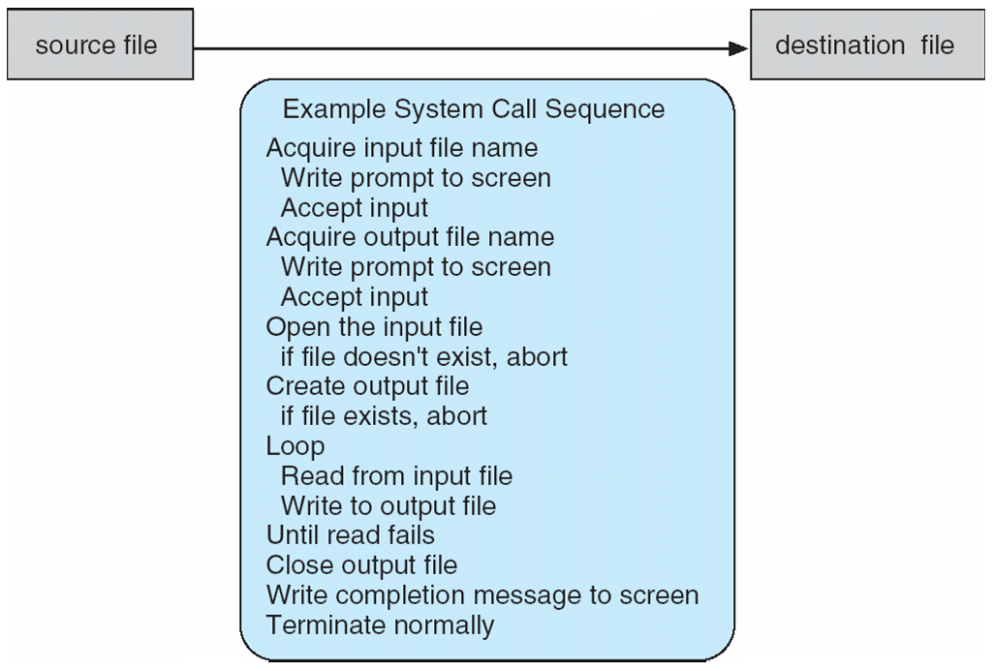
Example of System Calls
System call sequence to copy the contents of one file to another file
How system calls are used
41
Notes:
41
41
41
41
41
41
41
41

Slide 42
API
An API is a set of functions provided by an operating system or other system software.
An application program calls the functions to request the services.
An API clearly defines how to call functions and what the results are. (API is specification, not implementation)
Examples: APIs for file system, graphics user interface, networking, etc
42
Notes:
42
42
42

Slide 43
Advantages of using APIs
1. Portability: User programs that follow the API’s definition are portable.
2. An API can provide a common interface for different implementations of a service.
For example, the UNIX file system API is the same for all kinds of devices.
3. Using an API allows upgrading system software without changing user programs
4. APIs are faster than system call as there is no need of mode switch.
43
Notes:
43
43
43
43
43
43

Slide 44
System Call Implementation
Typically, a number associated with each system call
System-call interface maintains a table indexed according to these numbers
The system call interface invokes intended system call in OS kernel and returns status of the system call and any return values
The caller need know nothing about how the system call is implemented
Just needs to obey API and understand what OS will do as a result call
Most details of OS interface hidden from programmer by API
Managed by run-time support library (set of functions built into libraries included with compiler)
44
Notes:
44
44
44
44
44
44
44
44

Slide 45
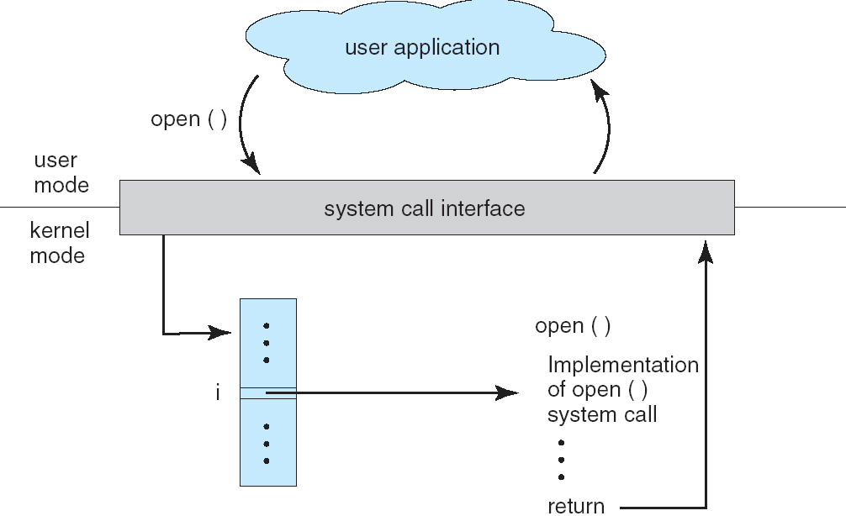
API – System Call – OS Relationship
45
Notes:
45
45
45
45
45
45
45
45

Slide 46
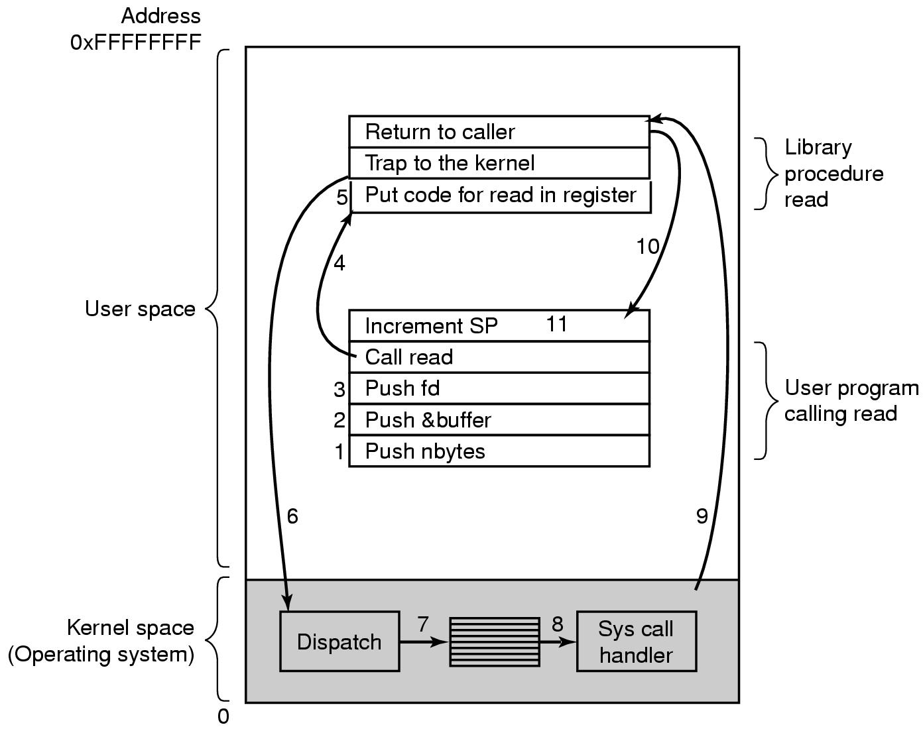
Steps in Making a System Call
There are 11 steps in making the system call
count=read (fd, buffer, nbytes)
46
Notes:
46
46
46
46
46
46

Slide 47
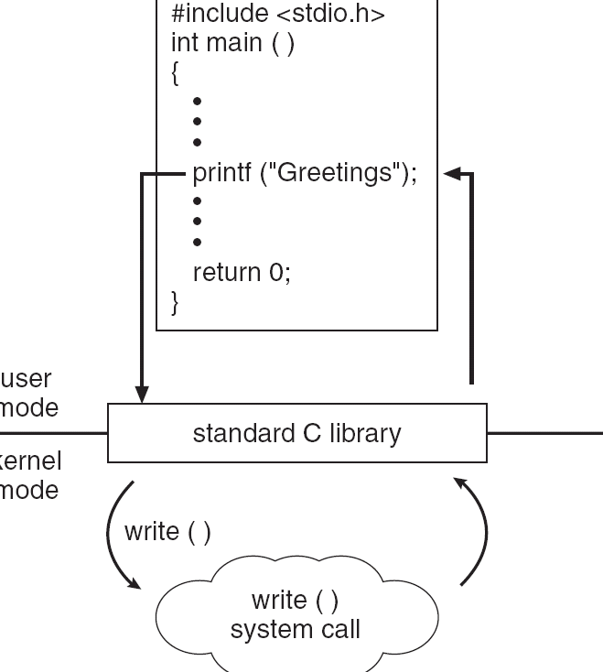
Standard C Library Example
C program invoking printf() library call, which calls write() system call
47
Notes:
47
47
47
47
47
47
47
47

Slide 48
System Call Parameter Passing
Often, more information is required than simply identity of desired system call
Exact type and amount of information vary according to OS and call
Three general methods used to pass parameters to the OS
Simplest: pass the parameters in registers
In some cases, may be more parameters than registers
Parameters stored in a block, or table, in memory, and address of block passed as a parameter in a register
This approach taken by Linux and Solaris
Parameters placed, or pushed, onto the stack by the program and popped off the stack by the operating system
Block and stack methods do not limit the number or length of parameters being passed
48
Notes:
48
48
48
48
48
48
48
48

Slide 49
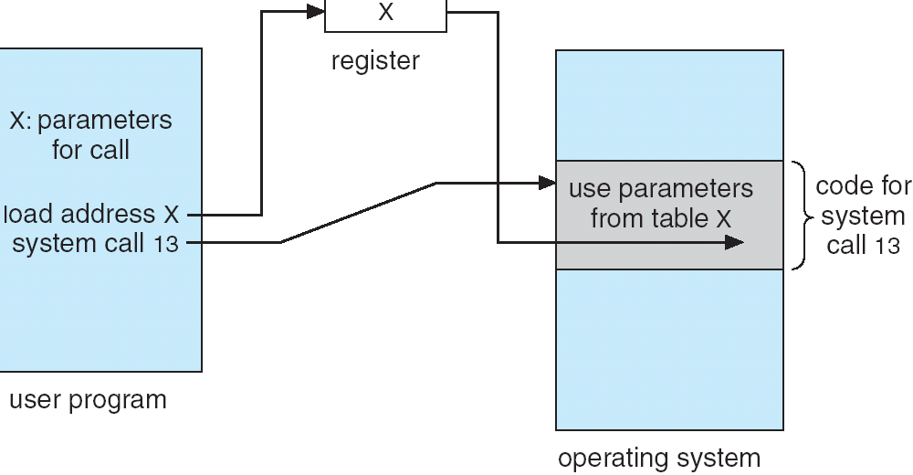
Parameter Passing via Table
49
Notes:
49
49
49
49
49
49
49
49

Slide 50
Types of System Calls
Process control
File management
Device management
Information maintenance
Communications
Protection
50
Notes:
50
50
50
50
50
50
50
50

Slide 51
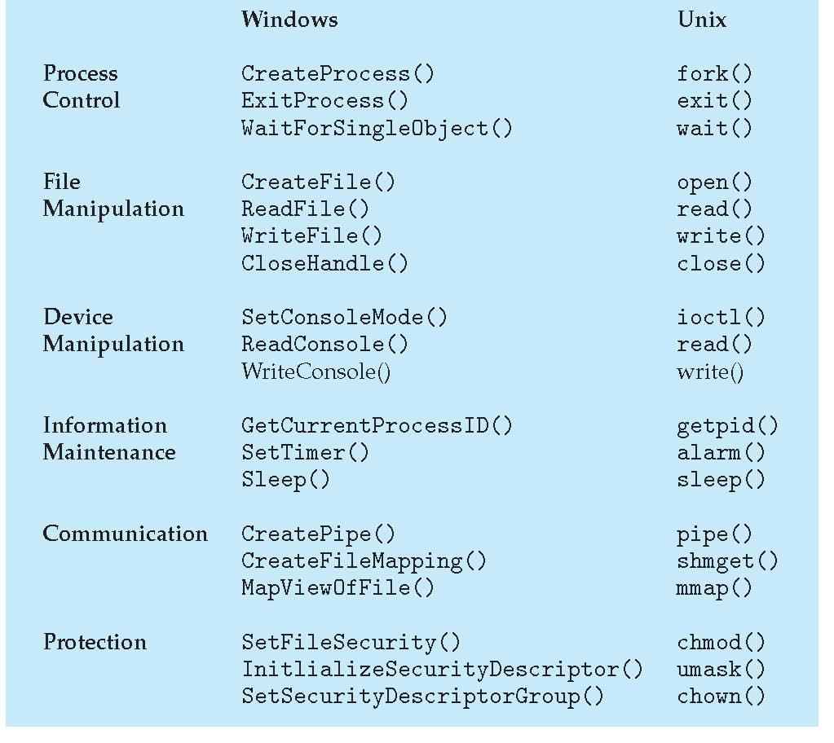
Examples of Windows and Unix System Calls
51
Notes:
51
51
51
51
51
51
51

Slide 52
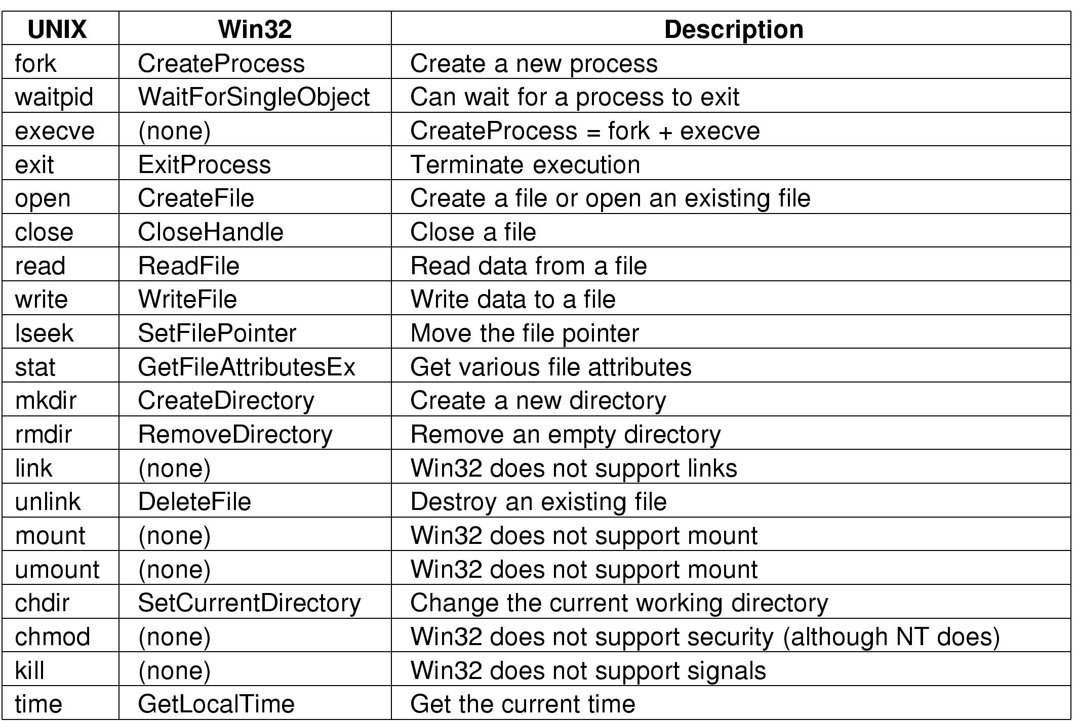
Notes:
52
52
52
52
52
52

Slide 53
Differences between library functions and system calls
System calls run in kernel-mode but library functions run in user-mode and may call system calls.
System calls are not linked to user programs.
There are only a small number of system calls.
53
Notes:
53
53
53
53
53
53

Slide 54
Types of Operating System:
08/06/11
54
Notes:
54
54
54

Slide 55
1.Batch OS
First OS
Developed around mid 1950s by GM
IBSYS had become quite famous by early 1960s
Special piece of software called monitor
User submits the job on cards or tape to a computer operator who batches the job together sequentially and places the entire batch on an input device for use by the monitor
Monitor loads one job, executes it, then loads the next and so on
55
Notes:
55
55
55

Slide 56
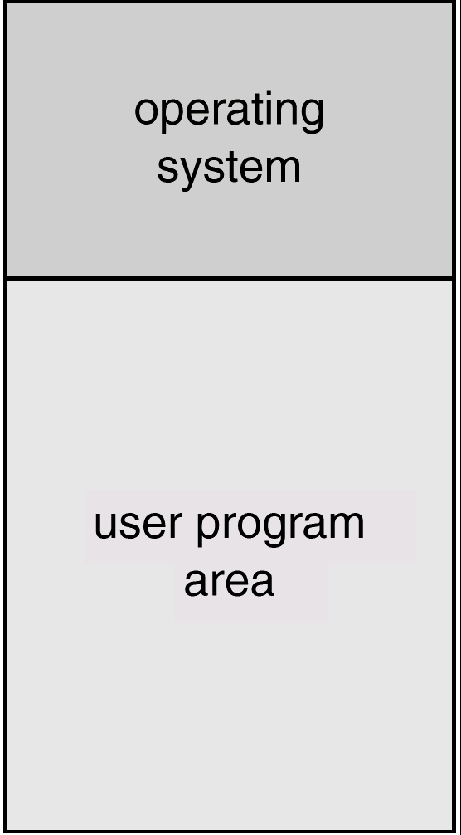
Batch Systems:
Memory Layout for a Simple Batch System
56
Notes:
56
56
56
56
56
56
56

Slide 57
Batch OS
Monitor controls sequence of events
Must always be in memory and available for execution
Called resident monitor
Rest of the monitor is utilities loaded as subroutines when required
Executes in kernel mode (contrast with user mode)
Job is placed in user program area and control is passed to it
Upon completion, the job returns the control to the monitor which proceeds with reading the next job
Results of each job are sent to an output device
JCL: Job Control Language – meta instructions
57
Notes:
57
57
57

Slide 58
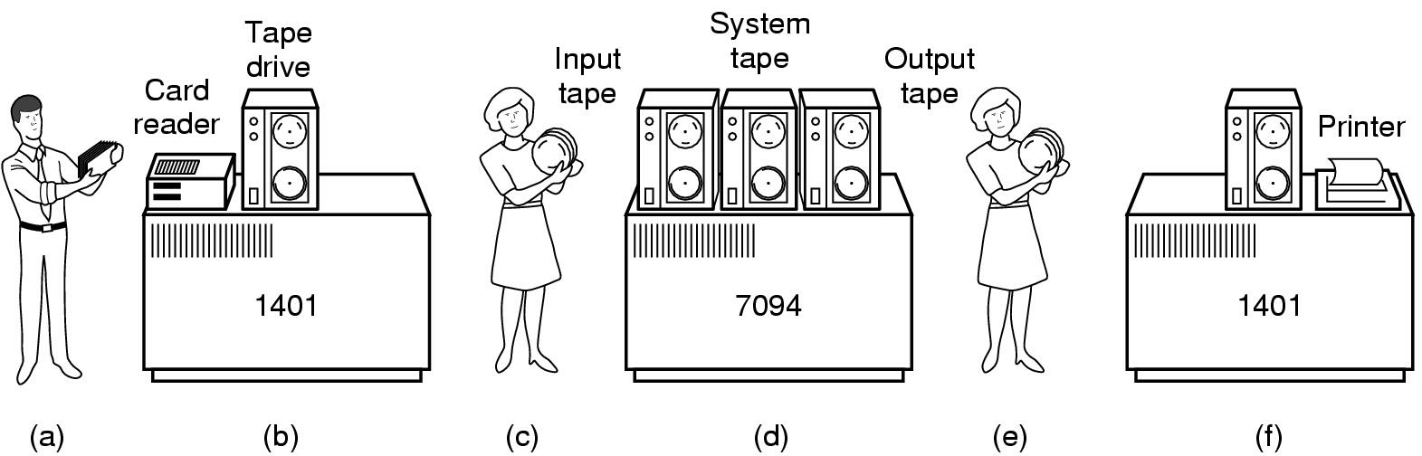
Batch Systems:
Bring cards to 1401
Read cards onto input tape
Put input tape on 7094
Perform the computation, writing results to output tape
Put output tape on 1401, which prints output
58
Notes:
58
58
58
58
58
58
58

Slide 59
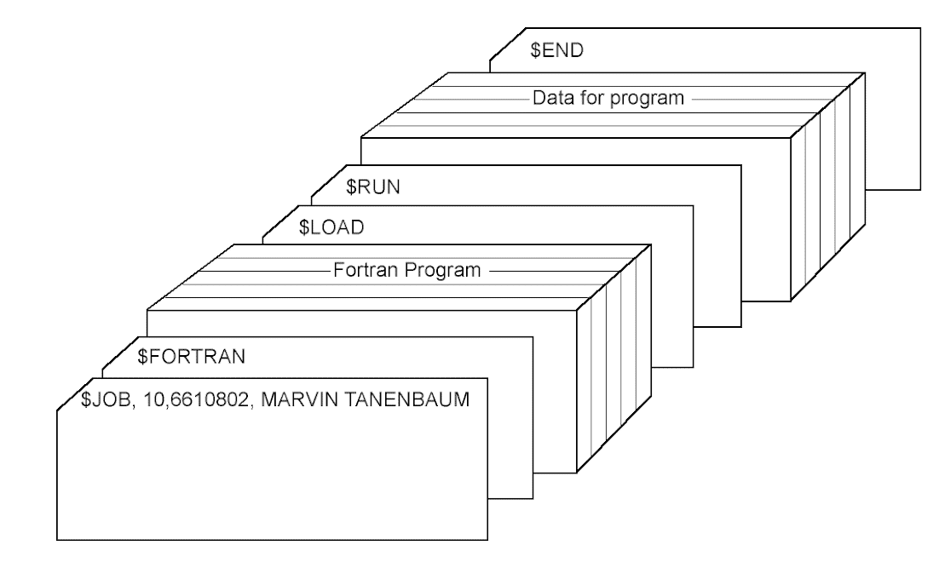
Batch Systems:
Structure of a typical FMS job
Issues
CPU idle during I/O operations
CPU time is wasted; CPU utilization is low
59
Notes:
59
59
59
59
59

Slide 60
2. Multiprogramming Systems:
Job 3
Multiple jobs in memory
Protected from one another
Operating system protected from each job as well
Resources (time, hardware) split between jobs
Still not interactive
User submits job
Computer runs it
User gets results minutes (hours, days) later
Job 2
Memory partitions
Job 1
Operating system
Increases CPU utilization
Job pool-jobs waiting on disk for allocation into memory
Job scheduling-selection of job from pool
CPU scheduling
60
Notes:
60
60
60
60
60
60
60

Slide 61

Uniprogramming
Processor must wait for I/O instruction to complete before preceding
61
Notes:
61
61
61
61

Slide 62
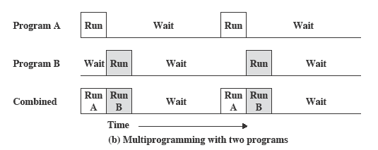
Multiprogramming
When one job needs to wait for I/O, the processor can switch to the other job
62
Notes:
62
62
62
62

Slide 63
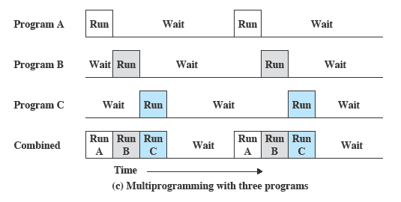
Multiprogramming
It is the central theme of modern operating systems
63
Notes:
63
63
63
63

Slide 64
3. Time-sharing or Multitasking:
Fast CPU switching between programs : Idea is to give a feeling of concurrency
CPU switches to another program
When current program blocks
When its currently allocated CPU time-interval ends
Also called multitasking
logical extension in which CPU switches jobs so frequently that users can interact with each job while it is running, creating interactive computing
Response time should be < 1 second
Each user has at least one program executing in memory process
If several jobs ready to run at the same time CPU scheduling
If processes don’t fit in memory, swapping moves them in and out to run
Virtual memory allows execution of processes not completely in memory
64
Notes:
64
64
64
64
64
64
64

Slide 65
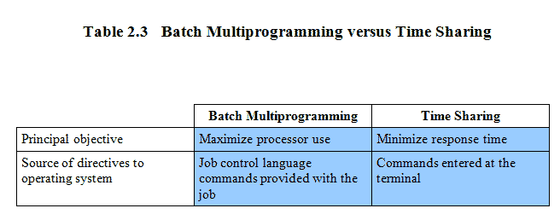
Batch Multiprogramming versus Time Sharing
65
Notes:
65
65
65
65

Slide 66
4. Parallel System/Multiprocessor/Tightly coupled:
As like multiprocessor system have more than one processors in close communication ,sharing the computer, bus clock & sometimes memory & peripheral devices.
Referred to as tightly coupled system.
Advantage
1. Throughput: get more work done in less time, Increases throughput
2. Economical :It saves money because process can share peripherals, mass storage and power supply.
3. Increases the reliability: Ability to continue providing service proportional to the level of surviving hardware -graceful degradation -> fault tolerant
66
Notes:
66
66
66
66
66
66
66

Slide 67
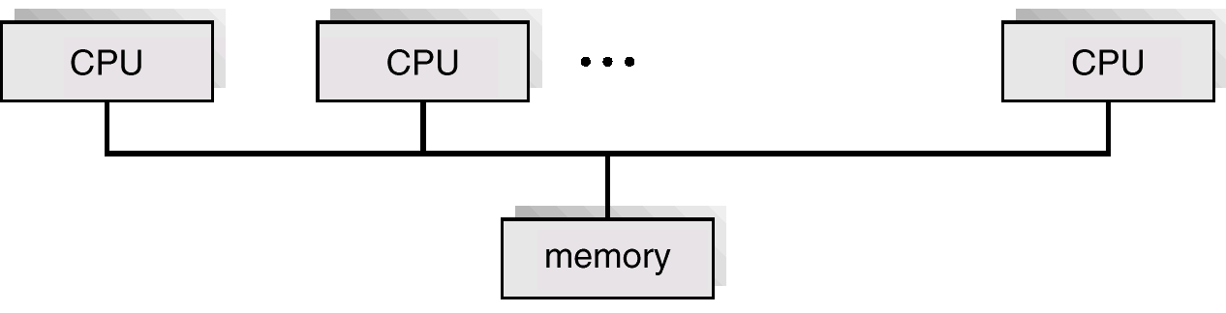
4. Parallel System:
Peer processors
Symmetric multiprocessing (SMP)
Each processor runs an identical copy of the operating system.
Many processes can run at once without performance drop.
Most modern operating systems support SMP.
Ex: Solaries 5,Win2000
Asymmetric multiprocessing
Each processor is assigned a specific task; master processor schedules and allocated work to slave processors.
More common in extremely large systems
Ex: Solaries 4,
67
Notes:
67
67
67
67
67
67
67

Slide 68


5. Distributed System
A distributed system is:
A collection of independent computers that appears to its users as a single coherent system.
68
Notes:
68
68
68
68
68
68

Slide 69

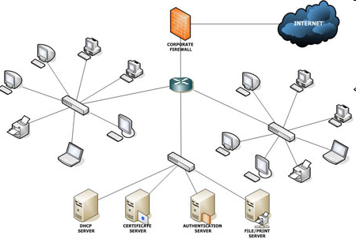
5. Distributed System
A collection of heterogeneous nodes connected by one or more interconnection networks which provides access to system-wide shared resources and services.
More than one physical computer, each consisting of CPUs, local memory, and possibly stable storage, and I/O paths to connect it with the environment.
Interconnections: The processors communicate with one another through various communication lines such as high speed buses or telephone lines.
Also known as loosely coupled system.
EX: Internet LAN
69
69
Notes:
69
69
69
69
69
69
69

Slide 70
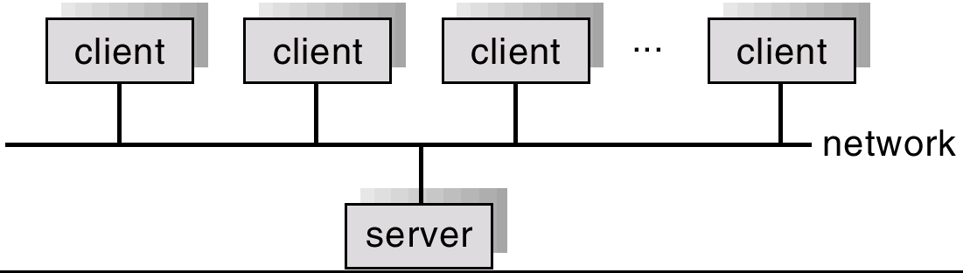
CPU
CPU
CPU
5. Distributed System
Advantages of distributed systems.
Resources Sharing
Computation speed up – load sharing
Reliability
Communications
Requires networking infrastructure.
Ex: Local area networks (LAN) or Wide area networks (WAN)
May be either client-server or peer-to-peer systems
Memory
Memory
Memory
General Structure of Client-Server
70
Notes:
70
70
70
70
70
70
70

Slide 71
6. Real-time OS.:
Often used as a control device in a dedicated application such as controlling scientific experiments, medical imaging systems, industrial control systems, and some display systems.
Well-defined fixed-time constraints.
Ex: Scientific experiments, home appliances
Real-Time systems may be either hard or soft real-time
71
Notes:
71
71
71
71
71
71
71

Slide 72
6. Real-time OS.:
Real-Time systems may be either hard or soft real-time
Hard real-time:
Secondary storage limited or absent, data stored in short term memory, or read-only memory (ROM)
Conflicts with time-sharing systems, not supported by general-purpose operating systems.
Time constraints can be not be relaxed.
Soft real-time
Limited utility in industrial control of robotics
Useful in applications (multimedia, virtual reality) requiring advanced operating-system features.
Time constraints can be relaxed.
72
Notes:
72
72
72
72
72
72
72

Slide 73
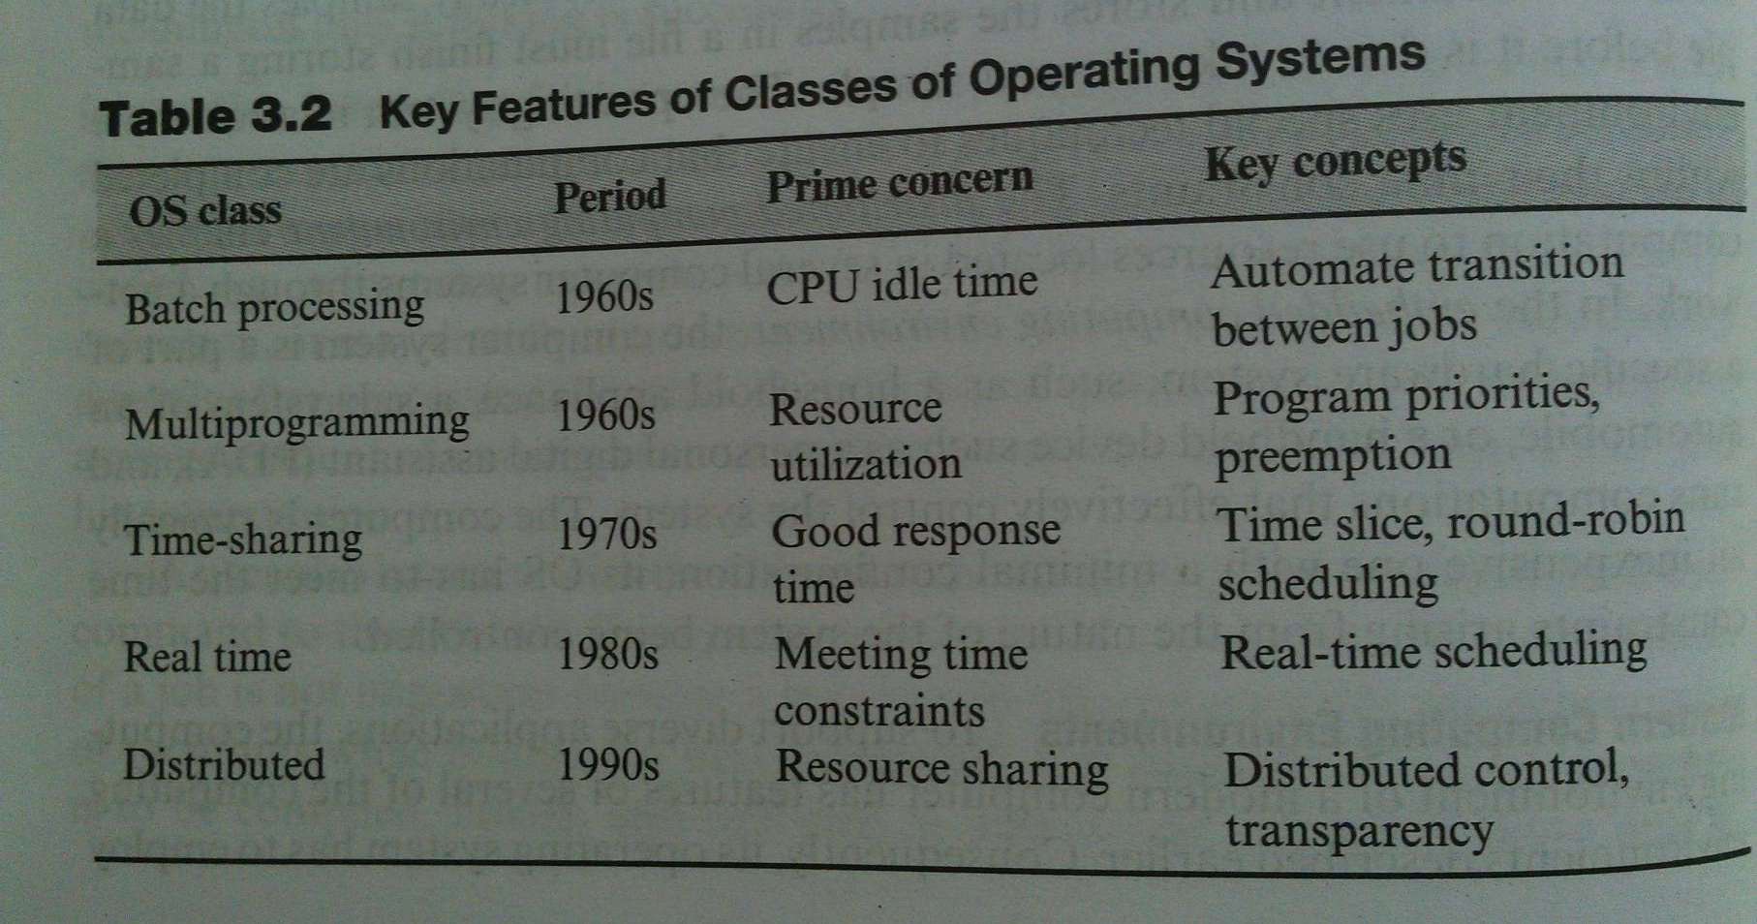
Classes of OS - Summary
73
Notes:
73
73
73

Slide 74
OS Structures
Monolithic
Layered
Ringed
Virtual Machines ,Hypervisor
Exo kernels
Client Server Systems and Microkernels
Notes:
74

Slide 75
OS Structure
The OS (a simplified view)
Command Interpreter
Information Services
Error Handling
Accounting System
File System
Protection System
Memory Management
Secondary Storage Management
Process Management
I/O System
Hardware
75
Notes:
75
75
75

Slide 76
OS Structure
An OS consists of all of these components, plus lots of others, plus system service routines, plus system programs (privileged and non-privileged), plus ....
The big issue:
how do we organize all of this?
what are the entities and where do they exist?
how does these entities cooperate?
Basically, how do we build a complex system that’s:
performance
reliable
extensible
76
Notes:
76
76
76

Slide 77
Monolithic system
“The Big mess”
Every component contained in kernel
direct communication among all elements
highly efficient
Traditionally, systems such as Unix were built as a monolithic kernel:
user programs
file system, virtual memory, I/O drivers, process control, system services, swapping, networks, protection, interrupt handling, windows, accounting, ...
OS kernel
everything
hardware
77
Notes:
77
77
77

Slide 78
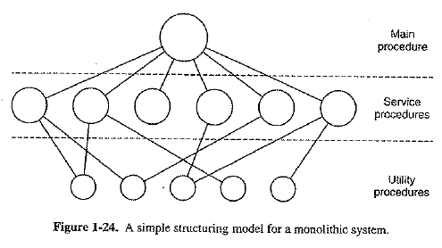
Monolithic system
Monolithic Systems
Entire OS runs as a single program in kernel mode
Examples: UNIX, LINUX, DOS, Windows 9x
System call/procedure
Fetch data from user prog.
78
Notes:
78
78
78

Slide 79
Monolithic system
Problems with monolithic kernels:
hard to understand
hard to modify
unreliable: a bug anywhere causes a system crash
hard to maintain
Since the beginnings of OS design, people have wanted ways to organize the OS to simplify its design and construction.
79
Notes:
79
79
79

Slide 80
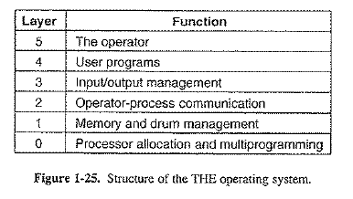
Layered system
Layered Systems
Generalization of previous approach
OS constructed as hierarchy of layers
The first description of this approach was Dijkstra’s THE system.
Layers in THE system
80
Notes:
80
80
80

Slide 81
Layered system
Traditional approach is layering
Groups components that perform similar functions into layers
Each layer communicates only with adjacent layer
System calls might pass through many layers before completion
layer 3
layer 2
layer 1 interface
layer 1
layer 0 “virtual machine”interface
layer 0
hardware arch. interface
hardware
81
Notes:
81
81
81

Slide 82
Layered system
Problems with Layering
Systems must be hierarchical, but real systems are more complex than that, e.g.,
file system would like to be a process layered on VM
VM would like to use files for its backing store I/O
Approach is not flexible.
Often has poor performance due to layer crossings.
Systems are often modelled as layered structures but not built that way (for better or worse).
82
Notes:
82
82
82

Slide 83
Virtual Machines
OS/360 -> batch system->time sharing
First example: VM/370
 Virtual machine monitor runs on bare hardware and does multi programming providing several virtual machines to next layer up
 These virtual machines are exact copies of bare hardware
 Can run any OS .
Notes:
83

Slide 84
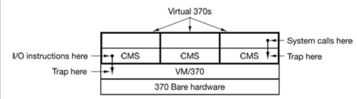
Virtual Machines
CMS: Conversational Monitor System
Uses
○ Different Oss can now serve different specific purposes
○ Running old MS-DOS programs (16 bit) on 32 bit or 64 bit Windows
○ Running Java Programs in JVM
Structure of VM/370 with CMS
Notes:
84

Slide 85
Virtual Machines
A virtual machine takes the layered approach to its logical conclusion.
It treats hardware and the operating system kernel as though they were all hardware.
The operating system host creates the illusion that a process has its own processor and (virtual memory).
A virtual machine provides an interface identical to the underlying bare hardware.
Each guest provided with a (virtual) copy of underlying computer.
85
Notes:
85
85
85
85

Slide 86
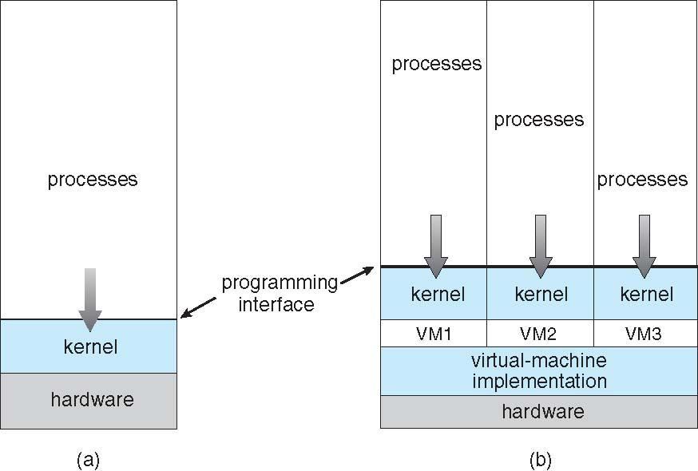
Virtual Machines (Cont.)
(a) Nonvirtual machine (b) virtual machine
86
Notes:
86
86
86
86

Slide 87
Microkernel
Moves as much from the kernel into “user” space.
Communication takes place between user modules using message passing
First microkernel system was Hydra (CMU, 1970)
Examples of microkernel systems are the CMU Mach system, Chorus (French Unix-like system), and in some ways Microsoft NT/Windows.
Benefits:
Easier to extend a microkernel
Easier to port the operating system to new architectures
More reliable (less code is running in kernel mode)
More secure
Limitation:
Performance overhead of user space to kernel space communication
87
Notes:
87
87
87

Slide 88
Microkernel
user processes
user mode
file system
high-level scheduling
system processes
thread system
external paging
network support
communication
microkernel
low-level VM
processor control
kernel mode
protection
hardware
Microkernel System Structure
88
Notes:
88
88
88

Slide 89
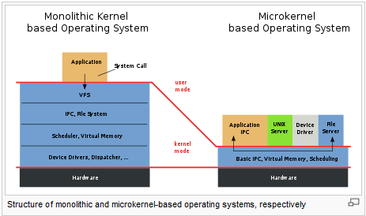
Monolithic vs Microkernel
89
Notes:
89
89
89

Slide 90
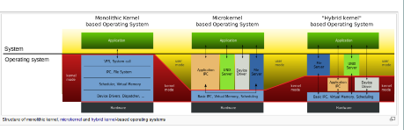
Microkernel
Notes:
90

