Slide 1

Department of Computer Science and Engineering
Major Project Progress Seminar-I
AI-Based – Smart Adaptive Network for Community Assistance, Local Communication & Public Safety
Group-24: AYUSH KATHOTE
Sarthak Mahore | Pruthviraj Gawande | Taha Saifee | Vedant Malode
Project Guide – Prof. Mohammad Sajid
Session: 2026–2027
Project Incharge
Prof. Tejas Dhule
HoD
Dr. S. Zade
Notes:
Introduce the project and the five team members. This project is a prototype for community emergency reporting and coordination.

Slide 2

Presentation Outline
3. PROBLEM STATEMENT & OBJECTIVES 4. LITERATURE SURVEY & RESEARCH GAP 5. PROPOSED SOLUTION 6. SYSTEM ARCHITECTURE 7. TECHNOLOGY STACK & TEAM ROLES 8. HOW THE SYSTEM WORKS 9. TESTING & VALIDATION 10. RESULTS & CONCLUSION 11. REFERENCES 12. RESEARCH STATUS, SCREENSHOTS & THANK YOU (SLIDES 12–14)
Computer Science & Engineering Department
2026–2027
Group-24: AYUSH KATHOTE
Notes:
This talk explains the problem, the proposed system, how it works, and what still needs testing.

Slide 3
Problem Statement & Objectives
PROBLEM
• Reports may be missing key details or a clear location.
• Citizens, volunteers, and management need one shared response view.
• Internet access can be weak during an emergency.
OBJECTIVES
• Collect a citizen SOS with text or voice and a location.
• Give management an explainable priority suggestion.
• Help management review, match, and guide responders.
• Queue a browser report when the connection is unavailable.
Computer Science & Engineering Department
2026–2027
Group-24: AYUSH KATHOTE
Notes:
Explain that reports can miss important details. Our goals are to collect useful information, show an explainable suggestion, and support human responders.

Slide 4
Literature Survey & Research Gap
No. | Study / year | Data | Approach | Finding | Limit
1 | AIDR: AI for Disaster Response (2014) | Social media posts | Human labels + classifiers | AI can help sort crisis posts. | Posts may be noisy or unverified.
2 | CrisisMMD (2018) | Tweets and images from disasters | Labeled multimodal dataset | Supports crisis content research. | Social posts are not verified SOS reports.
3 | CrisisTransformers (2023) | Crisis-related social text | Pre-trained language models | Studies text classification for crises. | Needs models, data, and computing resources.
Research gap: connect a structured SOS, explainable triage, human review, responder matching, maps, and bounded offline support in one prototype, then evaluate it with users and phones.
Computer Science & Engineering Department
2026–2027
Group-24: AYUSH KATHOTE
Notes:
AIDR, CrisisMMD, and CrisisTransformers study crisis information, especially social media. Our project focuses on a structured local SOS workflow. It still needs evaluation.

Slide 5
Proposed Solution
One local response system connects citizens, volunteers, and management.
• Citizens send an emergency report with text or voice and a location.
• Rule-based NLP suggests a category and P0–P3 priority.
• The report shows confidence, reasons, missing details, and duplicate hints.
• Management reviews the suggestion and can change it before dispatch.
• Volunteer matching considers distance, skills, and availability.
• Maps, offline browser storage, and Android BLE support the response flow.
The system supports emergency services; it does not replace 112.
Computer Science & Engineering Department
2026–2027
Group-24: AYUSH KATHOTE
Notes:
Show that the AI only suggests. Management reviews the report and makes the dispatch decision. The project complements 112.

Slide 6
System Architecture
Citizen / Volunteer
Submit or view a report
React App + AI
Keyword triage
P0–P3 suggestion
Local Node API
REST service
JSON data store
Management Room
Review, override
and dispatch
SUPPORT COMPONENTS
Browser Offline Queue
IndexedDB stores reports
until server sync
Android BLE Relay
Unique ID • expiry • hop limit
retry • acknowledgement
GIS + Route Guide
Leaflet map • OSRM route
turn-by-turn directions
Browser queue sync and Android BLE relay are separate paths. A BLE relay acknowledgement does not mean the central server received the SOS.
Computer Science & Engineering Department
2026–2027
Group-24: AYUSH KATHOTE
Notes:
Follow the top row from the citizen report to management. The lower row shows offline and map tools. A BLE acknowledgement is not a server receipt.

Slide 7
Technology Stack & Team Roles
TECH STACK
Frontend: React, Vite, Tailwind CSS
Maps: Leaflet, OpenStreetMap, OSRM
API and data: Node.js local REST API, JSON files
Browser offline: Dexie and IndexedDB
Android relay: Java and Bluetooth Low Energy
Voice: Vosk English/Hindi; Marathi uses device or browser speech support
SIMPLE SUGGESTED TEAM ROLES
AYUSH KATHOTE — Team lead and integration
Sarthak Mahore — Frontend and citizen reporting
Pruthviraj Gawande — Backend and data handling
Taha Saifee — AI triage and volunteer matching
Vedant Malode — Maps, Android relay, and testing
Computer Science & Engineering Department
2026–2027
Group-24: AYUSH KATHOTE
Notes:
Describe the tools used. The team roles are simple suggested assignments based on the project modules; the team can adjust them.

Slide 8
How the System Works
1. A citizen selects an emergency type and adds text or a voice note.
2. The app gets a location when allowed, or the user can correct it.
3. Local keyword rules suggest a category, priority, confidence, and reason.
4. Management reviews the report and can change the AI suggestion.
5. The system ranks approved volunteers using distance, skills, and availability.
6. The map shows a route. First-aid help is guidance, and 112 stays available.
7. If offline, the browser queues a report; nearby Android apps can relay BLE packets.
8. The interface shows BLE relay and server receipt as different statuses.
Computer Science & Engineering Department
2026–2027
Group-24: AYUSH KATHOTE
Notes:
Walk through a report from entry to review and volunteer guidance. The first-aid assistant gives basic guidance and does not replace emergency services.

Slide 9
Testing & Validation
• The web application production build has completed successfully.
• Triage uses keyword rules. No accuracy benchmark was supplied.
• The browser queue and reconnect sync are implemented in the prototype.
• Native BLE code includes expiry, hop limit, retries, signatures, and acknowledgements.
• Testing on multiple Android phones, BLE range, battery use, and background limits is still needed.
• No user study or live emergency field trial results were supplied.
The prototype should be tested before use in real emergencies.
Computer Science & Engineering Department
2026–2027
Group-24: AYUSH KATHOTE
Notes:
The web build is complete, but no accuracy study or user trial result was supplied. Test BLE on real phones before making field claims.

Slide 10
Results & Conclusion
• One prototype brings citizen reporting, management review, maps, and volunteer tools together.
• AI provides an explainable suggestion; management keeps the final decision.
• Responder ranking uses distance, relevant skills, and availability.
• Browser storage and Android BLE can help when normal internet access is limited.
• BLE relay does not prove that emergency services or the central server received the SOS.
• More testing with users and real Android phones is required.
This project supports community response and complements India’s 112 emergency service.
Computer Science & Engineering Department
2026–2027
Group-24: AYUSH KATHOTE
Notes:
Summarize what is connected in the prototype. The system is not a replacement for official emergency response, and BLE delivery has limits.

Slide 11
References
[1] M. Imran et al., “AIDR: Artificial Intelligence for Disaster Response,” WWW, 2014.
[2] F. Alam, F. Ofli, and M. Imran, “CrisisMMD,” ICWSM, 2018.
[3] S. Lamsal et al., “CrisisTransformers,” 2023.
[4] React Team, React Documentation.
[5] Leaflet Team, Leaflet Reference.
[6] Project OSRM, OSRM API Documentation.
[7] Mozilla, IndexedDB API Documentation.
[8] Android Developers, Bluetooth Low Energy Overview.
[9] Government of India, Emergency Response Support System (112).
Computer Science & Engineering Department
2026–2027
Group-24: AYUSH KATHOTE
Notes:
Sources: AIDR paper https://mimran.me/papers/imran_castillo_lucas_meier_vieweg_www2014.pdf ; CrisisMMD paper https://ojs.aaai.org/index.php/ICWSM/article/download/14983/14833/18502 ; CrisisTransformers https://arxiv.org/abs/2309.05494 ; React https://react.dev/learn/installation ; Leaflet https://leafletjs.com/reference-versions.html ; OSRM https://project-osrm.org/docs/v5.5.1/api/ ; IndexedDB https://developer.mozilla.org/en-US/docs/Web/API/IndexedDB_API/ ; Android BLE https://developer.android.com/develop/connectivity/bluetooth/ble/ble-overview?authuser=29 ; official 112 https://112.gov.in/ .

Slide 12
Research & Publication Status
Activity | Title / evidence | Venue / authority | Status
Project prototype | AI-Based Smart Adaptive Network | Major Project Seminar-I | Prototype developed
Research paper | No title supplied | Not supplied | Status not confirmed
Review paper | No title supplied | Not supplied | Status not confirmed
Copyright / patent | No certificate supplied | Not supplied | Status not confirmed
Computer Science & Engineering Department
2026–2027
Group-24: AYUSH KATHOTE
Notes:
No research-paper, review-paper, copyright, or patent record was supplied for this presentation, so this slide does not claim one.

Slide 13
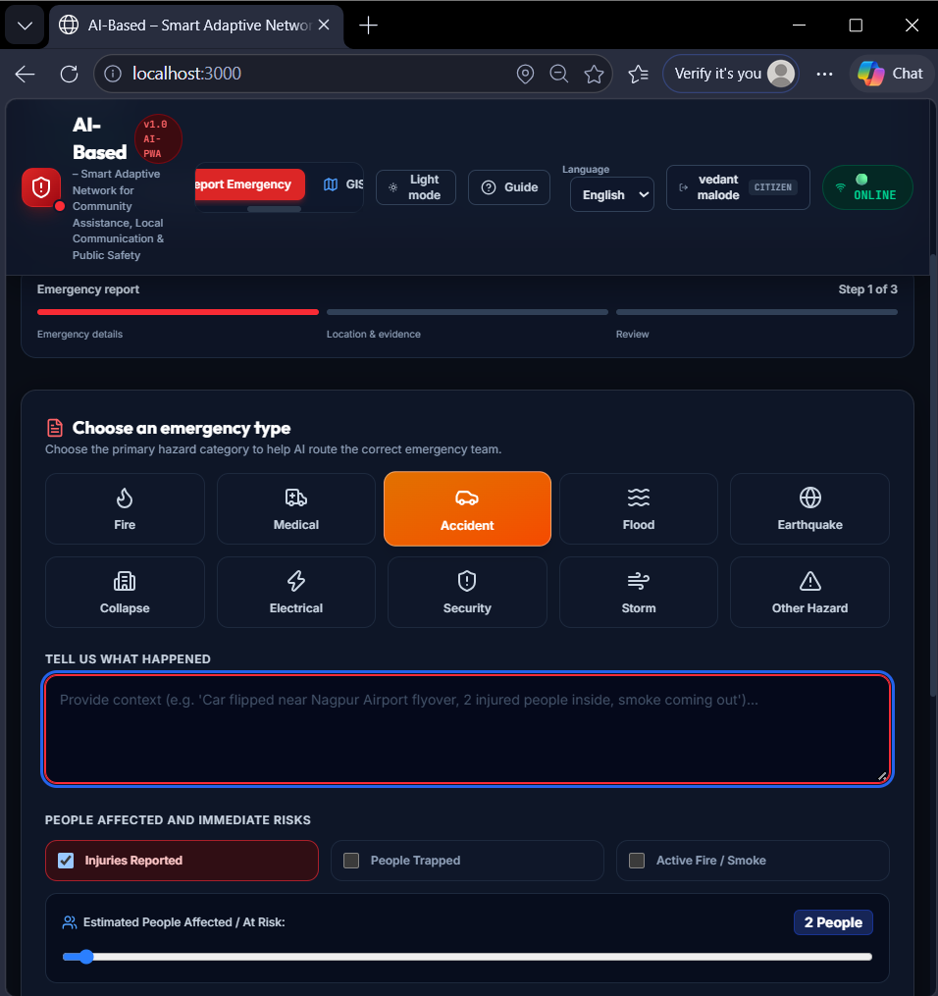
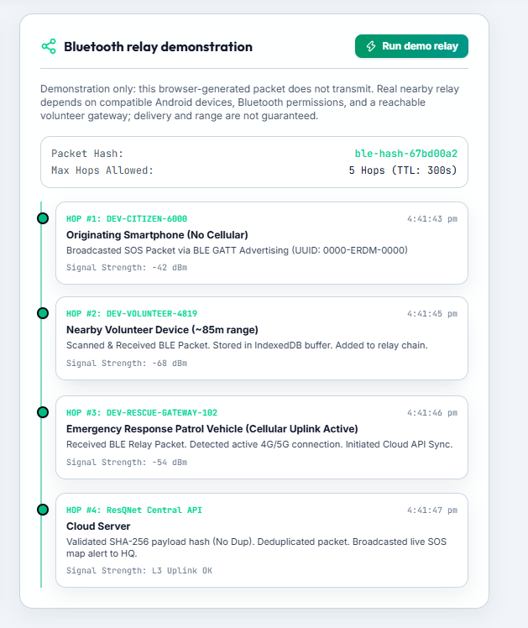
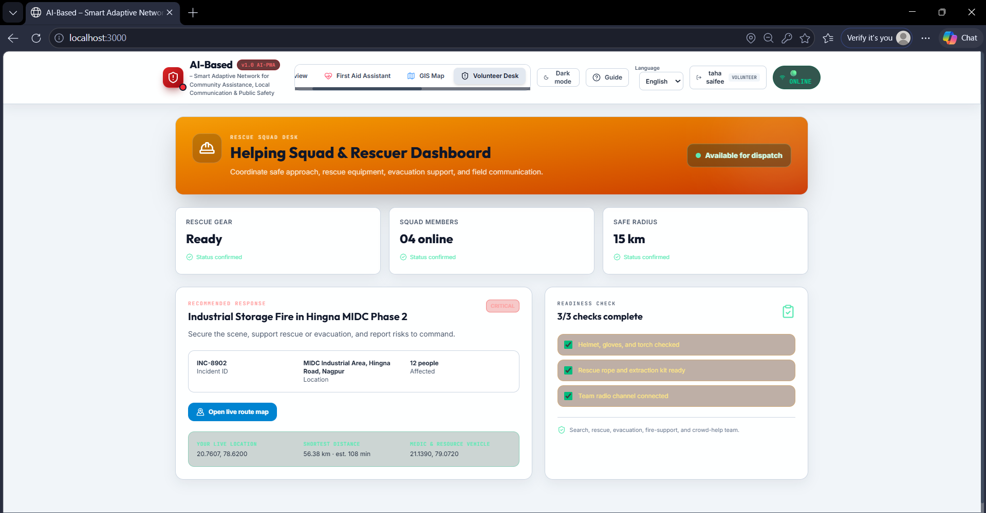
Prototype Screenshots
Citizen SOS + voice report
Volunteer route guidance
BLE relay demonstration
Screenshots show prototype screens. BLE range and delivery depend on compatible nearby Android phones and network availability.
Computer Science & Engineering Department
2026–2027
Group-24: AYUSH KATHOTE
Notes:
These screenshots show the citizen report, volunteer route, and BLE demonstration screens. The relay demo is not proof of delivery to emergency services.

Slide 14
Thank You!
Thank You!
Computer Science & Engineering Department
2026–2027
Group-24: AYUSH KATHOTE
Notes:
Thank the audience and invite questions.

