Slide 1

Department of Computer Science and Engineering
Major Project Final Progress Seminar
Group-1 : YASH RATHOD
Swarangi Rangari | Swayam Ratnaparkhi | Vedant Bombeka | Rahul Garpalliwar
Project Guide - Dr. Mahendra Makesar
Session: 2026-2027
Project Incharge
Prof. Tejas Dhule
HoD
Dr. S. Zade

Slide 2

Index
1. TITLE SLIDE 2. PROBLEM STATEMENT & OBJECTIVES 3. LITERATURE SURVEY & RESEARCH GAP 4. PROPOSED SOLUTION & NOVELTY 5. SYSTEM ARCHITECTURE / DESIGN 6. TECHNOLOGY STACK & RESOURCES 7. IMPLEMENTATION / WORKING PROJECT DEMONSTRATION 8. TESTING & VALIDATION 9. RESULT & CONCLUSION 10. REFERENCES (UPDATED) 11. RESEARCH & PUBLICATION STATUS 12. RESEARCH PUBLICATIONS, IPR & SUPPORTING EVIDENCE
Computer Science & Engineering Department
2026–2027
Group-24: AYUSH KATHOTE
Notes:
This is the index page. The slide sections follow the order in this list.

Slide 3
Problem Statement & Objectives
PROJECT: AI-Based – Smart Adaptive Network for Community Assistance, Local Communication & Public Safety
PROBLEM
• Emergency reports can arrive with missing details or unclear locations.
• Citizens, volunteers, and management need one shared response process.
• Weak internet can delay reports and coordination.
OBJECTIVES
• Collect SOS reports by text or voice and add a location.
• Suggest a priority and explain the reason and confidence.
• Let management review and override AI suggestions.
• Help match volunteers and guide them to an incident.
• Support offline browser storage and nearby Android BLE relay.
Computer Science & Engineering Department
2026–2027
Group-24: AYUSH KATHOTE
Notes:
Explain the emergency reporting problem, then introduce the project goals and team context.

Slide 4
Literature Survey & Research Gap
No. | Study / year | Data | Method | Key finding | Limit
1 | AIDR: AI for Disaster Response (2014) | Crisis social media | Human + AI classification | AI can help sort large message streams. | Posts may be noisy or unverified.
2 | CrisisMMD (2018) | Tweets and images from disasters | Labeled multimodal data | Provides crisis content for research. | Social posts are not verified SOS reports.
3 | CrisisTransformers (2023) | Crisis-related social text | Pre-trained language models | Studies text classification for crises. | Needs models, data, and computing resources.
Research gap: connect a structured SOS, explainable triage, human review, responder matching, maps, and offline support in one prototype, then evaluate it with users and phones.
Computer Science & Engineering Department
2026–2027
Group-24: AYUSH KATHOTE
Notes:
These studies explore AI and language methods for crisis information. Our gap is the end-to-end local response workflow and its evaluation.

Slide 5
Proposed Solution & Novelty
• A citizen sends an emergency report with type, description, and location.
• Rule-based NLP suggests a category and P0–P3 priority.
• The report shows confidence, reasons, missing details, and duplicate hints.
• Management checks the suggestion and can change it before dispatch.
• Volunteer matching considers skills, availability, and distance.
• Map routing, a browser retry queue, and Android BLE relay support response.
Project contribution: bring these response steps together with human approval and clear delivery states.
The prototype supports the official 112 service; it does not replace it.
Computer Science & Engineering Department
2026–2027
Group-24: AYUSH KATHOTE
Notes:
Explain that the system provides suggestions, while management makes the final dispatch decision.

Slide 6
System Architecture / Design
Citizen / Volunteer
Submit or view a report
React App + AI
Rule-based triage
P0–P3 suggestion
Local Node API
REST service
JSON data store
Management Room
Review, override
and dispatch
SUPPORT COMPONENTS
Browser Offline Queue
IndexedDB stores reports
until sync is available
Android BLE Relay
Unique ID • expiry • hop limit
retry • acknowledgement
GIS + Route Guide
Leaflet map • OSRM route
turn-by-turn directions
A nearby BLE acknowledgement does not mean the central server received the SOS.
Computer Science & Engineering Department
2026–2027
Group-24: AYUSH KATHOTE
Notes:
Follow the citizen report through AI, local API, and management. The lower row shows offline, BLE, and map components.

Slide 7
Technology Stack & Resources
TECH STACK & RESOURCES
Frontend: React, Vite, Tailwind CSS
API and storage: Node.js local REST API, JSON files
Maps: Leaflet, OpenStreetMap, OSRM routing
Browser offline queue: Dexie and IndexedDB
Android relay: Java and Bluetooth Low Energy
Voice: Vosk English/Hindi; Marathi depends on device or browser speech support
SIMPLE SUGGESTED TEAM ROLES
AYUSH KATHOTE — Team lead and integration
Sarthak Mahore — Frontend and citizen reporting
Pruthviraj Gawande — Backend and data handling
Taha Saifee — AI triage and volunteer matching
Vedant Malode — Maps, Android relay, and testing
Computer Science & Engineering Department
2026–2027
Group-24: AYUSH KATHOTE
Notes:
These are the main tools and a simple suggested split of work for the five group members.

Slide 8
Implementation / Working Project Demonstration
1. Citizen chooses a hazard and enters a text or voice description.
2. The app adds a current location or lets the user correct it.
3. AI rules show a category, priority, confidence, and reason.
4. Management reviews the report and records any override.
5. The system ranks approved volunteers by distance, skill, and availability.
6. The volunteer views the incident and the shortest available route.
7. First-aid assistant gives basic guidance; 112 stays visible.
8. Offline browser reports queue for sync. Android BLE relays are a separate path.
Computer Science & Engineering Department
2026–2027
Group-24: AYUSH KATHOTE
Notes:
Demonstrate a citizen report, management review, volunteer match, route, and the separate offline paths.

Slide 9
Testing & Validation
• Reporting: check hazard type, description, voice entry, and location correction.
• AI triage: inspect category, P0–P3 priority, confidence, reasons, and human override.
• Offline: verify IndexedDB queue and sync after the API becomes available.
• Routing: check the OSRM route and directions when its service is reachable.
• BLE: test duplicate handling, expiry, hop limit, retry, and receipt states.
• Accuracy, user study, BLE range, battery, and Android background tests are not reported yet.
Do not use the prototype as a replacement for official emergency services.
Computer Science & Engineering Department
2026–2027
Group-24: AYUSH KATHOTE
Notes:
Describe checks that should be performed. Accuracy and real-device results are not supplied.

Slide 10
Result & Conclusion
• The prototype connects citizen reports, triage, management review, maps, and volunteer tools.
• Triage is rule-based decision support, not a trained emergency decision model.
• Management has the final say on category, priority, and dispatch.
• Matching considers responder skill and availability along with distance.
• Browser queue and Android BLE can support limited connectivity in different ways.
• Real-phone testing and user evaluation are still needed.
This project supports community response and complements India’s 112 service.
Computer Science & Engineering Department
2026–2027
Group-24: AYUSH KATHOTE
Notes:
Summarize the prototype and clearly state that more field and user testing is needed.

Slide 11
References (Updated)
[1] M. Imran et al., “AIDR: Artificial Intelligence for Disaster Response,” WWW, 2014.
[2] F. Alam, F. Ofli, and M. Imran, “CrisisMMD,” ICWSM, 2018.
[3] S. Lamsal et al., “CrisisTransformers,” 2023.
[4] React Team, React Documentation.
[5] Leaflet Team, Leaflet Reference.
[6] Project OSRM, OSRM API Documentation.
[7] Mozilla, IndexedDB API Documentation.
[8] Android Developers, Bluetooth Low Energy Overview.
[9] Government of India, Emergency Response Support System (112).
Computer Science & Engineering Department
2026–2027
Group-24: AYUSH KATHOTE
Notes:
Sources include research papers, official software documentation, and the Government of India 112 service. Full links: https://mimran.me/papers/imran_castillo_lucas_meier_vieweg_www2014.pdf ; https://ojs.aaai.org/index.php/ICWSM/article/download/14983/14833/18502 ; https://arxiv.org/abs/2309.05494 ; https://react.dev/learn/installation ; https://leafletjs.com/reference-versions.html ; https://project-osrm.org/docs/v5.5.1/api/ ; https://developer.mozilla.org/en-US/docs/Web/API/IndexedDB_API/ ; https://developer.android.com/develop/connectivity/bluetooth/ble/ble-overview?authuser=29 ; https://112.gov.in/ .

Slide 12
Research & Publication Status
Research Activity | Title / evidence | Journal / Conference | Current Status
Project prototype | AI-Based Smart Adaptive Network | Major Project Seminar-I | Prototype developed
Research paper | No title or proof supplied | Not supplied | Status not confirmed
Copyright | No certificate supplied | Not supplied | Status not confirmed
Patent | No certificate supplied | Not supplied | Status not confirmed
Computer Science & Engineering Department
2026–2027
Group-24: AYUSH KATHOTE
Notes:
No publication or IPR records were shared, so the table marks those statuses as unconfirmed.

Slide 13
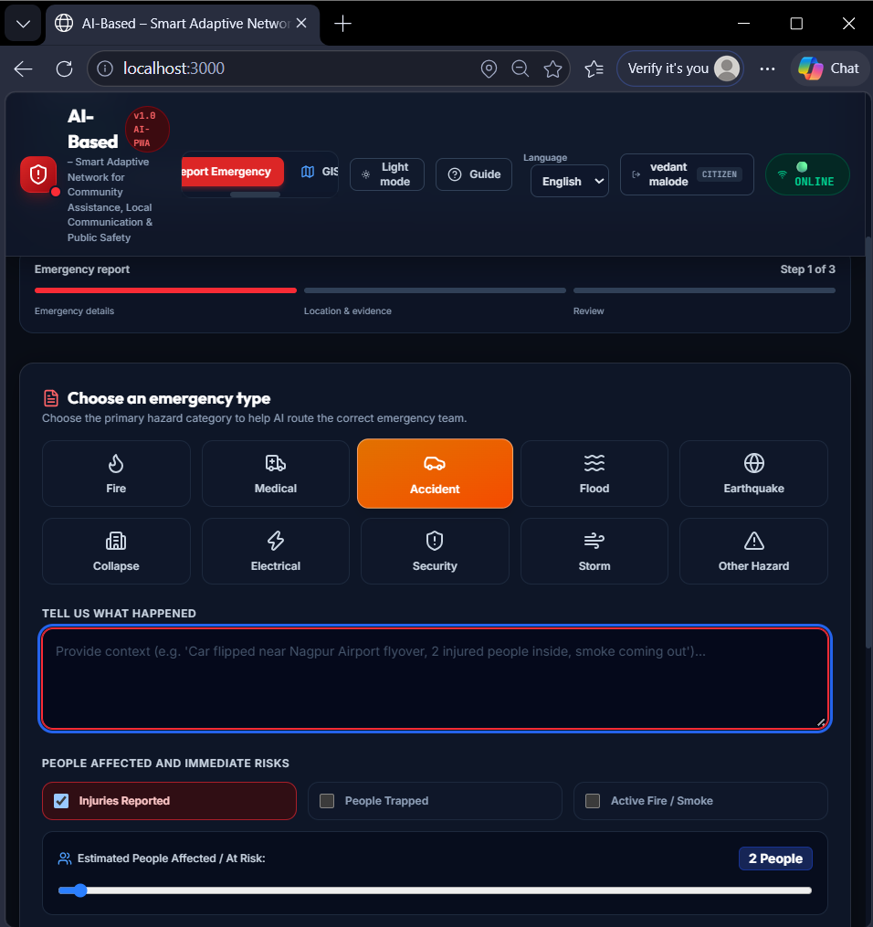
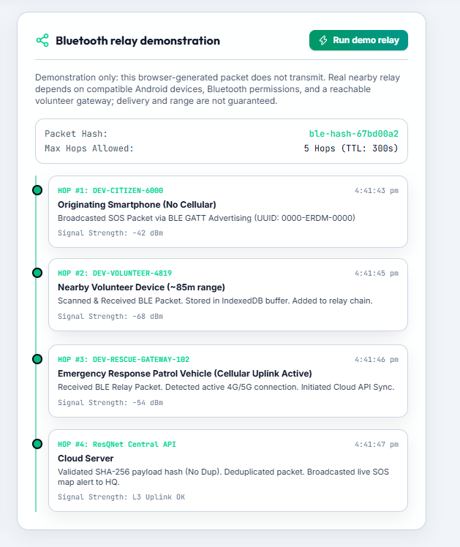
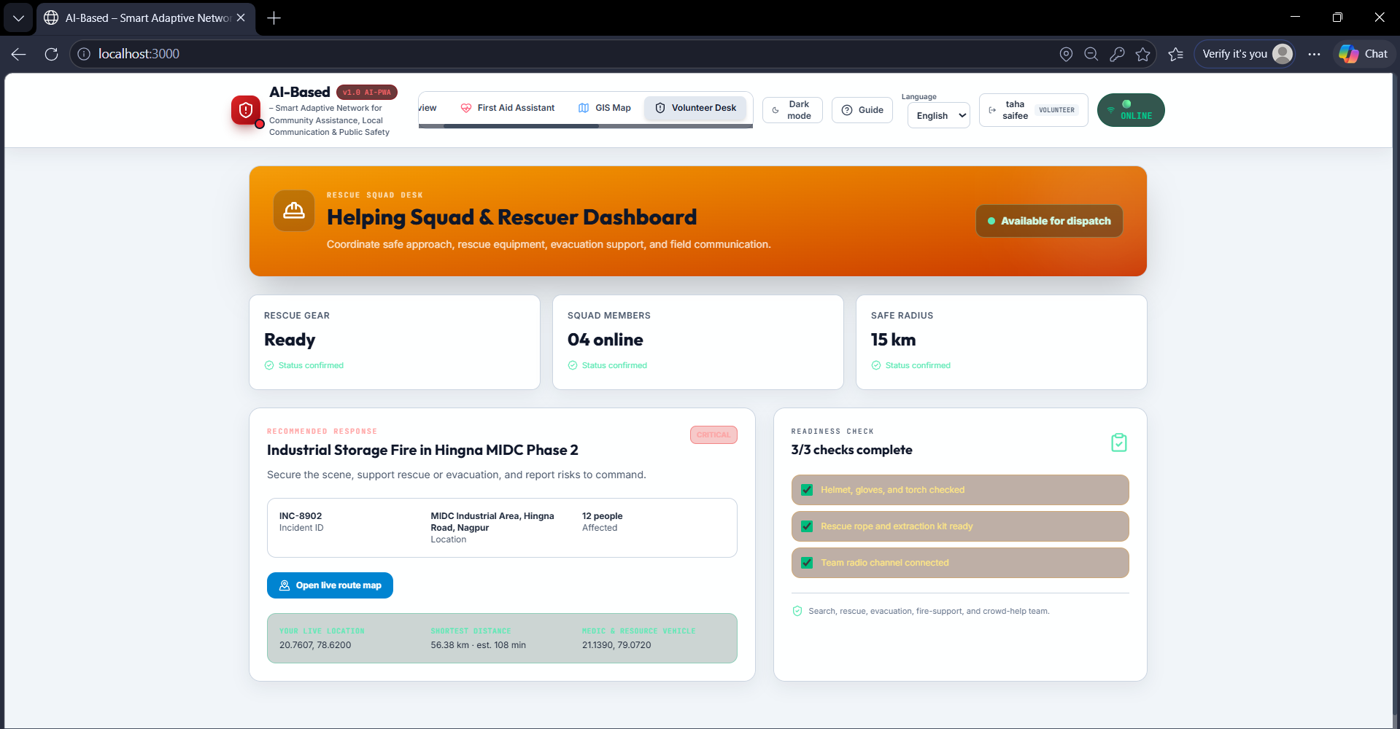
Research Publications, IPR & Supporting Evidence
Citizen SOS + voice report
Volunteer route guidance
BLE relay screen
These are prototype screenshots. No publication, copyright, or patent certificate was supplied.
Computer Science & Engineering Department
2026–2027
Group-24: AYUSH KATHOTE
Notes:
These screenshots show prototype screens. A BLE relay does not prove server or emergency-service receipt.

Slide 14
Thank You!
Thank You!
Computer Science & Engineering Department
2026–2027
Group-24: AYUSH KATHOTE

