Slide 1

Team KavachX
Vedant Nagul
Fabtech Technical Campus, Sangola
Cybersecurity / Mobile Defense
Digital Kavach

Slide 2
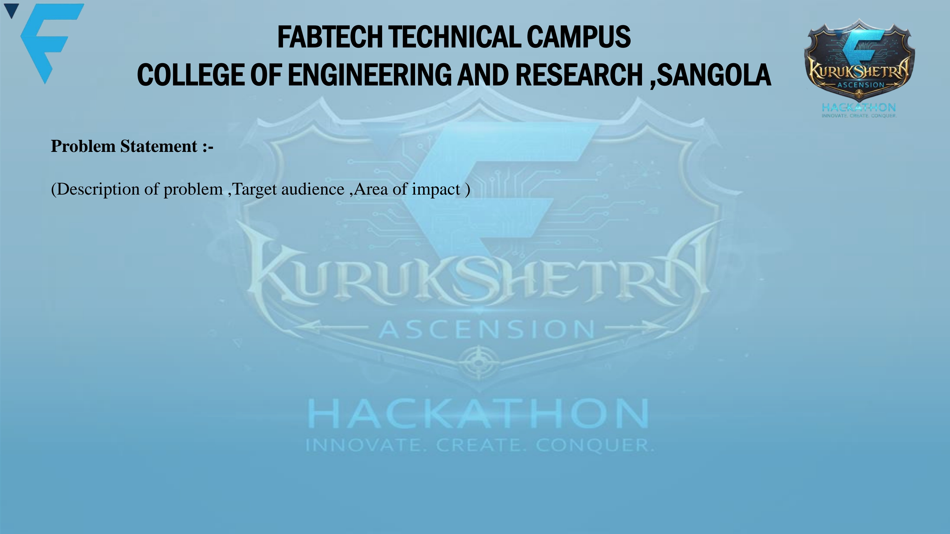
• Problem: Vernacular cyber-frauds, Devanagari scams & spoofed UPI QR codes bypass standard security tools.
• Target Audience: 800M+ Indian UPI users, senior citizens & vernacular speakers across Tier-2/3 regions.
• Impact: Stops financial loss in real time & recovers funds during the critical 24-hr Golden Hour window.

Slide 3

• Solution: Zero-trust mobile shield with background notification interception & on-device AI.
• Prototype: Functional Flutter Android app with real-time Sentinel, OCR & 1930 recovery wizard.
• Tech-Stack: Flutter, Riverpod, Hive, Google ML Kit (Devanagari OCR), Few-Shot RAG Threat Memory.
• Workflow: Notification Intercept ➔ 570+ Rules & OCR ➔ Ghost QR Check ➔ 1930 Golden Hour Action.

Slide 4
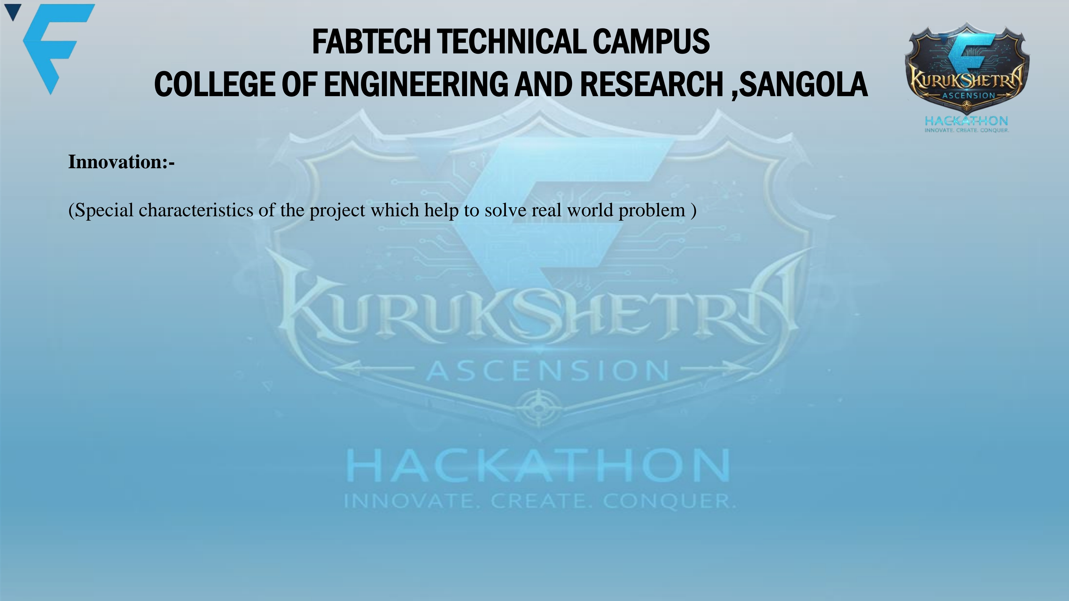
• Ghost UPI Shield: Detects forged merchant names masking private VPAs before payment triggers.
• AI ScamBaiter Bot: Proactively stalls fraudsters with decoy personas to extract mule account details.
• 10 Indian Languages: True native vernacular support across all screens, rules & OCR analysis.
• Zero-Key Security: Fully client-side protected architecture with zero exposed API keys or PII.

Slide 5

• Why Existing Apps Fail: Antivirus tools only check English links post-click; ignore SMS/WhatsApp & UPI QRs.
• Digital Kavach Differentiator: Proactive notification interception + Ghost UPI QR shield + Active ScamBaiting.
• Post-Scam Legal Automation: Only app with a 24-hr Golden Hour wizard auto-drafting NCRP & RBI dispute FIRs.
• Complete Life-Cycle: Protects citizens Before (Sentinel), During (Anti-Quishing), and After (Recovery).

