Slide 1

Healthcare Provider Fraud Detection Project
Welcome to our presentation on identifying potentially fraudulent healthcare providers. Healthcare fraud poses a significant challenge for insurance companies, leading to inflated costs and higher premiums. Our project aimed to develop a system to predict fraudulent providers and understand the patterns associated with such activities.
Presented By: Vedant Patil Task: Data Science Case Study

Slide 2




Project Objectives
Predictive Modeling
Feature Identification
Develop a machine learning model to classify providers as "Potential Fraud" or "Not Fraud."
Discover important variables that help in detecting fraudulent behavior.
Business Insights
Provide actionable recommendations to help combat fraud more effectively.

Slide 3
Data Overview
Beneficiary Data
Inpatient Data
Outpatient Data
Labels Data
Demographic and health information about patients (e.g., age, chronic conditions).
Details about claims where patients were admitted to a hospital for serious events.
Details about claims where patients visited a hospital but were not admitted, typically for shorter visits.
Crucial file providing historical flags for "Potential Fraud" providers, serving as our "answer key."

Slide 4

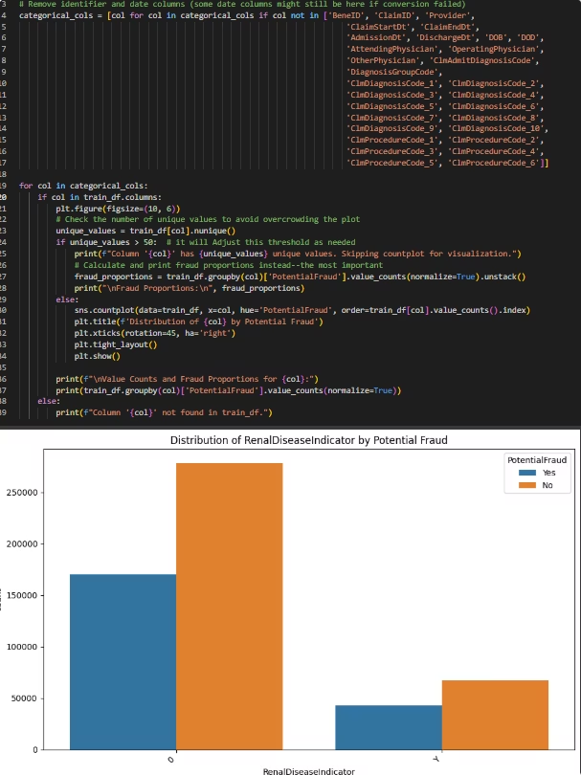




Project Approach: Data Management & Feature Engineering
Date Feature Extraction
Extracted useful information like LengthOfStay from claim and admission/discharge dates.
Claim Code Aggregation
Counted unique diagnosis and procedure codes to capture complexity or unusualness of treatments.
Beneficiary Profile Creation
Summarized chronic conditions and categorized patient ages to understand demographic associations with fraud.
Data Consolidation & Provider-Level Aggregation
Combined claims with beneficiary details and aggregated all features to the provider level, creating a comprehensive "report card" for each provider.

Slide 5

Feature Selection & Preprocessing
Encoding Categorical Features
Scaling Numerical Features
Handling Missing Values
OneHotEncoder would typically convert categories into numerical formats for model understanding.
Column Alignment
StandardScaler normalized numerical features, preventing larger values from dominating smaller ones.
Ensured features from unseen data matched the training data's columns and order.
Used SimpleImputer to fill numerical gaps, typically with mean values, preventing model errors.

Slide 6

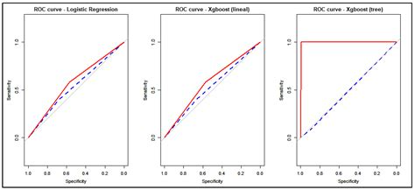
Model Building & Evaluation
Logistic Regression
XGBoost (Extreme Gradient Boosting)
A straightforward model for linear relationships, easy to interpret, providing a solid foundation for understanding feature impact.
An advanced, powerful model building "mini-detectives" to learn from mistakes, highly accurate for complex, imbalanced data like fraud detection.
Evaluation Metrics
Focused on Recall (catching fraudsters), Precision (minimizing false alarms), F1-Score (balance), and AUC-ROC (overall distinction ability). XGBoost generally performs better for fraud detection due to its robustness.

Slide 7
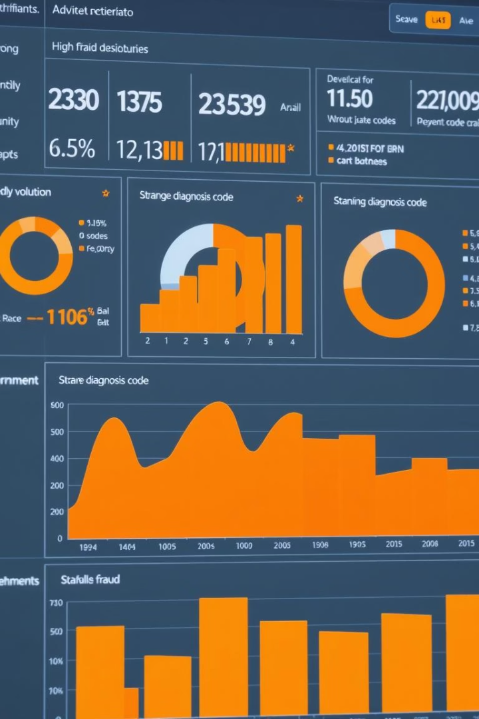




Key Findings & Business Insights
High Claim Volume/Amount
Unusual Length of Stay
Diverse/Ambiguous Diagnosis Codes
Significantly larger claim numbers or higher reimbursements can indicate over-billing.
Consistently very long or short hospital stays for specific diagnoses may be suspicious.
Frequent use of vague or expensive diagnosis codes could suggest "upcoding."
Patient Demographics & Deductible Patterns
Patterns in patient conditions or age groups, and suspicious deductible amounts, can indicate fraud.

Slide 8





Recommendations & Future Improvements
Prioritized Investigations
Use model probability scores to focus resources on providers with the highest fraud risk.
Automated Alert System
Integrate the model for real-time flagging of suspicious claims or providers.
Dynamic Thresholding
Utilize probability scores for nuanced decision-making, allowing for varied review levels.
Feature Importance Deep Dive
Analyze XGBoost's important features to reveal specific fraud patterns for targeted rules.
External Data Integration & Continuous Learning
Incorporate public records and network analysis, and regularly retrain the model with new data to counter evolving fraud tactics.

Slide 9

Conclusion
This project successfully established a machine learning pipeline for identifying potentially fraudulent healthcare providers. By transforming raw data into meaningful features and utilizing powerful models like XGBoost, we've created a robust tool to combat fraud effectively.
The insights gained will enable proactive fraud prevention, leading to significant cost savings and more efficient resource allocation for investigations. We are confident this system will be a valuable asset in safeguarding healthcare resources.

