Slide 1

Planning a Presentation
Learn about your audience and location
Adapt to your audience
Clarify objectives
Limit and organize content
Create links
Select and prepare visual aids

Slide 2
Adapting to the Audience
Audience considerations:
  motivation for attending
  attitude to your topic
  level of knowledge and expertise
  group dynamics
  linguistic and cultural background
  demography? (size, age range, etc.)
Environmental conditions
  seating, temperature, noise, lighting, etc.

Slide 3
Clarifying Objectives
If I am successful, my listeners will . . .
(Be as explicit as possible.)

Slide 4
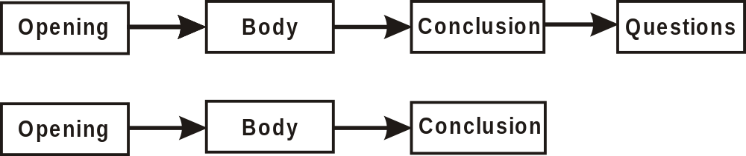
Structure of a Presentation
Open with big picture followed by presentation overview
Limit body to 3-5 main points
Conclude with summary of main points and what’s next
Accept questions throughout or contain them at end

Slide 5
Opening
Begin with a greeting or grabber
Explain value of presentation to audience
Outline the presentation
Indicate the structure for asking questions

Slide 6
Organizing the Body
Five Organizational Patterns
  Time sequence
  Selling
  Problem solving
  Spatial relationships
  PREP (Point, Reason, Example, Point)

Slide 7

Time Sequence
Suitable for the following purposes:
  To provide an update
  To describe history and point to the future
  To lead audience through a process
Notes:
Steve please add figure 5-2 Time-Sequence Pattern

Slide 8
Selling
Use this approach to win support for your proposal, idea, or product.
Notes:
Steve please add figure 5.3 Selling Pattern

Slide 9
Problem Solving
Suitable for the following purposes:
  To invite participants to help solve a problem
  To clarify your choice of solution
Notes:
Steve please add figure 5.4 Problem-solving pattern

Slide 10

Spatial Relationships
Use this approach to provide technical detail.
Notes:
Steve, please add figure 5.5 Spatial Relationship pattern

Slide 11
PREP
Consider using this pattern for persuasive presentations.
  State your position or point of view
  Explain the reason
  Provide an example (story, fact, or analogy)
  Restate your position or point
Notes:
Steve, please add figure 5.6 PREP pattern

Slide 12
Closing
Ways of ending a presentation:
  Review main points
  Emphasize information critical to decision making
  Remind audience of your purpose
  Suggest a course of action
  Give them something to think about

Slide 13
Creating Links
Use linking statements or transitions to move smoothly from section to section
  By creating bridges between points (tie where you’ve been to where you’re going)
  By reinforcing your purpose
  By reminding readers of the value of your presentation

Slide 14
Selecting Visual Aids
Consider your audience, purpose, and the constraints of the situation
Decide which visual aids are most appropriate
  PowerPoint
  On-line resources
  Overhead transparencies
  White board or flip charts
  Video or 35mm slides
  Objects
  Handouts

Slide 15
Limit Content
Simplify figures to remove all unnecessary detail
Follow the 5x5 guideline for text
  Strive for no more than five lines per slide
  Strive for no more than five words per slide

Slide 16
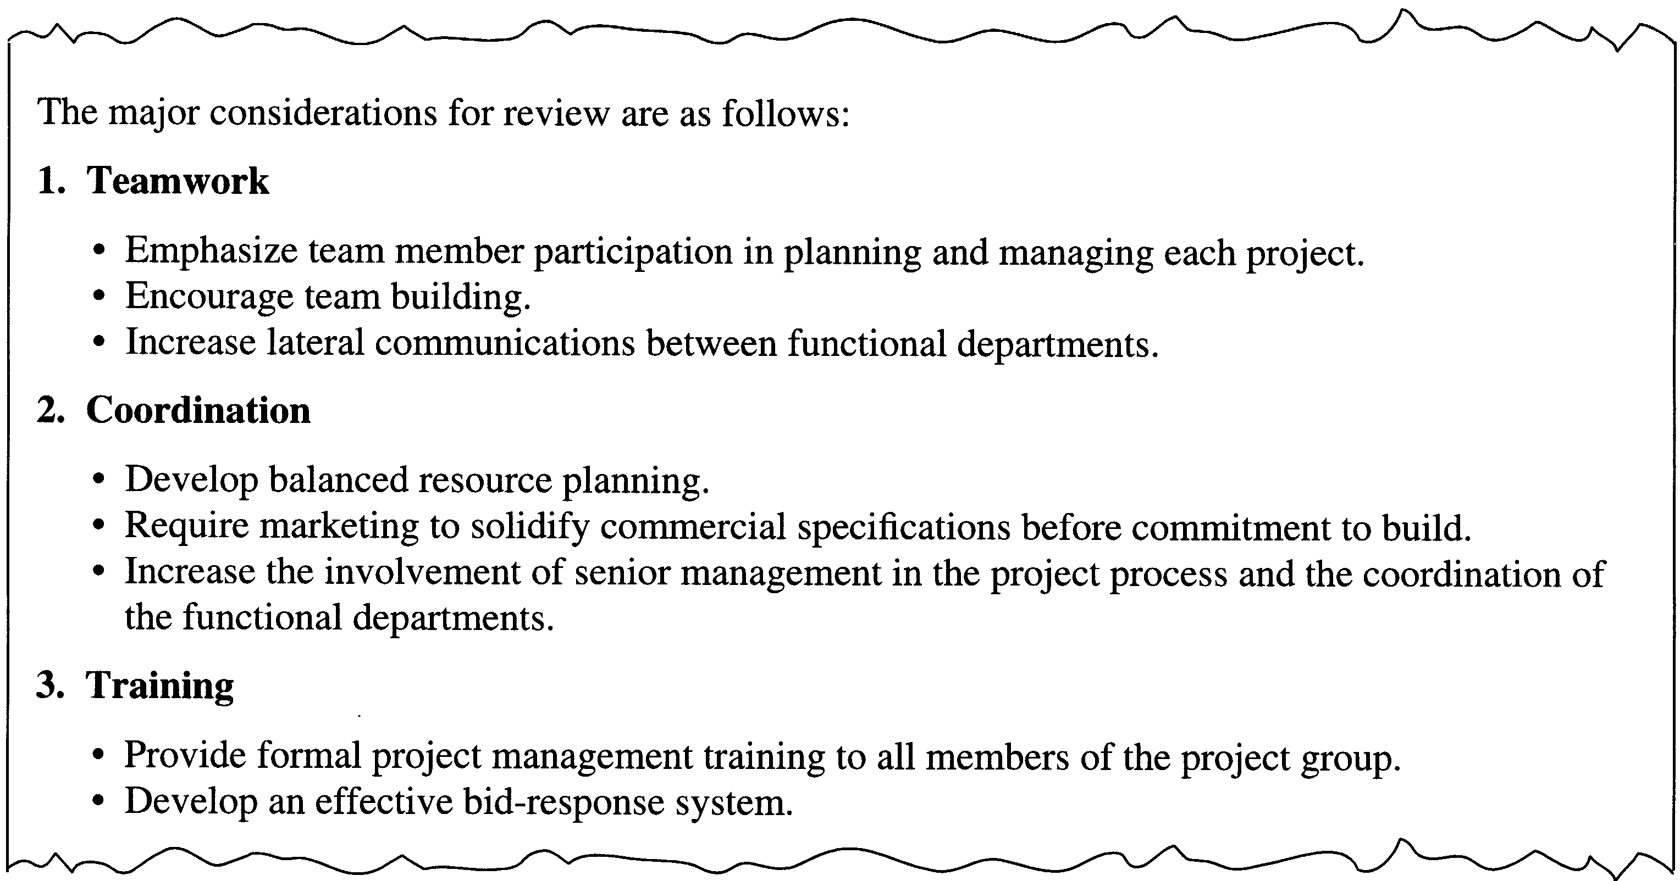
Report Format

Slide 17
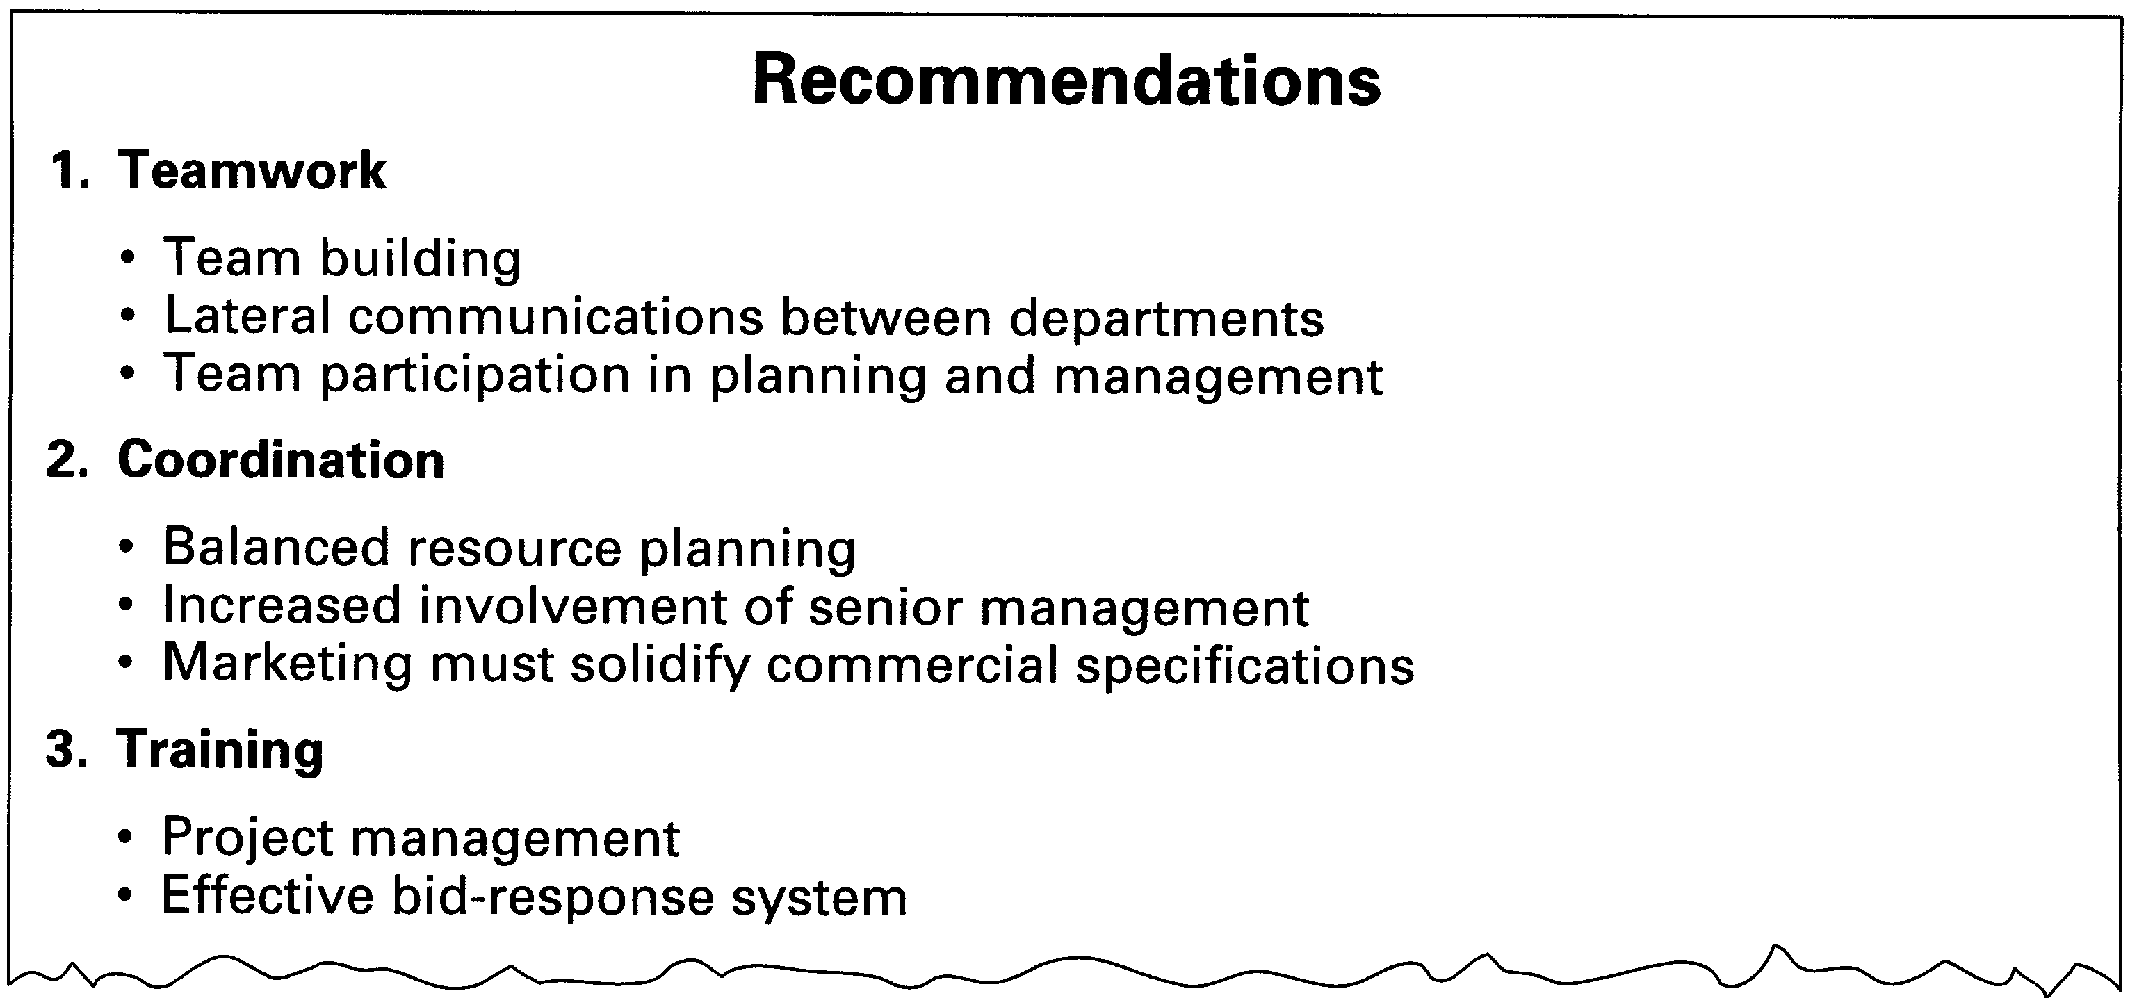
Presentation Format (5x5)
Notes:
Steve, add figure 5.8 here – Example from a Presentaton

Slide 18
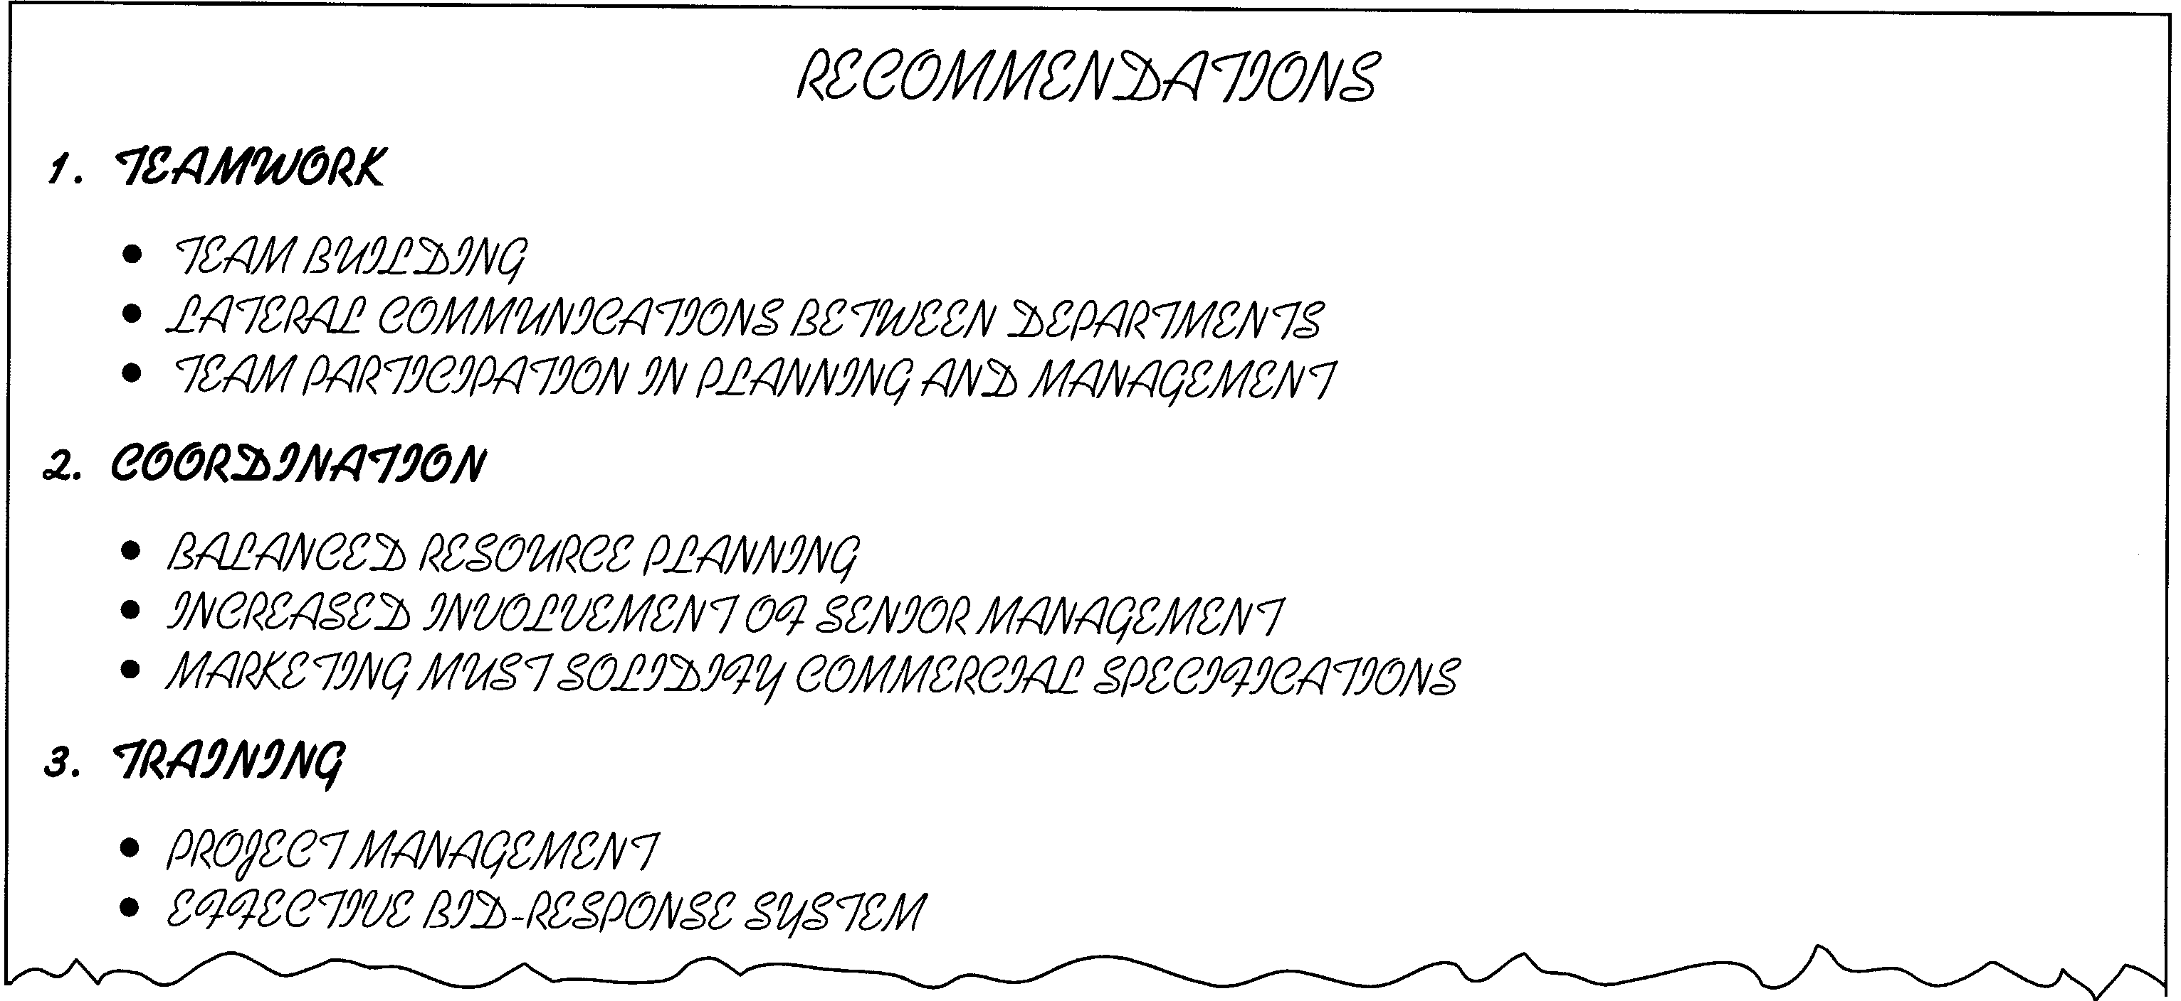
Pay Attention to Format
Notes:
Steve, please add figure 5.11 Overhead using Kaufmann Uppercase

Slide 19
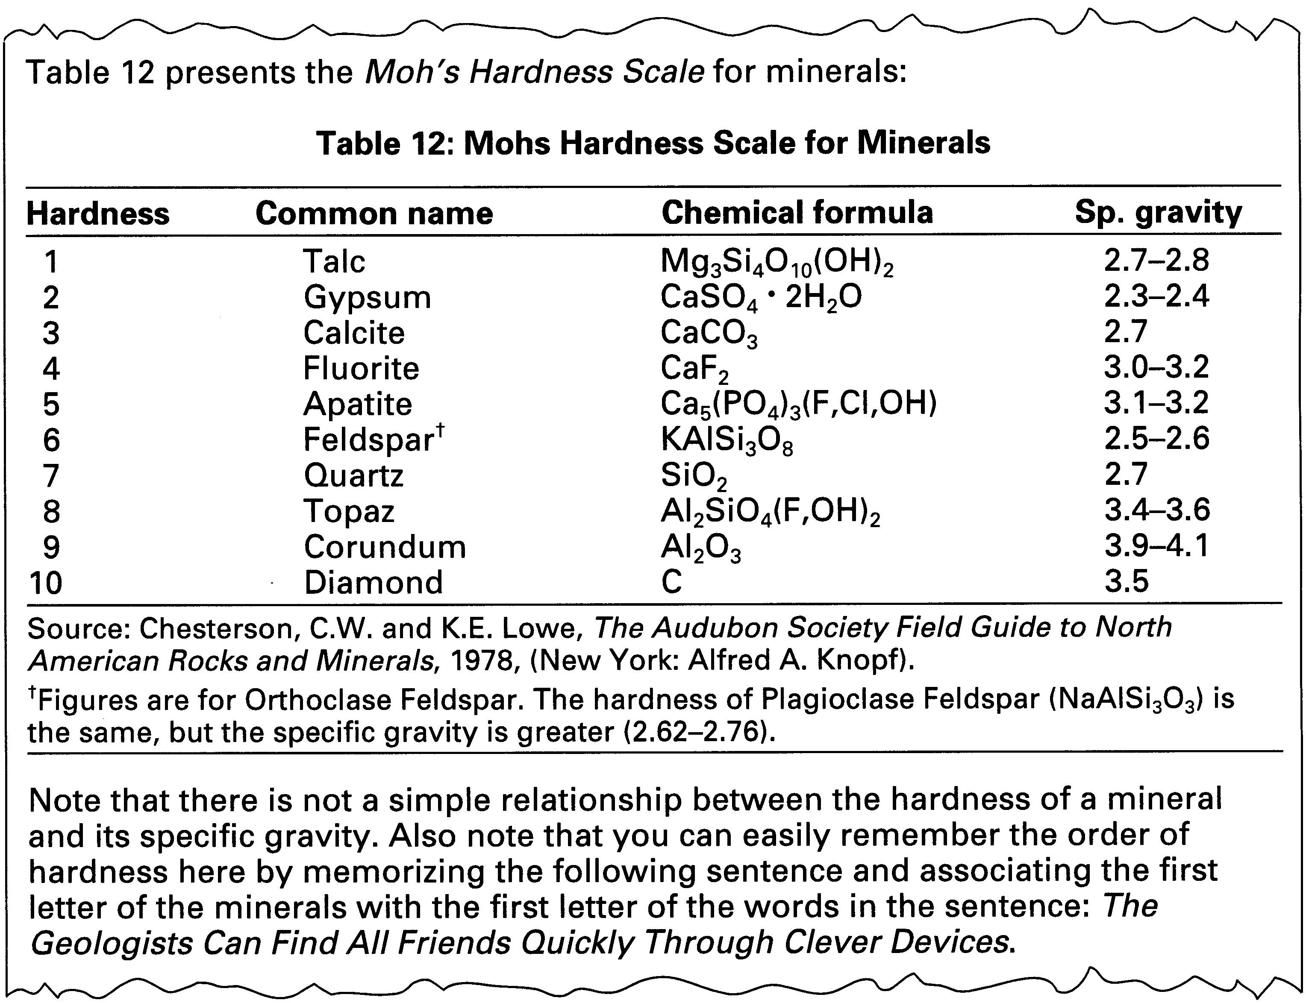
Table in a Report
Notes:
Steve, please add figure 5.9 Table in a report

Slide 20
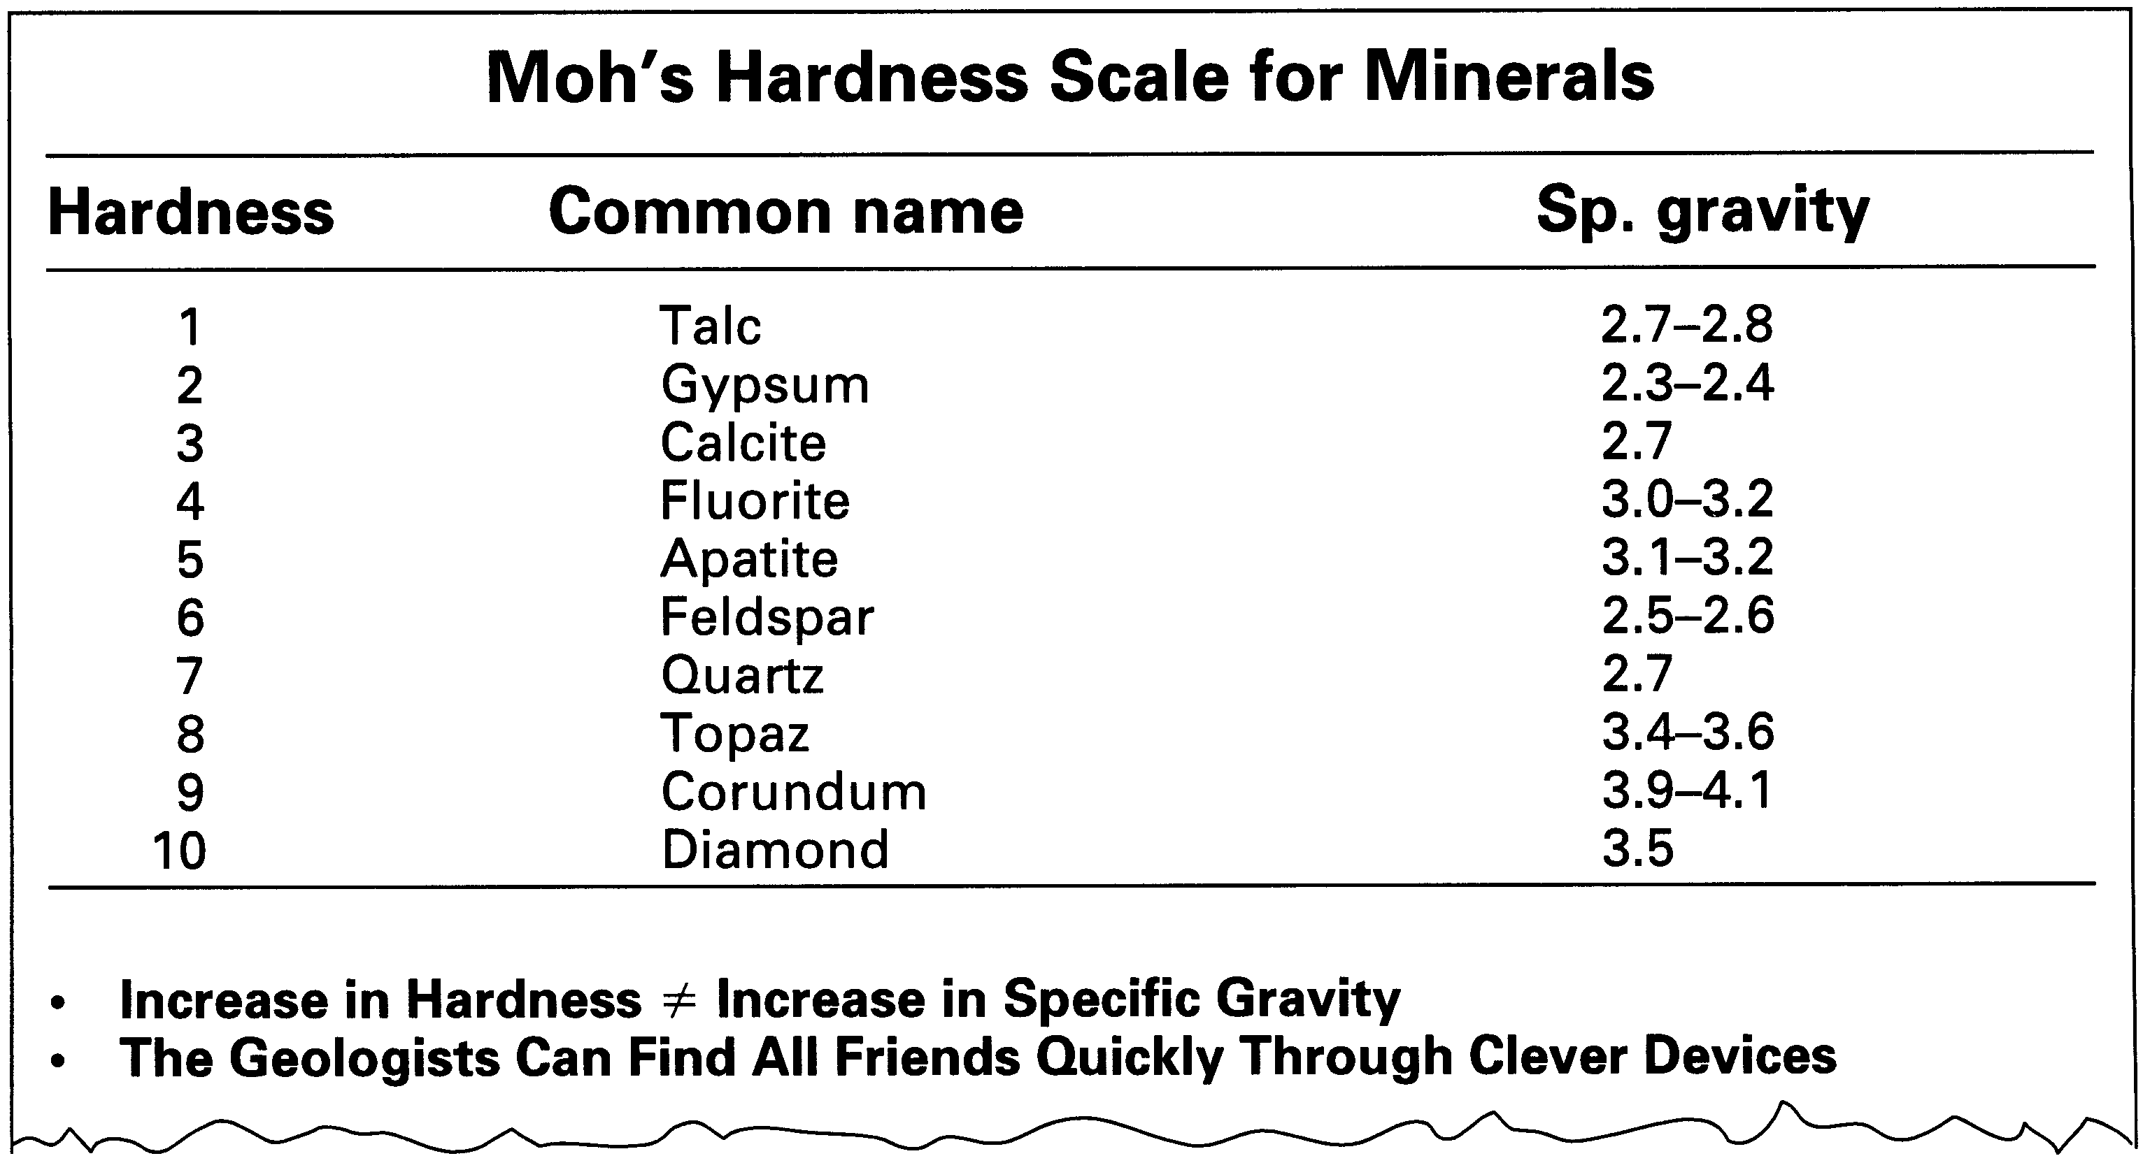
Table in a Presentation
Notes:
Please add Figure 5.10 Table on an overhead/in a Power Point Presentation

Slide 21
Creo Products Inc.
Yann Le Du
Research Assistant
Development of a Non-Contact
Diameter Gauge
September, 1997
Burnaby, BC
Notes:
This slide and the following 5 present an example of a PowerPoint presentation. Note that a similar presentation for overhead transparencies is available on the website (overhead_presentation.pdf).

Slide 22
Overview
Introduction and background
Motivations and objectives
How the gauge works
Test results
Conclusions
Notes:
This slide and the following 5 present an example of a PowerPoint presentation. Note that a similar presentation for overhead transparencies is available on the website (overhead_presentation.pdf).

Slide 23
Objectives of the Project
To build a gauge that is
Accurate to 3μm in 300mm
Suitable to a range of diameters
Hand held
Unaffected by surface irregularities caused by machining

Slide 24
How the Diameter Gauge Works
Directional
filter #1
α
Laser
Cylinder
α/2
h
R
Directional
filter #2
Phase/Time Delay
Signal #1
Signal #2
Sin (α/2) = h/R

Slide 25
How the Directional Filter Works
Photo-
detector
Lens
Focal Plane

Slide 26
Test Results
Accuracy of 1:100 000 achieved if incident rays limited to center of directional filter lens.
To restrict light, gauge must be rigidly supported
Supported gauge must be calibrated to measure cylinders of only one nominal size

