Slide 1
HR Analytics Project Presentation
Project based on HR Employee Attrition Analysis
Modules Covered: Excel, SQL, Power BI, Tableau
Objective: Understand employee attrition and workforce trends

Slide 2
P1249 Group 1 HR Analytics
Project contribution group member name
Vedant shinde
Kunal modi
Vishnu kv

Slide 3
Project Introduction
Employee attrition affects productivity and company growth
This project helps identify key reasons behind attrition
Data-driven decisions improve HR management

Slide 4
Excel Module – Data Cleaning
Removed duplicates and checked missing values
Standardized department and job role names
Created calculated columns like Attrition_Num for analysis

Slide 5
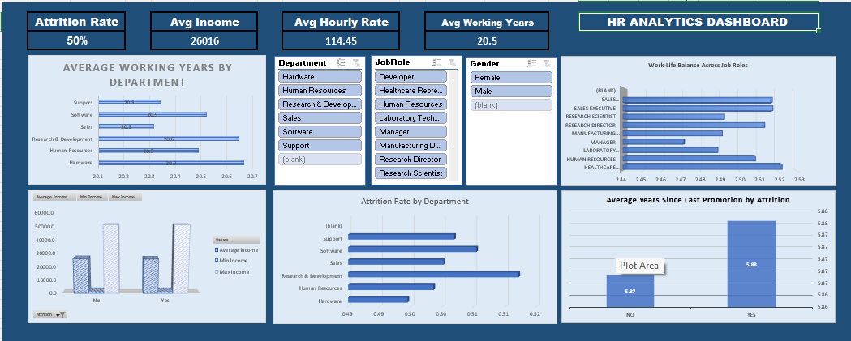

Slide 6
Excel Module – KPI Analysis
Attrition Rate: 50.21%
Average Monthly Income: 26015.78
Average Total Working Years: 20.5
Used Pivot Tables and Pivot Charts for summary

Slide 7
Excel Module – Dashboard
Created KPI cards and summary visuals
Department-wise attrition analysis
Income and promotion trend analysis

Slide 8
SQL Module – Database Work
Imported HR dataset into SQL database
Created queries for KPI extraction
Used GROUP BY, AVG, COUNT, CASE statements

Slide 9
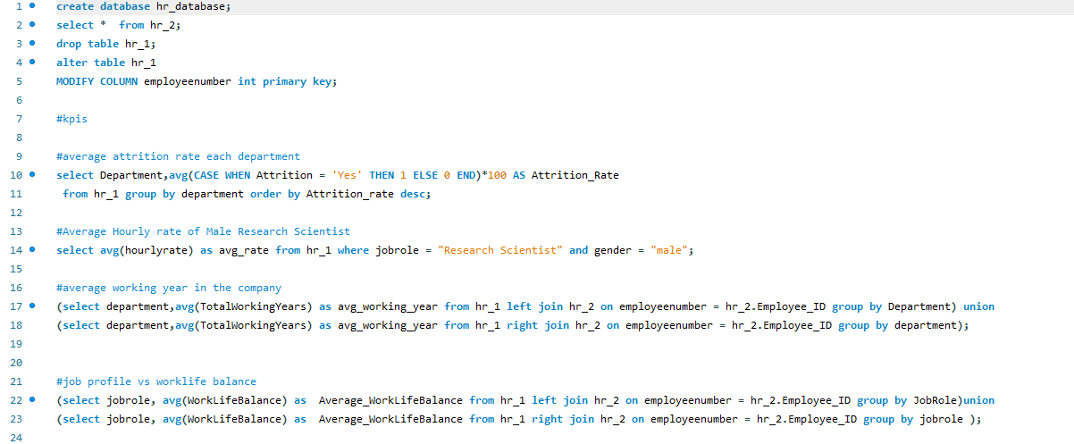

Slide 10
SQL Module – Important Queries
Attrition Rate vs Department
Attrition vs Monthly Income
Job Role vs Work-Life Balance
Promotion vs Attrition relationship

Slide 11
Power BI Module – Dashboard Creation
Imported cleaned dataset from Excel
Built interactive dashboard using visuals
Used slicers for filtering by department and job role

Slide 12
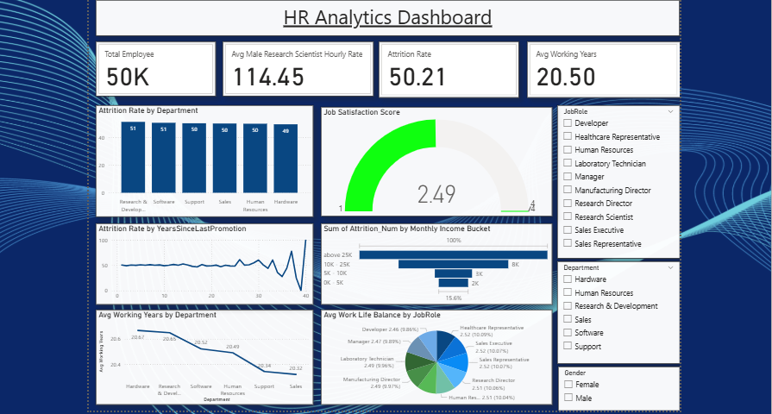

Slide 13
Power BI Module – Key Visuals
Attrition Rate KPI Card
Department-wise Attrition Chart
Income vs Attrition Analysis
Promotion and Satisfaction Insights

Slide 14
Tableau Module – Data Visualization
Connected dataset using Tableau workbook
Created visual storytelling dashboard
Focused on department and employee behavior analysis

Slide 15
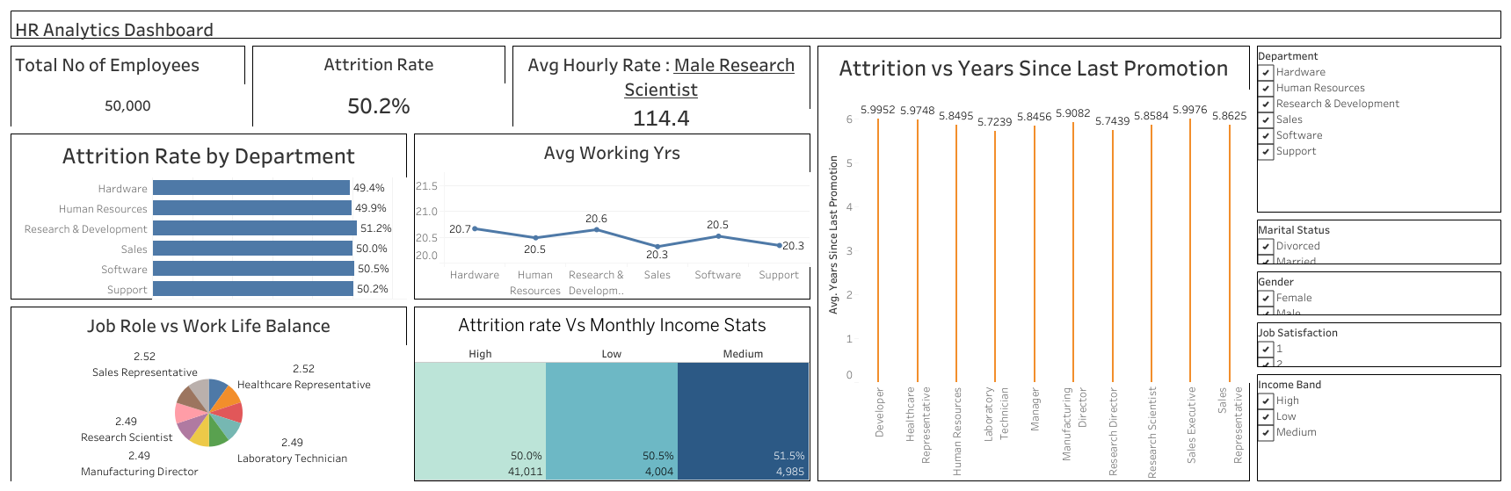

Slide 16
Tableau Module – Dashboard Insights
Work-Life Balance vs Job Role
Business Travel impact on Attrition
Employee Satisfaction and Retention trends

Slide 17
Overall Key Findings
Higher attrition seen in specific departments
Promotion delay and poor work-life balance affect retention
Income alone is not the major attrition factor

Slide 18
Recommendations
Improve promotion opportunities
Focus on employee engagement programs
Track high-risk departments regularly

Slide 19
Conclusion
Excel helped in cleaning and KPI preparation
SQL supported backend analysis
Power BI and Tableau improved visualization and presentation

