Slide 1
-Kunal Modi -Shubham Halder -Vedant Shinde -Shreyaa MR - Mekala Abinash
Insurance Dashboard Analytics

Slide 2
Objective
Analyze performance, revenue, and customer insights to support decision-making for Senior Management

Slide 3
Key Metrics
• Total Premium
• Policy Count
• Budget vs Achieved
• Meeting
• Top 4 opportunity by Revenue
• Product wise revenue

Slide 4
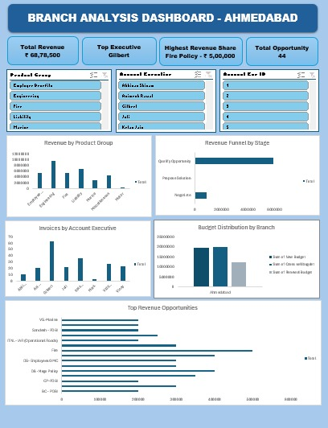
Dashboard –Excel
Excel is used for cleaning the Raw data and also help in converting the raw data into dynamic dashboards which will help the team removing the insights from the dashboard.

Slide 5
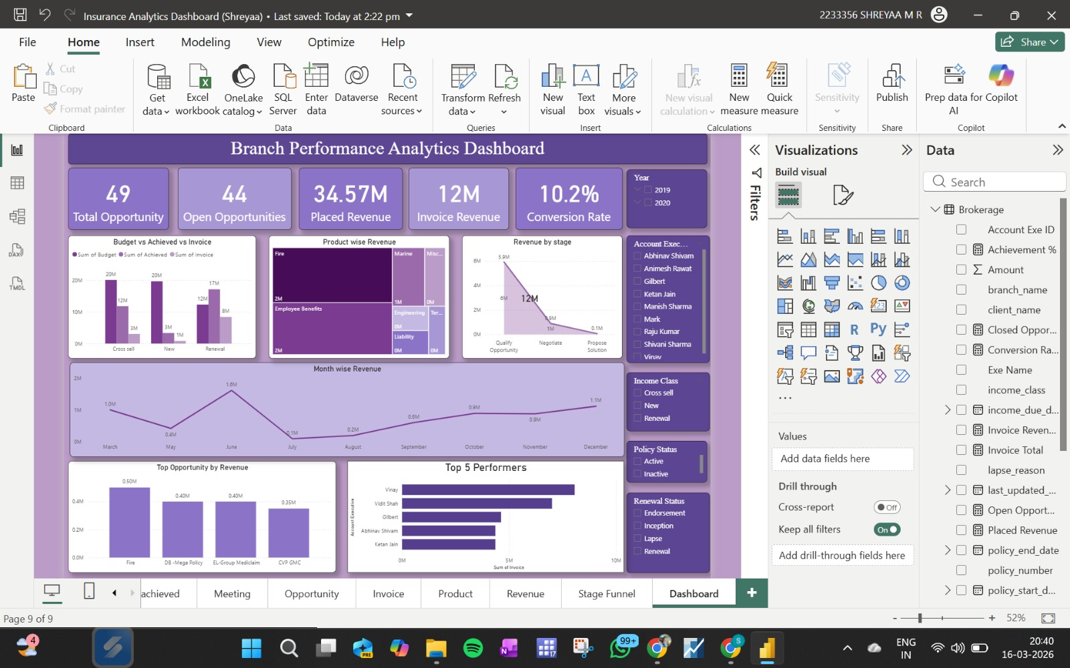
Dashboard –Power BI

Slide 6
Power BI Dashboard Overview
Interactive insurance analytics report pages include:
KPI
BAI (Budget Achievement Insights)
Meeting
Opportunity
Stage Funnel
Invoice
Product
Dashboard Summary

Slide 7
Sales Funnel & Opportunity Insights
Tracks insurance sales pipeline:
Opportunity conversion rate
Stage funnel performance
Invoice generation tracking
Meeting impact on sales

Slide 8
KPI Performance Analysis
Key metrics monitored:
Revenue achievement vs target
Agent performance indicators
Customer acquisition insights
Product performance trends

Slide 9
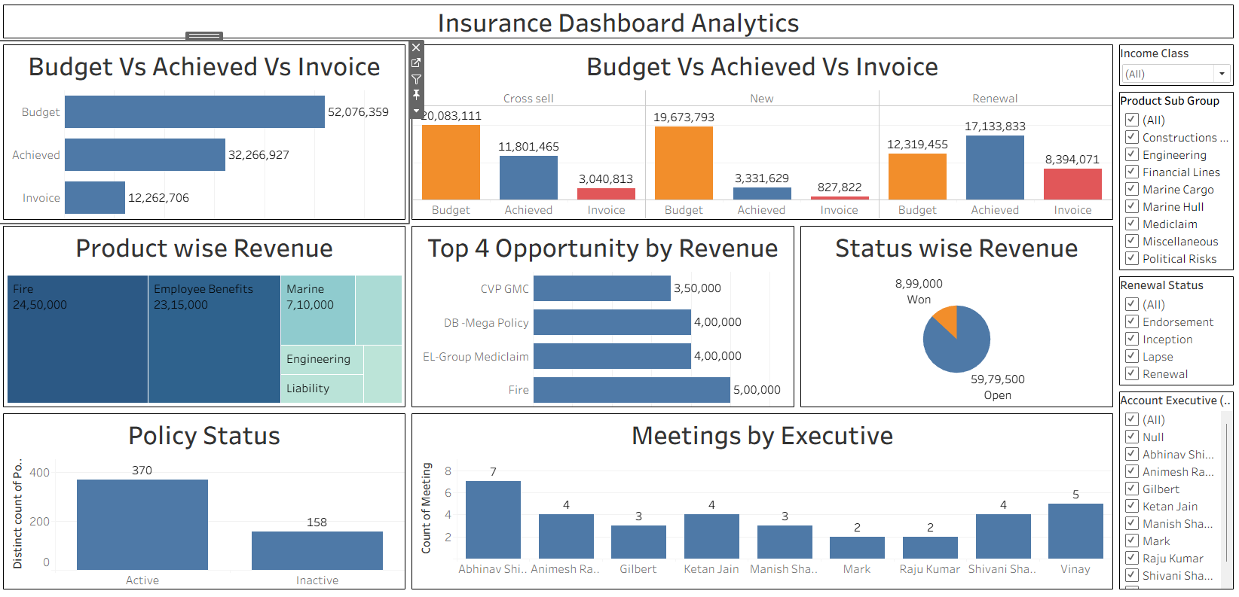
Dashboard –Tableau

Slide 10
Tableau Dashboard Overview
Insurance performance tracking using multiple analytical worksheets:
Budget vs Achieved
Budget vs Achieved vs Invoice
KPI Open
KPI Opportunity
Meetings Analysis
Policy Status
Product Wise Revenue
Stage Wise Revenue
Top 4 Revenue Sources

Slide 11
Revenue Analysis (Tableau)
Tracks insurance revenue performance using:
Product Wise Revenue
Stage Wise Revenue
Top Revenue Contributors
Budget vs Achieved comparison

Slide 12
KPI and Policy Monitoring
Dashboard helps monitor:
Open KPIs
Opportunity KPIs
Policy Status
Meeting Performance

Slide 13
Database - SQL
Database Name: insurance_db
Tables Used:
• brokerage
• invoice
• opportunity
• meeting
• fees
• individual_budget

Slide 14
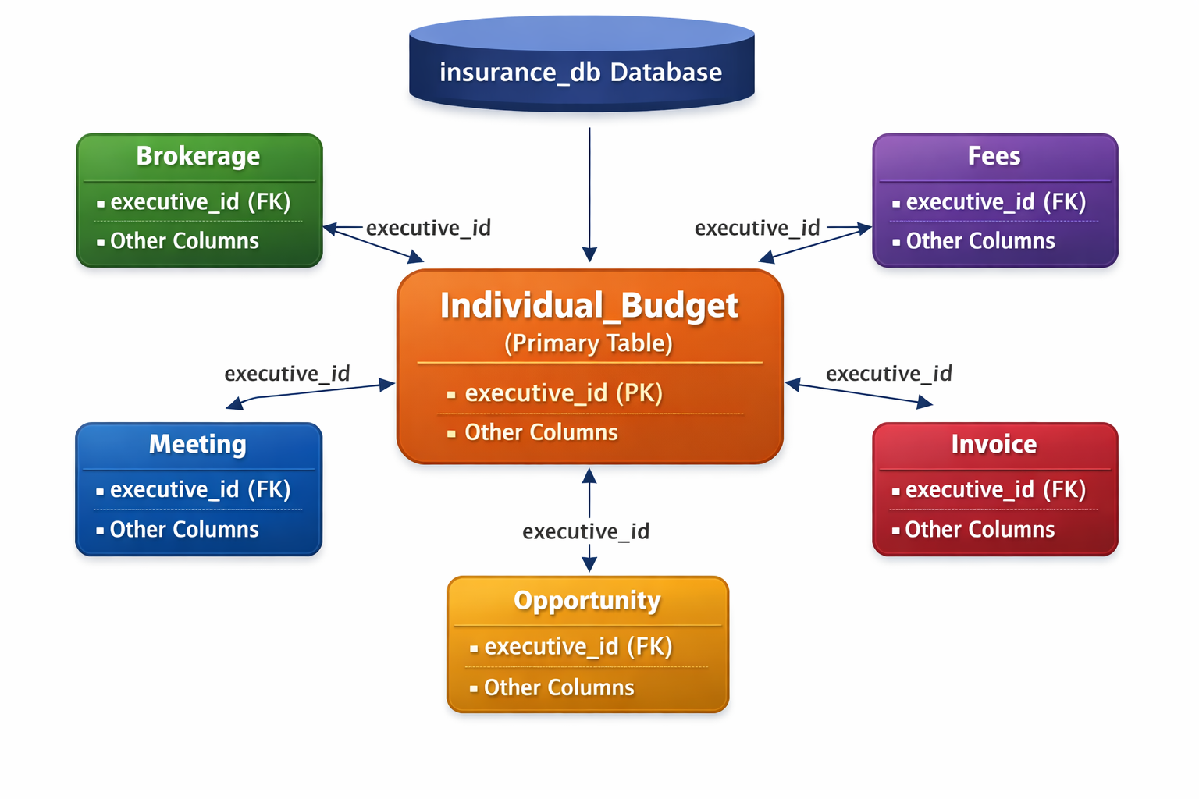

Slide 15
Project Objective
• Analyze insurance business performance
• Track meetings, invoices & opportunities
• Measure policy status & revenue KPIs
• Support business decision making
Data Preparation
• Renamed cleaned tables
• Modified data types (Amount → Float)
• Set Primary Key (account_exe_id)
• Established Foreign Key relationships

Slide 16
Meetings Analysis
• Total meetings conducted year‑wise
• Meetings handled by each executive
• Helps measure employee engagement & activity
Invoice Analysis
• Number of invoices generated by executives
• Identify top performing employees
• Track revenue generation process

Slide 17
Opportunity Funnel
• Revenue grouped by opportunity stage
• Identify high value opportunities
• Track sales pipeline performance
Product Performance
• Number of opportunities product‑wise
• Policies count by product group
• Helps understand popular insurance products

Slide 18
Policy KPI Analysis
• Active vs Inactive policies
• Total number of clients
• Policies expiring in current year

Slide 19
Conclusion
Strong pipeline but weak conversion: High opportunities and placed revenue are not translating into invoices → major revenue leakage
Performance concentration risk: Revenue heavily dependent on a few products and top executives → lack of diversification
Sales inefficiency in funnel: Significant drop from qualification to closure despite high meetings → process improvement needed
Inconsistent revenue trends: Fluctuations across months indicate unstable sales performance
Clear growth opportunity: Improving cross-sell, conversion rates, and team productivity can significantly boost overall revenue

Slide 20
THANK YOU

