Slide 1
Sentimental analysis on amazon fine food REVIEW dataset
- Ajinkya kunjir, kruti Lakhani, vedant singhvi

Slide 2
Abstract
Sentiment analysis is the measurement of positive and negative language. It is a way to evaluate written or spoken language to determine if the expression is favorable, unfavorable, or neutral, and to what degree.
Paired with text analysis it can reveal whether the review given is positive or negative and is it appropriate for the product’s rating.

Slide 3
AIM
With our dataset ‘Amazon fine food reviews’, we aim to build a prediction model where we will be able to predict if a review is positive or negative. In addition to that, we shall also filter out products which have got the most reviews and ratings.
We will be focusing on the textual reviews along with the food ratings to create accurate prediction.

Slide 4
Progress
Loaded sqllite format dataset
Cleaned textual data
Implemented Wordcloud
Performed Logistic Regression for prediction

Slide 5
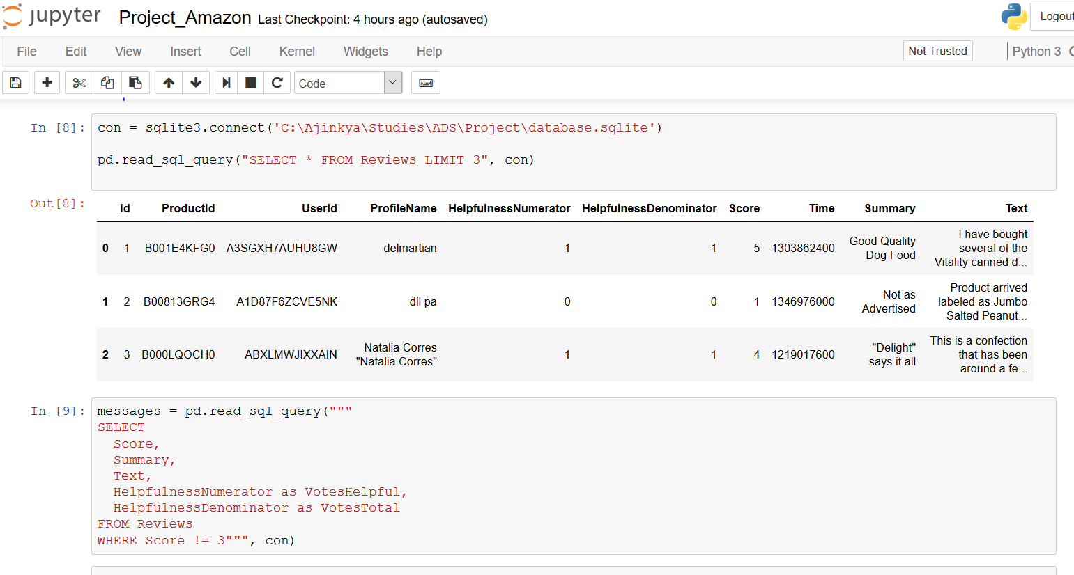
LOADING DATA
Used pandas to read the sqlite file downloaded from Kaggle
Used pandas.read_sql_query for data exploration
pandas.read_sql_query enabled to use SQL queries on the dataset

Slide 6
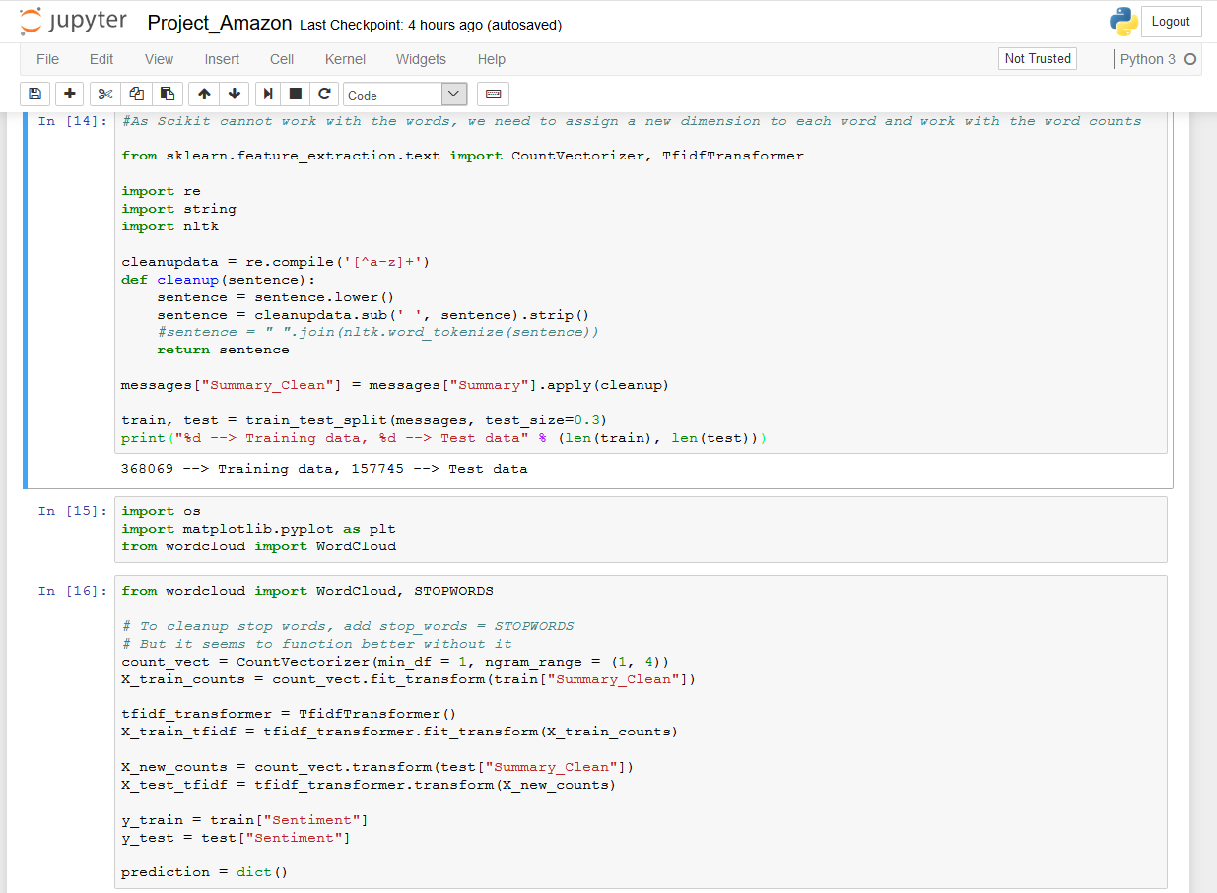
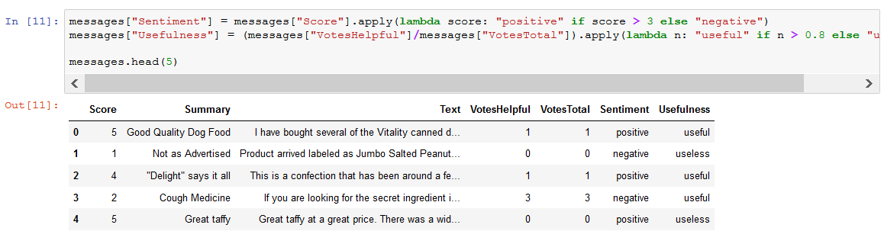
DATA CLEANING AND pruning
Removed Stopped words
Converted the text data into lower case
Used sklearn and nltk for data cleaning
Added columns Sentiment and Helpfulness

Slide 7
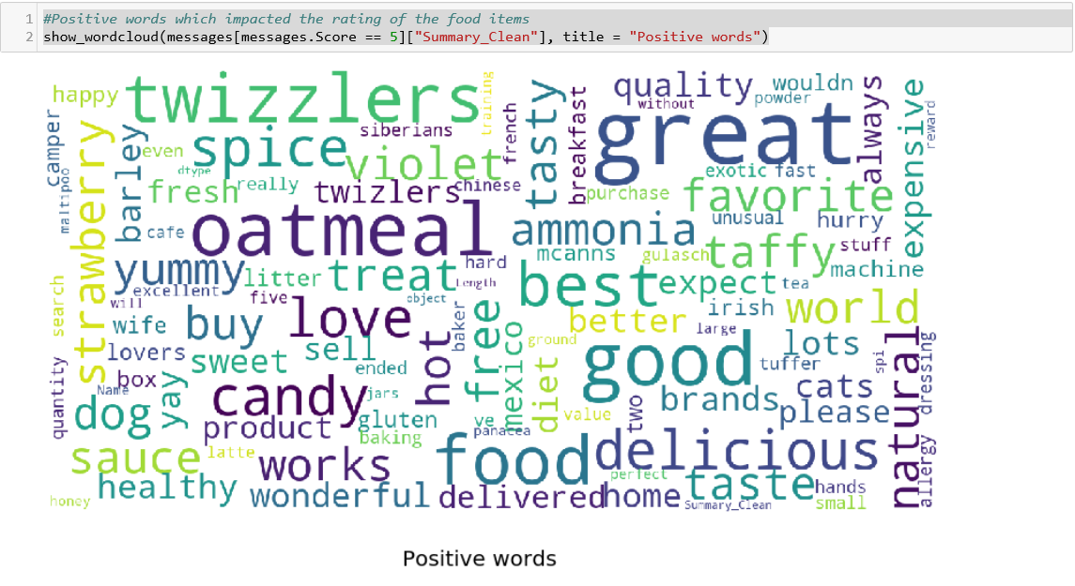
Wordcloud (Positive words)

Slide 8
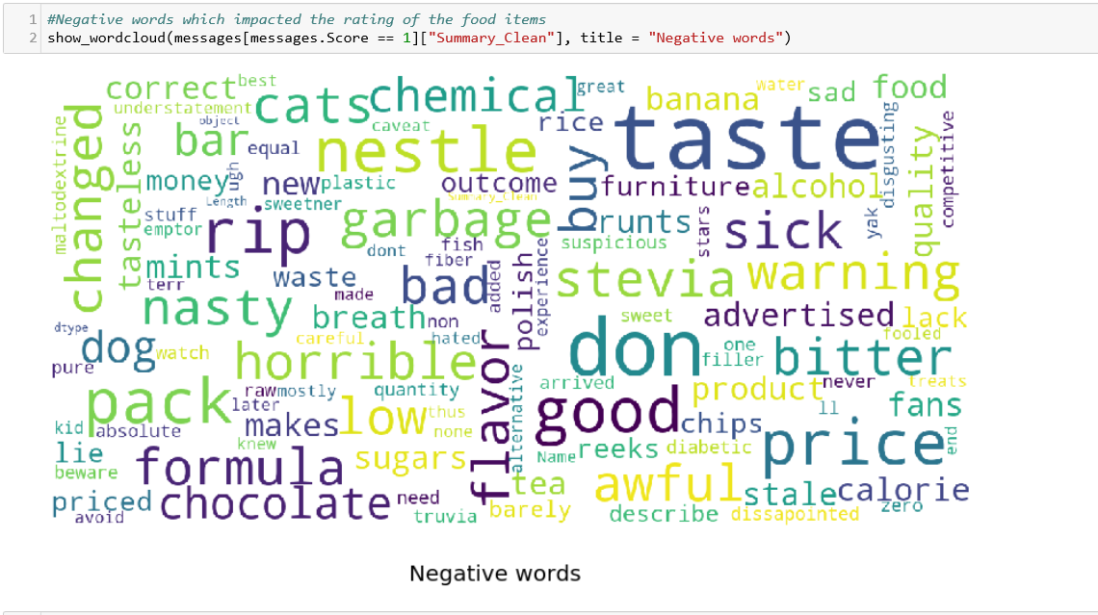
Wordcloud (negative words)

Slide 9
LOGISTIC REGRESSION
Applied logistic regression with 2 techniques:
tfidf
countvectoriser
X (independent variable) = Text
Y (dependent varaible) = score

Slide 10
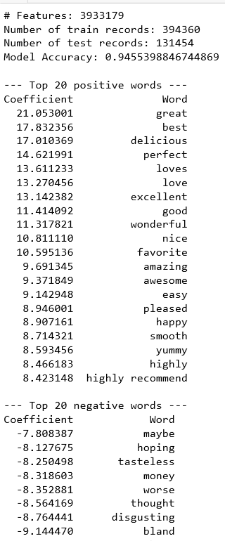
REGRESSION WITH tfidf
Used tfidf technique along with ngram
Term frequency – inverse document frequency
Accuracy of model increases to 94.5%

Slide 11
WHAT NEXT?
Multiple analysis can be performed on the dataset like
Understanding the taste of the user using the reviews and provide stronger recommendation
Automatically constructing summaries on the basis of a review (USE NEURAL NETWORKS)
Generating a score of the product on the basis of the review and summary
Predicting whether the reviews are useful or not based on number of reviews given

Slide 12
REFERENCES
Https://www.kaggle.com/eugen1701/predicting-sentiment-and-helpfulness/notebook
Https://www.kaggle.com/laowingkin/amazon-fine-food-review-sentiment-analysis
Https://www.kaggle.com/laowingkin/amazon-fine-food-review-sentiment-analysis
Http://blog.Alejandronolla.com/2013/05/20/n-gram-based-text-categorization-categorizing-text-with-python
Https://stackoverflow.com/questions/41409570/cant-install-wordcloud-in-python-anaconda

Slide 13
THANK YOU !!

