Slide 1
MUSICAL EVENT FESTIVAL DATABASE
PRESENTED BY
VEDANT SINGHVI
SECTION 06
001888731

Slide 2
CONTENT
Problem Statement
ER Diagram
Tables
Relationships
Stored Procedures
Views
Triggers

Slide 3
PROBLEM STATEMENT
Musical festivals are on the rise, with many bands coming out of the closet and performing internationally. A event of this level requires several entities to get involved, and calls for the need of a proper database to handle all the data.
Several entities are involved in organizing a musical festival like Advertising agency, Event Management Agency, Sponsor, Customer, Event Organizer, Customer, Employee etc.
Managing all the information can be a difficult task, and hence the need of a proper, normalised database.

Slide 4
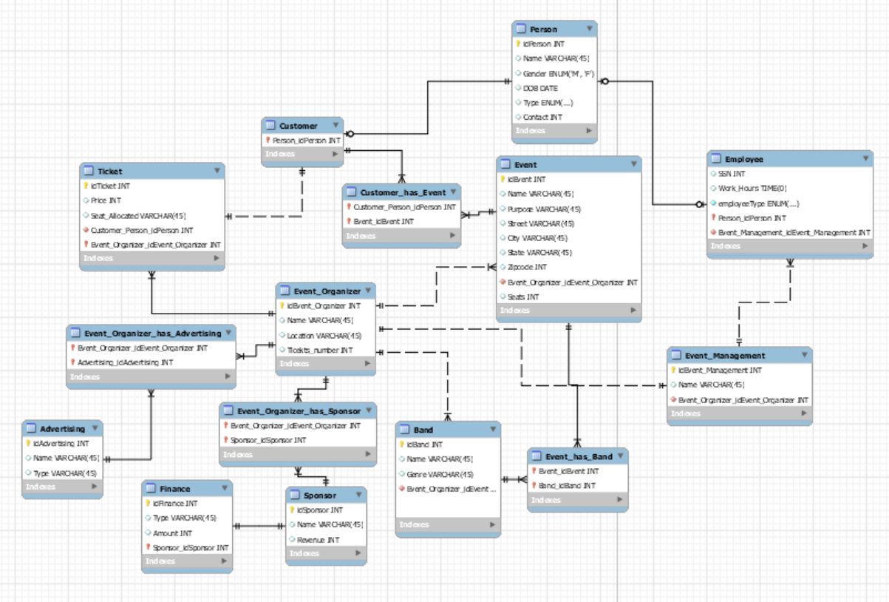
ER Diagram

Slide 5
TABLES
Event Organizer: Event Organizer organizes the event. Takes care of the tickets, handling the sponsor, advertising agency and the event management company and brining in the band to perform at the event.
Event Management Company: Managed by the event organizer. It manages the employee, who work for it.
Advertising Agency: It can be of several types, like social media, digital media, paper based etc.
Sponsor: Sponsor can be of several types, like charitable, private, government, etc. A sponsor will provide finance.
Finance: Finance is provided by the sponsor. Can be of the type cash, bank, loan etc.

Slide 6
Tables (Continued)
Event: A event is organized by the event organizer. Band can perform at a event and customers can attend the event. The event has a purpose like charity, fun, profit etc.
Band: A band performs at an event. It is brought in by a sponsor to organize at the event. It has a genre, and a name as the attributes.
Person: Person table includes the details of a person, and it is inherited by customer and employee.
Employee: Employee inherits the attributes of a person, and has specific attributes like work hours and SSN. Employees work for the event management company and are thee type of Security, Food and Décor.
Customer: Customer attend an event, buys tickets and inherits all the properties of person table.
Ticket: A ticket has the seat number, price od the ticket and ticket id. Tickets are provided by the organizer and a customer buys those tickets.

Slide 7
RELATIONSHIPS
Event Organizer>Tickets: One to Many. One organizer can distribute multiple tickets.
Event Organizer> Band: An event organizer can bring in multiple bands.
Event Organizer> Event: Event Organizer can organize multiple events, but multiple organizers can’t organize one event.
Event Organizer> Tickets: One organizer can provide mulilple tickets, for the customers to buy.
Customer<>Event: Multiple customers can attend an event, and multiple events can be attended by a single customer.
Customers> Tickets: One customer can buy only one ticket, and the ticket will contain the customer details along with seat allotted and the price,.

Slide 8
RELATIONSHIPS (CONTINUED)
Band<>Events: Multiple bands can perform at an event, a band can perform at multiple events as well.
Person>Customer, Employee: Person has the general details about a person, and the employee inherits that along with adding the SSN and Work hours info with it.
Employee> Event Management: Employee are of multiple types, and they work for an event management company.
Event Organizer<> Sponsor: An event organizer has multiple sponsor, and sponsors can also have multiple organizers.
Event Organizer<> Advertising: An event organizer has multiple advertising agencies, and sponsors can also have multiple agencies.
Sponsor> Finance: Sponsor provides finance, in the form of several types.

Slide 9
STORED PROCEDURES

Slide 10
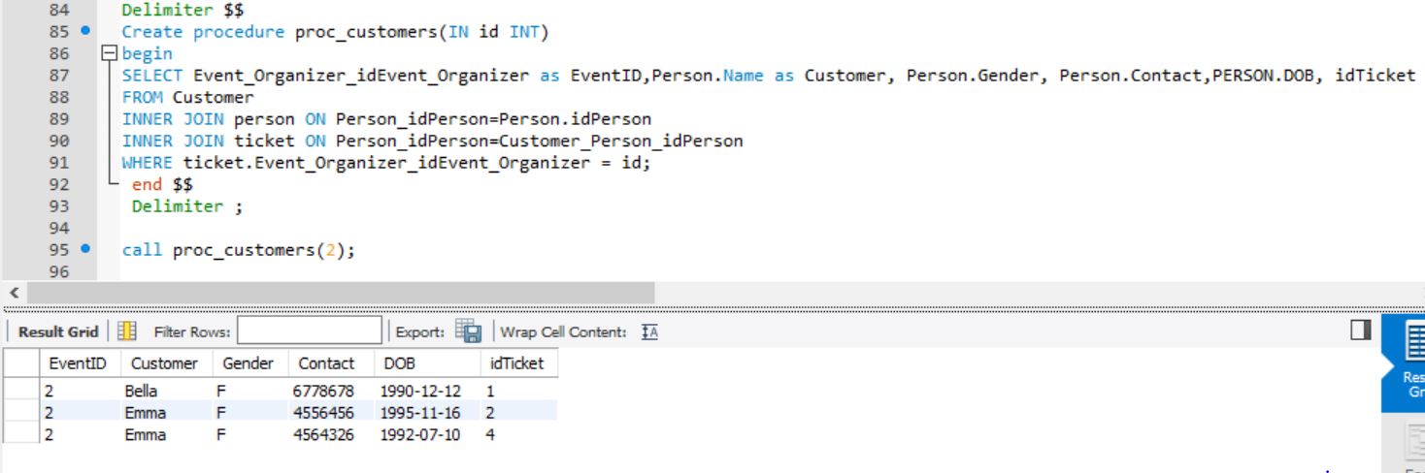
THIS SP CAN BE USED BY THE ORGANIZER TO SEE ALL THE CUSTOMERS ATTENDING THE EVENT, ALONG WITH THE CUSTOMER DETAILS AND TICKET ID.

Slide 11
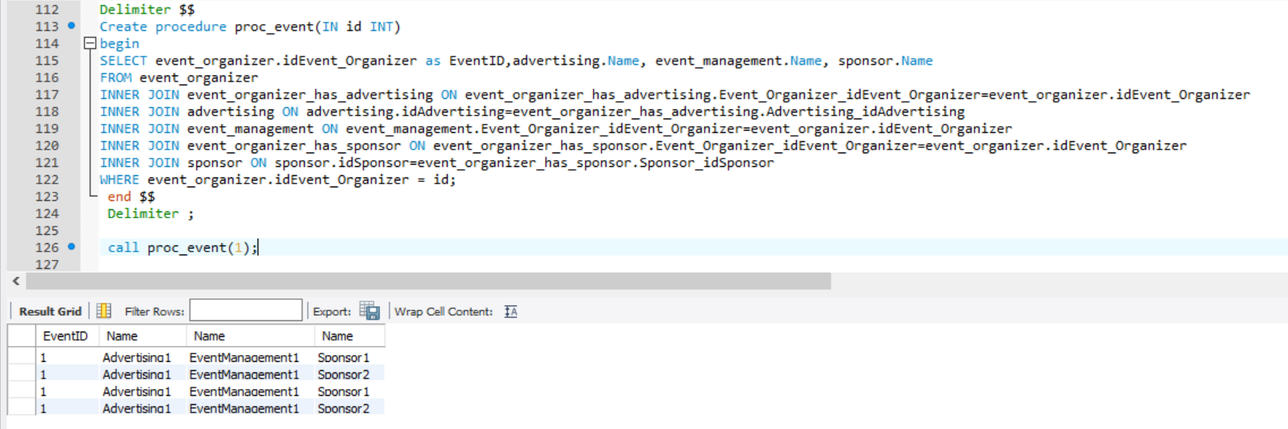
This sp can be used by the organiser to display all the advertising agencies, management company and the sponsors it is associated with.

Slide 12
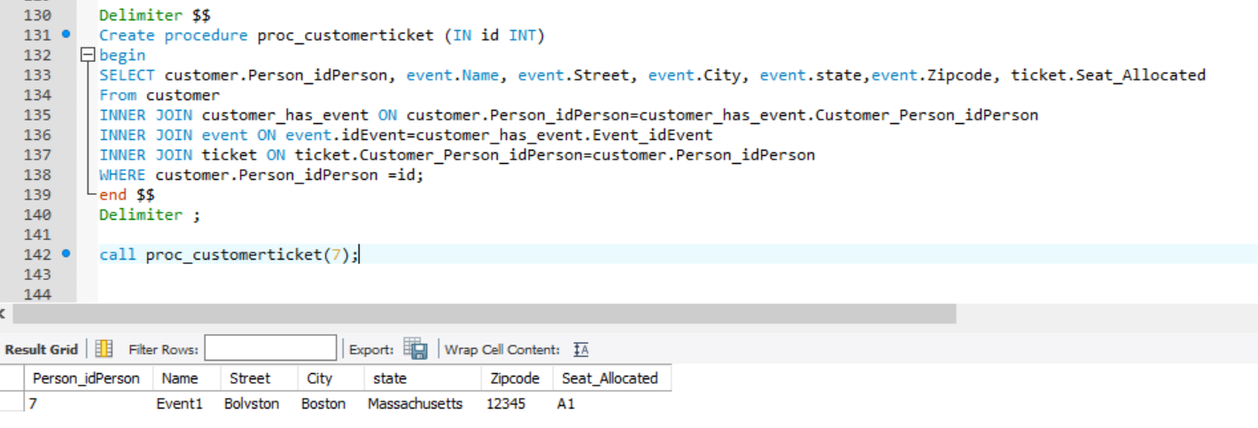
This sp can be used by the customer to view the event name, address, purpose and the seats allocated at that particular event.

Slide 13
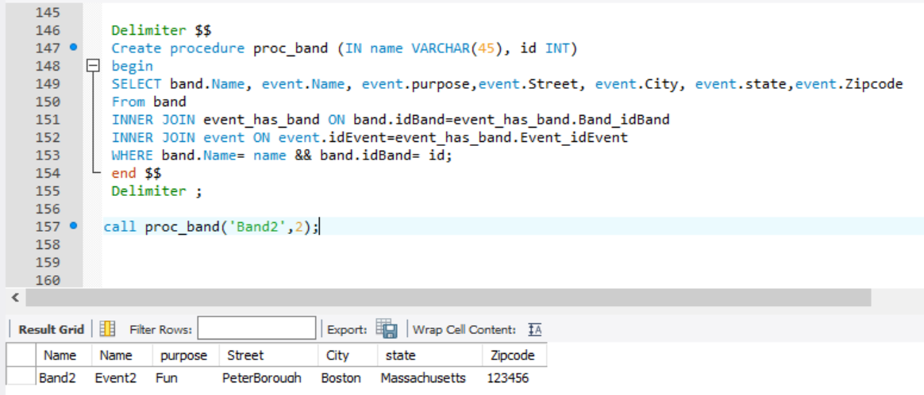
This SP can be used by the band, to view the details of the event it has to perform at.

Slide 14
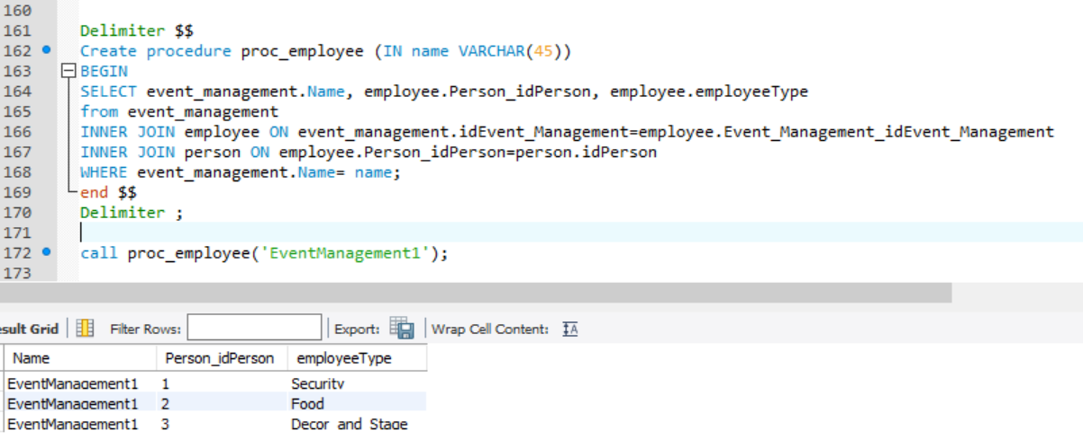
This SP CAN BE USED BY THE MANAGEMENT TO VIEW ALL THE CUSTOMES IT HAS UNDER IT.

Slide 15
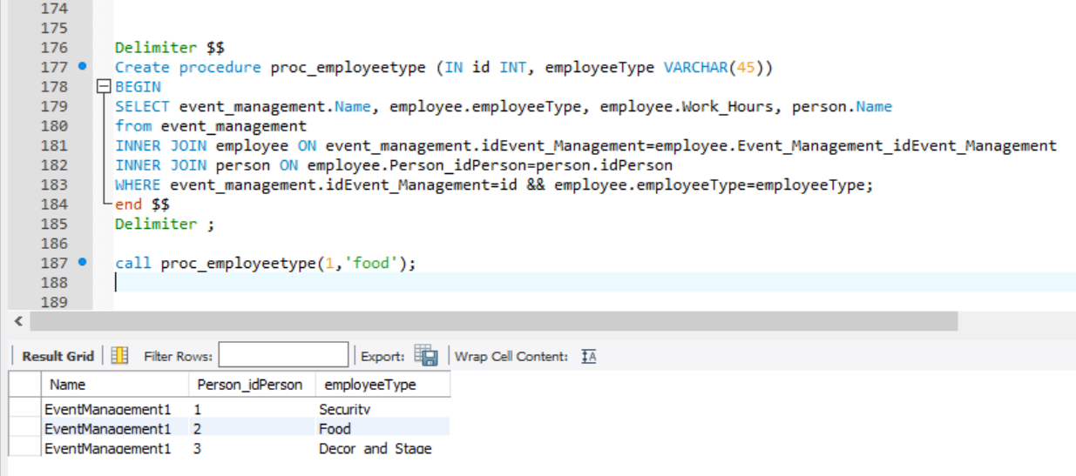
THIS SP can be used by the event management, to view employees of a specific type.

Slide 16
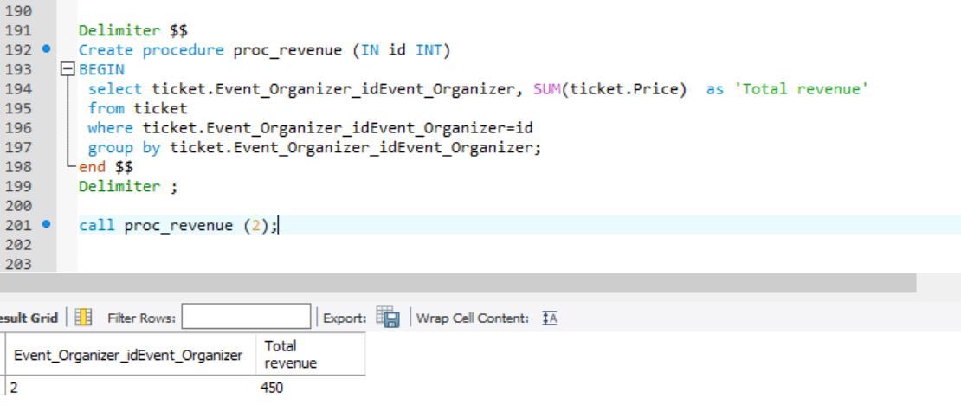
THIS SP CAN BE USED TO CALCULATE THE TOTAL REVENUE EARNED BY A SPECIFIC ORGANIZER, BY ADDING UP THE TOTAL PRICES OF THE TICKETS SOOLD UNDER THAT ORGANIZER.

Slide 17
TRIGGERS

Slide 18
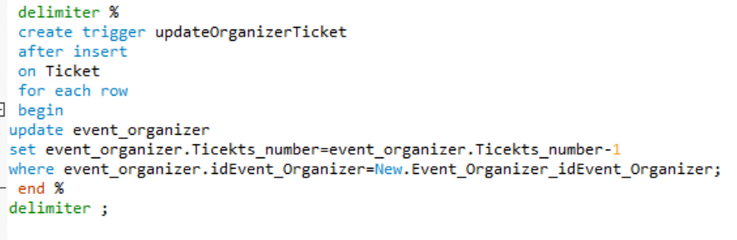
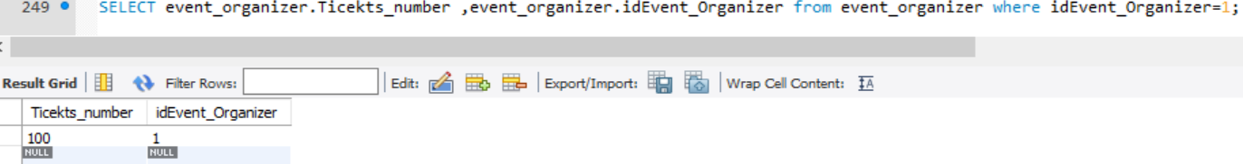
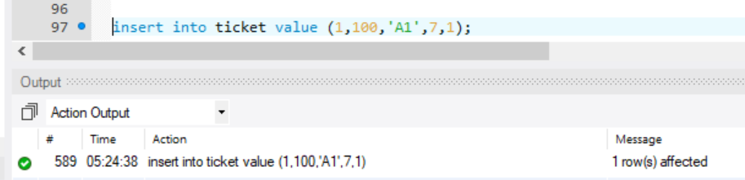
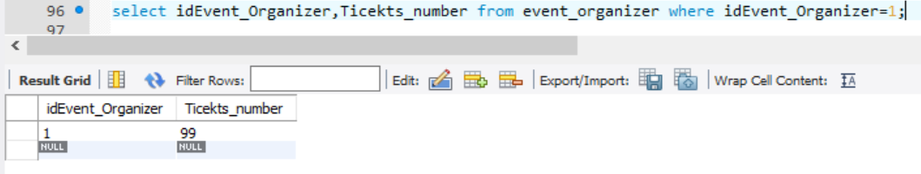
The trigger updates the value in the organizer table, of ticket number, after a ticket has been created.

Slide 19
VIEWS

Slide 20
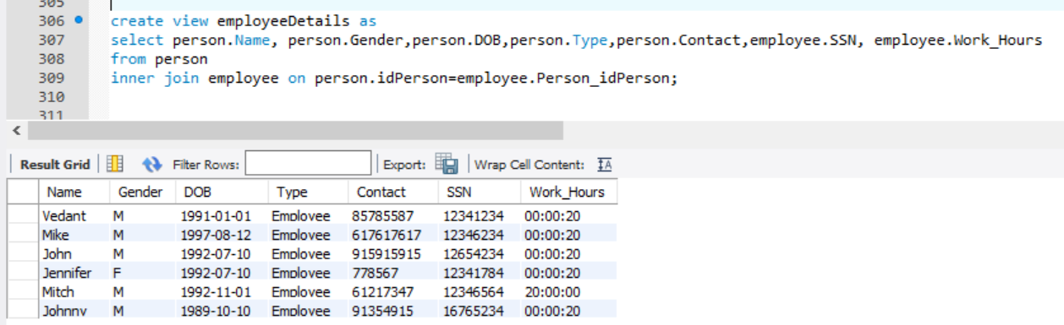
THIS VIEW CAN BE USED FTO VIEW ALL THE EMPLPOYEES WORKING. IT CAN BE PROBABLY USED BY SOME EXTERNAL AGENCY FOR INFORMATIO PURPOSES.

Slide 21
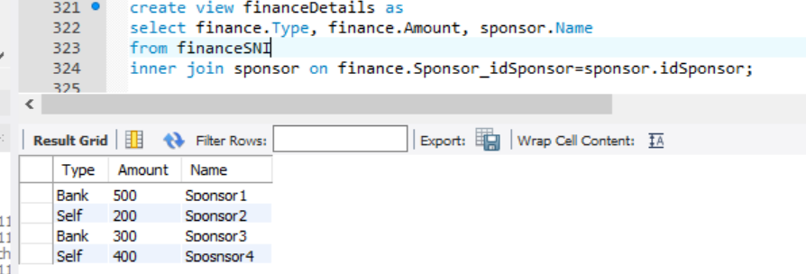
THIS VIEW CAN BE USED BY THE EVENT ORGANIZER, TO IDENTIFY POTENTIAL SPPONSORS.

Slide 22
THANK YOU

