Slide 1
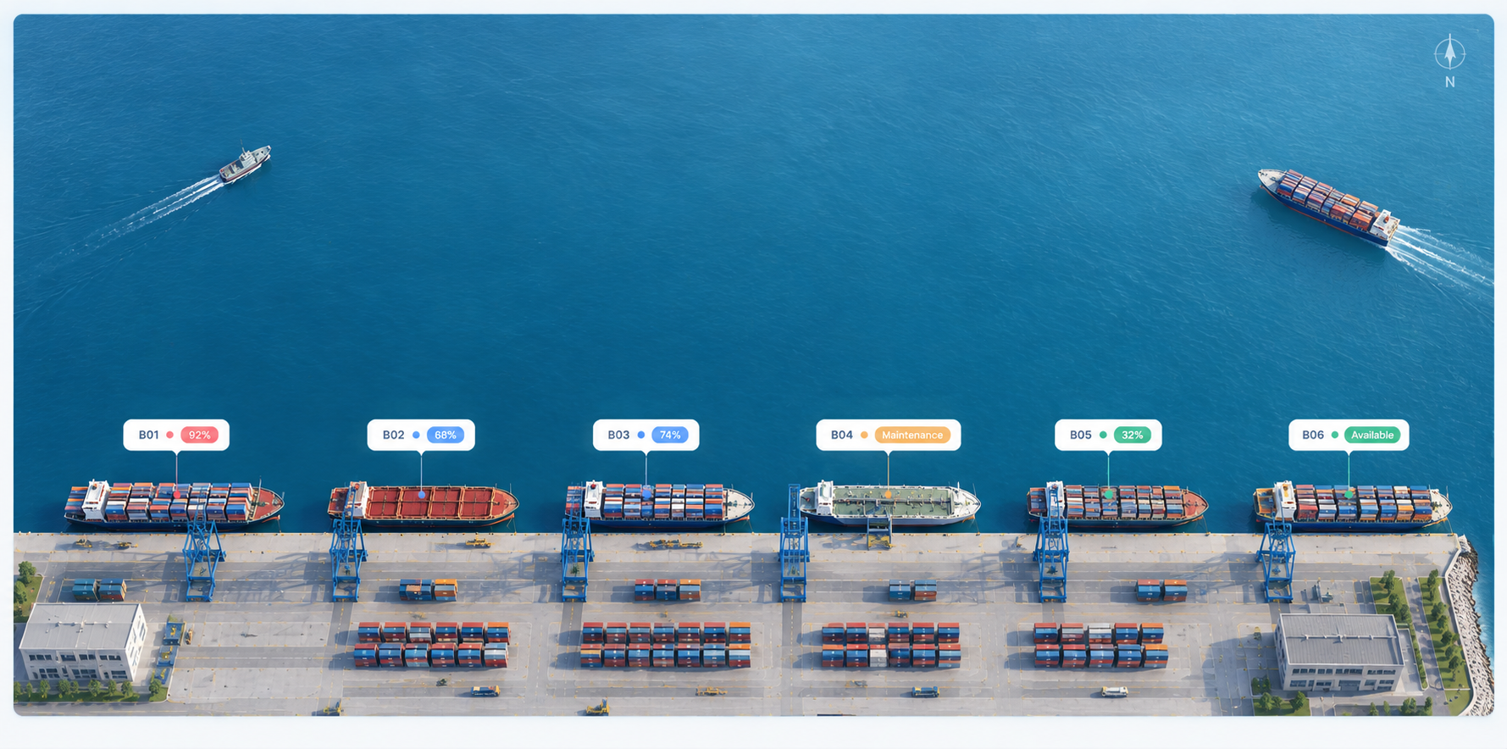
AI TRACK · HACKATHON SUBMISSION
Team Infinite Loop
Container Congestion Predictor & Port Operations Optimiser
AI-Powered Port Analytics, Optimization & Shift Planning Platform
Live Port Dashboard — Berth Status Overview
Prajapati Vedant
Rana Harsh
Savaliya Harshit
Patel Manav
Team Lead
Team Member
Team Member
Team Member
Notes:
Good morning — we're Infinite Loop, and we've built an AI-powered platform that predicts container port congestion and automatically optimizes berth, crane, and shift operations in real time. Let's show you how.

Slide 2



THE PROBLEM
Ports Are Bleeding Money to Congestion
The Old Way
$10B+
Port managers rely on static spreadsheets for planning
First-come-first-served (FCFS) scheduling ignores real constraints
lost annually to demurrage fees from global container port congestion
The Consequences
Inefficient berth allocation leaves vessels waiting
Unoptimized crane deployment wastes capacity
Operational bottlenecks are detected far too late
Problem Statement
Infinite Loop · 02 / 08
Notes:
Ports today are optimized like it's 1995. Spreadsheets and first-come-first-served scheduling can't handle modern vessel volumes. This causes berth conflicts, idle cranes, and congestion that isn't spotted until it's already a crisis — costing the industry over $10 billion a year.

Slide 3





OUR SOLUTION
One Platform: Simulate, Optimize, Predict, Plan
An end-to-end full-stack AI dashboard integrating discrete event simulation, constraint optimization, and forward prediction.
→
→
→
→
1. Simulate
2. Optimize
3. Predict
4. Plan
5. Report
SimPy discrete-event port model
CP-SAT berth & crane allocation
Monte Carlo hotspot forecasting
72-hour automated shift planning
One-click PDF operations report
LIVE DEMO
Live vessel map + real-time simulation controls, streamed over WebSocket.
port-congestion-optimiser-theta.vercel.app
Solution Overview
Infinite Loop · 03 / 08
Notes:
We built a full-stack platform that thinks like an operations analyst. It simulates real port dynamics, optimizes berth and crane allocation mathematically, predicts congestion hotspots before they happen, and turns all of that into an actionable 72-hour shift plan — automatically. You can try it live at the link on screen.

Slide 4



ARCHITECTURE
System Architecture & Data Flow
↔
↔
Frontend
Backend
Analytics Engine
React + Vite
MapLibre GL
FastAPI
REST API + WebSockets
CP-SAT Solver
SimPy DES · Monte Carlo
DATA FLOW
Scenario
Parameter Input
CP-SAT Berth /
Crane Allocation
Hotspot
Prediction
72-hr Shift
Plan Output
→
→
→
Technical Architecture
Infinite Loop · 04 / 08
Notes:
Architecturally, it's a clean three-tier system. The React frontend talks to a FastAPI backend over REST and WebSockets, which feeds our analytics engine — the real brain of the system, combining constraint solving, simulation, and prediction. Data flows from scenario input all the way to a finished shift plan in seconds.

Slide 5





KEY FEATURE
CP-SAT Berth Optimization & Real-Time Simulation
< 2 SECONDS
to compute the full berth + crane optimization pipeline
5 Scenario Presets
Live Vessel Map
Light Traffic, Surge, Shortages & more, ready to run instantly.
Satellite-style tracking streamed live via WebSocket.
What-If Comparisons
CP-SAT Solver Core
Compare optimization outcomes side by side interactively.
Google OR-Tools solves berth & crane constraints exactly.
Key Feature & Demo Flow
Infinite Loop · 05 / 08
Notes:
Here's our headline feature: our CP-SAT solver computes an entire berth and crane optimization in under two seconds. Operators can pick from five real-world scenario presets, watch vessels move live on our satellite-style map, and instantly compare what-if outcomes side by side.

Slide 6


TECHNOLOGY
Core AI & Algorithmic Stack
Four technologies work together to model, solve, forecast, and stream port operations in real time.
Google OR-Tools
(CP-SAT)
SimPy
Monte Carlo
Prediction
FastAPI &
WebSockets
Solves complex berth allocation & crane assignment constraints.
Discrete Event Simulation engine modeling real-world port dynamics.
Evaluates forward congestion risks and identifies hotspots.
Powers low-latency live streaming to the React dashboard.
Core Technology Integration
Infinite Loop · 06 / 08
Notes:
Under the hood, four core technologies power this system: Google OR-Tools' CP-SAT solver handles complex constraint optimization, SimPy simulates real port operations second by second, Monte Carlo methods forecast congestion risk, and FastAPI with WebSockets streams it all live to the dashboard with minimal latency.

Slide 7

RESULTS & IMPACT
Measurable Impact, Real Fast
20–40%
< 2 sec
72-hr
Reduction in vessel wait times vs. standard FCFS scheduling
End-to-end simulation and shift schedule generation
Automated shift work orders with contingency notes
Results & Impact
Infinite Loop · 07 / 08
Notes:
The impact is measurable. Compared to standard first-come-first-served scheduling, we cut vessel wait times by 20 to 40 percent. The whole simulation-to-schedule pipeline runs in under two seconds, and it produces ready-to-use 72-hour shift work orders — including contingency notes — that port operators can act on immediately.

Slide 8

OUR TEAM
Team Infinite Loop
LEAD
Prajapati Vedant
Rana Harsh
Savaliya Harshit
Patel Manav
Team Lead
Team Member
Team Member
Team Member
Architecture, CP-SAT Optimization & Backend APIs
Discrete Event Simulation (SimPy) & Monte Carlo Engine
Frontend UI/UX, MapLibre GL Vessel Map & Recharts
WebSockets Streaming, Shift Planner & PDF Report Generator
Live Demo:
https://port-congestion-optimiser-theta.vercel.app/
Team & Roles
Infinite Loop · 08 / 08
Notes:
That's Infinite Loop — Vedant led architecture and optimization, Harsh built the simulation and prediction engine, Harshit crafted the live map and dashboard experience, and Manav delivered real-time streaming and automated reporting. You can try the live demo yourself at the link on screen. Thank you — happy to answer questions.

