Slide 1
Olist_Ecommerce_Story
File created on: 26/05/26 06:31:51 IST

Slide 2
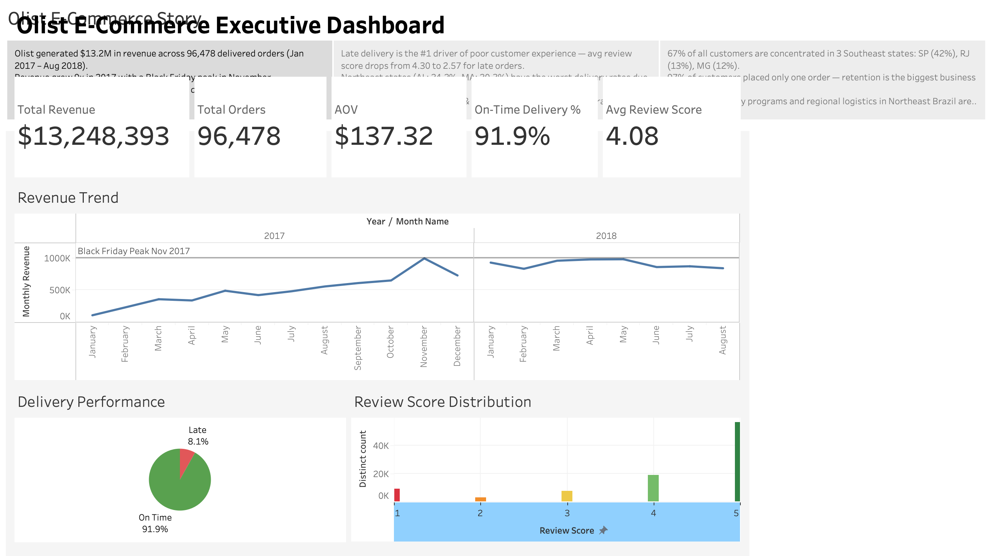

Slide 3
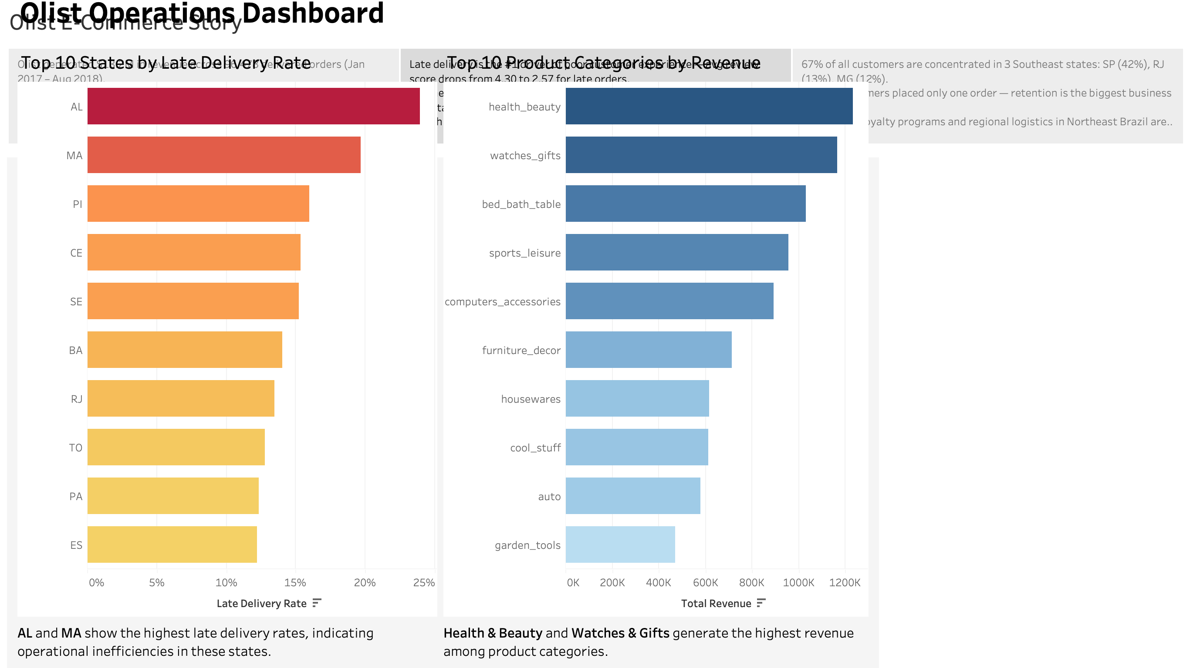

Slide 4
