Slide 1

Multi-Branch Banquet Management System
Digitizing and Centralizing Banquet Operations
Presented by: Vedashree Bhandigare
Arjun Raghav
Pranay Kumar

Slide 2
Presentation Outline
01
02
03
Problem Overview
Centralized Dashboard
Lead Lifecycle
Understanding the industry challenges.
Multi-branch control and insights.
From inquiry to conversion tracking.
04
05
06
Booking & Calendar
Event Management
Billing & Payments
Real-time availability and conflict resolution.
Comprehensive event workflow automation.
Automated financial processing.
07
AI Call Management (Beta)
Our advanced AI-powered feature.

Slide 3


The Core Industry Problem
Manual Lead Tracking
Inefficient, prone to errors, and time-consuming.
Double Bookings
Leads to customer dissatisfaction and lost revenue.
Poor Follow-ups
Missed opportunities and weak client relationships.
No Centralized Visibility
Lack of overview across multiple banquet branches.
Billing & Stock Inefficiencies
Manual errors and lack of real-time inventory.
These common pain points hinder growth and operational efficiency in the banquet industry.

Slide 4
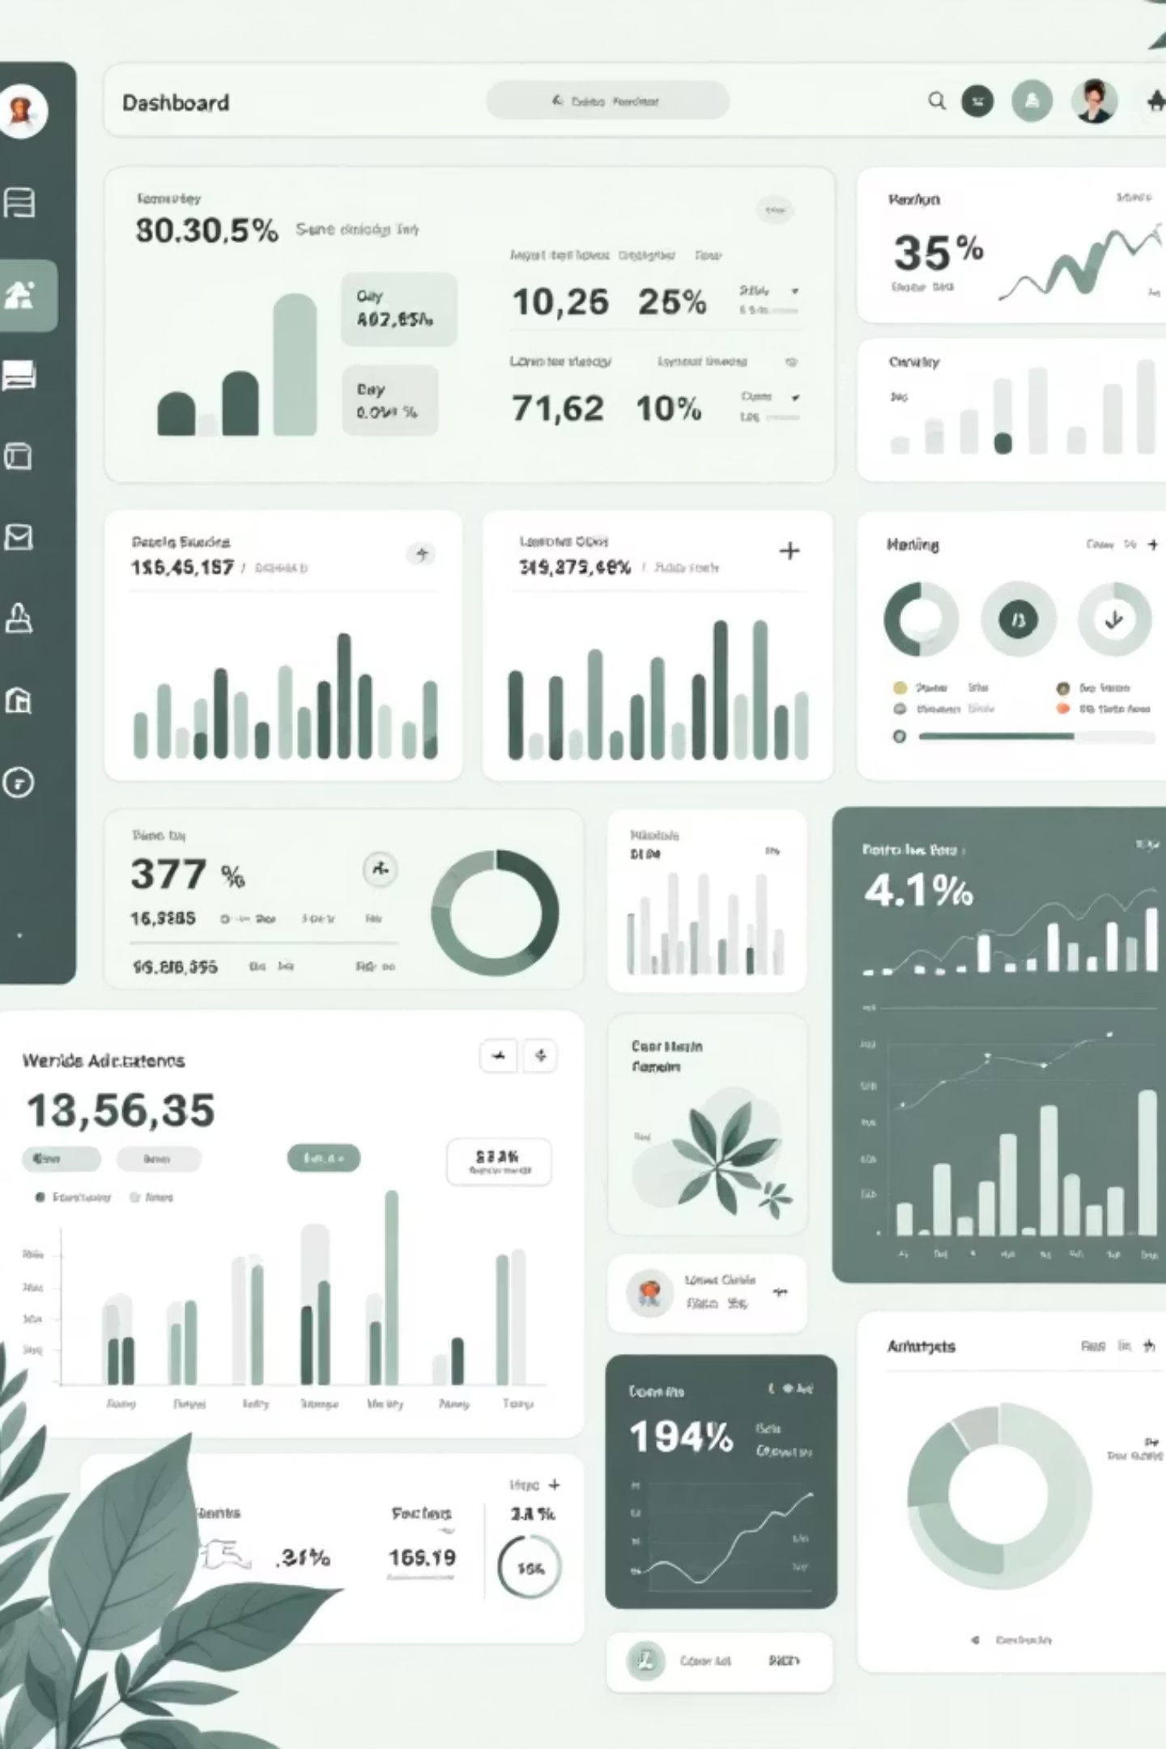
Implemented Features: Driving Efficiency
Our solution directly addresses industry challenges with robust, functional modules.

Slide 5
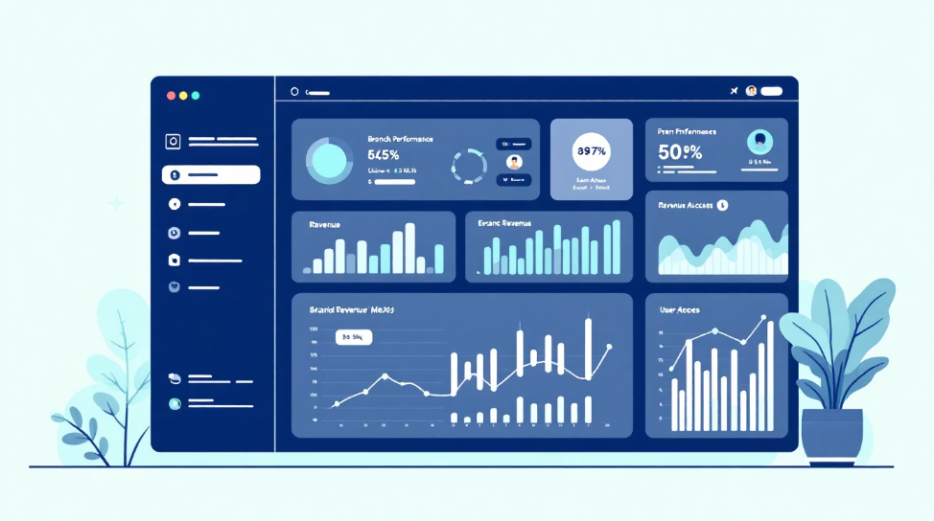
Centralized Multi-Branch Dashboard
Empowering owners with complete oversight.
Owner Dashboard Control
Branch-wise Access Control
Seamlessly manage and monitor all banquet branches from a single interface.
Define and manage user permissions for each branch, ensuring data security and relevance.
Performance Tracking
Revenue Visibility
Visualize and analyze key performance indicators (KPIs) for individual branches and the entire network.
Gain instant insights into revenue streams and financial health across all locations.
This fully functional module provides critical data and control, enabling informed decision-making.

Slide 6

Complete Lead Lifecycle Management
Streamlining every step from inquiry to conversion.
Call
Tasting
Initial client inquiry logged
Menu sampling and feedback
Visit
Advance
On-site consultation scheduled
Deposit collected to confirm
Our system meticulously tracks each lead through its entire journey, ensuring no opportunity is missed.
This module is fully implemented and operational, significantly boosting sales efficiency.

Slide 7

Pipeline
Status Pipeline
1
Visual progression from 'New' inquiry to 'Converted' or 'Lost' status.
Lead Assignment
2
Automated or manual assignment of leads to relevant team members.
Follow-up Reminders
3
Automated alerts to ensure timely communication and engagement.
Real-time Lead Tracking
4
Monitor lead status and activities in real-time for immediate action.

Slide 8



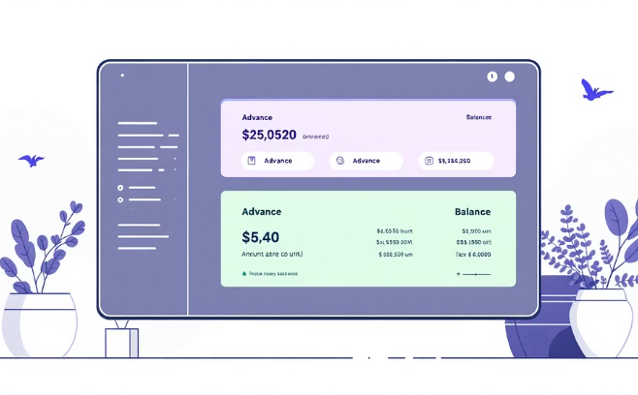
Real-Time Booking & Calendar System
Eliminating scheduling conflicts with intelligent automation.
Live Availability Calendar
Intuitive calendar showing real-time availability of all banquet halls.
Conflict Prevention Mechanism
Automated alerts and blocks to prevent any overlapping bookings.
Advance & Balance Payment Tracking
Integrated financial tracking for deposits and outstanding amounts linked to bookings.
Our system ensures zero double bookings and a smooth scheduling experience, fully implemented.

Slide 9

Event Management Module
Orchestrating flawless events from start to finish.
Guest Count Tracking
Dynamically manage and update guest attendance numbers.
Menu Selection
Streamlined process for selecting and customizing event menus.
Add-on Management
Easily include and track additional services like special lighting or entertainment.
Vendor Allocation
Assign and manage both internal and third-party vendors for specific event needs.
Event Checklist Tracking
Comprehensive checklists ensure all tasks are completed on time and in order.
This module provides robust tools for managing every aspect of an event workflow, active and essential for smooth operations.

Slide 10

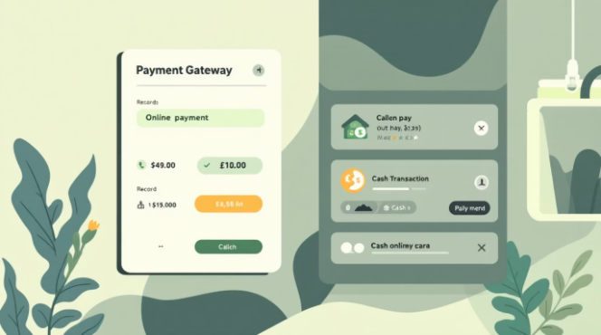
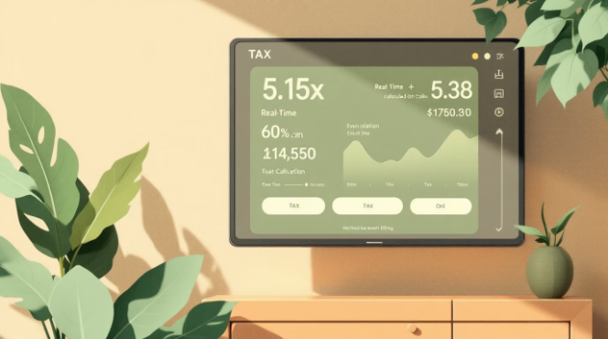
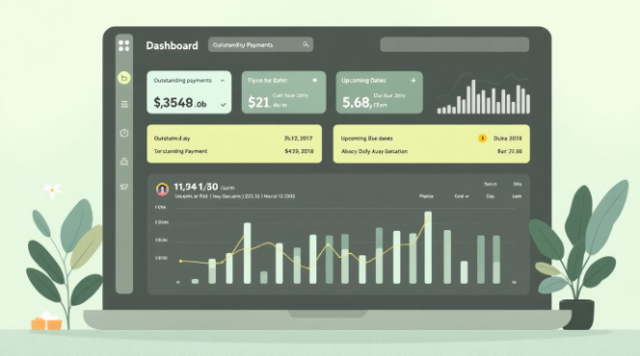
Billing & Payment System
Automating financial operations for accuracy and ease.
Automated Invoice Generation
Online & Cash Payment Tracking
Auto Tax Calculation
Outstanding Tracking
Accurate and compliant tax computations applied automatically.
Generate professional, itemized invoices instantly.
Record and reconcile all payment methods seamlessly.
Monitor pending payments and send automated reminders to clients.
Our billing calculations are fully automated and operational, ensuring financial accuracy and transparency.

Slide 11


