Slide 1
Student Command
Interpreter
A mini command-line shell in C
NAMES | ROLL NO.
RAKESH | 2510030405
Vedasri | 2510030094
Thrilochan | 2510030351
Sai Charan | 2510030112

Slide 2
>_
What is Our Project?
Why did we build it?
Technologies
To develop a Student Command Interpreter using the C programming language.
Design a command-line interface to perform student-related operations.
C
Linux / WSL
Core language
Runtime environment
To show how a command interpreter interacts with the Operating System
To combine OS concepts with a practical student information system
CSV Files
Student data

Slide 3
>_
Working of StudentShell
USER
Enters a command
StudentShell>
Read Input
COMMAND PARSER
Command + Arguments
LINUX COMMAND
ls, cat, date, mkdir, etc.
STUDENT COMMAND
attendance · internals · cgpa · student · note · help
fork() → execvp() → waitpid()
DATA FILES
CSV + Notes
OUTPUT — displayed to user
Input → Parse → Identify → Execute → Output

Slide 4
>_
Linux Commands
What is it?
What happens in the code?
The shell runs Linux commands dynamically instead of hardcoding every command.
User Input
Parse command + arguments
ls
mkdir
cat
date
clear
fork()
fork()
creates a child process
Child: execvp(command, args)
execvp()
replaces the child with the requested Linux program
Linux executes command
waitpid()
waitpid()
parent waits for the child to finish
Shell continues

Slide 5
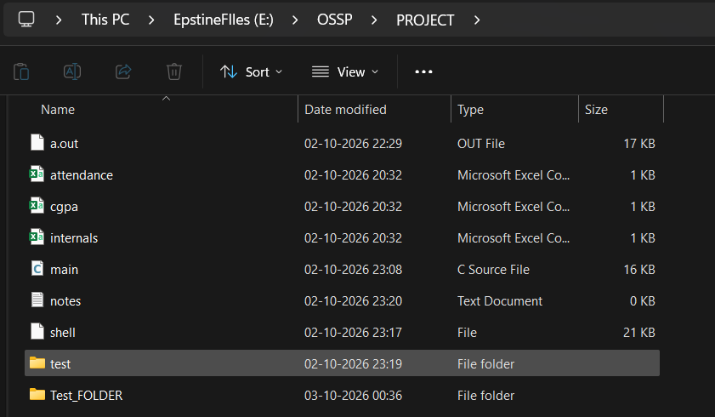
>_
Outputs
Linux Commands

Slide 6
>_
Attendance, Internals & CGPA
Command | File
attendance | attendance.csv
internals | internals.csv
cgpa | cgpa.csv
Custom C functions that retrieve a student's academic information from CSV files.
What happens in the code?
fopen() opens the CSV file
fgets() reads each row
get_field() extracts CSV fields
strcmp() compares roll number
Matching record is found
printf() displays the data
The same process is used for internals and cgpa.

Slide 7
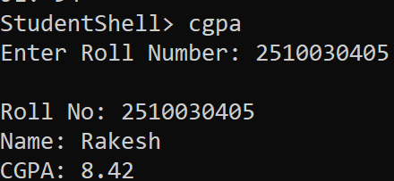
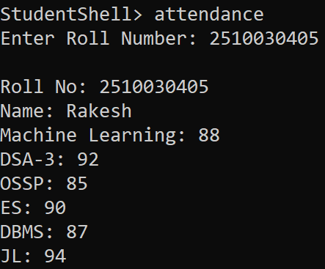
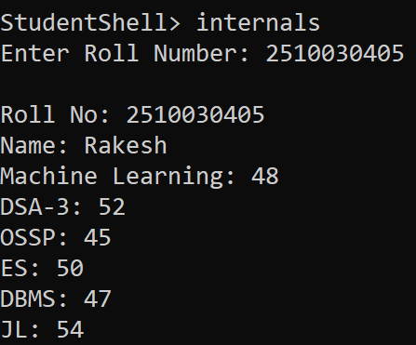
>_
Outputs

Slide 8
>_
Student Dashboard & Notes
student — Dashboard
note — Notes System
One command that combines data from all three CSV files.
note add
fopen("notes.txt","a") → time() + ctime() → write timestamp + note → fclose()
Enter roll number
Open 3 CSV files with fopen()
Search attendance.csv
Search internals.csv
Search cgpa.csv
Store the matching values
printf() displays the dashboard
note view
fopen("notes.txt","r") → fgets() reads notes → printf() displays
note delete
fopen("notes.txt","w") → opened for writing → existing contents cleared
The same roll number is used for all three files, so the data belongs to one student.

Slide 9
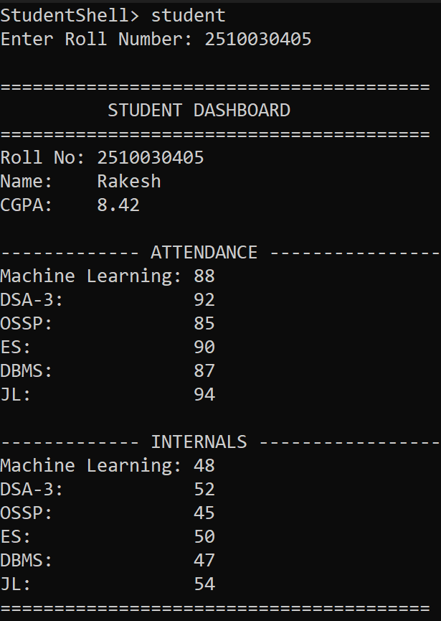
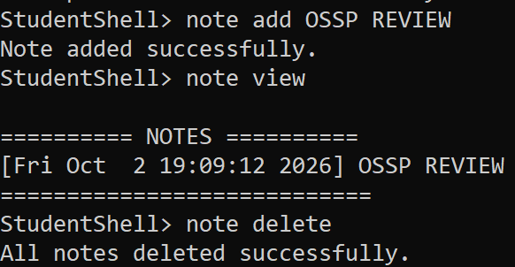
>_
Outputs

Slide 10
THANK YOU
StudentShell> exit

