Slide 1




LOOPLABS
•Problem Statement Title - Technology for Women’s Safety and Leveraging Public Spaces
•Theme -WOMEN SAFETY AND AWARENESS
•Team ID –VEDLOO44
•Team Name (Registered on Website) -LOOPLABS
•Participant Names –Vedavyas Reddy Somu (AI-ML)
Vaishnavi sree Ravva(AI-ML)
Sri Indu College of Engg & Tech - Cyber Club, Department of Cyber Security
Page 01

Slide 2

LOOPLABS
LOOPLABS
Proposed Solution
1.EMERGENCY SOS ALERT SYSTEM
2.LIVE LOCATION TRACKING
3.ONE –TAP CALL HELPLINE
4. SAFE ZONE ALERTS
5.FAKE CALL
Sri Indu College of Engg & Tech - Cyber Club, Department of Cyber Security
Page 02

Slide 3
TECHNICAL APPROACH
Technologies to be used are HTML5,CSS3 with Tailwind CSS,Vanilla JavaScript
METHODOLOGY : user security and privacy and real time tracking
Sri Indu College of Engg & Tech - Cyber Club, Department of Cyber Security
Page 03

Slide 4
s
FEASIBILITY AND VIABILITY
LOOPLABS
FEASIBILITY
1. Web technologies are readily available
2.users are likely to find it easy to adopt ,since it serves a critical purpose
VIABILITY
1.this addresses a real sociental need- enhancing women's safety
2.regular user feedback and data driven updates can help maintain relevance and effectiveness over t
Sri Indu College of Engg & Tech - Cyber Club, Department of Cyber Security
Page 04

Slide 5
IMPACT AND BENEFITS
LOOPLABS
Location Tracking
Enable real-time tracking of women's location to provide assistance during emergencies.
Emergency Alerts
Send immediate alerts to pre-selected contacts and authorities in case of danger.
Fake Call Feature
Escape Unsafe Situations
Allows women to simulate an incoming call to create a distraction or excuse to leave.
Pre-recorded Messages
Provides customizable messages and sound effects for realism.
•
Sri Indu College of Engg & Tech - Cyber Club, Department of Cyber Security
Page 05

Slide 6
RESEARCH AND REFERENCES
LOOPLABS
IDEAS:
1. GOOGLE SEARCH ENGINE
2.TEAM DISCUSSION
3.EXPERIENCE GUIDENS
4.AVAILABILITY OF HELP SERVICE
SOLUTIONS :
SOS HELP IN SINGLE CLICK
LIVE LOCATIONS TRACKING
FAKE CALLS
Sri Indu College of Engg & Tech - Cyber Club, Department of Cyber Security
Page 06

Slide 7
LOOPLABS
FUTURE ENHANCEMENTS
Database Integration
Connect to a database for secure profile data storage.
Audio Recording
Enable audio recording for detailed incident reporting.
Video Recording
Allow video recording to capture visual evidence.
Enhanced Reporting
Improve reporting features for easier incident documentation and submission.
Sri Indu College of Engg & Tech - Cyber Club, Department of Cyber Security
Page 07

Slide 8
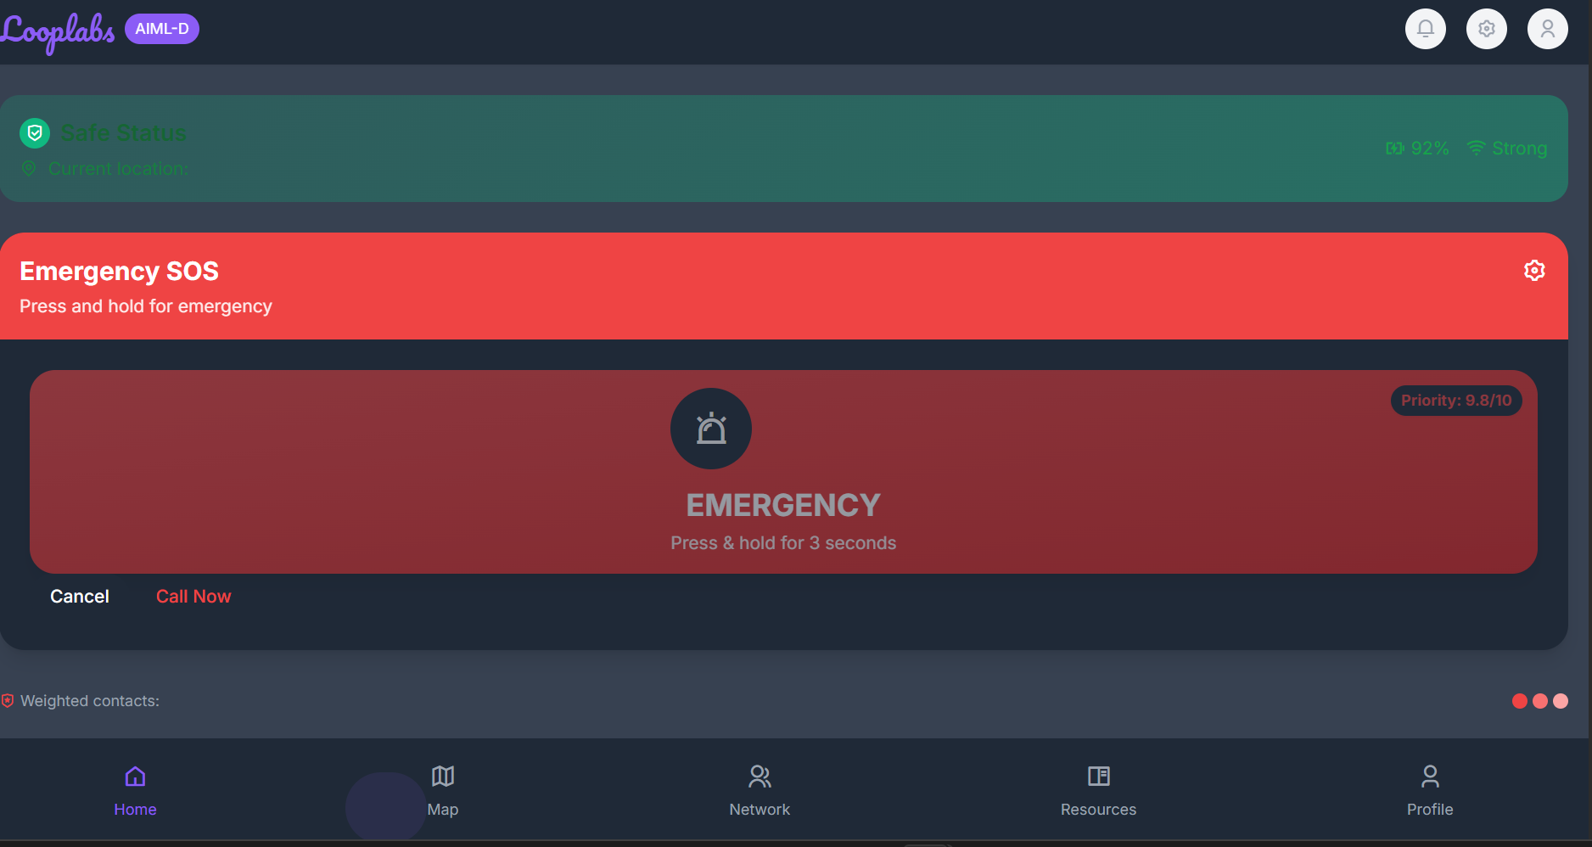
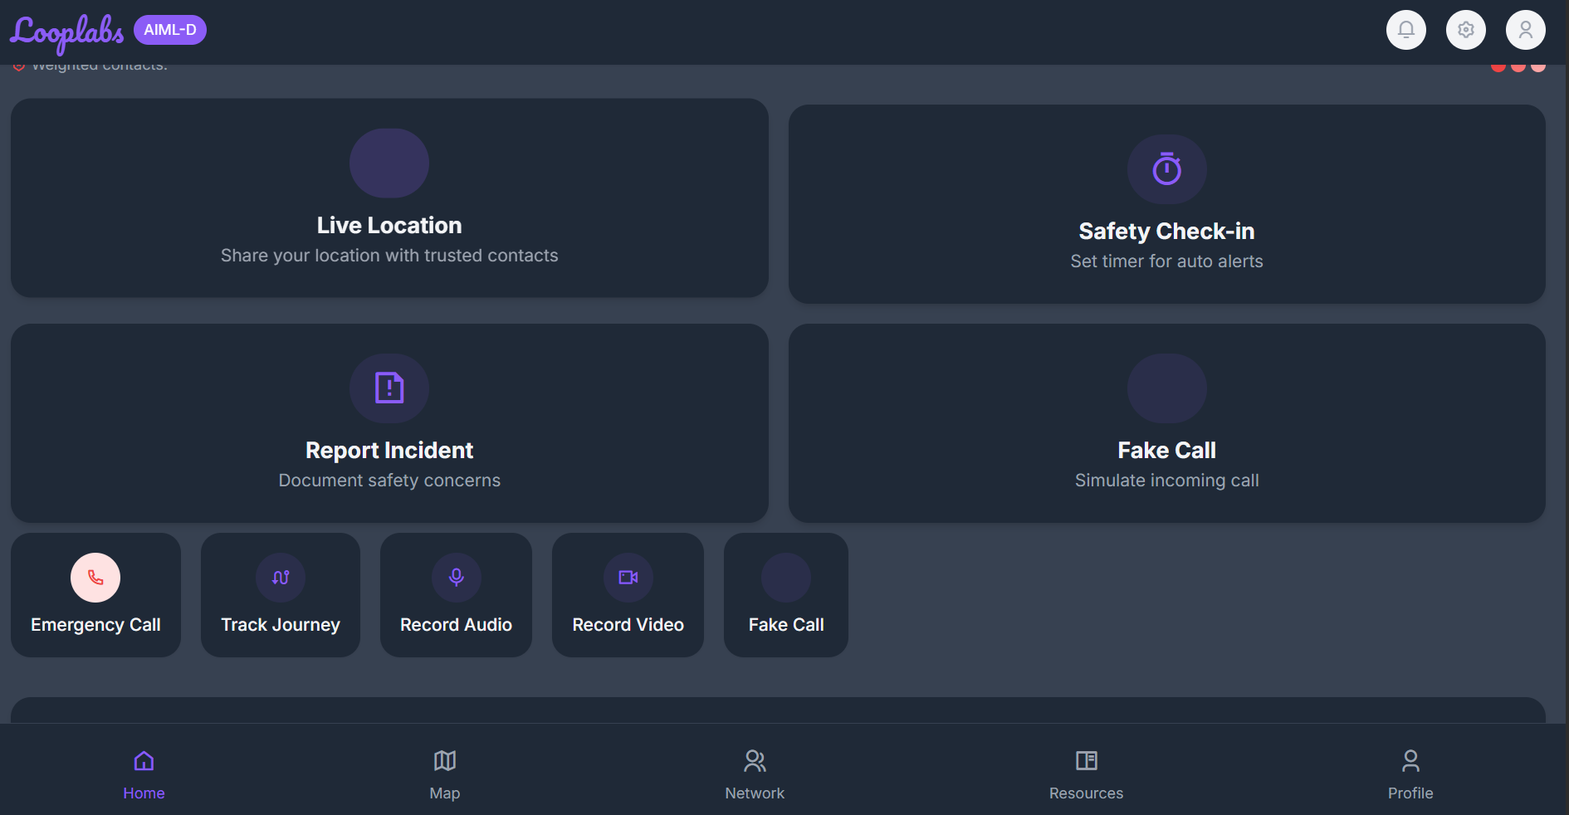
LOOPLABS
DEMO
Sri Indu College of Engg & Tech - Cyber Club, Department of Cyber Security
Page 08

Slide 9
L
CONCLUSION & THANK YOU
LOOPLABS
This innovative web application is designed to empower women and provide them with the tools and resources needed to feel safe and protected in their daily lives. By combining advanced technology with a community-based approach, we aim to create a safer and more inclusive environment for women around the world.
Sri Indu College of Engg & Tech - Cyber Club, Department of Cyber Security
Page 09

