Slide 1
DIGITAL MEDICO / ROUND TWO
Care, connected.
From a healthcare problem to a working, privacy-first website.
DIGITAL
MEDICO
01
Emergency history
02
Doctoc communication
Patient history. Medication adherence.
A direct line to the doctor.
03
Medication reminders
24-HOUR HACKATHON
ROUND 2 • BUILD STORY
DIGITAL MEDICO • CARE, CONNECTED.
01 / 16
Notes:
Introduce Digital Medico as a working website prototype. We built two portals around emergency medical history, patient–doctor communication and medication reminders. This presentation explains the implementation process, demonstrates verified workflows, and separates current capabilities from production proposals. Do not claim real biometric authentication, trained clinical AI or production healthcare compliance.

Slide 2
DIGITAL MEDICO / ROUND TWO
Care loses context when records are scattered.
The problem in the original presentation became three concrete product requirements.
THE EMERGENCY GAP
THE COMMUNICATION GAP
THE ADHERENCE GAP
Missing history
Delayed answers
Forgotten doses
A doctor may need to act before the patient can explain allergies, medication or previous treatment.
Patients wait for appointments to ask simple questions or clarify their care plan.
A prescription is useful only when the patient can follow its schedule consistently.
DIGITAL MEDICO • CARE, CONNECTED.
02 / 16
Notes:
We read the full presentation, including its diagrams and speaker notes. The emergency problem was not simply storing documents: the doctor needs a concise, reliable medical context. We translated the three gaps into the website’s three main workflows, without inventing measured impact figures.

Slide 3
DIGITAL MEDICO / ROUND TWO
Two portals. One connected care journey.
A shared backend connects the patient’s control with the doctor’s clinical actions.
PATIENT PORTAL
DOCTOR PORTAL
My health, my control
Care with full context
View medical history and prescriptions.
Ask questions and confirm doses.
Grant or revoke doctor access.
Select an assigned, consenting patient.
Update clinical records and prescriptions.
Review questions and dose activity.
THE RULE: shared care must never become unrestricted access.
DIGITAL MEDICO • CARE, CONNECTED.
03 / 16
Notes:
Describe the roles before demonstrating features. The patient can read their own information and make consent decisions. The doctor can make clinical updates only for assigned patients with active consent. Patient account creation creates an isolated profile instead of copying the seeded patient’s history.

Slide 4
DIGITAL MEDICO / ROUND TWO
How we built it, step by step.
A focused build sequence kept the prototype achievable and reviewable.
01
02
03
04
Define the scope
Design the experience
Build authentication
Enforce access
Read the deck; select core workflows.
Separate patient and doctor journeys.
Hash passwords; create secure sessions.
Check roles, patient identity and consent.
05
06
07
08
Connect medical records
Add communication & alarms
Validate the workflows
Package the website
Persist visits, profiles and prescriptions.
Doctor replies and medication actions.
API, browser, mobile and build checks.
VS Code setup and GitHub delivery.
DIGITAL MEDICO • CARE, CONNECTED.
04 / 16
Notes:
This is the implementation roadmap. We began with an almost empty repository, established the standard website stack, and built a real local API and database. Features were connected through that API rather than simulated solely in the interface. Validation and packaging were part of the build, not an afterthought.

Slide 5
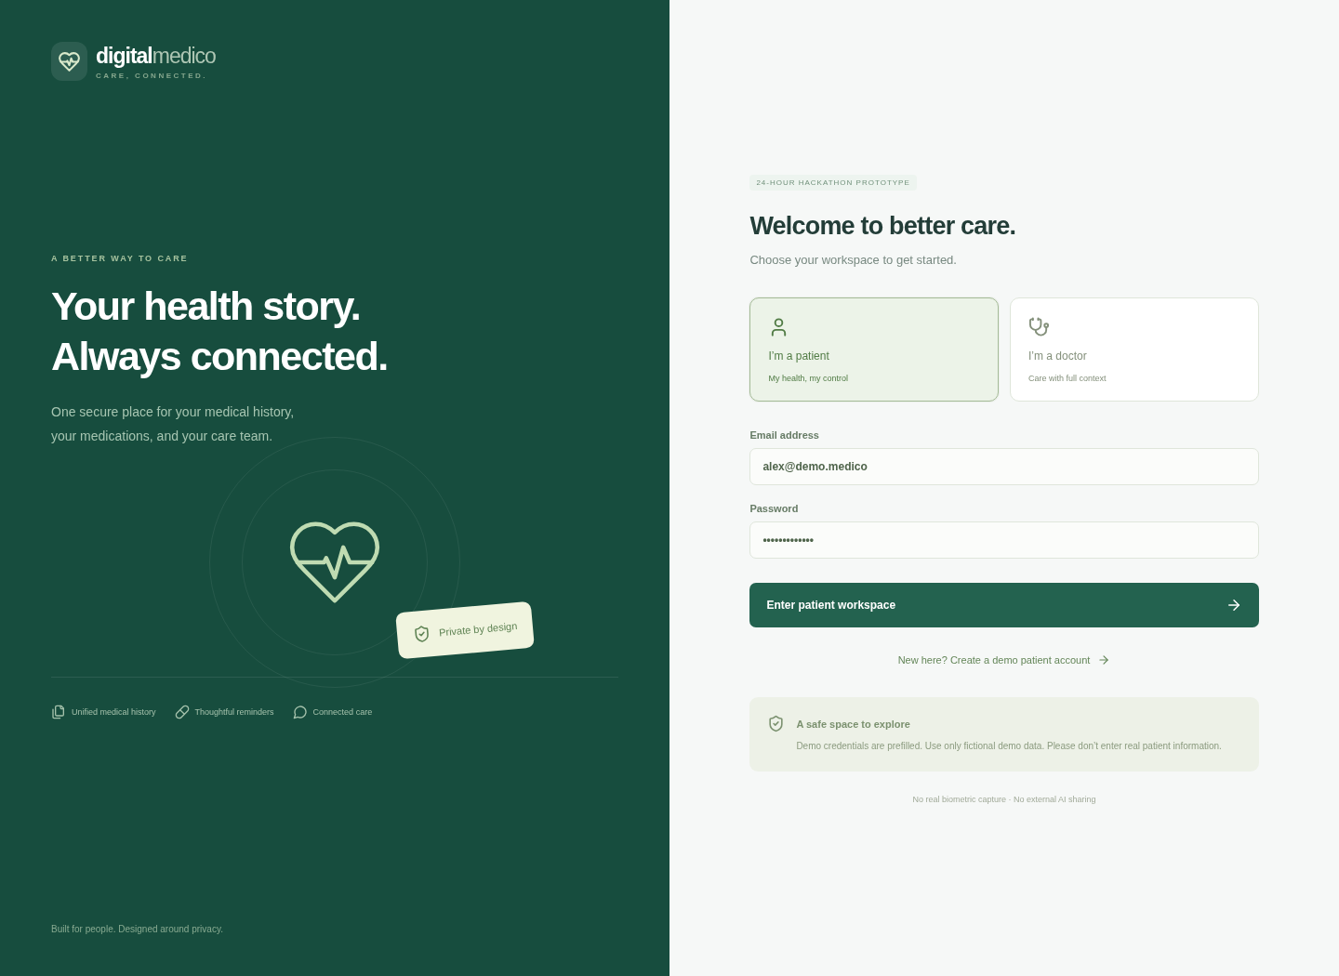
STEP 01 / USER EXPERIENCE + AUTHENTICATION
First, make each portal trustworthy.
Authentication determines the workspace; the interface cannot grant itself a role.
A real sign-in flow
CHOOSE A PORTAL
Patient and doctor credentials are checked against their stored role.
VERIFY CREDENTIALS
Normalized email + individually salted scrypt password hashes.
RESTORE THE SESSION
HTTP-only cookie; refresh keeps an active session. Logout invalidates it.
DIGITAL MEDICO • CARE, CONNECTED.
05 / 16
Notes:
Show the actual login screen. We fixed role mismatch handling so a patient account cannot enter the doctor portal by selecting it. Emails are normalized, passwords are hashed, sessions are rotated on login and authenticated writes require a CSRF token. Browser tests verified both portals, page refresh and sign-out in development and built-website modes.

Slide 6
STEP 02 / IMPLEMENTED ARCHITECTURE
Then, connect the interface to a real backend.
This is the architecture implemented in the current prototype.
WEBSITE
BACKEND
PERSISTENCE
React + Vite
Python HTTP API
Local SQLite
Two responsive portals
Forms, timelines and reminders
Authentication and authorization
Clinical and patient workflows
Records, consent, messages
Prescriptions and dose activity
Every medical request: session → role → patient assignment → consent → scoped query → audit.
DIGITAL MEDICO • CARE, CONNECTED.
06 / 16
Notes:
Be precise about the implemented stack: React and Vite, a Python standard-library HTTP API, and SQLite. FastAPI, MySQL and background workers are proposed upgrades, not present services. The website uses same-origin API requests; the production start mode serves both built frontend and API from one server. Medical authorization happens on the server.

Slide 7
STEP 03 / DATA MODEL + PATIENT ISOLATION
Give every patient a separate health story.
We designed the data boundaries before adding more accounts.
IDENTITY
PERMISSION
CLINICAL HISTORY
Users + patient profiles
Consent grants
Records + prescriptions
Account role, assigned doctor, emergency ID.
Explicit patient control over doctor access.
Visits, clinical notes, medication instructions.
ADHERENCE
COMMUNICATION
ACCOUNTABILITY
Dose schedules + logs
Messages + replies
Audit events
Today’s status and preserved activity history.
Private questions, escalation and doctor responses.
Who accessed or changed which patient’s information.
DIGITAL MEDICO • CARE, CONNECTED.
07 / 16
Notes:
Every clinical entity is associated with a patient. Registered patients begin with an empty profile and separate records. Server tests attempt cross-patient reads and medication writes and confirm they are rejected. Clinician queries also check assignment, so knowing a patient identifier is not enough to authorize access.

Slide 8
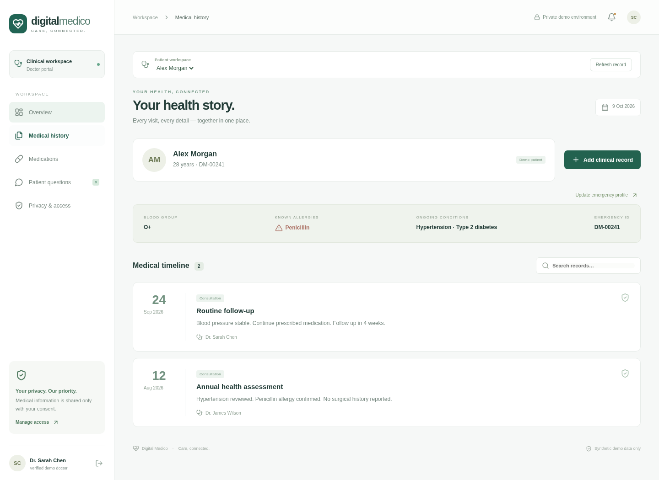
STEP 04 / CLINICAL RECORDS + PROFILES
Turn a consultation into a lasting record.
Doctor updates become visible in the correct patient’s portal.
Record once.
Keep the context.
01
Select the consented patient
02
Review allergies and conditions
03
Add the visit and clinical notes
04
Save a prescription and dose time
VERIFIED: RECORDS PERSIST
DIGITAL MEDICO • CARE, CONNECTED.
08 / 16
Notes:
Use the doctor history screenshot as evidence of the real interface. We implemented profile updates, clinical record creation, prescriptions, and persistence. The patient cannot edit clinical records through the API. Browser tests created a separate patient, added their first consultation and checked that it appeared only in that patient’s account.

Slide 9
STEP 05 / EMERGENCY MEDICAL HISTORY
Emergency history, with permission.
The demo verifies the workflow; biometric identity integration remains simulated.
01
02
03
04
05
Identify
Verify
Authorize
Summarize
Record
Matching emergency ID
Simulated identity check
Doctor + assignment + consent
Allergies, conditions, medicines
Reason and access audit
No biometric data is captured. Revoked consent also blocks emergency access.
Identity verification and permission to read medical information are separate decisions.
DIGITAL MEDICO • CARE, CONNECTED.
09 / 16
Notes:
The clinician provides a matching emergency ID and an access reason, then performs a clearly labeled simulated verification. The event is audited. This demo does not collect biometric data and does not bypass revoked consent. A production emergency override would need explicit institutional policy, legal basis, limited access and additional audit controls.

Slide 10
STEP 06 / PATIENT–DOCTOR COMMUNICATION
Build Doctoc around safe escalation.
The assistant keeps the doctor responsible for clinical decisions.
PATIENT QUESTION → PERMITTED CONTEXT → GUIDANCE OR HUMAN REVIEW
SCHEDULE QUESTION
CLINICAL QUESTION
URGENT SYMPTOMS
Read the prescription
Ask the doctor
Seek urgent care
Return this patient’s recorded medication schedule. No invented dose or treatment.
Send uncertain questions to the clinician inbox; save and display the doctor’s reply.
Show emergency-care guidance immediately. Never ask the patient to wait for chat.
Current Doctoc is scripted. No records are sent to an external AI. Without consent, questions stay private.
DIGITAL MEDICO • CARE, CONNECTED.
10 / 16
Notes:
Doctoc is a scripted assistant in this prototype, not a trained clinical language model. It can read recorded schedules, route clinical questions to a doctor and provide conservative emergency guidance for urgent symptom keywords. Questions sent while consent is disabled are stored privately and become shareable only when the patient grants access.

Slide 11
STEP 07 / MEDICATION ALARMS + ADHERENCE
Make the prescription actionable every day.
Medication schedules, reminders and dose decisions are connected.
Doctor sets
App reminds
Patient responds
Doctor reviews
Medicine + dose + time
IST schedule; open website
Taken / snooze / missed
Dose activity and status
WHAT WE VERIFIED
WHAT PRODUCTION MUST ADD
Due reminder → five-minute timeout → demo missed status.
Dose confirmation and activity history persist.
Durable scheduling and delivery tracking.
Separate unconfirmed doses from confirmed missed doses.
DIGITAL MEDICO • CARE, CONNECTED.
11 / 16
Notes:
Schedules use IST. The current website displays reminders while open, supports optional browser notifications and an opt-in short sound, and allows taken, snoozed or missed decisions. A browser test advanced the clock to verify the reminder and automatic timeout. The demo labels unconfirmed timeouts as missed; production must distinguish those states and cannot promise alarms when the browser is closed.

Slide 12
STEP 08 / PRIVACY ENGINEERING
Privacy is a request boundary—not a badge.
We tested denial paths, not only successful screens.
Role protection
Patient isolation
Patients cannot modify clinician-only records.
Accounts cannot read or update another patient’s data.
Consent enforcement
Interface cleanup
Revocation blocks doctor reads, edits and emergency access.
Open clinical forms and cached audit data clear after revocation.
Demo boundary: local storage is not encrypted at rest. Use fictional information only.
DIGITAL MEDICO • CARE, CONNECTED.
12 / 16
Notes:
The privacy tests check the backend and the visible interface. Revocation does not merely change a switch: server medical access is denied, and a cross-session browser test confirmed that an open clinical form and cached audit rows are cleared on refresh. We also use password hashing, HTTP-only sessions, CSRF tokens, rate limiting and scoped SQL. These are prototype controls, not a compliance certification.

Slide 13
STEP 09 / VALIDATION
Prove the workflow before presenting it.
Verification covered the API, the browser, packaging and the optimized website build.
13
2
PASS
API tests passed
Portal journeys verified
Production build
Authentication, roles, consent, patient isolation, profiles, prescriptions and messaging.
Patient and doctor login, refresh restoration, wrong-portal rejection and logout.
Optimized frontend served with the API; packaged source installation also checked.
Browser flow: registration → patient selection → profile → record → prescription → reply → reminder → consent revocation.
DIGITAL MEDICO • CARE, CONNECTED.
13 / 16
Notes:
All 13 functional API tests passed against an isolated temporary database. Browser automation verified both development and built modes and exercised the full patient-to-doctor workflow, including timed reminders and consent revocation. The mobile layout was checked for overflow and sign-out usability. Do not describe this as load testing, clinical validation or a penetration test.

Slide 14
STEP 10 / PACKAGING + DELIVERY
Deliver a website the team can actually run.
Source code, VS Code tasks and a verified setup—not just screenshots.
OPEN THE PROJECT IN VS CODE
FRONTEND
React source + responsive CSS
npm ci
npm run dev
BACKEND
Python API + local database
DEVELOPMENT
Node.js 22+ and Python 3.12+
HANDOFF
Open http://localhost:5173
Keep the terminal running.
README, VS Code tasks and GitHub main
DIGITAL MEDICO • CARE, CONNECTED.
14 / 16
Notes:
The repository includes complete website source, tests and documentation. npm run dev starts the interface and API together. npm run build followed by npm start serves the built website with its backend. Source was pushed to the main branch of vedhamreddy/digital-medico-branch-main. A GitHub source download requires installing dependencies and building if using the prebuilt launcher; local databases and node_modules were excluded.

Slide 15
NEXT / PRODUCTION ROADMAP
Scale the workflow. Upgrade the safeguards.
Proposed production architecture. These integrations are not implemented yet.
React website / future app
FastAPI modular backend
Private MySQL + storage
Keep the same patient and doctor API contract.
Identity, permission checks and clinical modules.
Encrypted records, documents and backups.
Verified identity
Doctor onboarding + MFA
Durable reminders
Redis + Celery; retries and delivery states
Protected audit
Separate append-only audit storage
Reviewed AI
Minimum approved context + clinician escalation
DIGITAL MEDICO • CARE, CONNECTED.
15 / 16
Notes:
Propose a modular FastAPI backend rather than prematurely splitting into microservices. Replace local SQLite with private MySQL, add encrypted document storage and backups, durable reminder workers, clinician verification and MFA, and a separate protected audit system. Any external clinical AI requires privacy review, minimal permitted context and clinical evaluation. Real biometric identity is also a separate specialist integration.

Slide 16
DIGITAL MEDICO / ROUND TWO
One demo. A complete care loop.
Show the judges the patient’s control—not only the doctor’s dashboard.
01
PATIENT
Read history, log a dose, send a question.
02
DOCTOR
Add care notes, prescribe, and reply.
03
PATIENT
See the update, then revoke access.
04
PROOF
Doctor access is denied; the audit explains why.
Faster context. Consistent care. Patient-controlled access.
DIGITAL MEDICO • CARE, CONNECTED.
16 / 16
Notes:
Close with the live demo sequence in docs/DEMO.md. Explain that the prototype demonstrates connected workflows and server-enforced access controls, not measured clinical outcomes. Answer questions honestly about simulated biometrics, scripted Doctoc, local storage encryption and browser reminder limitations. The production roadmap preserves the same care loop while upgrading identity, storage, notifications and clinical validation.

