Slide 1

CREDIT RISK ANALYSIS IN
SOCIAL LENDING ECOSYSTEM

Slide 2
Data Overview
Exploratory Data Analysis
Data Preprocessing
Data Modeling
Summary
Problem Statement Overview

Slide 3




OVERVIEW
Default
Funded
Non-Default
Applicants
LendingClub
Investors
Denied
(not in dataset)
Problem Statement
Build a machine learning model capable of predicting if a loan to be a fully-paid (good loan) or charged-off (bad loan) based on borrower's loan application.
Investors
ML
Notes:
Lending club is a Peer-to-Peer lending company that utilizes a group of private investors to fund loan requests. Investors are presented with a list of borrowers along with the graded risks based on their credit history. They choose the borrower and the amount of funding they want to cover for the borrower based on their credit profile. But it can so happen that borrower's default on their loan leading to a loss to both the investors and the lending club. The problem statement here is to build a comprehensive assessment strategy using machine learning techniques to identify new borrowers that are more likely to end up with charged off loans based on their credit profile to help the investors make smart business decision.

Slide 4
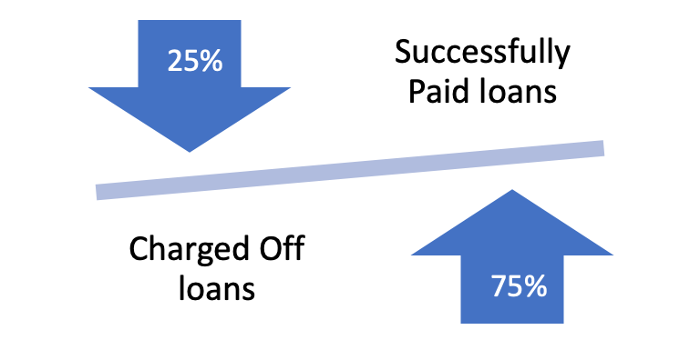
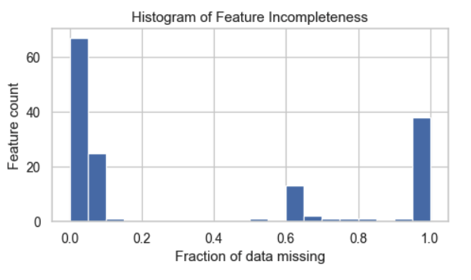
Data Overview
$11B
2.25 M loans issued from
2007 - 2018
1.35 M
Loan status : 9 categories
Interest area: 2 categories
Data Imbalance for good vs bad loans
Target
Class
0: Good / Fully paid: 75%
1: Bad / Charged off: 25%
Missing Data
Removed features with > 30% missing values
Notes:
The dataset consists of a total of 2.25 million records of accepted loans dating from 2007 to 2018 with the total amount summing up to $11 billion.
The attempt here was to only use data available to investors via the LendingClub loan listing, including information about the borrower (income, employment length, FICO score, debt-to-income ratio, etc.) and the loan listing (the loan amount, loan purpose, loan grade, interest rate, installment, etc.).
The target variable here is the loan_status which contains 9 different categories. Since our goal here is to learn differences in the features between completed loans that have been fully paid or charged off. We won't consider loans that are current, don't meet the credit policy, defaulted, or have a missing status. So, we only keep the loans with status "Fully Paid" or "Charged Off.”
Once this filtering is done, we are left with approx. 1.35 million record out of which 75% are successfully paid loans and 25% are charged off loans. This presents us with a huge data imbalance problem which we’ll need to consider before the modeling process.
Before moving on to the EDA phase, I also looked at the missing values percentages across the features and found across lot of features had high percentage of missing values. Visualizing the missing values percentage, it was noticed that majority of features either has less than 30% missing values or <50% values hence a safe cut off would be to keep feature which has less than or equal to 30% missing value. If any feature crosses this percentage, then we would not want to keep it since imputing those values may just introduce bias in our data.

Slide 5
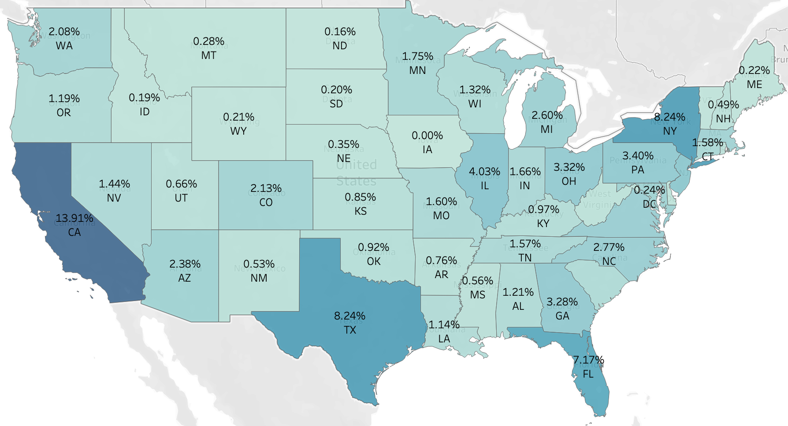
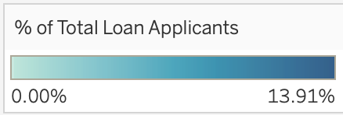
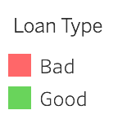
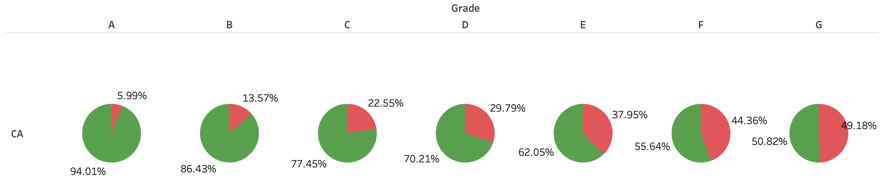
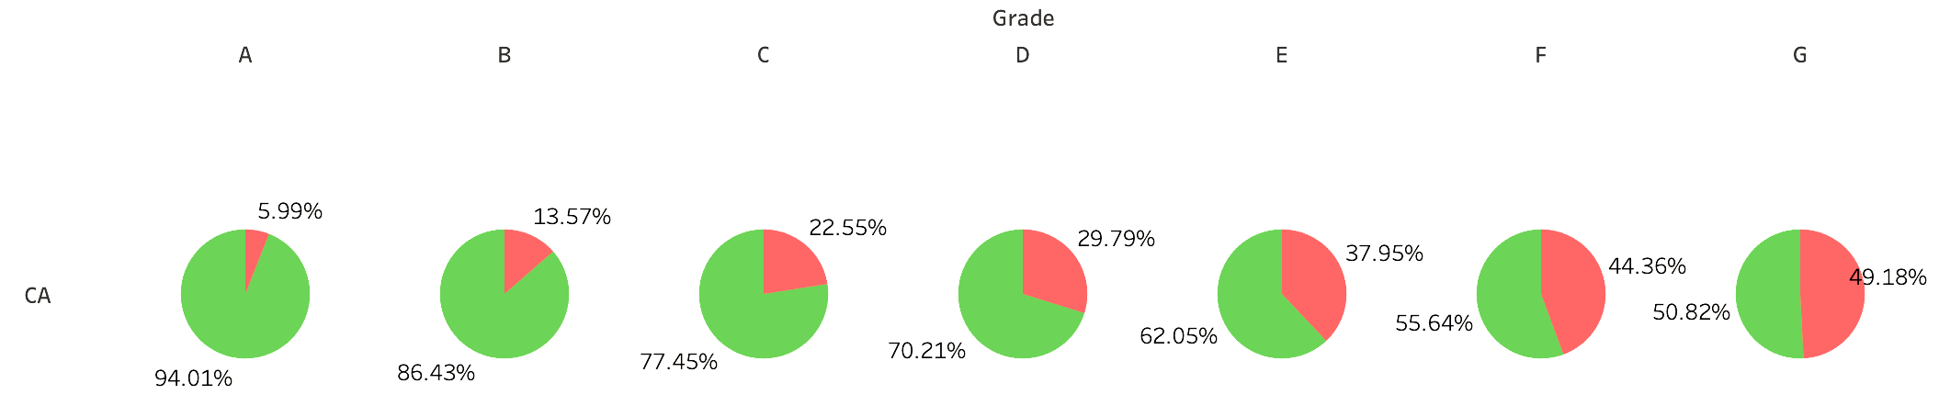
EDA: REGION WISE LOAN TARGET
Top States by Loan share:
California: 14%
New York: 8%
Texas: 8%
Florida: 7%
Fig 1. Region wise loan share distribution
CALIFORNIA
Fig 2. Percentage of good and bad loans over loan grades
Notes:
Moving further I perform exploratory data analysis on the features to understand the data better.
I started off inferring based on region-wise loan targets looking at the preliminary exploration of good and bad loan distribution concerning the state-wise distribution of average income, interest rates being offered etc. Some curious observations were:
California(CA) alone accounted for 14% of the total loan shares, followed by New York(8%), Texas(8%) and Florida(7%)
These top states along with many others had only a 5-6% default rate of Grade A loans. However, as we go down the Grade level especially for G, surprisingly close to 50% turned out to be of bad type i.e, were either defaulted or charged-off, thus indicative of the fact that Grade plays an important role in determining Loan Quality.

Slide 6
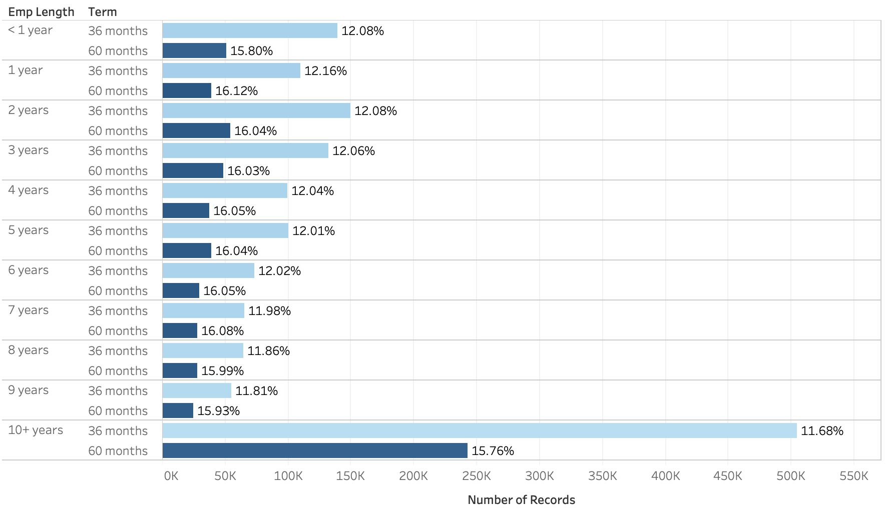
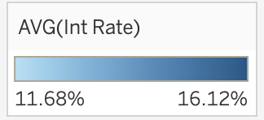
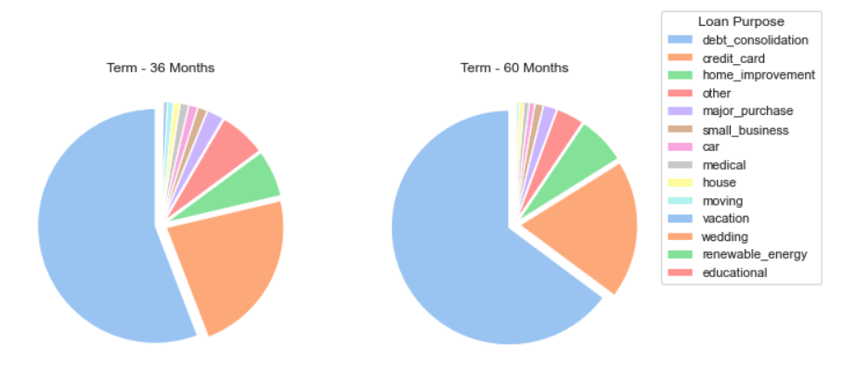
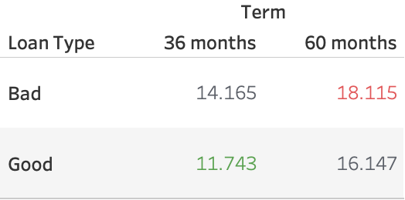
EDA: LOAN STATISTICS
Fig 3. Distribution of Loans based on employment length and term
Fig 4. Average interest rate based on term and loan type
Fig 5. Distribution of Loan purposes for each term category
Notes:
Moving on I studied the feature ’term’ looking to observe if it or any combination of features with it has a significant effect on the loan outcome.
For this I found a striking variation of 3-4% in interest rates across 36-month and 60-month loan tenure and so we can say that almost all preferred taking loans with lesser installment periods.
Looking further in the distribution of terms it was found that About 76% of the completed loans have three-year periods, and the rest 24% have five-year periods. Also, Loans with five-year periods are more than twice as likely to charge-off as loans with three-year periods.
From figure 4, we can see a difference of 3-6% in the interest rates of loans for each term with the loans on the higher end usually ending up being labeled as charged off or a bad loan.
Exploring the segregation of terms based on the loan purpose, as shown in figure 5, it was observed that for both the loan terms the majority of the loans belonged were taken for the purposes of debt consolidation , credit card and home improvement respectively.

Slide 7
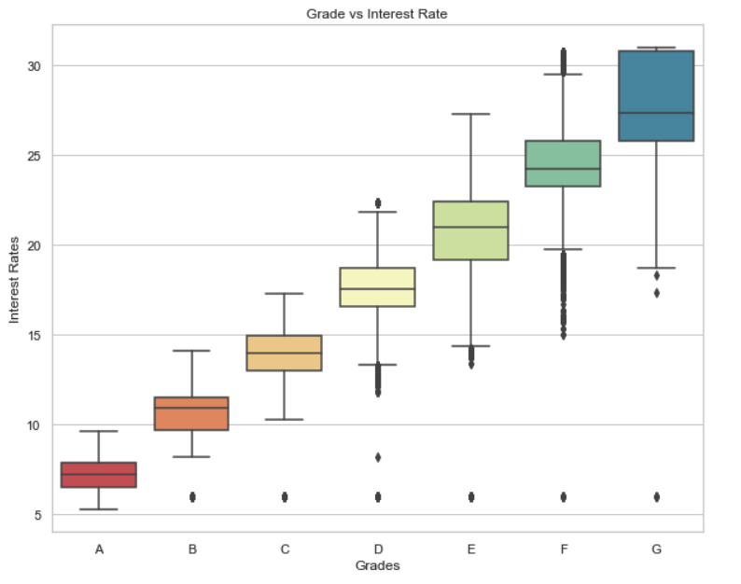
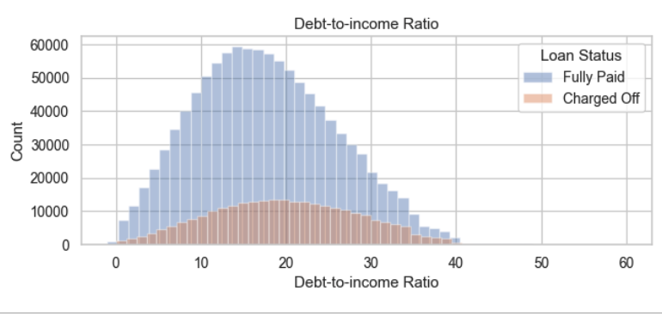
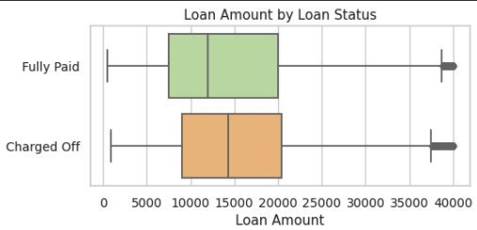
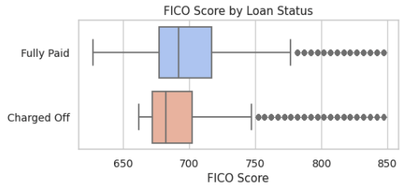
EDA
Fig 6.
Fig 6. Interest rate distribution over grades
Fig 7. Debt to income ratio distribution by loan status
Fig 8. Loan amount distribution by loan status
Fig 9. FICO Score distribution by loan status
Notes:
Other key findings were:
Figure 6 shows a positive linear correlation between Interest and grade. Grades range from A being the best to G being the worst are determined by LendingClub Platform based on the applicant's credit history, that is to my best knowledge. This conforms to the previous insights we had regarding the Grade and loan status relationship and interest to loan status relationship.
The debt-to-income ratio distribution by the loan status can be seen in figure 7. We see that the record do follow a normal distribution with the charged of distribution being flatter possibly due to less amount of data.
Figure 8 shows the loan amounts by loan status. We can observe that Charged-off loans tend to have higher loan amounts by approximately a couple thousand dollars.
From figure 9 we can see a noticeable difference in FICO scores between fully paid and charged-off loans with some outliers. Loans that charge off seemed to have a FICO score 10 points lower on average.

Slide 8
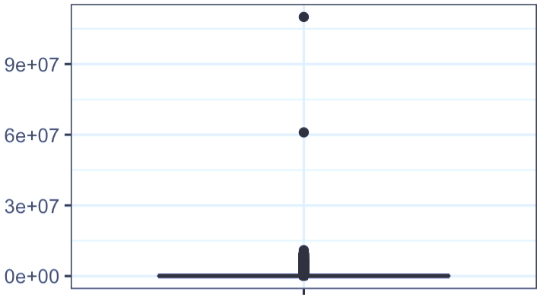
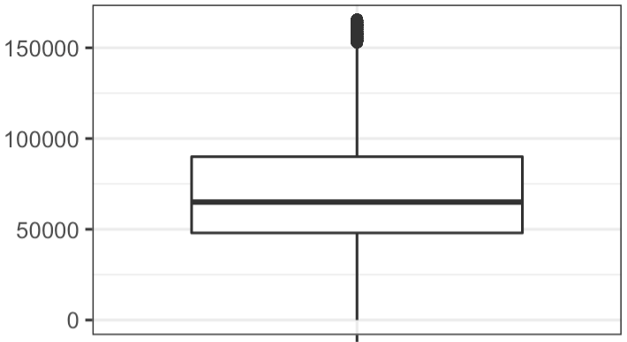

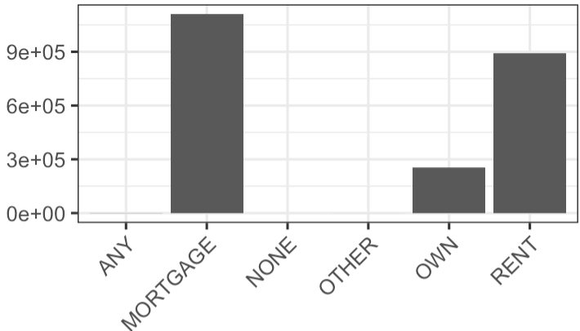
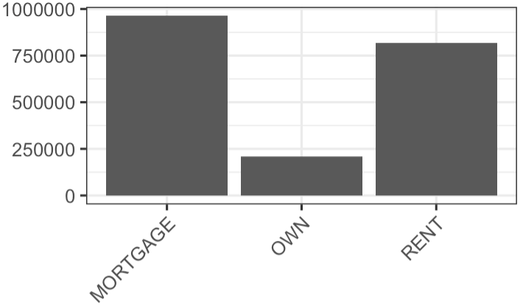
DATA PREPROCESSING
Outlier Detection/Handling
Data Transformation
Train/Test split 8:2
Feature Selection
Handled Imbalance
Examples:
OUTLIERS
ANNUAL INCOME
ANNUAL INCOME
Fig 10. Outlier Treatment – Annual Income
SPARSE
HOME OWNERSHIP
HOME OWNERSHIP
Fig 11. Handling data sparsity
Notes:
Exploratory Data analysis helped us understand some of the hidden relationships between the predictor and target variable.
To prepare the data for modeling I used a 5-step process starting off with outlier detection and handling for which I used IQR rule. One example of the feature on which this was done can be seen in figure 10. The same process was repeated for each of the variables to detect and treat the outlier.
IQR rule – Q1 – 1.5* IQR and Q3 _ 1.5*IQR
Next missing value imputations /cleaning were performed using ‘Missing Category Imputation’ where all the missing data was labeled as a new category for categorical variables and based on the number of missing values mode imputation and random sampling imputations were used .One such example can be seen in Fig 11 where the categories with almost no records were cleaned out since it would just result in making our data sparse if we were to one hot encode them directly.
After carefully going through the categorical variables and cleaning out such records the next step was to one hot encode the categorical variables as to convert them to numerical for fitting to our model.
(one hot encoding helps reduce the possibility of a model assuming ordinal relationship between categories)
Moving on the next step since the data had quite a lot features hence there was an apparent need for dimensionality reduction. To do so I went ahead with L1 regularized logistic regression which helped me reduce the feature space from 212 features (after one hot encoding) to 83 features.
Using only the features we got from L1 regularized model I went ahead to split the data into train and test sets.
The final step was to address one of the most important concerns in the data, the imbalance.

Slide 9
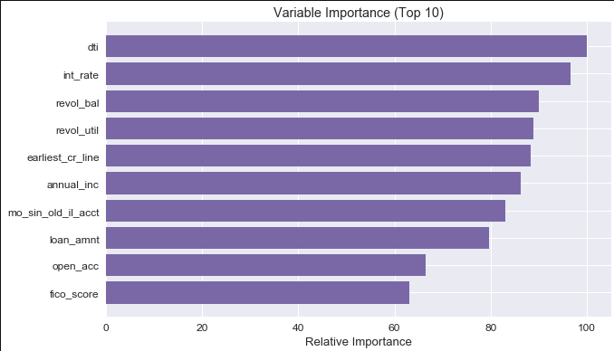
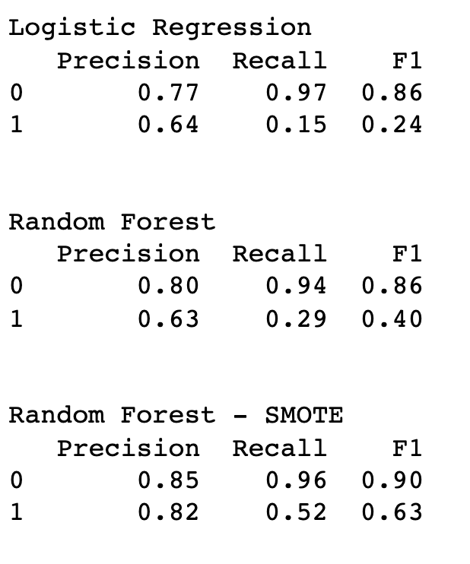
DATA MODELING
L1 Regularized Logistic regression used for feature selection
Handled class imbalance using Synthetic Minority Over Sampling (SMOTE)
Models tested: - Logistic regression - Random Forest
Evaluation Metrics: - Precision - Recall - F1 Score
Fig 12 . Feature Importance plot for Random Forest with SMOTE model
Fig 13 . Model Performance – Classification Report
Notes:
The first logistic regression and random forest models were trained as a baseline using the train data as it is.
The evaluation metric selected for the task were precision recall and F-1 score since the class importance varied with predicting Charged off loans being more important than fully paid loans for the use case at hand.
From Fig 13 it can be clearly seen that both the initial models performed really well on the majority class but fail to perform as good on the minority class.
To improve the model performance of minority class I tried different sampling technique such as under sampling, random over sampling and SMOTE with SMOTE showing the best results on both the models.
The best performance was achieved using SMOTE oversampling technique with Random forest classifier giving us a huge boost on recall for the minority class.

Slide 10
Summary
Future Work
Key Findings
Debt to income and Interest rate has a very strong relationship with the response variables.
Hyperparameter tuning
Dealing with data imbalance problem
Data modelling using complex algorithms like neural networks
Loans with 36 months tend to default more than loans with 60 months.
Debt consolidation looks to be major purpose for the issued loans.
Notes:
Conclusion:
This project applies evaluation of classification models in the context of LendingClub’s P2P lending business. We find significant opportunity for LendingClub to increase their profitability with the methods we lay out, and find our random forest model to be the most profitable choice combined with SMOTE resampling technique.

