Slide 1
ECE-5831 FINAL PROJECT
Vehicle Type and Speed Pattern Recognition
Ashwathi Ashok | Tharun Subramanya | Vedhesh A. Saravanan
December 2025

Slide 2
Presentation Outline
1. Introduction and Problem Statement
4. Speed Estimation Algorithm
2. Dataset and Preprocessing
5. Results and Evaluation
3. Methodology and Architecture
6. Demo and Conclusions

Slide 3
Problem Statement
THE CHALLENGE
APPLICATIONS
Develop an automated system to detect vehicles, classify their type, and estimate their speed from traffic video footage.
Traffic Management
Law Enforcement
KEY OBJECTIVES
Binary classification: Vehicle vs Non-vehicle
Multi-class: Car, Bus, Truck, Motorcycle
Speed estimation in mph from pixel motion
Real-time tracking with unique IDs
Road Safety
Urban Planning

Slide 4
System Architecture
Video Input
→
MOG2 Detection
→
Centroid Tracker
→
CNN Classifier
→
Speed + Type
FRAMEWORKS
TECHNIQUES
OUTPUT
TensorFlow | Keras | OpenCV
MOG2 | CNN | Centroid Tracking
Annotated Video | CSV Data

Slide 5
Datasets Used
Kaggle: Vehicle Detection Image Set (binary: vehicles vs non-vehicles).
Kaggle: Vehicle Detection 8 Classes (VOC boxes; we used a 4-class subset in the notebook).
Traffic video clips for end-to-end demo (detection → tracking → speed).
Binary Detection
Type Classification
Test Videos
Vehicle Detection Image Set
Vehicle Detection 8 Classes
Real Traffic Footage
Total: 17,760 images
Total Patches: 19,700+
M6 Motorway: 40s
Vehicles: 8,792
Classes Used: 4
Skybridge: 13s
Non-vehicles: 8,968
Car, Bus, Truck, Motorcycle
Resolution: 720p/1080p
Split: 80/20
Format: YOLO
FPS: 30

Slide 6
CNN Architecture
INPUT 128x128x3
→
Conv 16
→
Conv 32
→
Conv 64
→
Conv 128
→
Dense 256
→
OUTPUT
Binary Model
Multi-Class Model
Output: 1 neuron (Sigmoid)
Output: 4 neurons (Softmax)
Loss: Binary Cross entropy
Loss: Categorical Cross entropy
Optimizer: Adam (1e-3)
Classes: Bus, Car, Motorcycle, Truck
99.2% Accuracy
94% Accuracy

Slide 7
Vehicle Type Classification (Multi-class)
Goal
Predict vehicle type label (e.g., bus/car/truck/motorcycle).
We trained a lightweight CNN on labeled vehicle crops (subset used in notebook).
Notebook run achieved validation accuracy ≈ 95.9% after 5 epochs.
End-to-end overlay (type + speed + track ID)

Slide 8
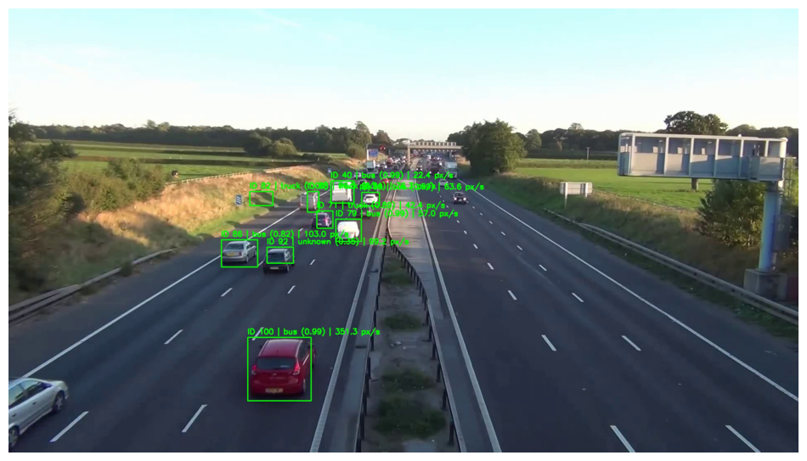
Vehicle Type Classification (Multi-class)
Approach
Foreground extraction: BackgroundSubtractorMOG2 (Gaussian mixture model).
Assign track IDs and keep per-track position history.
Tracking stability is critical before speed estimation.
Example overlay (IDs + pixel-domain speed)

Slide 9
Vehicle Detection: MOG2
HOW MOG2 WORKS
1. Models each pixel as mixture of Gaussians
Key Parameters
2. Learns background over time (history=500)
history = 500
3. Identifies foreground (moving vehicles)
varThreshold = 32
4. Shadow detection removed (gray=127)
detectShadows = True
POST-PROCESSING
Detection Flow
Median blur (5x5) for noise removal
Binary threshold at 200
Morphological open/dilate
Contour detection (area greater than 900px)
Frame → ROI → FG Mask → Contours → BBoxes
Adaptive to lighting, handles multi-modal backgrounds, efficient for real-time

Slide 10
Centroid Tracking Algorithm
ALGORITHM STEPS
Track Data Structure
1. Compute centroids from bounding boxes
centroid: (cx, cy)
bbox: (x, y, w, h)
lost: frame count
2. Match detections to existing tracks
history: position list
3. Update existing or create new IDs
KEY PARAMETERS
max_lost = 10 frames
4. Remove tracks after max_lost frames
dist_thresh = 60 pixels
History = Unlimited

Slide 11
Speed Estimation Algorithm
STEP 1: PIXEL SPEED
dist_px = sqrt[(x2-x1)^2 + (y2-y1)^2]
time_s = window / fps
speed_pxps = dist_px / time_s
COMPLETE FORMULA
V_mph = d_px * k * c / t
STEP 2: CALIBRATION
V = Speed (mph)
lane_px = 100 pixels (measured)
d = Pixel displacement
k = meters/pixel scale
lane_meters = 3.65 m (standard)
c = 2.23694 conversion
meters_per_pixel = 0.0365
STEP 3: CONVERSION
Moving average (k=7) smoothing applied
speed_mps = speed_pxps * meters_per_pixel
speed_mph = speed_mps * 2.23694

Slide 12
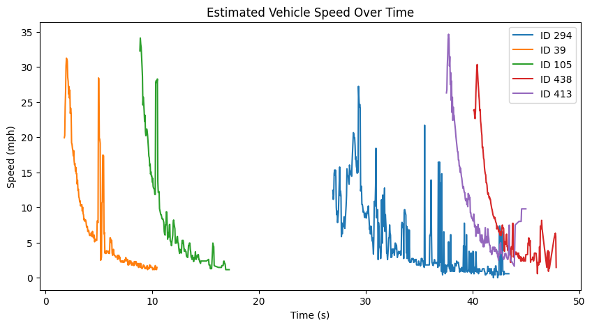
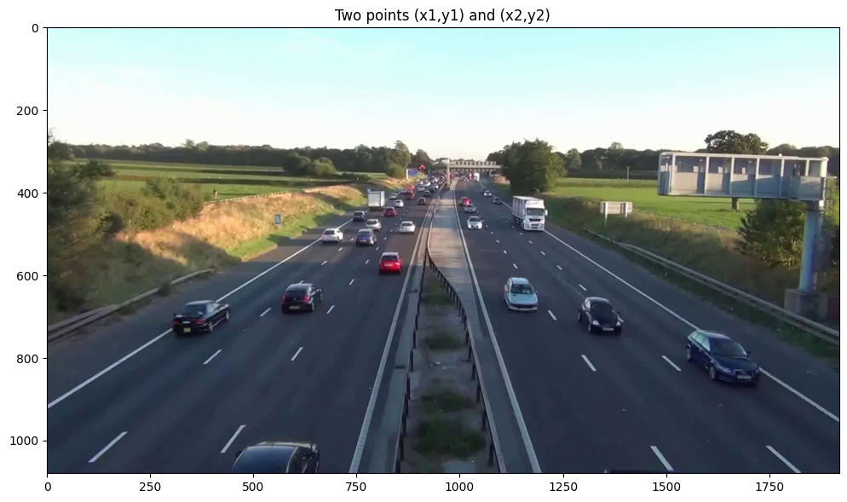
Speed Estimation
Computation
For each track: compute centroid displacement over a short window → px/s.
Convert px → meters using scene scale (lane width ≈ 3.65 m).
Convert m/s → mph (× 2.23694).
Scale example (two points define lane width in pixels)

Slide 13
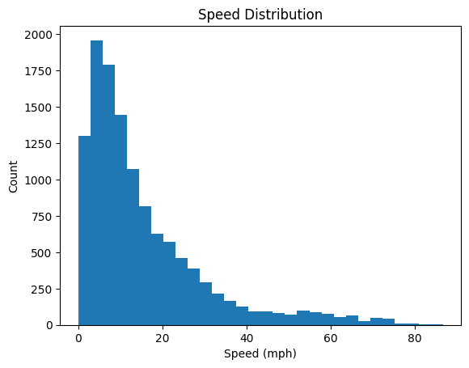
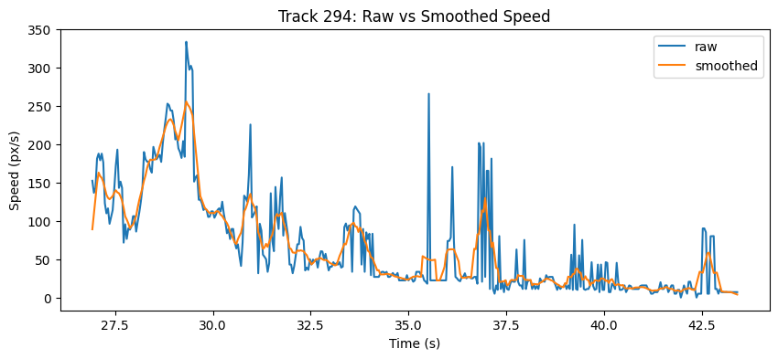
Stabilizing Speed: Smoothing / Filtering
Why smoothing?
Tracking noise creates spikes in instantaneous speed.
We applied a moving-average smoother (and explored Kalman-style filtering).
Smoother output is more stable for “speeding” decisions.

Slide 14
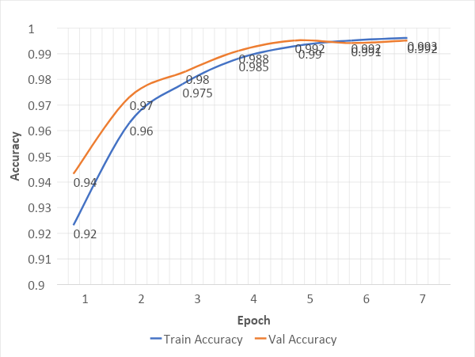

Training Results
Binary Classification Model Performance
VALIDATION ACCURACY
99.2%
CLASSIFICATION REPORT
Training & Validation Curves
Precision
0.99
Recall
0.99
F1-Score
0.99
TRAINING DETAILS
Epochs Run
7 (Early Stop)
Best Epoch
5
Final Loss
0.024
Presenter: Member 1 (Ashwathi Ashok)

Slide 15
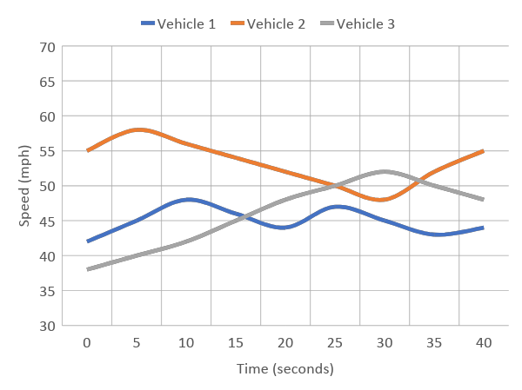
Speed Estimation Results
M6 Motorway Video Analysis
SPEED STATISTICS
Average Speed
45 mph
Max Speed
68 mph
Min Speed
22 mph
Std Deviation
±12 mph
Speed Over Time Chart
TRACKING SUMMARY
Vehicles Tracked
50+
Frames Processed
1,200
Video Duration
~40 sec
Output: CSV file with frame-by-frame speed data for each tracked vehicle ID.
Presenter: Member 3 (Vedhesh A. Saravanan)

Slide 16

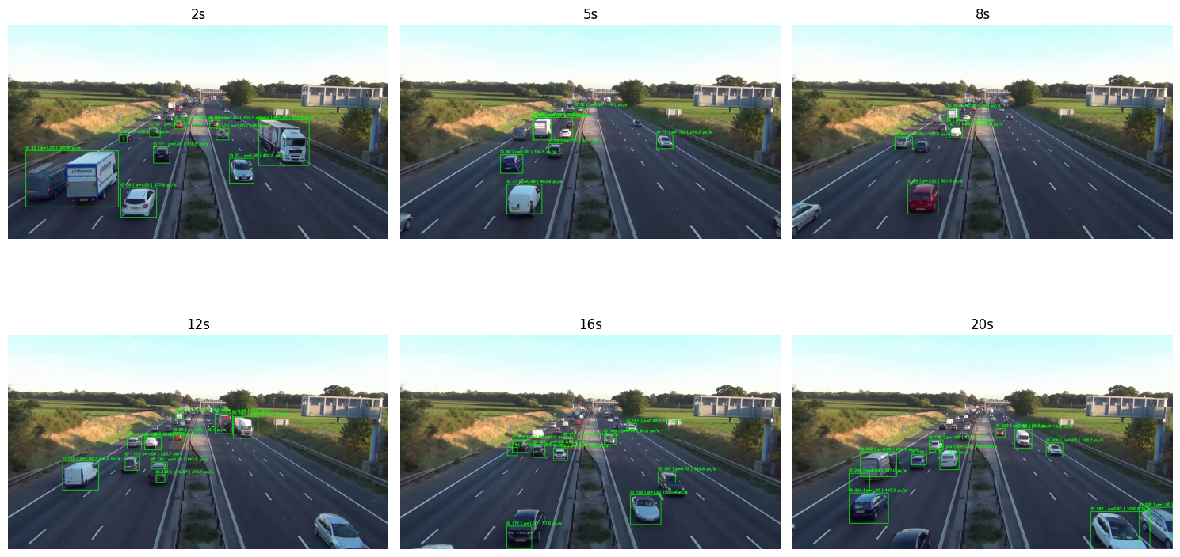
Annotated Output
Real-Time Vehicle Detection, Classification & Speed Display
Binary classifier (vehicle vs non-vehicle): ≈ 99.6% test accuracy.
Type classifier (bus/car/motorcycle/truck subset): ≈ 95.9% validation accuracy.
Speed estimation produces plausible mph trajectories; needs GT benchmark for MAE.
📦 Bounding Boxes
🏷️ Labels
📊 CSV Export
🎬 Video Output
Color-coded by vehicle type with unique track IDs
Vehicle type + real-time speed in mph
Frame-by-frame tracking data for analysis
MP4 with all annotations overlaid
Live demo video will be played during presentation

Slide 17






Key Achievements
1
99.2% Detection Accuracy
4
Robust Multi-Object Tracking
Binary CNN classifier achieves near-perfect vehicle vs non-vehicle detection on validation set.
Centroid tracker maintains unique IDs across frames, handles occlusions gracefully.
2
4-Class Type Classification
5
End-to-End Pipeline
Successfully classifies vehicles into Car, Bus, Truck, and Motorcycle categories with 94% accuracy.
Complete system from raw video input to annotated output with CSV data export.
3
Real-Time Speed Estimation
6
Multiple Video Sources
Converts pixel motion to mph using lane-width calibration with smoothing for stability.
Tested on M6 Motorway and Skybridge videos demonstrating generalization.
All team members contributed

Slide 18
Challenges & Solutions
⚠️ CHALLENGE
✓ SOLUTION
Speed Estimation Noise
Moving Average Filter
Frame-to-frame centroid jitter caused erratic speed readings
Applied k=7 window smoothing and 5-frame displacement window
⚠️ CHALLENGE
✓ SOLUTION
Shadow Detection
Shadow Removal
MOG2 detected shadows as foreground objects
Set shadow pixels (gray=127) to 0 before thresholding
⚠️ CHALLENGE
✓ SOLUTION
Flickering Type Labels
Majority Voting
Classification changed frame-to-frame for same vehicle
Track votes per ID, display most common classification
⚠️ CHALLENGE
✓ SOLUTION
Camera Calibration
Lane Width Reference
Unknown pixel-to-meter conversion factor
Measured lane in pixels, used standard 3.65m width
All team members contributed to problem-solving

Slide 19
Future Work
Potential Improvements and Extensions
1
YOLO-based Detection
4
Real-Time Optimization
Replace MOG2 with YOLO v8 for more robust detection in varying conditions.
GPU acceleration with TensorRT for edge deployment on NVIDIA Jetson.
2
Homography Calibration
5
Traffic Analytics
Implement camera calibration with homography matrix for accurate speed.
Add vehicle counting, lane occupancy, and congestion detection.
3
DeepSORT Tracking
6
Night Vision Support
Use deep appearance features to handle occlusions and re-identification.
Train on infrared footage for 24/7 monitoring capability.
All team members contributed

Slide 20
Thank You!
PROJECT SUMMARY
We developed an end-to-end system for vehicle detection, type classification, and speed estimation using deep learning and computer vision techniques.
99%
94%
4
Real
Detection Acc.
Classification
Vehicle Classes
Time Speed
Team Members
Ashwathi Ashok
Tharun Subramanya
Vedhesh A S
ECE-5831 Pattern Recognition and Neural Networks - December 2024 - Questions?

