Slide 1
COVID-19 Tweet Visualisation Web Application
Team: TheMinions
Ahan Bose
Prithwijit Banerjee
Vedica Rao

Slide 2
Introduction
The purpose of this project is to perform sentiment analysis on streamed tweets based on keyword search for visual and graphical analysis of public opinion on government measure. We also saved the incoming tweets in a database. Based on the analysed data, local authorities would be able to enact measures in accordance to the needs and desires of the public and enable better understanding of requirements and difficulties faced by the people during the pandemic thereby making better public policies.

Slide 3
Approach
India has a large and dynamic population. Therefore the authorities find it hard to reach out to the masses and often fail to truly understand their needs. Social media in general and twitter in particular connects millions of users provides a powerful means for analysts to perform sentiment analysis on tweets and understand their response to government measures with regard to COVID 19 and lockdown in India.
More often than not people express themselves on twitter using images attached to the tweet and analysis of the image adds to the sentiment of the tweet and perception of the user on the subject.
Public perception can vary geographically and because of the pandemic it is essential to understand how the needs of the public are varying on a location basis in India.

Slide 4
User Interface
User interface designed using HTML and CSS.
CSS animations/Perspective used in the design process.The landing page has a title section, a menu section(sentiment visualization dashboard, news updates, statistics and chatbot), health guidelines and COVID-19 centers.
Sentiment Visualization Dashboard.
News Updates - Twitter handles of relevant and important organisations like the WHO, Ministry of Health and Family Welfare(MoHFW) , IRCTC , AAI etc. The latest tweets from these twitter handles designed with a masonry layout are automatically updated on the web page so that users can stay updated about the latest COVID-19 news.

Slide 5
Statistics - Latest COVID-19 related data embedded on dynamic charts and maps for comprehensive analysis. Charts and Maps imported from Our World in Data.
Chatbot - COVID-19 assistant created using IBM Watson Assistant.The chatbot is trained to answer important covid-19 queries like country wise covid-19 statistics, general CDC health guidelines and other relevant information.
Health guidelines - relevant youtube videos from World Health Organisation embedded for users to view and follow.
COVID-19 centres - data collected from Karnataka government and plotted using Google My Maps. The map shows all COVID-19 centres in Karnataka.

Slide 6
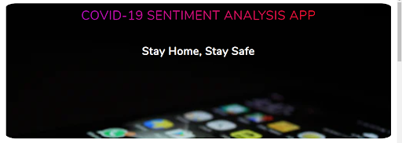
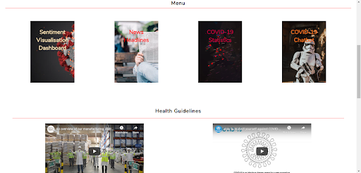

Slide 7
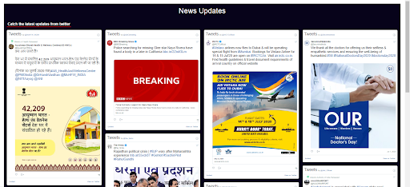
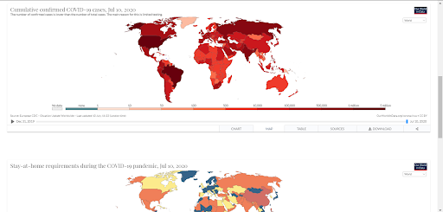

Slide 8
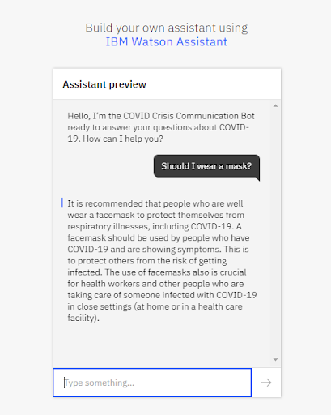

Slide 9
Sentiment Visualization Dashboard
Getting access to twitter API:
Connect to twitter API by creating a developer account and requesting credentials for access.
Setting up IBM cloud services:
Setting up an IBM cloud account in and creating Node Red Cloud Foundry App. Making all necessary Watson service connections with the Node Red example Watson Visual Recognition.
Building Node Red Flow for line chart:
Using Node Red Flow Editor we design a visualisation dashboard. The dashboard connects to the twitter API using twitter stream node and streams tweets. Sentiment analysis is performed on any language of tweet using multi-lang sentiment node and subsequently displayed on the dashboard in terms of line charts.The incoming tweets are connected and stored in a cloudant database.

Slide 10
Building Node Red Flow for time sentiment analysis:
In this flow we stream tweets, perform sentiment analysis and average the sentiment scores over 20, 100 and 1000 Tweets and continuously on a time series plot each line plot indicating a category of average tweets.
Building Node Red Flow for Image Analysis:
Here, we use Watson Visual Recognition, to analyse images attached to tweets and display the results on the dashboard along with a gauge to display the sentiment score.
Building Node Red Flow for Twitter Map:
We plot the tweets along with their sentiment on the world map.The tweets are localised mainly to India. A legend of the plotted tweets and sentiments is also displayed.
The inputs to this flow are taken based on keyword search from the user.
Social Media Dashboard and Lockdown Analysis:
The streamed tweets are saved in a database and then queried using ElephantSQL to return the pie chart representing sentiment ratio, top locations of tweets and average sentiment per day.

Slide 11
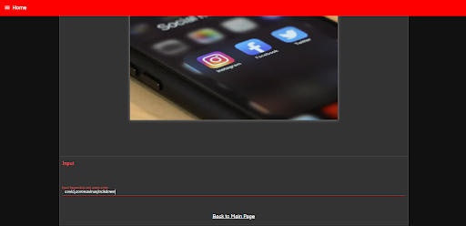
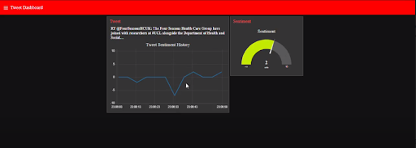

Slide 12
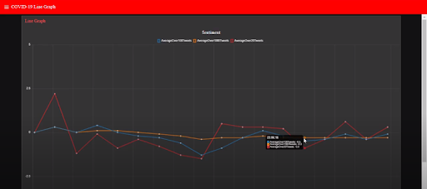
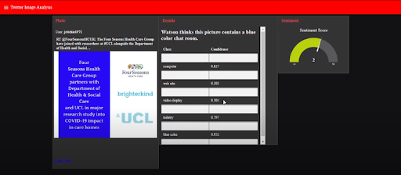

Slide 13
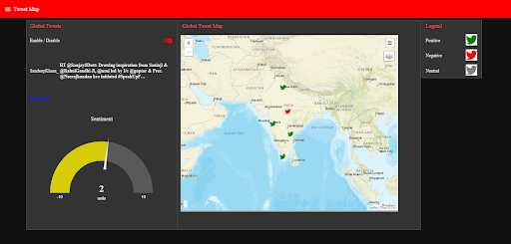
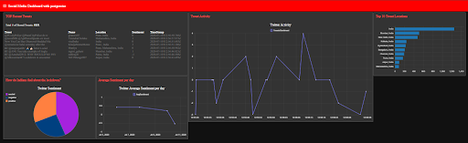

Slide 14
Applications
Our model can be used by data analysts to predict the general sentiment of people towards any government action.
Another application of our model(since our project allows for the user to input any keywords or hashtags)is to gauge and analyse the sentiment and its variation on their topic of choice.

Slide 15
Conclusion
The COVID-19 Twitter Sentiment Analysis Visualisation Dashboard is made using Node Red Flow editor.
We have displayed line charts for time analysis, gauge for sentiment score, visual recognition of images attached to tweets and plotting streamed tweets on a map with sentiment score and accompanying legend.
We have also trained a COVID-19 chatbot, displayed twitter news updates, statistics, and COVID-19 centers in Karnataka.

Slide 16
References
https://nodered.org/docs/getting-started/ibmcloud
https://cognitiveclass.ai/courses/node-red-basics-to-bots
https://flows.nodered.org/node/node-red-node-watson
https://flows.nodered.org/node/node-red-contrib-maps
https://dev.to/poojamakes/why-you-should-be-using-node-red-right-now-1n1l
https://ourworldindata.org/coronavirus
https://unsplash.com/
https://www.google.com/maps/d/u/0/

