Slide 1
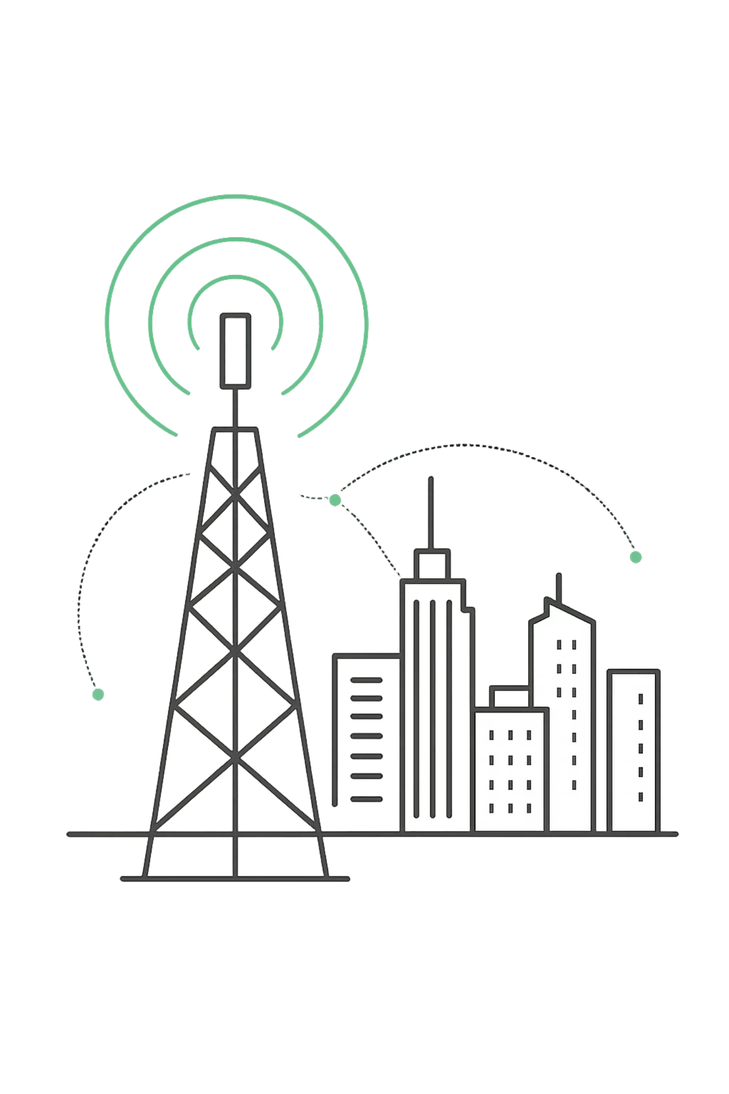
Telco Customer Churn Prediction
Predicting Customer Retention using Machine Learning
Name : Vedika Rana
Guide :
Mr. Ramavath Ganesh
Roll No. : 25SCS1003004589
Section : 1CSE31

Slide 2

Problem Statement
The Challenge
Telecommunications companies face exceptionally high customer churn rates in today's competitive market. Every lost customer represents direct revenue loss and increased acquisition costs. Identifying at-risk customers manually is nearly impossible with thousands of active accounts.
Project Goal
Develop an automated predictive system using machine learning to accurately forecast which customers are likely to churn, enabling proactive retention strategies.

Slide 3
Dataset Overview
7,043
21
Customer Records
Features
Complete dataset with active and churned customers
Diverse data points from demographics to service usage
The Telco Customer Churn Dataset provides comprehensive information spanning three key categories:
Customer Demographics
Service Details
Billing Information
Age, gender, location, and tenure with the company
Internet service type, phone lines, streaming services, and contract type
Monthly charges, total charges, payment methods, and contract duration

Slide 4


Data Understanding & Cleaning
01
Column Removal
Dropped customerID as it provided no predictive value
02
Missing Values
Handled missing values in TotalCharges column by removing affected records
03
Data Type Conversion
Converted numerical columns to appropriate data types for analysis
04
Final Validation
Verified no remaining null values across all 21 features
Key Insight: The dataset revealed significant class imbalance, with substantially more non-churn customers than churned customers, requiring special handling during model training.

Slide 5
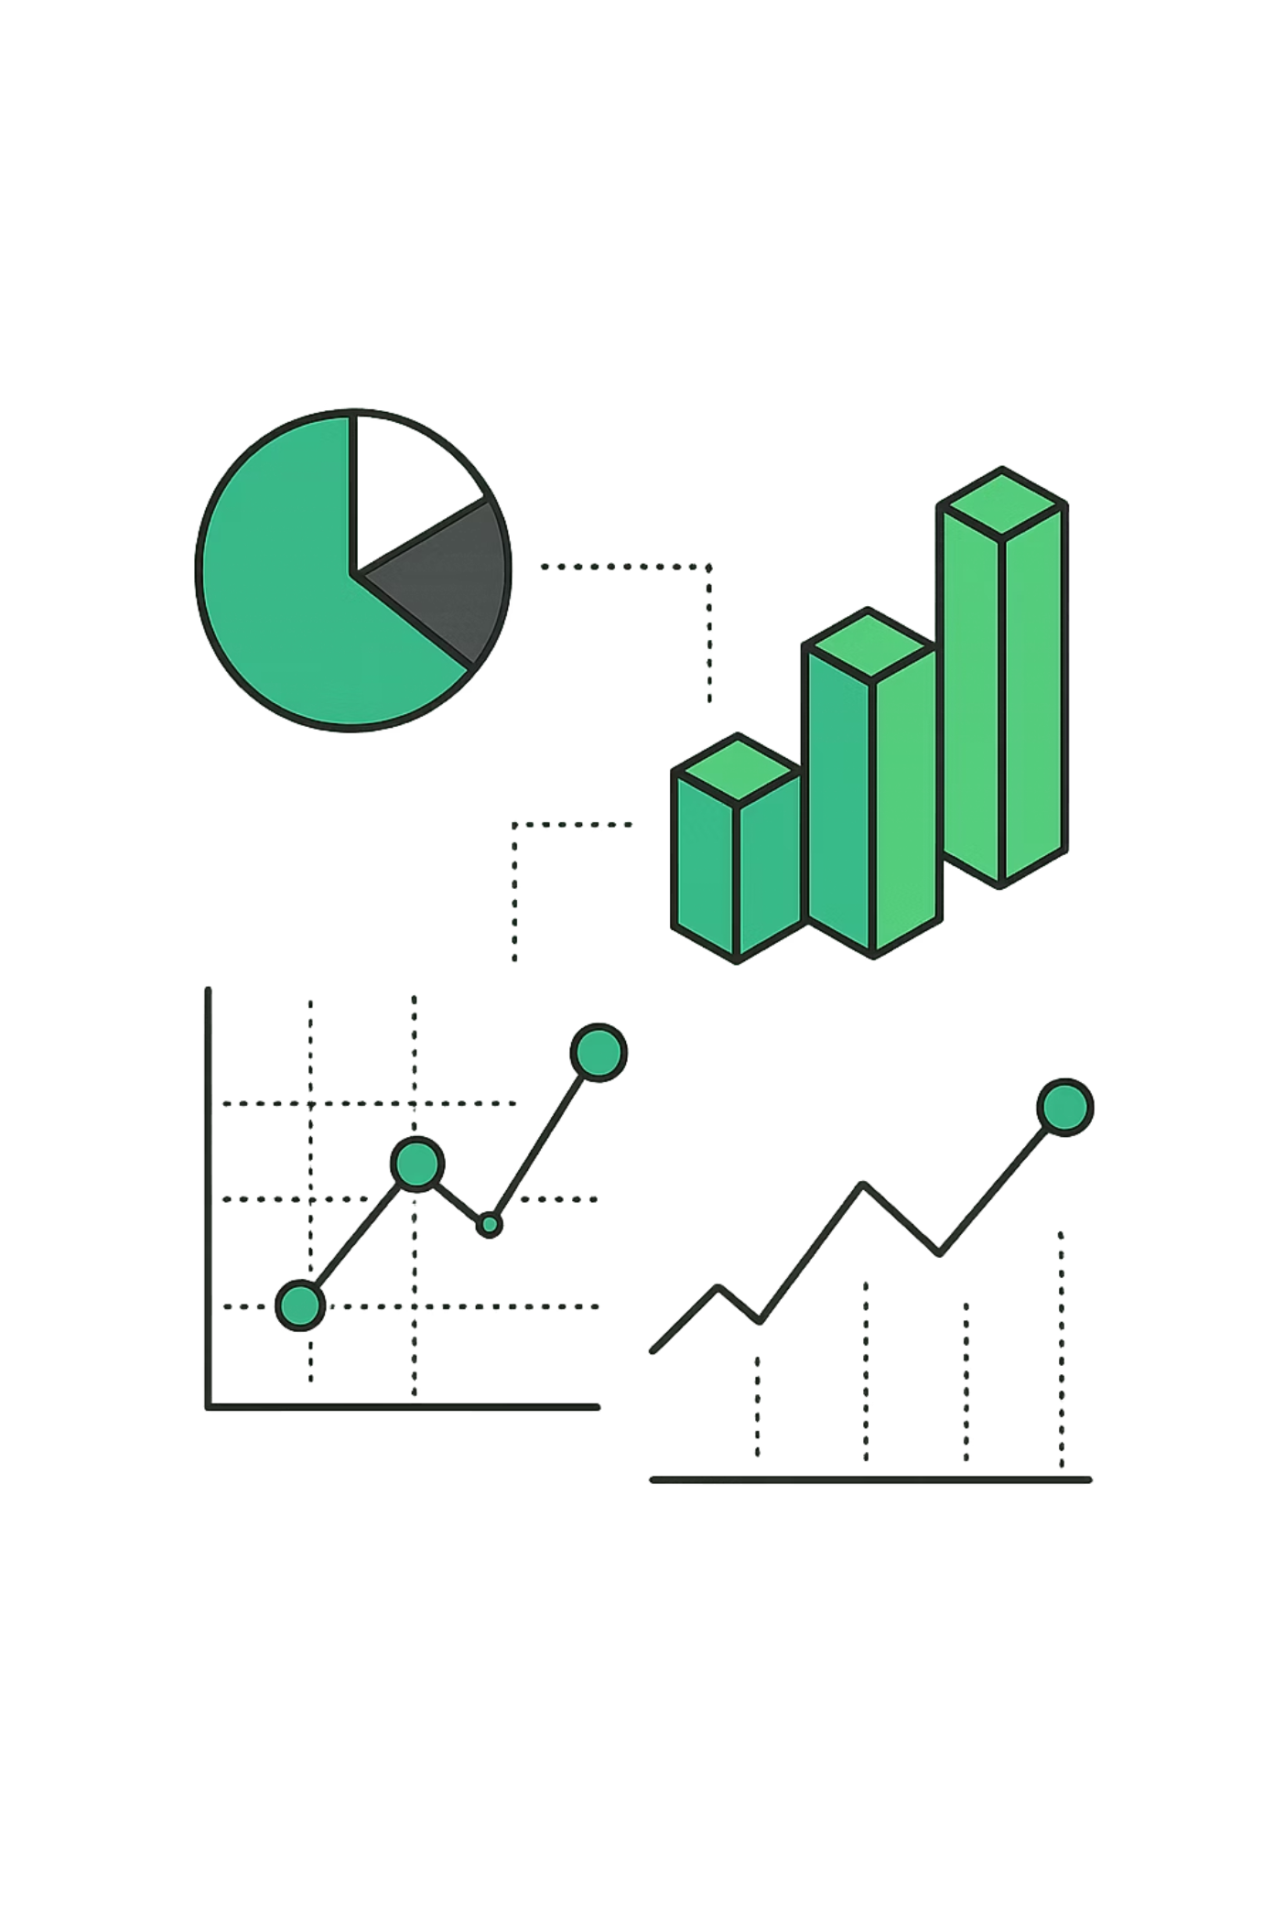
Exploratory Data Analysis
Numerical Analysis
Categorical Analysis
Tenure distribution showed bimodal pattern with peaks at short and long durations
MonthlyCharges displayed even distribution across range
TotalCharges exhibited right-skewed distribution with long tail
Contract type and InternetService emerged as significant churn indicators. Month-to-month contracts showed higher churn rates compared to annual or biennial contracts.
Correlation Insights
Service Impact
Strong positive correlation between tenure and TotalCharges, as expected with longer customers accumulating more charges.
Fiber optic internet service correlated with higher churn rates, while DSL customers showed better retention.

Slide 6
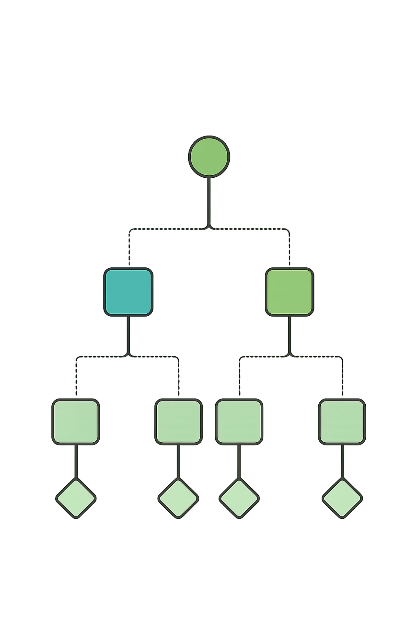
Methodology & Model Selection
Approach
1
Supervised Machine Learning for binary classification (churn vs. non-churn)
Candidate Models
2
Decision Tree, Random Forest, and XGBoost algorithms
Evaluation Criteria
3
Accuracy, precision, recall, F1 score, and cross-validation stability
Final Selection
4
Random Forest demonstrated superior performance and generalization

Slide 7
Implementation Workflow
Data Loading & Cleaning
Initial data import and quality assurance procedures
Feature Encoding
Converted categorical variables using appropriate encoding techniques
Train-Test Split
Divided data 80:20 ratio for validation purposes
SMOTE Application
Applied Synthetic Minority Oversampling to address class imbalance
Model Training
Fitted all three algorithms to balanced training data
Cross-Validation
Performed 5-fold cross-validation for robust performance assessment

Slide 8
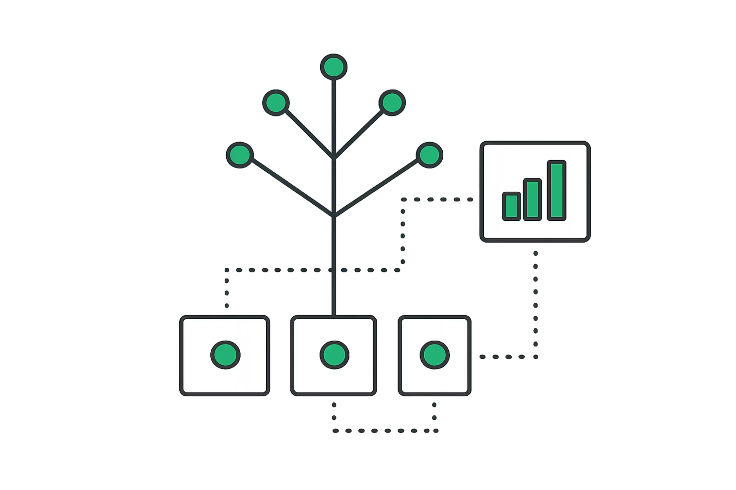
Model Training & Performance
Decision Tree
Random Forest
XGBoost
78% Accuracy
84% Accuracy
83% Accuracy
Basic tree structure with limited generalization
Ensemble method with best overall performance
Gradient boosting with strong results
Key Training Steps
Applied SMOTE to balance dataset classes
Performed 5-fold cross-validation
Selected Random Forest as final model
Validated stability across folds

Slide 9


Results and Analysis
Performance Metrics
78%
Accuracy
Overall correctness of predictions
58%
Precision
Proportion of predicted churn that actually churned
59%
Recall
Proportion of actual churn correctly identified
58%
F1 Score
Harmonic mean of precision and recall
Key Insight: The model demonstrates reasonable ability to detect churn customers, though there remains room for improvement, particularly in reducing false positives and negatives.

Slide 10
Conclusion
Targeted Retention
Revenue Protection
Data-Driven Strategy
Proactively reach high-risk customers with personalized offers and incentives
Reduce customer loss and associated revenue decline
Make informed decisions based on predictive analytics rather than intuition
Project Success
Future Improvements
Successfully developed a churn prediction system using Random Forest, achieving 78% accuracy with balanced precision and recall. The model identifies at-risk customers with reasonable reliability.
Incorporate additional features like customer service interactions
Experiment with deep learning architectures
Implement real-time prediction pipeline
Continuous model monitoring and retraining

