Slide 1
DBTHON 2026 / DATABASE SYSTEMS HACKATHON
SkillCraft
01
A job is posted
Local work, with a reliable record.
02
An artisan is selected
Employers post jobs. Artisans bid. The database keeps every decision, agreement and review connected.
03
A contract records the outcome
WORKING PROTOTYPE
Vedika Agarwal · Bhavyaveer Kumar · Anuj Deshpande
Faculty guide: Siva Sankari · 2026–27
Notes:
Open with one sentence: SkillCraft is a local-work marketplace whose main strength is the database record behind each job. Introduce the team.

Slide 2
SKILLCRAFT / DBTHON 2026
PROBLEM + DOMAIN · 4 MARKS
The problem is missing work history
Small jobs often live in calls and chat messages; decisions are hard to trace later.
Today: scattered messages
SkillCraft: linked records
Who it serves
Who applied? Which price was accepted? Was payment acknowledged? The answers can be buried or disputed.
The original job, every bid, the chosen artisan, the contract and the later review stay connected.
Local artisans seeking visible opportunities, and employers comparing offers for short projects.
DOMAIN: LOCAL EMPLOYMENT
SDG 8 alignment: access to decent work and a portable work record. Economic impact is a goal, not a measured result yet.
SkillCraft • database systems prototype
02
Notes:
Explain the old approach first: informal messages do not create a dependable sequence. Then state the target users and SDG 8 connection. Do not claim proven earnings gains.

Slide 3
SKILLCRAFT / DBTHON 2026
WORKING WORKFLOW
One job becomes one traceable agreement
The same workflow is visible from two different accounts.
1 POST
2 DISCOVER
3 BID
Employer adds a brief, location and budget.
Artisan searches by skill and place.
Artisan offers a price and optional note.
4 SELECT
5 ACKNOWLEDGE
6 REVIEW
Employer accepts one bid; other bids close.
Employer records payment sent; artisan confirms receipt.
Paid contract receives a review and updates trust score.
SkillCraft • database systems prototype
03
Notes:
Use Ramesh and Lakshmi as the concrete example. Emphasize that accepting a bid creates exactly one contract and that paid status for a new contract needs both sides.

Slide 4
SKILLCRAFT / DBTHON 2026
PROTOTYPE
Each account sees the work relevant to it
The roles share the same underlying job and contract, but their menus and actions differ.
EMPLOYER / RAMESH
ARTISAN / LAKSHMI
Hiring overview
Post a job and inspect bids
Accept or decline an offer
Record payment sent
Review a paid contract
My workspace
Find work and submit a bid
Track bid status
Confirm payment received
See agreements and reviews
The API also checks the role and ownership; the database applies row-level rules for private bids, contracts and events.
SkillCraft • database systems prototype
04
Notes:
Show the actual role navigation in the live prototype. Ramesh cannot use artisan bid actions; Lakshmi cannot post jobs or inspect someone else's bids.

Slide 5
SKILLCRAFT / DBTHON 2026
DBMS IMPLEMENTATION · 5 MARKS
The database does the critical work
A plain-language map of the technology stack.
React + Vite
Express API
PostgreSQL
→
→
Website pages and forms
Login and request checks
Records, rules and queries
Local preview: PGlite runs the PostgreSQL-compatible schema. Docker configuration uses PostgreSQL 15.
SkillCraft • database systems prototype
05
Notes:
React is the visible website. Express is the server API. PostgreSQL is the relational database that joins records and enforces integrity. PGlite is the local preview database, not a separate product design.

Slide 6
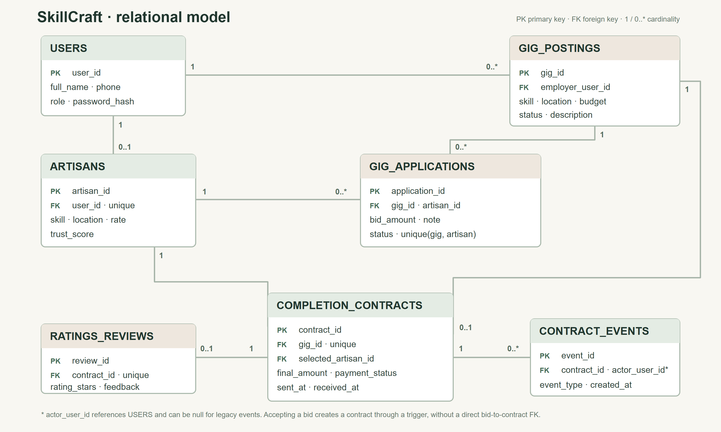
Notes:
Point to USERS, then GIG_POSTINGS, GIG_APPLICATIONS, COMPLETION_CONTRACTS, and finally RATINGS_REVIEWS plus CONTRACT_EVENTS. The accepted-bid trigger creates the contract; there is no direct bid-to-contract foreign key.

Slide 7
SKILLCRAFT / DBTHON 2026
TECHNICAL DEPTH · 5 MARKS
Rules protect the data when people act at once
These protections are in SQL and transactions, not only in button logic.
Keys + checks
Safe acceptance
One bid per artisan per job; one contract per job; positive amounts; valid statuses.
A transaction locks the job row. Accepting one bid closes the job and rejects competitors.
Triggers + functions
Two confirmations
Contract creation, event history and trust-score refresh happen in the database.
A new contract cannot be marked paid until payment-sent and receipt timestamps both exist.
SkillCraft • database systems prototype
07
Notes:
One of the strongest demonstrations is two attempts to accept different bids on the same job. Exactly one succeeds. Do not attribute the result to a single mechanism; the lock, transaction, trigger and unique constraint work together.

Slide 8
SKILLCRAFT / DBTHON 2026
INNOVATION 4 + NOVELTY 5
The innovation is a verifiable sequence of claims
Conventional status flags say 'paid'; SkillCraft records who said what and when.
CONVENTIONAL APPROACH
SKILLCRAFT NOW
Employer flips one
payment flag to paid.
Employer records sent.
Artisan confirms received.
The worker's acknowledgment is missing.
An append-only history records each event.
A review is allowed only after a new contract is paid. Older paid rows remain visibly legacy, not falsely backfilled.
SkillCraft • database systems prototype
08
Notes:
This is the main novelty story. Acknowledgments are assertions by users, not bank verification. Explain why old paid rows are labelled legacy: the migration refuses to invent an artisan confirmation.

Slide 9
SKILLCRAFT / DBTHON 2026
DATABASE FUNCTION + TRIGGER
A review updates a careful trust score
Only a paid contract can receive a review. A trigger refreshes the artisan's stored score.
ONE NEW 5-STAR REVIEW
(5 + 3 × 3.5) ÷ (1 + 3) = 3.88
ELIGIBLE DATA
STABILIZING PRIOR
AUTOMATIC UPDATE
Reviews tied to paid contracts.
Three virtual 3.5-star reviews.
Review insert runs the score function.
SkillCraft • database systems prototype
09
Notes:
Explain the prior without jargon: one perfect review should not immediately make a new artisan look perfect. The stored score is recalculated by a database trigger after a real eligible review. This is a design choice, not a validated fairness guarantee.

Slide 10
SKILLCRAFT / DBTHON 2026
IMPLEMENTATION + DIFFERENTIATION
Matching and privacy are database features
The discovery screens are backed by indexed queries and restricted database access.
SEARCH
EXPLAINABLE FIT
ROW SECURITY
Jobs and artisans can be filtered by skill and searched by place or keyword. B-tree and full-text indexes support those queries.
A simple 0–3 score prefers the same skill (2 points) and same city (1 point). It is inspectable, not an AI prediction.
A restricted database role and row-level policies limit access to a person's private bids, contracts and events.
Public artisan reputation appears through limited views; private account fields stay private.
SkillCraft • database systems prototype
10
Notes:
Use the search screen to show a match label. Say the ranking is transparent, not AI. Explain row-level security in ordinary words: the database itself filters rows based on the signed-in user's identity.

Slide 11
SKILLCRAFT / DBTHON 2026
VALIDATION · 3 MARKS
What we have actually validated
Functional evidence is strong; performance and social impact still need measurement.
API + SCHEMA
24 JEST CASES
2 BROWSER FLOWS
Checks the full job-to-review flow, foreign-key relationships, audit immutability, and ownership rules.
20 CRUD cases plus 4 concurrency and integrity cases passed on fresh local PGlite databases.
The two-role payment journey and long-text mobile layout passed in Edge.
Next evidence: benchmark indexed search vs. a baseline on native PostgreSQL; measure fit quality with labeled examples.
SkillCraft • database systems prototype
11
Notes:
Do not present test counts as a speed-up. These tests show behavior and integrity. Native PostgreSQL query-plan and ranking-quality comparisons are still planned.

Slide 12
SKILLCRAFT / DBTHON 2026
RUBRIC / 30 MARKS
What the panel grades · part 1
The numbers are available marks, not a score awarded to this project.
4
Problem + domain
Informal local hiring lacks a reliable, portable record.
5
Database design
Seven linked tables, ER diagram, keys, constraints and normalization.
5
DBMS depth
Transactions, triggers, functions, indexes, views and row-level security.
4
Innovation
Two-party acknowledgment plus append-only contract events.
SkillCraft • database systems prototype
12
Notes:
Tie every rubric criterion to one visible artifact. State that these are maximum marks allocated by the challenge PDF, not an estimated grade.

Slide 13
SKILLCRAFT / DBTHON 2026
RUBRIC / 30 MARKS
What the panel grades · part 2
The claim and the evidence should stay at the same level.
5
Novelty
Compare with employer-only payment and a plain rating average.
2
SDG impact
SDG 8 goal: fairer access and a portable history; impact unmeasured.
3
Validation
Show passing tests; be honest that benchmark data is pending.
2
TRL + demo
Run the two-account prototype live; no field pilot yet.
SkillCraft • database systems prototype
13
Notes:
The last two criteria are easy to overstate. Describe SDG alignment as an intention; describe TRL as a working prototype rather than a deployed or field-tested system.

Slide 14
SKILLCRAFT / DBTHON 2026
PANEL RUNBOOK
A five-minute live demonstration
Use the connected local preview, not the browser-only demo mode.
1
Ramesh posts
ramesh@constructionco.in
2
Lakshmi searches + bids
lakshmi@skillcraft.local
3
Ramesh accepts
One job closes; one contract appears
4
Both acknowledge
Sent → received → paid
5
Ramesh reviews
Show event history and trust score
BOTH PASSWORDS: password123
SkillCraft • database systems prototype
14
Notes:
Prepare a fresh job before the demo and use its distinctive description to search. Avoid posting a new bid on a previously bid job. Both accounts use password123 in the local seeded preview.

Slide 15
SKILLCRAFT / DBTHON 2026
CONCLUSION
A working prototype with clear next measurements
The database is the product's backbone; our claims stop where the evidence stops.
WHAT WORKS NOW
WHAT WE WILL MEASURE NEXT
Connected two-role website
Seven-table relational model
One-winner bid acceptance
Two-party payment record
Contract-linked trust and audit history
Native PostgreSQL query latency
Matching quality on labeled jobs
Security checks on a native server
User outcomes in a real pilot
SkillCraft records payment claims. It does not send money, verify banks, or prove an earnings uplift.
SkillCraft • database systems prototype
15
Notes:
Close by restating the database contribution. Invite questions. If asked about payment, distinguish acknowledgment from real bank verification. If asked about performance, explain the planned benchmark rather than inventing a result.

