Slide 1
EXPLORATORY DATA ANALYSIS
World University
Rankings
What actually separates elite institutions from everyone else
Times Higher Education World University Rankings · 2,191 institutions · 115 countries

Slide 2
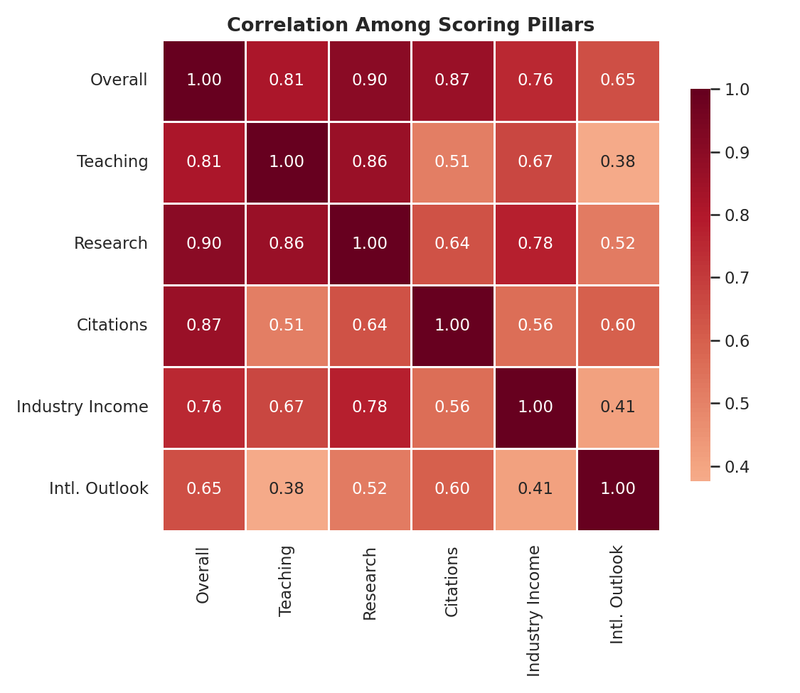
1
CORRELATION ANALYSIS
Research is the dominant driver of overall score
CORRELATION WITH OVERALL SCORE
Research
0.90
Single strongest predictor
Citations
0.86
Close second
Teaching
0.81
Still tightly linked to score
These are correlations among the five scoring pillars and the overall score only — institutional traits like staff ratio and international mix are covered separately.
World University Rankings · EDA
02

Slide 3
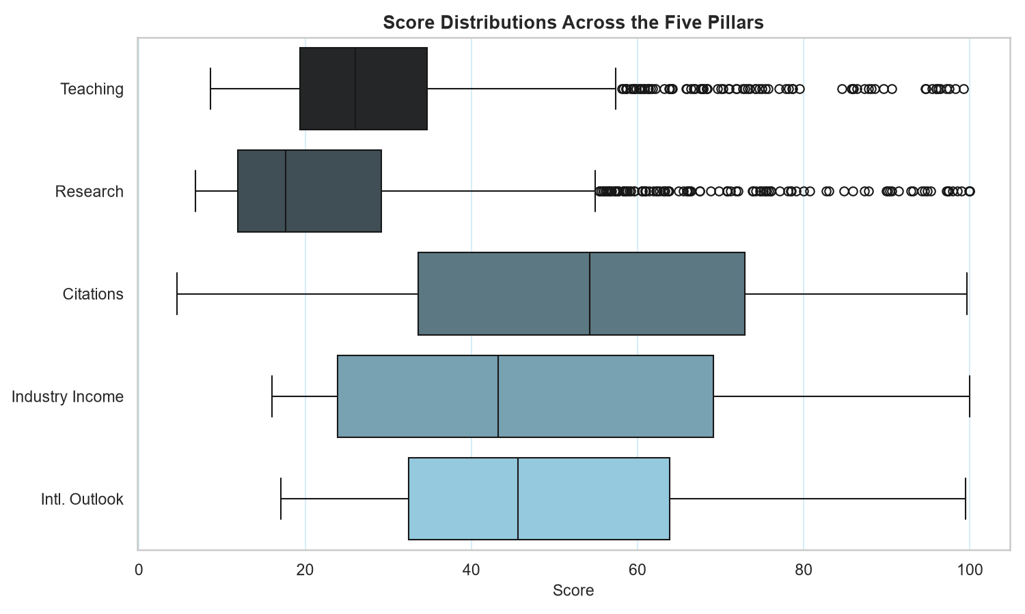
2
SCORE COMPOSITION
The five pillars are not on a comparable footing
Citations run hot
Citations score far higher on average than Research or Teaching — a mid-tier school can post a strong citations score while being nowhere near research-competitive.
Compressed vs. spread out
Citations & Industry Income spread broadly and separate institutions poorly. Research & Teaching sit compressed at the bottom with long elite tails.
World University Rankings · EDA
03

Slide 4
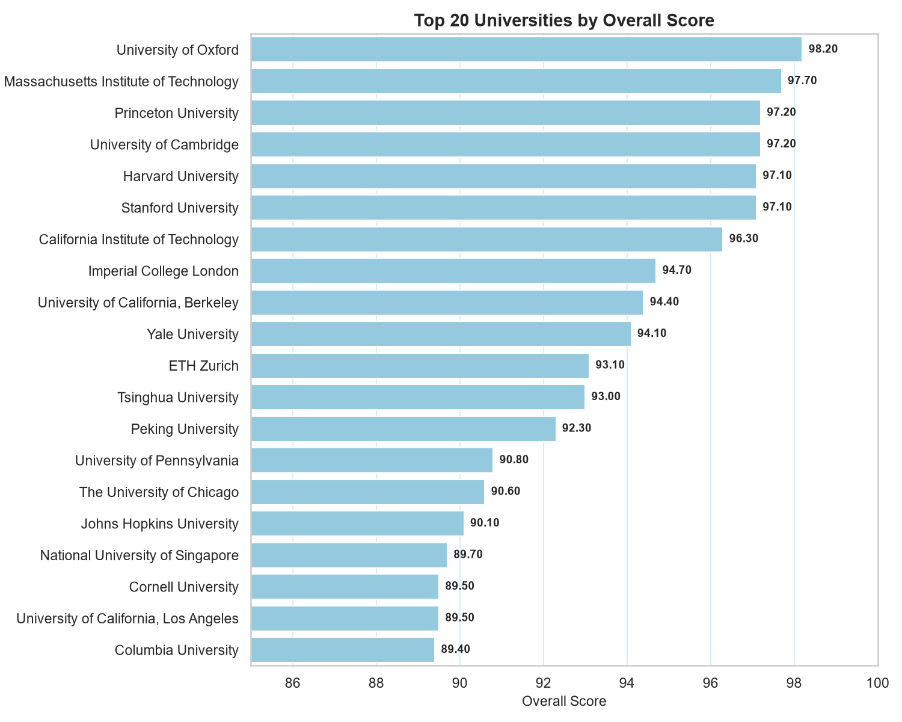
3
THE LEADING PACK
A very tight cluster at the very top
A 1.9-point spread
Oxford (#1, 98.2) to Caltech (#7, 96.3) — the leading pack is a tight cluster fighting over fractions of a point, not a steep drop from a lone leader.
WHO MAKES THE TOP 20
13
United States
of 171 ranked US universities
3
United Kingdom
of 109 ranked UK universities — Oxford, Cambridge, Imperial
4
Rest of world
ETH Zurich, Tsinghua, Peking, NUS
World University Rankings · EDA
04

Slide 5
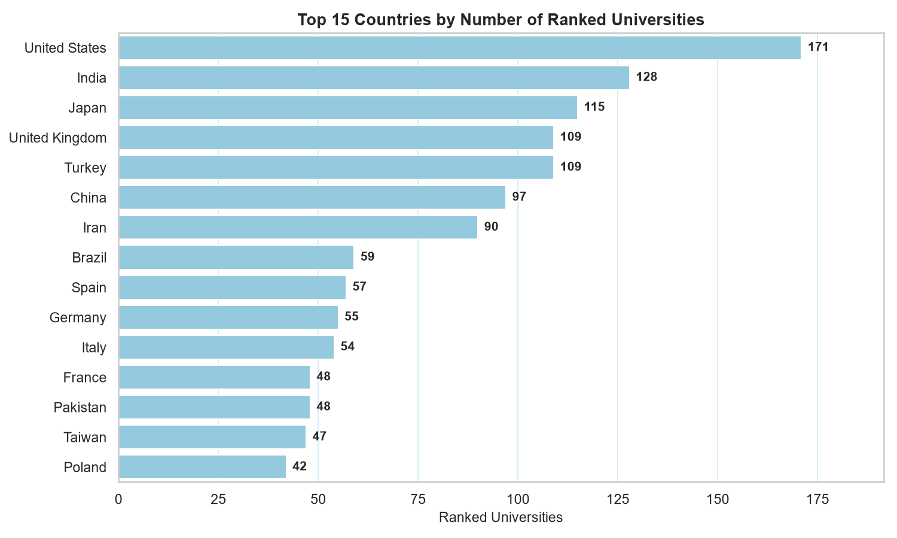
4
NATIONAL SYSTEMS — VOLUME
Who has the most ranked universities?
World University Rankings · EDA
05

Slide 6
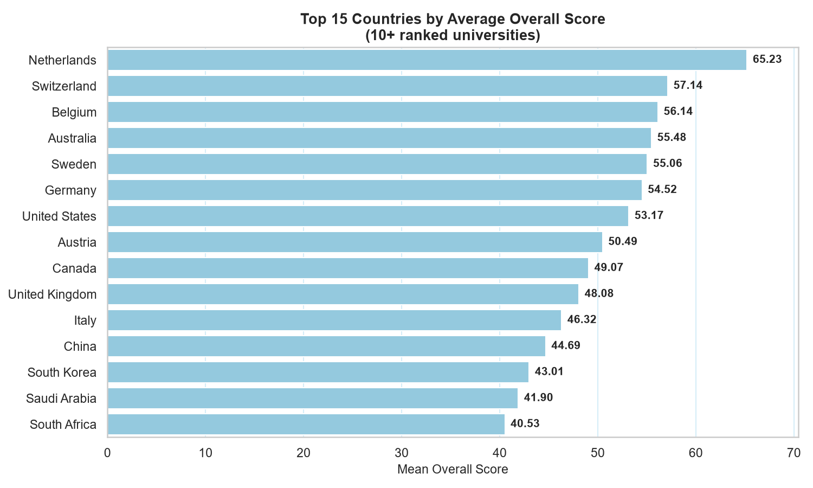
5
NATIONAL SYSTEMS — QUALITY
Volume and quality decouple sharply
Min. 10 ranked universities per country, so one or two outliers can't top the table.
Netherlands
65.2
#1 quality
Switzerland
57.1
Belgium
56.1
United States
53.2
171 unis, ranks 7th
United Kingdom
48.1
109 unis, ranks 10th
Large systems rank many mid-tier schools alongside their flagships, pulling the average down — headcount alone is a poor quality proxy.
World University Rankings · EDA
06

Slide 7
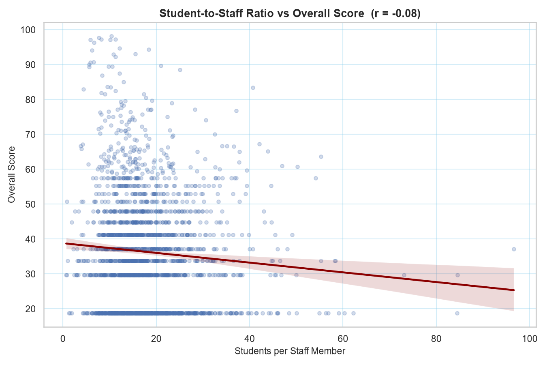
6
TESTING A COMMON ASSUMPTION
Student-staff ratio is not a useful quality signal
r = −0.076
ESSENTIALLY UNCORRELATED WITH OVERALL SCORE
Small classes are a conventional proxy for teaching quality. The data doesn't support that assumption at the institutional level — though the trendline does show a slight dip in score as students-per-staff increases.
World University Rankings · EDA
07

Slide 8
KEY TAKEAWAYS
Conclusions
1
Research is the dominant driver of rank
r = 0.90, and the largest top-100-vs-rest gap (+51.9 points). Elite status is fundamentally a research phenomenon.
2
Internationalization may be a promising lever
r = 0.52 (share of international students) is moderate, so it may prove a good aspect to build: diversity can be grown through admissions and recruitment far faster than research capacity.
3
Breadth and quality decouple nationally
The US (171 unis) and UK (109) lead on count but sit 7th (53.2) and 10th (48.1) on average score, behind the Netherlands (65.2), Switzerland (57.1) and Belgium (56.1) — restricted to countries with 10+ ranked universities.
4
Pillars aren't equally discriminating
Citations and Industry Income are broadly distributed and separate institutions poorly; Research and Teaching are compressed at the bottom with long elite tails.
5
Student-staff ratio is not a useful quality proxy
r = −0.076, essentially uncorrelated with overall score — despite being a common admissions talking point.

