Slide 1

Title: To Do Task
Student Name: Vedika Kulkarni
Student ID: 2520030350
Cluster:2
Section:7
Under the Guidance
of
Supervisor Name: Pavithra Duggineni
Assistant Professor
Department of CSE

Slide 2
OUTLINE
Abstract
Existing System
Proposed System
System Architecture
Project Modules
Objectives
Co’s Attainments - FWD
Co1
Co2
Co3
Co4
Co5
Screen Shots for FWD
Conclusion
Geo-Tagged Photos

Slide 3
ABSTRACT
PARAGRAPH:1
The Simple To-Do List Web Application helps users manage daily tasks efficiently. It allows users to add tasks, assign priorities, and mark tasks as completed using a simple and interactive interface built with HTML, CSS, and JavaScript.
The application uses different data structures to manage tasks effectively: a Linked List to store tasks dynamically, a Queue to manage task order, a Stack to track completed tasks, and a Priority Queue to organize tasks based on priority. This project demonstrates how data structures can be applied in real-world web applications for better task organization and productivity.

Slide 4
ABSTRACT
PRAGRAPH:2
Several data structures are used to manage tasks efficiently in this application. A Linked List stores tasks dynamically, a Queue maintains the execution order, a Stack tracks completed tasks, and a Priority Queue organizes tasks based on priority.
These structures help the system perform operations like adding, displaying, prioritizing, and completing tasks, demonstrating the practical use of data structures in web applications for better task management.

Slide 5
Existing System
Most To-Do list applications allow users to add, view, and delete tasks only.
Tasks are usually stored using simple lists or basic storage methods.
These systems do not use advanced data structures for efficient task management.
They often lack proper task prioritization mechanisms.
Workflow management is not well structured.
As a result, task processing and management remain basic and less efficient.

Slide 6
Proposed System
The proposed system introduces a more structured approach to task management by integrating multiple data structures. A Linked List is used to store tasks dynamically, a Queue manages tasks in the order they are processed, a Priority Queue organizes tasks based on their priority levels, and a Stack keeps track of completed tasks. The application also includes a web-based interface developed using HTML, CSS, and JavaScript, making it interactive and user-friendly. This system demonstrates how data structures can be applied to improve task organization and management.
.

Slide 7
System Architecture
1.User Interface (Frontend)
User interacts with the web page to add tasks, select priority, and mark tasks as completed.
Technologies used: HTML, CSS, JavaScript.
2.Input Processing
The application receives the user’s task and priority through JavaScript functions.
3.Data Structure Processing
Linked List stores tasks dynamically.
Queue manages tasks in the order they should be processed.
Priority Queue arranges tasks based on their priority.
Stack stores completed tasks.
4.Task Management Logic
The system processes operations like adding tasks, organizing them by priority, and marking them as completed.
5.Output / Display
The updated list of tasks and completed tasks is displayed back to the user on the web page.

Slide 8
Project Modules
User Interface Module
Displays the web page where users can enter tasks, choose priority, and view tasks. Built using HTML and CSS.
Input Handling Module
Takes user input (task name and priority) using input fields and buttons and processes it with JavaScript.
Task Management Module
Handles operations like adding tasks, displaying tasks, and completing tasks.
Priority Management Module
Uses a Priority Queue to arrange tasks according to their priority.
Task Processing Module
Uses a Queue to process tasks in the order they are added.
Completed Task Module
Uses a Stack to store tasks that are marked as completed.
Data Storage Module
Uses a Linked List to store and manage tasks dynamically.

Slide 9
Objectives
1.To develop a simple and user-friendly To-Do List web application for managing daily tasks.
2.To implement Data Structures such as Linked List, Queue, Stack, and Priority Queue for efficient task management.
3.To allow users to add, organize, and complete tasks based on priority.
4.To demonstrate the practical application of data structures in a real-world web application.
5.improve task organization and productivity through a structured task management system.

Slide 10
Co’sAttainments–FWD CO1
1.Internet Fundamentals – Web app runs in browser.
2.HTTP/HTTPS – Used to load the webpage.
3.Client–Server Architecture – Browser acts as client.
4. Browser Rendering – Browser displays HTML, CSS, JS.
5.HTML Structure – html, head, body.
6. Lists – ul, li for tasks.
7. CSS Syntax – selector, property, value.
8. Selectors – element, .class, #id.
9.Typography – font-family.
10. Colors – background colors.
11. Spacing – margin, padding, border.

Slide 11
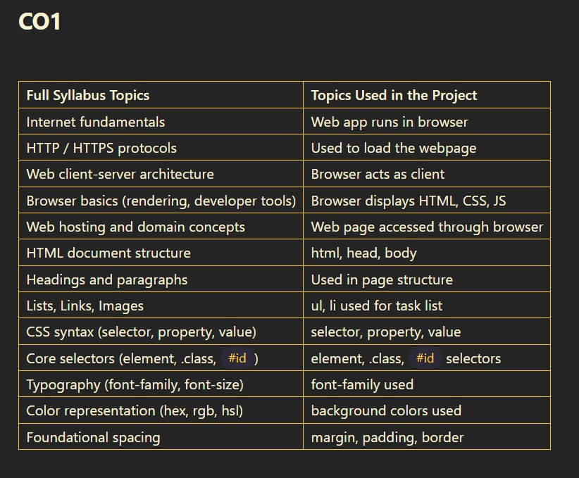
Co’sAttainments–FWD

Slide 12
CO2:
Forms & Input Handling
Form elements → input, select, button
Input types → text2.
Semantic & Structured Content
Basic structured tags → h2, div3.
Comprehensive CSS Layout & Styling
Typography → font-family
Block layout → display behavior of elements
Basic spacing and layout styling → margin, padding, container layout

Slide 13
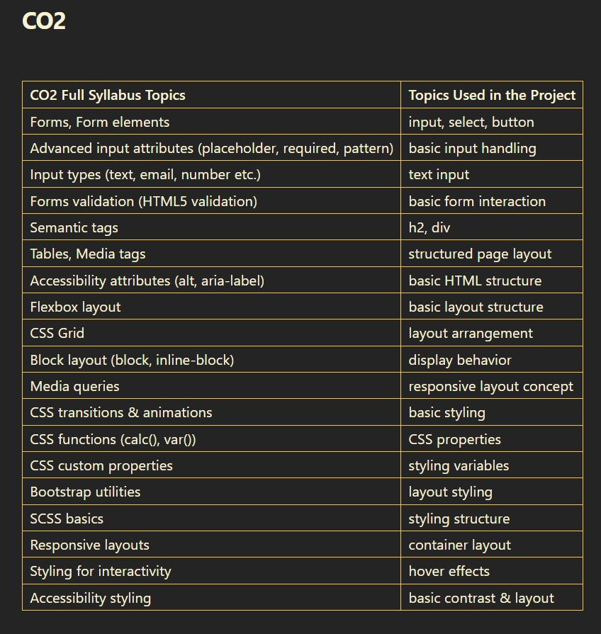

Slide 14
CO3:
JavaScript Fundamentals
Basic operators → = assignment operator
Conditions → if condition
Functions → functions like addTask(), completeTask(), display()
Parameters → used in constructors and methods
Objects & Arrays
Objects → task objects {task, priority}
Classes (Object inheritance concept) → class Node, class LinkedList, class Queue, class Stack, class PriorityQueue
Arrays → used in stack, queue, and priority queue storage

Slide 15
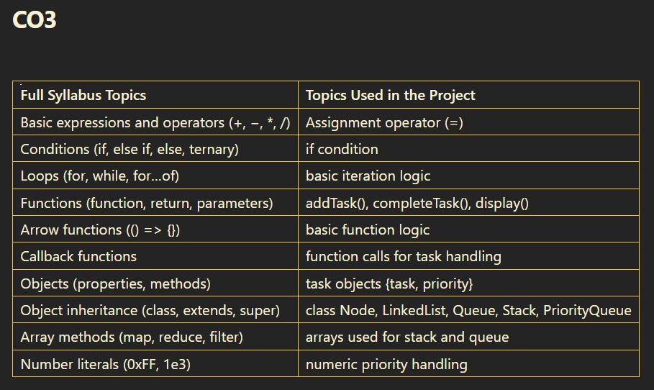
CO3:
JavaScript Fundamentals
Basic operators → = assignment operator
Conditions → if condition
Functions → functions like addTask(), completeTask(), display()
Parameters → used in constructors and methods
Objects & Arrays
Objects → task objects {task, priority}
Classes (Object inheritance concept) → class Node, class LinkedList, class Queue, class Stack, class PriorityQueue
Arrays → used in stack, queue, and priority queue storage

Slide 16
CO4:
Event handling (click) → onclick for buttons
DOM manipulation → document.getElementById()
DOM manipulation → innerHTML (to update task list)
DOM manipulation → textContent / innerText (to show tasks)

Slide 17
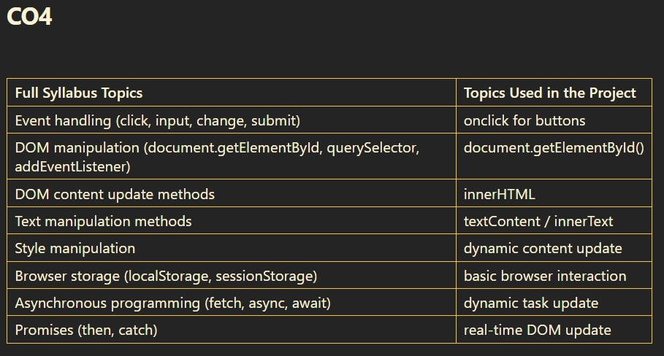
CO4:
Event handling (click) → onclick for buttons
DOM manipulation → document.getElementById()
DOM manipulation → innerHTML (to update task list)
DOM manipulation → textContent / innerText (to show tasks)

Slide 18
CO5:
JavaScript Features
- Handling user input dynamically → User enters task and priority and JavaScript processes it.
Performance Optimization & SEO
- Basic webpage loading in browser → HTML page loads and runs in the browser.

Slide 19
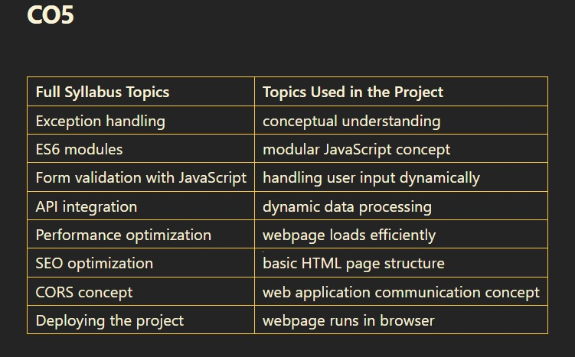
CO5:
JavaScript Features
- Handling user input dynamically → User enters task and priority and JavaScript processes it.
Performance Optimization & SEO
- Basic webpage loading in browser → HTML page loads and runs in the browser.

Slide 20
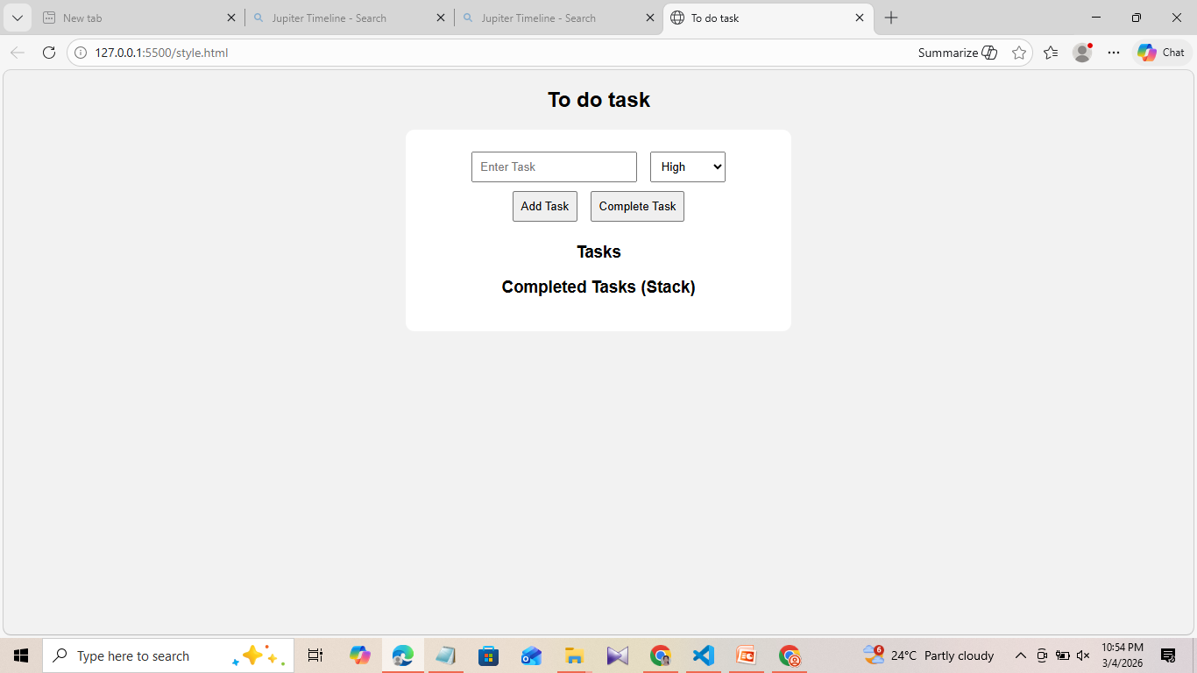
Screenshot for FWD

Slide 21
Conclusion
This project developed a Simple To-Do List Web Application that helps users manage their daily tasks efficiently. It demonstrates how web technologies (HTML, CSS, JavaScript) can be combined with data structures such as Linked List, Queue, Stack, and Priority Queue to organize and process tasks. The application allows users to add tasks, assign priorities, and mark tasks as completed through an interactive interface. Overall, the project highlights the practical use of data structures in a real-world web application and improves task organization and management.

Slide 22

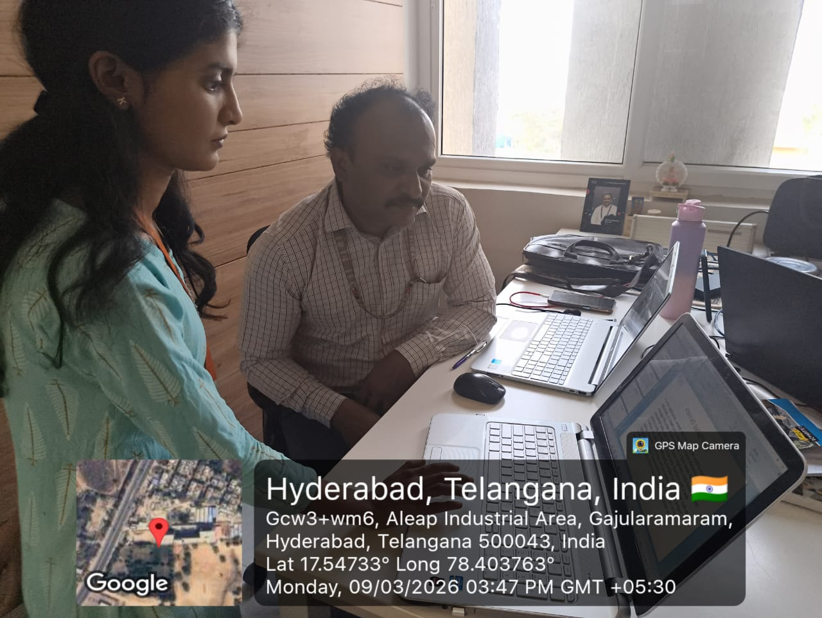
Geo- Tag Photos

Slide 23
THANK YOU

