Slide 1



Internship Demo
Name: Vedika Vijay Lohiya
College: MGM’s College of Engineering, Nanded
Company: Synergy Global IT Solutions
Role: Azure Data Engineer
Presented To:
Asst. Prof Pankaj P. Pawar

Slide 2



Company Overview
  Synergy Global IT Solutions is an IT service-based company providing tailored technology solutions since 2020.
  Located at Hyderabad & USA with approx. 130 plus associates
  The company delivers end-to-end project solutions from concept to deployment.
  It follows structured approaches such as Build–Operate–Transfer (BOT) and Product-Oriented Delivery (POD) and also supports GCC establishments.
  It works on Cloud computing, AI/ML, data analytics, and SAP enterprise applications.
  The company focuses on understanding client requirements and delivering scalable solutions.

Slide 3
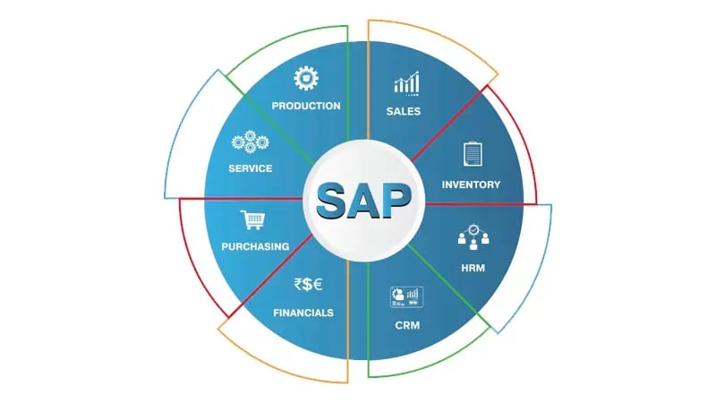
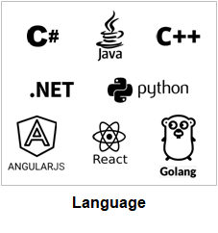
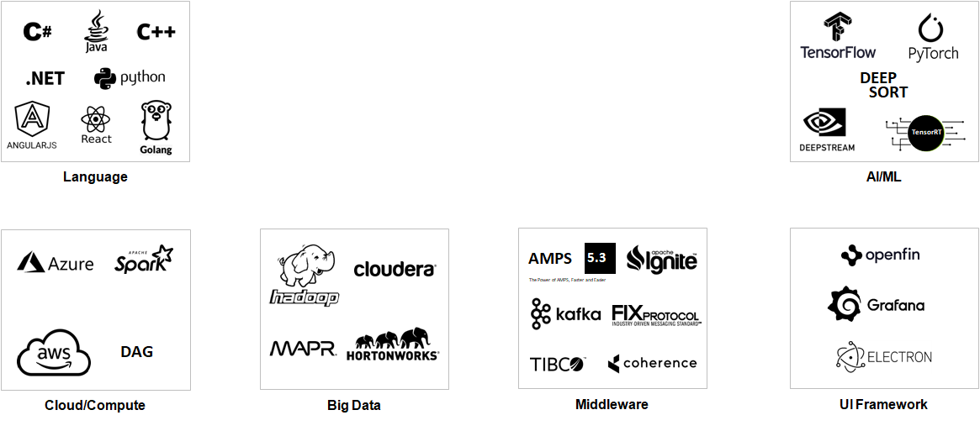
Technology Expertise
Engineering Practices
  Enterprise Architecture Engineering
  Low Latency & High-Frequency Compute Engineering
  Quality Engineering (QA/QP)
  Resiliency & Production Engineering
  Agile Transformation in Engineering
  Engineering Skill Harvesting

Slide 4




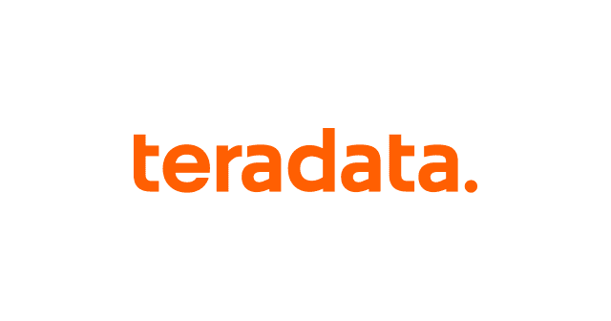



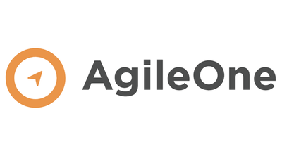

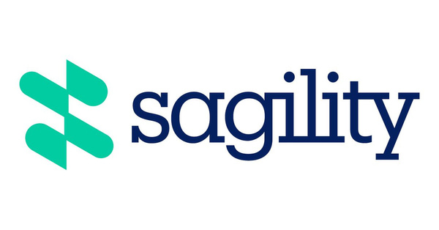







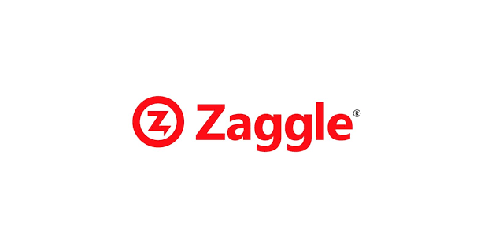

Key Clients Served

Slide 5
Internship Roles & Responsibilities
I am Vedika working as an Azure Data Engineer - Intern.
My role involves building and understanding Azure cloud-based solutions and services.
I am involved in writing SQL Queries, NOSql Queries performing Data ingestion, Data cleaning, aggregation and validation using azure SQL server and azure block storage & optimizing data workflows using Azure Data Factory.
I am working on project documentation of data and cloud services.
This internship focuses on gaining real-time project exposure and industry experience.

Slide 6
Project Overview & Problem statement
Project Overview
Problem statement
  Synergy’s client wants to analyze customer transaction data (like deposits, withdrawals, and UPI payments) to generate insights such as spending patterns and peak transaction hours. Currently, this data is siloed across different sources (core banking systems, mobile app logs, and transaction history). This aims to build Azure Data Engineering services that can centralize, clean, and analyze customer data efficiently.
  Synergy’s client generates massive volumes of transaction data daily across multiple channels such as: Core banking systems (deposits, withdrawals), Mobile banking apps (UPI, bill payments), ATM and POS systems
Current Challenges:
Data is siloed across disparate systems.
No unified view of customer transactions.
Difficult to analyze spending behavior & trends.
Limited ability to detect peak transaction hours.
Lack of near real-time insights for business decisions.
Objectives –
Consolidate all transaction data
Enable real-time & batch analytics
Generate actionable insights like:
Customer spending patterns
Peak transaction times
Channel-wise usage (UPI vs ATM vs Net Banking)
Fraud/anomaly detection signals
Integrates with existing banking systems

Slide 7
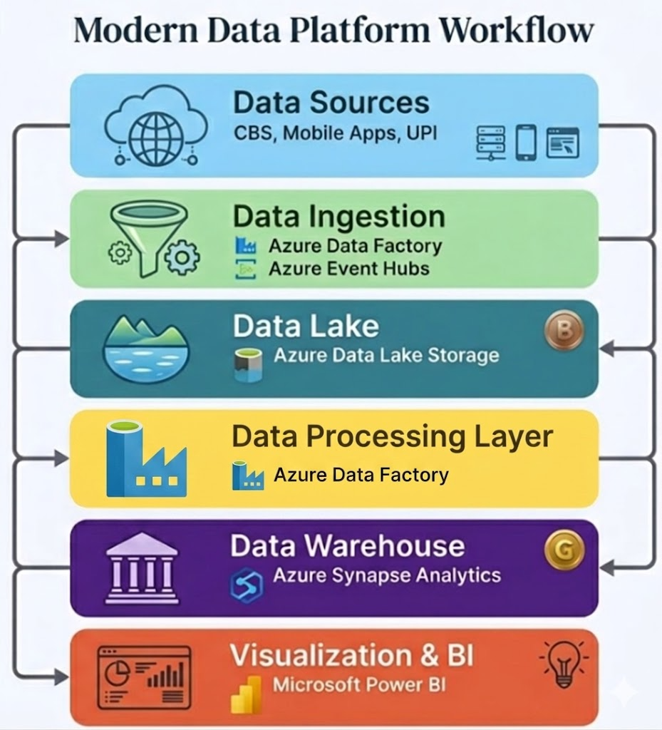
Proposed Solution (MVP)
Centralizing transaction data from multiple sources (Core Banking, Mobile Apps, UPI)
Ingesting data in batch using Azure Data Factory.
Storing data in a scalable data lake using Azure Data Lake Storage Gen2
Performing data cleaning, transformation, and enrichment using Azure Data factory.
Structuring and modeling data using Azure Synapse Analytics for analytics readiness
Building a data warehouse for efficient querying and data access
Generating insights using Power BI (customer behavior, trends, peak usage)
Ensuring data governance and security using Azure Purview and Azure Active Directory
Enabling scalable, real-time, and data-driven decision-making

Slide 8
MVP - Sprint wise report
SPRINT 0 – TRAINING PHASE | SPRINT 1 – REQUIREMENT UNDERSTANDING | SPRINT 2 – DESIGN & DOCUMENTATION | SPRINT 3 – INFRA CREATION & DATA INGESTION
Started understanding on Azure cloud Data Engineer fundamentals SERVICES. Gained foundational knowledge of SQL fundamentals. Built understanding of Azure cloud fundamentals Solved query-based scenarios in SQL. Worked on structuring and maintaining SQL and cloud documentation. | Understanding project requirements and business objectives. Analyzing use cases and system workflows. Identifying data sources and data flow requirements. Participating in team discussions for requirement clarity. Working on requirement documentation. | Reviewed and enhanced the existing BRD. Worked on functional design documentation. Worked on technical design documentation. Documents were prepared using templates provided by the team. Completed the certification of Azure-900. Received and reviewed the database schema design. Gained hands-on experience in building SQL queries using SSMS tools. | Created Azure services like SQL Server, Cosmos DB (NoSQL DB account), and Blob Storage account. Performed data loading and data source management in Azure services. Built Azure Data Factory (ADF) pipelines for data cleaning, aggregation, and transformation. Worked on data ingestion processes for banking transaction datasets. Created and monitored Azure Data Factory pipelines for moving transformed data to Azure Analytics Workspace.

Slide 9



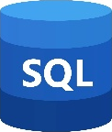


SPRINT 0 – TRAINING PHASE
Project Workflow, Architecture & Tech Stack
Tech Stack
Technology Stack
  Ramp up phase
  Requirement gathering
  BRD understanding and enhancement
  Functional design preparation
  Technical design preparation
  Proposed Architecture planning
1. | Azure Data Factory
2. | Azure Data Lake Storage Gen2
3. | Azure Synapse Analytics
4. | SQL, CosmosDb
5. | Power BI

Slide 10
Skills Learned and Daily Work
Skills Learned
Daily Work and Involvement
Applied SQL for data querying, transformation, and structured data handling.
Functional design and technical design concepts.
Hands-on documentation such as BRD.
Gained hands-on experience in building SQL queries using SSMS tools.
Understanding of Azure cloud fundamental services.
Created Azure services like SQL Server, Cosmos DB (NoSQL DB account), and Blob Storage account.
Performed data loading and data source management in Azure services.
Built Azure Data Factory (ADF) pipelines for data cleaning, aggregation, and transformation.
Learning SQL fundamentals and solving practical use cases daily.
Daily status update meetings with the team.
Regular interactions with my manager for guidance and task understanding.
Progress updates and clarified doubts during discussions.
Worked on data ingestion processes for banking transaction datasets.
Created and monitored Azure Data Factory pipelines for moving transformed data to Azure Analytics Workspace.
Supported data validation and workflow optimization during project execution.

Slide 11
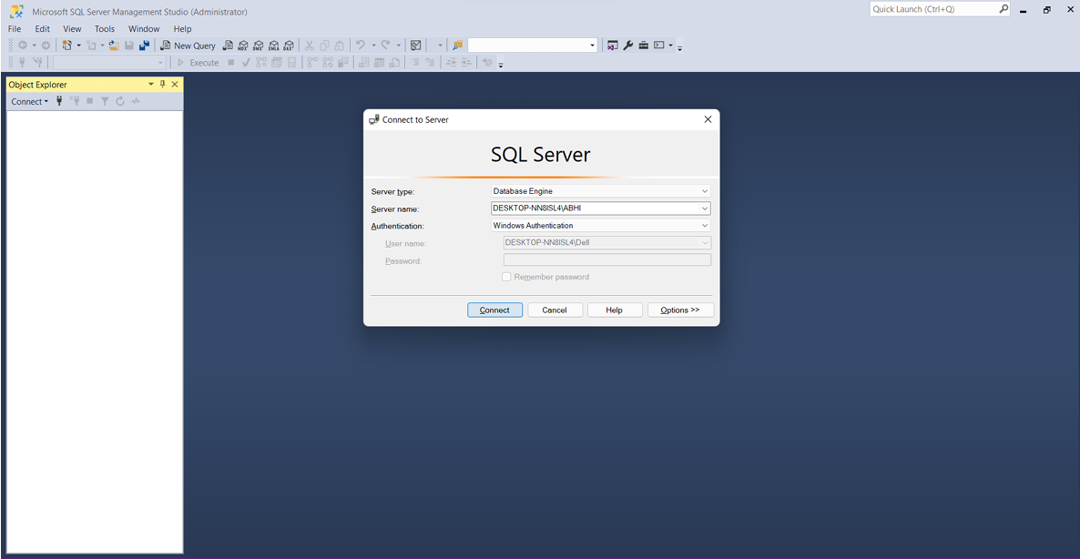
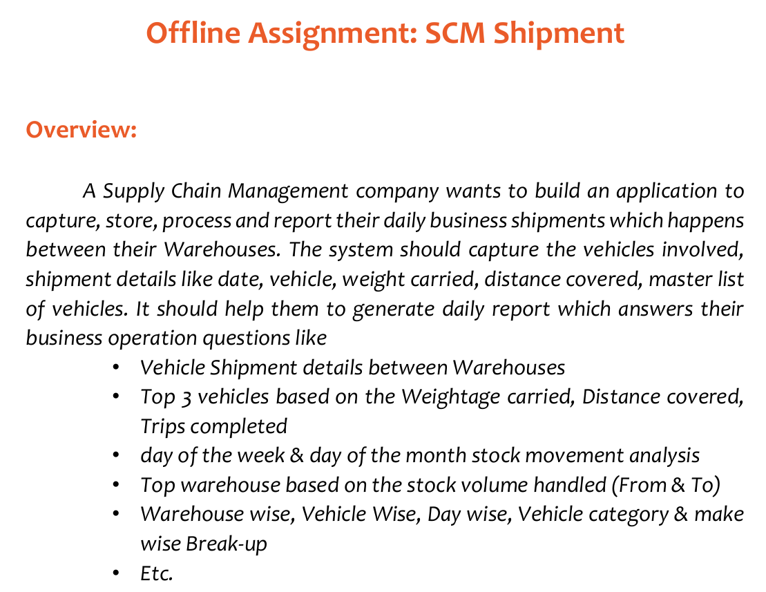
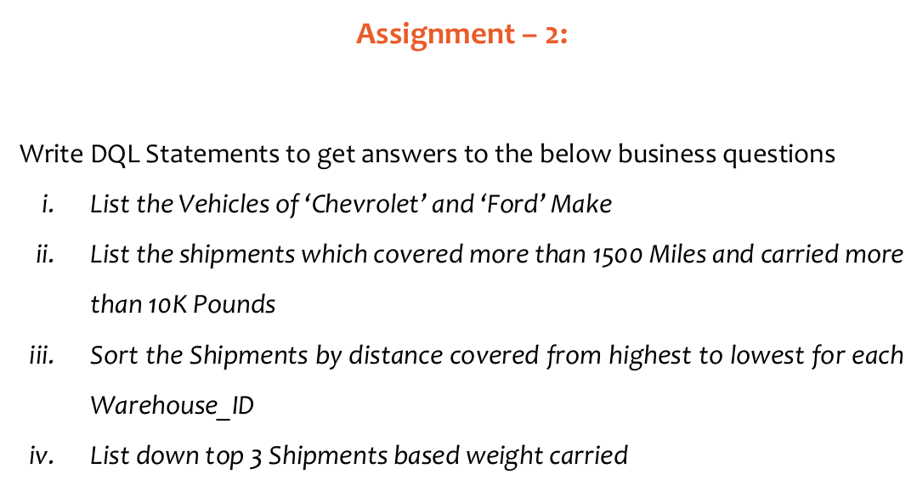
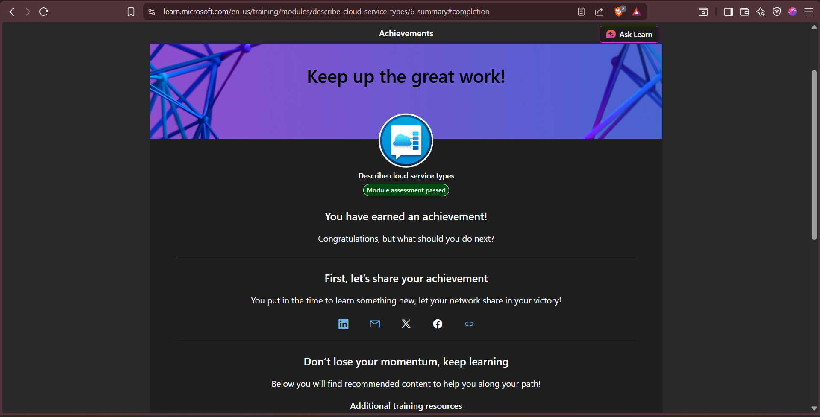
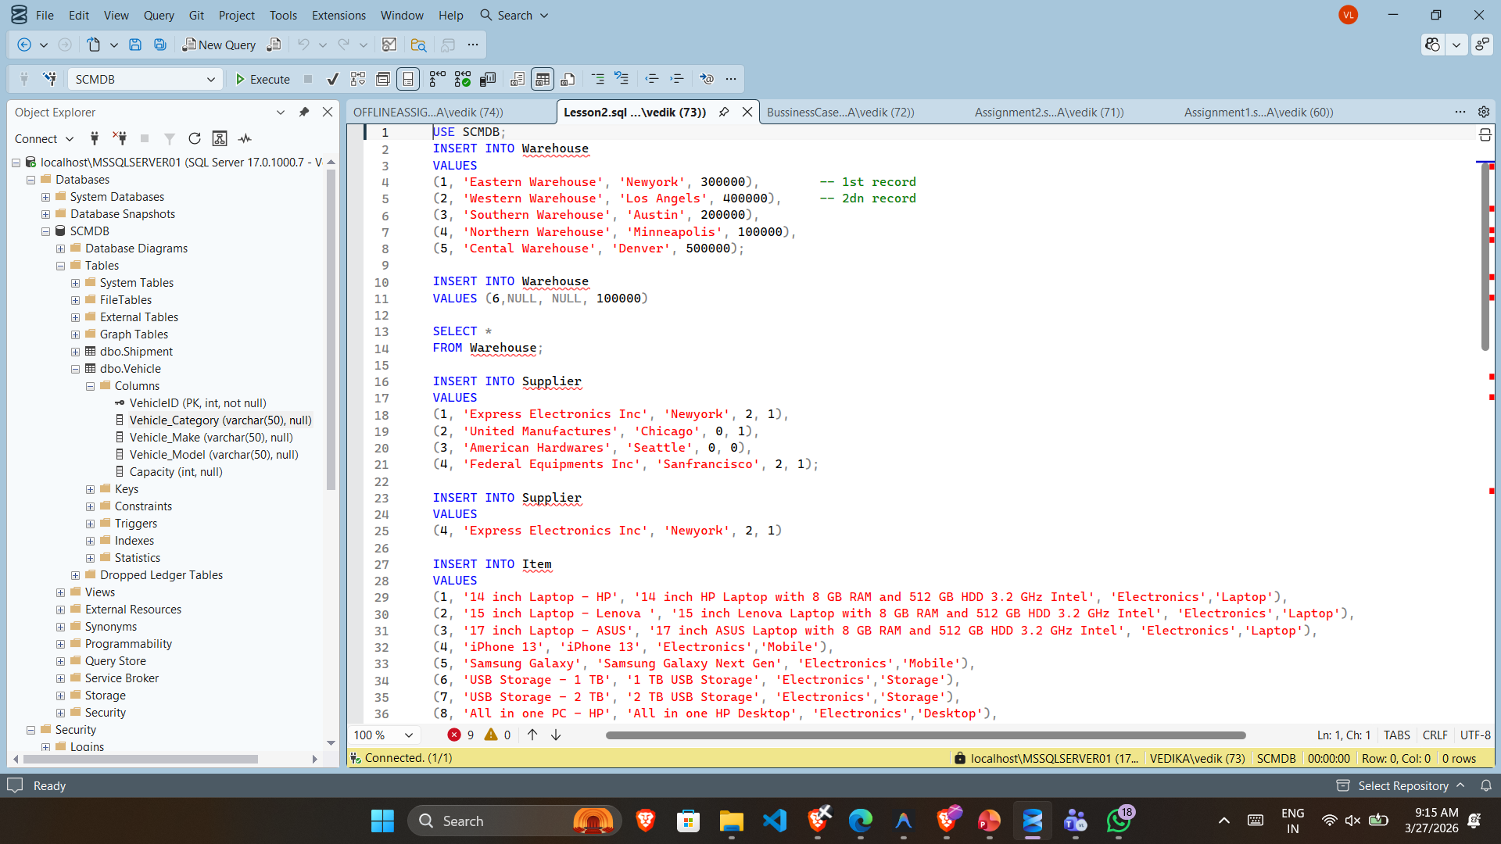
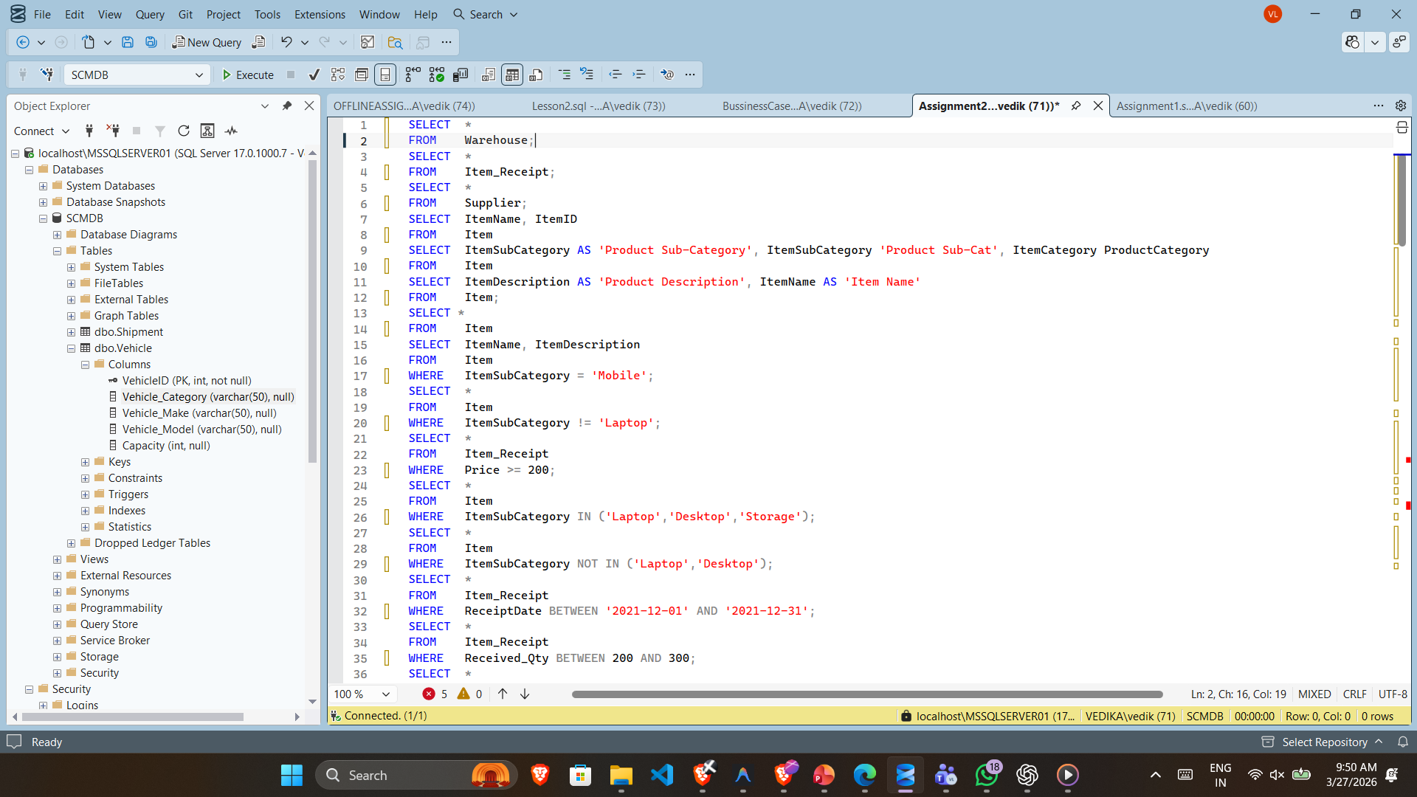
Glimpses of Work Done

Slide 12
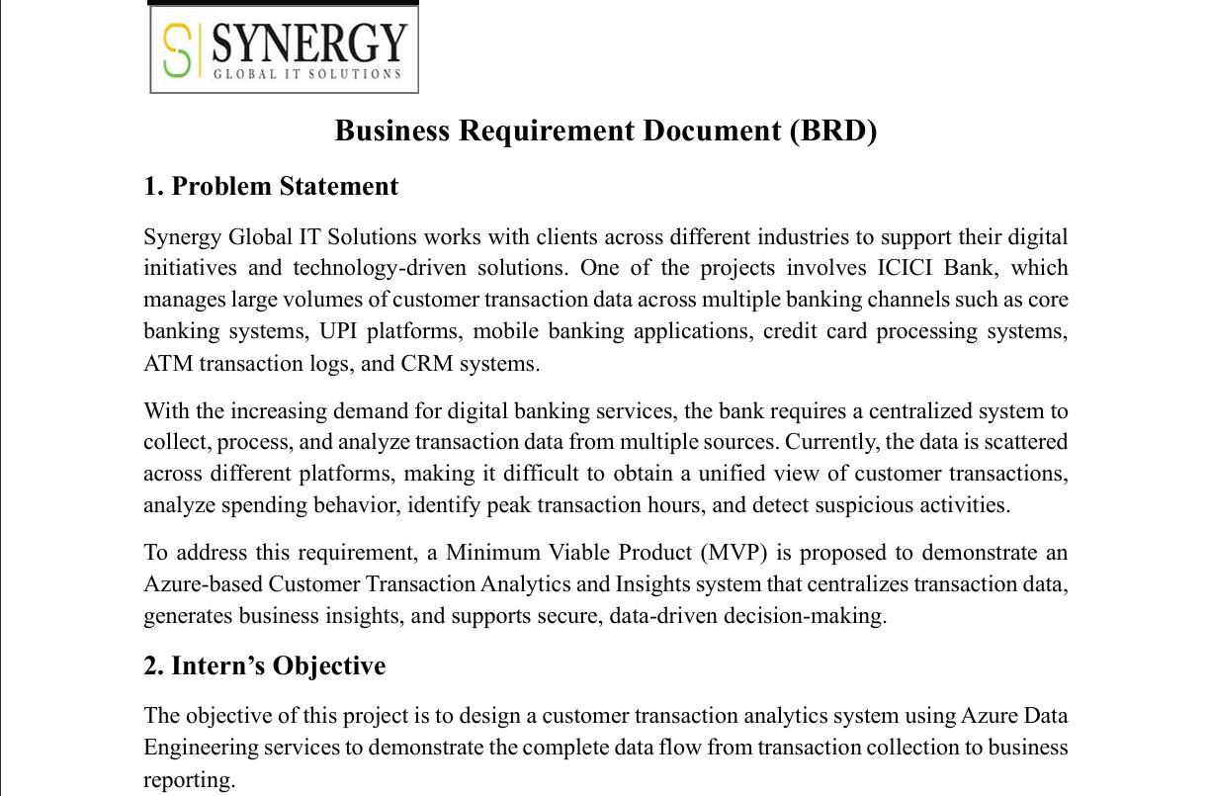
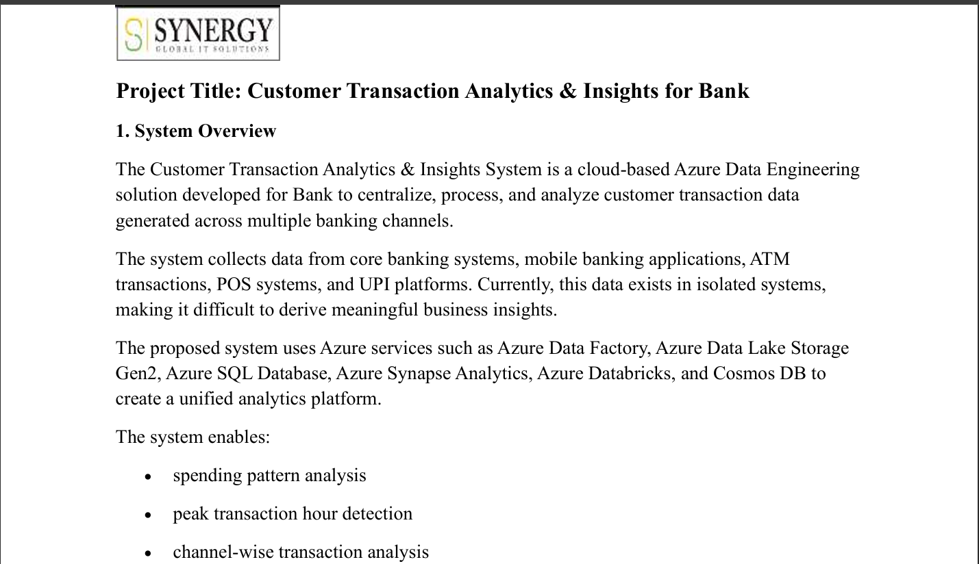
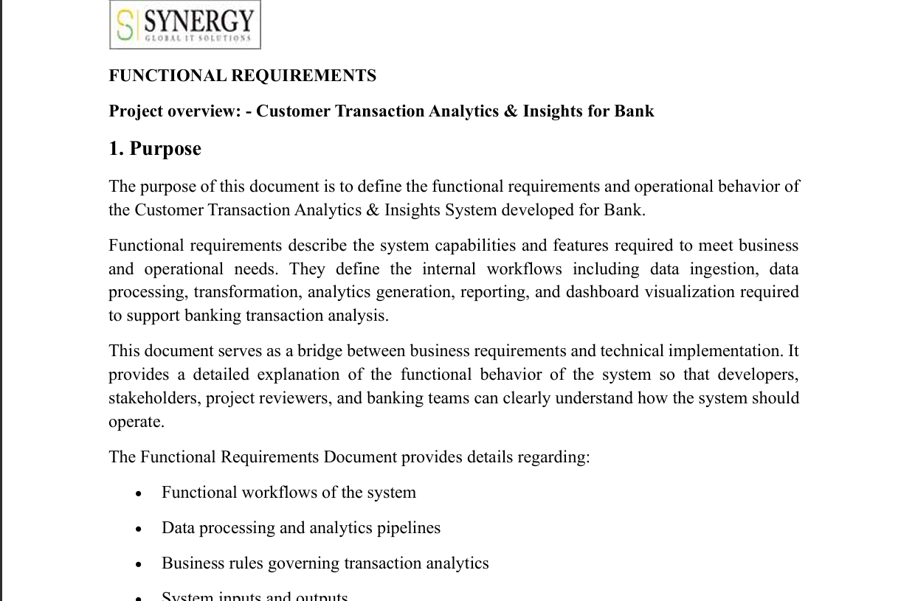
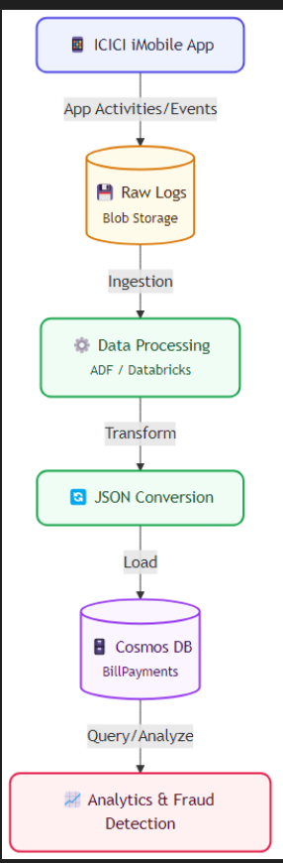
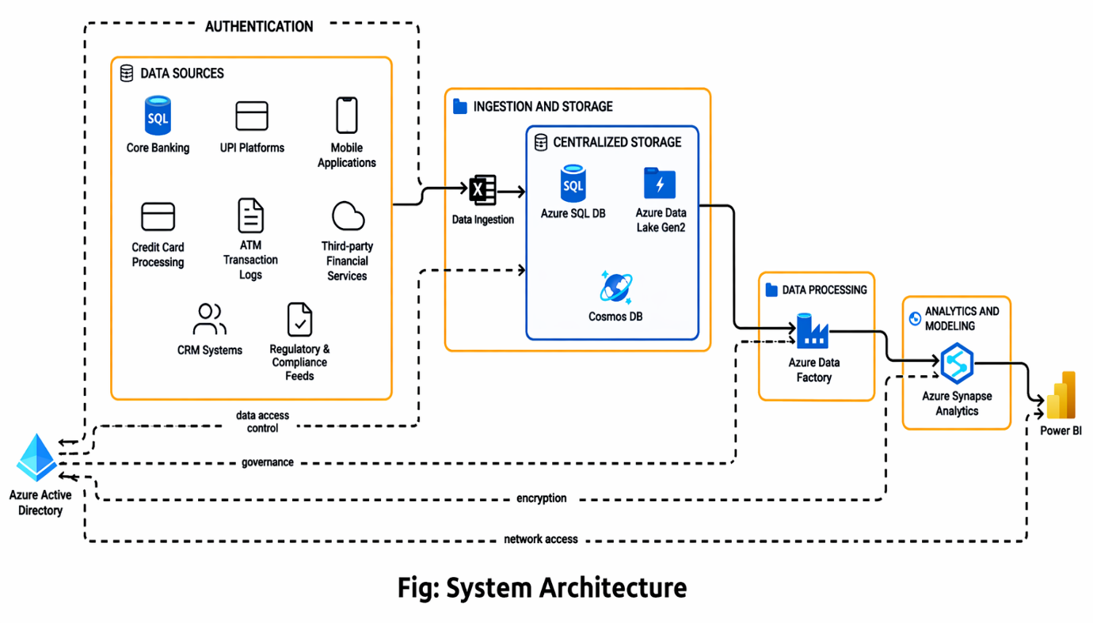
Glimpses of Work Done

Slide 13
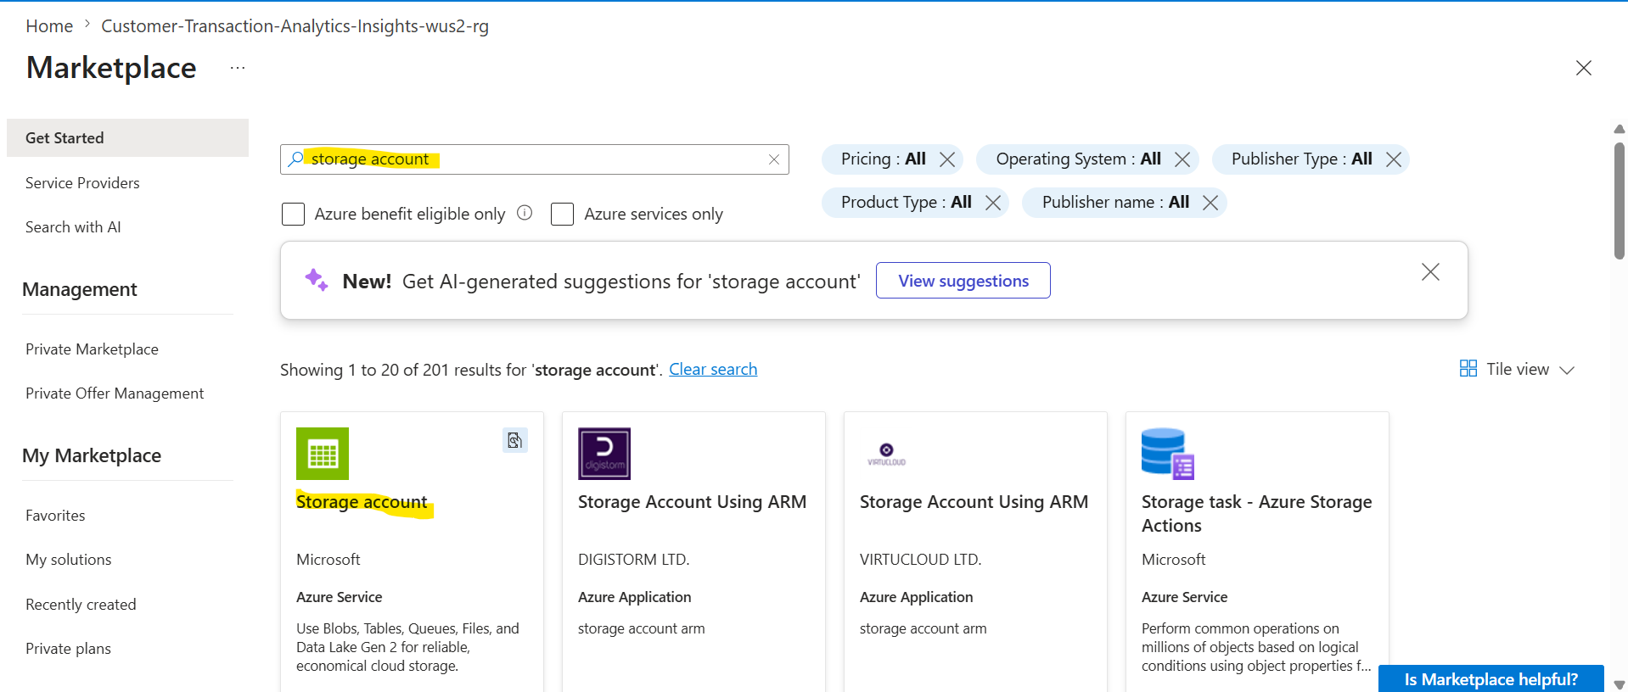
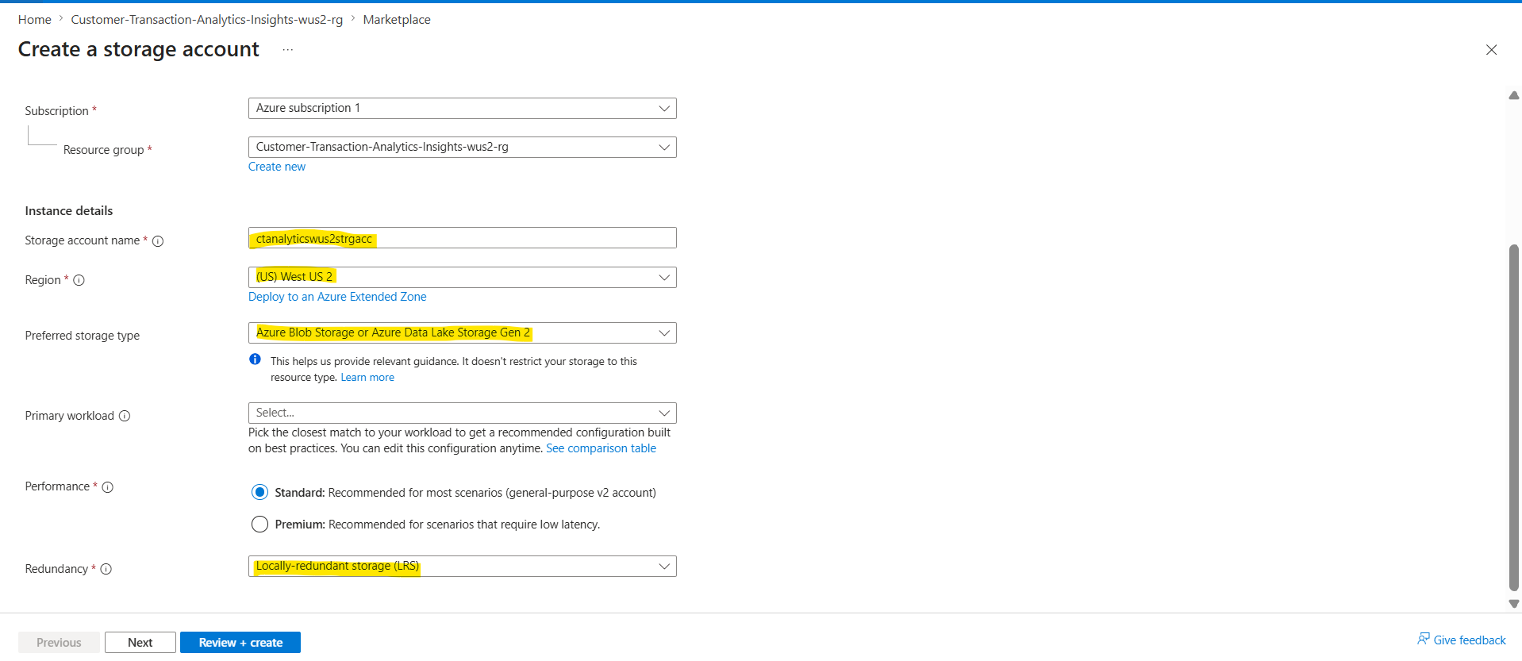
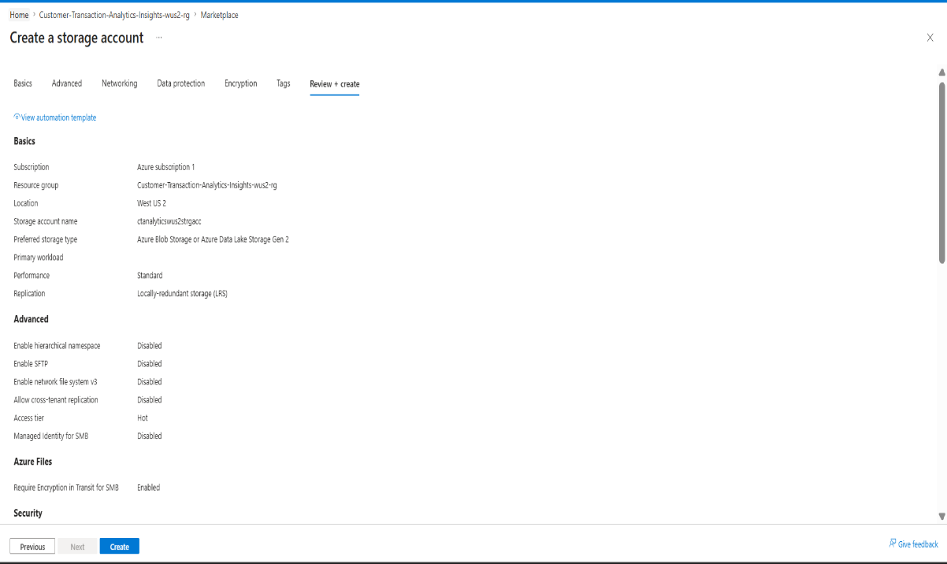
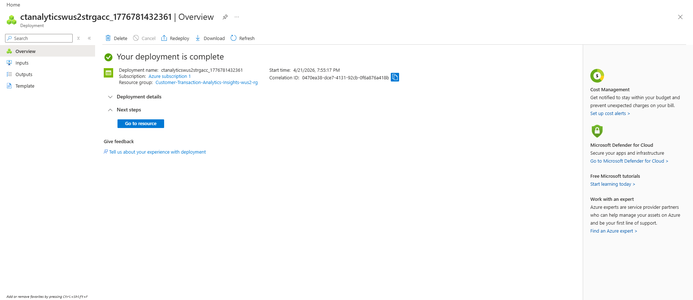
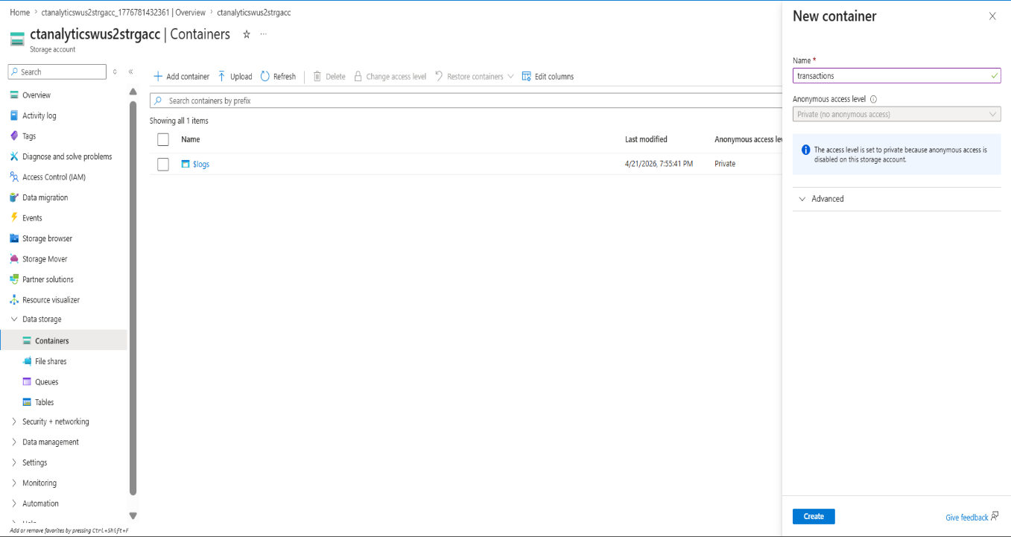
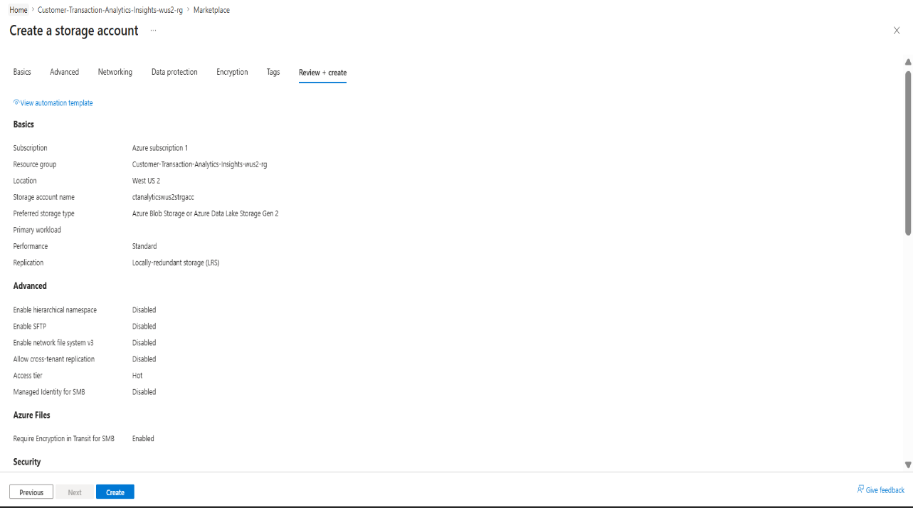
Glimpses of Work Done-Infra creation

Slide 14
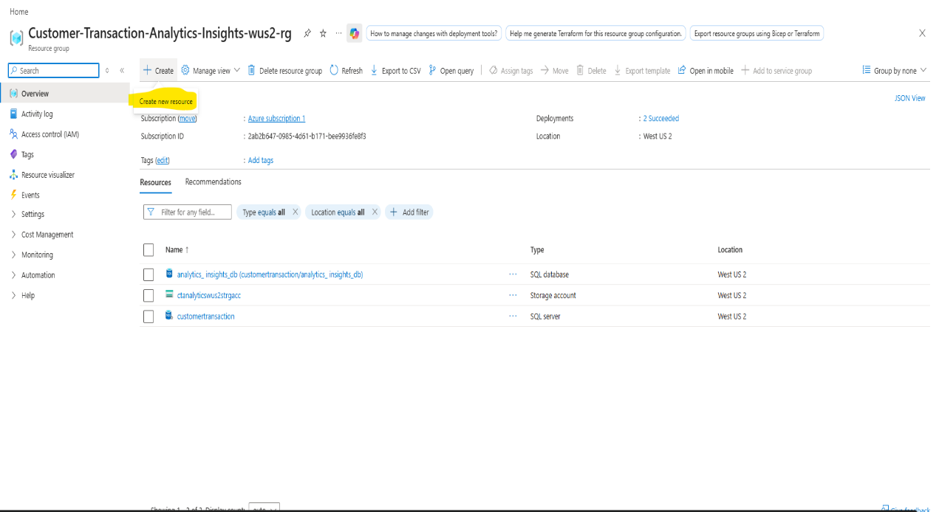
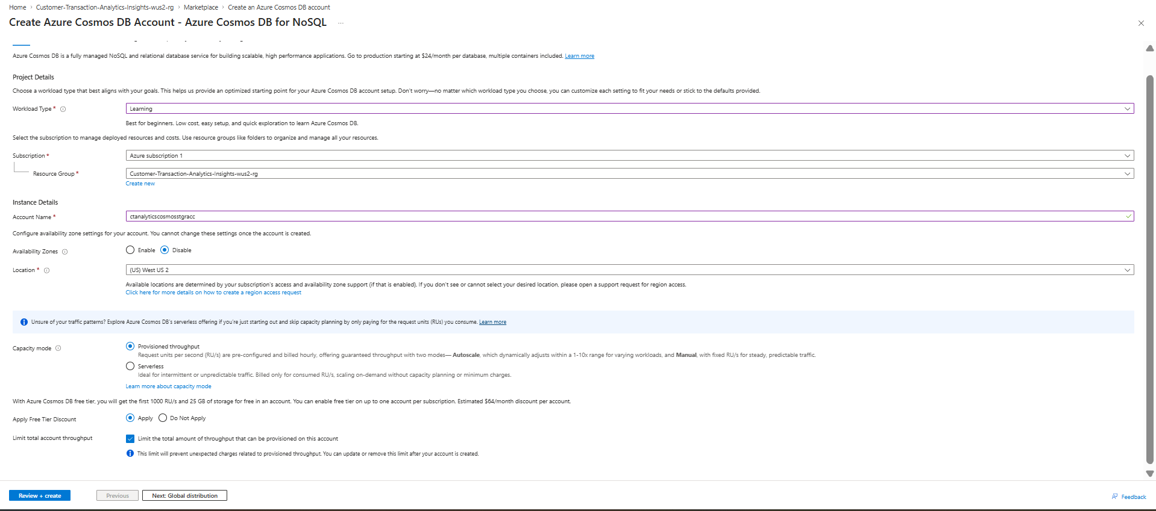
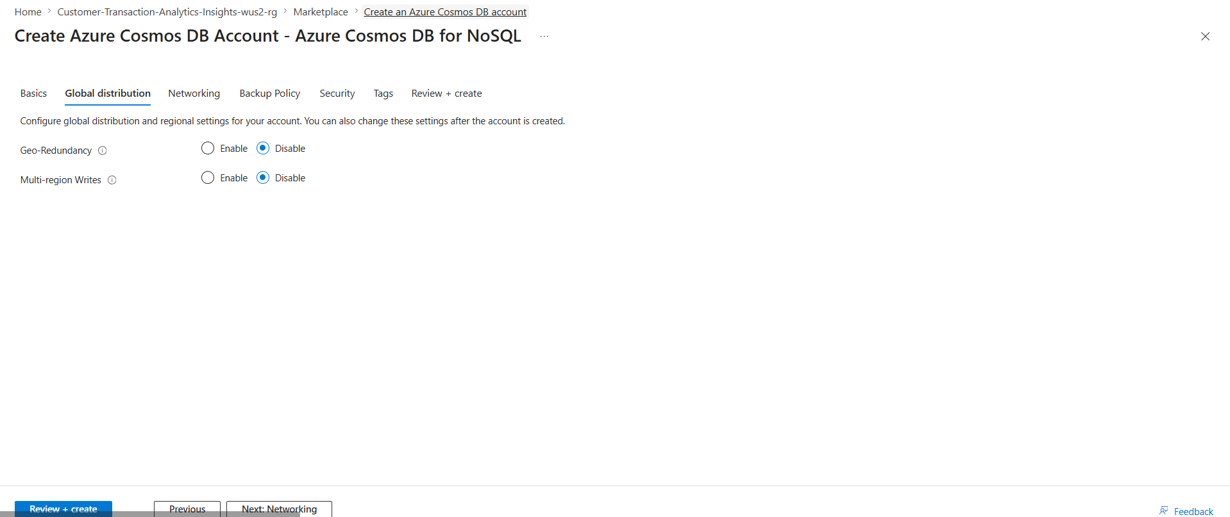
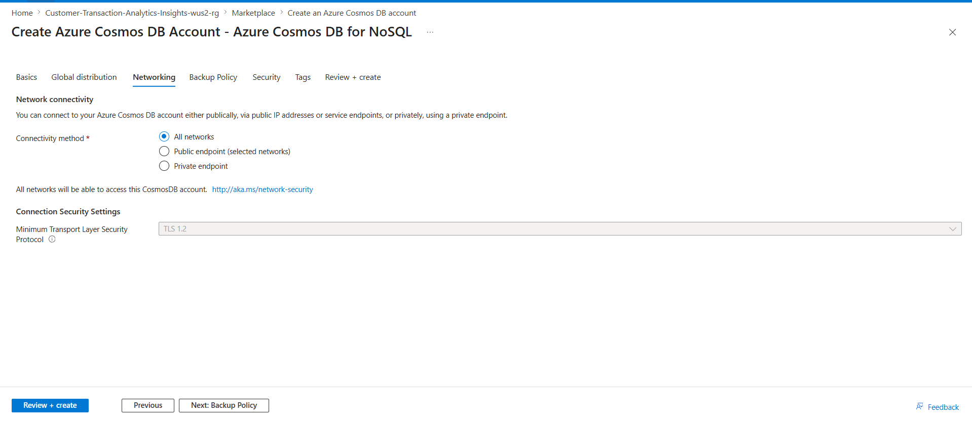
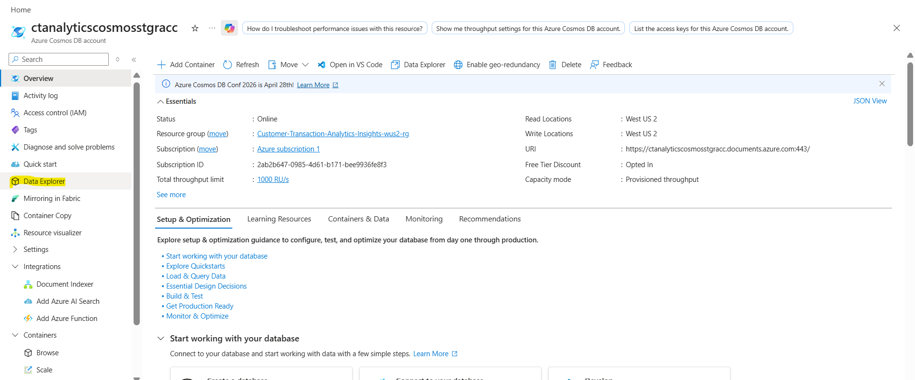
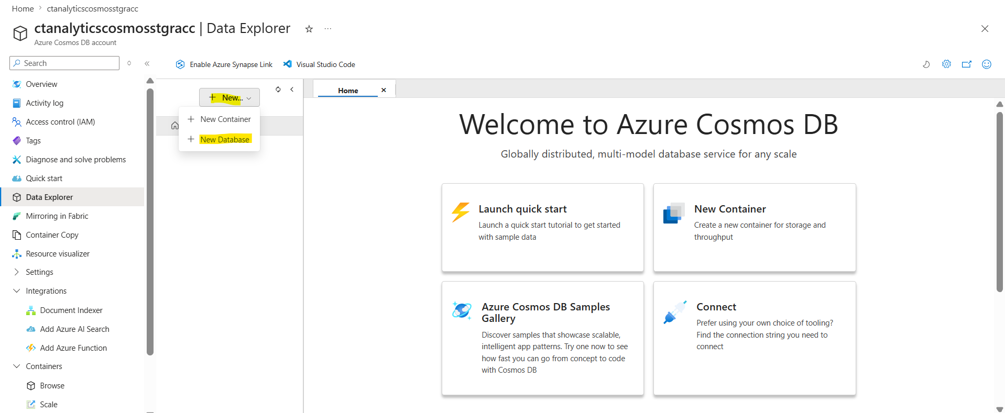
Glimpses of Work Done-Infra creation

Slide 15
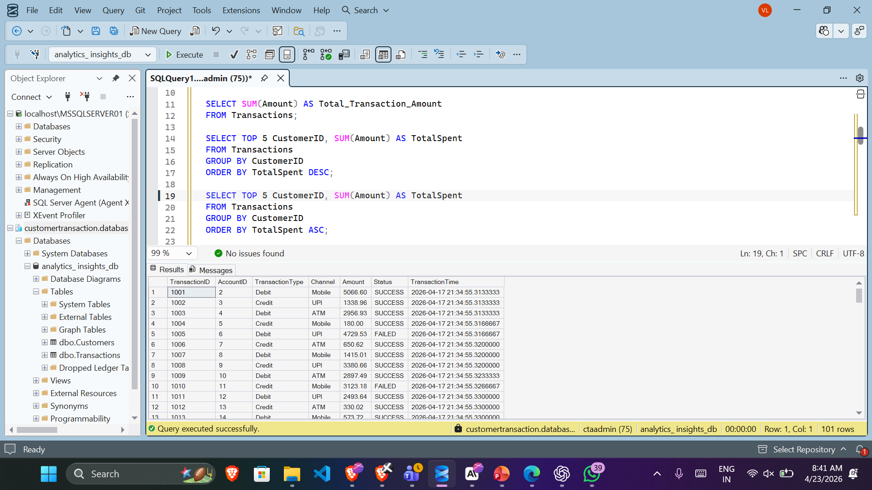
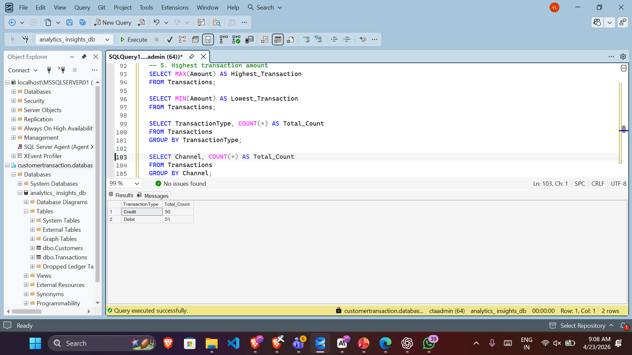
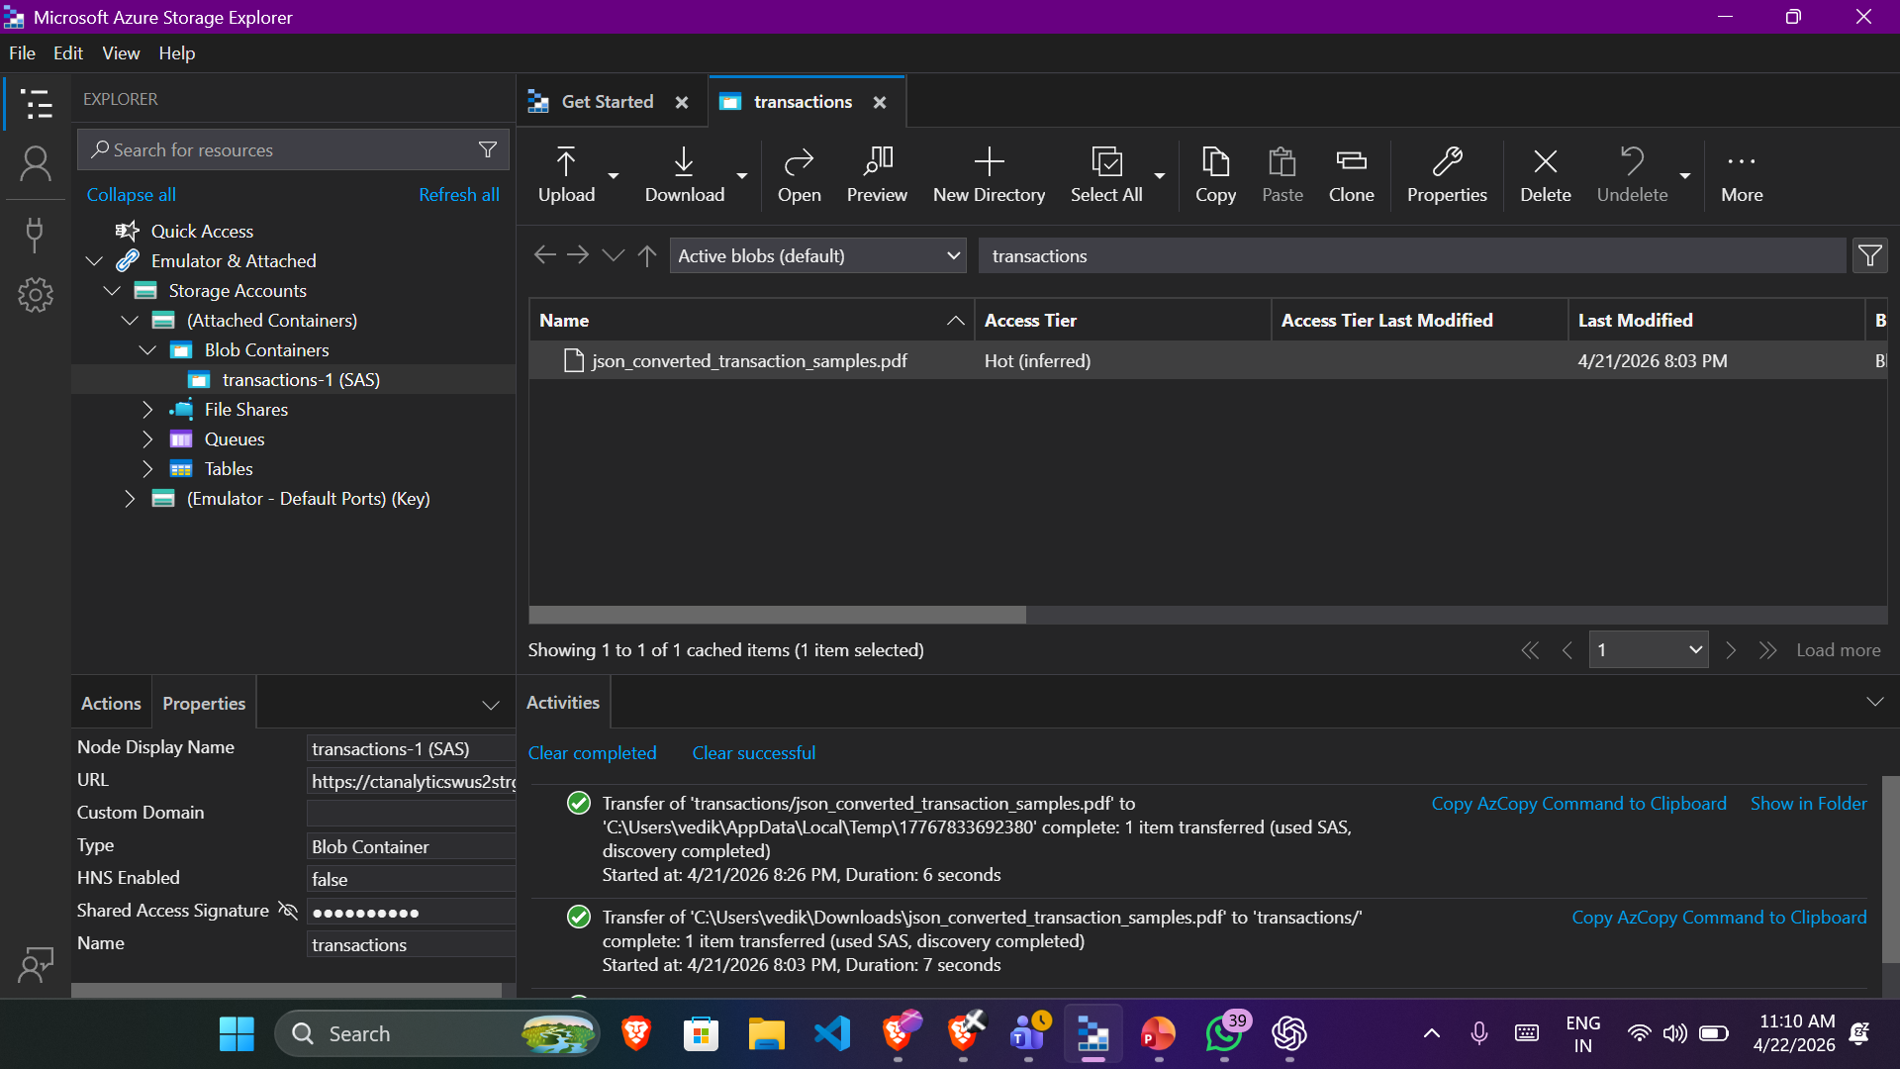
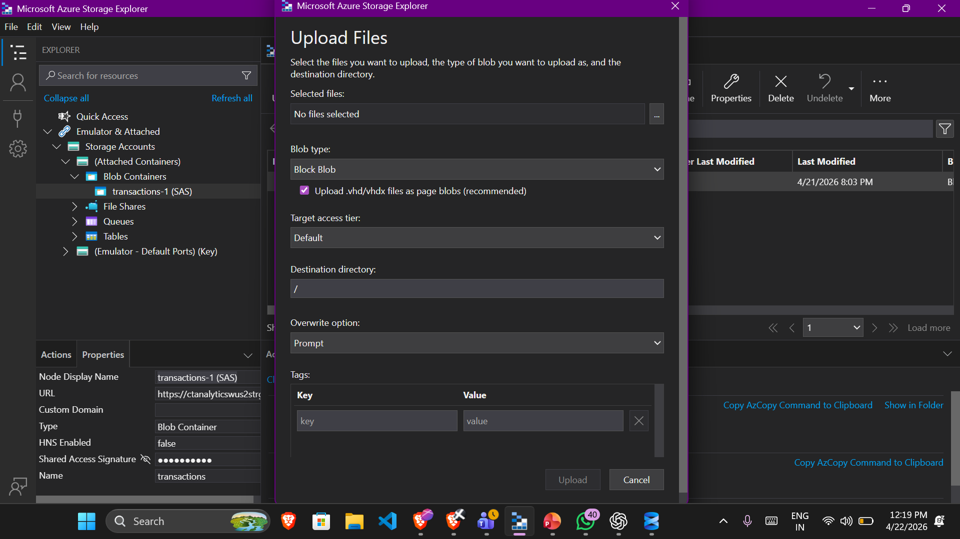
Glimpses of Work Done

Slide 16
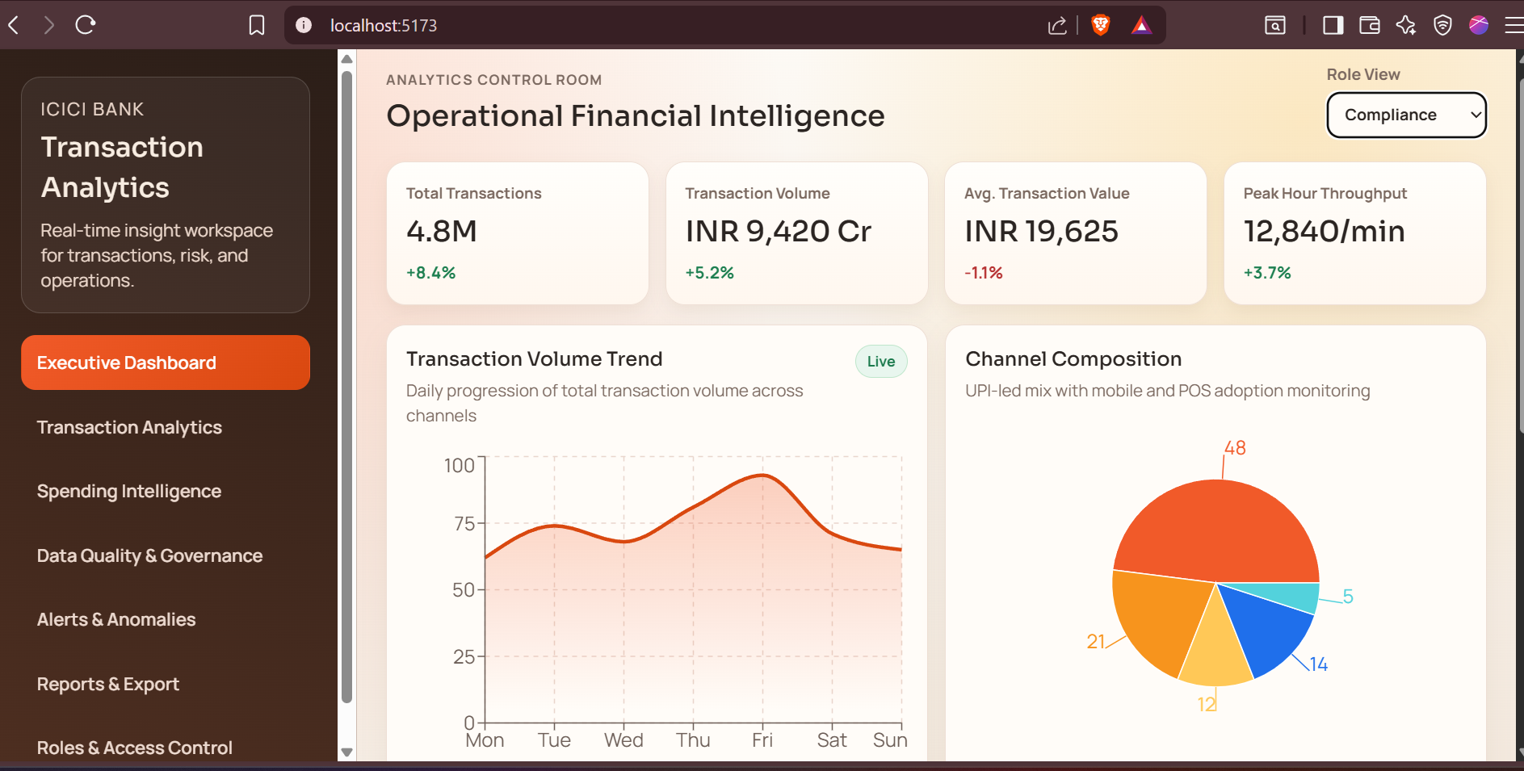
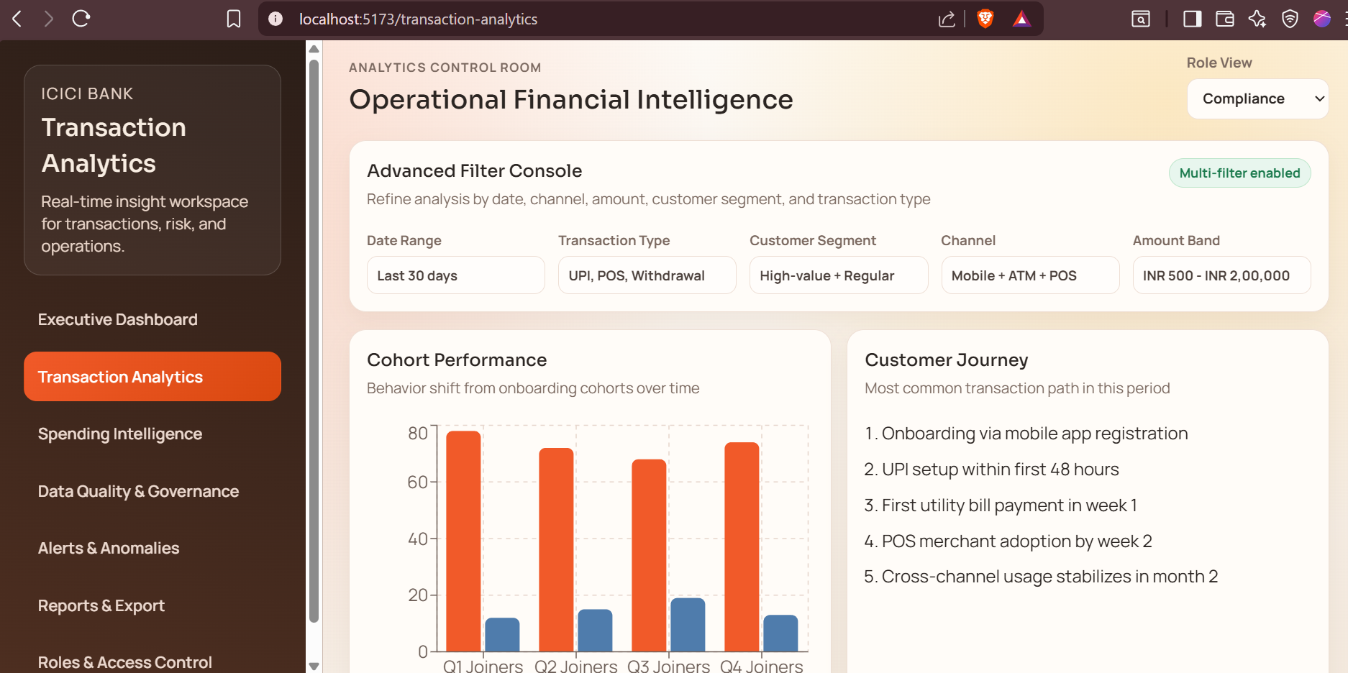
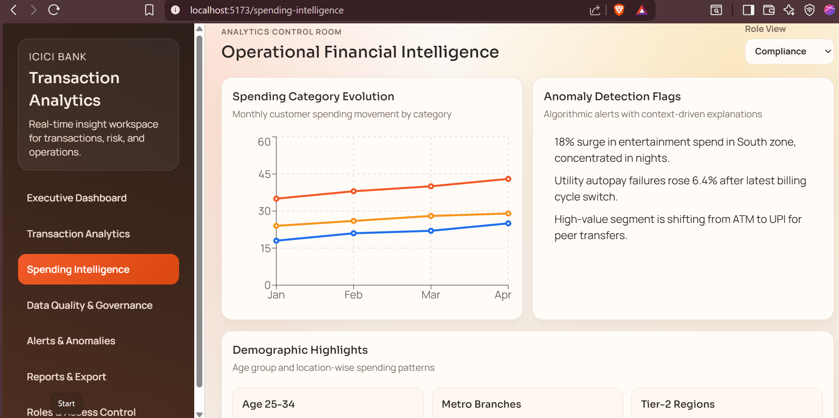
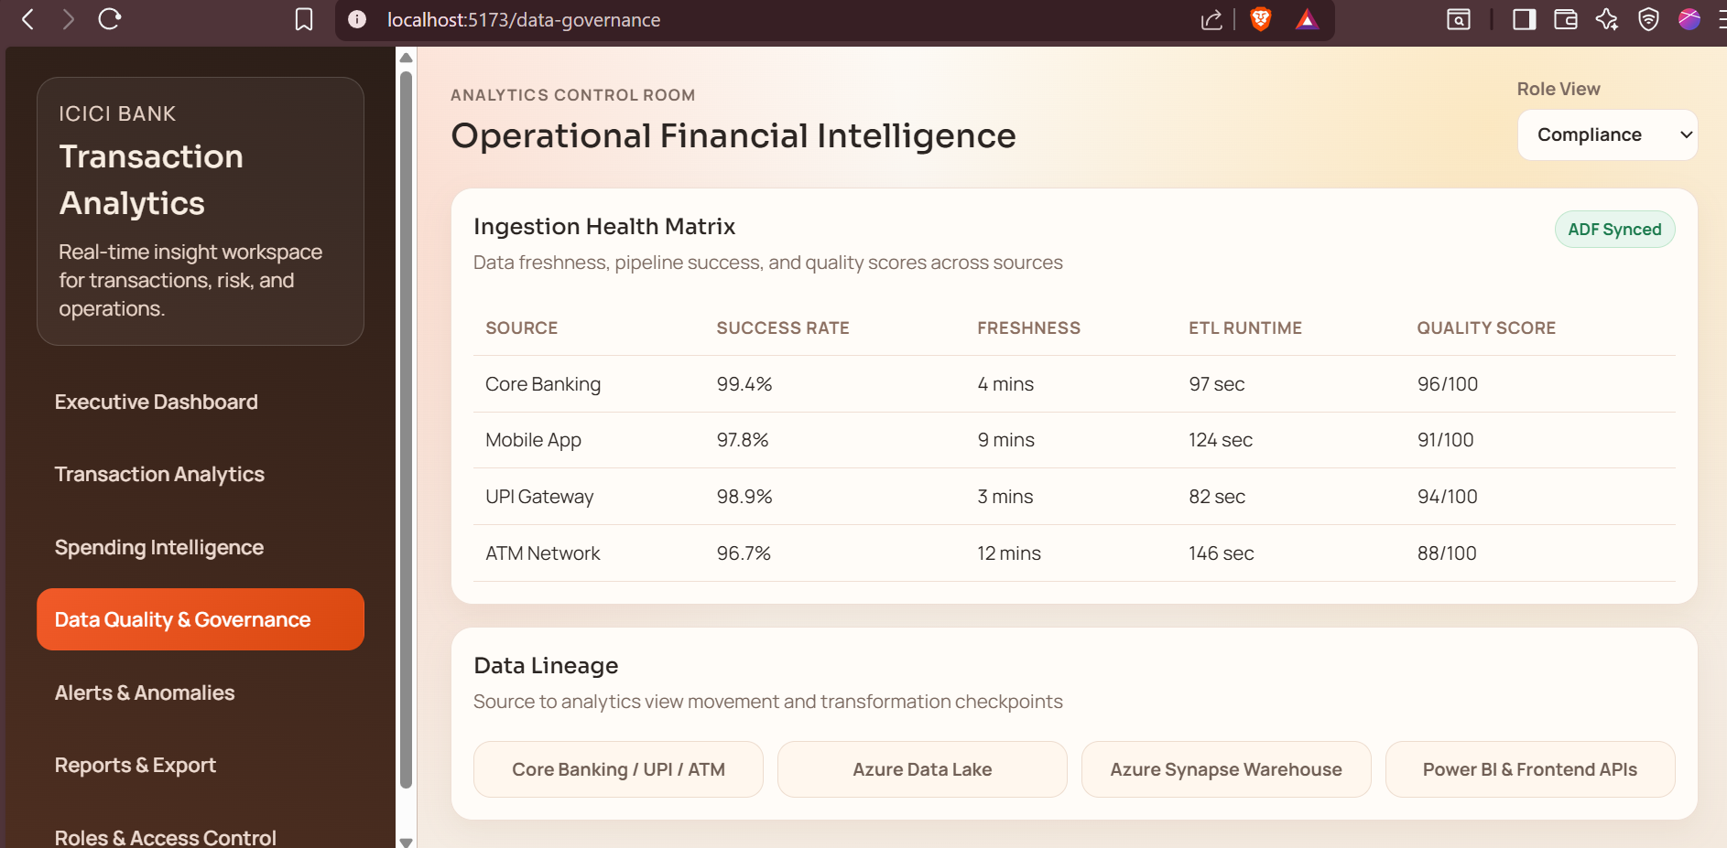
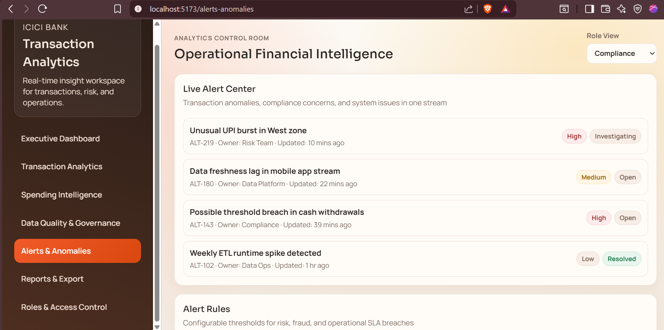
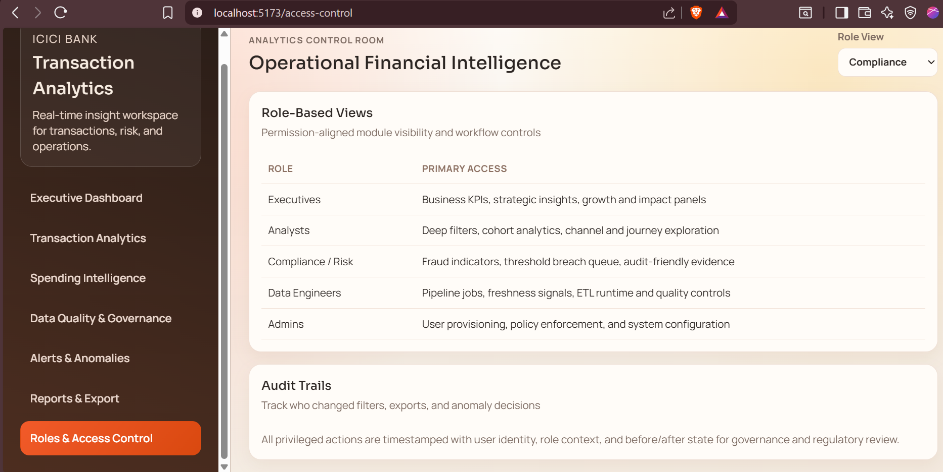




Glimpses of Project

Slide 17
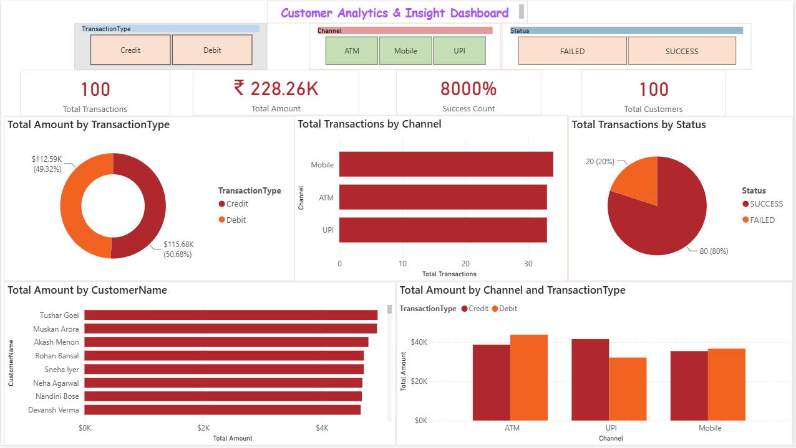
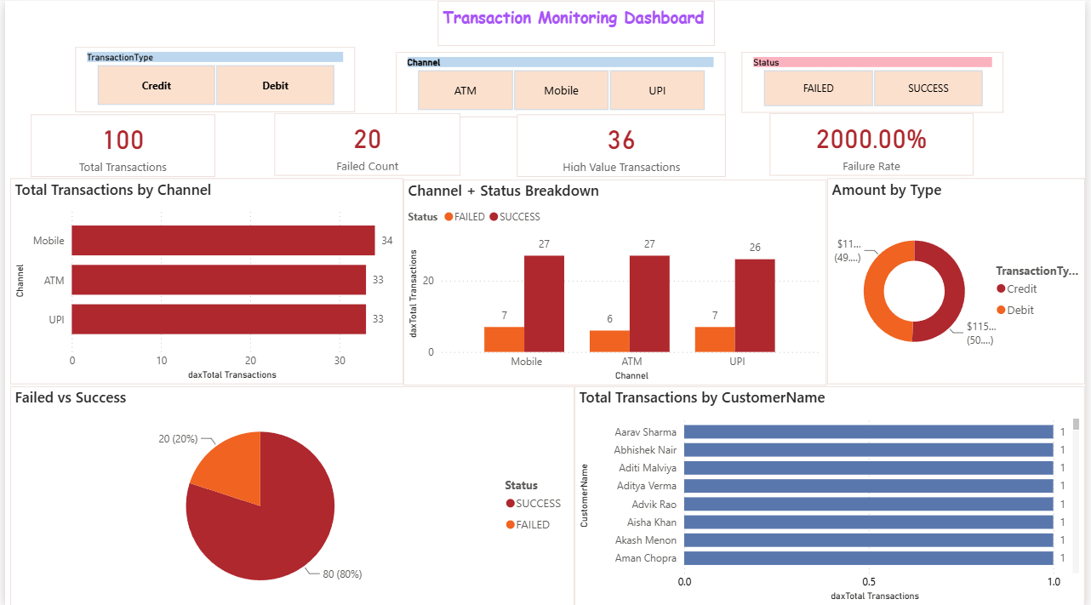
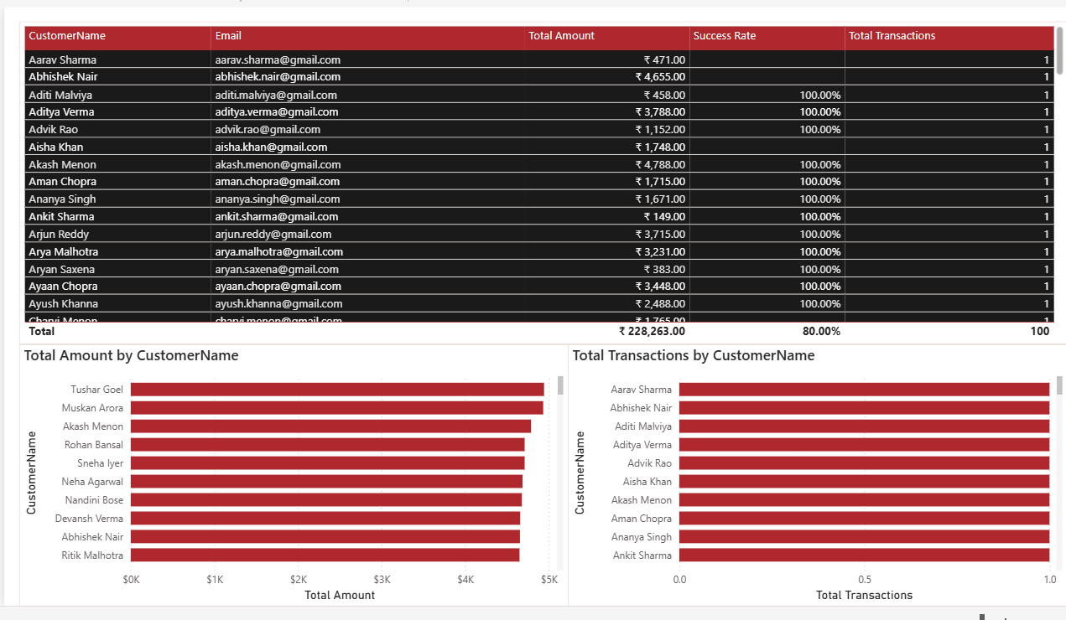
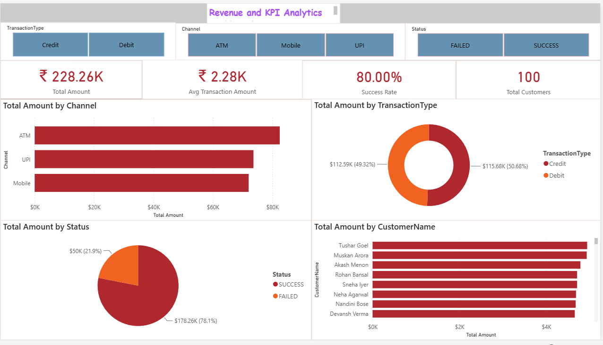


Glimpses of Power BI Dashboard

Slide 18
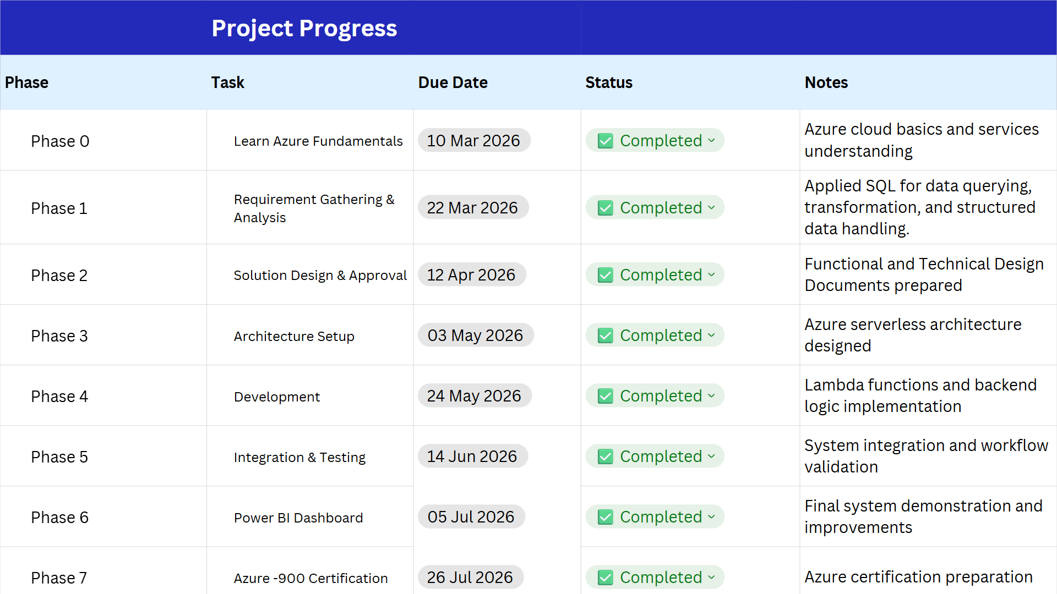
Project Progress

Slide 19
Thank You!!!

