Slide 1

Model to categorize and predict symptoms in medicinal data
K. K.Wagh Institute of Engineering Education and Research, Nashik
Department of Computer Engineering
BE-A
Spandan Patel
Vedika Mujgule
Tanvi Joshi
Rashmi Purandare

Slide 2
Introduction
A classifier is a Supervised function (machine learning tool) where the learned (target) attribute is categorical ("nominal").
It is used after the learning process to classify new records (data) by giving them the best target attribute(prediction).
The Naive Bayes algorithm is an intuitive method that uses the probabilities of each attribute belonging to each class to make a prediction. It is the supervised learning approach you would come up with if you wanted to model a predictive modeling problem probabilistically.
A random forest is a collection or ensemble of decision trees.
A decision tree is built using the whole dataset considering all features , but in random forests a fraction of the number of rows is selected at random and a particular number of features are selected at random to train on and a decision tree is built on this subset.

Slide 3
Problem Statement
Consider a labeled dataset belonging to an application domain. Apply suitable data preprocessing steps such as handling of null values, data reduction, discretization. For prediction of class labels of given data instances, build classifier models using different techniques (minimum 3), analyze the confusion matrix and compare these models. Also apply cross validation while preparing the training and testing datasets.

Slide 4
Keywords
Data Mining
Machine Learning
Classification algorithms
Data mining
Decision trees
Partitioning algorithms
Training
Data models
Large Scale Database

Slide 5
Objectives
To visualize the useful information stored in data warehouses
To categorize and predict symptoms in medicinal data

Slide 6
Dataset Desciption
This problem is comprised of 768 observations of medical details for Pima indians patents. The records describe instantaneous measurements taken from the patient such as their age, the number of times pregnant and blood workup. All patients are women aged 21 or older. All attributes are numeric, and their units vary from attribute to attribute.
Each record has a class value that indicates whether the patient suffered an onset of diabetes within 5 years of when the measurements were taken (1) or not (0).
This is a standard dataset that has been studied a lot in machine learning literature. A good prediction accuracy is 70%-76%.

Slide 7
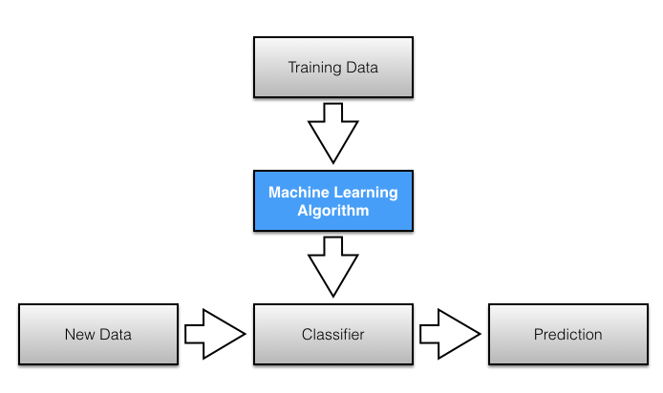
Model Diagram

Slide 8
Performance Indicators
Accuracy w.r.t. Three classifiers:
Naive Bayes
Decision Tree
Random Forest Algorithm

Slide 9
INSTRUCTIONS TO EXECUTE THE CODE:
C:\WINDOWS\system32>cd c:\Python27
C:\Python27>python classifier.py

Slide 10
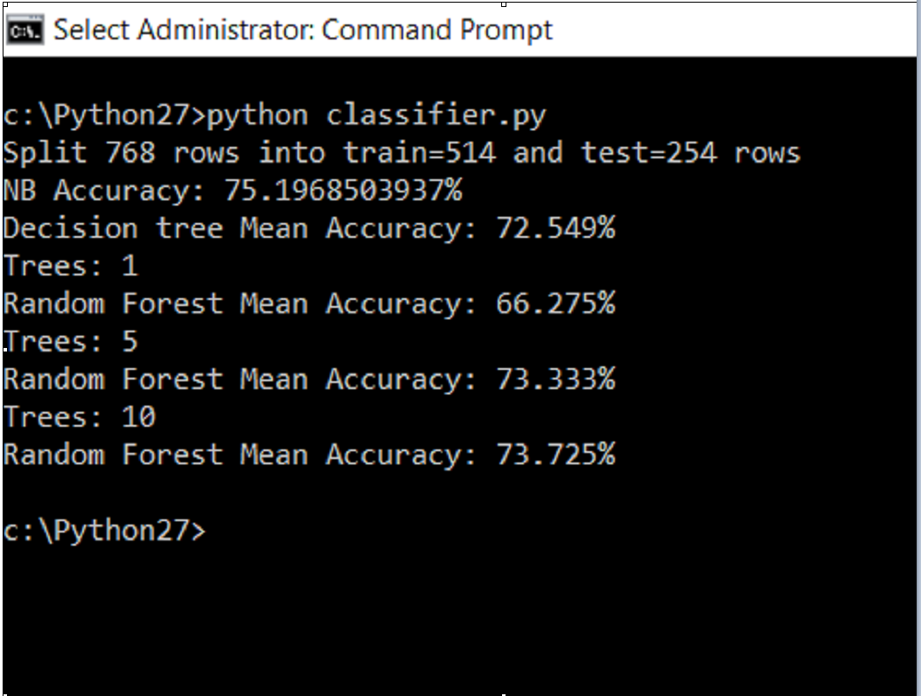

Slide 11
Results Summary
A good prediction accuracy is 70%-76%.
The predictions can be compared to the class values in the test dataset and a classification accuracy can be calculated as an accuracy ratio between 0& and 100%. The getAccuracy()will calculate this accuracy ratio.

Slide 12
References
Analyzing Diabetic Data using Classification Algorithms in DataMining:https://www.researchgate.net/publication/311067092_Analyzing_Diabetic_Data_using_Classification_Algorithms_in_Data_Mining
Journal of Applied Sciences:Application of Classification based Data Mining Technique in Diabetes Care by Abdullah A. Aljumah, Mohammad Khubeb Siddiqui and Mohammad Gulam Ahamad

