Slide 1


Python Web Framework

Slide 2

Agenda
Introduction
Features
Installation #
Django Architecture(MVT not MVC)
Live of Requests
Project structure
Settings
Project / Site creation
URL Dispatcher
Who uses it? # 2

Slide 3
Introduction
Django is a free and open source web application framework, written in Python, which follows the Model–View–Template architectural pattern.
It is maintained by the Django Software Foundation (DSF), an
independent organization.
Encourages rapid development and clean, pragmatic design.

Slide 4

Features
Object Relational Mapper - ORM
MVC (MVT) Architecture
Focuses on automating as much as possible and adhering to the Day principle
Template System
Out of the box customizable admin Interface, makes CRUD easy
Built-in light weight Web Server
Elegant URL design
Authentication / Authorization
Internationalization support
Cache framework, with multiple cache mechanisms
Fast Development
Free, and Great Documentation

Slide 5
Installation
Prerequisites
Python # not required
PIP for installing Python packages (http://www.pip-installer.org/en/latest/installing.html)
pip install Django==1.5.4
OR https://www.djangoproject.com/download/ - python setup.py install
pip install mysql-python
MySQL on windows https://pypi.python.org/pypi/MySQL-python/1.2.4
Add Python and Django to env path
PYTHONPATH D:\Python27
Path D:\Python27; D:\Python27\Lib\site-packages; D:\Python27\Lib\site-packages\django\bin;
Testing installation
shell> import django; django.VERSION;

Slide 6

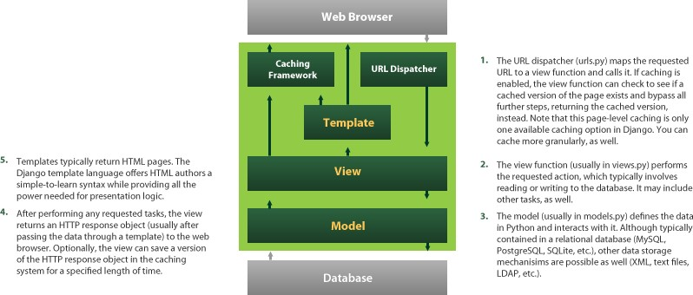
Django Architecture
Models Describes your data Views Controls what users sees Templates How user sees it Controller URL dispatcher

Slide 7
MVT not MVC
Model #Not required
defines the data structure
takes care for querying the database
View
defines what data should be presented
returns HTTP response
Template
renders the data in suitable format - HTML/XML/etc.

Slide 8
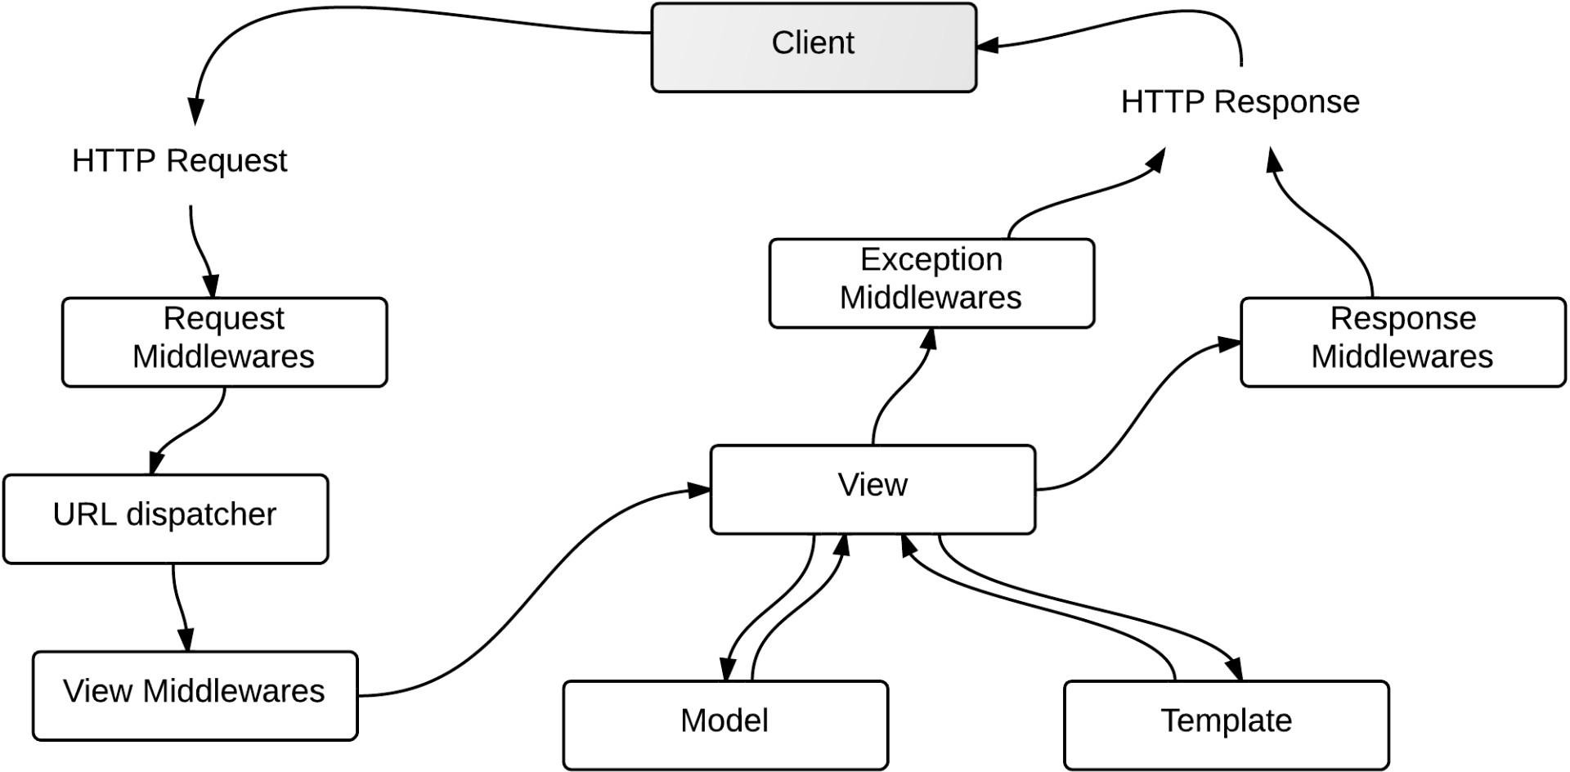
The flow of request

Slide 9

Project Directory Structure
demosite/
---------------------------------- Just a container for your project. Its name doesn’t matter to Django; you can rename
it to anything you like.
manage.py ------------------------- A command-line utility that lets you interact with this Django project in various ways.
Type python manage.py help. You should never have to edit this file.
demosite/
------------------------- Actual Python package for your project. Use this name to import anything inside it (e.g. import demosite.settings)
init .py ----------------- A file required for Python to treat the demosite directory as a package.
settings.py ----------------- Settings/configuration for this Django project
urls.py ---------------------- Root URL config, the URLs for this Django project, provides mapping to views
wsgi.py ---------------------- An entry-point for WSGI-compatible webservers to serve your project
templates/ ----------------- HTML files , renders based on views. You can change to any dir, configurable in settings.py
static/ ----------------------- CSS, JS, images.. etc, configurable in settings.py
demoapp/
init .py -------- urls.py
views.py ---------- Responsible for processing a user’s request and for returning the response
models.py --------- A model is the single, definitive source of information about your data.
Generally, each model maps to a single database table.
admin.py ---------- It reads metadata in your model to provide a powerful and production-ready interface
forms.py ----------- To create and manipulate form data

Slide 10

Settings
Project settings.py overrides from <python>/Lib/site-packgaes/django/conf/global_settings.py
Set DJANGO_SETTINGS_MODULE for your Project, tells django which settings to be used. (demoproject.settings)
export/set DJANGO_SETTINGS_MODULE=demoproject.settings
For server mod_wsgi: os.environ['DJANGO_SETTINGS_MODULE'] = 'demoproject.settings' True or False
DEBUG
DATABASES ENGINE
ROOT_URLCONF
MEDIA_ROOT
MEDIA_URL
STATIC_ROOT
STATIC_URL
TEMPLATE_DIRS
postgresql_psycopg2', 'mysql', 'sqlite3' or 'oracle'.. etc
directory that will hold user-uploaded files To serve media files
To any server static files css, js.. and admin UI files (can add more dirs to STATICFILES_DIRS) To serve static files
Template directories
Using settings in Python code
from django.conf import settings
if settings.DEBUG: # Do something

Slide 11

Project / Site Creation
Creating new Project
django-admin.py startproject demoproject A project is a collection of applications
Creating new Application
python manage.py startapp demosite
An application tries to provide a single, relatively self-contained set of related functions
Using the built-in web server
python manage.py runserver
python manage.py runserver 80 Runs by default at port 8000
It checks for any error and validate the models. Throws errors/warnings for any misconfigurations and invalid
entries.

Slide 12
URL Dispatcher / Patterns
Root URL should be configured in settings.py
o ROOT_URLCONF = 'app.urls'
Syntax
patterns(prefix,
(regular expression, Python callback function [, optional dictionary [, optional name]])
)
Example:
urlpatterns = patterns(' ',
(r'^articles-year/$', 'mysite.news.views.articles_year'),
)

Slide 13
Who uses Django?
BitBucket #Add logos
DISQUS (serving 400 million people)
Pinterest
Instagram
dPaste
Mozilla (support.mozill, addons.mozilla)
NASA
PBS (Public Broadcasting Service)
The Washington Post, NY Times, LA Times, The Guardian
National Geographic, Discovery Channel

Slide 14
Thank you

